Slide 1
Porters 5 Forces
Determine the competitive intensity and attractiveness of an industry in terms of its profitability
UpskilPRO e Institute for Sales & Marketing
Tools, Content & Templates
Hand built using experience & Insight

Slide 2
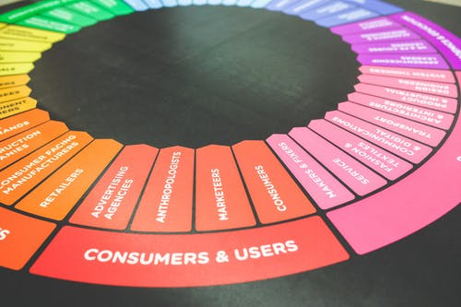
Created by
ex-Procter & Gamble, Rothmans, BAT, Gillette, Nokia,
Microsoft & 3M managers.
UpskilPRO tools are designed in easy-to-use solutions, all you need to do is download the tool and get to work immediately . All UpskilPRO material has taken 100’s of hours and many 1000’s of $ to build , all this expertise and content is brought to you for a fraction of the cost to help professionals enhance their capability.
core areas which are best suited to improve using our tools:
Subject matter expertise
Best practices
Analytical output & charting
Prioritization
Process
Capability enhancement tools for
Consumer Marketing, Trade Marketing &
Sales excellence professionals.
Tools in one place to get 10X productive now.

Slide 3
Job Descriptions
Develop roles clearly and completely across varying levels of experience
Agreements
Draft your business agreements across a variety of areas
Templates
Templates are designed based gather information in a structured manner
KPI’s
Performance indicator, a quantifiable measure of performance over time versus a specific objective.
Content Modules
Best practice material in power point for use as a knowledge base in business training , planning and execution .
Strategic tools
These tools are recognised the world over in business schools, consulting firms and companies who plan strategically.
Gain a competitive edge using the best tools and techniques to build a better you .
Analytical Tools
Interactive excel tools on specific business areas based on your data inputs delivered in a workbook model with instructions.
Scorecards
Designed as functional or subject indicators across a variety off situations to enable performance of situational evaluation versus aligned standards.
Calculators
calculate the right ratios for businesses looking for benchmarks in a variety of situations
Assessments
Assessments are designed around specific areas to conduct reviews and will center around a benchmark reviewing individuals or functions
Checklists
Designed around achieving milestones in a sequential manner.
Research
Research tools for sales and marketing engagement

Slide 4
2017
2018
100’s of tools grouped in 12 categories, 50 tool types and 12 business functions in 1 place.
get 10X productive now !
Categories
Functions
Analytical Tools
Types
Business Development
Agreements
Advertising
Customer Acquisition
Margins
Partner Search
Reports
Category Management
Assessments
Agreements
Customer Management
Market Analysis
Persona Development
Retail Measurement
Channel Management
Content Modules
Analytics
Distribution
Market Development
Planning
Reviews
Distribution
Checklists
Barriers
Distributor Management
Market Research
Positioning
Sales Management
Distributor Management
Calculators
Business Reviews
Forecasting
Market Segmentation
Pricing
Scorecards
General Management
Job Descriptions
Business Intelligence
GAP Analysis
Market Size
Prioritization
Segmentation
Key Account Management
KPI’s
Channels
Go To Market
Marketing
Product Development
Six Sigma
Marketing
Research
Communication
Job Descriptions
Marketing Comms
Product Life Cycle
Socio Economic Classification
Marketing Operations
Strategic Tools
Competitive Evaluation
Key Account Plans
Merchandising
Profit & Loss
Territory Design
Sales Management
Scorecards
Competitive Intelligence
Management Summary
New Market Entry
Promotions
Trade Marketing
Shopper Marketing
Templates
Trade Marketing

Slide 5
Porters 5 Forces
Determine the competitive intensity and attractiveness of an industry in terms of its profitability

Slide 6
“The company without a strategy is willing to try anything.” “You can't be all things to all people.” “Strategic thinking rarely occurs spontaneously.” “Good leaders need a positive agenda, not just an agenda of dealing with a crisis.”
Michael Porter

Slide 7
Porters 5 Forces
Porter's Five Forces Framework is a method for analysing the competition of a business
Porter's Five Forces Framework is a method for analysing the competition of a business. It draws from industrial organization (IO) economics to derive five forces that determine the competitive intensity and, therefore, the attractiveness (or lack thereof) of an industry in terms of its profitability. An "unattractive" industry is one in which the effect of these five forces reduces overall profitability. The most unattractive industry would be one approaching "pure competition", in which available profits for all firms are driven to normal profit levels. The five-forces perspective is associated with its originator, Michael E. Porter of Harvard University. This framework was first published in Harvard Business Review in 1979
Porter refers to these forces as the microenvironment, to contrast it with the more general term macroenvironment. They consist of those forces close to a company that affect its ability to serve its customers and make a profit. A change in any of the forces normally requires a business unit to re-assess the marketplace given the overall change in industry information. The overall industry attractiveness does not imply that every firm in the industry will return the same profitability. Firms are able to apply their core competencies, business model or network to achieve a profit above the industry average.
Porter's five forces include three forces from 'horizontal' competition – the threat of substitute products or services, the threat of established rivals, and the threat of new entrants – and two others from 'vertical' competition – the bargaining power of suppliers and the bargaining power of customers.
Porter developed his five forces framework in reaction to the then-popular SWOT analysis, which he found both lacking in rigor and ad hoc.
Porter's five-forces framework is based on the structure–conduct–performance paradigm in industrial organizational economics. Other Porter strategy tools include the value chain and generic competitive strategies.

Slide 8
Porters 5 Forces
Introduction
What benefits does Porter’s Five Forces analysis provide?
Five forces analysis helps organisations to understand the factors affecting profitability in a specific industry and can help to inform decisions relating to: whether to enter a specific industry; whether to increase capacity in a specific industry; and developing competitive strategies.
Supplier power.
An assessment of how easy it is for suppliers to drive up prices. This is driven by the: number of suppliers of each essential input; uniqueness of their product or service; relative size and strength of the supplier; and cost of switching from one supplier to another.
Buyer power.
An assessment of how easy it is for buyers to drive prices down. This is driven by the: number of buyers in the market; importance of each individual buyer to the organisation; and cost to the buyer of switching from one supplier to another. If a business has just a few powerful buyers, they are often able to dictate terms.
Competitive rivalry.
The main driver is the number and capability of competitors in the market. Many competitors, offering undifferentiated products and services, will reduce market attractiveness.
Threat of substitution.
Where close substitute products exist in a market, it increases the likelihood of customers switching to alternatives in response to price increases. This reduces both the power of suppliers and the attractiveness of the market.
Threat of new entry.
Profitable markets attract new entrants, which erodes profitability. Unless incumbents have strong and durable barriers to entry, for example, patents, economies of scale, capital requirements or government policies, then profitability will decline to a competitive rate.
Do’s
Don'ts
Use this model where there are at least three competitors in the market
Consider the impact that government has or may have on the industry
Consider the industry lifecycle stage – earlier stages will be more turbulent
Consider the dynamic / changing characteristics of the industry
Avoid using the model for an individual firm; it is designed for use on an industry basis

Slide 9
Porters 5 Forces
Limitations
Industry Level
According to Porter, the five forces framework should be used at the line-of-business industry level; it is not designed to be used at the industry group or industry sector level. An industry is defined at a lower, more basic level: a market in which similar or closely related products and/or services are sold to buyers.
Consultants
Limitations
Single Industry
Strategy consultants occasionally use Porter's five forces framework when making a qualitative evaluation of a firm's strategic position. However, for most consultants, the framework is only a starting point like all general frameworks, an analysis that uses it to the exclusion of specifics about a particular situation is considered naïve
Too General - only a starting point prior to deeper investigation
Better suited for static firms and less complex firms
Not suitable for non-profit organizations
Bias perspective on the industry and/or lack of training or research can jeopardize integrity of the analysis
The model lacks quantitative aspect as importance cannot be determined (quantitative facts can however be included)
A company which competes in a single industry should develop, at a minimum, one five forces analysis for its industry
The average Fortune Global 1,000 company competes in 52 industries.

Slide 10
Porters 5 Forces
Opinions & Criticisms
Upskil
Extension
An important extension to Porter's work came from Adam Brandenburger and Barry Nalebuff of Yale School of Management in the mid-1990s. Using game theory, they added the concept of complementors (also called "the 6th force") to try to explain the reasoning behind strategic alliances. Complementors are known as the impact of related products and services already in the market.[14] The idea that complementors are the sixth force has often been credited to Andrew Grove, former CEO of Intel Corporation. Martyn Richard Jones, while consulting at Groupe Bull, developed an augmented five forces model in Scotland in 1993
Consultants
Challenged !
Single Industry
Other criticisms include:
It places too much weight on the macro-environment and doesn't assess more specific areas of the business that also impact competitiveness and profitability
It does not provide any actions to help deal with high or low force threats (e.g., what should management do if there is a high threat of substitution?)
Porter's framework has been challenged by other academics and strategists. For instance, Kevin P. Coyne and Somu Subramaniam claim that three dubious assumptions underlie the five forces:
That buyers, competitors, and suppliers are unrelated and do not interact and collude.
That the source of value is structural advantage (creating barriers to entry).
That uncertainty is low, allowing participants in a market to plan for and respond to changes in competitive behaviour
Porter indirectly rebutted the assertions of other forces, by referring to innovation, government, and complementary products and services as "factors" that affect the five forces.[8]
It is also perhaps not feasible to evaluate the attractiveness of an industry independently of the resources that a firm brings to that industry. It is thus argued (Wernerfelt 1984)[15] that this theory be combined with the resource-based view (RBV) in order for the firm to develop a sounder framework.
Also, the last chapter of the book: "Age of agile" attributes the bankruptcy of Porter's firm to the outdated nature of his model around competitiveness instead of creating customer value and not making the customers at the centre of the universe, i.e. customer centricity.
.
.

Slide 11
Analysing Key Accounts.
Porters 5 Forces ( Impacting forces )
Porter’s Five Forces. The framework is used to assess the attractiveness and profit potential of an industry or firm by analysing the 5 key forces active upon it.
Threat of new entrants
Rivalry among existing competitors
No of competitors
Diversity of competitors
Concentration of rivals / industry
Industry growth
Quality differences
Brand loyalty
Barriers to exit
Switching costs
Threat of new entrants
Barriers to entry
Economies of scale
Brand loyalty
Capital requirements
Cumulative experience
Government policies
Access to distribution channels
Switching costs
Rivalry – Industry growth, fixed costs/value added, product differences, brand identity, switching costs, diversity of competitors, exit barriers •
New entrants – Economics of scale, proprietary product differences, brand identity, switching costs, capital requirements, access to distribution, absolute cost advantages, learning curve, access to necessary inputs, government policy, expected retaliation •
Buyers – Bargaining leverage, buyer purchase volume, buyer switching costs, buyer information, substitute products, price sensitivity, product differences, brand identity, impact on quality/performance, decision makers’ incentives •
Suppliers – Differentiation of inputs, switching costs of suppliers and firms in the industry, presence of substitute inputs, supplier concentration, importance of volume supplier, cost relative to total purchases in the industry, impact of inputs on costs or differentiation •
Substitutes – Relative price performance of substitutes, switching costs, buyer propensity to substitute
Rivalry
among
existing competitors
Bargaining power of suppliers
Bargaining power of buyers
Bargaining power of suppliers
No & size od suppliers
Uniqueness of suppliers product
Focal companies ability to substitute
Bargaining power of buyers
No of customers
Size of each customer order
Differences between competitors
Price sensitivity
Buyers ability to differentiate
Buyers information availability
Switching costs
Threat of substitute products
No of substitute products available
Buyers propensity to substitute
Relative price performance of substitute
Perceived level of product differentiation
Switching costs
Threat of substitute products
Use this excel tool , its available in the product page under the serial no 6003

Slide 12
Porters 5 Forces
Attributes & Scoring
6003
Drivers / Scoring
In Alignment with the drivers we use a simple but effective 6 Sigma scoring methodology which makes choices more thought out and clearer once defined .
0 – Indicates no complexity of any sort and a fair playing ground
1 – Indicates some emerging or existing threat
3 – Indicates a clear and present threat factor
9 – Indicates difficulty and complexity in the landscape.
The difference between 3 & 9 id deliberate making the choice to score difficult but ensures clarity when reviewed
Drivers / Attributes
We use the same drivers as outlined in the 5 forces strategic tool to ensure simplicity in communication and clarity .
The 5 Attributes are used within the format to a high level and each driver is scored on panel using a lean six sigma methodology for consistence and clarity .
Use this excel tool , its available in the product page under the serial no 6003

Slide 13
Porters 5 Forces
Overview
6003
Use this excel tool , its available in the product page under the serial no 6003

Slide 14
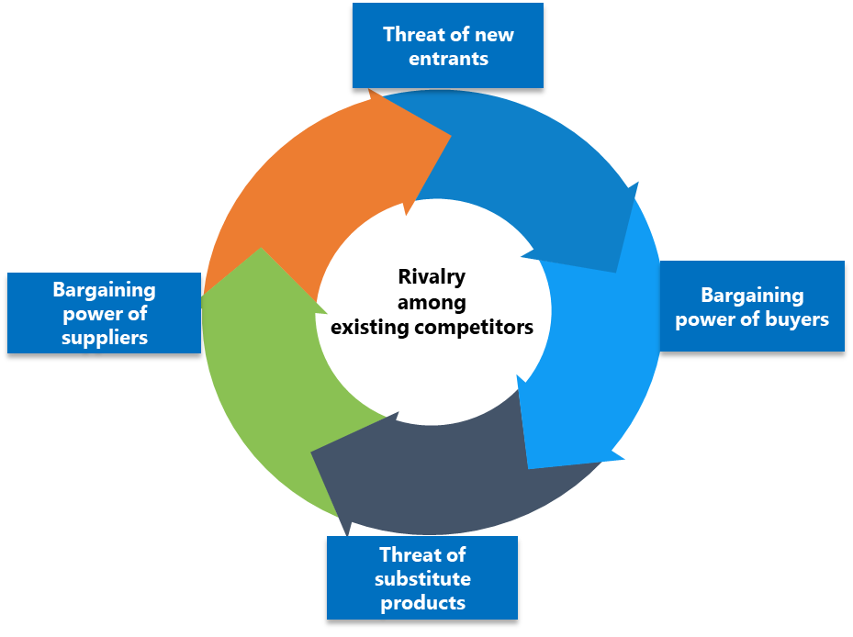
Porters 5 Forces
Threat of new entrants
Economies of scale
These are declines in the unit costs of a product as the absolute volume per period increases. These force the entrant to either come in at a large scale (risking strong reaction from incumbents) or a small scale (forcing a cost disadvantage).
Product differentiation
Incumbents have brand identification and customer loyalties. This forces entrants to spend heavily to overcome these loyalties. Start-ups may bring a different product to market, but its benefits must be clearly communicated to the target customer. Start-ups must find an effective positioning, which often requires marketing resources beyond their means.
Capital requirements
These are the financial resources required for infrastructure, machinery, R&D and advertising. Start-ups may get around capital requirements by outsourcing parts of the operation to companies that can leverage existing investments.
Switching costs
Switching costs
These are one-time costs the buyer faces when switching an existing supplier’s product to a new entrant (for example, employee retraining, new equipment, technical support).
Access to distribution channerls
This can be a barrier if logical distribution channels have been locked up by incumbents.
Cost disadvantages
Incumbents may have cost advantages that cannot be replicated by a potential entrant. Factors include the learning or experience curve, proprietary product technology, access to raw materials, favourable locations and government subsidies.
Government Policy
Governments can limit or prevent entry to industries with various controls (for example, licensing requirements, limits to access to raw materials). Start-ups in highly regulated industries will find that incumbents have fine-tuned their business according to regulation

Slide 15
Porters 5 Forces
Bargaining power of buyers
No of customers
These are declines in the unit costs of a product as the absolute volume per period increases. These force the entrant to either come in at a large scale (risking strong reaction from incumbents) or a small scale (forcing a cost disadvantage).
Size of customer orders
The buyer group is concentrated, or purchases large volumes relative to the seller’s sales
Differences between competitors
Products purchased from the industry are standard or undifferentiated—alternative suppliers are easy to find and competitors are played against each other
Price sensitivity
These are declines in the unit costs of a product as the absolute volume per period increases. These force the entrant to either come in at a large scale (risking strong reaction from incumbents) or a small scale (forcing a cost disadvantage).
Buyer’s ability to differentiate
These are declines in the unit costs of a product as the absolute volume per period increases. These force the entrant to either come in at a large scale (risking strong reaction from incumbents) or a small scale (forcing a cost disadvantage).
Buyer’s information availability
The buyer has full information (their knowledge of demand, market prices and supplier costs provides them with leverage
Switching costs
Few switching costs exist (little penalty for moving to another supplier)

Slide 16
Porters 5 Forces
Threat of substitute products
A substitute product uses a different technology to try to solve the same economic need. Examples of substitutes are meat, poultry, and fish; landlines and cellular telephones; airlines, automobiles, trains, and ships; beer and wine; and so on. For example, tap water is a substitute for Coke, but Pepsi is a product that uses the same technology (albeit different ingredients) to compete head-to-head with Coke, so it is not a substitute. Increased marketing for drinking tap water might "shrink the pie" for both Coke and Pepsi, whereas increased Pepsi advertising would likely "grow the pie
No of substitute products available
Buyer’s predilection to substitute
Buyer propensity to substitute. This aspect incorporated both tangible and intangible factors. Brand loyalty can be very important as in the Coke and Pepsi example above; however contractual and legal barriers are also effective.
Relative price performance of substitute
Relative price performance of substitutes is the price of substitutes for your output compared to the price you are charging. If the price of substitutes is lower, the competitive threat increases as the price differential increases
Product differentiation
Perceived level of product differentiation which is classic Michael Porter in the sense that there are only two basic mechanisms for competition – lowest price or differentiation. Developing multiple products for niche markets is one way to mitigate this factor.
Switching costs
Buyer's switching costs. This factor is well illustrated by the mobility industry. Uber and its many competitors took advantage of the incumbent taxi industry's dependence on legal barriers to entry and when those fell away, it was trivial for customers to switch. There were no costs as every transaction was atomic, with no incentive for customers not to try another product.

Slide 17
Porters 5 Forces
Bargaining power of suppliers
The Bargaining Power of Suppliers, one of the forces in Porter’s Five Forces Industry Analysis Framework, is the mirror image of the bargaining power of buyers and refers to the pressure that suppliers can put on companies by raising their prices, lowering their quality, or reducing the availability of their products.
No & Size of customers
There are a significant amount of suppliers relative to buyers (companies). Therefore, supplier power is low.
Uniqueness of supplier’s products
Uniqueness of suppliers products gives them a competitive edge and the buyer dependant in a space mostly dominated by a couple of suppliers , thereby driving up the suppliers position of strength .
Company’s ability to substitute
The availability of a substitution threat effects the profitability of an industry because consumers can choose to purchase the substitute instead of the industry's product. The availability of close substitute products can make an industry more competitive and decrease profit potential for the firms in the industry.
Bargaining power of suppliers
The bargaining power of suppliers is also described as the market of inputs. Suppliers of raw materials, components, labour, and services (such as expertise) to the firm can be a source of power over the firm when there are few substitutes.
Potential factors are:
Supplier switching costs relative to firm switching costs
Degree of differentiation of inputs
Impact of inputs on cost and differentiation
Presence of substitute inputs
Strength of distribution channel
Supplier concentration to firm concentration ratio
Employee solidarity (e.g. labour unions)
Supplier competition: the ability to forward vertically integrate and cut out the buyer.

Slide 18
Porters 5 Forces
Rivalry amongst existing competitors
No of customers
When there are many competitors, some companies believe that they can make competitive moves without being noticed. When companies are relatively balanced in strength, they are more likely to engage in competitive battles and attack and retaliate as they strive for market leadership.
Diversity of competitors
When there are many competitors, some companies believe that they can make competitive moves without being noticed. When companies are relatively balanced in strength, they are more likely to engage in competitive battles and attack and retaliate as they strive for market leadership.
Industry concentration
When there are many competitors, some companies believe that they can make competitive moves without being noticed. When companies are relatively balanced in strength, they are more likely to engage in competitive battles and attack and retaliate as they strive for market leadership.
Industry growth
In a slow growth market, companies can only grow by capturing market share from each other, which leads to increased competition.
Capacity differences
When economies of scale require large increases in capacity, it causes disruptions in the industry supply/demand balance, which then leads to periods of overcapacity and price cutting.
Differentiation Costs
When products are perceived as commodities, choice is often determined by price and service, which then leads to increased competition in price and service.
Barriers to exit
When there are many competitors, some companies believe that they can make competitive moves without being noticed. When companies are relatively balanced in strength, they are more likely to engage in competitive battles and attack and retaliate as they strive for market leadership.
High Costs Structures
High fixed costs create pressure for all companies to fill capacity, thus leading to price cutting when there is excess capacity. High storage costs push companies to decrease prices to ensure sales.
Lack of differentiation or switching costs

Slide 19
Porters 5 Forces
Determine the competitive intensity and attractiveness of an industry in terms of its profitability
UpskilPRO e Institute for Sales & Marketing
Tools, Content & Templates
Hand built using experience & Insight

