Slide 1
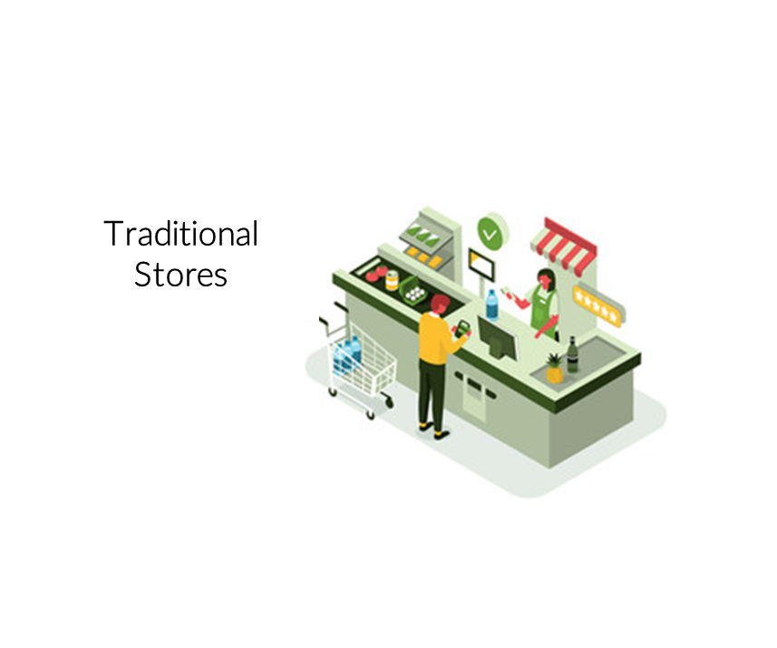
Trade Marketing.
Traditional Trade Engagement
Sales & Marketing Fundamentals.
UpskilPRO e Institute for Sales & Marketing
Tools, Content & Templates
Hand built using experience & insight

Slide 2
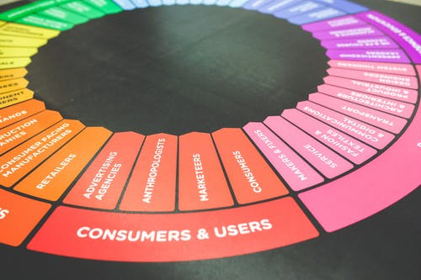
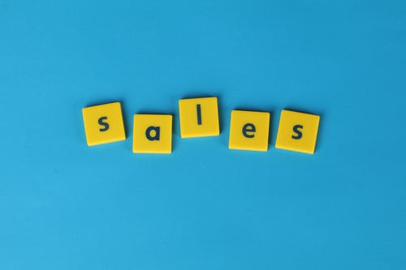
Created by
ex-Procter & Gamble, Rothmans, BAT, Gillette, Nokia,
Microsoft & 3M managers.
UpskilPRO tools are designed in easy-to-use solutions, all you need to do is download the tool and get to work immediately . All UpskilPRO material has taken 100’s of hours and many 1000’s of $ to build , all this expertise and content is brought to you for a fraction of the cost to help professionals enhance their capability.
core areas which are best suited to improve using our tools:
Subject matter expertise
Best practices
Analytical output & charting
Prioritization
Process
Training
Making life simpler for
Sales & Marketing professionals.
Sales & Marketing Fundamentals.
Tools in one place to get 10X productive now.

Slide 3
Job Descriptions
Develop roles clearly and completely across varying levels of experience
Agreements
Draft your business agreements across a variety of areas
Templates
Templates are designed based gather information in a structured manner
KPI’s
Performance indicator, a quantifiable measure of performance over time versus a specific objective.
Content Modules
Best practice material in power point for use as a knowledge base in business training , planning and execution .
Strategic tools
These tools are recognised the world over in business schools, consulting firms and companies who plan strategically.
Gain a competitive edge using the best tools and techniques to build a better you .
Analytical Tools
Interactive excel tools on specific business areas based on your data inputs delivered in a workbook model with instructions.
Scorecards
Designed as functional or subject indicators across a variety off situations to enable performance of situational evaluation versus aligned standards.
Calculators
calculate the right ratios for businesses looking for benchmarks in a variety of situations
Assessments
Assessments are designed around specific areas to conduct reviews and will center around a benchmark reviewing individuals or functions
Checklists
Designed around achieving milestones in a sequential manner.
Research
Research tools for sales and marketing engagement

Slide 4
2017
2018
100’s of tools grouped in 12 categories, 50 tool types and 12 business functions in 1 place.
get 10X productive now !
Categories
Functions
Analytical Tools
Types
Business Development
Agreements
Advertising
Customer Acquisition
Margins
Partner Search
Reports
Category Management
Assessments
Agreements
Customer Management
Market Analysis
Persona Development
Retail Measurement
Channel Management
Content Modules
Analytics
Distribution
Market Development
Planning
Reviews
Distribution
Checklists
Barriers
Distributor Management
Market Research
Positioning
Sales Management
Distributor Management
Calculators
Business Reviews
Forecasting
Market Segmentation
Pricing
Scorecards
General Management
Job Descriptions
Business Intelligence
GAP Analysis
Market Size
Prioritization
Segmentation
Key Account Management
KPI’s
Channels
Go To Market
Marketing
Product Development
Six Sigma
Marketing
Research
Communication
Job Descriptions
Marketing Comms
Product Life Cycle
Socio Economic Classification
Marketing Operations
Strategic Tools
Competitive Evaluation
Key Account Plans
Merchandising
Profit & Loss
Territory Design
Sales Management
Scorecards
Competitive Intelligence
Management Summary
New Market Entry
Promotions
Trade Marketing
Shopper Marketing
Templates
Trade Marketing

Slide 5
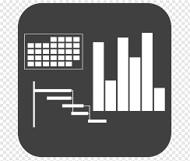
7 Benefits of using UpskilPRO :
Improve your knowledge
with professional Strategic Tools , Templates and planning documents for any business situation!
Use ready made tools
with filled in examples and ready to print & edit at your convenience . Just edit and fill-in the blanks !
Develop YOUR BUSINESS
Learn , & utilize the knowledge and processes and enhance your capabilities as the other companies have
We Created UpskilPRO for the
Sales Professional
Trade Marketer
Marketing Executive
Operations Manager
VP/Director/Manager
100’s of tools , TEMPLATES & documents
CREATED BY
world class sales and marketing
business professionals.
All tools
are based on topics and subject based situations and are simple and easy to use .
SAVE THOUSANDS OF DOLLARS
The average company will save 1000’s of $ per employee in time & effort using our ready tools !
Top Quality Tools & Templates for developing both you and your business.
www.upskilpro.com

Slide 6
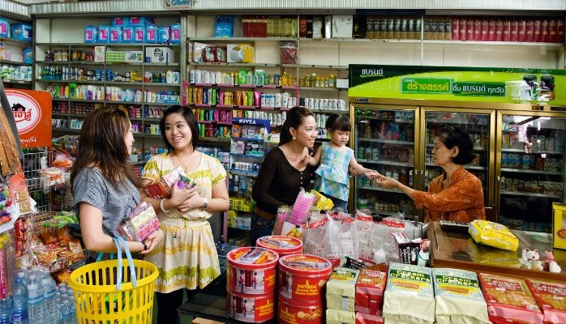
Brands that pay attention to the challenging and changing dynamics in traditional trade stand poised to drive not only visibility and share but enduring customer engagement.

Slide 7
Trade Marketing
Channel dynamics across regions
To develop strategic plans it's essential to know channel dynamics across regions or across countries or states .
GDP growth and markets or shifting towards developing markets which will be driven by a new middle class for the first time driving discretionary income to purchase services and products in addition to the gradual urbanisation and increasing labour forces .
emerging opportunities will drive a higher level of convenience for busier people with a short list to purchase whilst the plan purchases will generally be in favour of their larger store formats .
channel specific data along with shopper specific data with a love trade marketing to focus on the right channels outlets and customers to drive customer and consumer engagement
Source AC Nielsen thought leadership series 2022.

Slide 8
Trade Marketing
Traditional market share across countries
Greater China
Average of markets
Emerging Markets
Growth markets
Overview
Too broadly break up retail markets in two broad segments one would be modern trade which is your typical supermarket or hypermarket and traditional trade which is your neighbourhood convenience store or small grocery .
the chart had left indicates out of 100% what percentage is traditional trade my country Korea indicates on 96 penetration 96% penetration of modern trade which is the highest in the world and the bottom Nigeria which shows that approximately 2% of total trade is modern trade the balance is traditional .
In terms of who buys from these outlets it's mainly families with children followed by male shoppers .
In developing markets the most important mission for a visit is stocking up .
Shoppers visit daily with an average of 28 visits per month
On average shoppers buy two items per visit
Trade marketing Implications
From a channel perspective trade marketing has 2 broad segmentations A) modern trade and B) traditional trade
The trade marketing promotional mix will be differentiated utilising a communication strategy , product portfolio and pricing in order to be relevant for both segments
Modern trade marketing and communication strategies may be far more complex as opposed to traditional trade where communication strategies are a mix of digital and a major portion of traditional communication
in sheer outlet terms modern trade will always be a fraction off the entire universe
Modern trade route or Journey planning will be more predictable as opposed to traditional trade which is diverse and across geography‘s.
Source AC Nielsen thought leadership series 2022.

Slide 9
Trade Marketing
Segmentation Strategies
Overview
Through proven practices around the world, we have acquired the experience and knowledge to state that if we focus our efforts on the right place, results will be much better and manufacturers will have more opportunities in the market place. In this fragmented world, a simple segmentation is not enough, channel and micro-understanding is crucial,
An analysis done in partnership with McKinsey has demonstrated that successful companies in Latin Americas’ Traditional Trade, segmented their stores using criteria focused on growth potential and portfolio needs –
Winners considerations for store segmentation include:
100% channel,
67% own sales at the store,
67% store SOM,
67% Socioeconomic level of the area,
50% quality of relationship,
50% potential share,
50% physical store characteristics,
50% consumption occasions,
33% profitability potential.
Trade marketing Implications
Location attributes Dividing stores into regions or areas by store density, GDP, population density, economic class or income level enables efficient planning of sales force, numbers per region and provides guidance on brands/SKUs to be pushed in each region. Modelling across multiple data sources will help identifying high potential provinces/districts that will help realize potential with lower reach costs.
Performance attributes Whether at total store level or individual category level, performance attributes provide a clear focus for store visits to the highest potential stores. Sales territories can be allocated based on a store e performance profile. It is complex and cost intensive for manufacturers to reach all the category stores. Understanding how your distribution is built can help to identify and quantify distribution opportunities
Source : Nielsen thought leadership series 2022.

Slide 10
Trade Marketing
Winning strategies in Traditional trade
Execution
Standards
Overview
Brand owners will need to get a better understanding but how shoppers are different across different categories different brands and different regions .
Trade marketing Implications
Key aspects which need to be understood are how shoppers choose stores and products in store .
Traditional shopping is not aimed at stocking up it usually depends on the side of the store product range available the price freshness etc.
Merchandising is key specifically when space is at a premium and multiple brands are competing for the same space.
Packaging sizes are critical in traditional trade as they leverage the brand versus the size versus price to retain customers.
Labelling off products is 1 area which manufacturers need to spend more time on to better communicate product benefits and visibility in a crowded environment
Direct promotions at the category in terms of premium on pack price off or loyalty programmes need to be highly visible here on packing or next to packing to drive engagement
Distribution
Strategy
Segmentation
Strategy
Trade & Consumer Loyalty
Plans
Product
Strategy
Source AC Nielsen thought leadership series 2022.

Slide 11
Trade Marketing
Top 5 sales categories in countries
Fruit Juices 26.3 %
Overview
The top five categories in the countries on previous slide range from produces beer milk cigarettes and soft drinks these are averages across the 45 countries .
the broad indicators are they seem to be purchases where the frequency is extremely high and does not necessarily fall into a planned purchase .
One other interpretation you could take from these is that these five categories become a must have categories for retailers due to the high demand
Cigarettes 31%
Beer 52%
Trade marketing Implications
Predictable categories driven by some seasonality the same trade marketing strategies may not work for each category .
trade marketers were left to adopt differentiated strategy for each category St uniqueness and requirements are different for example cigarettes consumption may not necessarily rise due to a promotion but it may help to understand the profile of shoppers in specific key outlets to Taylor good product portfolio for cigarettes based on consumer needs .
another example maybe let milk will need chiller units to keep it fresh thereby non outlets which do not have chillers may not have access to the category .
in the case of beer companies may need to be ethical partners ensuring the local laws and regulations are met to the fullest and communicated clearly 2 bought the retailers and the consumers .
Soft drinks 57%
Milk
31.6 %
Source AC Nielsen thought leadership series 2022.

Slide 12
Trade Marketing
Trade and Distributor Loyalty plans
Overview
We already know that around the world shopkeepers strongly influence the purchase decisions of shoppers, 68% of Developing markets in the study declared that Traditional store owners are relevant because they decide the main product portfolio in the store and will continue selling any brand that they decide. This is why retailer’s voice needs to be heard and we should consider at the same level how can we improve our relationships with distributors in order to have stronger working partnerships – distributors are the main purchase place for shopkeepers around the world
Trade marketing Implications
Owner priorities and concerns
31% of countries share credit with suppliers
50% of countries feel threatened the relation between discounts and promotions on volume of purchase.
44% of countries feel threatened by better prices to alternate channels
81% of countries feel threatened by dropping margins
Engage retailers better and listen to the voice of the retailer to develop better trade marketing engagement and plans for execution.
33% of countries feel threatened small formats growth.
Source : Nielsen thought leadership series 2022.

Slide 13
Trade Marketing
Sources of stock for retailers
Overview
The same study in partnership with McKinsey, demonstrated that Latin American manufacturers who are winning in Traditional Trade, are using third party distributors, prioritizing exclusive and collaborative relationships rather than partnering with larger, lower-cost players. Consider implementing and engaging programs for shopkeepers and distributors in order to help them to take the business to the next level will be a key strategy around the world.
Trade marketing Implications
multiple sources are stock for retailers means at manufacturers need to be more aware off their stock to sales ratios to ensure nor were stalking or understocking happens
The ability to influence on pack promotions can be designed for execution from a wholesaler stock this allows tailoring of promotions
direct delivery of manufacturers gives retailers more control on terms and freshness and frequency of stock this gives better control two brand owners
direct delivery from wholesalers in cash and carry give manufacturers the ability to product segment based on types of retailers
52.7%
Wholesalers
Cash & Carry clubs
DIRECT DELIVERY FROM WHOLESALERS AND MANUFACTURERS, CASH & CARRY, PRICE CLUBS
47.4%
36.3%
DIRECT DISTRIBUTION FROM OTHER COMPANIES WITH A DELIVERY SERVICE
DIRECT DELIVERY FROM MANUFACTURERS
21 %
Source : Nielsen thought leadership series 2022.

Slide 14
Trade Marketing
Execution : Sources of stock for retailers
Trade marketing
Implications
Business training
Micro Financing
Space planning management
POS & Inventory management
Entrepreneurs community
The same study in partnership with McKinsey, demonstrated that Latin American manufacturers who are winning in Traditional Trade, are using third party distributors, prioritizing exclusive and collaborative relationships rather than partnering with larger, lower-cost players. Consider implementing and engaging programs for shopkeepers and distributors in order to help them to take the business to the next level will be a key strategy around the world.
Source : Nielsen thought leadership series 2022.

Slide 15
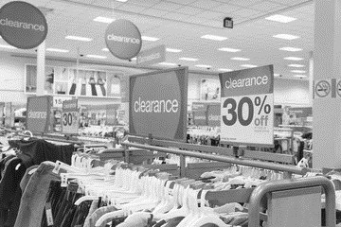
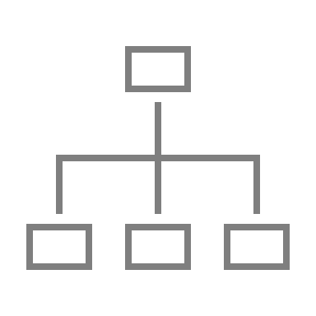
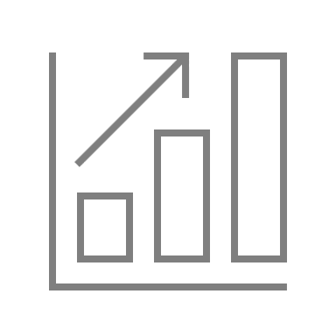
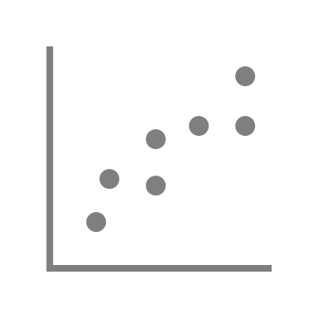
Trade Marketing
Execution Standards
Overview
In order for a brand to sell it requires visibility and visibility at the right place where it belongs in terms of category placement and shelf prominence in addition to this one of the most common executional standards is discounting to the shopkeeper in traditional trade but this is fast declining in favour of what activities the manufacturer will undertake to move the product from the shelf to the consumers hands
Trade marketing Implications
Discounts
Point of sale material
Posters and shell stockers
Tailored promotional packages
Branding
Product displays
Promoters
Predictable call cycle management
Credit Terms
Credit terms must be accurate to ensure customer engagement
Sales Calls
Sales call planning and intervals mut be known to the customer , ad hoc calls are a nonstarter
Pricing
The biggest fear of customers is uneven pricing with favoritism thrown in , this causes demotivation
Execution standards should be based on a process and KPI’s to deliver measurable standards
Promotions
Customers expect all promotions to be evenly spread out
Product Portfolio
Ensure portfolio is aligned to customer in a listing format
Quality & Damages
This area is a very sensitive one and best to have a process to automatically engage in situations
Administration
Ensure the account details are up to date
Promotional Material
A very sensitive area , always best to make customers aware you are fully engaged with best practices in POS design which fits their store and channel
Analytics
Customers are sensitive to performance metrics and respond very well to updates
Source : Nielsen thought leadership series 2022.

Slide 16
Trade Marketing
5 Minutes to capture a shoppers attention.
In 5 minutes , trade marketers can …
Overview
Within the traditional channel a shopper typically visits for between five and seven minutes and almost 70% of purchases are planned in this channel accordingly there are opportunities to promote and drive purchase and build brand equity here are some of the ways You can capture the shoppers attention
Trade marketing Implications
Gaining shoppers attention requires different metal methodologies used at different locations in different ways , Key aspect off trade marketing execution in these examples is specific needs based communication focused on the targeted product category being marketed.
Cash Counter
Shop keepers
Communicate a new product arrivals or new promotions with the limited time frame.
Instore communications
Use a broad screen TV to gain attention using a television commercial clip of 15 seconds to get eyeball attention .
Offer
Sampling
Engage a shopper and communicate new product uniqueness
Shoppers
Digitally engage through SMS and social media messaging systems conducive to traditional trade
Source : Nielsen thought leadership series 2022.

Slide 17
Thank you !

Slide 18
Job Descriptions
Develop roles clearly and completely across varying levels of experience
Agreements
Draft your business agreements across a variety of areas
Templates
Templates are designed based gather information in a structured manner
KPI’s
Performance indicator, a quantifiable measure of performance over time versus a specific objective.
Content Modules
Best practice material in power point for use as a knowledge base in business training , planning and execution .
Strategic tools
These tools are recognised the world over in business schools, consulting firms and companies who plan strategically.
Gain a competitive edge using the best tools and techniques to build a better you .
Analytical Tools
Interactive excel tools on specific business areas based on your data inputs delivered in a workbook model with instructions.
Scorecards
Designed as functional or subject indicators across a variety off situations to enable performance of situational evaluation versus aligned standards.
Calculators
calculate the right ratios for businesses looking for benchmarks in a variety of situations
Assessments
Assessments are designed around specific areas to conduct reviews and will center around a benchmark reviewing individuals or functions
Checklists
Designed around achieving milestones in a sequential manner.
Research
Research tools for sales and marketing engagement

Slide 19
Trade Marketing.
Traditional Trade Engagement
Sales & Marketing Fundamentals.
UpskilPRO e Institute for Sales & Marketing
Tools, Content & Templates
Hand built using experience & insight

