Slide 1

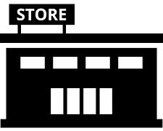

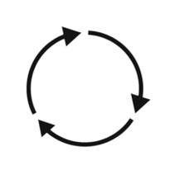



RETAILER
Distribution Partner Search
Situational Analysis
Covers all aspects of interviewing the potential channel / distribution partner from all angles,
Guide # 1
UpskilPRO e Institute for Sales & Marketing
Tools, Content & Templates
Hand built using experience & Insight

Slide 2
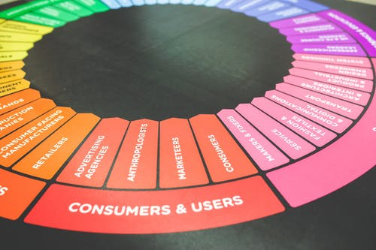

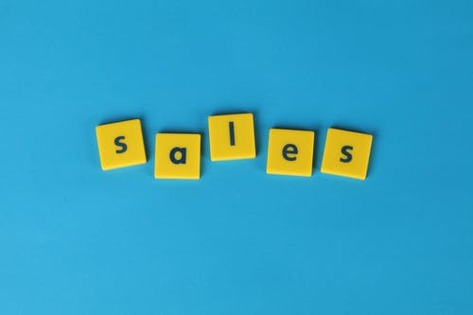

Created by
ex-Procter & Gamble, Rothmans, BAT, Gillette, Nokia,
Microsoft & 3M managers.
UpskilPRO tools are designed in easy-to-use solutions, all you need to do is download the tool and get to work immediately . All UpskilPRO material has taken 100’s of hours and many 1000’s of $ to build , all this expertise and content is brought to you for a fraction of the cost to help professionals enhance their capability.
core areas which are best suited to improve using our tools:
        Subject matter expertise
        Best practices
        Analytical output & charting
        Prioritization
        Process
Making life simpler for
Sales & Marketing professionals.
Tools in one place to get 10X productive now.

Slide 3


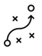

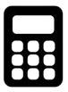

Job Descriptions
Develop roles clearly and completely across varying levels of experience
Agreements
Draft your business agreements across a variety of areas
Templates
Templates are designed based gather information in a structured manner
KPI’s
Performance indicator, a quantifiable measure of performance over time versus a specific objective.
Content Modules
Best practice material in power point for use as a knowledge base in business training , planning and execution .
Strategic tools
These tools are recognised the world over in business schools, consulting firms and companies who plan strategically.
Gain a competitive edge using the best tools and techniques to build a better you .
Analytical Tools
Interactive excel tools on specific business areas based on your data inputs delivered in a workbook model with instructions.
Scorecards
Designed as functional or subject indicators across a variety off situations to enable performance of situational evaluation versus aligned standards.
Calculators
calculate the right ratios for businesses looking for benchmarks in a variety of situations
Assessments
Assessments are designed around specific areas to conduct reviews and will center around a benchmark reviewing individuals or functions
Checklists
Designed around achieving milestones in a sequential manner.
Research
Research tools for sales and marketing engagement

Slide 4
2017
2018
100’s of tools grouped in 12 categories, 50 tool types and 12 business functions in 1 place.
get 10X productive now !
Categories
Functions
Analytical Tools
Types
Business Development
Agreements
Advertising
Customer Acquisition
Margins
Partner Search
Reports
Category Management
Assessments
Agreements
Customer Management
Market Analysis
Persona Development
Retail Measurement
Channel Management
Content Modules
Analytics
Distribution
Market Development
Planning
Reviews
Distribution
Checklists
Barriers
Distributor Management
Market Research
Positioning
Sales Management
Distributor Management
Calculators
Business Reviews
Forecasting
Market Segmentation
Pricing
Scorecards
General Management
Job Descriptions
Business Intelligence
GAP Analysis
Market Size
Prioritization
Segmentation
Key Account Management
KPI’s
Channels
Go To Market
Marketing
Product Development
Six Sigma
Marketing
Research
Communication
Job Descriptions
Marketing Comms
Product Life Cycle
Socio Economic Classification
Marketing Operations
Strategic Tools
Competitive Evaluation
Key Account Plans
Merchandising
Profit & Loss
Territory Design
Sales Management
Scorecards
Competitive Intelligence
Management Summary
New Market Entry
Promotions
Trade Marketing
Shopper Marketing
Templates
Trade Marketing

Slide 5



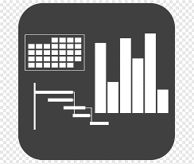




7 Benefits of using UpskilPRO :
Improve your knowledge
with professional Strategic Tools , Templates and planning documents for any business situation!
Use ready made tools
with filled in examples and ready to print & edit at your convenience . Just edit and fill-in the blanks !
Develop YOUR BUSINESS
Learn , & utilize the knowledge and processes and enhance your capabilities as the other companies have
We Created UpskilPRO for the
  Sales Professional
  Trade Marketer
  Marketing Executive
  Operations Manager
  VP/Director/Manager
100’s of tools , TEMPLATES & documents
CREATED BY
world class sales and marketing
business professionals.
All tools
are based on topics and subject based situations and are simple and easy to use .
SAVE THOUSANDS OF DOLLARS
The average company will save 1000’s of $ per employee in time & effort using our ready tools !
Top Quality Tools & Templates for developing both you and your business.
www.upskilpro.com

Slide 6
Distribution Partner Search
Aligning your business model with the right distributor is half the job ,ensuring your distributor is engaged with your business model is the other half.

Slide 7
Distribution Partner Search
Manufacturer
There are multiple steps to establishing a distribution function in a region or country , it depends on the manufacturer or brand owner to decide on whether to
Distribute directly
or
Appoint a distributor organization
In our partner search toolkit, we focus on the search and appointment of the Distributor at the national level
The other 2 layers may be considered in the bigger picture of the distribution layers and organization to service a country classified into 3 tiers.
The chart is a simplified version , it depends on brand owners and country dynamics to decide which layer, or all layers are going to be used.
Classification
Responsibility
Geographies
Distributor
Master distributor
National
Stockist
Regional distributor
State / Province
Sub Stockist
Area distributor
District/City

Slide 8
Distribution Partner Search
Broad footprint for adaptation
Market evaluation -1
Market Needs-2
Market Scan-3
Probables-4
  Top Management alignment
  Market Attractiveness
  Market Prioritization
  Market Modelling
  Market sizing
  Competitive evaluation
  Competitive landscape
  Needs evaluation
  Customer engagement
  Consumer evaluation
  Where is the gap
  Practical needs
  Infrastructure and capability
  Product Gaps
  Service Gaps
  Distribution models
  Brand owners
  Logistics & Infrastructure
  Management
  Channel reach
  Brand and reputation
  Financial Standards
  Legal framework
  Media Audit
  List of probable's
  Prioritized probable’s
  Credit reports
  Reporting system
  ERP capabilities
  Evaluation matrix
  Face to face
  Scoring criteria
  Key Questions
  Score the responses
Test Scenario-5
Appointment-6
Onboarding-7
Reviews-8
  Run a test scenario
  Evaluate the scenario
  Check list
  Communication
  Appointment
  Onboarding
  KPI
  Team Definition
  Objective setting
  Measurement
  Communication
  Reviews
  Business reviews
  Team engagement

Slide 9
Distribution Partner Search
Strategic Analysis - Porters 5 Forces
Strategic Analysis
Porters 5 Forces

Slide 10
Distribution Partner Search
Strategic Analysis - Porters 5 Forces
Porter’s Five Forces. The framework is used to assess the attractiveness and profit potential of an industry or firm by analysing the 5 key forces active upon it.
Threat of new entrants
Rivalry among existing competitors
No of competitors
Diversity of competitors
Concentration of industry
Industry growth
Quality differences
Brand loyalty
Barriers to exit
Switching costs
Threat of new entrants
Barriers to entry
Economies of scale
Brand loyalty
Capital requirements
Cumulative experience
Government policies
Access to distribution channels
Switching costs
Rivalry – Industry growth, fixed costs/value added, product differences, brand identity, switching costs, diversity of competitors, exit barriers •
New entrants – Economics of scale, proprietary product differences, brand identity, switching costs, capital requirements, access to distribution, absolute cost advantages, learning curve, access to necessary inputs, government policy, expected retaliation •
Buyers – Bargaining leverage, buyer purchase volume, buyer switching costs, buyer information, substitute products, price sensitivity, product differences, brand identity, impact on quality/performance, decision makers’ incentives •
Suppliers – Differentiation of inputs, switching costs of suppliers and firms in the industry, presence of substitute inputs, supplier concentration, importance of volume supplier, cost relative to total purchases in the industry, impact of inputs on costs or differentiation •
Substitutes – Relative price performance of substitutes, switching costs, buyer propensity to substitute
Rivalry
among
existing competitors
Bargaining power of suppliers
Bargaining power of buyers
Bargaining power of suppliers
No & size od suppliers
Uniqueness of suppliers product
Focal companies ability to substitute
Bargaining power of buyers
No of customers
Size of each customer order
Differences between competitors
Price sensitivity
Buyers ability to differentiate
Buyers information availability
Switching costs
Threat of substitute products
No of substitute products available
Buyers propensity to substitute
Relative price performance of substitute
Perceived level of product differentiation
Switching costs
Threat of substitute products

Slide 11
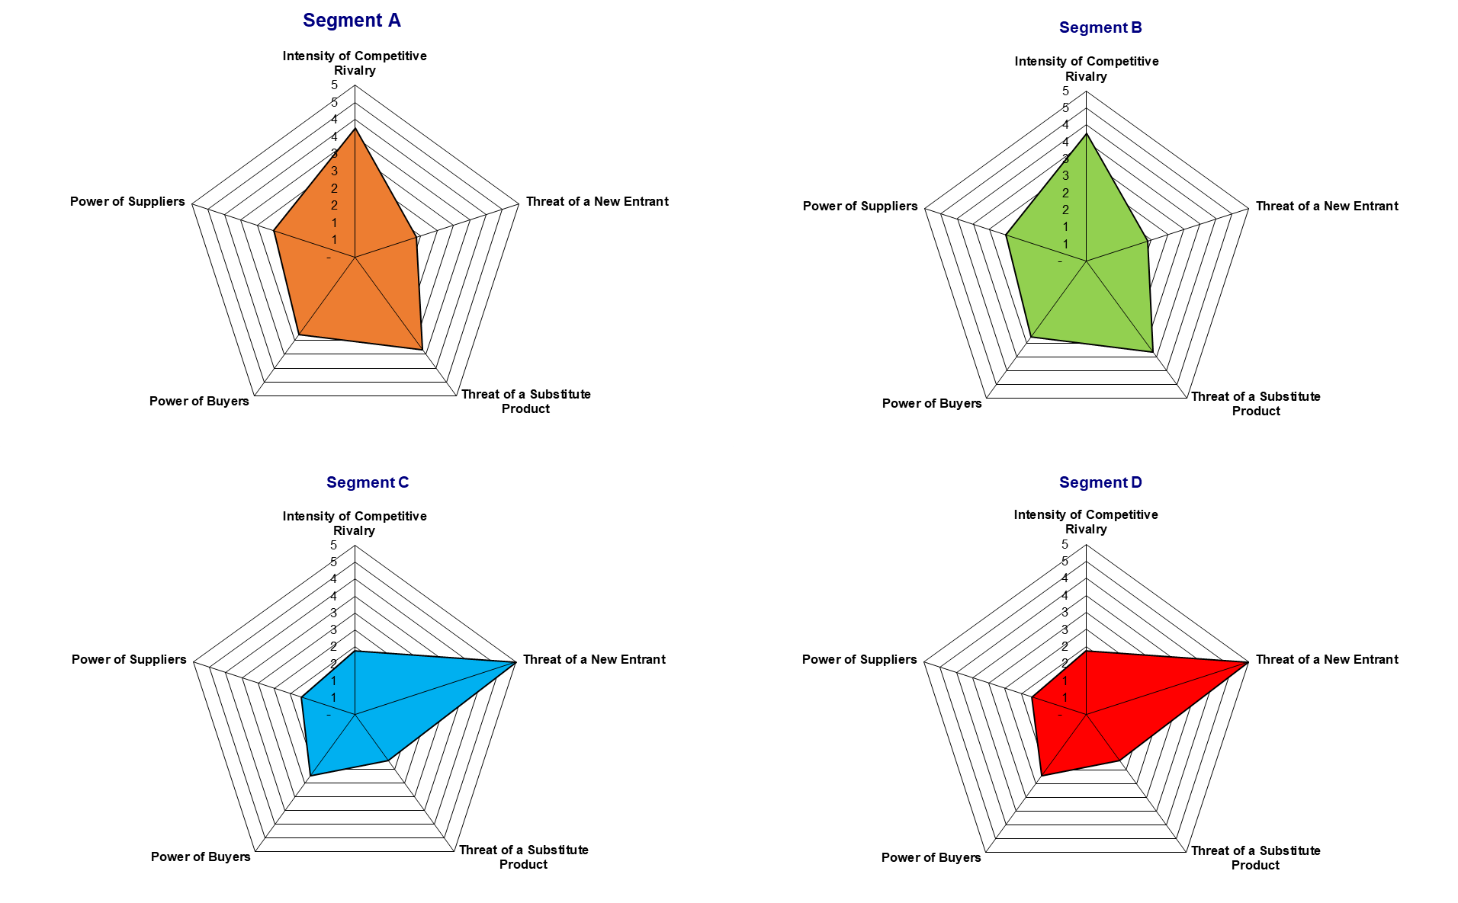
Distribution Partner Search
Strategic Analysis - Porters 5 Forces

Slide 12
Strategic Analysis
PESTLE Analysis

Slide 13
Distribution Partner Search
Strategic Analysis – PESTLE Analysis
P
E
S
T
E
L
Political
Economic
Social
Technological
Environmental
Legal
Stringent measures
Protection of copy rights
Patent legislation
Regulatory fees
Involvement in Labour practices
Conflict with customers that have high demand and occupy a large share of the business contribution or economy
Fragmented market
Declining customer share of wallet
Price pressure
Higher taxes
Higher duties
Reliance on manufacturers abroad
Shorter life cycle leading to higher investments
Lower birth rate
Lowe per capita consumption and spending
Product life cycle is shorter leading to difficulty in recovering investments
Unemployment
Emerging trends in ageing population and declining child birth
Pensionable age increased
Wage rates declining
Low copyright or Trade mark protection
Licensing
Intense competition from low cost countries
Technology gaps due to licencing or procedural delays
Raw material imports for technology specific production ( Rare earths )
Import licensing
Raw material shortage
Pollution & Greenhouse effect
Carbon reduction
Carbon footprint
Environmental legislation
Geographical location
Health & Safety
Equal opportunities
Consumer rights
Product labelling legislation
Labour laws
Competitive legislation
Combative legislation
Protectionism
Safety standards
Product safety and recall
Advertising standards
Drivers

Slide 14
Strategic Analysis
SWOT Analysis

Slide 15
Strategic Analysis Tool
SWOT Analysis
Strengths
Are things that your organization does particularly well, or in a way that distinguishes you from your competitors. Think about the advantages your organization has over other organizations. These might be the motivation of your staff, access to certain materials, or a strong set of manufacturing processes.
Your strengths are an integral part of your organization, so think about what makes it "tick." What do you do better than anyone else? What values drive your business? What unique or lowest-cost resources can you draw upon that others can't? Identify and analyse your organization's Unique Selling Proposition (USP), and add this to the Strengths section.
Then turn your perspective around and ask yourself what your competitors might see as your strengths. What factors mean that you get the sale ahead of them?
Remember, any aspect of your organization is only a strength if it brings you a clear advantage. For example, if all of your competitors provide high-quality products, then a high-quality production process is not a strength in your market: it's a necessity.
Weaknesses
Now it's time to consider your organization's weaknesses.
A SWOT Analysis will only be valuable if you gather all the information you need.
Weaknesses, like strengths, are inherent features of your organization, so focus on your people, resources, systems, and procedures. Think about what you could improve, and the sorts of practices you should avoid.
Once again, imagine (or find out) how other people in your market see you. Do they notice weaknesses that you tend to be blind to? Take time to examine how and why your competitors are doing better than you.
Opportunities
Opportunities are openings or chances for something positive to happen, but you'll need to claim them for yourself!
They usually arise from situations outside your organization, and require an eye to what might happen in the future. They might arise as developments in the market you serve, or in the technology you use. Being able to spot and exploit opportunities can make a huge difference to your organization's ability to compete and take the lead in your market.
Think about good opportunities you can spot immediately. These don't need to be game-changers: even small advantages can increase your organization's competitiveness. What interesting market trends are you aware of, large or small, which could have an impact?
You should also watch out for changes in government policy related to your field. And changes in social patterns, population profiles, and lifestyles can all throw up interesting opportunities.
Threats
Threats include anything that can negatively affect your business from the outside, such as supply chain problems, shifts in market requirements, or a shortage of recruits. It's vital to anticipate threats and to take action against them before you become a victim of them and your growth stalls.
Think about the obstacles you face in getting your product to market and selling. You may notice that quality standards or specifications for your products are changing, and that you'll need to change those products if you're to stay in the lead. Evolving technology is an ever-present threat, as well as an opportunity!
Always consider what your competitors are doing, and whether you should be changing your organization's emphasis to meet the challenge. But remember that what they're doing might not be the right thing for you to do, and avoid copying them without knowing how it will improve your position.
Be sure to explore whether your organization is especially exposed to external challenges. Do you have bad debt or cash-flow problems, for example, that could make you vulnerable to even small changes in your market? This is the kind of threat that can seriously damage your business, so be alert.

Slide 16
Strategic Analysis Tool
SWOT Analysis
6012
Strength
Weakness
What advantages do our organization represent
Key Features
Technologies and Resources
USP
Market share
Profitability
Patents
Pipeline
High A&M Ratio
Competitive advantages
Brand share
Corporate brand awareness
Company staff , How ready are they for the market in terms of training and qualification
Troubling internal trends
Under investments
Operational pain points
Issues in functions
Marketing or sales strategy gaps
Customer feedback
Category trends
Highest scores
Prevention of growth and improvement
Internal FACTORS
Opportunities
Threats
Trends
Opportunities without solutions
Government
Lifestyle
Population
Health
Our performance in relation to economic boom - bust cycles
Legislation
Regulations
Organizational culture
Product or service compatibility with market expectations
Opportunities = Creative solutions
Potential and real threats
External FACTORS

Slide 17
Distribution Partner Search
Broad View

Slide 18
Partner SEARCH
Partner search services are conducted using an extensive set of tools from upskilPRO.com
Leadership & Analysis
Playbook & Models
Strategy & Assessments
Prioritization & Capabilities
Brand
Leadership
Playbook
Marketing & Sales Strategy
Prioritization
Country
Country Analysis
Portfolio Alignment
Organisation design
Capability
Strategy
Strategic Analysis
Category Insights
Strategic Market Assessments
Market Sizing
Models
Distribution Models
Market & Distribution Models
Category Specific
Models
Portfolio
Distribution Partner search stages
Assessments
Competitive evaluation
Channels & Competitive Landscape
Organisation & Local assessments
Category assessment
Support
Reports / Check lists
ERP Engagement
Contracts
Logistics & SC
Assessment & engagement stages
© 2021 upskilPRO - Confidential & Proprietary

Slide 19
Distribution Partner Search

Slide 20
Distribution Partner Search

Slide 21
Media Visibility

Slide 22
Distribution Partner Search
Media Visibility Index

Slide 23
Risk

Slide 24
Distribution Partner Search
Industry Attractiveness
Industry Attractiveness
High
Medium
Low
Equal / Weaker
Company / Industry Attractiveness
Selection Criteria
High
Size
Market growth
Pricing
Market Diversity
Competitive structure
Industry profitability
Technical role
Social impact
Environmental
Legal
Human
Medium
Business Unit Position
Build
Hold
Low
Harvest

Slide 25
Distribution Partner Search
Risk Assessment

Slide 26
Reports

Slide 27
Distribution Partner Search
Distributor Reports

Slide 28
Thank you !

Slide 29
Job Descriptions
Develop roles clearly and completely across varying levels of experience
Agreements
Draft your business agreements across a variety of areas
Templates
Templates are designed based gather information in a structured manner
KPI’s
Performance indicator, a quantifiable measure of performance over time versus a specific objective.
Content Modules
Best practice material in power point for use as a knowledge base in business training , planning and execution .
Strategic tools
These tools are recognised the world over in business schools, consulting firms and companies who plan strategically.
Gain a competitive edge using the best tools and techniques to build a better you .
Analytical Tools
Interactive excel tools on specific business areas based on your data inputs delivered in a workbook model with instructions.
Scorecards
Designed as functional or subject indicators across a variety off situations to enable performance of situational evaluation versus aligned standards.
Calculators
calculate the right ratios for businesses looking for benchmarks in a variety of situations
Assessments
Assessments are designed around specific areas to conduct reviews and will center around a benchmark reviewing individuals or functions
Checklists
Designed around achieving milestones in a sequential manner.
Research
Research tools for sales and marketing engagement

Slide 30
RETAILER
Distribution Partner Search
Situational Analysis
Covers all aspects of interviewing the potential channel / distribution partner from all angles,
Guide # 1
UpskilPRO e Institute for Sales & Marketing
Tools, Content & Templates
Hand built using experience & Insight

