Slide 1
PEST Analysis
assess major external factors that influence your operation in order to become competitive.
UpskilPRO e Institute for Sales & Marketing
Tools, Content & Templates
Hand built using experience & Insight

Slide 2
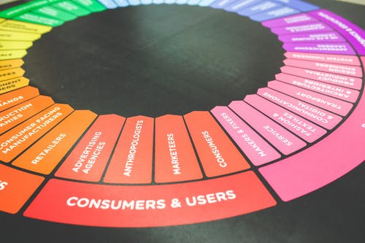
Created by
ex-Procter & Gamble, Rothmans, BAT, Gillette, Nokia,
Microsoft & 3M managers.
UpskilPRO tools are designed in easy-to-use solutions, all you need to do is download the tool and get to work immediately . All UpskilPRO material has taken 100’s of hours and many 1000’s of $ to build , all this expertise and content is brought to you for a fraction of the cost to help professionals enhance their capability.
core areas which are best suited to improve using our tools:
Subject matter expertise
Best practices
Analytical output & charting
Prioritization
Process
Capability enhancement tools for
Consumer Marketing, Trade Marketing &
Sales excellence professionals.
Tools in one place to get 10X productive now.

Slide 3
Job Descriptions
Develop roles clearly and completely across varying levels of experience
Agreements
Draft your business agreements across a variety of areas
Templates
Templates are designed based gather information in a structured manner
KPI’s
Performance indicator, a quantifiable measure of performance over time versus a specific objective.
Content Modules
Best practice material in power point for use as a knowledge base in business training , planning and execution .
Strategic tools
These tools are recognised the world over in business schools, consulting firms and companies who plan strategically.
Gain a competitive edge using the best tools and techniques to build a better you .
Analytical Tools
Interactive excel tools on specific business areas based on your data inputs delivered in a workbook model with instructions.
Scorecards
Designed as functional or subject indicators across a variety off situations to enable performance of situational evaluation versus aligned standards.
Calculators
calculate the right ratios for businesses looking for benchmarks in a variety of situations
Assessments
Assessments are designed around specific areas to conduct reviews and will center around a benchmark reviewing individuals or functions
Checklists
Designed around achieving milestones in a sequential manner.
Research
Research tools for sales and marketing engagement

Slide 4
2017
2018
100’s of tools grouped in 12 categories, 50 tool types and 12 business functions in 1 place.
get 10X productive now !
Categories
Functions
Analytical Tools
Types
Business Development
Agreements
Advertising
Customer Acquisition
Margins
Partner Search
Reports
Category Management
Assessments
Agreements
Customer Management
Market Analysis
Persona Development
Retail Measurement
Channel Management
Content Modules
Analytics
Distribution
Market Development
Planning
Reviews
Distribution
Checklists
Barriers
Distributor Management
Market Research
Positioning
Sales Management
Distributor Management
Calculators
Business Reviews
Forecasting
Market Segmentation
Pricing
Scorecards
General Management
Job Descriptions
Business Intelligence
GAP Analysis
Market Size
Prioritization
Segmentation
Key Account Management
KPI’s
Channels
Go To Market
Marketing
Product Development
Six Sigma
Marketing
Research
Communication
Job Descriptions
Marketing Comms
Product Life Cycle
Socio Economic Classification
Marketing Operations
Strategic Tools
Competitive Evaluation
Key Account Plans
Merchandising
Profit & Loss
Territory Design
Sales Management
Scorecards
Competitive Intelligence
Management Summary
New Market Entry
Promotions
Trade Marketing
Shopper Marketing
Templates
Trade Marketing

Slide 5
PEST Analysis
assess major external factors that influence your operation in order to become competitive.

Slide 6
PEST Analysis
4 Key reasons to use one
PEST Analysis is useful for four main reasons:
It helps you to spot business or personal opportunities, and it gives you advanced warning of significant threats.
It reveals the direction of change within your business environment. This helps you shape what you're doing, so that you work with change, rather than against it.
It helps you avoid starting projects that are likely to fail, for reasons beyond your control.
It can help you break free of unconscious assumptions when you enter a new country, region, or market; because it helps you develop an objective view of this new environment.

Slide 7
PEST Analysis
PEST Analysis summary
Political
Economic
Economic factors include growth, interest rates , exchange rates, and the inflation rate.
These factors have a major impact on how businesses operate and make decisions
Political factors relate to how and why a government intervenes in the local economy
Sociological
Technological
This includes the cultural aspect and includes health , population , age distribution , career, employment , and emphasis on safety
This covers areas such as R&D activity , automation , technology , incentives and the pace of technological change.

Slide 8
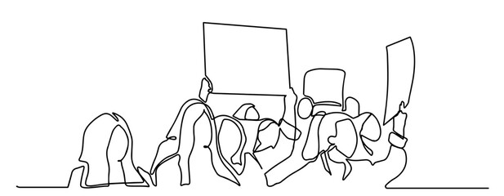
DCPEST Analysis
Political Analysis Components
Political Factors to Consider | Score
When is the country's next local, state, or national election? How could this change government or regional policy?
Who are the most likely contenders for power? What are their views on business policy, and on other policies that affect your organization?
Depending on the country, how well developed are property rights and the rule of law, and how widespread are corruption and organized crime? How are these situations likely to change, and how is this likely to affect you?
Could any pending legislation or taxation changes affect your business, either positively or negatively?
How will business regulation, along with any planned changes to it, affect your business? And is there a trend towards regulation or deregulation?
How does government approach corporate policy, corporate social responsibility, environmental issues, and customer protection legislation? What impact does this have, and is it likely to change?
What is the likely timescale of proposed legislative changes?
Are there any other political factors that are likely to change?
TOTALS
Scoring Guide
High | 9
Medium | 3
Low | 1
NA | 0
This table represents a basic view of a DC PEST analysis for marketing in general to summarize the situation.
Please consider political factors from a direct influence perspective as far as possible , which will impact the category and brand , you may relate this to Tobacco , Alcohol , Electric Vehicles and Green House Gases for instance . Similarly reach out to analyse the factors to consider when doing your political analysis.

Slide 9
DCPEST Analysis
Economic Analysis Components
Economic Factors to Consider | Score
How stable is the current economy? Is it growing, stagnating, or declining?
Are key exchange rates stable, or do they tend to vary significantly?
Are customers' levels of disposable income rising or falling? How is this likely to change in the next few years?
What is the unemployment rate? Will it be easy to build a skilled workforce? Or will it be expensive to hire skilled labour?
Do consumers and businesses have easy access to credit? If not, how will this affect your organization?
How is globalization affecting the economic environment?
Are there any other economic factors that you should consider?
TOTALS
Scoring Guide
High | 9
Medium | 3
Low | 1
NA | 0
This table represents a basic view of a DC PEST analysis for marketing in general to summarize the situation.
Please consider political factors from a direct influence perspective as far as possible , which will impact the category and brand , you may relate this to Tobacco , Alcohol , Electric Vehicles and Green House Gases for instance . Similarly reach out to analyse the factors to consider when doing your political analysis.

Slide 10
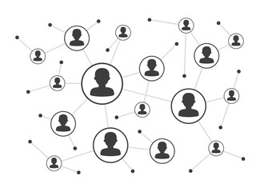
DCPEST Analysis
Sociological Analysis Components
Socio-Cultural Factors to Consider | Score
What is the population's growth rate and age profile? How is this likely to change?
Are generational shifts in attitude likely to affect what you're doing?
What are your society's levels of health, education, and social mobility? How are these changing, and what impact does this have?
What employment patterns, job market trends, and attitudes toward work can you observe? Are these different for different age groups?
What social attitudes and social taboos could affect your business? Have there been recent socio-cultural changes that might affect this?
How do religious beliefs and lifestyle choices affect the population?
Are any other socio-cultural factors likely to drive change for your business?
TOTALS
Scoring Guide
High | 9
Medium | 3
Low | 1
NA | 0
This table represents a basic view of a DC PEST analysis for marketing in general to summarize the situation.
Please consider Socio cultural factors from a direct influence perspective as far as possible , which will impact the category and brand , you may relate this to ageing populations , immigration , education , age related laws , retirement , baby boom etc.
Similarly reach out external bodies to analyse the factors to consider when doing your sociological analysis.

Slide 11
DCPEST Analysis
Technological Analysis Components
Technological Factors to Consider | Score
Are there any new technologies that you could be using?
Are there any new technologies on the horizon that could radically affect your work or your industry?
Do any of your competitors have access to new technologies that could redefine their products?
In which areas do governments and educational institutions focus their research? Is there anything you can do to take advantage of this?
How have infrastructure changes affected work patterns (for example, levels of remote working)?
Are there existing technological hubs that you could work with or learn from?
Are there any other technological factors that you should consider?
TOTALS
Scoring Guide
High | 9
Medium | 3
Low | 1
NA | 0
This table represents a basic view of a DC PEST analysis for marketing in general to summarize the situation.
Please consider Technological factors from a direct and indirect influence perspective as far as possible , which will impact the category and brand , you may relate this to new software , artificial intelligence , cost to use per unit , licensing ageing , the recent effects of covid and the learnings from them etc.

Slide 12
PEST Analysis
assess major external factors that influence your operation in order to become competitive.
UpskilPRO e Institute for Sales & Marketing
Tools, Content & Templates
Hand built using experience & Insight

