Slide 1


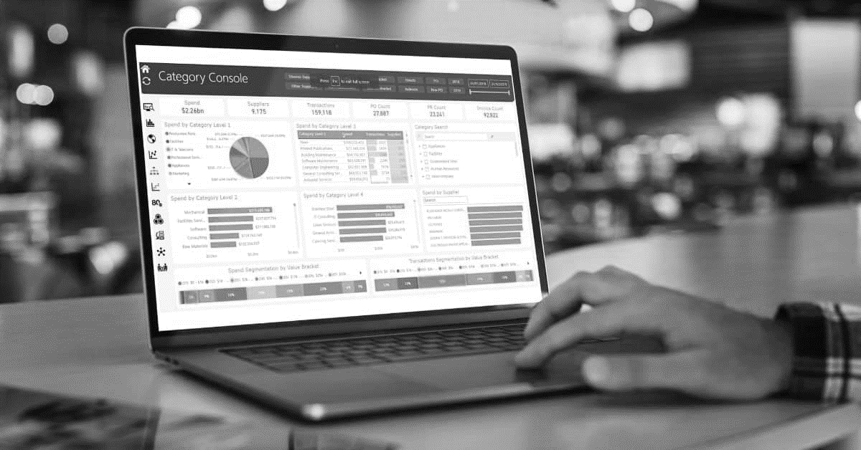
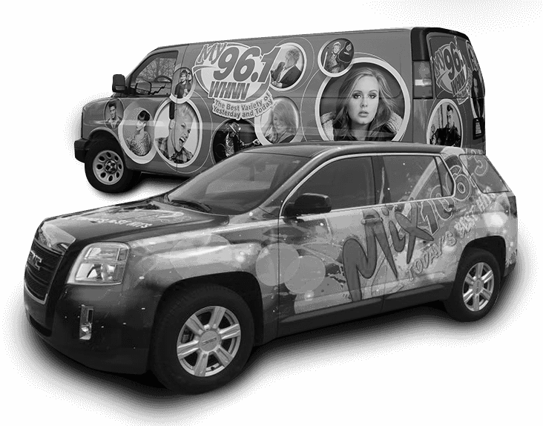
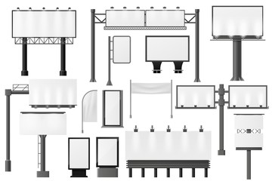
Trade Marketing Tools.
Sales & Marketing Fundamentals.
UpskilPRO e Institute for Sales & Marketing
Tools, Content & Templates
Hand built using experience & insight

Slide 2
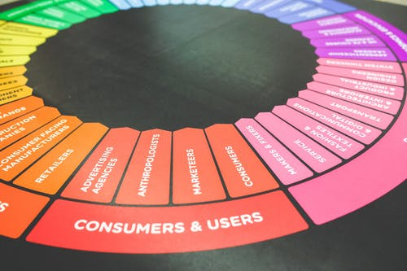

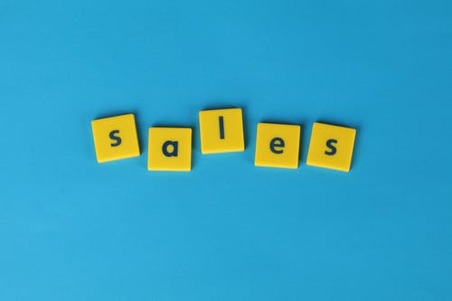
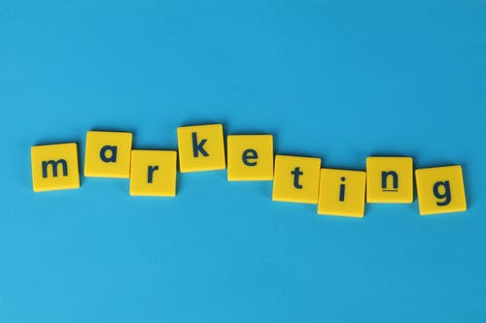
Created by
ex-Procter & Gamble, Rothmans, BAT, Gillette, Nokia,
Microsoft & 3M managers.
UpskilPRO tools are designed in easy-to-use solutions, all you need to do is download the tool and get to work immediately . All UpskilPRO material has taken 100’s of hours and many 1000’s of $ to build , all this expertise and content is brought to you for a fraction of the cost to help professionals enhance their capability.
core areas which are best suited to improve using our tools:
        Subject matter expertise
        Best practices
        Analytical output & charting
        Prioritization
        Process
        Training
Making life simpler for
Sales & Marketing professionals.
Tools in one place to get 10X productive now.

Slide 3


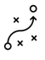

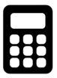
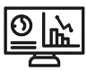
Job Descriptions
Develop roles clearly and completely across varying levels of experience
Agreements
Draft your business agreements across a variety of areas
Templates
Templates are designed based gather information in a structured manner
KPI’s
Performance indicator, a quantifiable measure of performance over time versus a specific objective.
Content Modules
Best practice material in power point for use as a knowledge base in business training , planning and execution .
Strategic tools
These tools are recognised the world over in business schools, consulting firms and companies who plan strategically.
Gain a competitive edge using the best tools and techniques to build a better you .
Analytical Tools
Interactive excel tools on specific business areas based on your data inputs delivered in a workbook model with instructions.
Scorecards
Designed as functional or subject indicators across a variety off situations to enable performance of situational evaluation versus aligned standards.
Calculators
calculate the right ratios for businesses looking for benchmarks in a variety of situations
Assessments
Assessments are designed around specific areas to conduct reviews and will center around a benchmark reviewing individuals or functions
Checklists
Designed around achieving milestones in a sequential manner.
Research
Research tools for sales and marketing engagement

Slide 4



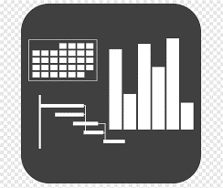




7 Benefits of using UpskilPRO :
Improve your knowledge
with professional Strategic Tools , Templates and planning documents for any business situation!
Use ready made tools
with filled in examples and ready to print & edit at your convenience . Just edit and fill-in the blanks !
Develop YOUR BUSINESS
Learn , & utilize the knowledge and processes and enhance your capabilities as the other companies have
We Created UpskilPRO for the
  Sales Professional
  Trade Marketer
  Marketing Executive
  Operations Manager
  VP/Director/Manager
100’s of tools , TEMPLATES & documents
CREATED BY
world class sales and marketing
business professionals.
All tools
are based on topics and subject based situations and are simple and easy to use .
SAVE THOUSANDS OF DOLLARS
The average company will save 1000’s of $ per employee in time & effort using our ready tools !
Top Quality Tools & Templates for developing both you and your business.
www.upskilpro.com

Slide 5
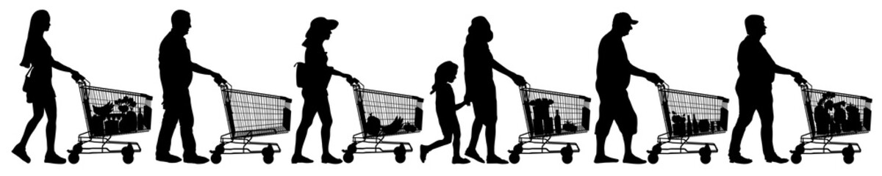
Trade Marketing
Promotions .
In the trade marketing toolbox, promotions are one tactical tool that can be applied in conjunction with the brand plans .
in this module we cover a variety of promotional tools which range from price to communication visibility and brand domination in a trade marketing context the most commonly applied tools are those which are directly customer facing .not all promotions need a price element , Other tools which work on persuading the consumer work just as well .
Trade marketing utilizes promotions to convert consumers and shoppers at the category or point of sale that is why we refer to tools here as being both tactical and strategic depending on alignment to the internal plans And the objectives .

Slide 6
Trade marketing promotions .
Promotions in trade marketing .
Wild brand marketing may use promotions from a strategic context trade marketing in conjunction with brand convert those strategic alignments into tactical executions utilising promotions .
Promotions emphasise 4 points
A Promotional purchase inducers
B Product communication
C Category communication
D Branding visibility.
Well thought out trade marketing promotions lay less emphasis on price and more emphasis on product benefits .
Consumer
Brand Owner
Trade Channel

Slide 7
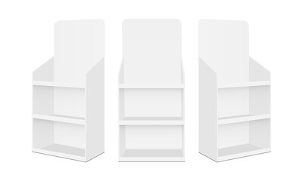
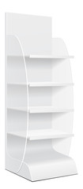
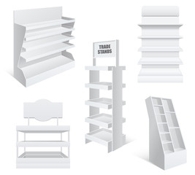
Trade Marketing
Portable Display Stands .
Summary
Display units give manufacturers a great way to showcase their products in various locations to make them viewable and accessible to the end consumer or shopper .
there are there are many forms off display units and all the left to the imagination of the brand owner however we concentrate on a few basic once
Mechanics
It display unit can store a certain number of units size and shape are left to the manufacturers objectives
Branding it is possible all across the display units
Extremely portable and can be moved to different locations very easily
Units can be they can be assembled on site
Cost for display unit usually is considerably lower as opposed to permanent units
Where used
Can be used in any retail environment or shopping mall easily as it takes very little space portable and is highly visible
Material
Corrugated cardboard , metal , wood , acrylic , and MDF
Benefits
Easy assembly
Low cost units
Can be placed anywhere
Biodegradable material unless it is made of metal
Branding flexibility
Dumpbins
Display stands

Slide 8
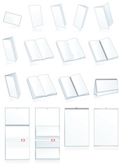
Trade Marketing
Leaflets.
Summary
Leaflets are used in almost any situation where you feel a consumer end user or shopper would naturally see it , leaflets are great printed communication material and easy to make and roll out
Mechanics
Leaflets are usually printed in the thousands ask they are small in size
They can be displayed in almost any situation if they have a holder
The possibilities of utilising different communication on leaflet simply enormous
Costs on in fractions of a cent
Where used
Can be used in any retail environment or shopping mall easily as it takes very little space portable and is highly visible , Place next to a product , cashier , or at promotion stands.
Material
Paper in varying sizes generally A5 or a A4 folded
Benefits
Easy assembly
Low cost
Can be placed anywhere
Biodegradable material
Branding flexibility
Leaflets

Slide 9
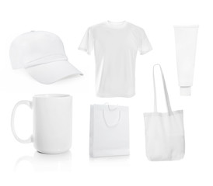

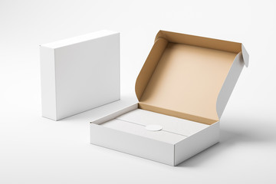
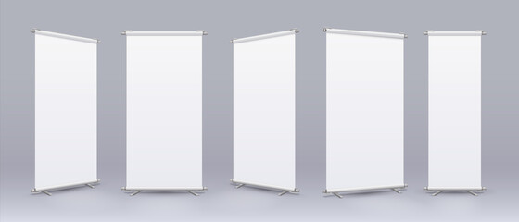

Trade Marketing
Collateral.
Summary
Sales and marketing collateral is designed for specific programmes could be either a corporate or marketing nature . they are more basic in design form such as bags caps tee shirts uh boxes et cetera what distinguishes them is the branding and communication printed.
Mechanics
Collateral is usually printed in the thousands ask they are generic and small in size
They can be Utilised in almost any situation rich marketing or sales desire
They are considered more of utility value to the end user smart companies designed their collateral and giveaways around useful objects and tools which can be reused
Where used
Sales and marketing collateral is usually use when communicating an idea , a promotion or a new initiative which is being rolled out , there are no limitations to the number of users that can be put to , however this is a promotional item which is usually kept year round and handed out to trade partners , retail partners , channel partners and shoppers and end users
Material
Paper cardboard , ceramic , glass , cloth et cetera
Benefits
Easy assembly
Low cost
Can be placed anywhere
Enormous branding flexibility
Sales & Marketing collateral

Slide 10
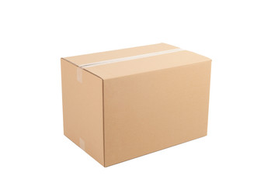
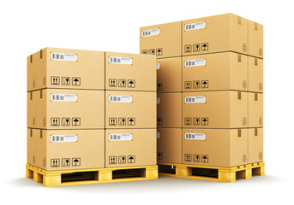
Trade Marketing
Trade Promotion.
Summary
The objective of a trade promotion is to assist in introducing or listing the product but tea trade channels this is more focused towards non retail channels such as wholesale , reseller’s and stockists .
Mechanics
There are two or three common ways in which a trade promotion is rolled out
  It's usually on a percentage for example buy 100 cases and get 5 cases free
  Standard stocking offer of 10 + 1
  Buy and reclaim specific prizes for the number of coupons you turn in we are stuck on the side of the carton
  Specific prizes for purchase of specific quantities , this is mainly for stockists and resellers
  The prizes are usually in between 5% and 8% off the end user price ( example )
  Stockists and resellers buy and sell the specified quantity to reclaim these prizes
Where used
Trade promotions are used in conjunction with the retail end , while the trade promotions are specific to resellers and stockists the idea here is to accelerate listing and product availability in the required channels
Material
Usually a high quality sticker stuck on the outside of a carton
Benefits
Excellent tool when used carefully to avoid over stocking
Easy to assemble mechanics
Claim prices based on details
100 + 5
Trade Promotions

Slide 11
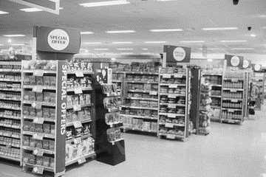
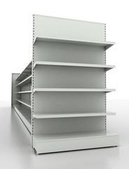
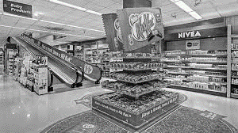
Trade Marketing
Displays ( end caps ) .
Summary
End caps are usually at the end of the category and the most visible display units in a retail environment in most retail outlets you will find all category ends having an end cap which then becomes a complete aisle walk as seen in the picture these are reserved for key promotions which are in a calendarized format driven by the retailer
Mechanics
endcaps are usually given out for periodic timeframes between a week to a fortnight , endcaps are best tied in with your trade marketing promotional calendar and the store theme , end caps may contain your promoted product along with promotional communication material and also a promoter who can talk to end users , in exceptional circumstances you may have your own end cap design replace the store in gap for a fixed duration
Where used
End cap placements are fixed in nature by the retailer and highly visible in any retail format
Material
usually designed in mild steel or aluminium format they belong to the store
Benefits
highly visible and accommodates a good level of stock thereby creating your branding and visibility awareness
Displays

Slide 12

Trade Marketing
Outdoor hoardings .
Summary
Outdoor units are extremely highly visible hoardings placed at strategic street and road intersections , they are usually visible from hundreds of metres to a kilometre large in dimensions and visible 24 hours due to the lighting and are fairly expensive to rent .
Mechanics
Outdoor units are either the primary responsibility off brand marketing or in some cases trade marketing , rented for normally a year you can change your branding and messaging as per local requirement and local regulations , while the hoarding is fixed to a location the possibilities of the branding being changed and rented to multiple brand owners makes it highly attractive.
Where used
Placed on high traffic roads and junctions highly visible from a distance.
Material
Steel frame long with supplied lighting.
Benefits
highly visible from a distance , Brand owners who are creative usually make the best long lasting impressions.
Outdoor branding

Slide 13
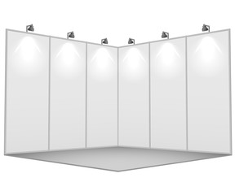
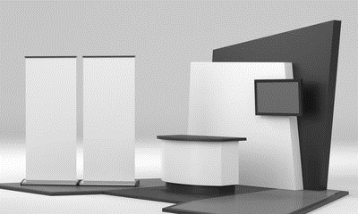
Trade Marketing
Exhibitions.
Summary
Exhibitions are strategic in nature for brand owners as they depend on these consistently year after year trademark it is target exhibitions which match their business. Exhibitions offer potential customers for looking for solutions similar to our product range .
Mechanics
exhibition stands coming a variety of sizes based on square meterage exhibition owners offer their standard fixtures and brand owners sometimes design their own exhibition stand Uniqueness and branding aesthetics , in the image on right the top image is a standard exhibition fixture , while the one at bottom is a customized unit
Where used
Most countries and cities have a standardised schedule off exhibitions across a range all industries this offers trade marketers the capability to plan ahead and utilise Synergies .
Material
Wood metal MDF and acrylic are commonly used in exhibition stands .
Benefits
standardised themes across a variety of industries I love you to target customers with a greater degree of precision and build a database for post exhibition communication
Exhibitions

Slide 14
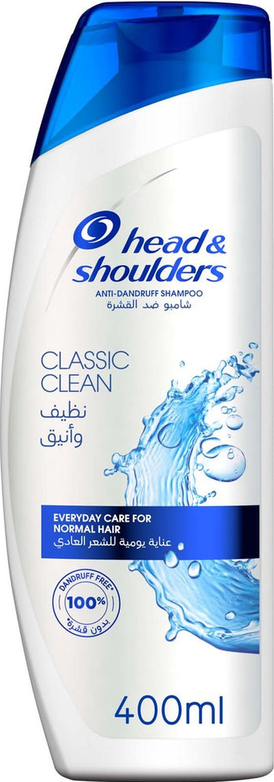
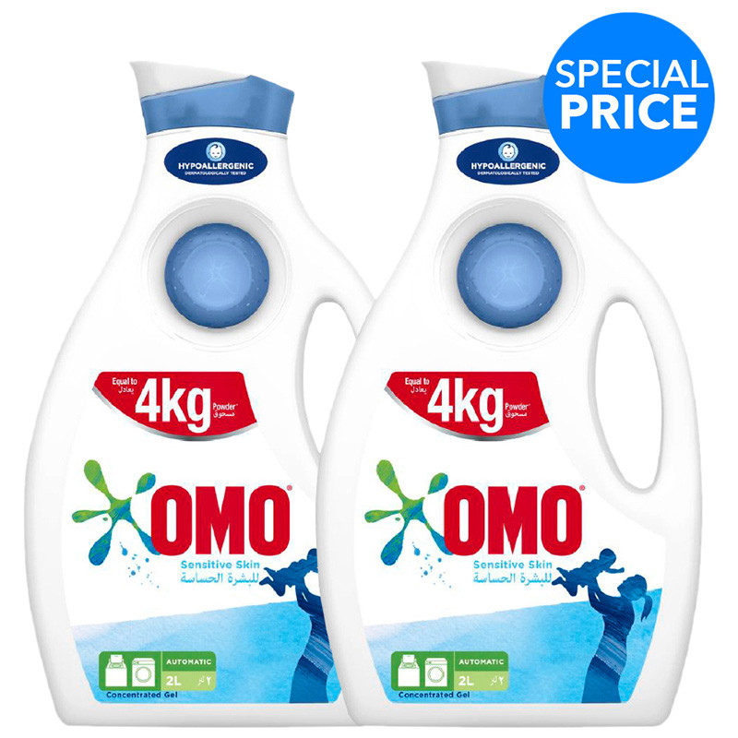
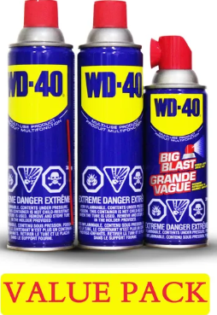
Trade Marketing
Consumer promotions .
Summary
Consumer promotions I usually done and very tactical manner based on a strategy the strategy could be very wide and long term whilst the consumer promotions tend to be narrower short term and focused on gaining knew consumers and driving revenue streams .
Mechanics
Let's compare the different types of consumer promotions Sean it right
The shampoo is clearly communicated with a 20% off
The liquid detergent offers two packs of four kilogrammes for a special price
The lubricant cleaner his position as a value pack which means price for three packs
Where used
consumer promotions are generally used in conjunction with a retail environment and a broadcast announcing the promotion for a fixed term
Material
Usually paper coupon or a sticker announcing the promotional details stuck on the product
Benefits
While the offers a clear in some cases different manufacturers have different motivations for their products across channels accordingly consumers may need to look at the regular price in the offer price to decide what benefit they're getting .
20 % off
Consumer Promotions

Slide 15
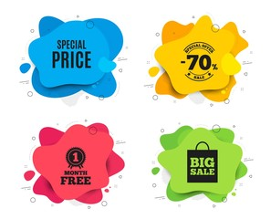

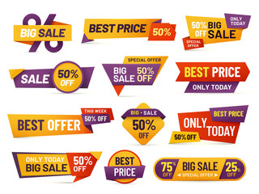
Trade Marketing
Price promotions
Summary
Price promotions come in two types basically 1 his when manufacturer sells to the trade and offer a discounted price over the normal regular price 2 when the manufacturer decides within the channel to reduce the retail price by a certain discount offering it to the end consumer or the shopper there may be many more variations but in general these are the two major elements of price promotions .
Mechanics
Where used
These consumer promotions are used effectively when control by trade marketing and brand marketing utilising margins as the key 2 deliver a lower price to the consumer in some cases the manufacturer may preserve the channel margin and deliver a lower price to the consumer Utilising his promotion budgets.
Material
While the material is merely communication sticker on the package or leaflet or coupon the detail and process needs to be carefully mapped out to manage all parties are compensated in time and accurately
Benefits
Lower price to consumers reinforcing their loyalty to the brand
Price promotions

Slide 16
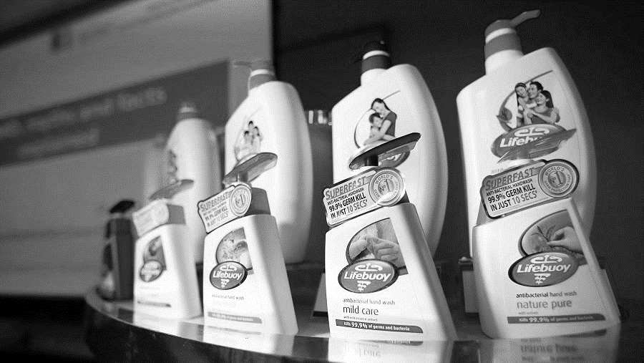
Trade Marketing
Examples of TM .
Summary
A good example of trade marketing execution is adding the product USP at the point of sale as in this example the USB may not have been fixed to the product .this makes for a great example off emphasising product benefits consumers
Mechanics
there are a variety of reasons sometimes for products to require additional communication on pack we use the same example to emphasise in this case in 99.9% German killer just 10 seconds as USP
Where used
in our example that right be focusing on the last-minute addition of the communication sticker at the point of sale
Material
Usually, paper coupon or a sticker announcing the promotional details stuck on the product
Benefits
For consumers the ability to see a clear USB communication on pack encourage them to buy the product as the job of communicating at the point of sale is done to a very high standard and efficiently

Slide 17
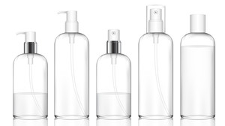
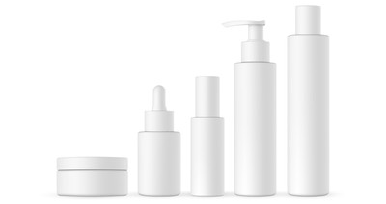
Trade Marketing
Planograms
Mechanics
For the retailer
the addition of an extra shelf as per example increases his available category meters from 10 to 12 representing a 20% increase and the possibility to either increase another brand or two on the shelf or if his space management data is utilized review the possibility of not only increasing another strong brand contender but giving more space to fast seller s to increase sales and reduce out of stocks
For the Brand owner
the addition of the extra shelf gives the possibility of starting engagement on space utilization also for his own brand to improve visibility and sell out.
In general, this is not always possible as the considerations are product dimensions and product fill , in the event his happens and the visual representation is considered good then the retailer has just improved his direct product profitability very creatively
Depth of shelf
The depth of shelf gives the planogram that many more units on shelf or lesser units , most retailers will adopt a 40cm depth as a standard , and that will be optimum , some retailers have been known to adopt 50 cm. the depth of a shelf remains a retailer's choice but can greatly affect stock management if they adopt a 50cm depth instead of 40cm.
Shelf breadth
The standard is usually uniform at 1.0 meter or 1.2 meters in general.
Benefits
POG fixtures when applied and maintained , reduce out of stocks , promote brand visibility and improve DPP and refill requirements
Level 1
1 linear meter
1 linear meter
Level 2
1 linear meter
1 linear meter
1.5 Meter
1 linear meter
1 linear meter
Level 3
Level 4
1 linear meter
1 linear meter
Level 5
1 linear meter
1 linear meter
1 Meter
1 Meter
Summary
The category layout above is referred to as a 2-meter category in general , for a trade marketer and retailer this will become a 2-meter category consisting of 10 linear meters dispersed 5 meters vertically per linear meter, this essentially means now the category is a 10 linear meter category .
A retailer can in many cases simply add shelves to a category and increase the category size , notwithstanding the elimination of the idle space above the products and the addition of 1 more shelf ( see example ) to optimize the space management , this is possible if there is idle space, and the addition of the extra shelf poses no major reconfiguration of the shelf .
www.upskilpro.com

Slide 18
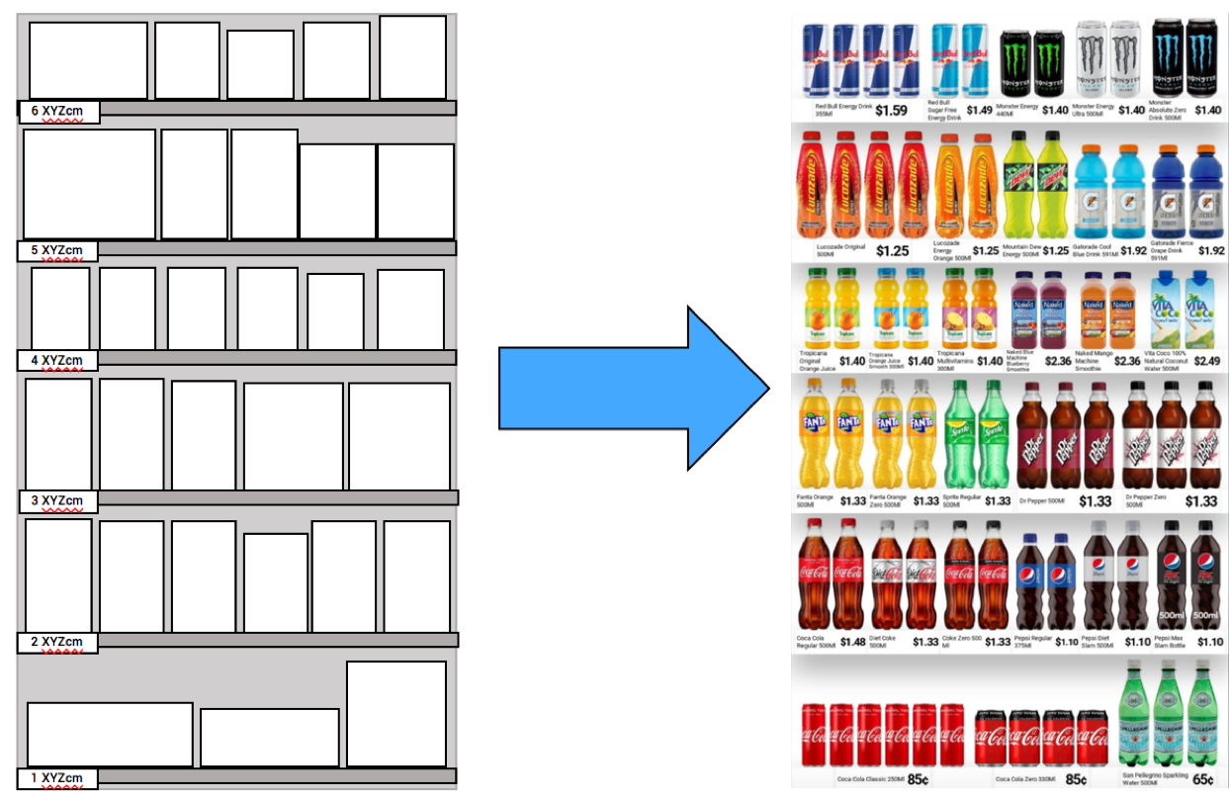
Trade Marketing
Planogramming.
Summary
Planogramming is the process of designing and arranging the layout of products within a retail space, such as a store shelf or display area. It involves creating a visual representation or diagram, known as a planogram, that specifies the placement and positioning of each item on the shelves.
Mechanics
Planograms are typically created using specialized software that takes into account various factors, including product sizes, packaging, brand guidelines, and sales data. The goal of planogramming is to optimize the arrangement of products in order to enhance the shopping experience, increase sales, and maximize the efficient use of space.
By strategically organizing products on shelves, planograms aim to attract customer attention, facilitate easy navigation, and promote complementary or impulse purchases
Where used
Any industry and channel where product placement is key for shoppers
Material
Software driven based on data collection at the site of the customer , these software is extremely efficient and flexible in delivering data based recommendations in minutes.
Benefits
Planogramming eliminates wastage in the process , frees up shelf space , reduces non selling products , maximizes preferred product space and reduces out of stocks.
Increase of Product Sales
Increase of Store and Staff Efficiencies
Reduction in Costs
Source : www.scorpionplanogram.com
www.upskilpro.com

Slide 19
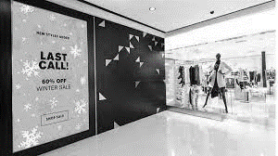
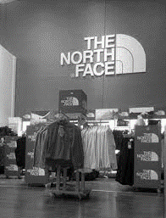
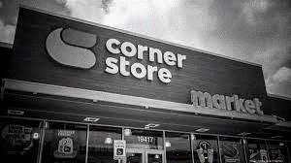
Trade Marketing
Store branding or Fascia.
Summary
A good example of trade marketing execution is adding the product USP at the point of sale as in this example the USB may not have been fixed to the product .this makes for a great example off emphasising product benefits consumers
Mechanics
there are a variety of reasons sometimes for products to require additional communication on pack we use the same example to emphasise in this case in 99.9% German killer just 10 seconds as USP
Where used
in our example that right be focusing on the last-minute addition of the communication sticker at the point of sale
Material
Usually, paper coupon or a sticker announcing the promotional details stuck on the product
Benefits
For consumers the ability to see a clear USB communication on pack encourage them to buy the product as the job of communicating at the point of sale is done to a very high standard and efficiently

Slide 20
Trade Marketing
Vehicle Branding.
Summary
Vehicle branding build an excellent way to communicate your brand proposition utilising space which is vacant , companies utilised vehicles across their brand portfolios making sure that all the space they have is utilised with attractive creative branding .
Mechanics
vehicle branding is normally graphic material which is pre-printed with your brand and pasted over the vehicle surface in a pleasing aesthetic manner and design normally vehicle graphics last for years When maintained well
Where used
Most brand owners utilise all the space on the vehicle please see example on right.
Material
High quality film with warranty coverage
Benefits
excellent visibility similar to a moving billboard your vehicle acts as a silent salesman 24/7

Slide 21
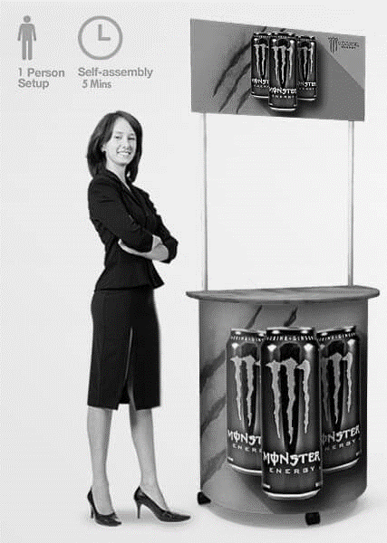
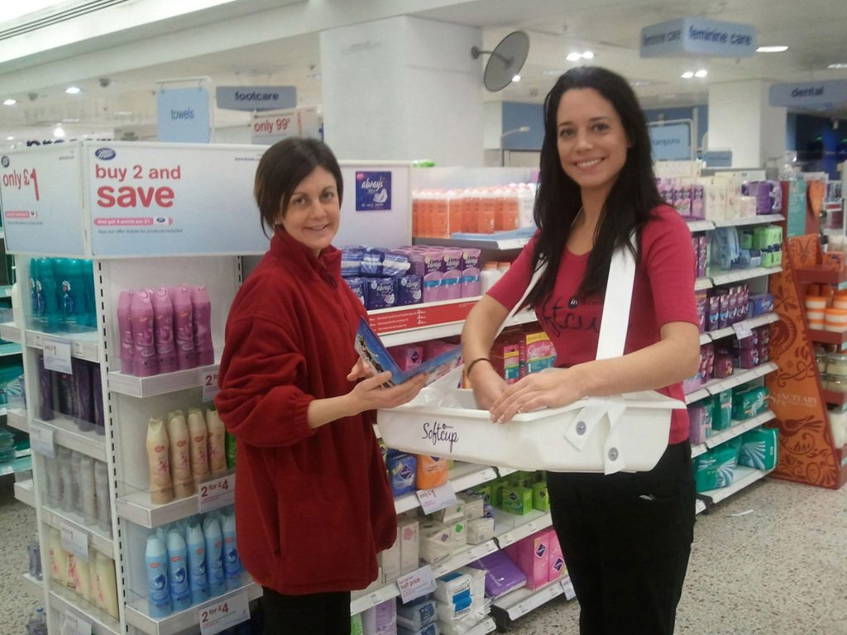
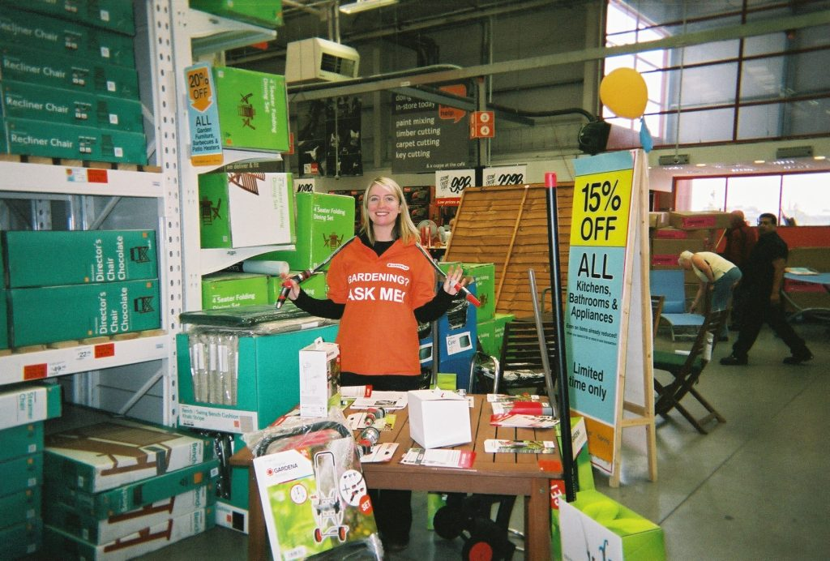
Trade Marketing
Product sampling .
Summary
Sampling is one of the most effective ways to get in front of your consumer engage them and get them to sample your product at that moment there are various mechanics or sampling but in general sampling gives your brand the human element
Mechanics
all that's required for sampling as a sampling stand branded and the product samples our demonstration gear you intend to promote at the venue along with a prepared script for your promoter to stick to .
Where used
normally sampling is done closer to the product you intend to sell or in high traffic areas where the consumer is bound to spend time or see you
Material
Sampling stands are mostly made of a mix of aluminium and graphical paste over material
Benefits
From a consumer perspective sampling gives you instant access to your consumer and the capability to engage them with your brand in hand , enter the brands perspective it's a great way to give a free sample along with promotional literature for the consumer to possibly read this is considered to be one of the best ways to interact with your consumer .

Slide 22
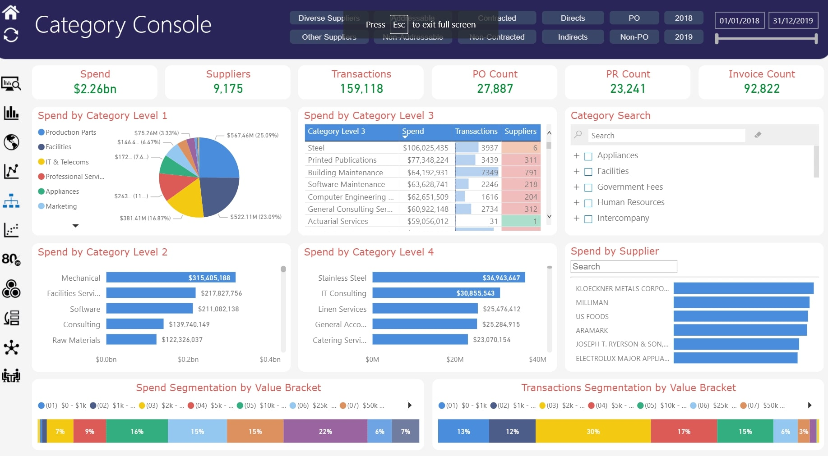
Trade Marketing
Category Management .
Summary
Category management is a strategic approach to managing product categories within retail or trade marketing. It involves analysing and understanding the dynamics of different product categories to drive sales, improve profitability, and enhance the overall shopping experience.
For trade marketers, category management plays a crucial role in collaborating with retailers to optimize the performance of specific product categories
Mechanics
Data Analysis: Trade marketers analyze sales data, market trends, consumer behavior, and other relevant data to gain insights into the performance of different product categories. This helps identify opportunities for growth, areas of improvement, and potential risks.
Material
Data is collected from multiple sources such as , POS Retailer data , Market research , syndicated data and even shipment data , but the most effective data set to be used is consumption data or POS data for accuracy , if this is not available then the rest of the sources will need to be evaluated
Benefits
Increased sales , improved shopper experience , enhanced profitability , data driven insights , adaptability , and engaged supplier – retailer relationship
Image Source : www.simfoni.com
www.upskilpro.com

Slide 23
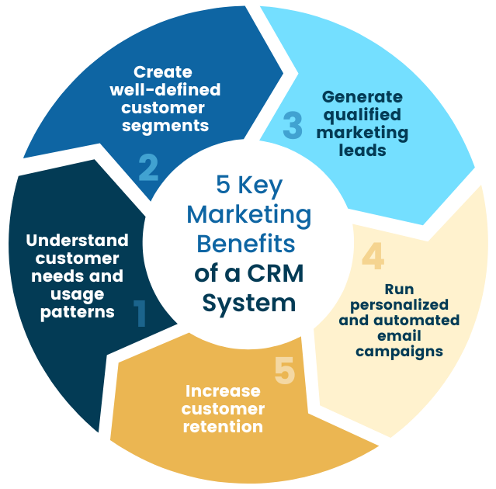
Trade Marketing
CRM.
Sending out a thank you when a customer makes a purchase. Upsell or cross-sell a client if they purchase a particular product. Offering a birthday greeting with a promo code. Sending a discount to a customer that hasn't made a purchase recently
Summary
A customer relationship management (CRM) solution helps you find new customers, win their business, and keep them happy by organizing customer and prospect information in a way that helps you build stronger relationships with them and grow your business faster.
Mechanics
Customer relationship management (CRM) refers to software that tracks and records customer interactions. In marketing, it can be used to personalize messages, create more targeted content, and expedite the sales process. CRMs are traditionally considered a tool for sales teams to track leads, prospects, and customers
Any industry and channel where product placement is key for shoppers
Material
Software driven communication tool , it can be used in conjunction with other related software , the most important aspect for CRM is quality data input and organisational adoption.
Benefits
CRM Allows you to remain and engage both prospective and current customers constantly when the messages are tastefully tailored to engage and result in a call to action .
www.upskilpro.com

Slide 24
1 X 8 Matrix Tool for Promotional Evaluation

Slide 25
Trade Marketing & Retail.
Key Tools for TM execution.
Customer
Channel
Consumer
Category
Channel Analytics
Retail Audits
Channel Specific portfolios
Product demonstrations
Social media
Channel Specific promotions
Consumer research
Consumer habits
Memberships
Loyalty programs
Social Media engagement
Trade Shows
Product Demos
Contests
Door drops
Sampling
Content Marketing
Category branding
Category merchandising plan
Category communication
Category location plan
Category research
CRM engagement
Customer relationship
Customer engagement
Contribution
Contract
Digital engagement
Promotion
Pricing
Communication
Product
Sampling
Point of sale material
Incentives
Coupons
Contests
Loyalty Programs
Right price for the channel
Profitability analysis
Price communication
Price tracking
Price promotion
Leaflets
Carton communication
On pack leaflets
Category communication
Check out communication
Header boards
In pack leaflets
Right product , right channel
Benefits visibility
Product visibility
Merchandising principles
Important tools
Premiums
On pack
Off pack
redemption
Value % off
$ off
Multi packs
Right location
www.upskilpro.com

Slide 26
Thank you !

Slide 27
Job Descriptions
Develop roles clearly and completely across varying levels of experience
Agreements
Draft your business agreements across a variety of areas
Templates
Templates are designed based gather information in a structured manner
KPI’s
Performance indicator, a quantifiable measure of performance over time versus a specific objective.
Content Modules
Best practice material in power point for use as a knowledge base in business training , planning and execution .
Strategic tools
These tools are recognised the world over in business schools, consulting firms and companies who plan strategically.
Gain a competitive edge using the best tools and techniques to build a better you .
Analytical Tools
Interactive excel tools on specific business areas based on your data inputs delivered in a workbook model with instructions.
Scorecards
Designed as functional or subject indicators across a variety off situations to enable performance of situational evaluation versus aligned standards.
Calculators
calculate the right ratios for businesses looking for benchmarks in a variety of situations
Assessments
Assessments are designed around specific areas to conduct reviews and will center around a benchmark reviewing individuals or functions
Checklists
Designed around achieving milestones in a sequential manner.
Research
Research tools for sales and marketing engagement

Slide 28
Trade Marketing Tools.
Sales & Marketing Fundamentals.
UpskilPRO e Institute for Sales & Marketing
Tools, Content & Templates
Hand built using experience & insight

