Slide 1

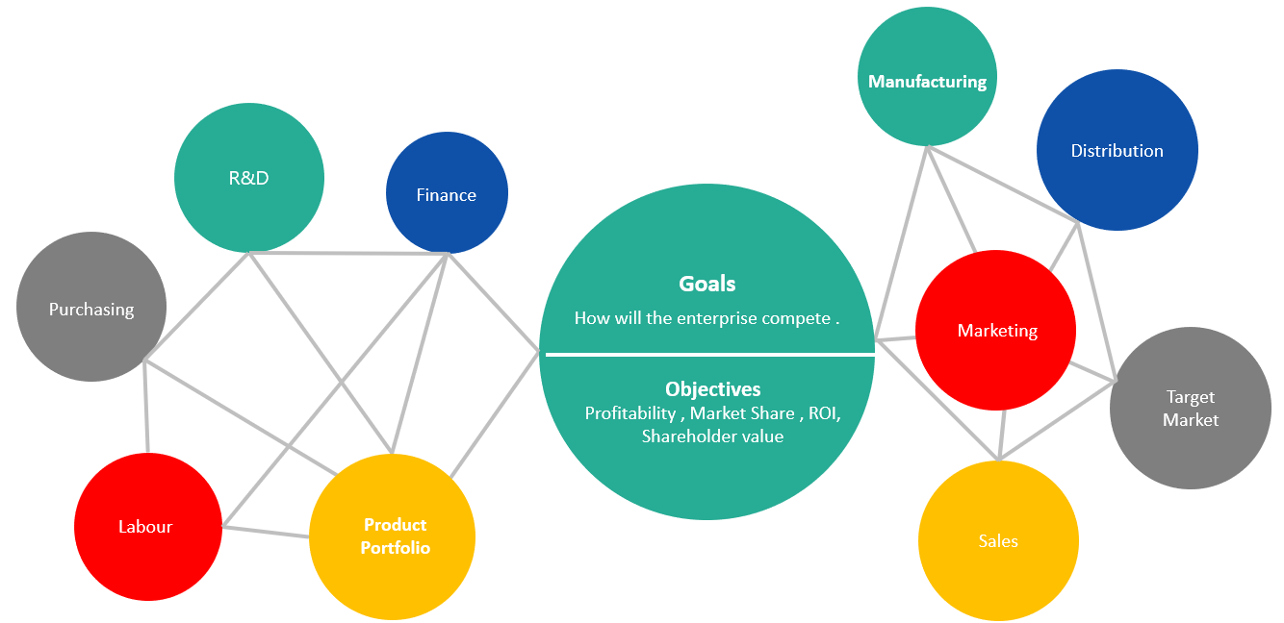
Competitive Analysis
Define your competition, using methodologies to conduct your competitive analysis and data capture methods .
UpskilPRO e Institute for Sales & Marketing
Tools, Content & Templates
Hand built using experience & insight

Slide 2
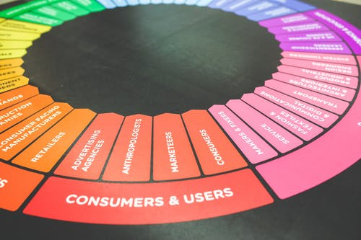

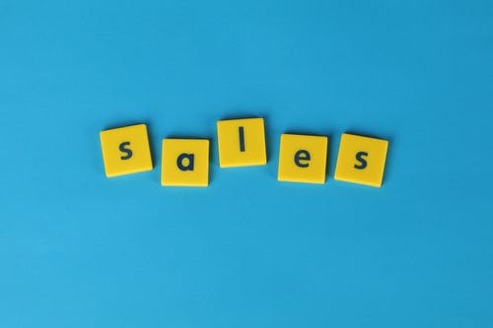

Created by
ex-Procter & Gamble, Rothmans, BAT, Gillette, Nokia,
Microsoft & 3M managers.
UpskilPRO tools are designed in easy-to-use solutions, all you need to do is download the tool and get to work immediately . All UpskilPRO material has taken 100’s of hours and many 1000’s of $ to build , all this expertise and content is brought to you for a fraction of the cost to help professionals enhance their capability.
core areas which are best suited to improve using our tools:
        Subject matter expertise
        Best practices
        Analytical output & charting
        Prioritization
        Process
Making life simpler for
Sales & Marketing professionals.
Tools in one place to get 10X productive now.

Slide 3


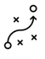

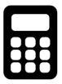
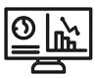
Job Descriptions
Develop roles clearly and completely across varying levels of experience
Agreements
Draft your business agreements across a variety of areas
Templates
Templates are designed based gather information in a structured manner
KPI’s
Performance indicator, a quantifiable measure of performance over time versus a specific objective.
Content Modules
Best practice material in power point for use as a knowledge base in business training , planning and execution .
Strategic tools
These tools are recognised the world over in business schools, consulting firms and companies who plan strategically.
Gain a competitive edge using the best tools and techniques to build a better you .
Analytical Tools
Interactive excel tools on specific business areas based on your data inputs delivered in a workbook model with instructions.
Scorecards
Designed as functional or subject indicators across a variety off situations to enable performance of situational evaluation versus aligned standards.
Calculators
calculate the right ratios for businesses looking for benchmarks in a variety of situations
Assessments
Assessments are designed around specific areas to conduct reviews and will center around a benchmark reviewing individuals or functions
Checklists
Designed around achieving milestones in a sequential manner.
Research
Research tools for sales and marketing engagement

Slide 4
2017
2018
100’s of tools grouped in 12 categories, 50 tool types and 12 business functions in 1 place.
get 10X productive now !
Categories
Functions
Analytical Tools
Types
Business Development
Agreements
Advertising
Customer Acquisition
Margins
Partner Search
Reports
Category Management
Assessments
Agreements
Customer Management
Market Analysis
Persona Development
Retail Measurement
Channel Management
Content Modules
Analytics
Distribution
Market Development
Planning
Reviews
Distribution
Checklists
Barriers
Distributor Management
Market Research
Positioning
Sales Management
Distributor Management
Calculators
Business Reviews
Forecasting
Market Segmentation
Pricing
Scorecards
General Management
Job Descriptions
Business Intelligence
GAP Analysis
Market Size
Prioritization
Segmentation
Key Account Management
KPI’s
Channels
Go To Market
Marketing
Product Development
Six Sigma
Marketing
Research
Communication
Job Descriptions
Marketing Comms
Product Life Cycle
Socio Economic Classification
Marketing Operations
Strategic Tools
Competitive Evaluation
Key Account Plans
Merchandising
Profit & Loss
Territory Design
Sales Management
Scorecards
Competitive Intelligence
Management Summary
New Market Entry
Promotions
Trade Marketing
Shopper Marketing
Templates
Trade Marketing

Slide 5



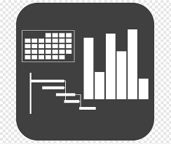




7 Benefits of using UpskilPRO :
Improve your knowledge
with professional Strategic Tools , Templates and planning documents for any business situation!
Use ready made tools
with filled in examples and ready to print & edit at your convenience . Just edit and fill-in the blanks !
Develop YOUR BUSINESS
Learn , & utilize the knowledge and processes and enhance your capabilities as the other companies have
We Created UpskilPRO for the
  Sales Professional
  Trade Marketer
  Marketing Executive
  Operations Manager
  VP/Director/Manager
100’s of tools , TEMPLATES & documents
CREATED BY
world class sales and marketing
business professionals.
All tools
are based on topics and subject based situations and are simple and easy to use .
SAVE THOUSANDS OF DOLLARS
The average company will save 1000’s of $ per employee in time & effort using our ready tools !
Top Quality Tools & Templates for developing both you and your business.
www.upskilpro.com

Slide 6
Competitive Analysis.
“If you know the enemy and know yourself, you need not fear the result of a hundred battles,” Sun Tzu writes. “If you know yourself but not the enemy, for every victory gained you will also suffer a defeat. If you know neither the enemy nor yourself, you will succumb in every battle.”
Sun Tzu , 506 B.C.

Slide 7
Competitive Analysis.
Business Summary
Competitive Analysis To establish the competitive landscape and competitive forces arrayed in a manner in which it can be understood logically and strategically.
Public Domain | Step 1 Company description Demographics , Size and Locations | Step 2 Summary of key management Identify the management structure and their strengths , this will be an indicator of past successes and possible future alignments | Step 3 Financials Publicly available financials preferably trended over a period
Evaluation | Step 5 Product / Services Rank the key attributes and rank them for objectivity | Step 5 Strategy ( Sales & Marketing ) brand positioning consistently along identified drivers | Step 6 Positioning analysis Stress of key areas of differentiation where you measure or state the uniqueness exists
Estimation | Step 7 Threats Look at threats both as short terms and long term , establish threats across a variety of drivers/attributes | Step 8 Opportunities The opportunities exist externally and internally, the external ones represent direct revenue the internal ones reflection.

Slide 8
Competitive Analysis.
Topic - 3 Stages.
Establishing guidelines
Scoring and Detail
Deployment & Analysis
1
2
3
Understand your competitor first
Are they local , regional , national , international
Build the analysis format , is it in a particular area ( features ) company wide , or pretty much a scorecard to evaluate the competitive landscape
Set out your information templates for easy mapping and cross-sectional analysis
At this state you will be clear on what publications , research , and online sources you will be using to collate your media inputs .
Additionally, you will be clear on research inputs
Your goal here will be to collate a complete picture from both online and offline sources
Broaden the analysis from the predictable aspects of Product, Price , Promotion , and Place .
Now that you have the data you will need to do the following
Collate into sections and headers
Draw down the appropriate information into the templates which you have predesigned earlier ( stage 2 )
Assimilate into sections
Conclusion by section
Conclusion by Top level finally
Ideally all conclusions are quantifiable and based on a preapproved scoring method to be objective

Slide 9
Competitive Analysis
Topic - Internal / External View
Step 6
Step 1
Organizational Structure
Backgrounds of C – Suite
Leadership Style
Public Interviews
  Procedures
  Systems
  Policies
External
Step 5
Step 2
  Workforce
  Skills
  Competencies
Functional Leadership
Background
Style of leadership
Culture
Internal
Step 4
Step 3
  Workforce / Staff
  Capabilities
  Attitudes
Business Model
Competitive Edge
Strategies & Tactics
Competitor Feedback

Slide 10
Competitive Analysis
Topic – 10 Competitive elements
YOUR TITLE HERE
Manufacturing
R&D
Distribution
Finance
Goals
Purchasing
How will the enterprise compete .
Objectives
Profitability , Market Share , ROI, Shareholder value
Marketing
Target Market
Labour
Product Portfolio
Sales

Slide 11
Competitive Analysis
Intelligence Gathering Cycle
Specific Intelligence needed
Engages Intelligence Analyst
Both parties agree brief and deliverables
Methods, Techniques & Process determined
Experience & Analytical skills and techniques applied in extraction
Intelligence material is organized into usable buckets
Available data requestioned
Additional data acquisition
Initial analysis sketch
Gaps identified
Improvements & Implementation
Conclusions & Recommendations
Data dissemination
Outcome and Process reviewed
Comment
Intelligence gathering is ultimately the domain of the individual or the group who identify what specific information they are in need of .
There are various ways to gather intelligence , broadly it can fall into A) Primary data B ) Secondary data
There's intelligence , There is Data , and there is Analysis , all three come together to form actionable intelligence
Business analysts perform a crucial role , it is the business which must empower the analyst in the specific area they need intelligence on with a full awareness of the larger picture or background

Slide 12
Competitive Analysis
Avenues and Sources of Data
Industry
Observers
  Press
  Competitors facilities
  Media releases
  PR
  Online
  Chambers of commerce
  Internationalal organisations
  Consumer groups
  Financial Community
  Agencies in regulation
  Agencies in marketing
Customers
Suppliers
Industry
Distributors
  Market research
  Sales Organisations
  Former employees
  Engineering
  Purchasing
  R&D Departments
  Trade Associations
  Banks / Investment banks
  Auditors
  Advertising agencies
  Marketing agencies

Slide 13
Competitive Analysis
Competitive evaluation framework
MARKETING COMPETITIVE ANALYSIS
VALUE PROPOSITION | BRAND COMMUNICATION | CONTENT
Solving a problem , how does the value proposition solve a customers problem | Cover the vital areas , such as tag lines , core messaging , imagery and reference points | Key content and communication drivers , such as white papers , webinars , TVC , case studies articles of interest etc
ADVERTISING SPEND | SOCIAL MEDIA | PR&COMMUNICATIONS
Advertising expenditure on any type of media | Key channels used to target consumers , could be linked in , twitter , Instagram etc | Is PR a part of the marketing mix deployed, if so what are the key elements being communicated and what publications are being used
INFLUENCERS | CHANNEL ENGAGEMENT | CAMPAIGNS
Key influencers , do they represent only 1 brand in the category or do they represent multiple brands | What are the driver channels both in traditional and digital | What is the nature of campaigns run , is it more brand , promotionally driven etc

Slide 14
Competitive Analysis
Competition at Industry level
Suppliers remain one of the levers , in creating scarcity , controlling pipelines , and in turn are at risk from Labour , raw materials and inflation .
Possible New entrants
As markets and technologies and consumer’s mature, new entrants come in to take advantage of a new interest , wave or profit possibilities.
Technology platforms are a clear indication of the new entrant wave
Competitors
Suppliers
Buyers
Substitute's products are always a threat , the more the choices and features available the greater the portfolio of substitute solutions .
View them not only on a same platform basis but alternate platforms basis also .
Buyers exert downward pressure in many ways , from controlling costs , managing multi suppliers , exerting features , aligning competing categories , and constantly extracting higher margins with lower cost economics.
Substitutes

Slide 15
Competitive Analysis
Competitive evaluation framework Perception Map
The High Price and High-Quality Box represents the optimum positioning , which reflects a well thought out strategy and reflects profitability , unique positioning , and excellent product benefits
High Quality
Low Price
High Price
Low Quality

Slide 16
Competitive Advantage.
3 Differentiated leadership strategies
Overall Cost
leadership
Focus
Differentiation
Key features
Efficient facilities
Cost management
Overhead control
Cost minimization
Leadership control
Capital investment
Supervision skills
Low cost distribution system
Brand positioning
Design
Marketing capability
Engineering productivity
Channel management
Corporate reputation
Brand reputation
Combination of the 2 policies
Differentiation in focus
Strategic target engagement
Needs management
Derived benefits
Cost advantage
Relative market share
Reinvestment margins
Deep entrenchment
Loyalty
Long terms relationship
Rivalry management
Profitability improvement
Uniqueness barrier
Market share gain
Segment loyalty
Low market forces impact
Specialized needs

Slide 17
Competitive Analysis
Strategy Choice Map
Has strengths relative to competition for established areas
Lacks integral strength relative to competition
Inherent strengths
Equal / Weaker
Leadership
Or
Niche
Harvest
Or
Divest
Favourable industry structure for decline
Industry Strength
Niche
Or
Harvest
Divest
Soon
unfavourable industry structure for decline

Slide 18
Competitive Analysis
Attractiveness Position Map.
Industry Attractiveness
High
Medium
Low
Equal / Weaker
Company / Industry Attractiveness
Selection Criteria
High
Size
Market growth
Pricing
Market Diversity
Competitive structure
Industry profitability
Technical role
Social impact
Environmental
Legal
Human
Medium
Business Unit Position
Build
Hold
Low
Harvest

Slide 19
Competitive Analysis
Competitive evaluation framework
Competitive strength
Competitive weakness
-
-
-
Portfolio Coverage
* This file is available on www.upskilpro.com in an editable version , use the reference number provided on the top right

Slide 20
Competitive Analysis
Intelligence Gathering Sources.
1
2
3
Publications ( Print )
Management Publications
Trade Publications
Company Public Reports
Public events
Publications ( Online )
Social media Sites
Company Websites
Affiliate Websites
E mail broadcasts ( memberships )
E commerce sites
Market research
Market trends research
Research reports
Subscriptions to global research platforms

Slide 21
Competitive Analysis
Competitive Canvas
The Competitive Analysis Canvas
Competitor Name | Completed | Date | Ref
Mission & Vision | Company Size | Products & Services | Customer
Business Model |  |  | Price
Culture |  |  | Value Proposition
Finance / Revenues / Income |  | Customer Experience | Client Base

Slide 22
Competitive Analysis
Corporate View - Intelligence Gathering
* This file is available on www.upskilpro.com in an editable version , use the reference number provided on the top right

Slide 23
Competitive Analysis
Competitive Strength Evaluation Matrix – Tool
* This file is available on www.upskilpro.com in an editable version , use the reference number provided on the top right

Slide 24
Competitive Analysis
Scorecard
In progress / completed
Not yet completed
2004
Macro level features
State
Micro level features
State
Have we identified our competitors
Profitable Business Segments
Do we understand their Sales & Marketing Strategy
Source of Manufacturing and Supply
Competitive leadership organization
Distributor or Market Analysis
Market Positioning
Credit reports
Core competencies
Staff Turnover
Financial Model
Brand Share
Digital Footprint & Analysis
Pricing & profitability
Annual Reports & Analyst Reports
STEEPLE Analysis
Portfolio Design
SWOT Analysis
Sub Total
9/9
Sub Total
9/9
Total
18/18

Slide 25
Thank You

Slide 26
Job Descriptions
Develop roles clearly and completely across varying levels of experience
Agreements
Draft your business agreements across a variety of areas
Templates
Templates are designed based gather information in a structured manner
KPI’s
Performance indicator, a quantifiable measure of performance over time versus a specific objective.
Content Modules
Best practice material in power point for use as a knowledge base in business training , planning and execution .
Strategic tools
These tools are recognised the world over in business schools, consulting firms and companies who plan strategically.
Gain a competitive edge using the best tools and techniques to build a better you .
Analytical Tools
Interactive excel tools on specific business areas based on your data inputs delivered in a workbook model with instructions.
Scorecards
Designed as functional or subject indicators across a variety off situations to enable performance of situational evaluation versus aligned standards.
Calculators
calculate the right ratios for businesses looking for benchmarks in a variety of situations
Assessments
Assessments are designed around specific areas to conduct reviews and will center around a benchmark reviewing individuals or functions
Checklists
Designed around achieving milestones in a sequential manner.
Research
Research tools for sales and marketing engagement

Slide 27
Competitive Analysis
Define your competition, using methodologies to conduct your competitive analysis and data capture methods .
UpskilPRO e Institute for Sales & Marketing
Tools, Content & Templates
Hand built using experience & insight

