Slide 1

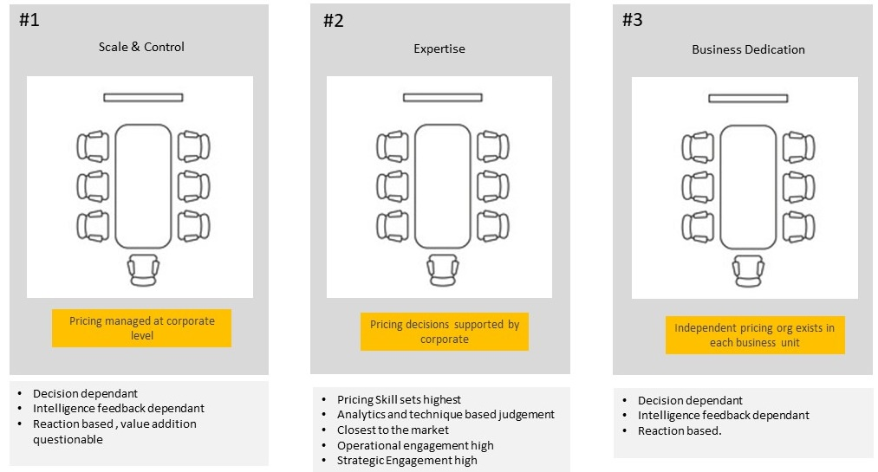
Pricing Construction
Construct your pricing with all the elements to make your bottom-line look and feel better.
UpskilPRO e Institute for Sales & Marketing
Tools, Content & Templates
Hand built using experience & Insight

Slide 2
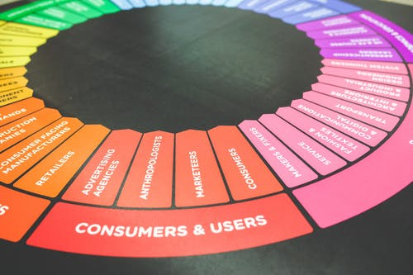

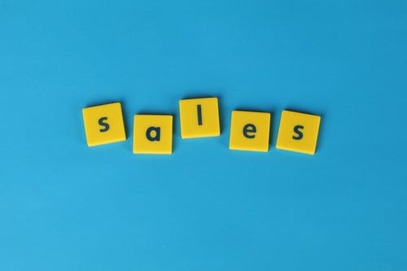

Created by
ex-Procter & Gamble, Rothmans, BAT, Gillette, Nokia,
Microsoft & 3M managers.
UpskilPRO tools are designed in easy-to-use solutions, all you need to do is download the tool and get to work immediately . All UpskilPRO material has taken 100’s of hours and many 1000’s of $ to build , all this expertise and content is brought to you for a fraction of the cost to help professionals enhance their capability.
core areas which are best suited to improve using our tools:
        Subject matter expertise
        Best practices
        Analytical output & charting
        Prioritization
        Process
Making life simpler for
Sales & Marketing professionals.
Tools in one place to get 10X productive now.

Slide 3


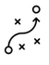

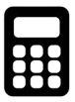
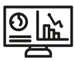
Job Descriptions
Develop roles clearly and completely across varying levels of experience
Agreements
Draft your business agreements across a variety of areas
Templates
Templates are designed based gather information in a structured manner
KPI’s
Performance indicator, a quantifiable measure of performance over time versus a specific objective.
Content Modules
Best practice material in power point for use as a knowledge base in business training , planning and execution .
Strategic tools
These tools are recognised the world over in business schools, consulting firms and companies who plan strategically.
Gain a competitive edge using the best tools and techniques to build a better you .
Analytical Tools
Interactive excel tools on specific business areas based on your data inputs delivered in a workbook model with instructions.
Scorecards
Designed as functional or subject indicators across a variety off situations to enable performance of situational evaluation versus aligned standards.
Calculators
calculate the right ratios for businesses looking for benchmarks in a variety of situations
Assessments
Assessments are designed around specific areas to conduct reviews and will center around a benchmark reviewing individuals or functions
Checklists
Designed around achieving milestones in a sequential manner.
Research
Research tools for sales and marketing engagement

Slide 4
2017
2018
100’s of tools grouped in 12 categories, 50 tool types and 12 business functions in 1 place.
get 10X productive now !
Categories
Functions
Analytical Tools
Types
Business Development
Agreements
Advertising
Customer Acquisition
Margins
Partner Search
Reports
Category Management
Assessments
Agreements
Customer Management
Market Analysis
Persona Development
Retail Measurement
Channel Management
Content Modules
Analytics
Distribution
Market Development
Planning
Reviews
Distribution
Checklists
Barriers
Distributor Management
Market Research
Positioning
Sales Management
Distributor Management
Calculators
Business Reviews
Forecasting
Market Segmentation
Pricing
Scorecards
General Management
Job Descriptions
Business Intelligence
GAP Analysis
Market Size
Prioritization
Segmentation
Key Account Management
KPI’s
Channels
Go To Market
Marketing
Product Development
Six Sigma
Marketing
Research
Communication
Job Descriptions
Marketing Comms
Product Life Cycle
Socio Economic Classification
Marketing Operations
Strategic Tools
Competitive Evaluation
Key Account Plans
Merchandising
Profit & Loss
Territory Design
Sales Management
Scorecards
Competitive Intelligence
Management Summary
New Market Entry
Promotions
Trade Marketing
Shopper Marketing
Templates
Trade Marketing

Slide 5



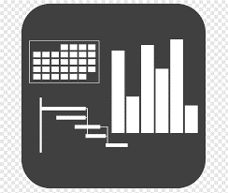




7 Benefits of using UpskilPRO :
Improve your knowledge
with professional Strategic Tools , Templates and planning documents for any business situation!
Use ready made tools
with filled in examples and ready to print & edit at your convenience . Just edit and fill-in the blanks !
Develop YOUR BUSINESS
Learn , & utilize the knowledge and processes and enhance your capabilities as the other companies have
We Created UpskilPRO for the
  Sales Professional
  Trade Marketer
  Marketing Executive
  Operations Manager
  VP/Director/Manager
100’s of tools , TEMPLATES & documents
CREATED BY
world class sales and marketing
business professionals.
All tools
are based on topics and subject based situations and are simple and easy to use .
SAVE THOUSANDS OF DOLLARS
The average company will save 1000’s of $ per employee in time & effort using our ready tools !
Top Quality Tools & Templates for developing both you and your business.
www.upskilpro.com

Slide 6
Pricing Construction.
“ Pricing is the only element of the marketing mix which is directly represented on the Profit & Loss Statement”
It’s a wonder then that few companies pay attention to it...

Slide 7
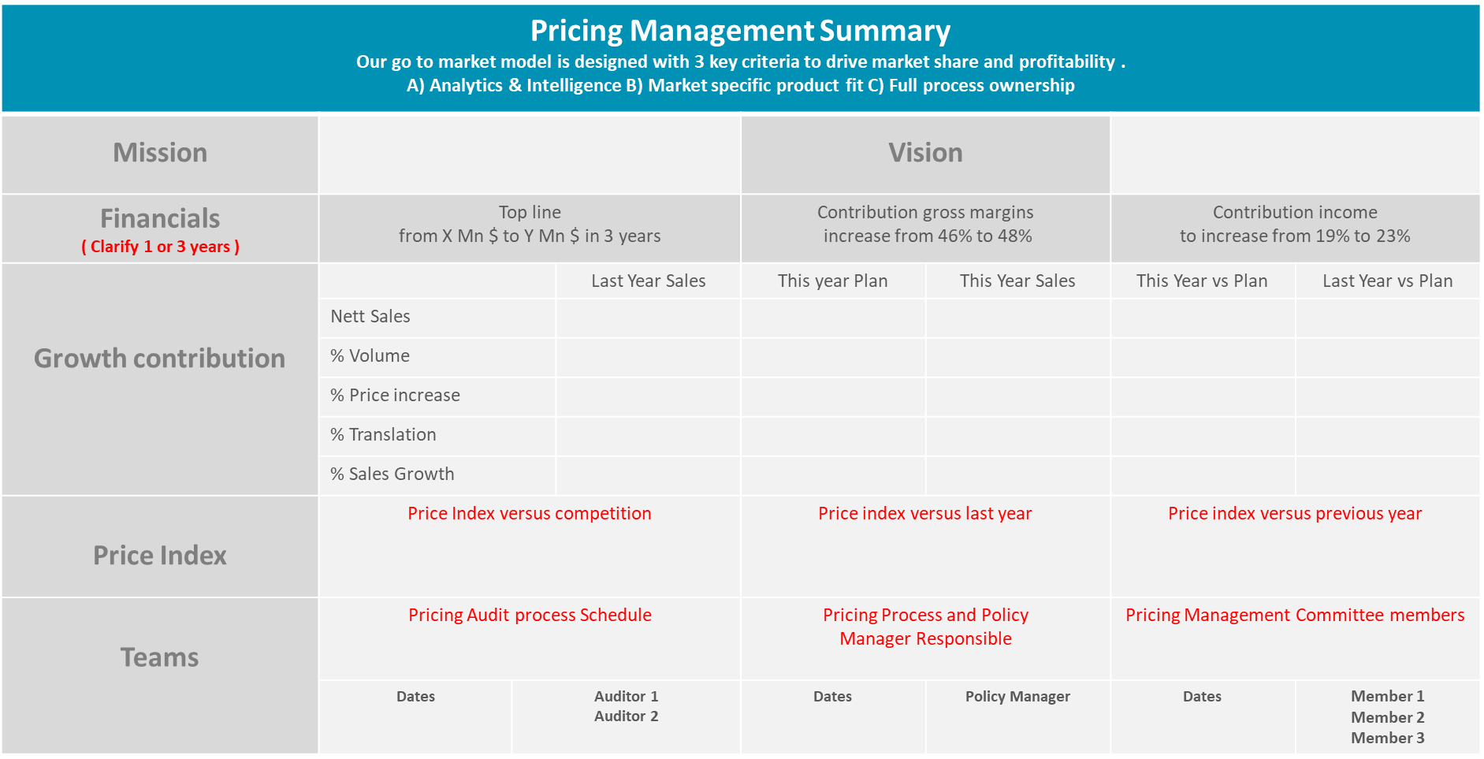
Pricing Construction
Pricing Management Summary
Enter your company vision here
8080
Your accounting standard is best . Net sales is used in line with International Accounting Standards
* This file is available on www.upskilpro.com in an editable version , use the reference number provided on the top right

Slide 8
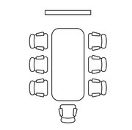
Pricing Construction
Pricing Organization Structures
#1
#2
#3
Scale & Control
Expertise
Business Dedication
Pricing managed at corporate level
Pricing decisions supported by corporate
Independent pricing org exists in each business unit
Decision dependant
Intelligence feedback dependant
Reaction based , value addition questionable
Pricing Skill sets highest
Analytics and technique based judgement
Closest to the market
Operational engagement high
Strategic Engagement high
Decision dependant
Intelligence feedback dependant
Reaction based.

Slide 9
Pricing Construction
Pricing Components
Strategic Vision
List Price
Customers
Sales Effectiveness
Pricing Strategy
Discount Management
Channels
Customer facing
Cost of Goods
Selling costs
Gen Admin Costs
Price Analytics
Pricing elements
Financial Reporting
Price Positioning
Financial Reporting
Unit Economics
& Factory Cost
Pricing Guidelines
Value drivers
Reporting currency
Pricing Policy and Ownership team
People , Systems , Tools & Processes

Slide 10
Pricing Construction
4 Common pricing strategies
Setting prices high because of significant product differentiation or brand perception. Premium pricing is appropriate when substantial and sustainable competitive advantages exist.
Setting a high price initially because of a market of product advantage while recognizing that the advantage is not sustainable. As competitors respond and supply of competing alternatives increases, prices must come down to remain competitive. Skimming is appropriate for pulling profits from market segments that are not sensitive to price.
Premium
Skimming
Volume
High
Low
Premium
Skimming
High
Price
Economy
Penetration
Low
Initially setting prices artificially low to gain market share, then increasing price once share targets are achieved. Penetration pricing is appropriate when the threat of competition is imminent and the opportunity to lower production costs comes as a result of volume sales. This strategy’s appeal increases as the market potential grows
Low frills pricing enabled by keeping marketing and production costs to a bare minimum. Economy pricing is appropriate when a product is a “Cash Cow” and marketing for the product category done by competitors provides adequate awareness.
Penetration
Economy

Slide 11
Pricing Construction
Process and Design
Define Major Pricing Activities
This step involves the definition of the major process activities such as opportunity assessment, price setting, negotiation, and contracting.
The objective is to put boundaries around the commercial system so that all relevant activities affecting profitability are included.
Map Current Processes
This step creates a visual depiction of the processes by which pricing decisions are currently made, as illustrated Even if there are no formally defined processes currently in place, this is a critical step for finding the source of undesirable pricing outcomes.
Major Process Steps
Map Current Process
This final step
creates a series of redesigned pricing processes for each of the major pricing activities identified in step one. In order to implement the new processes, it is frequently necessary to revise decision rights to account for new individuals included in the revised process and to account for current decision-makers from whom decision rights have been taken away.
Process Design
Identify Profit Leaks
This step uses a variety of pricing analytics (discussed in the next section) to identify where profit leaks are occurring in the current pricing process
Profit Leak Identification

Slide 12
Pricing Construction
Ineffective Pricing Process indicators
Cause
Effect
Too many special prices
Frequent deviations from agreed price schedules
Unclear pricing authority & process
Frequent non-standard customer requests
Communication issues and personal promises
Strategy misalignment and no communication
Price strategy not reflected on changes and NPI
System updates not timely s
Misaligned Sales and Marketing functions
Sales communication not updated
Low data base decision making
Marketing system updates on Products and customer alignment not updated
Too many distracting prices too little strategy
Unclear customer communication and no price system uploads
High price deviations and returns
Communication issues from sales and possible familiarity
A large number of uncollected charges and an increased number of write-offs
Excessive unearned discounts and waived up-charges
Increased pricing errors
Increased order processing and fulfilment errors
Disparity between discounts , customers and volumes
Pricing value discounts not aligned to corporate strategy
Mismatch between customers , volumes , prices and products.
Ineffective customer and product segmentation

Slide 13
Pricing Construction
Ethics and Constraints.
Ethical Under these circumstances .
Proscription
The Price or exchange is voluntary.
The Sales is based on equal information
Buyers essential needs are not exploited
The sales is justified by costs
The sales provides equal access to goods regardless of ones ability to cover the cost
Buyer must be made aware
No sales without full disclosure
No excessive profits on essentials such as critical pharmaceuticals
No segmented pricing based on pricing ; no excessive profits based on shortages
No exchange for personal gain
Ethical when
Implication

Slide 14

Pricing Construction
Global Financial Standards
Global standards for global markets
Trade beyond borders
Non-comparable financial Statements
Understanding of local standards
Modern economies rely on cross-border transactions and free flow of international capital.
Investors seek diversification and investment opportunities across the world
Companies raise capital & undertake transactions
Management of international operations and subsidiaries in multiple countries
Cross-border activities are complicated by different countries maintaining their own national accounting standards.
Patchwork accounting
Standardization requirements add costs, complexity and ultimately risks
local accounting standards mean amounts in financial statements might be calculated differently, based on non-standard methods or assumptions.
User / investor would need to have a good understanding of the local accounting standards, to better decipher the entity results.
Audit issues on host country
IFRS is a global body , most listed companies are obliged to adhere to the standards which in turn makes auditing easier and pricing related subjects .
If your country or company is not following it , its recommended to speak to your Finance head for the locally adopted standard

Slide 15
Pricing Construction
Global Financial Standards
Common accounting language to increase transparency, accountability, and efficiency
Consistent Financial statements across different industries and countries.
Fosters corporate governance
Helps investors identify opportunities and risks by analyzing comparable corporate results.
Lowers cost of capital and reduces international reporting costs
Benefits of IFRS Standards
The challenges are largely addressed through application of globally recognized accounting principles, which are called International Financial Reporting Standards (IFRS).
These are reviewed, amended, and approved periodically by a universally accepted accounting body called International Accounting Standards Board (IASB).
Many countries have fully adopted the IFRS and a statement acknowledging conformity is noted in the audit report and the notes to the financial statements.
for companies traded on global markets/targeting foreign institutional investors…

Slide 16
Pricing Construction
Pricing development process
STAGE 1
STAGE 2
STAGE 3
STAGE 4
STAGE 5
Assess
Evaluate
Conclude
Execute
Review
  Key Activities:
  Assess Competitors
  Analyze & Size Market
  Determine Price Positioning
  Financials validation
  Major Deliverables:
  Competitive Landscape summary & price positions
  Financial plan with forecast
  Share objectives
  Break-Even Analysis
  Product Features Prioritization
  Key Activities:
  Update product and customer portfolio.
  NPI System update
  Value based price list aligned to customers and products.
  Financial objectives
  Key Deliverables:
  Pricelist draft
  Customer and Product segmentation and alignment
  Price Positioning Statement
  Key Activities:
  Price automation trials
  Update systems and signatories / approvers
  Pricing Policy finalization
  Align customer deliverables and rewards
  Key Deliverables:
  Pricing Strategy
  Profitability Analysis
  Pricing Development Charter
  Customer segmentation and treatment
  Key Activities:
  Communication to internal and external stakeholders
  External Stakeholders communication
  Technical Specs update
  Financial Objectives aligned
  Key Deliverables:
  Locked price list
  Pricing policy
  Price communication copy
  Financial Plan
  KPI’s
  Stakeholder feedback
  Sales ratios and delivery
  Financial plan reviews
  Customer plans review
  Product category financials review

Slide 17
Pricing Construction
Price List Elements and Alignment
Assign these areas to a specific code for analytics friendliness .
Discount applied on the list or gross price .
Assign discounts which are reduced from the list price.
Assign discounts in a structured form to ensure performance .
A Basic
B Value Added
C Special
This will allow you to add or remove discounts without upsetting the entire pricing strategy
Post discount price .
Costs applied to shipping product inland .
Duties are always part of the final price to the buyer , not to be confused with VAT equivalent.
Assign these areas to a specific code for analytics friendliness .
The Net factory cost here is the unit cost before transportation and COgS
Assigning a Stock, No is a good way to have a double description check and manage inventory
* This file is available on www.upskilpro.com in an editable version , use the reference number provided on the top right

Slide 18

Pricing Construction
List Price
Cost
Margin
Discounts
List Price
Layered % across channels
List price scenarios
Interpretation.
A list price is supposed to be the highest price a product or service is positioned at .
In some cases a list price may be a anchor price, subject to discounts but the actual price a end user or consumer gets it may be higher , this is particular to industries , channels and even customer groups , and not the general practice.
List price can be related to a price position
A price position can be equated to a consumption price
List price is a reference price
List price is subject to discounts
Other names for List price are , Full price , Rack Rate , Full rate etc
Importance
List prices in conjunction with customer specific discounts allow a great amount of automation
Setting up of list prices allows automation and transitioning to an ERP environment much easier
There can only be one list price for a product in 1 financial system or company.
All subsequent discounts are based on a list price
Companies which have used special pricing for customers may not be able to transition to managing customers effectively in an automated environment
Original list price
Higher Price
List Price
Same Price
Lower Price
Scenario 1
Sales price by customers is higher than the original intended ( list ) price
Scenario 3
Sales price by customers is lesser than the original intended ( list ) price .
Scenario 2
Sales price by customers is more or less the same as the original intended ( list ) price

Slide 19
Pricing Construction
Price Management & Maturity assessment
FROM X (Current State) TO Y ( Target State )
From X - Current State
To Y-Target State
Set up the X to Y targets to ensure the team / function is in line with corporate and functional guidelines and responsibilities
Pricing maturity and Understanding is first before the team can undertake pricing projects of a strategic NATURE
Align the functions with the RACI matrix ensuring a clearer picture.
* This file is available on www.upskilpro.com in an editable version , use the reference number provided on the top right in red

Slide 20

Pricing Construction
Effect of Discounting in Pricing
Resultant volume required based on 30%.
Every time a discount is applied it takes between 2 to 5 times the discount rate in volume to recover the $ value discounted
Discount applied on the list or gross price .
 | % Discount Applied | + VOLUME Required
Product 1 | 5% | 14%
Product 2 | 10% | 33%
Product 3 | 20% | 80%
Product 4 | 30% | 120%
Discount & Volume effect levelers
Above information was modelled on a 40% Contribution gross margin .
Discount applied in a modelled environment .
Effect of discount applied in a volume surge to deliver the same $ value
%
Vol

Slide 21
Pricing Construction
Price List – Product Approval Process
Administrator
Product Head
Marketing Head
FINANCE
Strategic Business Head
Review and approve
Based on
Strategy
Classifications
Deliverables
Review parameters and approve
Finance approves based on established and agreed parameters
Business Heads
Approval ,
rejection happens under extreme circumstances
Details approved
All fields checked and passed
Shared Services
Pricing Analytics
Business Analytics review
Administration
Key Process Step
END
Product Details and Pricing updated
Process Approval flow
Key Stage
START
Process reject and
reviewed flow

Slide 22
Pricing Construction
Price Change Engagement
Competitor price reduction
Hold current price
NO
YES
Price reduction
Will it cause
  Share loss
  Profit Loss
NO
Quality improvment
YES
Increase price
Should we take assertive action
NO
YES
Introduce no frills flanker

Slide 23
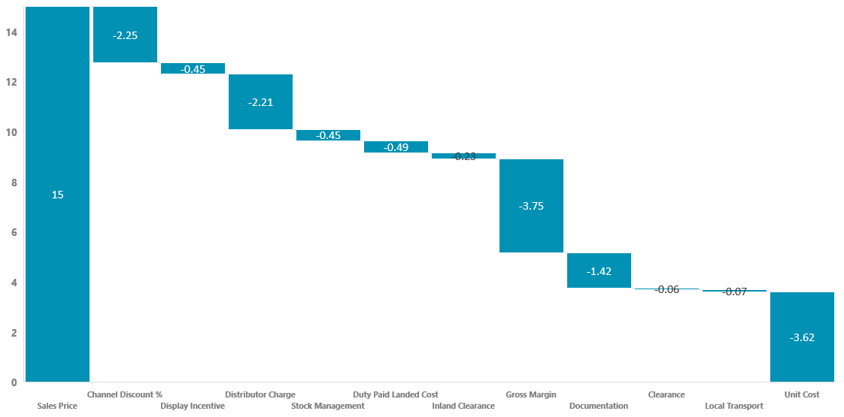
Pricing Construction
Price List Elements and Alignment
Price list – component clarity and revenue sieve
Each of the revenue walk areas reflects an opportunity to tighten pricing and improve gross profitability
The example below is based on a value pricing model
Analytical Tools
Cost to get the unit to be billed as a ready to sale product .
Do not confuse this with COgS
This is the net price unit cost
Deductible expenses
Gross Margin is resultant of the top line deductibles resulting in payables
This is the List price or gross price

Slide 24
Price Positioning
Price Waterfall ( P&L Statement )
The Deductions between Gross and Nett sales usually difficult to pin down as they reflect market driven deductions
Well managed financially driven sales and marketing organisations drive cogs to a ¼ to 1/3 of sales or in the vicinity
Analytical Tools
The higher the list price
The lower the discounts and allowances after gross sales deductions it leads to a better CoGS.
The higher the list price
The lower the discounts
Delivers a higher and better gross sales revenue
Gross Sales Price
Deduction
Net Sales Price
S2
Deduction
CoGS
The lower the CoGS as a % of sales the more resource it frees up for sales and marketing driving higher contribution income .
Sales Costs
Marketing Costs
Many organisations driven by Global Financial Standards make a clear distinction between Gross and Net sales for reporting reasons
Travel
S1
Administration
COI
TAX
PAT
Revenue waterfall
Sales (less)
  CoGS
  Gen admin expenses
Contribution income

Slide 25
Pricing Construction
Pricing Elements
Analytical Tools
SKU | Market or List Price | Trade / Channel Discounts | Special Discounts | Invoice & Floor Price | Profitability | Taxes | Clearance | Unit Cost
SKU 1
SKU 2
SKU 3
SKU 4
SKU 5
SKU 6
SKU 7
SKU 8
SKU 9
SKU 10

Slide 26
Pricing Construction
Good Practices in Pricing
 | Good Practices | Advantages | Your review
Market Strategy | Pricing strategy built around groups | Optimized pricing target and positioning
 | Competitive pricing strategy intelligence | Clear price positioning and comparison
Financials Synchronised | Annual Plans incorporate pricing role | Clear deliverables
 | Price Delivery measured | Operations engaged with plans
Value Proposition | Reflects business and brand attributes | Sets internal and external communication
 | Communicated to stakeholders | Clear strategy advancement.
Competitive Analysis | Audit data on hand for decision making | Enables pricing strategy insight
 | Segmentation analysis in place | Targeting capabilities enhanced
Life Cycle Analysis | Products calibrated to PLC | 12-24 months outside view
 | Customer Profitability & DPP analysis | constant management & Pruning
Systems / Infrastructure | Full Reporting on the Price chain | Visibility management
 | Price structure reviewed every quarter | Alignment with financial reporting

Slide 27
Pricing Construction
State of pricing
Key Components | Standards | Advantages | Review
Market Strategy | Pricing strategy aligned | Optimized pricing target and positioning
 | Competitive pricing strategy intelligence | Clear price positioning and comparison
Value Proposition | Reflects business and brand attributes | Sets internal and external communication
 | Communicated to stakeholders | Clear strategy advancement.
Competitive analysis | Audit data on hand for decision making | Enables pricing strategy insight
 | Segmentation analysis in place | Targeting capabilities enhanced
Life cycle analysis | Products calibrated to PLC | 12-24 months outside view
 | Customer Profitability & DPP analysis | constant management & Pruning
Financials | Annual Plans incorporate pricing role | Clear deliverables
 | Price Delivery measured | Operations engaged with plans
Systems and Infrastructure | Full Reporting on the Price chain | Visibility management
 | Price structure reviewed every quarter | Alignment with financial reporting

Slide 28
Pricing Construction
Project Plans
Notes
It is customary to adapt templates to drive organizational ease .
Change of symbols and inserted text relevant to your goals and organization
Milestone
Major Review dates
Analytical Tools
* This file is available on www.upskilpro.com in an editable version , use the reference number provided on the top right in red

Slide 29
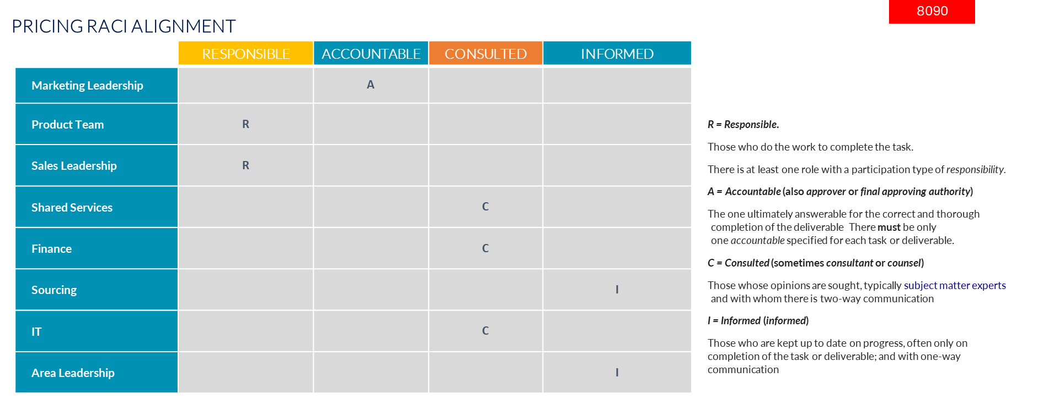
Pricing Construction
RACI Alignment for pricing accountability
R
A
C
I
* This file is available on www.upskilpro.com in an editable version , use the reference number provided on the top right in red

Slide 30
Pricing Construction
Price list accounting line items
* This file is available on www.upskilpro.com in an editable version , use the reference number provided on the top right in red

Slide 31
Pricing Construction
Functional Responsibility
Analytical Tools
R
A
C
I
Major & Critical
Notes
You may change roles to align with responsibilities in your organization
All roles and terminology used are standardized , you may choose to change of symbols and inserted text relevant to your goals and organization
Minor & Important
* This file is available on www.upskilpro.com in an editable version , use the reference number provided on the top right in red

Slide 32
Pricing Construction
Functional Responsibility ( RACI Matrix)
R
A
C
I
Analytical Tools
* This file is available on www.upskilpro.com in an editable version , use the reference number provided on the top right in red

Slide 33
Price List Construction

Slide 34
Pricing Construction
Discount Management
Strategic and operational discounts applied at various layers for management
Analytical Tools
Basic Structure
Tiers – Customers are divided into tiers to manage them better – This gives customers price and service advantages in relation to contribution
Product – This is clear product descriptions which are the same across all company systems and specially customer invoice
Category – This is a tactical discount in relation to category importance and priorities , it may be withdrawn at any stage as it is time bound and separate to normal discounts
List Price – This is the most important position in the price list as it defines the starting point of customer value and of the price discount strategy
Channel Discount – This may be a normal discount applied in line with industry standards
Special Discount _ this is a normal exigency discount field used in special strategic circumstances
Tiers Discount – This is applied on a mix of customer importance and category importance , on the basis of customer achieving strategic objectives and maintaining this discount over a period.
Activity Discount – This is a tactical discount used on a tactical basis on a limited basis for execution based initiatives
Prompt Payment – This field is driven by operational excellence objectives in this case for securing outstanding payment on time .
Final price – may be taken as nett price after all discounts .
* This file is available on www.upskilpro.com in an editable version , use the reference number provided on the top right in red

Slide 35
Pricing Construction
Pricing Influences
Basic Structure
Analytical Tools
Tiers – Customers are divided into tiers to manage them better – This gives customers price and service advantages in relation to contribution
Product – This is clear product descriptions which are the same across all company systems and specially customer invoice
Category – This is a tactical discount in relation to category importance and priorities , it may be withdrawn at any stage as it is time bound and separate to normal discounts
List Price – This is the most important position in the price list as it defines the starting point of customer value and of the price discount strategy
Channel Discount – This may be a normal discount applied in line with industry standards
Special Discount _ this is a normal exigency discount field used in special strategic circumstances
Tiers Discount – This is applied on a mix of customer importance and category importance , on the basis of customer achieving strategic objectives and maintaining this discount over a period.
Activity Discount – This is a tactical discount used on a tactical basis on a limited basis for execution based initiatives
Prompt Payment – This field is driven by operational excellence objectives in this case for securing outstanding payment on time .
Final price – may be taken as nett price after all discounts .
* This file is available on www.upskilpro.com in an editable version , use the reference number provided on the top right in red

Slide 36
Pricing Construction
Pricing Influences
Analytical Tools
Tiers – Customers are divided into tiers to manage them better – This gives customers price and service advantages in relation to contribution
Product – This is clear product descriptions which are the same across all company systems and specially customer invoice
Category – This is a tactical discount in relation to category importance and priorities , it may be withdrawn at any stage as it is time bound and separate to normal discounts
List Price – This is the most important position in the price list as it defines the starting point of customer value and of the price discount strategy
Channel Discount – This may be a normal discount applied in line with industry standards
Special Discount _ this is a normal exigency discount field used in special strategic circumstances
Tiers Discount – This is applied on a mix of customer importance and category importance , on the basis of customer achieving strategic objectives and maintaining this discount over a period.
Activity Discount – This is a tactical discount used on a tactical basis on a limited basis for execution based initiatives
Prompt Payment – This field is driven by operational excellence objectives in this case for securing outstanding payment on time .
Final price – may be taken as nett price after all discounts .
* This file is available on www.upskilpro.com in an editable version , use the reference number provided on the top right in red

Slide 37
Pricing Construction
Pricing Influences
Integrated Structure
Analytical Tools
Tiers – Customers are divided into tiers to manage them better – This gives customers price and service advantages in relation to contribution
Product – This is clear product descriptions which are the same across all company systems and specially customer invoice
Category – This is a tactical discount in relation to category importance and priorities , it may be withdrawn at any stage as it is time bound and separate to normal discounts
List Price – This is the most important position in the price list as it defines the starting point of customer value and of the price discount strategy
Channel Discount – This may be a
normal discount applied in line with industry standards
Special Discount _ this is a normal exigency discount field used in special strategic circumstances
Tiers Discount – This is applied on a mix of customer importance and category importance , on the basis of customer achieving strategic objectives and maintaining this discount over a period.
Activity Discount – This is a tactical discount used on a tactical basis on a limited basis for execution based initiatives
Prompt Payment – This field is driven by operational excellence objectives in this case for securing outstanding payment on time .
Final price – may be taken as nett price after all discounts .
* This file is available on www.upskilpro.com in an editable version , use the reference number provided on the top right in red

Slide 38
Pricing Construction
Pricing Influences
Analytical Tools
The Above Table is a Matrix indicating in grey boxes the responsibility and accountability of the function.
While the above is an example , we recommend the exercise be undertaken using our RACI matrix template and assign functional responsibility for control.
* This file is available on www.upskilpro.com in an editable version , use the reference number provided on the top right in red

Slide 39
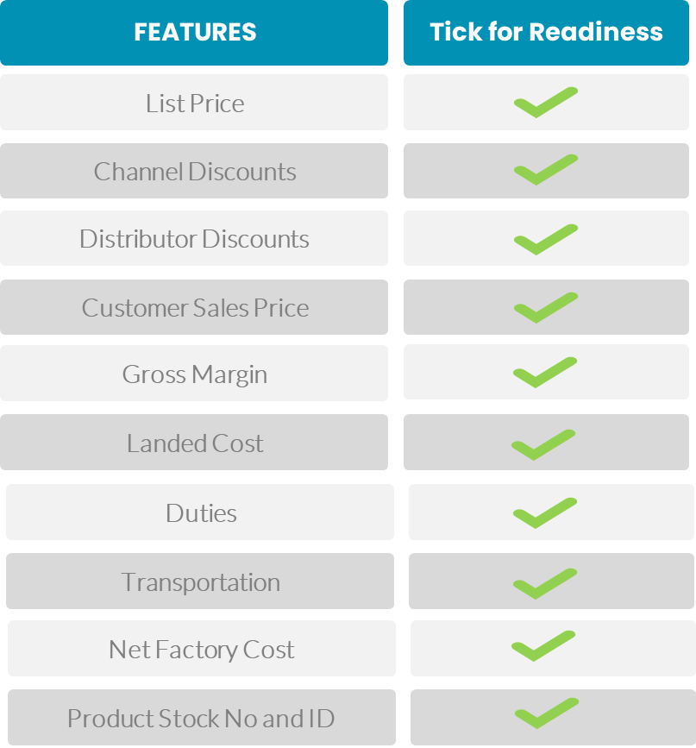
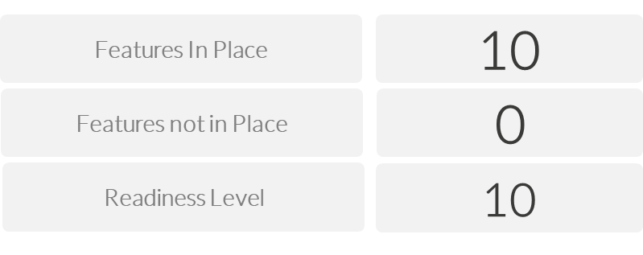
Pricing Construction
Price list features readiness assessment
These are basic components of a price construction of a distribution led business in a value pricing model
8081
A readiness level of 10 indicates you can manage prices effectively and translate into Financials with measurability
* This file is available on www.upskilpro.com in an editable version , use the reference number provided on the top right in red

Slide 40





Pricing Construction
Price List Communication Stakeholders
PRICE CHANGE - LIST LINE ITEMS
Sales team
Finance
Legal
Supply Chain
IT
Inter Company
Management
Sales
Finance
Ownership
P&L
Price List
Websites
Intranet
E mails
Tools
Leaflets
Literature
Price list design
External Communication
Invoice
Line item check
Discounts check
Item No
Currency
Automation
Internal
Distribution Partners
Marketing Team
Digital Collateral
Sales Collateral
PR Team
Order Processing

Slide 41
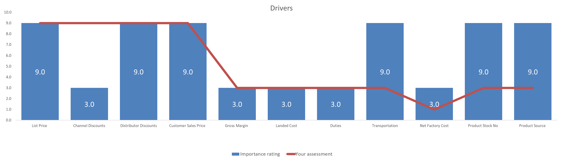
Pricing Construction
Pricing Scorecard / Scores
9013 Pricing Construction Tool
Analytical Tools
* This file is available on www.upskilpro.com in an editable version , use the reference number provided on the top right in red

Slide 42
Thank you

Slide 43
Job Descriptions
Develop roles clearly and completely across varying levels of experience
Agreements
Draft your business agreements across a variety of areas
Templates
Templates are designed based gather information in a structured manner
KPI’s
Performance indicator, a quantifiable measure of performance over time versus a specific objective.
Content Modules
Best practice material in power point for use as a knowledge base in business training , planning and execution .
Strategic tools
These tools are recognised the world over in business schools, consulting firms and companies who plan strategically.
Gain a competitive edge using the best tools and techniques to build a better you .
Analytical Tools
Interactive excel tools on specific business areas based on your data inputs delivered in a workbook model with instructions.
Scorecards
Designed as functional or subject indicators across a variety off situations to enable performance of situational evaluation versus aligned standards.
Calculators
calculate the right ratios for businesses looking for benchmarks in a variety of situations
Assessments
Assessments are designed around specific areas to conduct reviews and will center around a benchmark reviewing individuals or functions
Checklists
Designed around achieving milestones in a sequential manner.
Research
Research tools for sales and marketing engagement

Slide 44
Pricing Construction
Construct your pricing with all the elements to make your bottom-line look and feel better.
UpskilPRO e Institute for Sales & Marketing
Tools, Content & Templates
Hand built using experience & Insight

