Slide 1
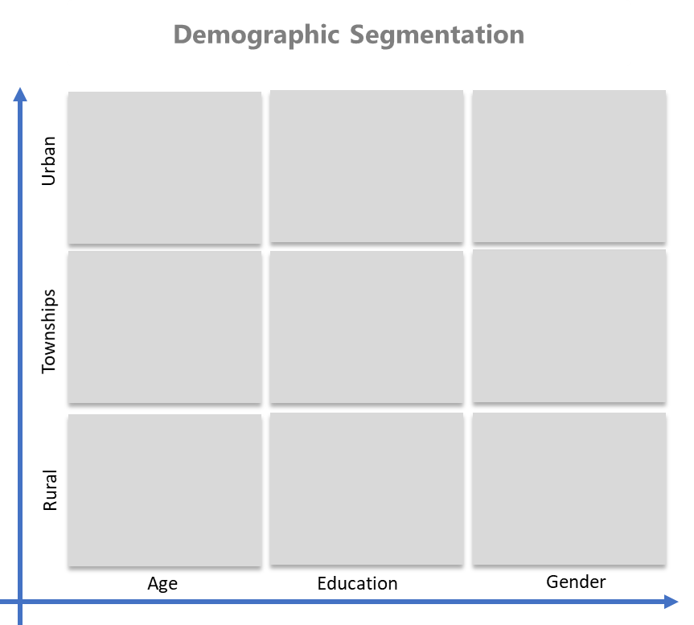
Segmentation Matrix
Examples
Segment your consumers and markets effectively.
Planning Templates
UpskilPRO e Institute for Sales & Marketing
Tools, Content & Templates
Hand built using experience & Insight

Slide 2
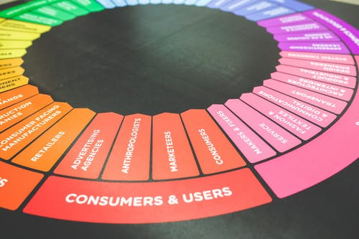
Created by
ex-Procter & Gamble, Rothmans, BAT, Gillette, Nokia,
Microsoft & 3M managers.
UpskilPRO tools are designed in easy-to-use solutions, all you need to do is download the tool and get to work immediately . All UpskilPRO material has taken 100’s of hours and many 1000’s of $ to build , all this expertise and content is brought to you for a fraction of the cost to help professionals enhance their capability.
core areas which are best suited to improve using our tools:
Subject matter expertise
Best practices
Analytical output & charting
Prioritization
Process
Capability enhancement tools for
Consumer Marketing, Trade Marketing &
Sales excellence professionals.
Tools in one place to get 10X productive now.

Slide 3
Job Descriptions
Develop roles clearly and completely across varying levels of experience
Agreements
Draft your business agreements across a variety of areas
Templates
Templates are designed based gather information in a structured manner
KPI’s
Performance indicator, a quantifiable measure of performance over time versus a specific objective.
Content Modules
Best practice material in power point for use as a knowledge base in business training , planning and execution .
Strategic tools
These tools are recognised the world over in business schools, consulting firms and companies who plan strategically.
Gain a competitive edge using the best tools and techniques to build a better you .
Analytical Tools
Interactive excel tools on specific business areas based on your data inputs delivered in a workbook model with instructions.
Scorecards
Designed as functional or subject indicators across a variety off situations to enable performance of situational evaluation versus aligned standards.
Calculators
calculate the right ratios for businesses looking for benchmarks in a variety of situations
Assessments
Assessments are designed around specific areas to conduct reviews and will center around a benchmark reviewing individuals or functions
Checklists
Designed around achieving milestones in a sequential manner.
Research
Research tools for sales and marketing engagement

Slide 4
2017
2018
100’s of tools grouped in 12 categories, 50 tool types and 12 business functions in 1 place.
get 10X productive now !
Categories
Functions
Analytical Tools
Types
Business Development
Agreements
Advertising
Customer Acquisition
Margins
Partner Search
Reports
Category Management
Assessments
Agreements
Customer Management
Market Analysis
Persona Development
Retail Measurement
Channel Management
Content Modules
Analytics
Distribution
Market Development
Planning
Reviews
Distribution
Checklists
Barriers
Distributor Management
Market Research
Positioning
Sales Management
Distributor Management
Calculators
Business Reviews
Forecasting
Market Segmentation
Pricing
Scorecards
General Management
Job Descriptions
Business Intelligence
GAP Analysis
Market Size
Prioritization
Segmentation
Key Account Management
KPI’s
Channels
Go To Market
Marketing
Product Development
Six Sigma
Marketing
Research
Communication
Job Descriptions
Marketing Comms
Product Life Cycle
Socio Economic Classification
Marketing Operations
Strategic Tools
Competitive Evaluation
Key Account Plans
Merchandising
Profit & Loss
Territory Design
Sales Management
Scorecards
Competitive Intelligence
Management Summary
New Market Entry
Promotions
Trade Marketing
Shopper Marketing
Templates
Trade Marketing

Slide 5
Segmentation
Segmentation Matrix examples
8037
8037 Segmentation Matrix examples
This product is a template
A Template is a pre-planned and organised way to collect information for presentation in a neat and structured manner
Your Concern.
How to plan a segmentation of your market? What re the examples of Segmentation?
How will this tool benefit you?
Segmenting a market is a deliberate and thought-out process, we cover the 4 most relevant and used elements of segmentations, anything further is usually referred to as micro segmentation
We illustrate a very simple method of segmentation of markets.
Key Benefits
Clear segmentation template aligning with positioning.
Presents well-structured layout for decision making
Save 2 hours on formatting
Saves many hours of understanding methodology for segmentation.
Saves many hours searching for comphrensive information
Report ready format

Slide 6
Segmentation
Segmentation Matrix examples
8037
The segmentation matrix is a strategic framework employed by businesses to categorize and analyze various market segments in a structured manner. Here's a more detailed expansion of its components and functions:
Segment Identification and Definition: The segmentation matrix begins with the identification and definition of different market segments. This involves gathering data and insights about consumers' demographics, psychographics, behaviour, and geographic location. By segmenting the market, businesses can understand the diverse needs, preferences, and characteristics of their customer base.
Segment Characteristics Analysis: Once segments are identified, the segmentation matrix allows for a comprehensive analysis of each segment's characteristics. This analysis may include factors such as age, gender, income, lifestyle, attitudes, purchasing behaviour, geographic distribution, and level of brand loyalty. By understanding these characteristics, businesses can tailor their marketing strategies to effectively target each segment.
Segment Prioritization and Evaluation: The segmentation matrix facilitates the prioritization and evaluation of market segments based on various criteria. These criteria may include the segment's size, growth potential, profitability, accessibility, and compatibility with the company's resources and objectives. Segments that exhibit high growth potential, profitability, and alignment with the company's goals are typically prioritized for strategic focus and resource allocation.
Resource Allocation and Strategy Development: With segments prioritized, businesses can allocate resources more effectively to target and engage specific segments. This may involve developing tailored marketing strategies and tactics for each segment, including product development, pricing strategies, distribution channels, and promotional activities. By allocating resources strategically, businesses can maximize their return on investment and enhance customer satisfaction and loyalty.
Continuous Monitoring and Adaptation: As the segmentation matrix is a dynamic tool that requires continuous monitoring and adaptation to changes in the market environment especially as consumer preferences evolve, new competitors enter the market, and external factors impact consumer behaviour, businesses must regularly reassess their segmentation strategies and adjust accordingly.
This may involve refining segment definitions, updating criteria for segment prioritization, and modifying marketing tactics to better meet the needs of target segments.
In summary, the segmentation matrix serves as a valuable framework for businesses to analyze, prioritize, and target different market segments effectively. By understanding the unique characteristics and needs of each segment, businesses can develop tailored marketing strategies that resonate with their target audience, drive growth, and maintain a competitive edge in the marketplace.

Slide 7
Segmentation
Segmentation Matrix examples
8037
Income Group Segmentation
Urban
Townships
Rural
Lower Income
Middle Income
Higher Income

Slide 8
Segmentation
Segmentation Matrix examples
8037
Demographic Segmentation
Urban
Townships
Rural
Age
Education
Gender

Slide 9
Segmentation
Segmentation Matrix examples
8037
Psychographic Segmentation
Urban
Townships
Rural
Values
Beliefs
Attitudes
Behaviours

Slide 10
Segmentation
Segmentation Matrix examples
8037
Behavioral Segmentation
Complex buying Behavior
Variety seeking buying behavior
Significant differences between brands
Dissonance reducing buying behavior
Habitual Buying behavior
Few differences between brands

Slide 11
Segmentation Matrix
Examples
Segment your consumers and markets effectively.
Planning Templates
UpskilPRO e Institute for Sales & Marketing
Tools, Content & Templates
Hand built using experience & Insight

