Slide 1


Key Account Management.
Module 5 – Buyers view.
Sales & Marketing Fundamentals.
UpskilPRO e Institute for Sales & Marketing
Tools, Content & Templates
Hand built using experience & insight

Slide 2
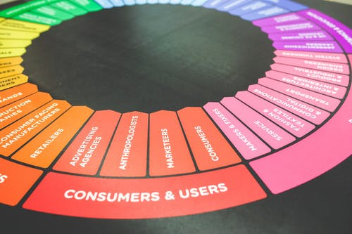



Created by
ex-Procter & Gamble, Rothmans, BAT, Gillette, Nokia,
Microsoft & 3M managers.
UpskilPRO tools are designed in easy-to-use solutions, all you need to do is download the tool and get to work immediately . All UpskilPRO material has taken 100’s of hours and many 1000’s of $ to build , all this expertise and content is brought to you for a fraction of the cost to help professionals enhance their capability.
core areas which are best suited to improve using our tools:
        Subject matter expertise
        Best practices
        Analytical output & charting
        Prioritization
        Process
        Training
Making life simpler for
Sales & Marketing professionals.
Tools in one place to get 10X productive now.

Slide 3


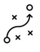

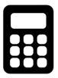

Job Descriptions
Develop roles clearly and completely across varying levels of experience
Agreements
Draft your business agreements across a variety of areas
Templates
Templates are designed based gather information in a structured manner
KPI’s
Performance indicator, a quantifiable measure of performance over time versus a specific objective.
Content Modules
Best practice material in power point for use as a knowledge base in business training , planning and execution .
Strategic tools
These tools are recognised the world over in business schools, consulting firms and companies who plan strategically.
Gain a competitive edge using the best tools and techniques to build a better you .
Analytical Tools
Interactive excel tools on specific business areas based on your data inputs delivered in a workbook model with instructions.
Scorecards
Designed as functional or subject indicators across a variety off situations to enable performance of situational evaluation versus aligned standards.
Calculators
calculate the right ratios for businesses looking for benchmarks in a variety of situations
Assessments
Assessments are designed around specific areas to conduct reviews and will center around a benchmark reviewing individuals or functions
Checklists
Designed around achieving milestones in a sequential manner.
Research
Research tools for sales and marketing engagement

Slide 4
2017
2018
100’s of tools grouped in 12 categories, 50 tool types and 12 business functions in 1 place.
get 10X productive now !
Categories
Functions
Analytical Tools
Types
Business Development
Agreements
Advertising
Customer Acquisition
Margins
Partner Search
Reports
Category Management
Assessments
Agreements
Customer Management
Market Analysis
Persona Development
Retail Measurement
Channel Management
Content Modules
Analytics
Distribution
Market Development
Planning
Reviews
Distribution
Checklists
Barriers
Distributor Management
Market Research
Positioning
Sales Management
Distributor Management
Calculators
Business Reviews
Forecasting
Market Segmentation
Pricing
Scorecards
General Management
Job Descriptions
Business Intelligence
GAP Analysis
Market Size
Prioritization
Segmentation
Key Account Management
KPI’s
Channels
Go To Market
Marketing
Product Development
Six Sigma
Marketing
Research
Communication
Job Descriptions
Marketing Comms
Product Life Cycle
Socio Economic Classification
Marketing Operations
Strategic Tools
Competitive Evaluation
Key Account Plans
Merchandising
Profit & Loss
Territory Design
Sales Management
Scorecards
Competitive Intelligence
Management Summary
New Market Entry
Promotions
Trade Marketing
Shopper Marketing
Templates
Trade Marketing

Slide 5








7 Benefits of using UpskilPRO :
Improve your knowledge
with professional Strategic Tools , Templates and planning documents for any business situation!
Use ready made tools
with filled in examples and ready to print & edit at your convenience . Just edit and fill-in the blanks !
Develop YOUR BUSINESS
Learn , & utilize the knowledge and processes and enhance your capabilities as the other companies have
We Created UpskilPRO for the
  Sales Professional
  Trade Marketer
  Marketing Executive
  Operations Manager
  VP/Director/Manager
100’s of tools , TEMPLATES & documents
CREATED BY
world class sales and marketing
business professionals.
All tools
are based on topics and subject based situations and are simple and easy to use .
SAVE THOUSANDS OF DOLLARS
The average company will save 1000’s of $ per employee in time & effort using our ready tools !
Top Quality Tools & Templates for developing both you and your business.
www.upskilpro.com

Slide 6
Buyer’s view.
Directional Summary
Successful buyers look for sellers who can satisfy their requirements , professional buyers seek companies which they identify have competitive advantages and are able to keep doing business without interruption in the long run especially satisfying their requirements..

Slide 7

Buyers.
Directional Summary
Key Account Management
Buyer’s view
Buyers in any organisation play a very key role.
They are the primary commercial interface for businesses wanting to manage and list new suppliers , in a more advanced context they play a strategic role of aligning their buying capabilities to align with the strategic view of the business and improve competitive advantages , all while ensuring their unit or purchase costs are low and their profit maximization is high.
For a commercial relationship to be complementary the common point of intersection for both brand owner and business is products , their business approach , and the ensuing relationship , speaking in context the buyer has to learn a lot about his suppliers and understand their product portfolios for him or her to understand where the buying role can add considerable competitive advantage through the business by maximizing and managing a portfolio of suppliers who mirror their strategy and strategic plan in general .
Once a relationship is established the extent of commonality and cost savings increase on both sides as trust between the two parties grows and barriers are reduced. In some situations, reducing risk by working with a known partner allows costs to be cut in addition to a better more representative product line growing into a product portfolio line and eventually a wider range of solutions

Slide 8
Buyers.
Purchasing view & relevance
In general buyers are isolated from their company's customer together than ever before. The buying role has become a central role and organization in many cases using the latest best practices , using analytics and market data to facilitate their decisions, in general it is estimated a well-run buying role in a buying organization can add 4 to 5 points in gross profitability to a profit and loss statement versus the traditional set up without the tools the current role is equipped with and make decisions in real time to facilitate strategy and profitability.
When a supplier works with a deep understanding of the customer, this usually is one side of the equation: the receptiveness of the customer is also critical in achieving relationship success. There is a tendency for selling companies to view their relationships with buying companies in isolation implying buyers do not have relationships with other suppliers or with other kinds of organizations.
Understand customer drivers
Understand customer's strategic vision
Design customer solution

Slide 9
Buyers.
Perspective
Intersection
Brand
Business
Resuppliers
Customers
Ancillary suppliers
Suppliers
External parties
Point of Intersection
Business Unit
( Customer )
Extended Suppliers
Brand Owner
Co operative
Collaborative units
Suppliers
Common parties
Local customers
Customers
Understand customer drivers
Understand customers strategic vision
Design customer solution

Slide 10
Buyers.
Sole Organisation versus Enterprise Organisation .
Number of accounts
Volume Contribution
Small Accounts
Status
Focus
Small Accounts
Buyer Strength
Medium Accounts
Medium Accounts
Streamline
Star
Number of accounts
Large Accounts
Large Accounts

Slide 11

Buyers.
Customer Drivers.
10 Customer drivers influencing ( purchasing ) buyers roles
Emerging and collapsing routes to market
Speed of change and flexibility
Globalization
All roles will be determined in context by a few drivers for direction and clarity .
These drivers touch upon the high level direction and deliverables for a particular role or function at right we establish a few of the most important drivers that customers ( businesses ) are expected to strive to achieve constantly .
Deep competitive MOATS ( Advantages)
Innovation & shorter product life cycles
Downsizing, upsizing, & merging
Cost reduction & Competitiveness
Supply chain integration and customization
Independent prices
Risk reduction.

Slide 12
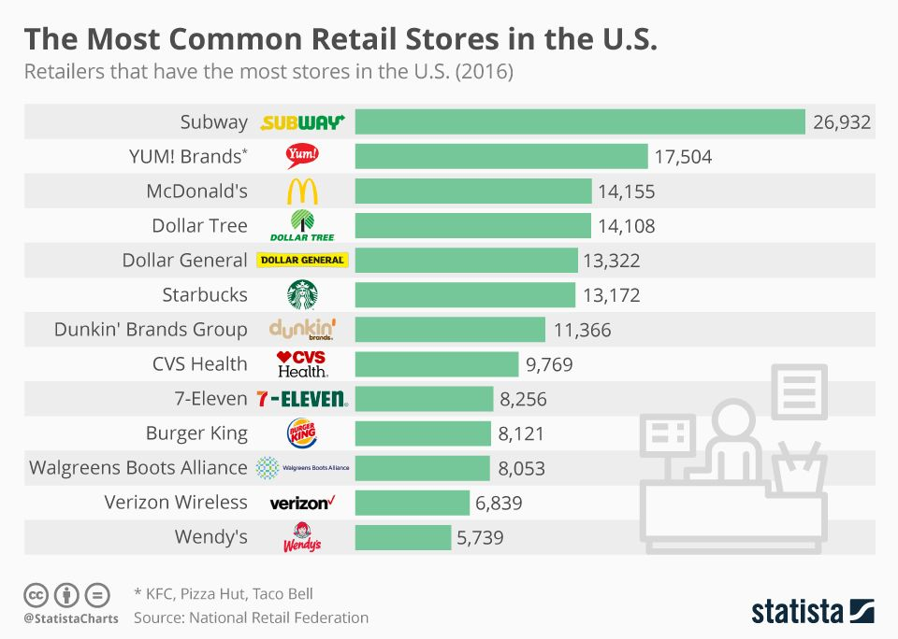
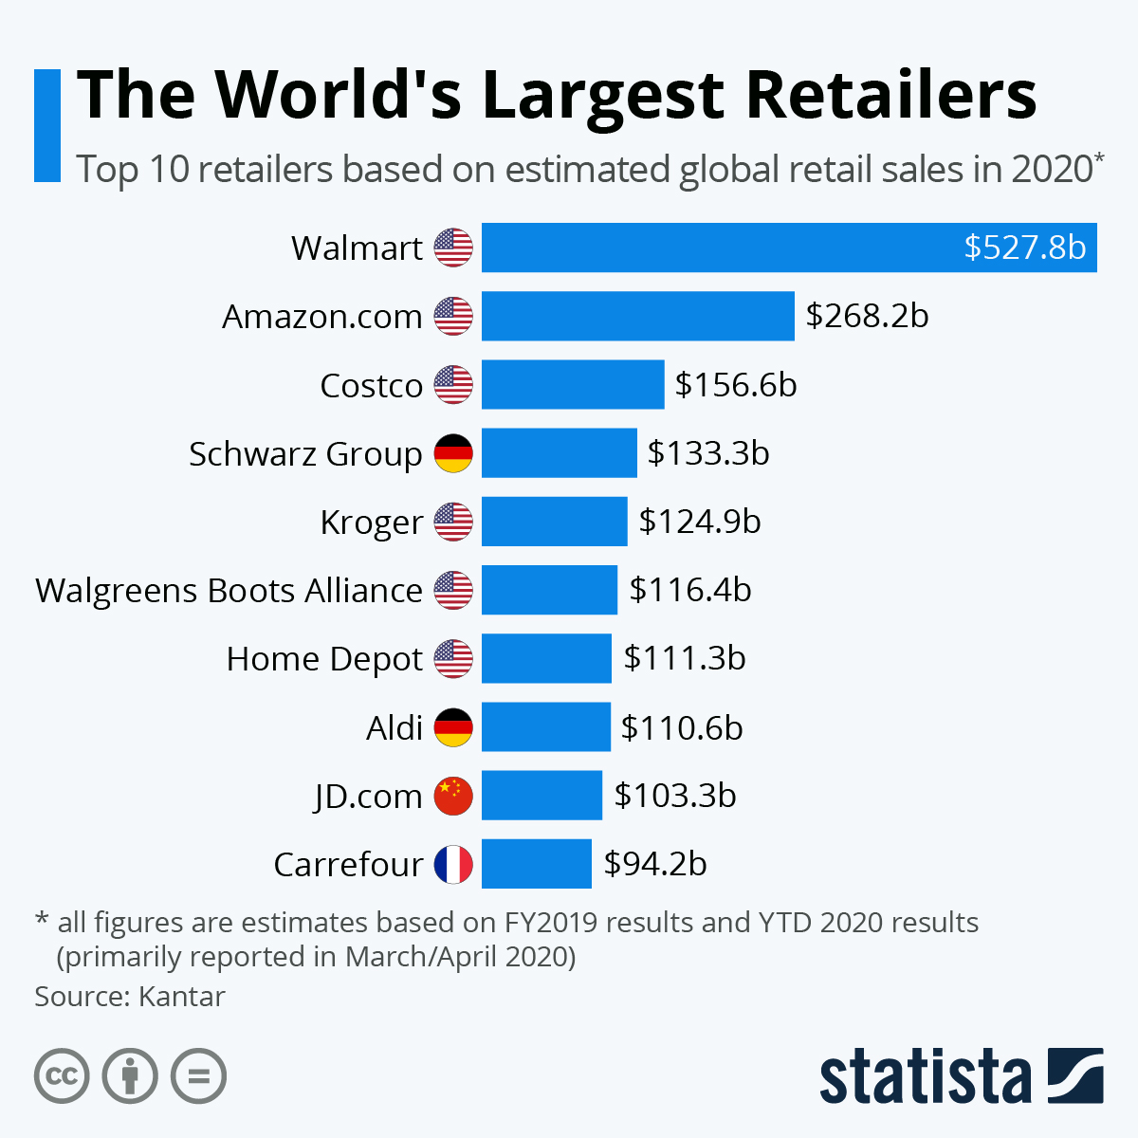
Buyers.
The Buyer Concentration Across Accounts .

Slide 13
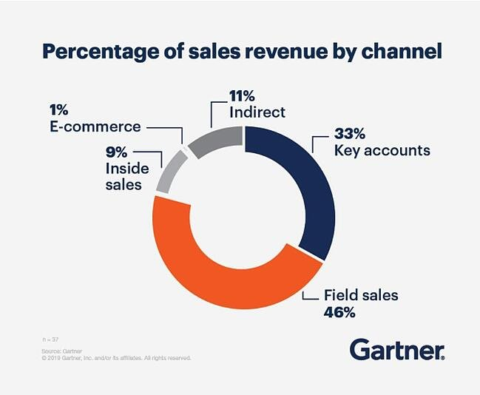
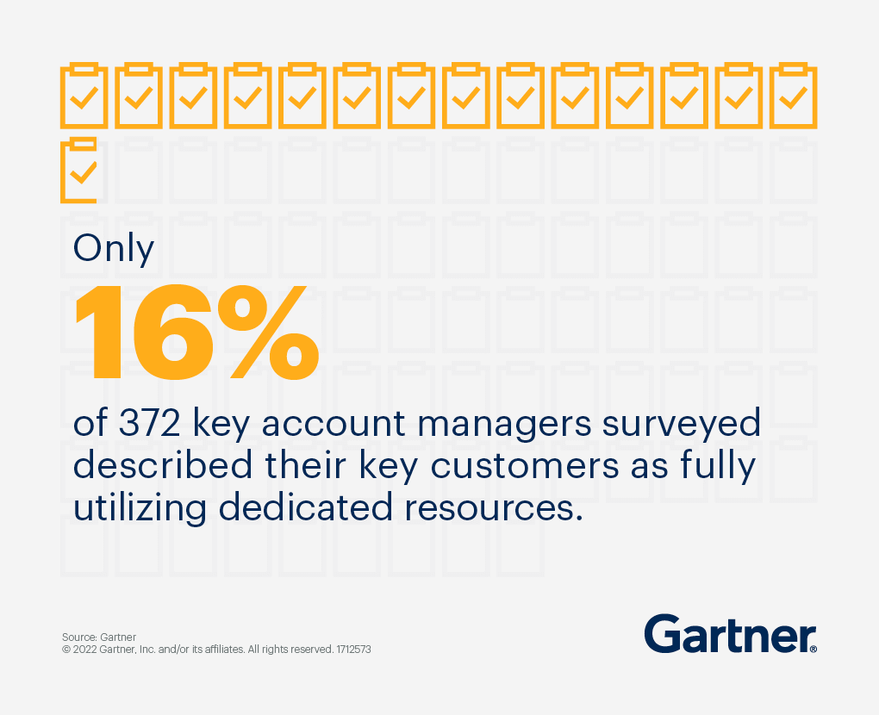
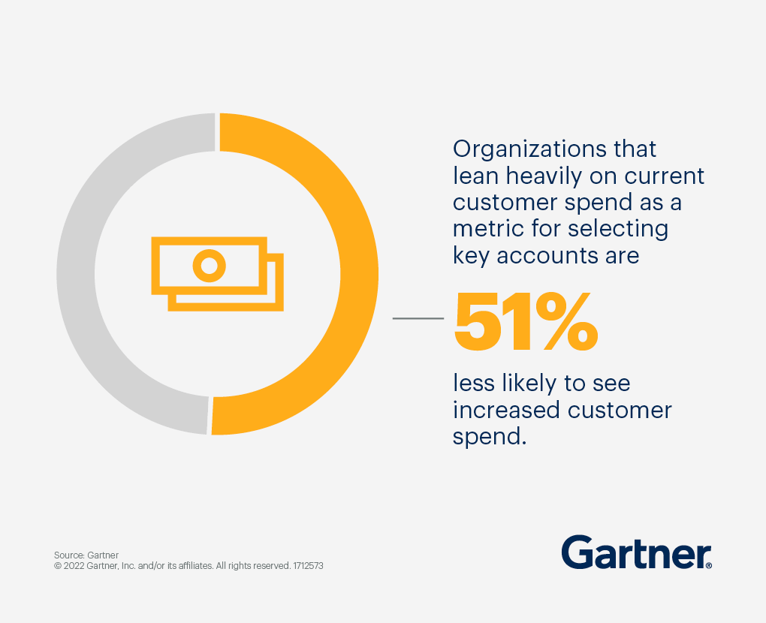
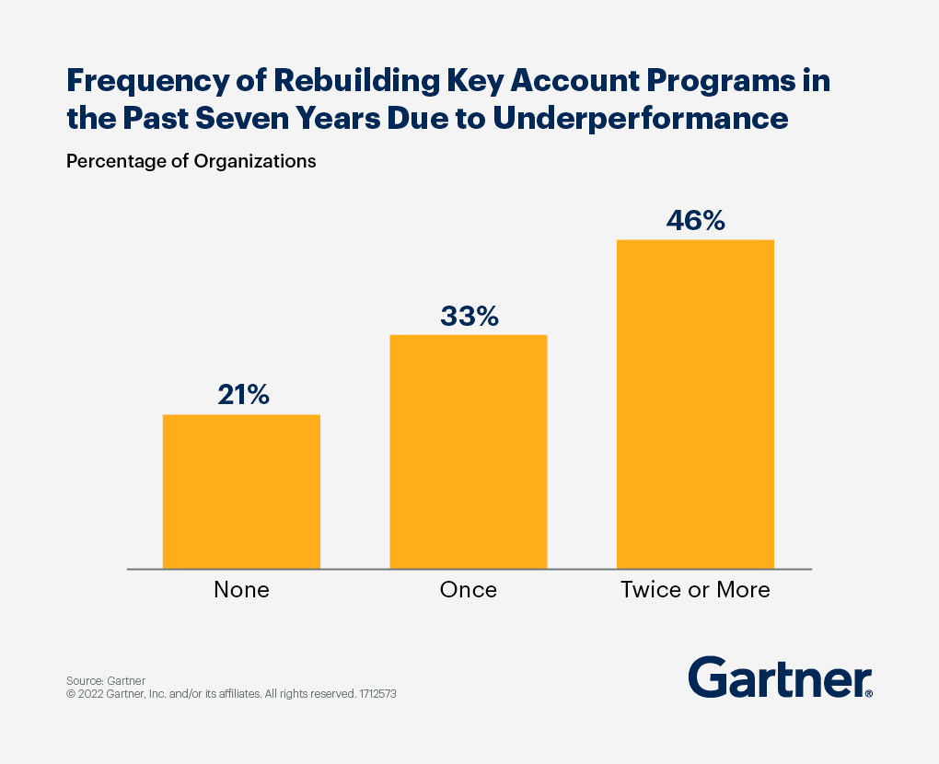
Buyers.
Sole Organisation versus Enterprise Organisation .
Source : Gartner

Slide 14
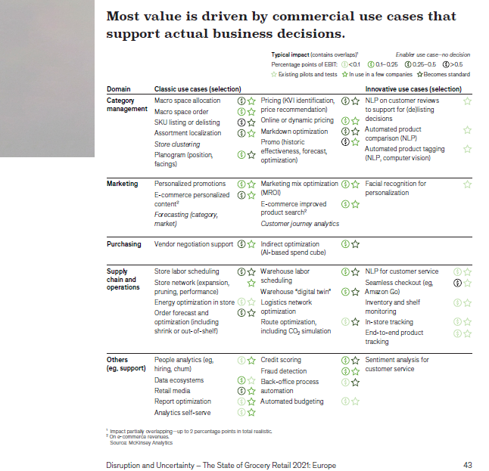

Buyers.
Sole Organisation versus Enterprise Organisation .
We refer to a study done by The State of Grocery Retail in Europe where they identify 5 key areas in the retail sector which are key elements of the KAM approach

Slide 15
Buyers.
Cost reduction.
Customer Value
Market Share
Profitability
Suppliers Priorities
( Brand Owners )
While Brand owners concentrate on driving share , profitability will remain one key gauge of determining achievement of business objectives.
Business Priorities
Market Share
Cost Reduction
Business Priorities
For business owners who manage a many suppliers , unit cost or category profitability will always be a constant focus to be managed during every interaction with the supplier.
As you will notice , the same pressures are sometimes common to all businesses .

Slide 16

Buyers.
Cost reduction.
Better information
Reduction of barriers
Elimination of duplicated processes
Improved material supply
Processed transactions
Tighter quality control
Reduced production costs
Cost-effective design of new products
Cost sharing on R&D
Lower sourcing costs.
Supply chain efficiency
Cost reduction.
Some of the cost savings that are potentially available
to companies when two links in the supply chain work closely together are as follows

Slide 17
Buyers.
Risk reduction.
Reduction of risk is one of the major drivers that cause companies to seek
closer relationships and encompasses the following:
● Reduction of uncertainty generally
● Protection against pressures from the business environment
● Protection against opportunism by powerful trading partners
● Protection against losing the business altogether.
PEST
Analysis tools can be used to gauge this.
Buying company concerns
The buying company’s first concern is always opportunism on the part of selling companies
Will suppliers pass on any lower costs to the buyer?
Will they hold the buyer to ransom for higher prices if they have the advantage?
Will they respect confidential information?
Will they provide continuity of supply?
Buying companies protection mechanisms
Broaden supplier base
Fully specified contracts
While the above reduces seller freedom it also creates difficulties in building trust and business for buyers
Relationship influencers
For buyers , its more the question of are the sellers the ones who will be there with them long term
Will the sellers bring a competitive edge
Do the sellers offer products which are branded and represent consumer choices

Slide 18
Reduction of risk is one of the major drivers that push companies to seek closer relationships using any or a mix of the following strategies.
● A reduction of uncertainty generally
● Protection against pressures from the business environment
● Protection against opportunism by powerful trading partners
● Protection against losing the business altogether.
Buyers.
Risk reduction strategies .
General
Downturn in demand
Upturn in demand
Price pressure
Technology improvement
Sharing data
Asset engagement to lower costs
Volume engagement
Supply chain integration
Joint R&D
External
Price increases
Disengagement
Asset engagement inappropriately
Strategy
Commitment
Trust
Dependence mutuality
Flexible vertical integration
Joint planning
Strategic Investments
Internal
Risk
Managing Risk

Slide 19
Buyers.
Buying Company - Strategic direction.
Supplier Development
Development
Core
Client development
Business expansion
Opportunity development
Client development
Competitive MOAT development
Service engagement
Responsive vs React
Strategic direction matrix
If the selling company’s relationship with the customer is not close enough for joint planning, then the next best approach is to carry out a strategic analysis from the customer’s point of view and to assemble an appropriate strategy on the basis of the findings.
To do this, selling companies may find it helpful to employ the strategy direction tool commonly used by buyers to determine
how they should manage their suppliers.
Nuisance
Exploitable
Low priority
Trust
Dependence mutuality
Flexible vertical integration
Joint planning
Strategic Investments
Business Attractiveness
Business Value Generation

Slide 20
Buyers.
Buying Strategies for companies .
Strategy independence
In many cases it is possible and is the norm that both buyer and the seller strategies run a similar course as that of the brand owner or selling companies , this is not a surprise in any way as both roles on either side run similar charters or goals , which can for example have core areas for improvement as shown below.
Conversely selling companies have established strategies and work around finding out the commercial nature of the buying company strategy in order to accommodate the buying company into their strategy , this is because while the product strategy can be driven by the selling company the commercial strategy is usually the area which needs to be carefully considered in order to lower the objections and consolidate the relationship
Reduce Supplier base
Develop specific strategies for key suppliers
Develop category specific strategies
Consolidate supplier by speciality
Reduce Inventory turns and stock days
List suppliers certified by an industry body
Develop suppliers who can exhibit add value in the areas of Training , Innovation & marketing .

Slide 21
Buyers.
Business Advantages in Relationship Management.
Supplier Pyramid
Supplier Features
Area | Contribution | Criteria
Strategic Suppliers | Primary Mover Channels drivers to market Value / revenue generation | Strategy driven Dual engagement on buyer and seller sides
Preferred Suppliers | All points solution Technology advantages Operational excellence | Relationship development Strategy for category management Service level scorecard
Commodity Suppliers | Cost improvement Service levels Transaction ease | Managed locally Performance driven Cost benefit
Strategic
5%
Preferred
15%
Commodity
75%
Figures in % are indicated roughly of the business value contribution across the 3 segments of suppliers .
This image is also representative of the business splits in most companies from the market side

Slide 22















Buyers.
Sole Organisation versus Enterprise Organisation .
 | Sole Organisation Mind Set |  | Enterprise Mind Set
 | Customer Focus |  | Ultimate consumer focus
 | Own profit focus |  | Profit maximization
 | Consider won costs |  | Total costs rolled up
 | Jealously guard own resources |  | Resource sharing
 | Focussed on internal processes mainly |  | Joint business plans and resource management
 | Sales profitability |  | Market Share and Revenue Share

Slide 23
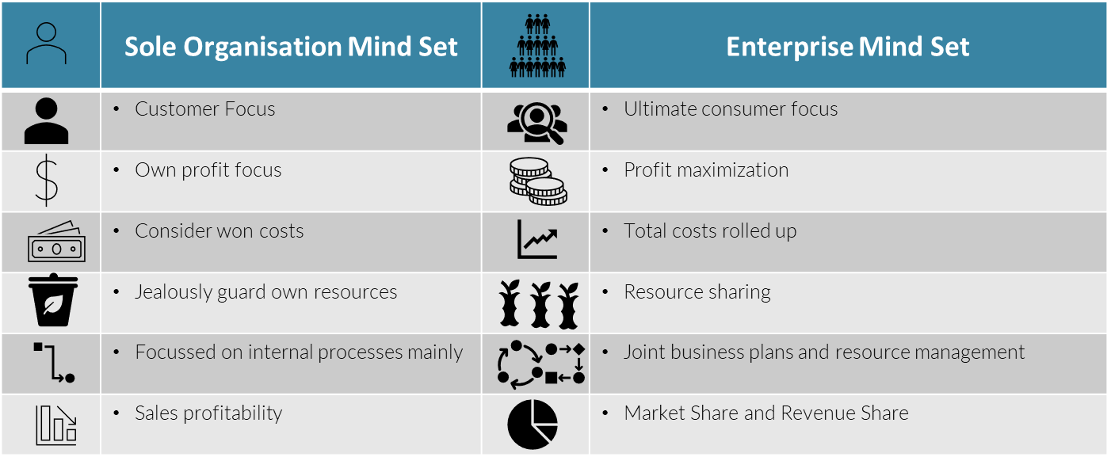


Buyers.
Sole Organisation versus Enterprise Organisation .
The external context in which buyer–seller relationships exist is becoming increasingly extensive and complex. Change drivers include the rapid pace of change, the refinement of processes, market maturity, heightened customer power and the globalization of business. At the same time, the internal, organizational context is also changing, removing traditional delineations of remit and responsibility. Conditions are more conducive to ‘partnering’ between suppliers and customers and, hence, the nature of marketing has altered. Marketers are moving away from a traditional transaction focus towards a customer focus. Thus, there is a pressing need to find ways to describe relationships as a basis from which to understand them better and build them stronger – and this has led to the ascendancy of KAM.

Slide 24
Buyers.
Strategy Engagement.
Integrated Accounts
Features | Basic | Cooperative | Inter dependent | Integrated
Efficiency
Competitive Advantages
Margins
KAM Adoption
Information
Joint Business Planning
M&A Relationship
Resources
Geographical Presence
Profitability
 | LOW | MED | HIGH
Lack of reality
Supplier view of relationship level
Independent Accounts
Cooperative Accounts
Basic Accounts
Buyer view of relationship level

Slide 25


Buyers.
Strategy Engagement.
Supplier
In the case of power between a supplier and a customer might not affect the duration of a relationship, it certainly makes a huge difference to its nature. Power is obviously linked to the perceived degree of dependency on the partner. In fact, the one is the reverse of the other. Dependency increases as the size of the business with the trading partner increases and as its share of the company’s turnover grows. Dependency also increases if loss of the business would damage either company’s reputation and trigger the defection of other partners, or if finding a substitute would be difficult.
Customer
For a selling company with high fixed costs, the consequences of losing a major customer can be crippling, but where most costs are variable the effects are more manageable. The sources of power in a buyer–seller relationship as identified by a group of practitioners from blue-chip companies. Whether the company is buying or selling, most of the sources of power are potentially mirror images of each other. What differs is the list of them possessed by each organization in a given relationship at a given point in time.

Slide 26





Buyers.
Sources of power.
Source |  | Buyers ( Power sources ) | Sellers ( Power sources )
Size |  | Consolidation Globalization Larger share of supplier business | Buyer dependence Demand dependant Dominant share of business
Competition |  | Sort and select suppliers Currency & Price Selection | Supply shortage Patents & monopolies Barriers to new competitors
Skills |  | Information access Market knowledge and best practices leverage Professional buyers | Professional KA Mgrs. Leverage market knowledge Information access
Strategies |  | Supplier rationalization Shift to e-commerce Supply chain improvement | Global competency record Reputation management Relevant expertise
Threats |  | Low cost of switching for customer High cost of switching for supplier Cost increases and losses | High cost of switching for customer Low cost of switching for supplier Alternatives availability
Leverage |  | Regulatory bodies Reputation management | Within regulatory bodies

Slide 27
Buyers.
Sources of power.
Favours Seller
Balanced
Favours Buyer
High level of communication
Promises mutual benefit
Actually a win or lose situation
Cooperative
Open
Trusting
Long term view
Data share
Useful information offered by seller signal’s cooperation
High
Balance of power
Common Interest
One sided communication
Threats driven
Seldom delivers on promises
Low quality information exchange
Seller low on any type of cooperation
Low
Power Balance

Slide 28
Thank you !

Slide 29
Job Descriptions
Develop roles clearly and completely across varying levels of experience
Agreements
Draft your business agreements across a variety of areas
Templates
Templates are designed based gather information in a structured manner
KPI’s
Performance indicator, a quantifiable measure of performance over time versus a specific objective.
Content Modules
Best practice material in power point for use as a knowledge base in business training , planning and execution .
Strategic tools
These tools are recognised the world over in business schools, consulting firms and companies who plan strategically.
Gain a competitive edge using the best tools and techniques to build a better you .
Analytical Tools
Interactive excel tools on specific business areas based on your data inputs delivered in a workbook model with instructions.
Scorecards
Designed as functional or subject indicators across a variety off situations to enable performance of situational evaluation versus aligned standards.
Calculators
calculate the right ratios for businesses looking for benchmarks in a variety of situations
Assessments
Assessments are designed around specific areas to conduct reviews and will center around a benchmark reviewing individuals or functions
Checklists
Designed around achieving milestones in a sequential manner.
Research
Research tools for sales and marketing engagement

Slide 30

Key Account Management.
Module 5 – Buyers.
Sales & Marketing Fundamentals.
UpskilPRO e Institute for Sales & Marketing
Tools, Content & Templates
Hand built using experience & insight

