Slide 1
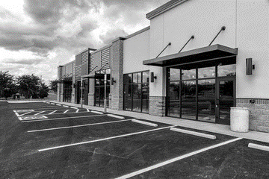
Trade Marketing.
Stores & Formats
Sales & Marketing Fundamentals.
UpskilPRO e Institute for Sales & Marketing
Tools, Content & Templates
Hand built using experience & insight

Slide 2
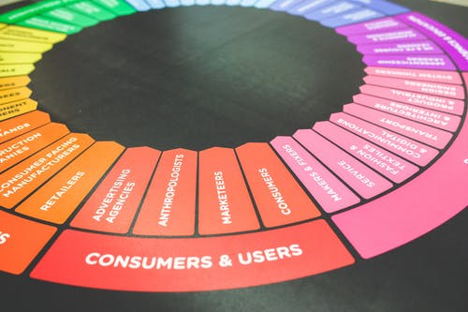
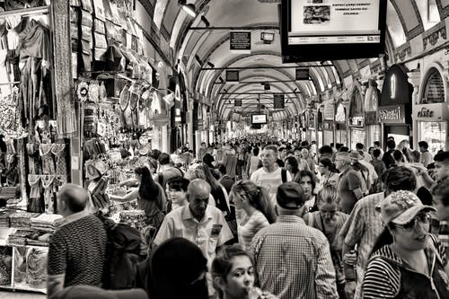
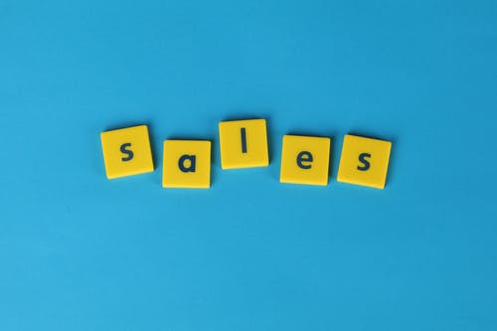
Created by
ex-Procter & Gamble, Rothmans, BAT, Gillette, Nokia,
Microsoft & 3M managers.
UpskilPRO tools are designed in easy-to-use solutions, all you need to do is download the tool and get to work immediately . All UpskilPRO material has taken 100’s of hours and many 1000’s of $ to build , all this expertise and content is brought to you for a fraction of the cost to help professionals enhance their capability.
core areas which are best suited to improve using our tools:
Subject matter expertise
Best practices
Analytical output & charting
Prioritization
Process
Training
Making life simpler for
Sales & Marketing professionals.
Tools in one place to get 10X productive now.

Slide 3
Job Descriptions
Develop roles clearly and completely across varying levels of experience
Agreements
Draft your business agreements across a variety of areas
Templates
Templates are designed based gather information in a structured manner
KPI’s
Performance indicator, a quantifiable measure of performance over time versus a specific objective.
Content Modules
Best practice material in power point for use as a knowledge base in business training , planning and execution .
Strategic tools
These tools are recognised the world over in business schools, consulting firms and companies who plan strategically.
Gain a competitive edge using the best tools and techniques to build a better you .
Analytical Tools
Interactive excel tools on specific business areas based on your data inputs delivered in a workbook model with instructions.
Scorecards
Designed as functional or subject indicators across a variety off situations to enable performance of situational evaluation versus aligned standards.
Calculators
calculate the right ratios for businesses looking for benchmarks in a variety of situations
Assessments
Assessments are designed around specific areas to conduct reviews and will center around a benchmark reviewing individuals or functions
Checklists
Designed around achieving milestones in a sequential manner.
Research
Research tools for sales and marketing engagement

Slide 4
2017
2018
100’s of tools grouped in 12 categories, 50 tool types and 12 business functions in 1 place.
get 10X productive now !
Categories
Functions
Analytical Tools
Types
Business Development
Agreements
Advertising
Customer Acquisition
Margins
Partner Search
Reports
Category Management
Assessments
Agreements
Customer Management
Market Analysis
Persona Development
Retail Measurement
Channel Management
Content Modules
Analytics
Distribution
Market Development
Planning
Reviews
Distribution
Checklists
Barriers
Distributor Management
Market Research
Positioning
Sales Management
Distributor Management
Calculators
Business Reviews
Forecasting
Market Segmentation
Pricing
Scorecards
General Management
Job Descriptions
Business Intelligence
GAP Analysis
Market Size
Prioritization
Segmentation
Key Account Management
KPI’s
Channels
Go To Market
Marketing
Product Development
Six Sigma
Marketing
Research
Communication
Job Descriptions
Marketing Comms
Product Life Cycle
Socio Economic Classification
Marketing Operations
Strategic Tools
Competitive Evaluation
Key Account Plans
Merchandising
Profit & Loss
Territory Design
Sales Management
Scorecards
Competitive Intelligence
Management Summary
New Market Entry
Promotions
Trade Marketing
Shopper Marketing
Templates
Trade Marketing

Slide 5
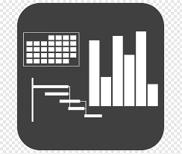
7 Benefits of using UpskilPRO :
Improve your knowledge
with professional Strategic Tools , Templates and planning documents for any business situation!
Use ready made tools
with filled in examples and ready to print & edit at your convenience . Just edit and fill-in the blanks !
Develop YOUR BUSINESS
Learn , & utilize the knowledge and processes and enhance your capabilities as the other companies have
We Created UpskilPRO for the
Sales Professional
Trade Marketer
Marketing Executive
Operations Manager
VP/Director/Manager
100’s of tools , TEMPLATES & documents
CREATED BY
world class sales and marketing
business professionals.
All tools
are based on topics and subject based situations and are simple and easy to use .
SAVE THOUSANDS OF DOLLARS
The average company will save 1000’s of $ per employee in time & effort using our ready tools !
Top Quality Tools & Templates for developing both you and your business.
www.upskilpro.com

Slide 6
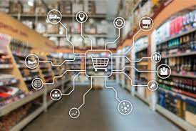
Retail is Detail.

Slide 7
Trade Marketing
Store layouts : Objectives of store layout
Objectives of store layout
key features
Optimum utilisation of space
maximum visibility of products to customers
enable customers to visit multiple departments and product areas
maximum safety for employees and customers
easily maintain store
ease of product handling
Different store layouts
Free flow layout
Grid layout
Loop layout
Spine layout

Slide 8
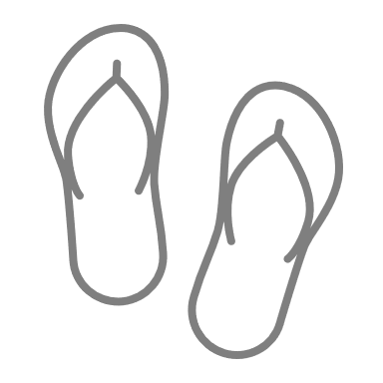
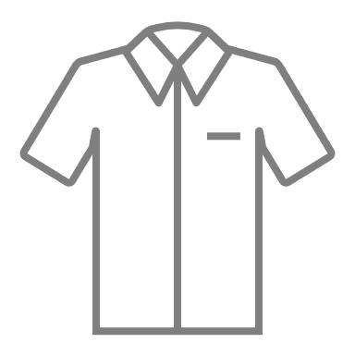
Trade Marketing
Store layouts : Free flow layout
Store based formats |  | Non-Store based formats
Grocery | Non grocery | Internet | Other Non-store formats
Convenience | Speciality stores | e-stores / e-commerce | Direct selling
Discount stores | Mixed retailers | Online auctions | Television home shopping shampoo channels
Hypermarkets | Department stores | Group buying | Mail order catalogues
Superstores | Variety stores | Socially focus commerce | Market stands
Supermarkets | Mass merchandisers |  | Vending
Small grocers | Warehouse clubs
Food and drink specialist

Slide 9
Trade Marketing
Global Store Formats.
 | Hypermarkets | Supermarket | Convenience stores | Department store | General stores | Discount
Detail | Hypermarkets are very large retail formats at the highest end of retailing providing a wide variety of choice exclusive merchandise and standard merchandise driven by penetration pricing high footfall and focuses on mostly the planned consumer purchase | Supermarket is one level below a hypermarket focusing on is small slightly lesser product portfolio than a hyper market Celebrate Baited fine then history Then I got around the movie Anna in the case of a bit more going in that case you're fired | convenience stores are mostly found in residential areas providing a standardised but limited product range that's slightly higher than average prices and often work an 18 our day focusing on customer engagement and quick checkouts these stores are usually ideal for immediate unplanned purchases | department stores a large stores offering a huge assortment of soft and hard goods or they have a large assortment of goods at mostly an average price | general stores are found and urban and rural areas focusing on the needs of a specific community | these stores our position to compete mainly on price do you have an extensive or large assortment of product at affordable and price driven levels they are positioned billow branded products
 | warehouse stores | variety stores | mom and pop stores | speciality stores | E-tailers | Vending
Detail | Where are stores a large format stores typically found and low density areas they offer high quality product mainly driven by volume purchases on pallets and typically charge a service fee on an annualised basis to remain profitable | These offer low cost product with very limited selection | Mom and pop stores can be found in mostly urbanised environment operated by a family or individual and focuses on a standardised set of products which are in regular demand and maybe compared to your C stores formats | speciality stores are more focused on specific categories and provide a high level of customer and technical service to customers for example pet stores electronics stores DIY are all focused towards a specific customer and within these stores brands play a large part | e-tailers are an emerging channel Witcher come to being in the last 15 years consumers can shock through the Internet and merchandise dropped off at the consumers doorstep this is called drop shopping technique this this channel has gained enormous strength during COVID . | Vending machines are automated They have a specific product range they accept cash sometimes cards as payment methods for delivering the product witton the machine the usually a purely convenience method for consumers they require an Internet connexion

Slide 10
Trade Marketing
Store Layouts

Slide 11
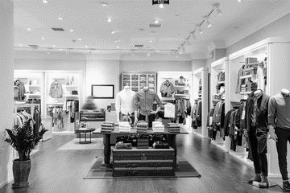
Trade Marketing
Store layouts : Free flow layout
product is grouped into free flowing patterns on the sales floor nearby there is no specific traffic pattern.
The model had left is typically for small stores below 5000 square feet
this model works best when the merchandise is of the same type and brand
Though there is variety this model may not work well as departmental segmentation is difficult , however it remains the chosen model for most garment retailers below 5,000 Square feet
Storage / receiving / marketing
Dressing rooms
Underwear
Accessories
Tops
Check out
counter
Check out
counter
Clearance items
Jeans casual wear stockings
Pants
Tops
Feature
Feature
Display window
Display window

Slide 12
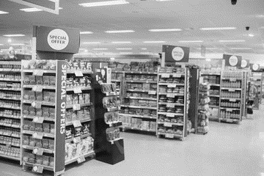
Trade Marketing
Store layouts : Grid layout
Bakery
Electrical
Storage / receiving / marketing
Electronics
Fruits
Display
Accessories
Clothing
Vegetables
Clothing
Categorisation of products is very clearly laid out
Entry and exit are planned right across checkouts and shopping trolleys
Which will frozen bakery are clustered together offering fresh produce in the same vicinity
All dry and wet products are neatly categorised across the 18 aisles
Electrical have been deliberately kept on the right corner as it's a completely preplanned area
Clothing has been kept closer to the shopping trolleys and entrance because it's a planned purchase.
Jeans casual wear stockings
Clothing
Pants
Clothing
Chillers
Entrance
Checkouts
Office
Exit

Slide 13
Trade Marketing
Store layouts : Maze layout
The maze layout is easy to navigate for customers you may compare this to the IKEA layout which is a single direction layout , which means you travel in one direction , an if you wish to go back to a particular area , you may retrace your steps
the categories are marked in blue
shoppers move in one Direction in case you want to go back they have to retrace their steps
stores like this will need an over abundance of signage to remind customers what's behind and what's in front off them
Entrance
Exit
Side walls
Categories

Slide 14
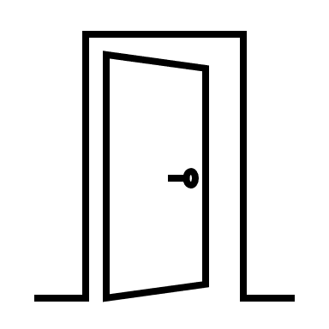
Trade Marketing
Store layouts : Spine layout
Back room
The oil virtually splits the store into two that's why it's called spine
on either side merchandise department branch off towards the sidewalls
this type of format is used by medium size speciality stores between two and 10,000 square feet
customers knew to the store will initially find it confusing, but familiarity will eventually allow them to pick up merchandise easily
Swivel category stands
Categories
Entrance
Exit

Slide 15
Trade Marketing
International Chain Sales Data

Slide 16
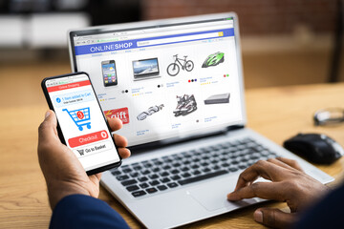
Trade Marketing
Store layouts : instore and e-commerce retail sales worldwide ( Trillions of US $ )
Value of instore and e-commerce retail sales ( US $ ) worldwide between
2021 - 2025
In 2021, the global in-store or brick-and-mortar retail channel generated an estimated 19.1 trillion U.S. dollars in sales. Total retail sales (online and offline retail) worldwide amounted to around 24.2 trillion U.S. dollars that year. By 2025, it is estimated that the value of e-commerce retail sales will reach 8.5 trillion U.S. dollars on a global scale.
Source : Statista 2022

Slide 17
Trade Marketing
Global Retail Development Index
 | Launch | Growth | Maturity | Decline
GRDI Priority
Definition | Expanding middle class consumers willing to engage explorer organise formats Governments relax restrictions | Consumers are more aware and seek organise formats with greater exposure to global practises retail shopping districts are evolving Real estate is yet affordable and available | consumer spending is expanding significantly retail estate is becoming difficult to secure and expensive local competition has become sophisticated | Consumers are comfortable with modern retail practises Discretionary spending is high Competition is fierce from both local and foreign retailers Real estate is expensive and not available
Mode of entry | Minority investment in local retailer | Organic Similar to directly operated stores. | organic growth slows and are focused more on Tier 2 and tier three cities | Acquisition
Labour strategy | Identify locally available skilled labour for management roles | Higher train and retain local talent with an expatriate element . | Shift off talent from expatriate to local stuff | Mainly local stuff
Higher
Lower
Yearly, A. T. Kearney ranks 30 developing nations on a 0- to 100-point Global Retail Development Index (GRDI) scale. Higher-ranked countries represent better opportunities to enter or
expand in that market. The GRDI scores are based on four attributes: market attractiveness (25 percent), country and business risk (25 percent), market saturation (25 percent), and time pressure (25 percent).2 Table A3-1 shows the GRDI scores for the top 10 performing foreign countries. When embarking on an international retailing strategy, firms should consider the various factors shown in Figure A3-1.
Source : https://www.kearney.com/global-retail-development-index/2021

Slide 18
Trade Marketing
Store Formats : Leading retailers worldwide in 2020, by retail revenue ( Bn of US $ )
The retail industry encompasses the journey of a good or service. This typically starts with the manufacture of a product and ends with said product being purchased by a consumer from a retailer. As a result of globalization and various trade agreements between markets and countries, many retailers can do business on a global scale. Based on retail sales generated in the financial year 2020, Walmart was by far the world's leading retailer with retail revenues reaching over 559 billion U.S. dollars.
Based on FY2020 retail revenue (according to source, "financial years ending within the 12 months from 1 July 2020 to 30 June, 2021"). Figures have been rounded. * Estimate. ** Estimate and revenue includes wholesale and retail sales. *** Revenue includes wholesale and retail sales.
Source : https://www.statista.com/statistics/266595/leading-retailers-worldwide-based-on-revenue/

Slide 19
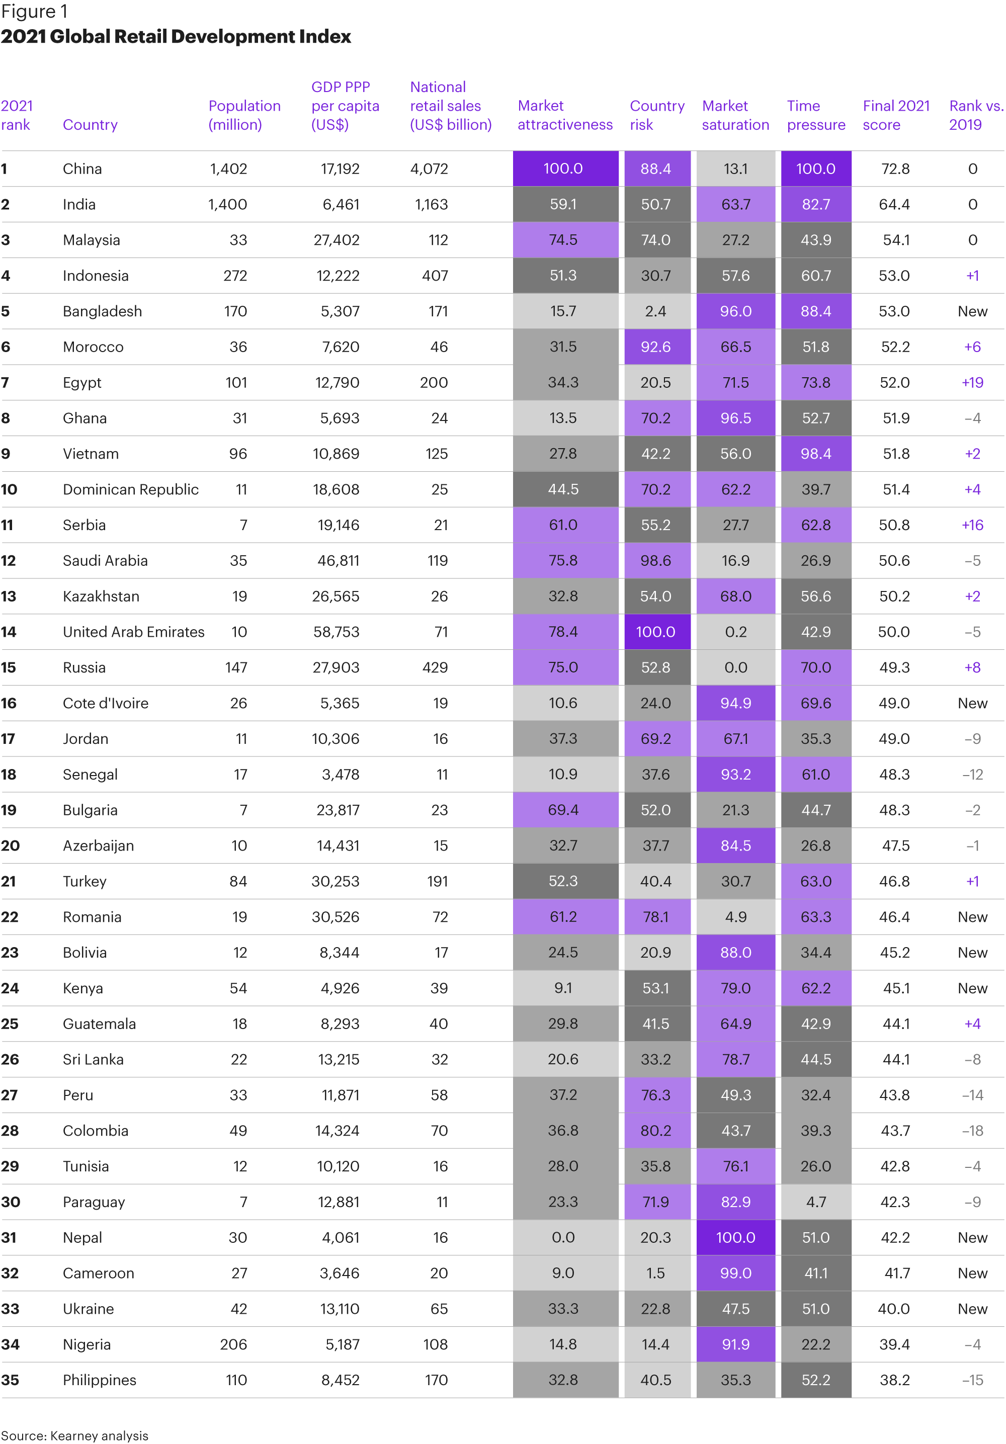
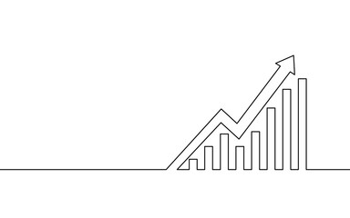
Trade Marketing
Global Retail Development Index - 2021
These are some of the questions Kearney’s Global Retail Development Index (GRDI), which tracks selected emerging retail markets, was created to answer.
Source : https://www.kearney.com/global-retail-development-index/2021

Slide 20
Thank you !

Slide 21
Job Descriptions
Develop roles clearly and completely across varying levels of experience
Agreements
Draft your business agreements across a variety of areas
Templates
Templates are designed based gather information in a structured manner
KPI’s
Performance indicator, a quantifiable measure of performance over time versus a specific objective.
Content Modules
Best practice material in power point for use as a knowledge base in business training , planning and execution .
Strategic tools
These tools are recognised the world over in business schools, consulting firms and companies who plan strategically.
Gain a competitive edge using the best tools and techniques to build a better you .
Analytical Tools
Interactive excel tools on specific business areas based on your data inputs delivered in a workbook model with instructions.
Scorecards
Designed as functional or subject indicators across a variety off situations to enable performance of situational evaluation versus aligned standards.
Calculators
calculate the right ratios for businesses looking for benchmarks in a variety of situations
Assessments
Assessments are designed around specific areas to conduct reviews and will center around a benchmark reviewing individuals or functions
Checklists
Designed around achieving milestones in a sequential manner.
Research
Research tools for sales and marketing engagement

Slide 22
Trade Marketing.
Stores & Formats
Sales & Marketing Fundamentals.
UpskilPRO e Institute for Sales & Marketing
Tools, Content & Templates
Hand built using experience & insight

