Slide 1

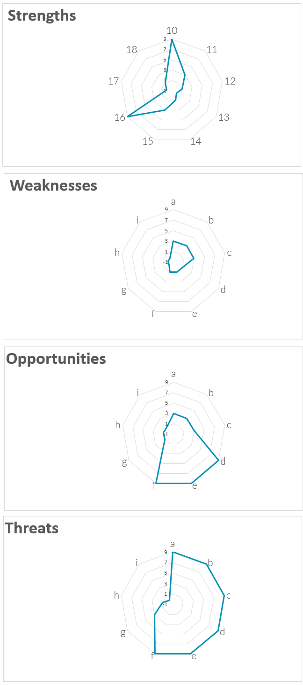
SWOT Analysis
Build, engage and communicate your SWOT analysis to make better decisions
UpskilPRO e Institute for Sales & Marketing
Tools, Content & Templates
Hand built using experience & Insight

Slide 2
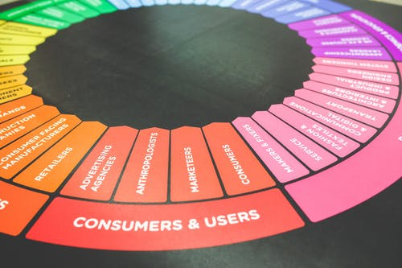



Created by
ex-Procter & Gamble, Rothmans, BAT, Gillette, Nokia,
Microsoft & 3M managers.
UpskilPRO tools are designed in easy-to-use solutions, all you need to do is download the tool and get to work immediately . All UpskilPRO material has taken 100’s of hours and many 1000’s of $ to build , all this expertise and content is brought to you for a fraction of the cost to help professionals enhance their capability.
core areas which are best suited to improve using our tools:
        Subject matter expertise
        Best practices
        Analytical output & charting
        Prioritization
        Process
Capability enhancement tools for
Consumer Marketing, Trade Marketing &
Sales excellence professionals.
Tools in one place to get 10X productive now.

Slide 3


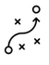

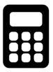
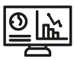
Job Descriptions
Develop roles clearly and completely across varying levels of experience
Agreements
Draft your business agreements across a variety of areas
Templates
Templates are designed based gather information in a structured manner
KPI’s
Performance indicator, a quantifiable measure of performance over time versus a specific objective.
Content Modules
Best practice material in power point for use as a knowledge base in business training , planning and execution .
Strategic tools
These tools are recognised the world over in business schools, consulting firms and companies who plan strategically.
Gain a competitive edge using the best tools and techniques to build a better you .
Analytical Tools
Interactive excel tools on specific business areas based on your data inputs delivered in a workbook model with instructions.
Scorecards
Designed as functional or subject indicators across a variety off situations to enable performance of situational evaluation versus aligned standards.
Calculators
calculate the right ratios for businesses looking for benchmarks in a variety of situations
Assessments
Assessments are designed around specific areas to conduct reviews and will center around a benchmark reviewing individuals or functions
Checklists
Designed around achieving milestones in a sequential manner.
Research
Research tools for sales and marketing engagement

Slide 4
2017
2018
100’s of tools grouped in 12 categories, 50 tool types and 12 business functions in 1 place.
get 10X productive now !
Categories
Functions
Analytical Tools
Types
Business Development
Agreements
Advertising
Customer Acquisition
Margins
Partner Search
Reports
Category Management
Assessments
Agreements
Customer Management
Market Analysis
Persona Development
Retail Measurement
Channel Management
Content Modules
Analytics
Distribution
Market Development
Planning
Reviews
Distribution
Checklists
Barriers
Distributor Management
Market Research
Positioning
Sales Management
Distributor Management
Calculators
Business Reviews
Forecasting
Market Segmentation
Pricing
Scorecards
General Management
Job Descriptions
Business Intelligence
GAP Analysis
Market Size
Prioritization
Segmentation
Key Account Management
KPI’s
Channels
Go To Market
Marketing
Product Development
Six Sigma
Marketing
Research
Communication
Job Descriptions
Marketing Comms
Product Life Cycle
Socio Economic Classification
Marketing Operations
Strategic Tools
Competitive Evaluation
Key Account Plans
Merchandising
Profit & Loss
Territory Design
Sales Management
Scorecards
Competitive Intelligence
Management Summary
New Market Entry
Promotions
Trade Marketing
Shopper Marketing
Templates
Trade Marketing

Slide 5
SWOT Analysis
Build, engage and communicate your SWOT analysis to make better decisions

Slide 6
“SWOT is cool, but strategic thinkers know there is a point when :- strengths become weaknesses , weaknesses become strengths - opportunities become threats and threats become opportunities.
Strategic concentrators and leaders find the greatest insights hiding behind SWOT”
- Richie Norton -

Slide 7
Strategic Analysis Tool
SWOT Analysis
What Is a SWOT Analysis?
SWOT stands for Strengths, Weaknesses, Opportunities, and Threats, and so a SWOT Analysis is a technique for assessing these four aspects of your business.
You can use SWOT Analysis to make the most of what you've got, to your organization's best advantage. And you can reduce the chances of failure, by understanding what you're lacking, and eliminating hazards that would otherwise catch you unawares.
Better still, you can start to craft a strategy that distinguishes you from your competitors, and so compete successfully in your market.

Slide 8
Account Management & Marketing Planning.
SWOT Analysis
5
The marketing audit is a method of determining what the company’s marketing objectives and strategies should be based on the evaluation of all the elements .
One key strategic tool employed is the SWOT analysis .
A SWOT analysis is an audit into 4 key strategic areas in reference to your business.
A SWOT is a summary of the audit under the headings, internal strengths, and weaknesses as they relate to external opportunities and
threats.
The SWOT should be conducted for each segment that is considered to be important in the company’s future. Each entry or SWOT These SWOT analyses should, if possible,
contain just a few lines of observations focusing on key factors only. They should highlight internal differential strengths and weaknesses versus competitors and key external opportunities and threats.
A summary of reasons for good or bad performance should be included. They
should be evaluative and concise statements, add relevant and important data, and interpret using relative scores or evaluative engagement.
Helpful
Harmful
Internal
Strengths
Weakness
External
Opportunities
Threats

Slide 9
Strategic Analysis Tool
SWOT Analysis
Strengths
Are things that your organization does particularly well, or in a way that distinguishes you from your competitors , basically the advantage your organization has over other organizations. These will and can include , IP , Trademarks , Patents , Geographical reach , Talent , A&P, or superior marketing .
Your strengths are an integral part of your organization, " Aspects of what we are better at than anyone else ! values that drive the business? low-cost resources , Strong market share ,
Then turn your perspective around and ask yourself what your competitors might see as your strengths. What factors mean that you get the sale ahead of them?
Remember, any aspect of the organization deemed a strength is only so because it brings you a clear competitive advantage. For example, if all of your competitors provide high-quality products, then a high-quality production process is not a strength in your market: it's a basic necessity.
Weaknesses
A SWOT is viewed purely from the internal perspective.
A SWOT Analysis Is based on all the information such as .
Weaknesses, like strengths, are inherent features of your organization,
people, resources, systems, and procedures. Dwell on the improvement aspects or the gaps , review what you could improve and the practices you should avoid.
The next steps is to look at it from the outside towards the inside , better so from your critical or competitive perspective, and reflect on why your competitors are doing better than you.
Internal FACTORS
Opportunities
Opportunities are openings or chances for something positive to happen, but you'll need to claim them for yourself!
They usually arise from situations outside your organization and require an eye to what might happen in the future. They might arise as developments in the market you serve, or in the technology you use. Being able to spot and exploit opportunities can make a huge difference to your organization's ability to compete and take the lead in your market.
Think about good opportunities you can spot immediately. These don't need to be game-changers: even small advantages can increase your organization's competitiveness. What interesting market trends are you aware of, large or small, which could have an impact?
You should also watch out for changes in government policy related to your field. And changes in social patterns, population profiles, and lifestyles can all throw up interesting opportunities.
Threats
Threats include anything that can negatively affect your business from the outside, such as supply chain problems, shifts in market requirements, or a shortage of recruits. It's vital to anticipate threats and to act against them before you become a victim of them and your growth stalls.
Think about the obstacles you face in getting your product to market and selling. You may notice that quality standards or specifications for your products are changing, and that you'll need to change those products if you're to stay in the lead. Evolving technology is an ever-present threat, as well as an opportunity!
Always consider what your competitors are doing, and whether you should be changing your organization's emphasis to meet the challenge. But remember that what they're doing might not be the right thing for you to do and avoid copying them without knowing how it will improve your position.
Be sure to explore whether your organization is especially exposed to external challenges. Do you have bad debt or cash-flow problems, for example, that could make you vulnerable to even small changes in your market? This is the kind of threat that can seriously damage your business, so be alert.
External FACTORS

Slide 10
Strategic Analysis Tool
SWOT Analysis
6013
Strength
Weakness
What advantages do our organization represent
Key Features
Technologies and Resources
USP
Market share
Profitability
Patents
Pipeline
High A&M Ratio
Competitive advantages
Brand share
Corporate brand awareness
Company staff , How ready are they for the market in terms of training and qualification
Troubling internal trends
Under investments
Operational pain points
Issues in functions
Marketing or sales strategy gaps
Customer feedback
Category trends
Highest scores
Prevention of growth and improvement
Internal FACTORS
Opportunities
Threats
Trends
Opportunities without solutions
Government
Lifestyle
Population
Health
Our performance in relation to economic boom - bust cycles
Legislation
Regulations
Organizational culture
Product or service compatibility with market expectations
Opportunities = Creative solutions
Potential and real threats
External FACTORS
You can also use the excel equivalent of this tool found under serial no 6013

Slide 11
Strategic Analysis Tool
SWOT Analysis
You can also use the excel equivalent of this tool found under serial no 6013
www.upskilpro.com

Slide 12
SWOT Analysis
Build, engage and communicate your SWOT analysis to make better decisions
UpskilPRO e Institute for Sales & Marketing
Tools, Content & Templates
Hand built using experience & Insight

