Slide 1
Segmentation
Prioritization Matrix
Use a prioritization matrix to drive your efforts and resource utilization
Planning Templates
UpskilPRO e Institute for Sales & Marketing
Tools, Content & Templates
Hand built using experience & Insight

Slide 2
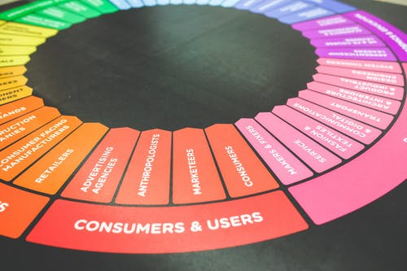
Created by
ex-Procter & Gamble, Rothmans, BAT, Gillette, Nokia,
Microsoft & 3M managers.
UpskilPRO tools are designed in easy-to-use solutions, all you need to do is download the tool and get to work immediately . All UpskilPRO material has taken 100’s of hours and many 1000’s of $ to build , all this expertise and content is brought to you for a fraction of the cost to help professionals enhance their capability.
core areas which are best suited to improve using our tools:
Subject matter expertise
Best practices
Analytical output & charting
Prioritization
Process
Capability enhancement tools for
Consumer Marketing, Trade Marketing &
Sales excellence professionals.
Tools in one place to get 10X productive now.

Slide 3
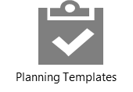
Segmentation
Prioritization matrix
8034
8034 Product Life Cycle Prioritization Matrix.
This product is a template
A Template is a pre-planned and organised way to collect information for presentation in a neat and structured manner
Your Concern.
How to prioritize initiatives to apply scarce resources?
How will this tool benefit you?
We have used the 4-quadrant approach to delivering the possibilities of growing, by applying scare resources across designed quadrants which give you the ideal mix of applying resources to initiatives and prioritizing them in a logical order.,
Each quadrant will deliver you a few solutions which are related to initiatives over work
Key Benefits
High level co-ordination between silo functions, countries, and engagement between teams
Covers specific high-level areas across subjects
Presents well-structured layout for decision making
Save 2 hours on formatting
Saves many hours of aligning strategies and industry traits
Saves many hours searching for comphrensive information
Report ready format

Slide 4
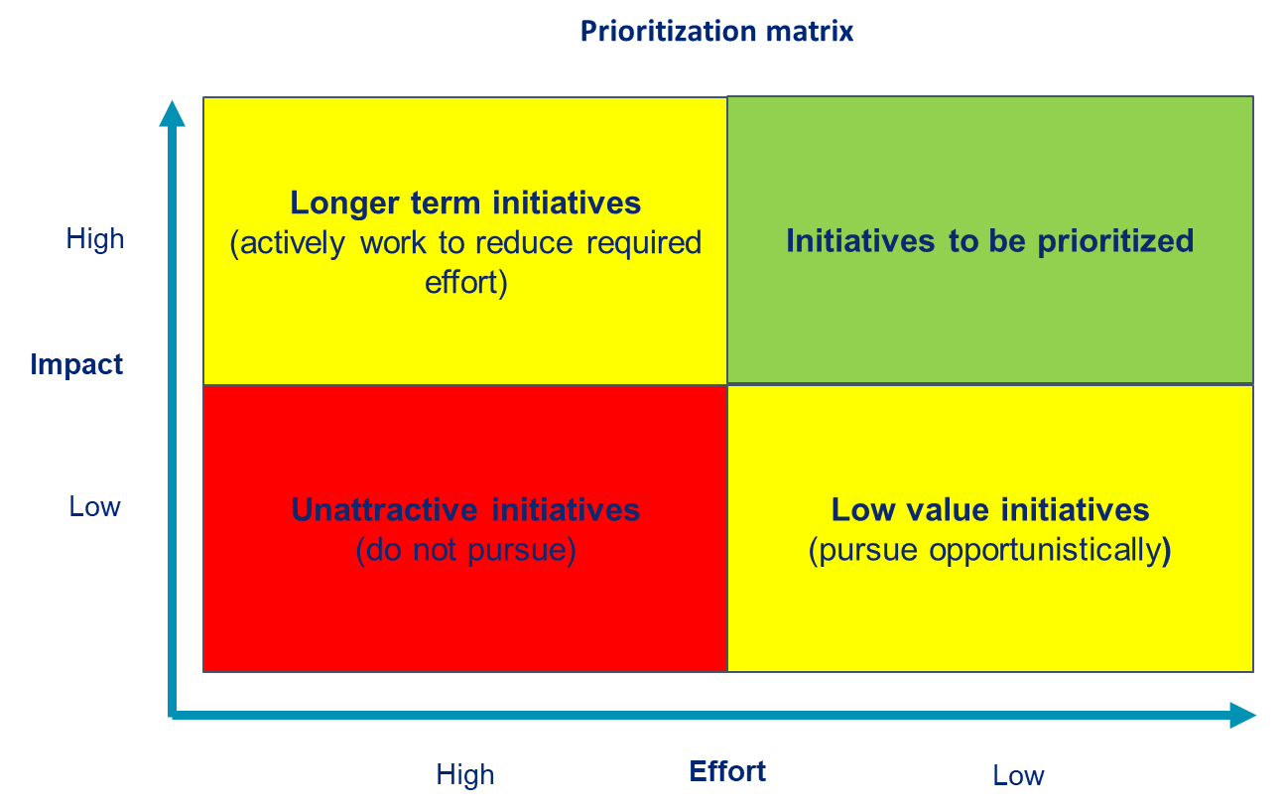
Segmentation
Prioritization matrix
8034
The Segmentation Prioritization Matrix is a strategic tool used by businesses to identify and prioritize target market segments based on various criteria such as market size, growth potential, profitability, accessibility, and compatibility with the company's resources and capabilities.
It involves categorizing potential market segments into different quadrants or tiers based on their attractiveness and feasibility for targeting. High-priority segments typically exhibit characteristics such as
substantial size,
rapid growth,
high profit margins, and
alignment
with the company's strengths and objectives. By utilizing the Segmentation Prioritization Matrix, businesses can allocate resources more effectively, tailor marketing efforts, and maximize returns on investment by focusing on segments with the greatest potential for success.

Slide 5
Segmentation
Prioritization matrix
8034
In relation to the Segmentation Prioritization Matrix, businesses typically implement initiatives across multiple levels to effectively target and prioritize market segments. These initiatives can be categorized into three main levels:
Strategic Initiatives:
Market Research and Analysis: Conducting thorough market research to understand customer needs, preferences, behaviors, and trends across various segments.
Segmentation Analysis: Analyzing demographic, psychographic, geographic, and behavioral data to segment the market into distinct groups with similar characteristics and needs.
Competitive Analysis: Evaluating competitors' strategies, strengths, weaknesses, and market positioning to identify opportunities and threats in target segments.
Setting Objectives: Establishing clear and measurable objectives for market segmentation and targeting efforts, aligning them with overall business goals and objectives.
Tactical Initiatives:
Segment Prioritization: Using the Segmentation Prioritization Matrix to assess and prioritize market segments based on criteria such as size, growth potential, profitability, and compatibility with organizational resources and capabilities.
Targeting Strategies: Developing targeted marketing strategies and tactics tailored to the needs, preferences, and characteristics of priority segments.
Product Customization: Adapting products, services, pricing, distribution channels, and promotional messages to resonate with the specific needs and preferences of target segments.
Customer Relationship Management (CRM): Implementing CRM systems and processes to track customer interactions, preferences, and behaviours, and personalize marketing efforts accordingly.
Operational Initiatives:
Implementation Planning: Developing detailed action plans and timelines for executing segmentation and targeting initiatives, allocating resources, and assigning responsibilities.
Marketing Campaign Execution: Implementing marketing campaigns across various channels such as digital, social media, traditional advertising, and direct marketing to reach and engage target segments effectively.
Performance Measurement: Monitoring key performance indicators (KPIs) such as customer acquisition, retention, satisfaction, and profitability to evaluate the effectiveness of segmentation and targeting strategies.
Continuous Improvement: Gathering feedback, analyzing results, and making adjustments to segmentation and targeting initiatives based on insights and lessons learned to optimize performance and maximize ROI.
By implementing initiatives across these three levels, businesses can systematically identify, prioritize, and target market segments to achieve their strategic objectives and drive sustainable growth in competitive markets.

Slide 6
Always aim to conserve resource and be in the High / High box at extreme left . High impact Effort low
Segmentation
Prioritization matrix
Prioritization matrix
8034
Longer term initiatives (actively work to reduce required effort)
Initiatives to be prioritized
High
Impact
Unattractive initiatives (do not pursue)
Low value initiatives (pursue opportunistically)
Low
High
Effort
Low
The focus should be on the initiatives that have the greatest impact and require the lowest effort

Slide 7
2017
2018
100’s of tools grouped in 12 categories, 50 tool types and 12 business functions in 1 place.
get 10X productive now !
Categories
Functions
Analytical Tools
Types
Business Development
Agreements
Advertising
Customer Acquisition
Margins
Partner Search
Reports
Category Management
Assessments
Agreements
Customer Management
Market Analysis
Persona Development
Retail Measurement
Channel Management
Content Modules
Analytics
Distribution
Market Development
Planning
Reviews
Distribution
Checklists
Barriers
Distributor Management
Market Research
Positioning
Sales Management
Distributor Management
Calculators
Business Reviews
Forecasting
Market Segmentation
Pricing
Scorecards
General Management
Job Descriptions
Business Intelligence
GAP Analysis
Market Size
Prioritization
Segmentation
Key Account Management
KPI’s
Channels
Go To Market
Marketing
Product Development
Six Sigma
Marketing
Research
Communication
Job Descriptions
Marketing Comms
Product Life Cycle
Socio Economic Classification
Marketing Operations
Strategic Tools
Competitive Evaluation
Key Account Plans
Merchandising
Profit & Loss
Territory Design
Sales Management
Scorecards
Competitive Intelligence
Management Summary
New Market Entry
Promotions
Trade Marketing
Shopper Marketing
Templates
Trade Marketing

Slide 8
Job Descriptions
Develop roles clearly and completely across varying levels of experience
Agreements
Draft your business agreements across a variety of areas
Templates
Templates are designed based gather information in a structured manner
KPI’s
Performance indicator, a quantifiable measure of performance over time versus a specific objective.
Content Modules
Best practice material in power point for use as a knowledge base in business training , planning and execution .
Strategic tools
These tools are recognised the world over in business schools, consulting firms and companies who plan strategically.
Gain a competitive edge using the best tools and techniques to build a better you .
Analytical Tools
Interactive excel tools on specific business areas based on your data inputs delivered in a workbook model with instructions.
Scorecards
Designed as functional or subject indicators across a variety off situations to enable performance of situational evaluation versus aligned standards.
Calculators
calculate the right ratios for businesses looking for benchmarks in a variety of situations
Assessments
Assessments are designed around specific areas to conduct reviews and will center around a benchmark reviewing individuals or functions
Checklists
Designed around achieving milestones in a sequential manner.
Research
Research tools for sales and marketing engagement

Slide 9
Segmentation
Prioritization Matrix
Use a prioritization matrix to drive your efforts and resource utilization
Planning Templates
UpskilPRO e Institute for Sales & Marketing
Tools, Content & Templates
Hand built using experience & Insight

