Slide 1
Scorecard – Channel Distribution
Establish new channel baseline areas to ascertain alignment with objectives
UpskilPRO e Institute for Sales & Marketing
Tools, Content & Templates
Hand built using experience & insight

Slide 2
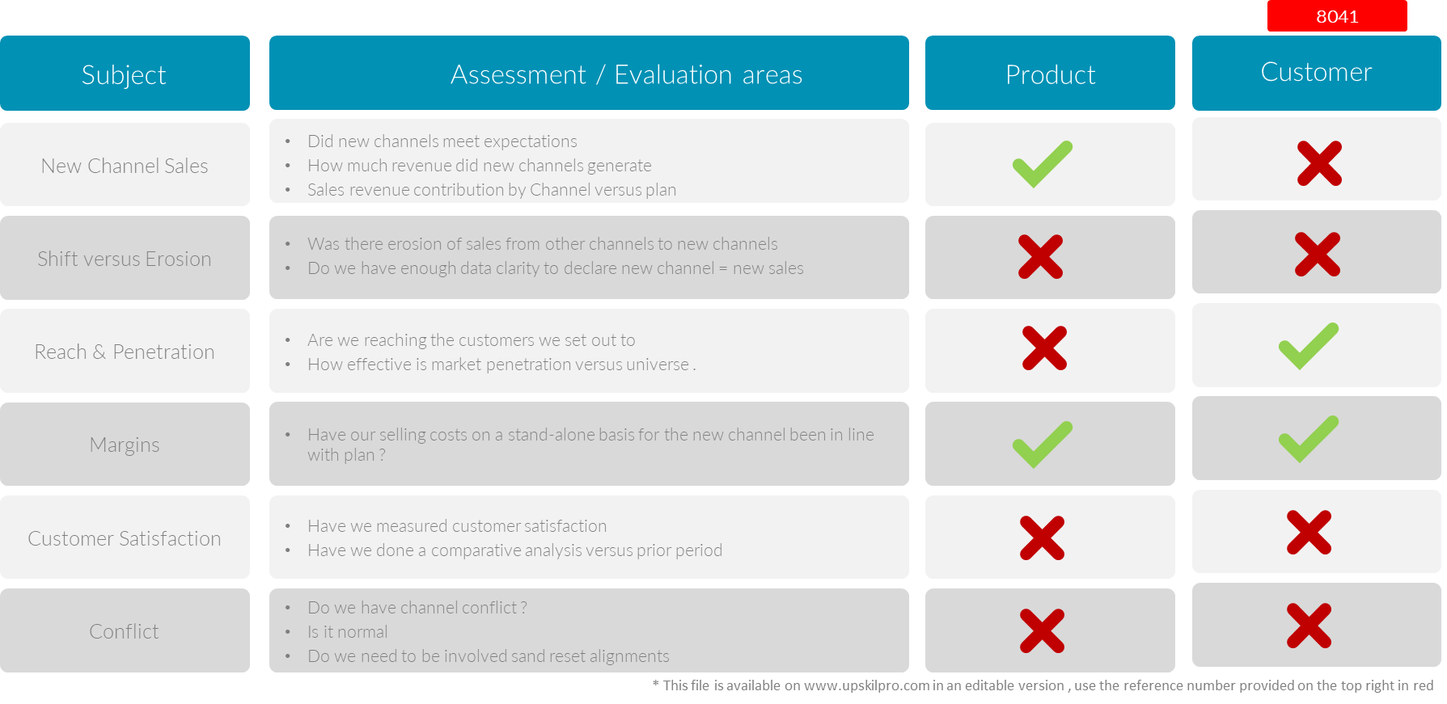
Channels of distribution
Scorecard – New Channel Baseline Management Areas.
3006

Slide 3
Scorecard – Channel Distribution
Establish new channel baseline areas to ascertain alignment with objectives
UpskilPRO e Institute for Sales & Marketing
Tools, Content & Templates
Hand built using experience & insight

