Slide 1
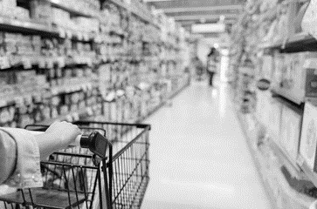
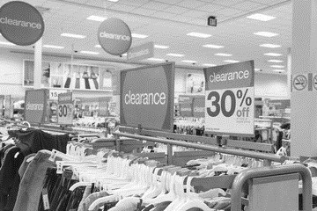
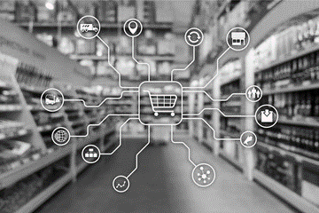
Trade Marketing
Fundamentals
Introduction
Sales & Marketing Fundamentals.
UpskilPRO e Institute for Sales & Marketing
Tools, Content & Templates
Hand built using experience & insight
Notes:
If you have been in a retailer recently and have been talked to by a person at the category inviting, you to try out the product then chances are you have experienced trade marketing as a consumer
Welcome to trade marketing. My name is sudarshan and I will be your host to help you in your exciting journey of trade marketing.

Slide 2
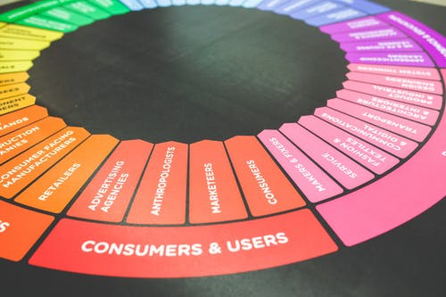
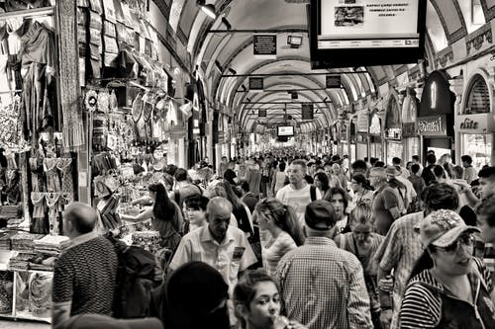
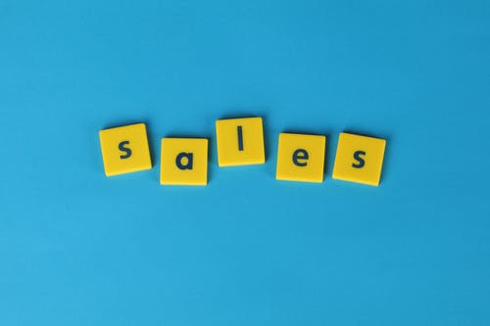
Created by
ex-Procter & Gamble, Rothmans, BAT, Gillette, Nokia,
Microsoft & 3M managers.
UpskilPRO tools are designed in easy-to-use solutions, all you need to do is download the tool and get to work immediately . All UpskilPRO material has taken 100’s of hours and many 1000’s of $ to build , all this expertise and content is brought to you for a fraction of the cost to help professionals enhance their capability.
core areas which are best suited to improve using our tools:
Subject matter expertise
Best practices
Analytical output & charting
Prioritization
Process
Training
Making life simpler for
Sales & Marketing professionals.
Sales & Marketing Fundamentals.
Tools in one place to get 10X productive now.
Notes:
Before we start.
We are UpskilPRO a company created by
ex-Procter & Gamble, Rothmans, BAT, Gillette, Nokia,
Microsoft & 3M managers.
Our goal is to make life simpler for sales and marketing professionals in their learning and development journey

Slide 3
Trade Marketing Fundamentals
Material Breakdown.
Introduction
Touch Points
The Eco system
Responsibilities
Objectives
Functional Engagement
Trade Marketing Mix
Engaging TM
Knowing your Target Market
Process & Tactics
Notes:
We have 10 smaller modules in the Fundamentals of trade marketing Module. From Introduction all the way down to Process & tactics.
In this module we shall cover Introduction.

Slide 4
Introduction

Slide 5
Trade Marketing Fundamentals
Trade Marketing Engagement.
Brand marketing talks to people , Trade Marketing talks with them.
Category
POS
Retailer
Consumer
ROI
Promotions
Notes:
So how do you distil the effect of what marketing does in 2 lines ?
Marketing talks to people through various mediums
Trade Marketing talks with people
That is the key difference.

Slide 6
Trade Marketing Fundamentals
What is trade marketing.
Trade marketing represents a specialized facet of marketing dedicated to aligning with the overarching marketing strategy.
It revolves around constructing a range of engagement mechanisms designed to involve both the trade and ultimate consumers.
The primary objective of trade marketing is to establish compelling opportunities for product or brand engagement, with consumers to interact and consume products and services.
Simultaneously, it aims to foster an environment conducive to purchasing within the relevant trade channels.
Notes:
Let's get some basics in place
Trade marketing aligns with marketing strategy and its built around various forms of engagement with the consumer.
The Key Objectives are built around Product or brand engagement fostering an eventual product or service purchase

Slide 7
Trade Marketing Fundamentals
What is trade marketing.
Which box signifies trade marketing ?
A
B
It’s nothing but sales in another form.
Sales divested some of their responsibilities.
Marketing reduced some of their responsibilities.
Management of wholesalers mainly.
Builds and delivers engagement with consumers
Works closely with customers to build meaningful relationships & promotions
Works with the strategic vision of marketing
Works to Category priorities aligning them to customers.
Notes:
Let's do a quick check in ahead of time!
Treat this more of a quick orientation…
Look at both boxes , and let us know which box relates closely to Trade Marketing , Is it Box A or Box B ?

Slide 8
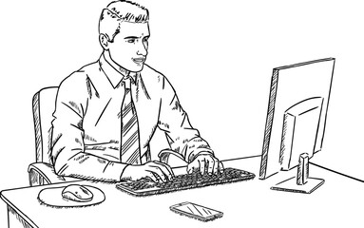
Trade Marketing Fundamentals
Customer versus Consumer.
Consumer
Is a person who buys and consumes the product ultimately , a consumer acts on a deep insight of a brand and what values it offers.
Example
It can be a decision maker in a family
A member of the family who acts on behalf of the family
It can be in a B2B context the electrician who buys the electrical supplies for using in a job
Common aspect : the same person buys and consumes the product
Customer
In trade marketing, the term "customer" can refer to different entities depending on the context, but it typically encompasses
Example
Retailers: These are businesses that sell products directly to consumers. It can be a neighborhood grocer buying in bulk to take to his convenience store
Distributors: These are intermediaries who purchase products from manufacturers and sell them to retailers or other businesses The shopper can be using a shopping list and buying for another person
Wholesalers: Similar to distributors, wholesalers buy products in bulk from manufacturers and sell them to retailers
Trade Partners: This broader category includes any business entity involved in the supply chain
Common aspect : While all the above are customers , they play different roles in the value chain based on their capabilities and competencies.
Trade Marketing Fundamentals : 7031 Source – upskilPRO.com
Notes:
Now we should get 2 roles right , this will help you understand the influences each has on trade marketing
Customers – They are the ones who sell to your consumer , good examples Carrefour , Walmart , 7/11 , BP , ESSO , customers essentially buy and resell the product to consumers
Consumers – If you have bought something from a retailer , then you have played the role of a consumer , essentially you consumer the product.

Slide 9
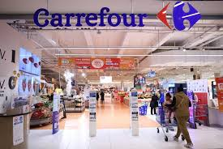
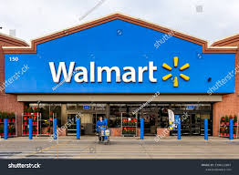
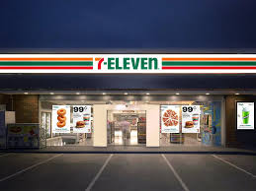
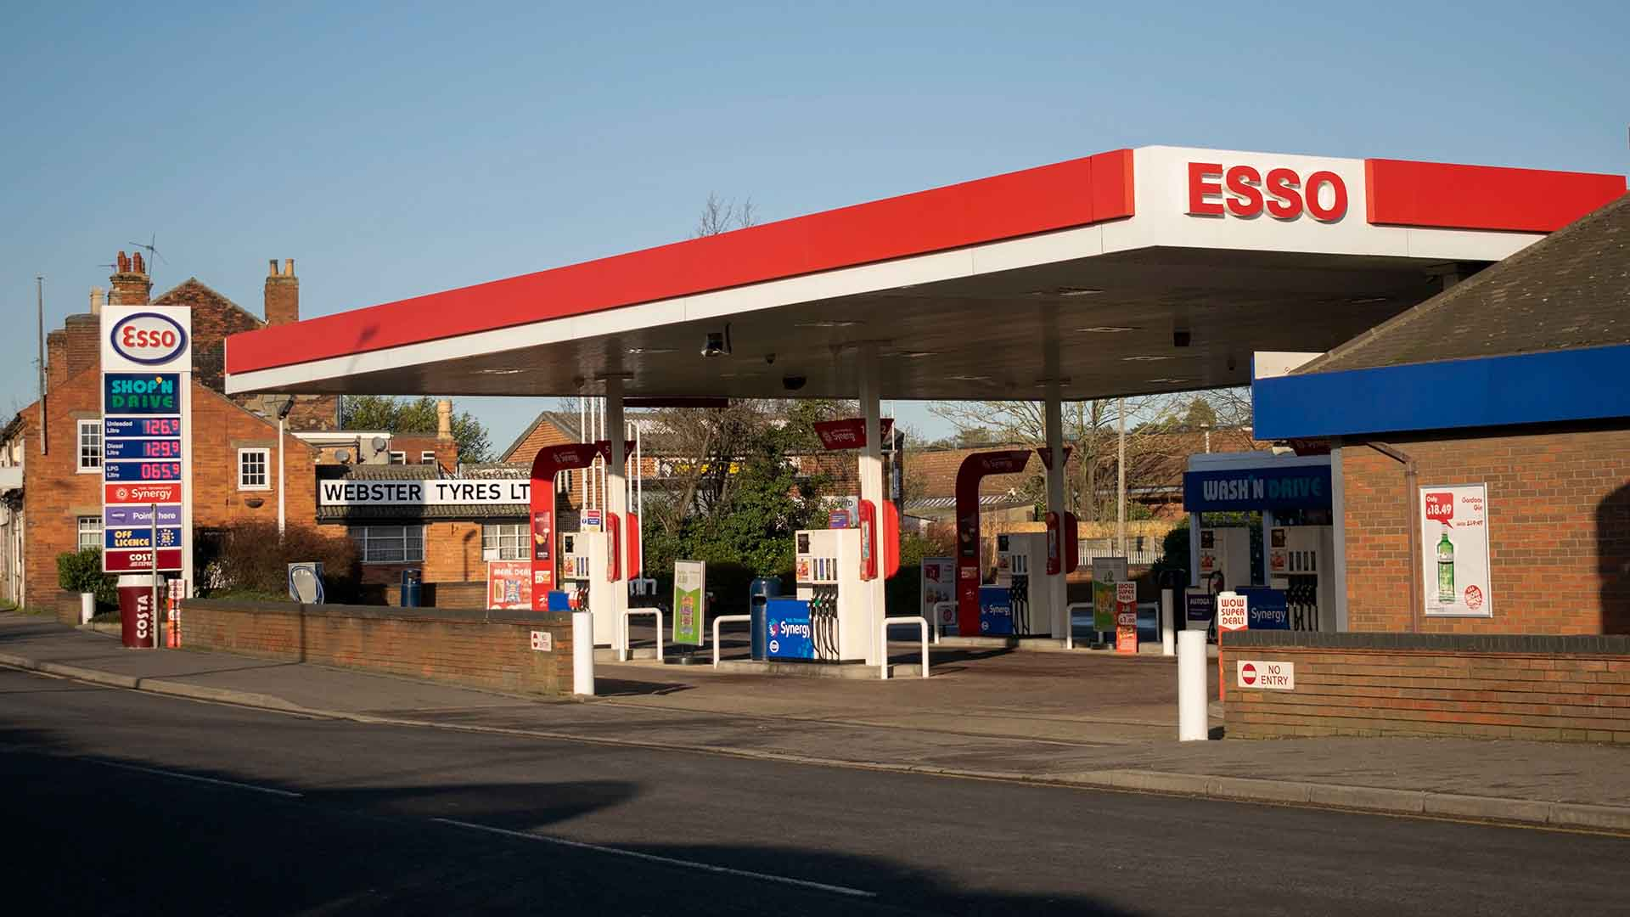
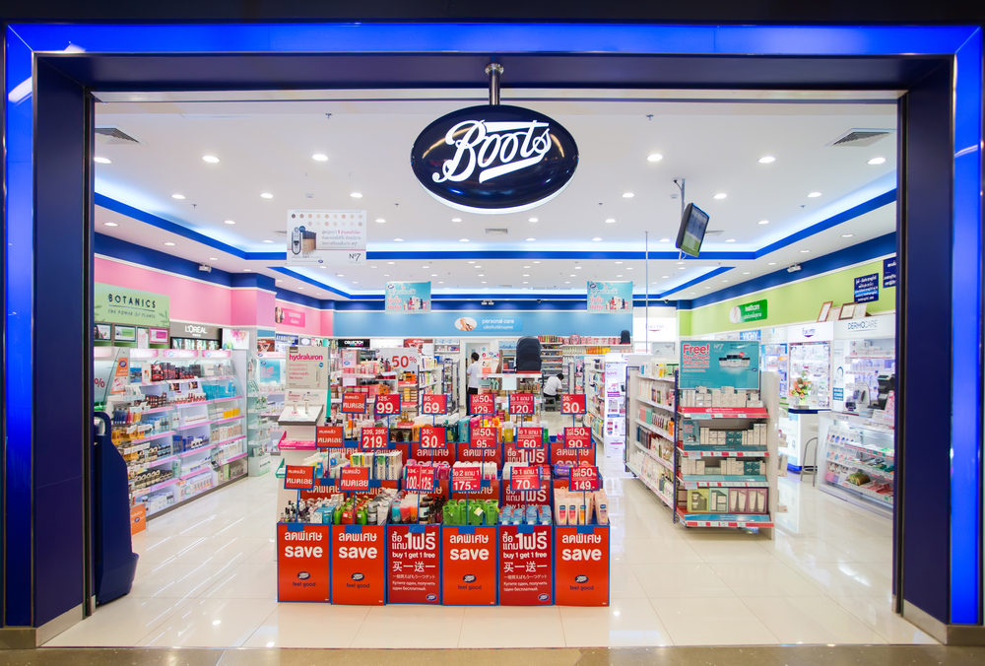
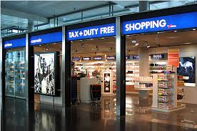
Trade Marketing Fundamentals
Customers.
Notes:
Here are some examples of customers.
The Top 3 are retailers called supermarkets , ESSO is a Gas Station retailer , Boots is a Pharmacy and We have a duty-free example, essentially all are retailers in different forms catering to different needs

Slide 10
Trade Marketing Fundamentals
Consumers.
Notes:
Here are some examples of consumers.
Consumers – If you have bought something from a retailer , then you have played the role of a consumer , essentially you consumer the product.
You could be a housewife, Husband , Back to School shopper , or even a customer on the way home who is buying product for home.
Essentially its the role each one of us plays

Slide 11
Trade Marketing Fundamentals
Trade Marketing Engagement .
Consumer
Brand Owner
Manufacturer
Trade marketing is centered on analyzing and influencing consumer purchasing behaviors directly within the customer's premises.
This approach aims to understand how consumers make buying decisions in-store, optimizing marketing strategies to enhance product visibility, appeal, and sales performance at the point of purchase.
By closely examining shopping patterns and preferences, trade marketing efforts can effectively tailor promotions, displays, and pricing to align with consumer needs and drive sales growth
Trade Channel
Trade
Marketing engagement
Consumer
Notes:
Let's stop to add 3 more learning points
On the top you see various forms of distribution channels
In the middle you see the interaction of the channel , the brand owner and the consumer
The arrow pointing to the middle is the area of trade marketing engagement

Slide 12
Trade Marketing Fundamentals
Trade Marketing Engagement .
Sales / KAM
The role of marketing ,trade marketing, brand marketing ,shopper marketing and category management are ultimately focused on the consumer .
Trade marketing and category management are critical because about 2/3rds of the decision to buy is made at the category or point of sale.
The existence of the trade marketing function indicates the organisations have matured and are focused on developing brand to customer relationships with the intention of increasing brand share along with medium to long term profitability.
Retailer
Shopper
Marketing
Trade Marketing
Engagement before the category
Consumer
Engagement at the category
Marketing
Trade Marketing Fundamentals : 7031 Source – upskilPRO.com
Notes:
Now that you have the roles clarified let's put it into perspective
Sales sells into the retailer
Marketing communicates to the consumer
Trade Marketing engages with shopper in the retail environment
The Shopper buys from categories

Slide 13
Trade Marketing Fundamentals
Key Points.
Key points
Trade marketing works closely with both customers and consumers.
It plays a pivotal role in introducing , promoting and communicating brands and services to consumers .
Trade marketing works across many channels like retail , wholesale , resellers , etc.
Trade marketing closely aligns with other functions like sales , marketing , research etc. to optimize the functional delivery
Trade marketing has a clear differentiation from other functions
Notes:
With this we come to end of our mini module , so let's spend a moment to cover the key learnings
TM works with consumers and customers
TM works across different prioritized channels
TM works with consumers especially
&
TM is an integrative function which works closely with allied functions
I enjoyed being your host and look forward to seeing you at the next module.
Until then Keep well and be safe.

Slide 14
Trade Marketing Fundamentals
Introduction
Sales & Marketing Fundamentals.
UpskilPRO e Institute for Sales & Marketing
Tools, Content & Templates
Hand built using experience & insight
Notes:
It was great having you on Trade Marketing Fundamentals ( Introduction ) , don’t forget to like and subscribe to our channel and wherever you are, have a great day and be safe.
Want to know more visit our site www.upskilPRO.com or simply write to us at hello@upskilPRO.com

