Slide 1


Additional Value
Monitor
Stakeholders
Marketing.
Strategic Plan
1 Page Strategic Plan.
Business
Metrics
Communication
Reviews
Sales & Marketing Fundamentals.
UpskilPRO e Institute for Sales & Marketing
Tools, Content & Templates
Hand built using experience & insight

Slide 2
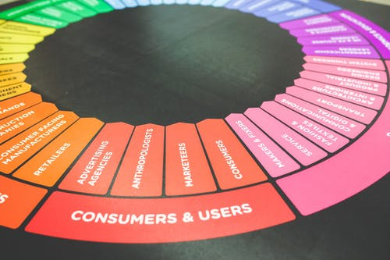



Created by
ex-Procter & Gamble, Rothmans, BAT, Gillette, Nokia,
Microsoft & 3M managers.
UpskilPRO tools are designed in easy-to-use solutions, all you need to do is download the tool and get to work immediately . All UpskilPRO material has taken 100’s of hours and many 1000’s of $ to build , all this expertise and content is brought to you for a fraction of the cost to help professionals enhance their capability.
core areas which are best suited to improve using our tools:
        Subject matter expertise
        Best practices
        Analytical output & charting
        Prioritization
        Process
        Training
Making life simpler for
Sales & Marketing professionals.
Tools in one place to get 10X productive now.

Slide 3


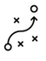

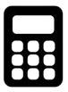

Job Descriptions
Develop roles clearly and completely across varying levels of experience
Agreements
Draft your business agreements across a variety of areas
Templates
Templates are designed based gather information in a structured manner
KPI’s
Performance indicator, a quantifiable measure of performance over time versus a specific objective.
Content Modules
Best practice material in power point for use as a knowledge base in business training , planning and execution .
Strategic tools
These tools are recognised the world over in business schools, consulting firms and companies who plan strategically.
Gain a competitive edge using the best tools and techniques to build a better you .
Analytical Tools
Interactive excel tools on specific business areas based on your data inputs delivered in a workbook model with instructions.
Scorecards
Designed as functional or subject indicators across a variety off situations to enable performance of situational evaluation versus aligned standards.
Calculators
calculate the right ratios for businesses looking for benchmarks in a variety of situations
Assessments
Assessments are designed around specific areas to conduct reviews and will center around a benchmark reviewing individuals or functions
Checklists
Designed around achieving milestones in a sequential manner.
Research
Research tools for sales and marketing engagement

Slide 4
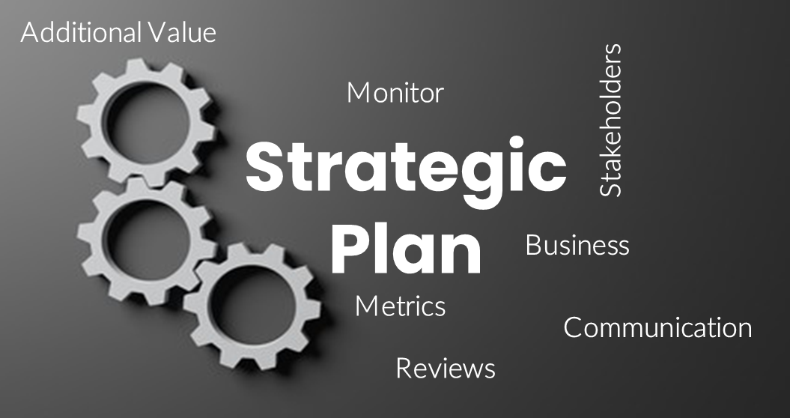
Marketing
Strategic Marketing : One page strategic plan
“ Having a strategic plan ….
It’s what enables you to stay the course , even in times of change.”
- Non-profit CEO
www.upskilpro.com

Slide 5
Marketing Plan
Strategic Marketing : One page strategic plan
7051
identify a short list of key metrics | Plan document and monitor
Communicate with business leaders and stakeholders to establish your business strategy and goals after securing alignment then identify metrics that relate to your preferred outcomes | The metrics and assumptions that underpin your strategy are critical tools for communication simply because they reflect why you're pursuing the target and initiatives are better than alternatives
Set-up a baseline for the metrics on day one and then set-up quarter reviews for a period of 12/20 quarters depending on the importance assigned and for the need to give corporate alignment and strategy time to work . Goals should ideally should be tracked every quarter to remain top of mind and on everyone's priority list | Why is communicating the value drivers for your function it is important that you relate cause and effect relationships and interdependencies to drive home the business ecosystem it is always a good idea to insure do the assumptions are solid with monitoring being done by systems and watch and then sure that day to pick up is not compromised in any manner .
in a typical function we recommend a minimum of three KPI’s or metrics and no more in an extreme situation of seven our recommendation is 3 to 5
www.upskilpro.com

Slide 6
Marketing Plan
Strategic Marketing : One page strategic plan
7051
Key Actions in a strategic plan | Develop and communicate your strategy
Plan your agenda to change the business | While creating your statement aim to position the core element of your strategy in a single statement
Drive value creation beyond the existing business | Plan your communication on getting the elements right in a short statement leaving no ambiguity off purpose.
Consolidate and group smaller projects under key initiatives | Your strategic plan can be documented on a single page making it easy for the whole organisation to understand and refer too.
Plan your overall agenda on business change not business management! The key driver here is to include initiatives which drive incremental but sizeable growth and milestones After identifying initiatives work on setting a project planned for key milestones and completion | Concise Strategic Planning
 | Objective measurement and allocation of performance gaps between strategy development and execution Effective communication for teams that execute Faster and more engaging and collaborative strategy development Optimal planning correction
www.upskilpro.com

Slide 7

Marketing Plan
Strategic Marketing : One page strategic plan
7051
Current State | Plan |  | Planned State
Measure 3 to 5 metrics | 3 to 5 initiatives |  | Measure 3 to 5 targets
Do measure the organisational baseline Establish target state | Do Aim to reconcile conflicting views , establish buy in Focus organisation attention & resources |  | Do Explain the organisations desired state Set goals to determine when end state will be reached
Do not Stress on detailed metrics which are complex and related to daily performance | Do not Go ahead until consensus is reached between all team members |  | Do not Aim for targets which are too far away and not SMART
Example Use a “from” – “to” approach Sale of 3,500 MSU’s to 4,250 MSU”s in calendar year | Example : Implement targeted brand campaign for homecare business |  | Example MSU growth by 20% YOY , however 75% of growth to come from existing customers
 | Example : Implement |  | Example Value share up from 15% to 25% by end of 20XX…
Example Market ( value ) share growth from 11.5% to 15% in 12 months as measure by external agencies | Rationalize – Clear communication Specify goals Allow for course correction | Do not - Create disagreement around strategy.
 | Example : Rebuild and energise our Channel management engagement with top 80% contributing accounts in each channel on a direct basis.
 | Example : Build a new strategic approach with top nominated key accounts to drive corporate objectives and customer engagement.
 | Communicate Do Capture the essence of the strategy in 1 line at most to keep the message crisp. Do not create confusion around the meaning of strategy or mix it with tactics.
www.upskilpro.com

Slide 8
Marketing Plan
Strategic Marketing : One page strategic plan
7051
Current State | Plan | Planned State
Measure 3 to 5 metrics | 3 to 5 initiatives | Measure 3 to 5 targets
 | Rationalize – 3 – 5 assumptions
 | Express as 1 sentence
www.upskilpro.com

Slide 9
Thank you !

Slide 10
Job Descriptions
Develop roles clearly and completely across varying levels of experience
Agreements
Draft your business agreements across a variety of areas
Templates
Templates are designed based gather information in a structured manner
KPI’s
Performance indicator, a quantifiable measure of performance over time versus a specific objective.
Content Modules
Best practice material in power point for use as a knowledge base in business training , planning and execution .
Strategic tools
These tools are recognised the world over in business schools, consulting firms and companies who plan strategically.
Gain a competitive edge using the best tools and techniques to build a better you .
Analytical Tools
Interactive excel tools on specific business areas based on your data inputs delivered in a workbook model with instructions.
Scorecards
Designed as functional or subject indicators across a variety off situations to enable performance of situational evaluation versus aligned standards.
Calculators
calculate the right ratios for businesses looking for benchmarks in a variety of situations
Assessments
Assessments are designed around specific areas to conduct reviews and will center around a benchmark reviewing individuals or functions
Checklists
Designed around achieving milestones in a sequential manner.
Research
Research tools for sales and marketing engagement

Slide 11
Additional Value
Monitor
Stakeholders
Marketing.
Strategic Plan
1 Page Strategic Plan.
Business
Metrics
Communication
Reviews
Sales & Marketing Fundamentals.
UpskilPRO e Institute for Sales & Marketing
Tools, Content & Templates
Hand built using experience & insight

