Slide 1

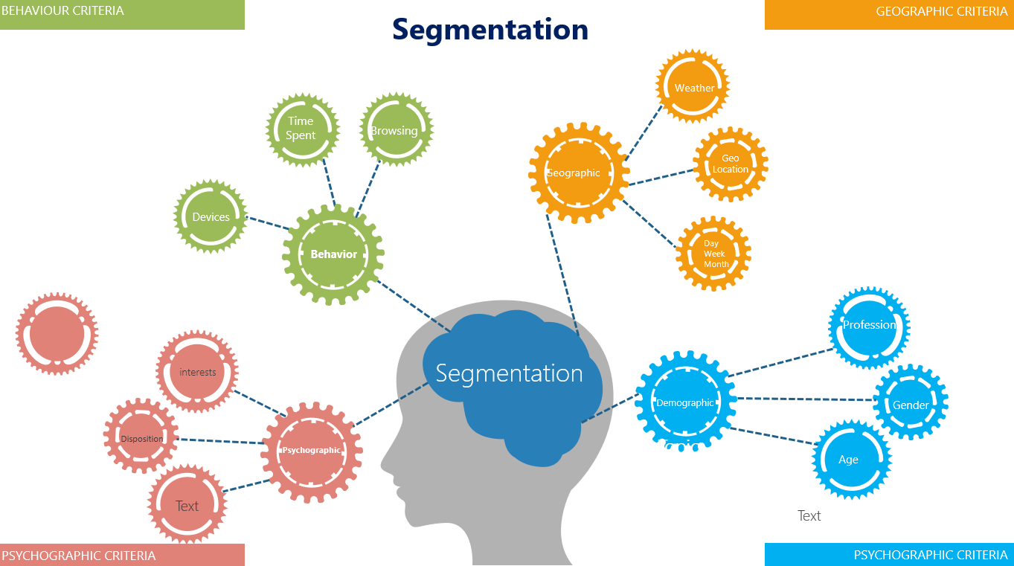
Segmentation
In segmentation we concentrate on establishing the importance of segmentation.
Knowing your consumer takes a sizeable amount of effort
UpskilPRO e Institute for Sales & Marketing
Tools, Content & Templates
Hand built using experience & Insight

Slide 2
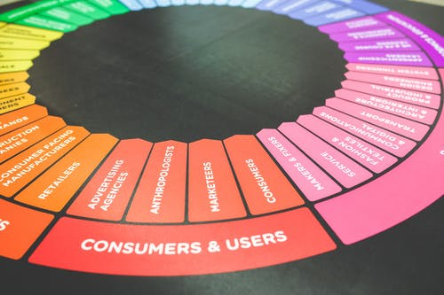



Created by
ex-Procter & Gamble, Rothmans, BAT, Gillette, Nokia,
Microsoft & 3M managers.
UpskilPRO tools are designed in easy-to-use solutions, all you need to do is download the tool and get to work immediately . All UpskilPRO material has taken 100’s of hours and many 1000’s of $ to build , all this expertise and content is brought to you for a fraction of the cost to help professionals enhance their capability.
core areas which are best suited to improve using our tools:
        Subject matter expertise
        Best practices
        Analytical output & charting
        Prioritization
        Process
Making life simpler for
Sales & Marketing professionals.
Tools in one place to get 10X productive now.

Slide 3


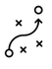

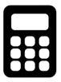
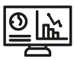
Job Descriptions
Develop roles clearly and completely across varying levels of experience
Agreements
Draft your business agreements across a variety of areas
Templates
Templates are designed based gather information in a structured manner
KPI’s
Performance indicator, a quantifiable measure of performance over time versus a specific objective.
Content Modules
Best practice material in power point for use as a knowledge base in business training , planning and execution .
Strategic tools
These tools are recognised the world over in business schools, consulting firms and companies who plan strategically.
Gain a competitive edge using the best tools and techniques to build a better you .
Analytical Tools
Interactive excel tools on specific business areas based on your data inputs delivered in a workbook model with instructions.
Scorecards
Designed as functional or subject indicators across a variety off situations to enable performance of situational evaluation versus aligned standards.
Calculators
calculate the right ratios for businesses looking for benchmarks in a variety of situations
Assessments
Assessments are designed around specific areas to conduct reviews and will center around a benchmark reviewing individuals or functions
Checklists
Designed around achieving milestones in a sequential manner.
Research
Research tools for sales and marketing engagement

Slide 4
2017
2018
100’s of tools grouped in 12 categories, 50 tool types and 12 business functions in 1 place.
get 10X productive now !
Categories
Functions
Analytical Tools
Types
Business Development
Agreements
Advertising
Customer Acquisition
Margins
Partner Search
Reports
Category Management
Assessments
Agreements
Customer Management
Market Analysis
Persona Development
Retail Measurement
Channel Management
Content Modules
Analytics
Distribution
Market Development
Planning
Reviews
Distribution
Checklists
Barriers
Distributor Management
Market Research
Positioning
Sales Management
Distributor Management
Calculators
Business Reviews
Forecasting
Market Segmentation
Pricing
Scorecards
General Management
Job Descriptions
Business Intelligence
GAP Analysis
Market Size
Prioritization
Segmentation
Key Account Management
KPI’s
Channels
Go To Market
Marketing
Product Development
Six Sigma
Marketing
Research
Communication
Job Descriptions
Marketing Comms
Product Life Cycle
Socio Economic Classification
Marketing Operations
Strategic Tools
Competitive Evaluation
Key Account Plans
Merchandising
Profit & Loss
Territory Design
Sales Management
Scorecards
Competitive Intelligence
Management Summary
New Market Entry
Promotions
Trade Marketing
Shopper Marketing
Templates
Trade Marketing

Slide 5



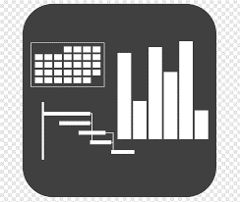




7 Benefits of using UpskilPRO :
Improve your knowledge
with professional Strategic Tools , Templates and planning documents for any business situation!
Use ready made tools
with filled in examples and ready to print & edit at your convenience . Just edit and fill-in the blanks !
Develop YOUR BUSINESS
Learn , & utilize the knowledge and processes and enhance your capabilities as the other companies have
We Created UpskilPRO for the
  Sales Professional
  Trade Marketer
  Marketing Executive
  Operations Manager
  VP/Director/Manager
100’s of tools , TEMPLATES & documents
CREATED BY
world class sales and marketing
business professionals.
All tools
are based on topics and subject based situations and are simple and easy to use .
SAVE THOUSANDS OF DOLLARS
The average company will save 1000’s of $ per employee in time & effort using our ready tools !
Top Quality Tools & Templates for developing both you and your business.
www.upskilpro.com

Slide 6
Segmentation

Slide 7
Know your customer, Know your market.
Segmentation is the practice of dividing your target market into
approachable sets.

Slide 8
BEHAVIOUR CRITERIA
Segmentation
GEOGRAPHIC CRITERIA
Weather
Time Spent
Browsing
Geo Location
Geographic
Topic
5
Devices
Behavior
Topic
2
Day
Week
Month
Profession
interests
Segmentation
Demographic
Gender
Disposition
Topic
3
Psychographic
Age
Text
Text
PSYCHOGRAPHIC CRITERIA
PSYCHOGRAPHIC CRITERIA

Slide 9

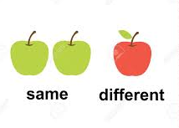



Segmentation
Rating Segment/s
Rating Segments To be useful, market segments must rate favourably on five key criteria.
Measurable.
The size, purchasing power, and characteristics of the segments can be measured.
Substantial.
The segments are large and profitable enough to serve. A segment should be the largest possible homogeneous group worth going after with a tailored marketing program.
Accessible.
The segments can be effectively reached and served
Differentiable.
The segments are conceptually distinguishable and respond differently to different marketing-mix elements and programs.
If married and single women respond similarly to a sale on perfume, they do not constitute separate segments.
Actionable.
Effective programs can be formulated for attracting and serving the segments

Slide 10

Segmentation
Basic levers of positioning
PRODUCT
PLACE
PREMIUM
ALL CHANNELS
BASIC
MIXED CHANNELS
POSITIONING
levers
VALUE/ DURABLE
SELECT CHANNELS
PROMOTION
PRICE
PRESTIGE
PREMIUM
FUN
PARITY
POWERFUL
ECONOMY

Slide 11
Segmentation
Segmentation characteristics & Verification
Segmentation Criteria
Measurable
Substantial
Accessible
Different
Actionable
The size, purchasing power, and characteristics of the segments can be
measured.
The segments are large and profitable enough to serve. A segment should
be the largest possible homogeneous group worth going after with a tailored marketing
program.
The segments can be effectively reached and served
The segments are conceptually distinguishable and respond differently to
different marketing-mix elements and programs.
Effective programs can be formulated for attracting and serving the segments
Key Steps
Your remarks
Define overall Corporate Strategy, including the target state of the corporate business unit portfolio

Slide 12

Segmentation
Segmentation by variables
  Geographic region State
  City or Metro size Size in population
  Density Urban or rural
  Climate Tropical , Rainy , Hot& Humid , cold .
  Demographic age Age group periods
  Family size Headcount in family
  Family life cycle Young , single and up to married , older , and other
  Gender Male , female
  Income Income groups in periods
  Occupation Professional , technical , proprietors , students , unemployed etc
  Education Diploma , Under graduate , graduate , post graduate
  Occupation Professional , technical , proprietors , students , unemployed etc
  Education Diploma , Under graduate , graduate , post graduate
  Religion Catholic , Muslim , Protestant , Hindu , Jewish , other.
  Race Asian , European , Middle eastern , Pacific islander , African.
  Generation Baby boomers , Gen X, Millennial's
  Nationality Country specific
  Social Class Lower – Middle - Upper
  Psychographic lifestyle Culture , Outdoor , Indoor , sports etc
  Behavioural occasions Cultural and Personal
  User level beginner , first time , repeat etc
  Usage rate Frequency
  Loyalty status None , repeat , promotional .
  Readiness stage Unaware , Informed , interested , probable
  Attitudes Hostile ,negative , positive , engaged .
SEGMENTATION
Variable for B2C Market

Slide 13
Segmentation
Segmentation by variables
* This file is available on www.upskilpro.com in an editable version , use the reference number provided on the top right in red

Slide 14
Segmentation
Segmentation by variables
* This file is available on www.upskilpro.com in an editable version , use the reference number provided on the top right in red

Slide 15
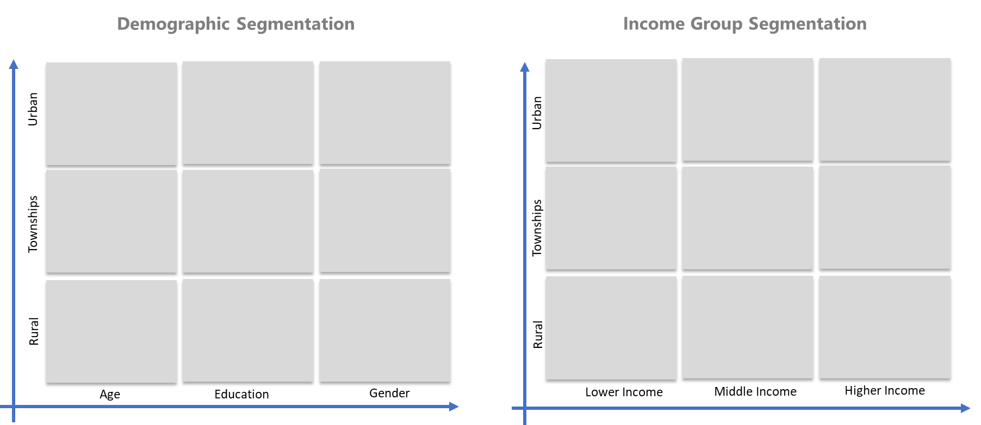
Segmentation
Segmentation Matrix examples
8037
* This file is available on www.upskilpro.com in an editable version , use the reference number provided on the top right in red

Slide 16
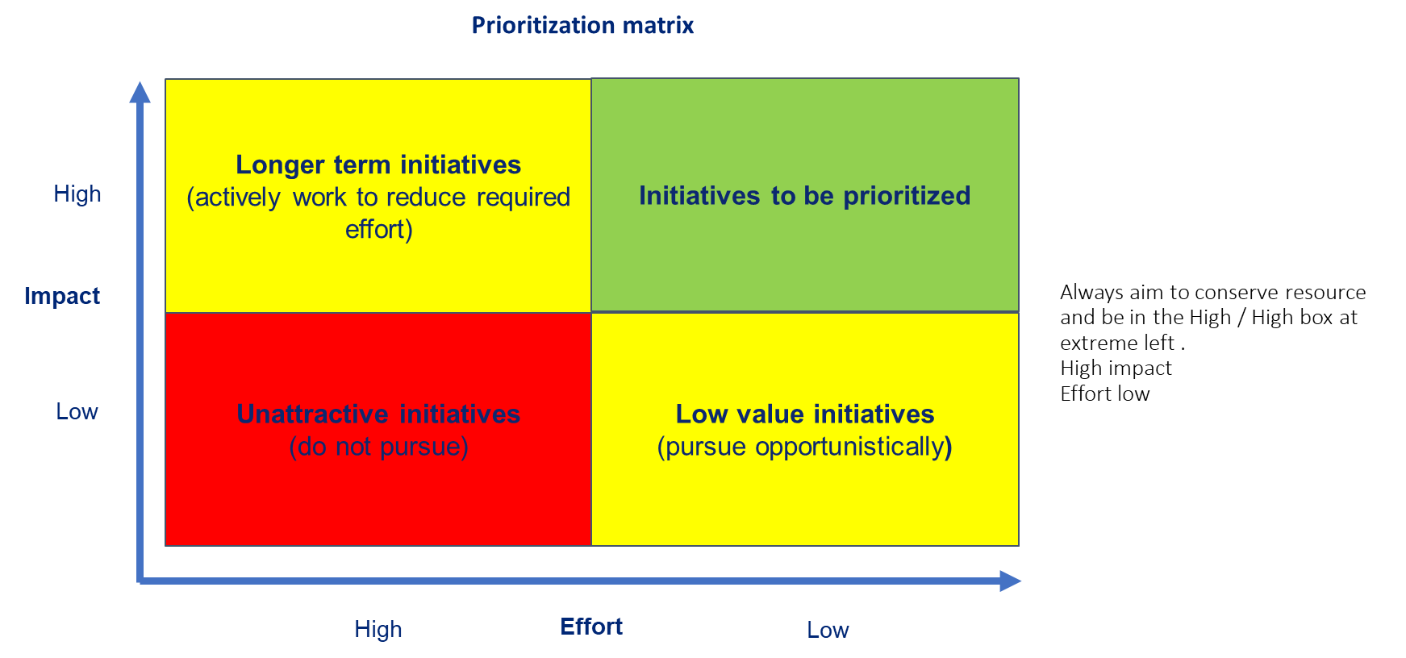
Segmentation
Prioritization matrix
8034
The focus should be on the initiatives that have the greatest impact and require the lowest effort
* This file is available on www.upskilpro.com in an editable version , use the reference number provided on the top right in red

Slide 17
Segmentation
STP Methodology
ENABLEMENT ZONE
Targeting
ENGAGEMENT ZONE
Segmentation
Positioning
P
S
T
Target by Personal attributes
Target by Segment attractiveness
Identify positioning
  A) Demographic
  Age,
  marital status,
  gender,
  ethnicity,
  sexuality,
  education,
  occupation.
  Geographic
  By country,
  region,
  state,
  city
B) Psychographic
  Personality
  Risk aversion,
  Values
  lifestyle.
C) Behavioural
  Product usage
  Loyalty
  Expected benefits
.
Review profitability of each segment.
size and potential growth of each customer group ( Market Size ).
Is steady growth possible?
how does it compare with the other segments?
Avoid small niche markets to start
Select Marketing mix – target segments
Review why customers should purchase your product rather than those of your competitors.
Develop or use unique selling proposition,
Build a positioning map to understand how each segment perceives your product, brand or service. This will help you determine how best to position your offering.
Can you service this market
  Political
  Economic
  Sociological
  Technological
Review needs and Wants of each segment wants and needs of each segment, or the problem that your solution solves
Create a value proposition about your offering will meet this requirement versus any of your competitors' products,
Lastly develop a marketing campaign that presents the value proposition in a way that your audience will appreciate.
.

Slide 18
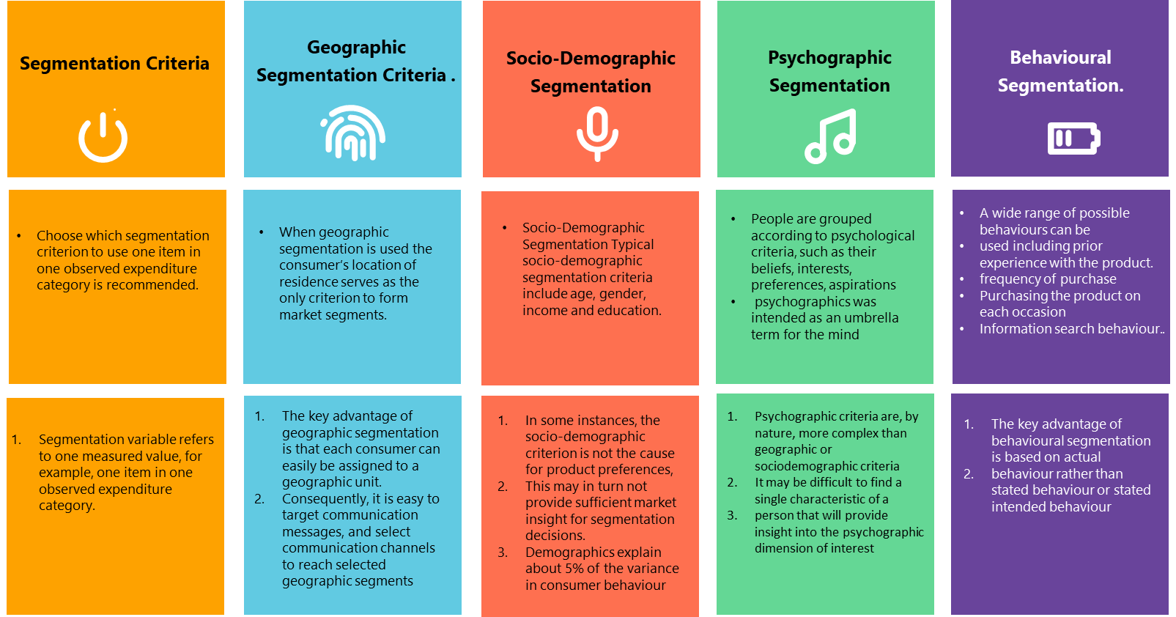
Segmentation, Targeting & Positioning
Market Segmentation using Market research agencies
8036
* This file is available on www.upskilpro.com in an editable version , use the reference number provided on the top right

Slide 19
Segmentation
Steps in segmentation
* This file is available on www.upskilpro.com in an editable version , use the reference number provided on the top right in red

Slide 20
Segmentation
Core of Market Segmentation
Market Segments
Summary
Customers
Competitors
Corporate Mission& Objectives
Market Research
Internal Data / Analytics
Definition / Engagement
of
Markets & Segments
Value understanding
Segment evaluation
Segment Attractiveness
Positioning
&
Value
Analysis

Slide 21
Segmentation
Segmentation Difficulties
Position your product to the most attractive segment
Expect “Fringe customers” form outside your segment to also buy into your product .
Caution on Segmentation
Understanding Features
Develop/ Redevelop
Positioning statements
Many Customers
Many Markets
Differing purchase habits
Differing purchase habits
Varying levels of appeal
Varying Segments
Customers
Needs based Proposition
Variable motivations
Benefits appeal

Slide 22
Segmentation
Define your market & How it works.
Establish decision making stages on a map based on different features required by the market , where and how it is bought and by whom .
The 5 Steps in market segmentation
Stage 4
Next Page
Stage 1
Stage 2
Stage 3
1
2
3
4
5
Define your market
Market Mapping
Specification
Segmenting
Defining Segments
Clearly establish the scope of your market
Establish the structure
Establish the decision makers
Who specifies and what do they specify
Establish the decision makers
Establish their purchases
Establish the needs of the decision makers
Group decision makers who have similar choices
Validate the real reasons versus the real need's buyers look out for and their real value to the buyer.
START
This is the stage of real importance in features , rank the needs and the importance with the inclusion of price

Slide 23
Segmentation
Segmentation Attractiveness and Competitiveness
Establish criteria to conclude segment attractiveness . Use a scoring method to establish segment attractiveness in relation to reach other
Stage 4
Define your market
6
7
Segment
Attractiveness
Company
Competitiveness
Market Mapping
Specification
Segment attractiveness & potential measurement
Company strength measured by segment
Segmenting
Defining Segments
Segment Attractiveness
Company Competitiveness
By combining segment attractiveness and relative company competitiveness a compelling strategic picture of the market can be established
Selection of attractive segments will be the next logical step.
CONTINUATION FROM
Stage 3
Step 5

Slide 24
Segmentation
Segmentation Rules
Segmentation Data
Rules for segmentation
An understanding of how the market works and who makes the
decisions
each segment should consist of customers who are relevant to the
purchase situation in that they are responsible for making the
decision or can affect buying behaviour;
size of the market and how this divides between the competing
products and services
each segment should have sufficient potential size to justify the time
and effort involved in planning specifically for this business
opportunity
characteristics that can be used to identify the different customers
found within the market (customer profiling);
each segment should be distinguishable from other segments, such
that each has a distinctive set of requirements and can be served by
an equally distinctive marketing strategy
the key product and service requirements, and key channel, frequency
and method of purchase requirements, from the customer’s
point of view
each segment should be reachable by sales and distribution channels
currently being used or which could be used;
the benefits delivered by these requirements, also from the customer’s
point of view;
each segment should be capable of being identified by a set of
characteristics, such that the customers in that segment can be
reached by a distinctive and cost-effective communications strategy
the relative importance of these benefits to the different customers
found within the market
the company must be capable of making the necessary changes to its
structure, information and decision-making systems so that they
become focused on the new segments.

Slide 25
Segmentation
Socio Economic Classification of Toothpaste users ( Example )
* This file is available on www.upskilpro.com in an editable version , use the reference number provided on the top right

Slide 26

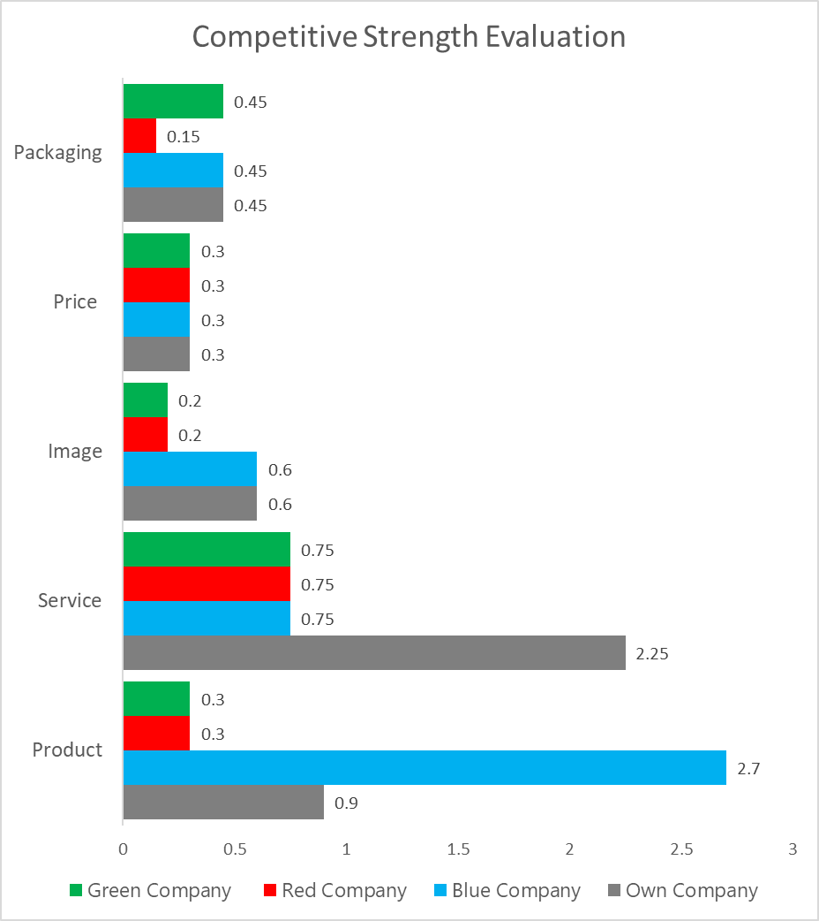
Segmentation
Competitive Strength Evaluation ( Example )
* This file is available on www.upskilpro.com in an editable version , use the reference number provided on the top right

Slide 27
Segmentation
Defining Markets ( Example )
Insights and Definition of markets
It is crucial that the market definition should avoid the inclusion within it of any reference to specific products or services, as this can lead to a narrow and blinkered understanding of the real market

Slide 28
Segmentation
Defining Markets ( Example )
Concrete
Screed
Flags/ Rafts
These 3 subsegments represent levels of the market in the Industrial segment
Total market represents the entire market composed of Level 2 and Level 3
Industrial
Commercial
Domestic
Carpet
Tiles
Lino
Cork
These 4 sub segments represent levels in commercial segment
Total
Market
These 3 subsegments represent levels of the market in the domestic segment
Carpet
Tiles
Mosaic
These 3 segments form the main market segments at the total market level appropriately called sub segments
Level 1
Level 2
Level 3

Slide 29
Segmentation
High level Market Segmentation Survey
* This file is available on www.upskilpro.com in an editable version , use the reference number provided on the top right in red

Slide 30
Segmentation
Criteria
* This file is available on www.upskilpro.com in an editable version , use the reference number provided on the top right in red

Slide 31
Segmentation
Assessment
Scoring criteria – We use a Six Sigma scoring method to ensure that the 10 criteria are aligned and meet needs for closest criteria , accordingly the scores 0,1,3 & 9 are used to establish the alignment
* This file is available on www.upskilpro.com in an editable version , use the reference number provided on the top right

Slide 32
Segmentation Module

Slide 33
Thank you !

Slide 34
Job Descriptions
Develop roles clearly and completely across varying levels of experience
Agreements
Draft your business agreements across a variety of areas
Templates
Templates are designed based gather information in a structured manner
KPI’s
Performance indicator, a quantifiable measure of performance over time versus a specific objective.
Content Modules
Best practice material in power point for use as a knowledge base in business training , planning and execution .
Strategic tools
These tools are recognised the world over in business schools, consulting firms and companies who plan strategically.
Gain a competitive edge using the best tools and techniques to build a better you .
Analytical Tools
Interactive excel tools on specific business areas based on your data inputs delivered in a workbook model with instructions.
Scorecards
Designed as functional or subject indicators across a variety off situations to enable performance of situational evaluation versus aligned standards.
Calculators
calculate the right ratios for businesses looking for benchmarks in a variety of situations
Assessments
Assessments are designed around specific areas to conduct reviews and will center around a benchmark reviewing individuals or functions
Checklists
Designed around achieving milestones in a sequential manner.
Research
Research tools for sales and marketing engagement

Slide 35
Segmentation
In segmentation we concentrate on establishing the importance of segmentation.
Knowing your consumer takes a sizeable amount of effort
UpskilPRO e Institute for Sales & Marketing
Tools, Content & Templates
Hand built using experience & Insight

