Slide 1

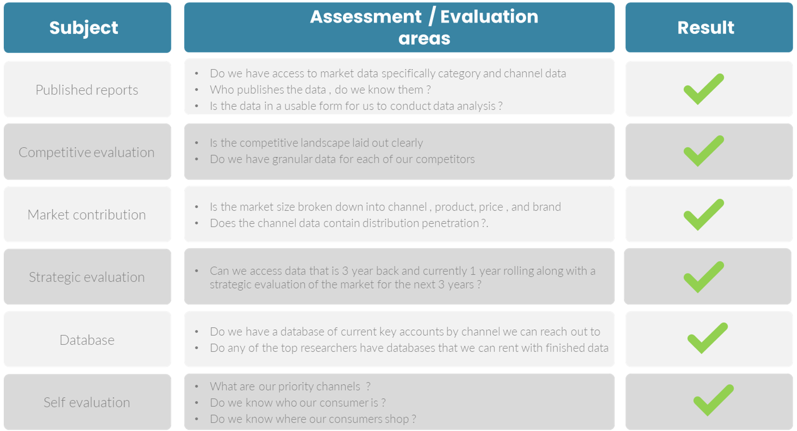
Channel Scorecards
Core scorecards to evaluate and measure progress in channel development.
UpskilPRO e Institute for Sales & Marketing
Tools, Content & Templates
Hand built using experience & Insight

Slide 2
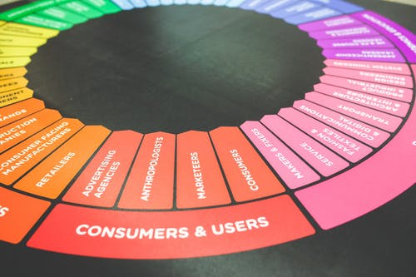



Created by
ex-Procter & Gamble, Rothmans, BAT, Gillette, Nokia,
Microsoft & 3M managers.
UpskilPRO tools are designed in easy-to-use solutions, all you need to do is download the tool and get to work immediately . All UpskilPRO material has taken 100’s of hours and many 1000’s of $ to build , all this expertise and content is brought to you for a fraction of the cost to help professionals enhance their capability.
core areas which are best suited to improve using our tools:
        Subject matter expertise
        Best practices
        Analytical output & charting
        Prioritization
        Process
        Training
Making life simpler for
Sales & Marketing professionals.
Tools in one place to get 10X productive now.

Slide 3


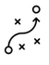

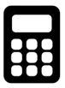

Job Descriptions
Develop roles clearly and completely across varying levels of experience
Agreements
Draft your business agreements across a variety of areas
Templates
Templates are designed based gather information in a structured manner
KPI’s
Performance indicator, a quantifiable measure of performance over time versus a specific objective.
Content Modules
Best practice material in power point for use as a knowledge base in business training , planning and execution .
Strategic tools
These tools are recognised the world over in business schools, consulting firms and companies who plan strategically.
Gain a competitive edge using the best tools and techniques to build a better you .
Analytical Tools
Interactive excel tools on specific business areas based on your data inputs delivered in a workbook model with instructions.
Scorecards
Designed as functional or subject indicators across a variety off situations to enable performance of situational evaluation versus aligned standards.
Calculators
calculate the right ratios for businesses looking for benchmarks in a variety of situations
Assessments
Assessments are designed around specific areas to conduct reviews and will center around a benchmark reviewing individuals or functions
Checklists
Designed around achieving milestones in a sequential manner.
Research
Research tools for sales and marketing engagement

Slide 4
2017
2018
100’s of tools grouped in 12 categories, 50 tool types and 12 business functions in 1 place.
get 10X productive now !
Categories
Functions
Analytical Tools
Types
Business Development
Agreements
Advertising
Customer Acquisition
Margins
Partner Search
Reports
Category Management
Assessments
Agreements
Customer Management
Market Analysis
Persona Development
Retail Measurement
Channel Management
Content Modules
Analytics
Distribution
Market Development
Planning
Reviews
Distribution
Checklists
Barriers
Distributor Management
Market Research
Positioning
Sales Management
Distributor Management
Calculators
Business Reviews
Forecasting
Market Segmentation
Pricing
Scorecards
General Management
Job Descriptions
Business Intelligence
GAP Analysis
Market Size
Prioritization
Segmentation
Key Account Management
KPI’s
Channels
Go To Market
Marketing
Product Development
Six Sigma
Marketing
Research
Communication
Job Descriptions
Marketing Comms
Product Life Cycle
Socio Economic Classification
Marketing Operations
Strategic Tools
Competitive Evaluation
Key Account Plans
Merchandising
Profit & Loss
Territory Design
Sales Management
Scorecards
Competitive Intelligence
Management Summary
New Market Entry
Promotions
Trade Marketing
Shopper Marketing
Templates
Trade Marketing

Slide 5



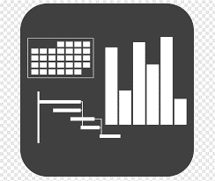




7 Benefits of using UpskilPRO :
Improve your knowledge
with professional Strategic Tools , Templates and planning documents for any business situation!
Use ready made tools
with filled in examples and ready to print & edit at your convenience . Just edit and fill-in the blanks !
Develop YOUR BUSINESS
Learn , & utilize the knowledge and processes and enhance your capabilities as the other companies have
We Created UpskilPRO for the
  Sales Professional
  Trade Marketer
  Marketing Executive
  Operations Manager
  VP/Director/Manager
100’s of tools , TEMPLATES & documents
CREATED BY
world class sales and marketing
business professionals.
All tools
are based on topics and subject based situations and are simple and easy to use .
SAVE THOUSANDS OF DOLLARS
The average company will save 1000’s of $ per employee in time & effort using our ready tools !
Top Quality Tools & Templates for developing both you and your business.
www.upskilpro.com

Slide 6
Channels I
Module

Slide 7
Channels I
Distribution channels are responsible to create a two-sided connection from the manufacturer to the customer.
Most organisations focus on one direction.

Slide 8
Channel Scorecards
Management Summary
Channel Management Summary Channel management strategy and appropriate choice of channels based on data and customer throughput will be the 2 elements of our decision making capabilities in choosing channels .
Mission |  |  | Vision
Financials | Top line from X Mn $ to Y Mn $ in 3 years |  | Contribution gross margins increase from 46% to 48% |  | Contribution income to increase from 19% to 23%
Channel Data |  | LY Sales | TY Plan | TY Sales | TY vs Plan | LY vs Plan
 | Channel A
 | Channel B
 | Channel C
 | Channel D
Initiatives | Budgets |  | Technologies |  | Strategic Channel Programs
Teams | Lead team |  | New Hires |  | TY Initiatives

Slide 9
Channels Scorecard

Slide 10
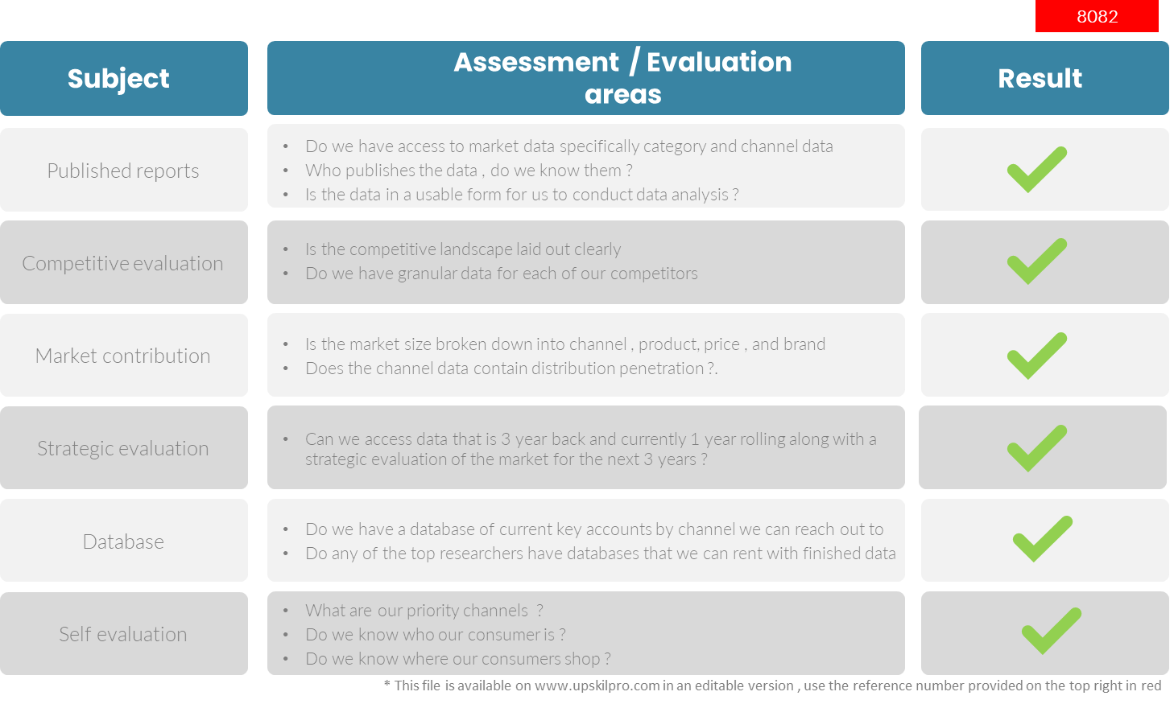
Channel Scorecards
Scorecard - How to find the right channel

Slide 11
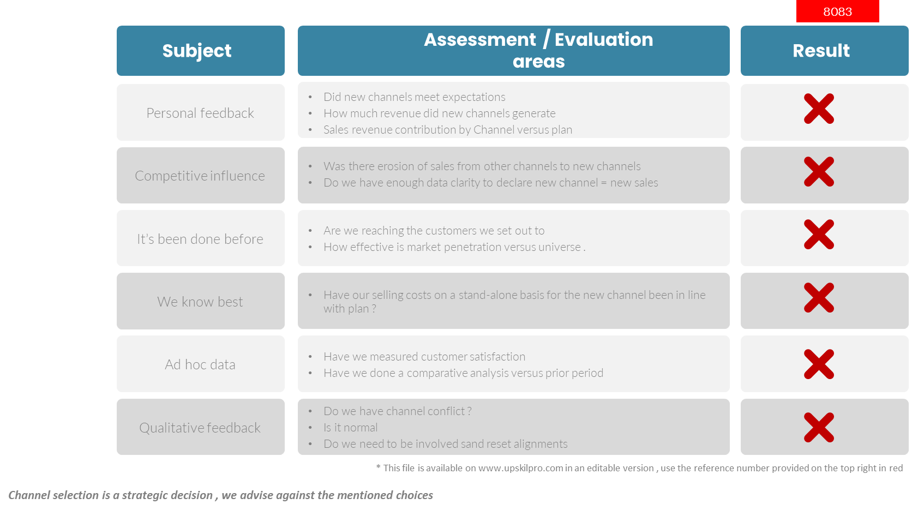
Channel Scorecards
Scorecard - What to do and not to do !

Slide 12
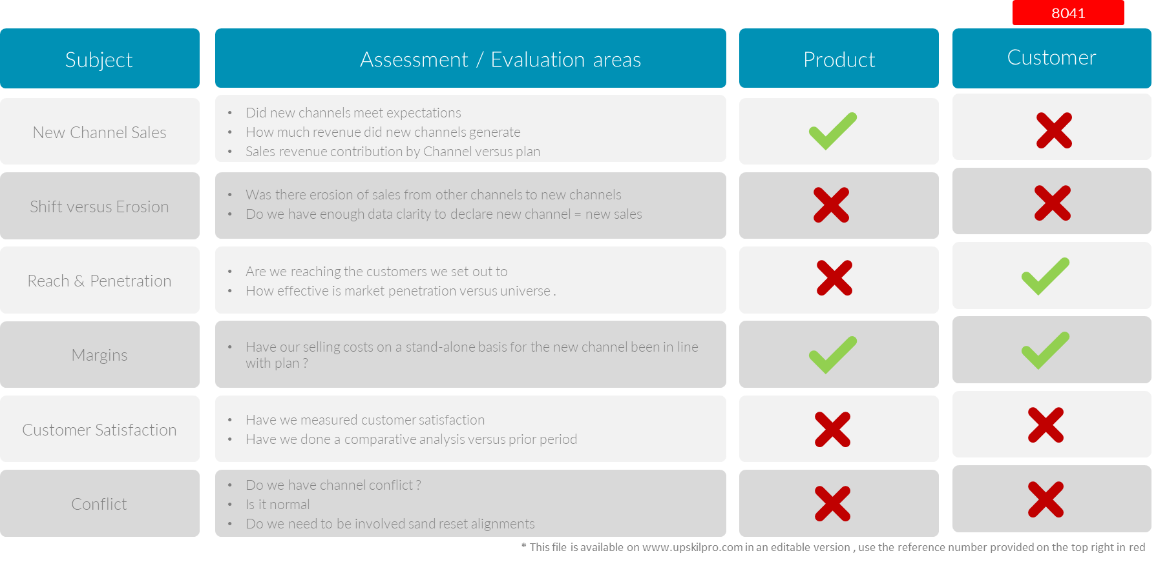
Channel Scorecards
Scorecard - Channel Baseline Management Areas.

Slide 13
Channel Scorecards
Market evaluation criteria.
Market evaluation criteria
We start with identifying drivers to weight the 9 important drivers indicating importance ( cost to serve to barriers )
We then weight the drivers to reflect the intensity and importance of the driver in the decision-making process
Drivers are situational in both identification and importance
We recommend identifying the drivers closer to the decision-making process and working back from there
Sources in this context are for data and intelligence sources gathering.
* This file is available on www.upskilpro.com in an editable version , use the reference number provided on the top right in red

Slide 14
Thank you !

Slide 15
Job Descriptions
Develop roles clearly and completely across varying levels of experience
Agreements
Draft your business agreements across a variety of areas
Templates
Templates are designed based gather information in a structured manner
KPI’s
Performance indicator, a quantifiable measure of performance over time versus a specific objective.
Content Modules
Best practice material in power point for use as a knowledge base in business training , planning and execution .
Strategic tools
These tools are recognised the world over in business schools, consulting firms and companies who plan strategically.
Gain a competitive edge using the best tools and techniques to build a better you .
Analytical Tools
Interactive excel tools on specific business areas based on your data inputs delivered in a workbook model with instructions.
Scorecards
Designed as functional or subject indicators across a variety off situations to enable performance of situational evaluation versus aligned standards.
Calculators
calculate the right ratios for businesses looking for benchmarks in a variety of situations
Assessments
Assessments are designed around specific areas to conduct reviews and will center around a benchmark reviewing individuals or functions
Checklists
Designed around achieving milestones in a sequential manner.
Research
Research tools for sales and marketing engagement

Slide 16
Channel Scorecards
Core scorecards to evaluate and measure progress in channel development.
UpskilPRO e Institute for Sales & Marketing
Tools, Content & Templates
Hand built using experience & Insight

