Slide 1
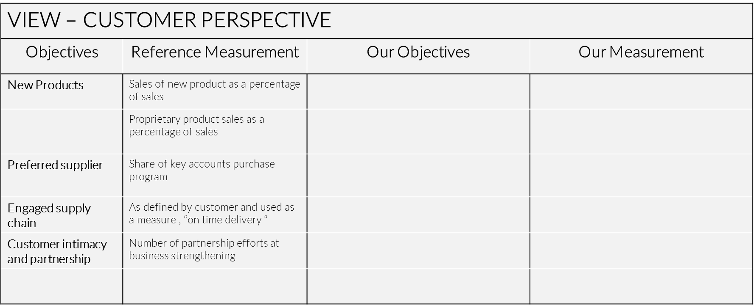
Balanced SCORECARD
The scorecard puts strategy and vision, not control, at the centre. It establishes goals and assumes that people will adopt whatever behaviours and take whatever actions are required.
Financial
Learning & Innovation
Internal Business Perspective
Customer Perspective
UpskilPRO e Institute for Sales & Marketing
Tools, Content & Templates
Hand built using experience & Insight

Slide 2
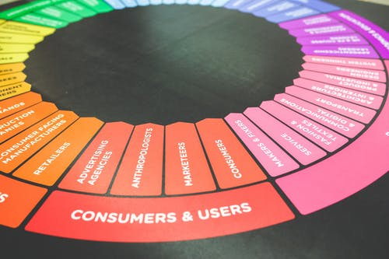
Created by
ex-Procter & Gamble, Rothmans, BAT, Gillette, Nokia,
Microsoft & 3M managers.
UpskilPRO tools are designed in easy-to-use solutions, all you need to do is download the tool and get to work immediately . All UpskilPRO material has taken 100’s of hours and many 1000’s of $ to build , all this expertise and content is brought to you for a fraction of the cost to help professionals enhance their capability.
core areas which are best suited to improve using our tools:
Subject matter expertise
Best practices
Analytical output & charting
Prioritization
Process
Capability enhancement tools for
Consumer Marketing, Trade Marketing &
Sales excellence professionals.
Tools in one place to get 10X productive now.

Slide 3
Job Descriptions
Develop roles clearly and completely across varying levels of experience
Agreements
Draft your business agreements across a variety of areas
Templates
Templates are designed based gather information in a structured manner
KPI’s
Performance indicator, a quantifiable measure of performance over time versus a specific objective.
Content Modules
Best practice material in power point for use as a knowledge base in business training , planning and execution .
Strategic tools
These tools are recognised the world over in business schools, consulting firms and companies who plan strategically.
Gain a competitive edge using the best tools and techniques to build a better you .
Analytical Tools
Interactive excel tools on specific business areas based on your data inputs delivered in a workbook model with instructions.
Scorecards
Designed as functional or subject indicators across a variety off situations to enable performance of situational evaluation versus aligned standards.
Calculators
calculate the right ratios for businesses looking for benchmarks in a variety of situations
Assessments
Assessments are designed around specific areas to conduct reviews and will center around a benchmark reviewing individuals or functions
Checklists
Designed around achieving milestones in a sequential manner.
Research
Research tools for sales and marketing engagement

Slide 4
2017
2018
100’s of tools grouped in 12 categories, 50 tool types and 12 business functions in 1 place.
get 10X productive now !
Categories
Functions
Analytical Tools
Types
Business Development
Agreements
Advertising
Customer Acquisition
Margins
Partner Search
Reports
Category Management
Assessments
Agreements
Customer Management
Market Analysis
Persona Development
Retail Measurement
Channel Management
Content Modules
Analytics
Distribution
Market Development
Planning
Reviews
Distribution
Checklists
Barriers
Distributor Management
Market Research
Positioning
Sales Management
Distributor Management
Calculators
Business Reviews
Forecasting
Market Segmentation
Pricing
Scorecards
General Management
Job Descriptions
Business Intelligence
GAP Analysis
Market Size
Prioritization
Segmentation
Key Account Management
KPI’s
Channels
Go To Market
Marketing
Product Development
Six Sigma
Marketing
Research
Communication
Job Descriptions
Marketing Comms
Product Life Cycle
Socio Economic Classification
Marketing Operations
Strategic Tools
Competitive Evaluation
Key Account Plans
Merchandising
Profit & Loss
Territory Design
Sales Management
Scorecards
Competitive Intelligence
Management Summary
New Market Entry
Promotions
Trade Marketing
Shopper Marketing
Templates
Trade Marketing

Slide 5
Balanced SCORECARD
4 Perspectives
Financial
Learning & Innovation
Internal Business Perspective
Customer Perspective

Slide 6
Balanced Scorecard
The Balanced Scorecard and Strategy Maps are performance planning and measurement systems
These systems work to measure whether the smaller-scale activities of an organization work in terms of its larger-scale strategy.
www.upskilpro.com

Slide 7
Balanced Scorecard
VIEW-FINANCIALLY
Objectives : Please insert agreed corporate objectives
Measurement : Please enter your measures
VIEW - FINANCIALLY
Objectives | Reference Measurement | Our Objectives | Our Measurement
Survive | Cash flow
Succeed | Sales growth measured by quarter and Operating income by business unit
Prosperity | Market share increase , and return of capital employed
www.upskilpro.com

Slide 8
Balanced Scorecard
VIEW LEARNING & INNOVATION
Objectives : Please insert agreed corporate objectives
Measurement : Please enter your measures
VIEW – LEARNING & INNOVATION PERSPECTIVE
Objectives | Reference Measurement | Our Objectives | Our Measurement
Technology leadership | Next generation development
Manufacturing | Process time to reach maturity
Product focus | Employ Parettos rule ,concentrate on 80% or lesser to drive efficiency
Time to market | NPI versus competitive forces
www.upskilpro.com

Slide 9
Balanced Scorecard
VIEW - INTERNAL BUSINESS PERSPECTIVE
Objectives : Please insert agreed corporate objectives
Measurement : Please enter your measures
VIEW – INERNAL BUSINESS PERSPECTIVE
Objectives | Reference Measurement | Our Objectives | Our Measurement
Technology Capability | Manufacturing assessment versus identified competition
Manufacturing excellence | Unit cost per cycle time measured
Design productivity | Engineering efficiency
New Product introduction | Launch planning schedule versus actual production
www.upskilpro.com

Slide 10
Balanced Scorecard
VIEW – CUSTOMER PERSPECTIVE
Objectives : Please insert agreed corporate objectives
Measurement : Please enter your measures
VIEW – CUSTOMER PERSPECTIVE
Objectives | Reference Measurement | Our Objectives | Our Measurement
New Products | Sales of new product as a percentage of sales
 | Proprietary product sales as a percentage of sales
Preferred supplier | Share of key accounts purchase program
Engaged supply chain | As defined by customer and used as a measure , “on time delivery “
Customer intimacy and partnership | Number of partnership efforts at business strengthening
www.upskilpro.com

Slide 11
Created by
ex-Procter & Gamble, Rothmans, BAT, Gillette, Nokia,
Microsoft & 3M managers.
UpskilPRO tools are designed in easy-to-use solutions, all you need to do is download the tool and get to work immediately . All UpskilPRO material has taken 100’s of hours and many 1000’s of $ to build , all this expertise and content is brought to you for a fraction of the cost to help professionals enhance their capability.
core areas which are best suited to improve using our tools:
Subject matter expertise
Best practices
Analytical output & charting
Prioritization
Process
Capability enhancement tools for
Consumer Marketing, Trade Marketing &
Sales excellence professionals.
Tools in one place to get 10X productive now.

Slide 12
Balanced SCORECARD
The scorecard puts strategy and vision, not control, at the centre. It establishes goals and assumes that people will adopt whatever behaviours and take whatever actions are required.
Financial
Learning & Innovation
Internal Business Perspective
Customer Perspective
UpskilPRO e Institute for Sales & Marketing
Tools, Content & Templates
Hand built using experience & Insight

