Slide 1

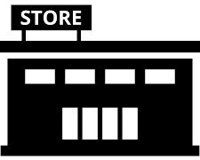

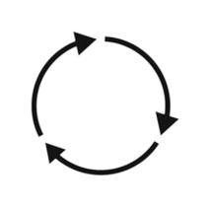



RETAILER
Distribution Partner Search
Engaging Markets
Covers all aspects of interviewing the potential channel / distribution partner from all angles,
Guide # 2
UpskilPRO e Institute for Sales & Marketing
Tools, Content & Templates
Hand built using experience & Insight

Slide 2
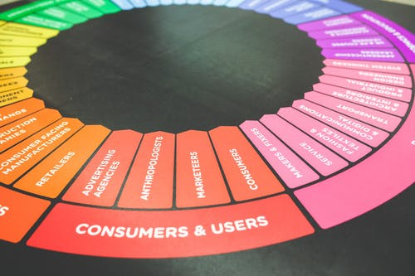

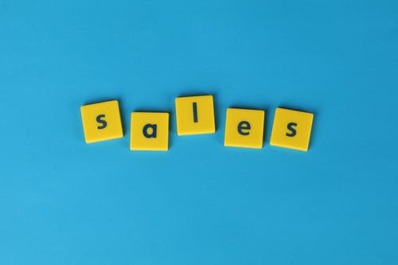

Created by
ex-Procter & Gamble, Rothmans, BAT, Gillette, Nokia,
Microsoft & 3M managers.
UpskilPRO tools are designed in easy-to-use solutions, all you need to do is download the tool and get to work immediately . All UpskilPRO material has taken 100’s of hours and many 1000’s of $ to build , all this expertise and content is brought to you for a fraction of the cost to help professionals enhance their capability.
core areas which are best suited to improve using our tools:
        Subject matter expertise
        Best practices
        Analytical output & charting
        Prioritization
        Process
Making life simpler for
Sales & Marketing professionals.
Tools in one place to get 10X productive now.

Slide 3
Created by
ex-Procter & Gamble, Rothmans, BAT, Gillette, Nokia,
Microsoft & 3M managers.
UpskilPRO tools are designed in easy-to-use solutions, all you need to do is download the tool and get to work immediately . All UpskilPRO material has taken 100’s of hours and many 1000’s of $ to build , all this expertise and content is brought to you for a fraction of the cost to help professionals enhance their capability.
core areas which are best suited to improve using our tools:
        Subject matter expertise
        Best practices
        Analytical output & charting
        Prioritization
        Process
Capability enhancement tools for
Consumer Marketing, Trade Marketing &
Sales excellence professionals.
Tools in one place to get 10X productive now.

Slide 4


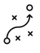

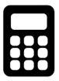
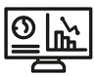
Job Descriptions
Develop roles clearly and completely across varying levels of experience
Agreements
Draft your business agreements across a variety of areas
Templates
Templates are designed based gather information in a structured manner
KPI’s
Performance indicator, a quantifiable measure of performance over time versus a specific objective.
Content Modules
Best practice material in power point for use as a knowledge base in business training , planning and execution .
Strategic tools
These tools are recognised the world over in business schools, consulting firms and companies who plan strategically.
Gain a competitive edge using the best tools and techniques to build a better you .
Analytical Tools
Interactive excel tools on specific business areas based on your data inputs delivered in a workbook model with instructions.
Scorecards
Designed as functional or subject indicators across a variety off situations to enable performance of situational evaluation versus aligned standards.
Calculators
calculate the right ratios for businesses looking for benchmarks in a variety of situations
Assessments
Assessments are designed around specific areas to conduct reviews and will center around a benchmark reviewing individuals or functions
Checklists
Designed around achieving milestones in a sequential manner.
Research
Research tools for sales and marketing engagement

Slide 5
2017
2018
100’s of tools grouped in 12 categories, 50 tool types and 12 business functions in 1 place.
get 10X productive now !
Categories
Functions
Analytical Tools
Types
Business Development
Agreements
Advertising
Customer Acquisition
Margins
Partner Search
Reports
Category Management
Assessments
Agreements
Customer Management
Market Analysis
Persona Development
Retail Measurement
Channel Management
Content Modules
Analytics
Distribution
Market Development
Planning
Reviews
Distribution
Checklists
Barriers
Distributor Management
Market Research
Positioning
Sales Management
Distributor Management
Calculators
Business Reviews
Forecasting
Market Segmentation
Pricing
Scorecards
General Management
Job Descriptions
Business Intelligence
GAP Analysis
Market Size
Prioritization
Segmentation
Key Account Management
KPI’s
Channels
Go To Market
Marketing
Product Development
Six Sigma
Marketing
Research
Communication
Job Descriptions
Marketing Comms
Product Life Cycle
Socio Economic Classification
Marketing Operations
Strategic Tools
Competitive Evaluation
Key Account Plans
Merchandising
Profit & Loss
Territory Design
Sales Management
Scorecards
Competitive Intelligence
Management Summary
New Market Entry
Promotions
Trade Marketing
Shopper Marketing
Templates
Trade Marketing

Slide 6


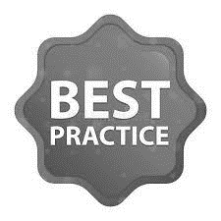
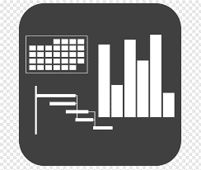




7 Benefits of using UpskilPRO :
Improve your knowledge
with professional Strategic Tools , Templates and planning documents for any business situation!
Use ready made tools
with filled in examples and ready to print & edit at your convenience . Just edit and fill-in the blanks !
Develop YOUR BUSINESS
Learn , & utilize the knowledge and processes and enhance your capabilities as the other companies have
We Created UpskilPRO for the
  Sales Professional
  Trade Marketer
  Marketing Executive
  Operations Manager
  VP/Director/Manager
100’s of tools , TEMPLATES & documents
CREATED BY
world class sales and marketing
business professionals.
All tools
are based on topics and subject based situations and are simple and easy to use .
SAVE THOUSANDS OF DOLLARS
The average company will save 1000’s of $ per employee in time & effort using our ready tools !
Top Quality Tools & Templates for developing both you and your business.
www.upskilpro.com

Slide 7
Distribution Partner Search
Aligning your business model with the right distributor is half the job ,ensuring your distributor is engaged with your business model is the other half.

Slide 8
Scorecard

Slide 9
Distribution Partner Search
Scorecard
2005
Macro level features
State
Micro level features
State
Country Analysis
Sales Plan & Budgets
Strategic Analysis
Contracts
Competitive Landscape
Stocking & Resupply
Distribution Models
IT
Distribution Model Assessment
Staff / Organization Interviews
Organization Design
Leadership Interviews
Local Market Visit 1 - Evaluation
Sub Total
6/15
Local Market Visit 2 - Assessment
Total
15/15
Local Market Visit 3 – Finalization
Sub Total
9/15
In progress / completed
Not yet completed

Slide 10
Distribution Partner Types

Slide 11
Distribution Partner Search
Distributor Models ( 5 Types)
Partner types
Models
Based on modelling and existing market models partners usually come in a broad range of 5 models, each model has its own characteristics and is usually dependant on the brand owner’s priorities .
The aim is to get the right engagement within the top 2 of the 5 models, this evaluation is a complex fit of internal, external findings and capabilities and references which we fit into a rating and suitability indicator.
.
Stockists
#1
Start up
Non dedicated
Dedicated
Managed & Dedicated

Slide 12
Distribution Partner Search
Distributor Models ( 5 Types)
Start up
Stockists
Non-Dedicated
Dedicated
Managed and Dedicated
Start up’s may be Stockists or wholesalers who agree to distribute without being a distributor .
These are usually starting out and may base their decisions on relationships, local knowledge , local insights or the entrepreneurial interest.
Typically found in large geographies and in almost every ZIP code and PIN code.
They are like large wholesalers , and have their own sales force to drive sales , and are tightly bound to designated territories as agreed.
Usually, these distributors are well established and have business verticals which sell multi brands as they are focused on the outlet or buyer rather than the go to market model of dedication and modular business units.
These distributors work off modular units which are based on a business optimum size and ensure the organization is well staffed and self dedicated to ensuring goals are met.
These distributors are modular and work well with the bigger brands which need dedication.
These distributors are very large and have the brand owner working with them from the inside and running their operations .
The main driver here is consistency and business design in an external organization managed by the brand owner.
National Distributors
National Distributors
National Distributors
National Distributors
National Distributors
Stockists
Stockists
Stockists
Stockists
Stockists
Sub-Stockists
Sub-Stockists
Sub-Stockists
Sub-Stockists
Sub-Stockists

Slide 13
Distribution Partner Search
Distributor Models ( 5 Types)

Slide 14
Distribution Partner Search
Distributor Models ( 5 Types)
This model identifies the types of features versus the service delivery capability.
In the 5 models identified we have aligned the service delivery in colour codes to indicate the relative strengths.
We recommend focussing on the Blue areas before the colour codes in order to prioritize the capability requirement.
This template is fully editable and used drop downs to indicate the relative score
We use Six Sigma scores and methodology to drive decision making for accuracy.

Slide 15
Distribution Partner Search
Partner Validation / Assessment
Partner Validation / Assessment
We use a varied set of parameters carefully identified to evaluate the partner suitability, as no 2 businesses are the same
We use the parameters as a first line and the market-based observation subsequently.
#2

Slide 16
Distribution Partner Search
Partner Validation .

Slide 17
Distribution Partner Search
Categories
Categories
Every product fits into a subcategory which fits into a category, we build on the category insights to know more about the market and the insights of performance and predictability.
#3

Slide 18
Distribution Partner Search
Categories
Industry report Tea Market in Philippines to 2022 - Market Size, Development, and Forecasts offers the most up-to-date market data on the actual market situation, and future outlook for tea in Philippines.
The research includes historic market data from 2011 to 2017 and forecasts until 2022 which makes the report an invaluable resource for industry executives, marketing, sales and product managers, analysts, and other people looking for key industry data in readily accessible and clearly presented tables and graphs.
The latest market data for this research include:
- Overall tea market size, 2011-2022
- Tea market size by product segment, 2011-2022
- Growth rates of the overall tea market and different product segments, 2011-2022
- Shares of different product segments of the overall tea market, 2011, 2017 and 2022
The product segments discussed in this data report include:
Green tea (unfermented)
Black tea (fermented or partly fermented)
Tea concentrates, extracts and essences
The report helps answering the following questions:
- What is the current size of the tea market in Philippines?
- How is the tea market divided into different product segments?
- How are the overall market and different product segments growing?
- How is the market predicted to develop in the future?
Among the key reasons to purchase include the following:
- Gain an outlook of the historic development, current market situation, and future outlook of the tea market in Philippines to 2022
- Track industry development and identify market opportunities
- Plan and develop marketing, market-entry, market expansion, and other business strategies by identifying the key market opportunities and prospects
- Save time and money with the readily accessible key market data included in this PDF format industry report. The market data is clearly presented and can be easily incorporated into presentations, internal reports, etc.

Slide 19
Distribution Partner Search
Categories
List of Tables
Table 1 Demand for tea in Philippines, 2011-2017 (US dollars)
Table 2 Demand for tea in Philippines, by type, 2011 and 2017 (share)
Table 3 Demand for in green tea (unfermented) in Philippines, 2011-2017 (US dollars)
Table 4 Demand for black tea (fermented or partly fermented) in Philippines, 2011-2017 (US dollars)
Table 5 Demand for tea concentrates, extracts and essences in Philippines, 2011-2017 (US dollars)
Table 6 Demand for tea in Philippines, 2017-2022 (US dollars)
Table 7 Demand for tea in Philippines, by type, 2011, 2017 and 2022 (share)
Table 8 Demand for green tea (unfermented) in Philippines, 2017-2022 (US dollars)
Table 9 Demand for black tea (fermented or partly fermented) in Philippines, 2017-2022 (US dollars)
Table 10 Demand for tea concentrates, extracts and essences in Philippines, 2017-2022 (US dollars)
List of Graphs
Graph 1 Demand for tea in Philippines, 2011-2017 (US dollars)
Graph 2 Demand for green tea (unfermented) in Philippines, 2011-2017 (US dollars)
Graph 3 Demand for black tea (fermented or partly fermented) in Philippines, 2011-2017 (US dollars)
Graph 4 Demand for tea concentrates, extracts and essences in Philippines, 2011-2017 (US dollars)
Graph 5 Demand for tea in Philippines, 2011-2022 (US dollars)
Graph 6 Demand for green tea (unfermented) in Philippines, 2011-2022 (US dollars)
Graph 7 Demand for black tea (fermented or partly fermented) in Philippines, 2011-2022 (US dollars)
Graph 8 Demand for tea concentrates, extracts and essences in Philippines, 2011-2022 (US dollars)
Market for Tea in Philippines 6
Overall Market 6
Market by Type 7
Green tea (unfermented) 8
Black tea (fermented or partly fermented) 9
Tea concentrates, extracts and essences 10
Forecasts and Future Outlook 11
Overall Market 11
Market by Type 12
Green tea (unfermented) 13
Black tea (fermented or partly fermented) 14
Tea concentrates, extracts and essences 15
Market Definition 18
Methodology and Sources 19

Slide 20
Distribution Partner Search
Categories.
Categories
Distributors
Regions
Channels
Customers
White Goods
Master distributor
Pharmacies
Construction
Regional distributor
National
Construction equipment
Chain / Professional Buyers
The basis of this model is how to reach our target market of housewives through a distribution model.
It then works backward through the regions to determine if a national level model is needed
Then works back again to a national level distributor or multiple state level distributors
Then works further back that the ideal environment for thee housewives will be to purchase the solution from a pharmacy as its mot likely.
Having identified 2 possibilities from each layer , its now a matter of running a exercise to determine which of the 2 models will work for the business
Electrical
Area distributor
State / Province
Education Institutions
SEC Identified Groups
Retail
Stockist
District/City
Contractors & builders
Bachelors
SaaS
Sub Stockist
City
Showrooms / Resellers
Housewives
Pharmaceutical
Start up Stockist
Zip Code
Retail chains
Educators
Safety
Managed Distributor
Street
Supermarkets
Children
Schools
Managed Distributor
Electrical resellers

Slide 21
Distribution Partner Search
Interviews
Interviews
The face-to-face interview is key to engaging with potential partners
We start from a list of topics and scoring tools we use to identify key strengths and opportunities .
We process all our reviews with Tools and templates from review all partners from UpskilPRO.com
Markets
Management
Portfolio
#4
Systems
Channel
Win/Loss
Competition
Compliance
Metrics
Reference file 8055

Slide 22
Distribution Partner Search
Modelling Criteria
Modelling Criteria
Markets
Management
Portfolio
The Business model is an engagement exercise between the Principal’s desire and what the market potentially will require, this may come close to the 5 Models we described earlier
#5
Systems
Channel
Win/Loss
Competition
Compliance
Metrics

Slide 23
Distribution Partner Search
Categories.
Categories
Distributors
Regions
Channels
Product Groups
Customers
White Goods
Master distributor
Pharmacies
Construction
Regional distributor
National
Construction equipment
A
Chain / Professional Buyers
Electrical
Area distributor
State / Province
Education Institutions
B
SEC Identified Groups
Retail
Stockist
District/City
Contractors & builders
C
Bachelors
SaaS
Sub Stockist
City
Showrooms / Resellers
D
Housewives
Pharmaceutical
Start up Stockist
Zip Code
Retail chains
E
Educators
Safety
Managed Distributor
Street
Supermarkets
F
Children
Schools
Managed Distributor
Electrical resellers
The basis of this model is how to reach our target market of housewives through a distribution model.
It then works backward through the regions to determine if a national level model is needed
Then works back again to a national level distributor or multiple state level distributors
Then works further back that the ideal environment for thee housewives will be to purchase the solution from a pharmacy as its more likely.
Having identified 2 possibilities from each layer , its now a matter of running a exercise to determine which of the 2 models will work for the business

Slide 24
Distribution Partner Search
Metrics
Metrics
Within the dashboard of business management, we establish key metrics from both an Internal and market perspective to help monitor and manage the business. We establish this via the balanced scorecard method from UpskilPRO.
Markets
Management
Portfolio
#6
Systems
Channel
Win/Loss
Competition
Compliance
Metrics

Slide 25
Distribution Partner Search
Balanced Scorecard – Route to Market ( RtM)
Balanced Scorecard – Route to Market ( RtM)
Comment
This is a principal document for management of the Distributor.

Slide 26
Distribution Partner Search
Balanced Scorecard – Route to Market ( RtM)
The balanced scorecard tool Is available on www.upskilpro.com and can be downloaded using the reference no 9024.

Slide 27
Distribution Partner Search
Coverage & Distribution
Coverage & Distribution
Coverage & Distribution are critical aspects of the capability awareness stage.
We cover Channel , Geography, Outlet and Physical distribution as key relevance aspects
Markets
Management
Portfolio
#7
Systems
Channel
Win/Loss
Competition
Compliance
Metrics

Slide 28
Distribution Partner Search
Distribution Measurement Tool

Slide 29
Distribution Partner Search
Distribution Assessment Dashboard

Slide 30
Distribution Partner Search
Distribution Assessment Tool

Slide 31
Distribution Partner Search
Distribution Assessment Tool

Slide 32
Distribution Partner Search
Portfolio Management
Portfolio Management
The portfolio management check is done to gather inherent strengths and potential conflicts.
We also cover lost and gained brands conflicts, portfolio fit, and business relevance for the partner.
Categories
Label Type
Category Development Index
#8
Subcategory
Channel
Pricing level
Brands
Category Expertise
Conclusion

Slide 33
Distribution Partner Search
Portfolio Management

Slide 34
Distribution Partner Search
Market Assessment
Market Assessment
The market assessment is done to evaluate the market from a wider set of parameters with a strategic and operational intent.
Markets
Management
Portfolio
#9
Systems
Channel
Win/Loss
Competition
Compliance
Metrics

Slide 35
Distribution Partner Search
Market Assessment

Slide 36
Distribution Partner Search
Channel Access
Channel Access
Every business in a “Go to Market” Strategy has a relevant set of channels; the key here is to establish channel access capability relevant to the brand portfolio
Markets
Management
Portfolio
#10
Systems
Channel
Win/Loss
Competition
Compliance
Metrics

Slide 37
Distribution Partner Search
Channel Selector Tool

Slide 38
Channel Selector Tool

Slide 39
Distribution Partner Search
Basic Channel Mapping
Overall Category Sales Contribution
Your category sales contribution . Both are different , this requires some category insight to find out if your brand is under contributing .
Basic go to market layout of channels
Push Campaigns
Sales
Contribution
Category
Contribution
Direct Sales
Channel partners
Customer
Brand Owner
or
Manufacturer
Or
Distributor
Customer
Value Added Resellers
Customer
Internet / reseller
Customer
Wholesalers / Stockists
Pull Campaigns
Demand creation campaigns using the marketing mix
Comment
Most generic descriptors have been used for channels
The model uses a flow from manufacturing to customer / end-user .
The emerging channel is the online reseller who is able to resell online to other e commerce resellers

Slide 40
Distribution Partner Search
Reporting
Reporting
The key here is to establish a clear protocol and design for reports as mandated.
Markets
Management
Portfolio
#11
Systems
Channel
Win/Loss
Competition
Compliance
Metrics

Slide 41
Distribution Partner Search
Reporting

Slide 42
Distribution Partner Search
Competitive Landscape
Competitive Landscape
The CL forms a key aspect of recognising the landscape and the inherent capability of the partner to navigate the landscape.
Markets
Management
Portfolio
#12
Systems
Channel
Win/Loss
Competition
Compliance
Metrics

Slide 43
Distribution Partner Search
Competitive Analysis Measurement Tool

Slide 44
Distribution Partner Search
Competitive Analysis
9004

Slide 45
Distribution Partner Search
Competitive Intelligence Framework
Competitive strength
Competitive weakness
-
-
-
Portfolio Coverage

Slide 46
Distribution Partner Search
Distributor Rating
Distributor rating
Distributors form a very important part of the value chain, developing a business with a rated distributor is far easier than starting with a non-rated distributor.
We rate distributors through a rating panel which is structured to cover all important attributes
Markets
Management
Portfolio
#13
Systems
Channel
Win/Loss
Competition
Compliance
Metrics

Slide 47
Distribution Partner Search
Distributor Rating ( Interview Context )

Slide 48
Distribution Partner Search
Brand & Reputation
Brand & Reputation
Brand and reputation check is compiled form a variety of sources with emphasis on available data digitally.
Online
Social networks
Newsletters
#14
Blogs
News Sites
Podcasts

Slide 49
Distribution Partner Search
Brand & Reputation
Public Domain
The tool collects publicly available brand mentions in real-time.
Reputation Management
reputation management platform that collects and analyses the results. It helps you spot positive or negative mentions and react
Sentiment analysis
which will help you determine whether the online talk about your company is positive or negative;
Hashtag metrics
to see where and who talks about your company online;
PDF reports – to present the results you gathered in a clear and consistent way;
Widget – to share customers’ reviews on your website.

Slide 50
Distribution Partner Search
Brand & Reputation
Social Networks
Social Networks
Facebook, Instagram, Twitter, YouTube, Twitch, and TikTok review sites
Online
Online
Blogs
Blogs
Online news carried by news portals and in general any online portal in the business of public news
Blogs and online forums
Media Monitoring
News Letters
News Sites
Newsletters
News Sites
Newsletters in general which are in the public domain and subscribed by default or requested
Any online new site.
Podcasts
Podcasts
The podcast is an audio communication which is picked up for every mention of the chosen brand or name .

Slide 51
Distribution Partner Search
Bench Marking
Bench Marking
Bench marking is based on a wider evaluation potentially using a designated survey
This is totally dependent on the country and the accessibility of conducting the survey
Performance benchmarking
Internal benchmarking
#15
Practice benchmarking
External benchmarking

Slide 52
Distribution Partner Search
Bench Marking
Performance benchmarking
Practice benchmarking
involves gathering and comparing quantitative data (i.e., measures or key performance indicators). Performance benchmarking is usually the first step organizations take to identify performance gaps.
What you need: Standard measures and/or KPIs and a means of extracting, collecting, and analysing that data.
What you get: Data that informs decision making. This form of benchmarking is usually the first step organizations take to identify performance gaps.
involves gathering and comparing qualitative information about how an activity is conducted through people, processes, and technology.
What you need: A standard approach to gather and compare qualitative information such as process mapping.
What you get: Insight into where and how performance gaps occur and best practices that the organization can apply to other areas.
#15
Internal benchmarking
External benchmarking
compares metrics (performance benchmarking) and/or practices (practice benchmarking) from different units, product lines, departments, programs, geographies, etc., within the organization.
What you need: At least two areas within the organization that have shared metrics and/or practices.
What you get: Internal benchmarking is a good starting point to understand the current standard of business performance. Sustained internal benchmarking applies mainly to large organizations where certain areas of the business are more efficient than others.
.
compares metrics and/or practices of one organization to one or many others.
What you need: For custom benchmarking, you need one or more organizations to agree to participate. You may also need a third party to facilitate data collection. This approach can be highly valuable but often requires significant time and effort. That’s why organizations engage with groups like APQC, which offers more than 3,300 measures you can use to compare performance to organizations worldwide and in nearly every industry.
What you get: An objective understanding of your organization’s current state, which allows you to set baselines and goals for improvement.

Slide 53
Distribution Partner Search
Credit Check
Credit Check
The credit report is a key indicator of financial health, we run a credit check if the company is listed to evaluate amongst other things the company and its health.
This is a confidential assessment document.
Performance benchmarking
Internal benchmarking
#16
Practice benchmarking
External benchmarking

Slide 54
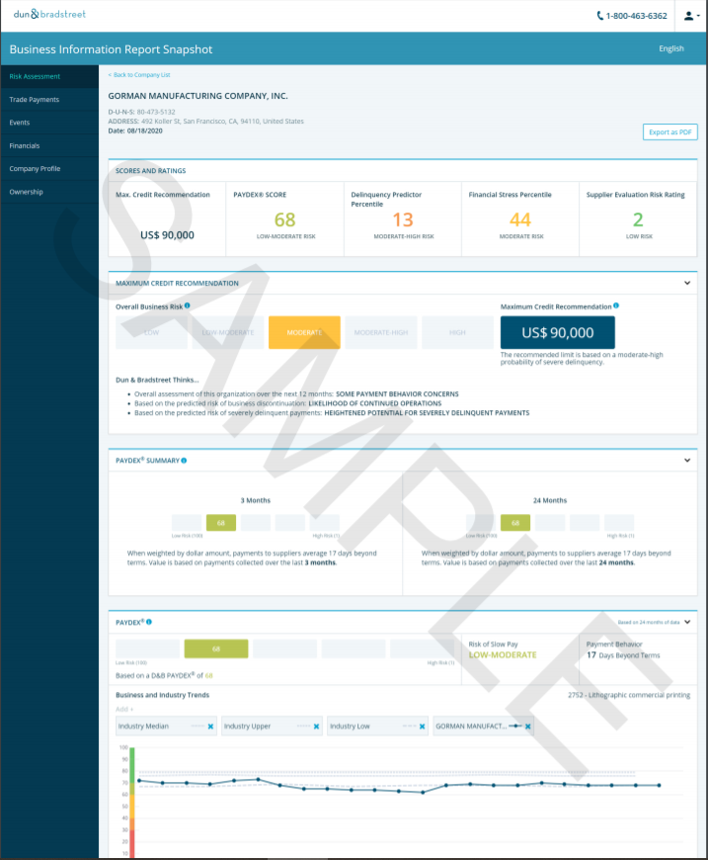
Distribution Partner Search
Credit Reports
A one-time detailed credit report that may help you assess a company’s payment history before doing business
How It Works
Use this detailed one-time report that may help mitigate potential business risks by accessing a company’s operations, financial performance, and public filing records.
Help avoid late payment defaults and assess a company’s potential business risk with straightforward risk indicators like the D&B PAYDEX® Score, D&B® Supplier Evaluation Risk (SER) Rating, and D&B® Delinquency Predictor Score.
Source : Dun & Brandstreet

Slide 55
Distribution Partner Search
Credit Reports
Worldwide Credit Reports
Get the most up-to-date financial information available on international customers.
Worldwide Credit Reports
In-Depth Credit Reports provide a comprehensive view of a company’s legal status, ownership, management, banking and finance, operational and payment history, and the latest full financial statements*. Our vetted partners conduct on-the-ground investigations of subject companies by contacting trade references, government sources and employees
Next Business Day Reports
cover more than 60 countries and offer a fast and affordable alternative to our In-Depth Credit Reports. Built upon a fresh investigation, not a database, they provide verification of a company’s legal status, basic financial information*, a predictive credit risk rating, credit recommendation, legal filings, operational history and more.
Source : https://companyinspector.com

Slide 56
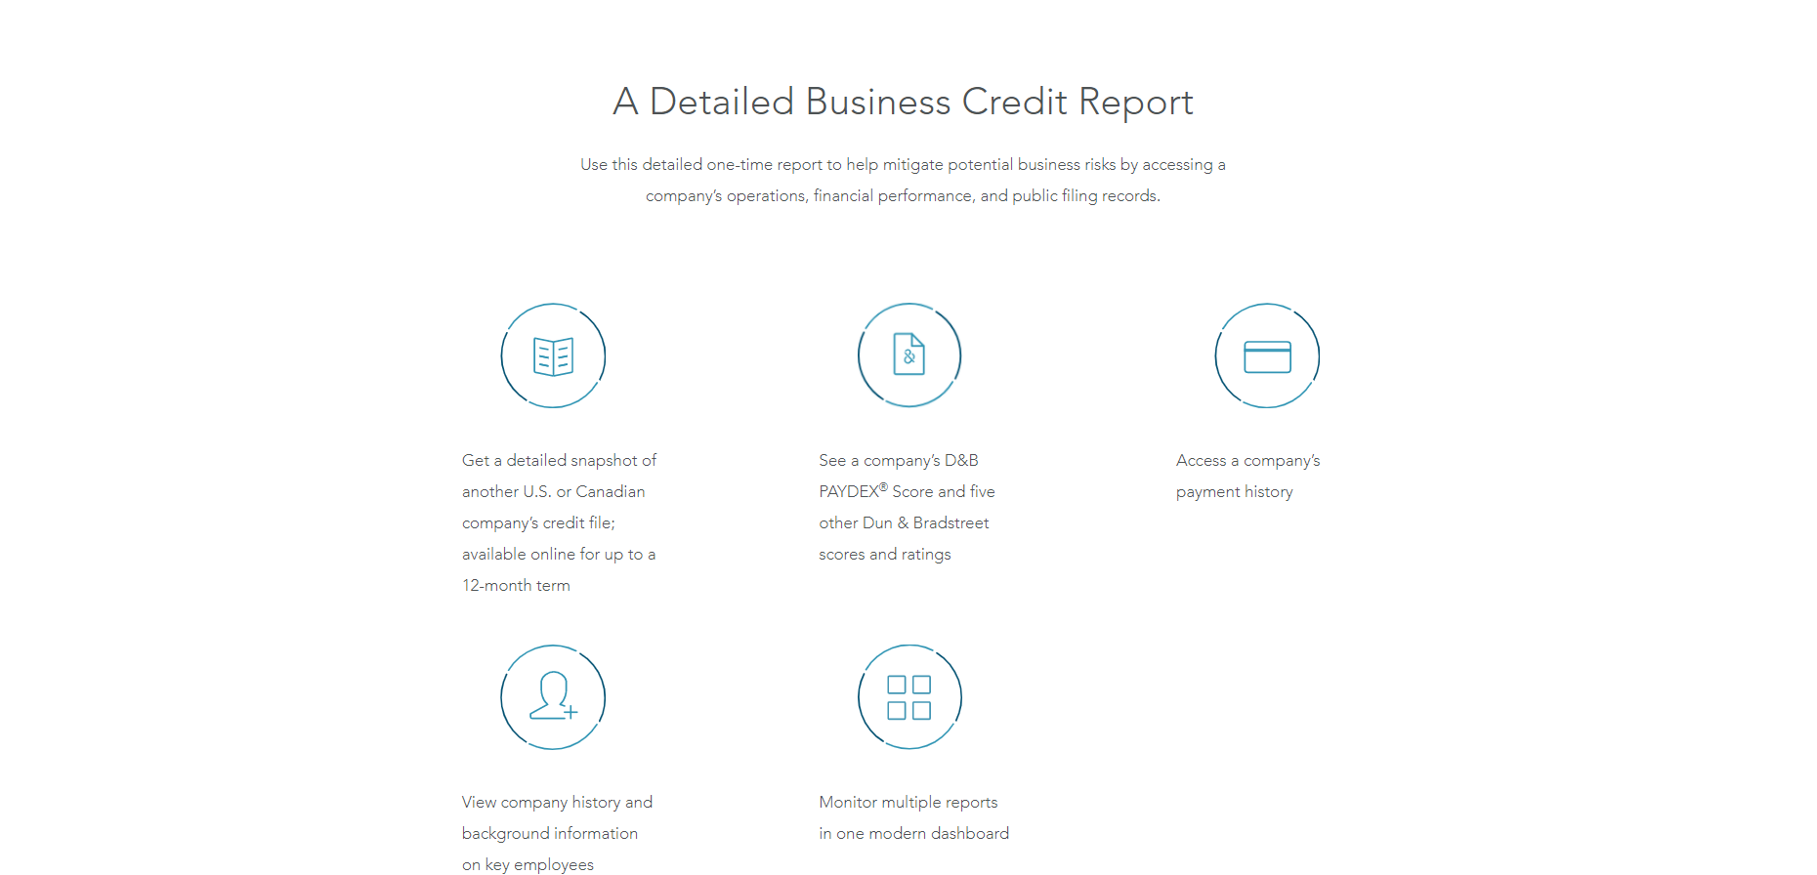
Distribution Partner Search
Credit Reports
Source : Dun & Brandstreet

Slide 57
Thank you !

Slide 58
Job Descriptions
Develop roles clearly and completely across varying levels of experience
Agreements
Draft your business agreements across a variety of areas
Templates
Templates are designed based gather information in a structured manner
KPI’s
Performance indicator, a quantifiable measure of performance over time versus a specific objective.
Content Modules
Best practice material in power point for use as a knowledge base in business training , planning and execution .
Strategic tools
These tools are recognised the world over in business schools, consulting firms and companies who plan strategically.
Gain a competitive edge using the best tools and techniques to build a better you .
Analytical Tools
Interactive excel tools on specific business areas based on your data inputs delivered in a workbook model with instructions.
Scorecards
Designed as functional or subject indicators across a variety off situations to enable performance of situational evaluation versus aligned standards.
Calculators
calculate the right ratios for businesses looking for benchmarks in a variety of situations
Assessments
Assessments are designed around specific areas to conduct reviews and will center around a benchmark reviewing individuals or functions
Checklists
Designed around achieving milestones in a sequential manner.
Research
Research tools for sales and marketing engagement

Slide 59
RETAILER
Distribution Partner Search
Engaging Markets
Covers all aspects of interviewing the potential channel / distribution partner from all angles,
Guide # 2
UpskilPRO e Institute for Sales & Marketing
Tools, Content & Templates
Hand built using experience & Insight

