Slide 1



Channel Selection & Coverage
Channel end user engagement and the sales & marketing mix .
UpskilPRO e Institute for Sales & Marketing
Tools, Content & Templates
Hand built using experience & Insight

Slide 2
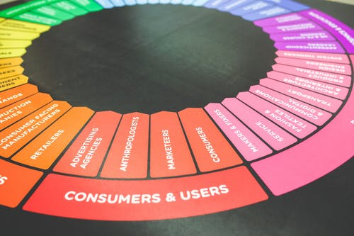

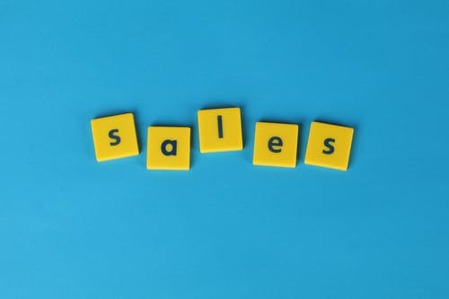

Created by
ex-Procter & Gamble, Rothmans, BAT, Gillette, Nokia,
Microsoft & 3M managers.
UpskilPRO tools are designed in easy-to-use solutions, all you need to do is download the tool and get to work immediately . All UpskilPRO material has taken 100’s of hours and many 1000’s of $ to build , all this expertise and content is brought to you for a fraction of the cost to help professionals enhance their capability.
core areas which are best suited to improve using our tools:
        Subject matter expertise
        Best practices
        Analytical output & charting
        Prioritization
        Process
        Training
Making life simpler for
Sales & Marketing professionals.
Tools in one place to get 10X productive now.

Slide 3


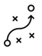

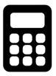
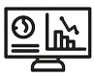
Job Descriptions
Develop roles clearly and completely across varying levels of experience
Agreements
Draft your business agreements across a variety of areas
Templates
Templates are designed based gather information in a structured manner
KPI’s
Performance indicator, a quantifiable measure of performance over time versus a specific objective.
Content Modules
Best practice material in power point for use as a knowledge base in business training , planning and execution .
Strategic tools
These tools are recognised the world over in business schools, consulting firms and companies who plan strategically.
Gain a competitive edge using the best tools and techniques to build a better you .
Analytical Tools
Interactive excel tools on specific business areas based on your data inputs delivered in a workbook model with instructions.
Scorecards
Designed as functional or subject indicators across a variety off situations to enable performance of situational evaluation versus aligned standards.
Calculators
calculate the right ratios for businesses looking for benchmarks in a variety of situations
Assessments
Assessments are designed around specific areas to conduct reviews and will center around a benchmark reviewing individuals or functions
Checklists
Designed around achieving milestones in a sequential manner.
Research
Research tools for sales and marketing engagement

Slide 4
2017
2018
100’s of tools grouped in 12 categories, 50 tool types and 12 business functions in 1 place.
get 10X productive now !
Categories
Functions
Analytical Tools
Types
Business Development
Agreements
Advertising
Customer Acquisition
Margins
Partner Search
Reports
Category Management
Assessments
Agreements
Customer Management
Market Analysis
Persona Development
Retail Measurement
Channel Management
Content Modules
Analytics
Distribution
Market Development
Planning
Reviews
Distribution
Checklists
Barriers
Distributor Management
Market Research
Positioning
Sales Management
Distributor Management
Calculators
Business Reviews
Forecasting
Market Segmentation
Pricing
Scorecards
General Management
Job Descriptions
Business Intelligence
GAP Analysis
Market Size
Prioritization
Segmentation
Key Account Management
KPI’s
Channels
Go To Market
Marketing
Product Development
Six Sigma
Marketing
Research
Communication
Job Descriptions
Marketing Comms
Product Life Cycle
Socio Economic Classification
Marketing Operations
Strategic Tools
Competitive Evaluation
Key Account Plans
Merchandising
Profit & Loss
Territory Design
Sales Management
Scorecards
Competitive Intelligence
Management Summary
New Market Entry
Promotions
Trade Marketing
Shopper Marketing
Templates
Trade Marketing

Slide 5



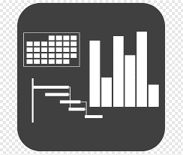




7 Benefits of using UpskilPRO :
Improve your knowledge
with professional Strategic Tools , Templates and planning documents for any business situation!
Use ready made tools
with filled in examples and ready to print & edit at your convenience . Just edit and fill-in the blanks !
Develop YOUR BUSINESS
Learn , & utilize the knowledge and processes and enhance your capabilities as the other companies have
We Created UpskilPRO for the
  Sales Professional
  Trade Marketer
  Marketing Executive
  Operations Manager
  VP/Director/Manager
100’s of tools , TEMPLATES & documents
CREATED BY
world class sales and marketing
business professionals.
All tools
are based on topics and subject based situations and are simple and easy to use .
SAVE THOUSANDS OF DOLLARS
The average company will save 1000’s of $ per employee in time & effort using our ready tools !
Top Quality Tools & Templates for developing both you and your business.
www.upskilpro.com

Slide 6
Channel Coverage

Slide 7
Channel coverage
One of the early steps in channel management is to find out which channels are relevant and how many doors or outlets there are by sectional geography to make effective decisions in coverage.

Slide 8
Channel coverage
Management Summary
Management Summary Channel management strategy and appropriate choice of channels based on data and customer throughput will be the 2 elements of our decision making capabilities in managing channels .
Mission |  |  | Vision
Financials | Top line from X Mn $ to Y Mn $ in 3 years |  | Contribution gross margins increase from 46% to 48% |  | Contribution income to increase from 19% to 23%
Channel Data |  | LY Sales | TY Plan | TY Sales | TY vs Plan | LY vs Plan
 | Channel A
 | Channel B
 | Channel C
 | Channel D
Initiatives | Budgets |  | Technologies |  | Strategic Channel Programs
Teams | Lead team |  | New Hires |  | TY Initiatives

Slide 9
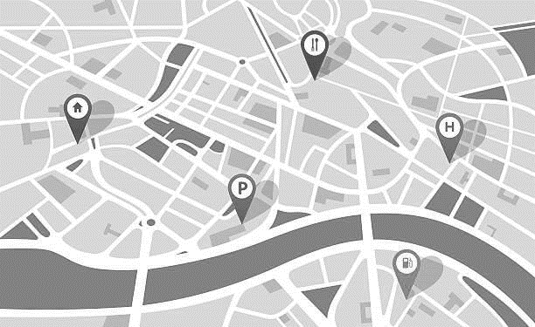




Channel coverage
Retail Census .
There are two methods to conduct a census off the number of outlets which lie within them this would cover all types of outlets within the scope off a single industry .
the task of collecting documenting and clarifying all the necessary features off the outlet including their geographical location is called is census enumeration.
Retail index
Scan track

Slide 10



Channel coverage
Retail Census .
Channels not covered
Channels covered
Wholesalers
Street vendors
Airports
Duty free
Movie theatres
Exports
Warehouse
Fitness centres
Internet cafes
Drug stores
Cash and carry
Restaurants
Coffee shops
Bakeries
Flea markets
Hypermarkets
Supermarkets
Convenience stores
Wine and liquor shops
Independent groceries
Chain groceries
The purpose off the above table is to illustrate what is covered in a retail census and who is covering it
While the above table is retail centric this is because brand owners in the consumer goods industry are able sign off a retail census with common objectives in mind
In the B to B environment it will need Taylor one of the larger brand owners 2 sign off on a census or for the research company to talk to multiple brand owners and put together a census .
the major point is it can be done for b2b but a single brand owner might find costs prohibitive .
Nielsen refer to the census as RMS or retail measurement services
Source : Nielsen retail measurement services

Slide 11
Channel coverage
Retail Census .
Market
Product
Fact
Period
Markets are a composition of geographies , channels and accounts of all sizes
Products are a composition of a total category , driven by manufacturer , brands , price segments and volume formats
Facts are a composition of the location of business, the retail price, product distribution availability , sales share and purchases by the consumer
Periods are a representation of months ( time frame ) which can be configured into days , weeks , months , and quarters running along a same period previous year basis
Source : Nielsen retail measurement services

Slide 12





Channel coverage
Retail Census What & How .
The real question is which industries have a census and how do I get a census data set for my industry .
the most popular industries which have a census for the outlets contained in their specific country geographies are mostly what in the CPG and allied industries , And this is possible mainly for outlet types which are serviced by CPG companies for the rest of the outlets which are not mainstream or serviced by CPG it's a discussion to be had quit a research organisation the type of AC Nielsen who specialise in this day to pick up as a service .
let's take an example if you wish to know how many automobile garages there are in Poland then the first call would be 2 the top ranked research agencies to ask them if they cover or if they have data for garages in Poland chances are the answer will be “no”.
then the next stage is to ask if we can commission it the cost might be prohibitive if it is a single customer and more long lasting if multiple customers were to Commission the research as costs will be lower and more data points will be accumulated .
  Option would be too look at the relevant ministry in your city such as economic department which may have compiled this data in a more basic form which may merely give you the number of outlets by city or town and nothing more.
  Option two might be to use the Yellow Pages and compile the data
  Option three might be to use online desk research capabilities and compile the data
  The three options above are purely data capture exercises what they won't do is give you the level of information exchange which the CPG companies get out of utilising Nielsen reports and data

Slide 13
Channel coverage
Territory Design

Slide 14
Channel coverage
Basic rules for efficient territory coverage and management.
Efficient territory coverage
Location mapping is important for efficient time management .
Account classification is key for managing time on site .
Locations
Account Classification
Objectives
Driving & Admin time
Objectives management are important to ensure productivity on calls.
Driving and admin time management ensure calls are well managed and documented .

Slide 15
Channel coverage
Territory Design Best Practices
Build
Build
Alignment
Build territories from the ground up aligning all characteristics and processes visible .
Align customers to territories and then to regions , this will keep the territory alignment to geograpies clear.
Balance
Alignment
Balance
Best Practices
Census
Balance territories in clear segments of channel and accounts indicating varying scales of resources needed .
Develop and publish the census of accounts to align and allow for further development using both internal and external sources and data
Quota
Census
Quota
Bill to Ship to
Quotas represent opportunity , base these on sound data and calculation to drive the economic value of a region , this will go a long way in aligning territories to teams .
Bill to
Ship to
Ensure all accounts have a bill to and ship to as the management of some accounts may be different from the physical location .

Slide 16
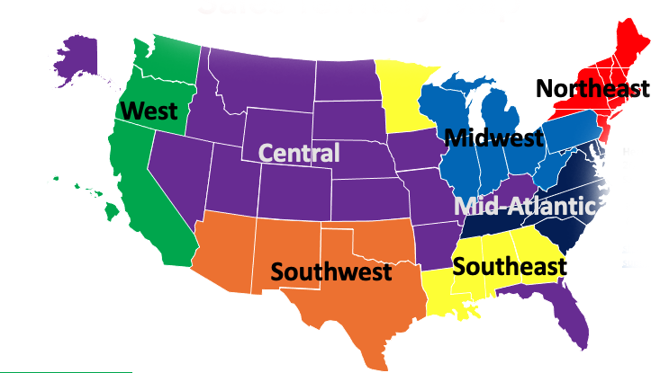
Channel coverage
What is a territory ? .
In the sales context a territory is a designated area allocated and assigned to a named territory , it may be a cluster of accounts of similar types , or dissimilar types but its common features are that it is primarily a geographical expanse , which uses a common demarcation which is either natural or man mage such as roads or rivers as an example.
The sales territory design is often different for each company but drives on common features such as , Accounts , Account types , Channels , and account classification all within demarcated geographies.

Slide 17
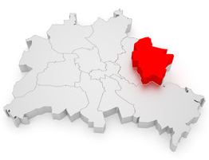
Channel coverage
Territory Features .
Territory design is both an art and a science , the best way to design a territory is to look ahead at the strategic plan and work backward to the type of territory design which matches it.
Territory 1
Account
Business
Listing
Account Type
Zip Code
Division
Category
Classification
Street
Sales Organization
Subcategory
Channel
Municipality
Product
Credit Rating
City
State
A sales territory can be as complex or simple as you desire.
Most territories evolve from analogue to a digital form which makes mapping and management much simpler , the key for territory design is to ensure the mapping tool used is interfaced with the financial system of the company to ensure data pick up and analysis
Country

Slide 18
Channel coverage
Efficient Coverage .
Make Territory Coverage Efficient
Business/Account locations
Geography and driving time
AWARENESS
DESIRE
KNOWLEDGE
ABILITY
REINFORCEMENT
Balance territories on metrics similar to the ones used to pay sales commissions
Build territories from the ground up for greater clarity and alignment
Build territories around logical geographies & customers, not sales reps.
Base quotas on opportunity , market size and actual sales from each territory
Involve field managers in the territory alignment process.

Slide 19

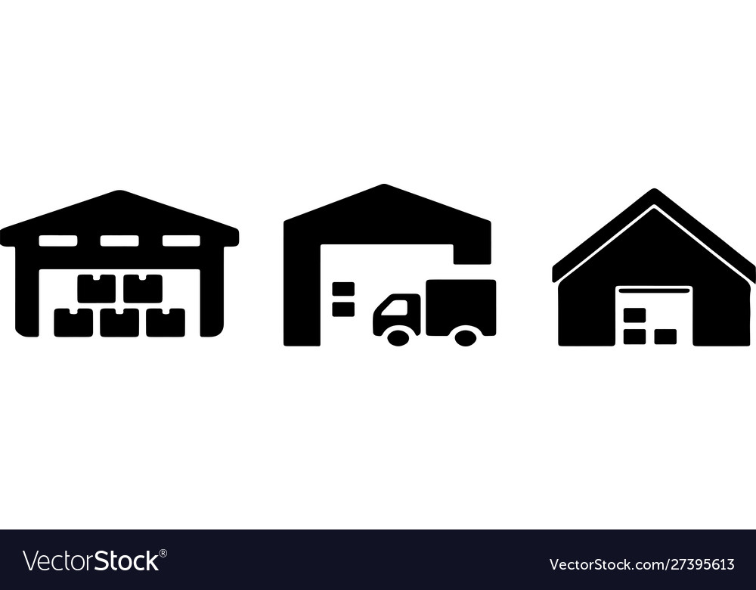


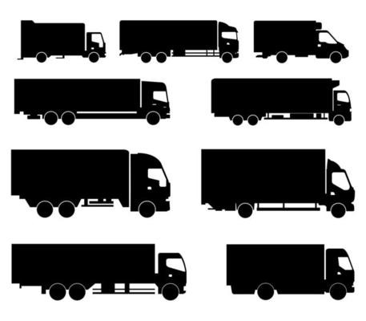
Channel coverage
Supply Chain .
Territory design implications
Territory design implications
RETAILER
Manufacturing
Inland Transportation
Distributor Or Wholesaler
Transportation
Retail
Customer
Sell in
Sell Through
( Sell to larger or smaller retailers serviced by brand owner )
POS - Sell out
( Point of sale )
End consumer
( Consumer the product)
Data capture ( Product/Outlet/ Geography ) by research companies like Nielsen
There are two different types of data capture 1 is the product sale at to retail end where in the final sale is concluded to the consumer 2 the actual documentation or sensors of the type of retail or wholesale outlet in the census in numeration tallying up from neighbourhood to city to state and finally country
This will give us the number of outlets by type for the for the assigned region
This data is usually collected based on an omnibus approach buy the bigger brand owners
This approach may not be only related to retail but can be designed and approached for any industry but the costs and timing may vary.

Slide 20
Channel coverage
Categories.
Categories
Distributors
Regions
Channels
Product Groups
Customers
White Goods
Master distributor
Pharmacies
Construction
Regional distributor
National
Construction equipment
A
Chain / Professional Buyers
Electrical
Area distributor
State / Province
Education Institutions
B
SEC Identified Groups
Retail
Stockist
District/City
Contractors & builders
C
Bachelors
SaaS
Sub Stockist
City
Showrooms / Resellers
D
Housewives
Pharmaceutical
Start up Stockist
Zip Code
Retail chains
E
Educators
Safety
Managed Distributor
Street
Supermarkets
F
Children
Schools
Managed Distributor
Electrical resellers
The basis of this model is how to reach our target market of housewives through a distribution model.
It then works backward through the regions to determine if a national level model is needed
Then works back again to a national level distributor or multiple state level distributors
Then works further back that the ideal environment for thee housewives will be to purchase the solution from a pharmacy as its more likely.
Having identified 2 possibilities from each layer , its now a matter of running a exercise to determine which of the 2 models will work for the business

Slide 21
#1
Channel coverage
nnel Description Guidelines (Example)

Slide 22
Channel coverage
Channel Description Guidelines (Example)
#2

Slide 23
Channel coverage
Channel Description Guidelines (Example)
#3

Slide 24
Channel coverage
Partner Types
This model identifies the types of features versus the service delivery capability.
In the 5 models identified we have aligned the service delivery in colour codes to indicate the relative strengths.
We recommend focussing on the Blue areas before the colour codes in order to prioritize the capability requirement.
This template is fully editable and used drop downs to indicate the relative score
We use Six Sigma scores and methodology to drive decision making for accuracy.

Slide 25
Channel coverage
Metrics
Metrics
Within the dashboard of business management, we establish key metrics from both an Internal and market perspective to help monitor and manage the business. We establish this via the balanced scorecard method from UpskilPRO.
Markets
Management
Portfolio
#6
Systems
Channel
Win/Loss
Competition
Compliance
Metrics

Slide 26
Channel coverage
Balanced Scorecard – Route to Market ( RtM)
Balanced Scorecard – Route to Market ( RtM)
Comment
This is a principal document for management of the Distributor.

Slide 27
Thank you !

Slide 28
Job Descriptions
Develop roles clearly and completely across varying levels of experience
Agreements
Draft your business agreements across a variety of areas
Templates
Templates are designed based gather information in a structured manner
KPI’s
Performance indicator, a quantifiable measure of performance over time versus a specific objective.
Content Modules
Best practice material in power point for use as a knowledge base in business training , planning and execution .
Strategic tools
These tools are recognised the world over in business schools, consulting firms and companies who plan strategically.
Gain a competitive edge using the best tools and techniques to build a better you .
Analytical Tools
Interactive excel tools on specific business areas based on your data inputs delivered in a workbook model with instructions.
Scorecards
Designed as functional or subject indicators across a variety off situations to enable performance of situational evaluation versus aligned standards.
Calculators
calculate the right ratios for businesses looking for benchmarks in a variety of situations
Assessments
Assessments are designed around specific areas to conduct reviews and will center around a benchmark reviewing individuals or functions
Checklists
Designed around achieving milestones in a sequential manner.
Research
Research tools for sales and marketing engagement

Slide 29
Channel Selection & Coverage
Channel end user engagement and the sales & marketing mix .
UpskilPRO e Institute for Sales & Marketing
Tools, Content & Templates
Hand built using experience & Insight

