Slide 1

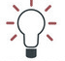

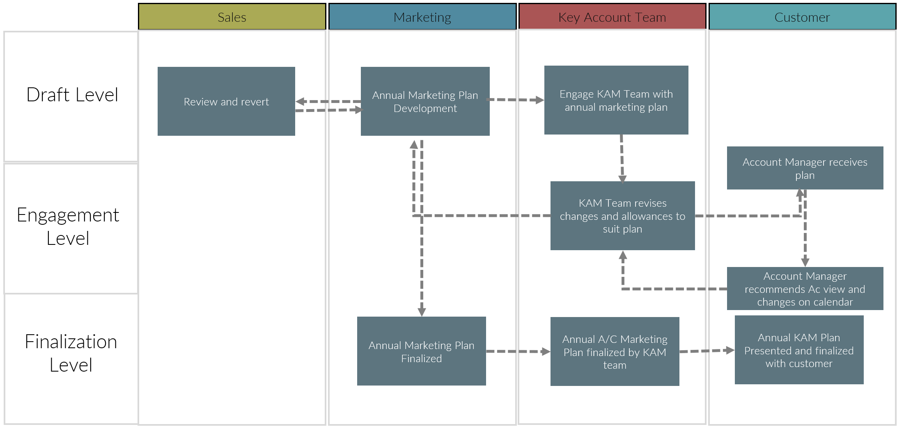
Key Account Management.
Module 9 – Deploying Processes.
Sales & Marketing Fundamentals.
UpskilPRO e Institute for Sales & Marketing
Tools, Content & Templates
Hand built using experience & insight

Slide 2
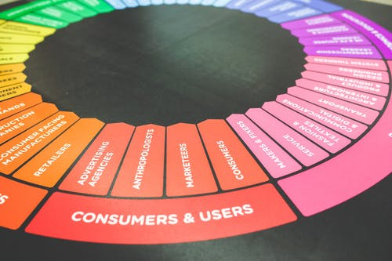



Created by
ex-Procter & Gamble, Rothmans, BAT, Gillette, Nokia,
Microsoft & 3M managers.
UpskilPRO tools are designed in easy-to-use solutions, all you need to do is download the tool and get to work immediately . All UpskilPRO material has taken 100’s of hours and many 1000’s of $ to build , all this expertise and content is brought to you for a fraction of the cost to help professionals enhance their capability.
core areas which are best suited to improve using our tools:
        Subject matter expertise
        Best practices
        Analytical output & charting
        Prioritization
        Process
        Training
Making life simpler for
Sales & Marketing professionals.
Tools in one place to get 10X productive now.

Slide 3


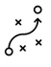



Job Descriptions
Develop roles clearly and completely across varying levels of experience
Agreements
Draft your business agreements across a variety of areas
Templates
Templates are designed based gather information in a structured manner
KPI’s
Performance indicator, a quantifiable measure of performance over time versus a specific objective.
Content Modules
Best practice material in power point for use as a knowledge base in business training , planning and execution .
Strategic tools
These tools are recognised the world over in business schools, consulting firms and companies who plan strategically.
Gain a competitive edge using the best tools and techniques to build a better you .
Analytical Tools
Interactive excel tools on specific business areas based on your data inputs delivered in a workbook model with instructions.
Scorecards
Designed as functional or subject indicators across a variety off situations to enable performance of situational evaluation versus aligned standards.
Calculators
calculate the right ratios for businesses looking for benchmarks in a variety of situations
Assessments
Assessments are designed around specific areas to conduct reviews and will center around a benchmark reviewing individuals or functions
Checklists
Designed around achieving milestones in a sequential manner.
Research
Research tools for sales and marketing engagement

Slide 4
2017
2018
100’s of tools grouped in 12 categories, 50 tool types and 12 business functions in 1 place.
get 10X productive now !
Categories
Functions
Analytical Tools
Types
Business Development
Agreements
Advertising
Customer Acquisition
Margins
Partner Search
Reports
Category Management
Assessments
Agreements
Customer Management
Market Analysis
Persona Development
Retail Measurement
Channel Management
Content Modules
Analytics
Distribution
Market Development
Planning
Reviews
Distribution
Checklists
Barriers
Distributor Management
Market Research
Positioning
Sales Management
Distributor Management
Calculators
Business Reviews
Forecasting
Market Segmentation
Pricing
Scorecards
General Management
Job Descriptions
Business Intelligence
GAP Analysis
Market Size
Prioritization
Segmentation
Key Account Management
KPI’s
Channels
Go To Market
Marketing
Product Development
Six Sigma
Marketing
Research
Communication
Job Descriptions
Marketing Comms
Product Life Cycle
Socio Economic Classification
Marketing Operations
Strategic Tools
Competitive Evaluation
Key Account Plans
Merchandising
Profit & Loss
Territory Design
Sales Management
Scorecards
Competitive Intelligence
Management Summary
New Market Entry
Promotions
Trade Marketing
Shopper Marketing
Templates
Trade Marketing

Slide 5








7 Benefits of using UpskilPRO :
Improve your knowledge
with professional Strategic Tools , Templates and planning documents for any business situation!
Use ready made tools
with filled in examples and ready to print & edit at your convenience . Just edit and fill-in the blanks !
Develop YOUR BUSINESS
Learn , & utilize the knowledge and processes and enhance your capabilities as the other companies have
We Created UpskilPRO for the
  Sales Professional
  Trade Marketer
  Marketing Executive
  Operations Manager
  VP/Director/Manager
100’s of tools , TEMPLATES & documents
CREATED BY
world class sales and marketing
business professionals.
All tools
are based on topics and subject based situations and are simple and easy to use .
SAVE THOUSANDS OF DOLLARS
The average company will save 1000’s of $ per employee in time & effort using our ready tools !
Top Quality Tools & Templates for developing both you and your business.
www.upskilpro.com

Slide 6





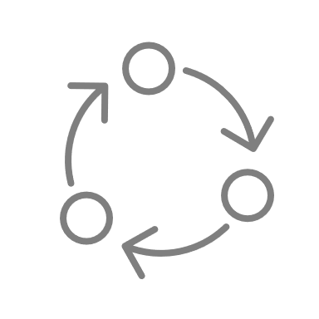


Deploying KAM Processes
Directional Summary
KAM is a continual process, not a project !
Companies today rely on processes to deliver value to customers , because at the core of a business are processes which help deliver that value and service to a customer , the same way every time , irrelevant of the location .
Processes are designed from start to finish for tasks , whether it be a service or a product mapping all relevant areas , stakeholders and the customer in mind, , this ensures track ability and measurability with a view to improvement.
Once a process has been used , its always a good idea to go back and audit the process specially in terms of the various key accounts its delivering a service to in areas where you find the service is being delivered in a grey manner , or that it is adding no value , this is the start of not only auditing the service but changing the process delivery to deliver the same claim made to the customer

Slide 7







Deploying KAM Processes
Directional Summary
Strategic
Value Realization
Operational
Selecting attractiveness criteria and key customers
Managing the customer portfolio
Considering implications of customer strategies
Incorporating account plans in business planning
Allocating/prioritizing resources
Assessing and managing risk to the company
Sponsoring key customers
Coordinating across boundaries
Enabling organizational learning.
Analysing key accounts, developing strategy and planning
Developing relationships with customers
Developing business, capturing opportunities
Selling and negotiating
Pricing
Developing new products
Customizing products and service
Managing the product mix
Developing marketing programmes
Developing the supply chain
Developing transaction handling
Providing customer training.
Developing internal relationships
Providing information.
Selling
Processing orders
Manufacturing/operations
Servicing customers
Delivering to customers
Collecting payment.

Slide 8
Deploying KAM Processes
Directional Summary
Sales
Marketing
Key Account Team
Customer
Draft Level
Review and revert
Annual Marketing Plan Development
Engage KAM Team with annual marketing plan
Account Manager receives plan
KAM Team revises changes and allowances to suit plan
Engagement Level
Account Manager recommends Ac view and changes on calendar
Finalization Level
Annual Marketing Plan Finalized
Annual A/C Marketing Plan finalized by KAM team
Annual KAM Plan Presented and finalized with customer

Slide 9
Deploying KAM Processes
Audit / Scoring Matrix for evaluating supplier process
Delivering Customer Expectations
11002
Attributes | Process |  |  |  |  |  | Score
 | A | B | C | D | E | F
Cost
Information
Transparent
Integratable
Fast
Flexible
Robust
Average Score
Flexible: Responsive to the customer’s needs and open to customization.
Fast: Performance to agreed timing is generally what is required but, when speed is important, the process needs to be able to shift up a gear to meet that need.
Integratable’: Aligned and able to integrate with customers’ processes, based on the same or a complementary framework to ensure a smooth ‘handshake’.
Robust: Reliable delivery to expectation every time, not fragile or likely to collapse under pressure or change.
Transparent: Able to answer questions like ‘What is happening now? What progress has been made?’
informative: To yield accurate, accessible, manageable performance measurement.
Costed: Suppliers (possibly customers too) should have an understanding of where the costs are so the cost/saving impact of changes can be discussed.
Flexible : the process must be adaptable to suit customer requirements as having a great process that only works for the supplier doesn’t augur well for KAM development.
As you start engaging key customers who are larger , you will experience changes required , and customers expect those changes with minor disruption to their processes and engagement .This is when the more multi-level contacts you have developed will help deliver those changes with great value and minimal disruption

Slide 10
Deploying KAM Processes
Audit / Scoring Matrix for evaluating supplier process
A scoring matrix can be used to evaluate how suppliers are doing versus other similar suppliers and versus bench mark set up by the customer , the more you are prepared the better you can manage expectations
This tool is available for download at www.upskilpro.com please use the number in the red box at top right

Slide 11
Deploying KAM Processes
Relationship development and stages in a process
Strategic Plan Development
Role mapping to functions and individuals
A process has a number of advantages for instance
It can be monitored
It can be compared
People can see where to help
viewing a process improve speed and certainty of delivery
missing steps is unlikely
Identify key areas to develop
Customer Understanding of relationship management
Review and Score each relationship for importance
Summarize
Current Relationship
Score desired state of relationship planned
Identify team building process
Summarize
Desired Relationship
Review the state of the business
Launch the Plan for link building
Identify a simple point of convergence to get team building activities going ideally.
Study functions and individuals
Development plan
in terms of goals , objectives and aspirations desired state of relationship
Evaluate
Monitor
Review
This is the plan that will get your team and individual relationships going , do not underestimate this .
Develop the strategy on the how, when , what .

Slide 12
Deploying KAM Processes
Measuring Management Engagement.
Measuring Management Engagement
Measuring senior leadership engagement defines whether KAM stays as a service or becomes a function within the organisation and is given the importance and resources to thrive and deliver a stellar performance , quite often leadership support makes the rest of the organisation aware of the upcoming importance of KAM and its relevance to the wider organisation , this is specifically relevant to organisations where some form of KAM is practiced but KAM still remains a service and not a full function.
How do we create an engagement dashboard for leadership
At this stage we have covered the launch of the KAM role in previous chapters , we are merely trying to get alignment between the KAM function and the leadership attention and mentoring that the role deserves.
For this we recommend developing a similar or same tool that captures 5 to 10 key points relevant to the function and the leadership position towards the function. As you will see we have graded leadership engagement across 4 layers of 0 to 9 in 4 layers.
Using just 4 layers of scoring makes choices difficult and yet clearer, whether you use 4- or 10-point rating scale it’s the vertical pointers which need to be most relevant to your task of leadership attributes / for engagement.
Use these engagement matrices every quarter or half year to evaluate engagement and use these in your management meetings for briefing.
This tool is available for download at www.upskilpro.com please use the number in the red box at top right

Slide 13
Deploying KAM Processes
Measuring Management Engagement.
A scoring matrix can be used to evaluate how suppliers are doing versus other similar suppliers and versus bench mark set up by the customer , the more you are prepared the better you can manage expectations
This tool is available for download at www.upskilpro.com please use the number in the red box at top right

Slide 14

Deploying KAM Processes
Measuring Management Engagement.
Change always goes “Top to Bottom”
There are 3 situations in companies
Don’t need KAM
Have KAM not sure where it belongs
Driving KAM engagement
Its possible that some companies will come through the 3 levels , whilst others will pretend they have KAM while its playing more of a sales role .
To get to position #3 you will need management support , and that will need more than words of assurance.
You will need to engage Top Management to get KAM prioritized .
Developing a schedule of meetings
Developing an Agenda
Developing a system of measurement to engage top management with data in the form of internal engagement ( this is apart from market based data )
Presenting KAM on a Scheduled basis with objectives and achievements which are documented.
KAM is a process , not a project !
This tool is available for download at www.upskilpro.com please use the number in the red box at top right.

Slide 15
Deploying KAM Processes
Process Steps – Business Development Planning
Opportunity
Engagement
Data Gathering
Opportunity analysis
& Prioritization
Analysis & Planning
Output Plan
Monitor
Review
Results & Costs
Summary analysis
Scoping
Team Structure
Business analysis
Competitive evaluation
Risks and rewards
Budgets & resources
Forecasts
Evaluate markets & channels
Prioritization matrix
Align opportunity criteria
Run opportunity analysis
Segregate results into descending order
Align components of plan
Align decision makers
Align milestones
Business Development Planning ( KAM )
BDP tends to be a more long drawn effect of planning as its meant to be ahead of the sales cycle.
Opportunity development is often more strategic and based on clear data and market analysis which is actionable
BDP is based on defined goal posts of how to achieve a winning proposition , and the elements required to execute the plan
BDP tends to work off a sizeable amount of data analysis and market and customer engagement.

Slide 16
Thank you !

Slide 17
Job Descriptions
Develop roles clearly and completely across varying levels of experience
Agreements
Draft your business agreements across a variety of areas
Templates
Templates are designed based gather information in a structured manner
KPI’s
Performance indicator, a quantifiable measure of performance over time versus a specific objective.
Content Modules
Best practice material in power point for use as a knowledge base in business training , planning and execution .
Strategic tools
These tools are recognised the world over in business schools, consulting firms and companies who plan strategically.
Gain a competitive edge using the best tools and techniques to build a better you .
Analytical Tools
Interactive excel tools on specific business areas based on your data inputs delivered in a workbook model with instructions.
Scorecards
Designed as functional or subject indicators across a variety off situations to enable performance of situational evaluation versus aligned standards.
Calculators
calculate the right ratios for businesses looking for benchmarks in a variety of situations
Assessments
Assessments are designed around specific areas to conduct reviews and will center around a benchmark reviewing individuals or functions
Checklists
Designed around achieving milestones in a sequential manner.
Research
Research tools for sales and marketing engagement

Slide 18
Key Account Management.
Module 9 – Deploying Processes.
Sales & Marketing Fundamentals.
UpskilPRO e Institute for Sales & Marketing
Tools, Content & Templates
Hand built using experience & insight

