Slide 1

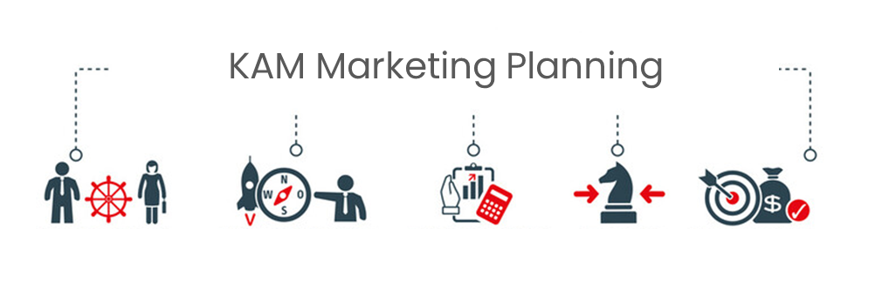
Trade Marketing Plans
Trade Marketing Plans
Sales & Marketing Fundamentals.
UpskilPRO e Institute for Sales & Marketing
Tools, Content & Templates
Hand built using experience & insight

Slide 2
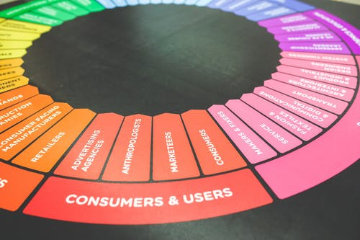



Created by
ex-Procter & Gamble, Rothmans, BAT, Gillette, Nokia,
Microsoft & 3M managers.
UpskilPRO tools are designed in easy-to-use solutions, all you need to do is download the tool and get to work immediately . All UpskilPRO material has taken 100’s of hours and many 1000’s of $ to build , all this expertise and content is brought to you for a fraction of the cost to help professionals enhance their capability.
core areas which are best suited to improve using our tools:
        Subject matter expertise
        Best practices
        Analytical output & charting
        Prioritization
        Process
        Training
Making life simpler for
Sales & Marketing professionals.
Tools in one place to get 10X productive now.

Slide 3


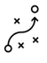



Job Descriptions
Develop roles clearly and completely across varying levels of experience
Agreements
Draft your business agreements across a variety of areas
Templates
Templates are designed based gather information in a structured manner
KPI’s
Performance indicator, a quantifiable measure of performance over time versus a specific objective.
Content Modules
Best practice material in power point for use as a knowledge base in business training , planning and execution .
Strategic tools
These tools are recognised the world over in business schools, consulting firms and companies who plan strategically.
Gain a competitive edge using the best tools and techniques to build a better you .
Analytical Tools
Interactive excel tools on specific business areas based on your data inputs delivered in a workbook model with instructions.
Scorecards
Designed as functional or subject indicators across a variety off situations to enable performance of situational evaluation versus aligned standards.
Calculators
calculate the right ratios for businesses looking for benchmarks in a variety of situations
Assessments
Assessments are designed around specific areas to conduct reviews and will center around a benchmark reviewing individuals or functions
Checklists
Designed around achieving milestones in a sequential manner.
Research
Research tools for sales and marketing engagement

Slide 4
2017
2018
100’s of tools grouped in 12 categories, 50 tool types and 12 business functions in 1 place.
get 10X productive now !
Categories
Functions
Analytical Tools
Types
Business Development
Agreements
Advertising
Customer Acquisition
Margins
Partner Search
Reports
Category Management
Assessments
Agreements
Customer Management
Market Analysis
Persona Development
Retail Measurement
Channel Management
Content Modules
Analytics
Distribution
Market Development
Planning
Reviews
Distribution
Checklists
Barriers
Distributor Management
Market Research
Positioning
Sales Management
Distributor Management
Calculators
Business Reviews
Forecasting
Market Segmentation
Pricing
Scorecards
General Management
Job Descriptions
Business Intelligence
GAP Analysis
Market Size
Prioritization
Segmentation
Key Account Management
KPI’s
Channels
Go To Market
Marketing
Product Development
Six Sigma
Marketing
Research
Communication
Job Descriptions
Marketing Comms
Product Life Cycle
Socio Economic Classification
Marketing Operations
Strategic Tools
Competitive Evaluation
Key Account Plans
Merchandising
Profit & Loss
Territory Design
Sales Management
Scorecards
Competitive Intelligence
Management Summary
New Market Entry
Promotions
Trade Marketing
Shopper Marketing
Templates
Trade Marketing

Slide 5








7 Benefits of using UpskilPRO :
Improve your knowledge
with professional Strategic Tools , Templates and planning documents for any business situation!
Use ready made tools
with filled in examples and ready to print & edit at your convenience . Just edit and fill-in the blanks !
Develop YOUR BUSINESS
Learn , & utilize the knowledge and processes and enhance your capabilities as the other companies have
We Created UpskilPRO for the
  Sales Professional
  Trade Marketer
  Marketing Executive
  Operations Manager
  VP/Director/Manager
100’s of tools , TEMPLATES & documents
CREATED BY
world class sales and marketing
business professionals.
All tools
are based on topics and subject based situations and are simple and easy to use .
SAVE THOUSANDS OF DOLLARS
The average company will save 1000’s of $ per employee in time & effort using our ready tools !
Top Quality Tools & Templates for developing both you and your business.
www.upskilpro.com

Slide 6
Trade Marketing Plans.
Directional Summary
Trade Marketing Plans set the tone for ensuring that the marketing objectives are translated into engaging the customer at the category or in specific events , this is the part where the actual engagement between company , customer , brand and category takes place.

Slide 7
Executive Summary |  | Page No
1.0 | Summary
 | Corporate Objectives and Mission Statement
 | Market specifics
 | Category overview
 | Customer overview
 | Channel Overview
 | Key Opportunities identified (B2B & B2C)
 | Priority Categories and Brands
2.0 | Analysis
 | Market sizing / Channel Sizing
 | Key Channels and Customers
 | Competitive analysis
 | Opportunities and threats
3.0 | Resources
 | Human resource plan
 | POS Resources
 | Investments plan
4.0 | Tactics
 | Brands channels and tactics
 | Branding Plans
 | Communication Plans
 | POS Plan
 | High level tactical calendar
5.0 | P&L
 | Marketing ROI and Ratios
6.0 | Conclusions
 | Recommendations and Reviews
Trade Marketing Plan.

Slide 8
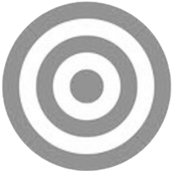
Trade Marketing Planning Process.
Corporate Objectives
Corporate objectives usually contain at least the following elements:
Such a corporate plan, containing projected profit and loss accounts and balance sheets, being the result of the process described above, is more likely to provide long-term stability for a company than plans based on a more intuitive process containing forecasts , technologies , trends etc
Summary
The desired level of profitability
Business boundaries
  What kind of products will be sold to what kinds of markets
  (marketing)
  What kinds of facilities will be developed (operations, R&D,
  information systems, distribution, etc.)
  The size and character of the labour force (personnel)
  Funding (finance)
Other corporate objectives, such as social responsibility, corporate image, stock market image, employer image, etc.
Trade Marketing
Focus on Markets / Customers &
Products
Corporate
OBJECTIVES
Business
Focus on resources which must be applied on your markets
Corporate
This covers business plans based specifically on each business vertical

Slide 9
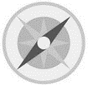
Trade Marketing Plans.
Mission Statements
Mission Statement
A Trade marketing plan should begin with a mission or purpose statement.
This is perhaps the most difficult aspect of trade marketing planning for managers to master, because it is largely philosophical and qualitative in nature. Many organizations find their different departments, and sometimes even different groups in the same department, pulling in different directions, often with poor results, simply because the organization hasn’t defined the boundaries of the business and the way it wishes to do business.
The following should appear in a mission or purpose statement, which
should normally run to no more than one page:
Role or contribution
Profit (specify), or
Service, or
Opportunity seeker
Business definition – define the business, preferably in terms of the benefits
you provide or the needs you satisfy, rather than in terms of what you
make.
Distinctive competences – these are the essential skills/capabilities resources that underpin whatever success has been achieved to date.
Competence can consist of one particular item or the possession of a number
of skills compared with competitors. If, however, you could equally
well put a competitor’s name to these distinctive competences, then they
are not distinctive competences.
Indications for the future
What the firm will do
What the firm might do
What the firm will never do
Mission
STATEMENT
1

Slide 10
Trade Marketing Planning Process.
Marketing Objectives
An objective is what you want to achieve.
A strategy is how you plan to achieve your objectives ,
Tactics are a series of steps engaged in to deliver the strategy
Trade Marketing Plans
There can be objectives and strategies for varying levels in trade marketing.
Overall Trade marketing objectives are brand driven and resultant in shelf offtake and market share gains in general versus identified competition, its important this aligns with the business and corporate direction.
Tactically for example, there can be branding objectives , category presence, POS, Display , Consumer engagement, displays, consumer contacts, volume offtake, market share improvement etc , all of which are framed differently and come one level below in the tactical engagement part, and strategies and pricing objectives and strategies.
However, the important point to remember about trade marketing objectives is that they are about products and markets. Common sense will confirm that it is only by selling something to someone that the company’s financial goals can be achieved, and that advertising, pricing, service levels, are the means (or tactics) by which we might succeed in doing this.
Objectives should be capable of measurement, Directional terms such as “maximize”, “minimize”, “penetrate”, “increase”, etc. are only acceptable if quantitative measurement can be attached to them. Measurement should be in terms of some, or all, of the following: sales volume, sales value, market share, profit, and percentage penetration of outlets (e.g. to have 25% of all retail outlets stocking our product by year 2).
The elements of Trade Marketing are reflected in the below matrix requiring a prioritized manner of application
Markets | Account | Category
Portfolio | Budgets | Customers
Tactics | Timeframe | Organisation

Slide 11
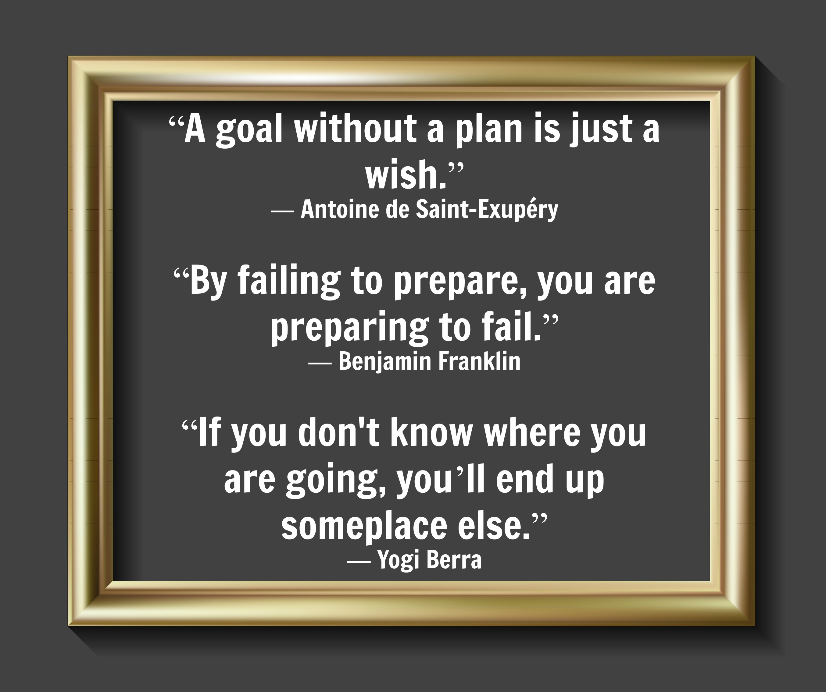

Slide 12


Trade Marketing
Examples of TM .
Brand marketing talks to people , Trade Marketing talks with them.
Category
POS
Retailer
Consumer
ROI
Promotions

Slide 13
Trade Marketing
Building a Trade Marketing Plan everybody can follow .
Start with a deep dive business review which includes brand levels and review every area surrounding the brand.
Market : Macro view economic indicators , consumer behaviour , technology and political trends regarding the category .
Consumer : Target buying habits , trends , consumer enemies , key insights
Channels : Growth channels ,major customers , available tools and key programs
Competitors: Performance , positioning , innovation , pricing , and distribution
Brand : Funnel , results , pricing , distribution , and basic financial analysis
Focus on strategic questions which in turn will help you frame key issues which are brand facing
Strategic Framing
What is the core strength of your brand , that it wins on
How well engaged is your consumer to the brand
Dwell on your current competitive position
Focus on business situations the brands face
Summarize drivers and inhibitors currently that are brand facing and then opportunities
Use the strategic framing to elucidate into key issues and strategies.
Drivers
Inhibitors
Key Issues
Focus on growth priorities such as new users and frequency among current users
Focus on trade marketing related distribution gaps
Focus on any new developments in the market or challenges
Strategies
Drive trial post launch by a trade marketing calendar focussing on the brand positioning
Engage sales to fix specific high value distribution gaps
Communicate at ground level with brand
Factors that hasten or slow your brand growth
Weaknesses that are directly brand facing
Opportunities
Threats
Stress on changing consumer needs , technologies , and channels
Focus on competitors , customer barriers , and consumer preferences

Slide 14
Trade Marketing
Examples of TM .
9052
Trade Marketing Vision : To be the most effective function engaging the trade and delivering category growth along with innovative promotions to increase users of our brands
Analysis |  | Strategies | Channels & Target Market | Execution Plans
P&L Forecast Sales Gross Margin GM Marketing Expenses Contribution Margin | 350,000 $ 175,000$ 50% 45,000$ | Key Issues What is the priority choice for growth , is it driven by new users , new accounts or new categories and engagement ? Where should we invest our trade marketing resources How do we prioritize accounts Which categories will we drive and what is the category prioritization | Core Channels will be as follows Hyper Markets DIY Stores Hardware Stores | Tactical Advertising Use advertising in a trade marketing sense tactically to drive consumer engagement , utilizing social media engagement and localized radio formats to target specific accounts or regions
Drivers Consumers are looking for a new speed drill and the high trials to conversion indicates a sales opportunity Excellent brand awareness for the mother brand |  |  | Hypermarkets will be dominant players in the tools category and have separate sections to develop a category approach , and will be home to multiple brands of power tools and related categories | Sampling Drive trials and initiatives with instore sampling across mapped channels and chains to each category and rand for delivering effective engagement and customer acquisition .
Inhibitors Price points are at a premium of 10 % Distribution is high on VW and Low on ND |  | Tactics | DIY Stores will be our most prominent channel as the traditional power tool user shops at DIY stores to get both his application knowledge and the power tool of choice | Promotions Deliver consumer promotions which are carefully balanced in cost terms and aimed at target markets in effective easy to use packaging and communication in high visibility placements and positions
Risks None observed |  | #1 Increase penetration of core channel from 18 to 25% | Hard ware Stores will be a support channel as they will stock up product and resupply all smaller customers and channels where the shopper goes to
Opportunities The 4 Variants of the drill favour the DIY enthusiasts DIY Stores are a large untapped opportunity Social media channels are a great way to influence the target market |  | #2 Develop and monitor usage panel in core customers ensuring steady loyalty |  | Point of sale material Create effective and highly visible point of sale material in conjunction with brand marketing to stock our initiatives in key locations and drive impulse purchasing engagement.
 |  | #3 Develop specific promotion plan for categories to enable brand switch which includes sampling
 |  | #4 Target 0 losses on shelf due
Comments : You may use sales data generated at a store level for your Trade Marketing P&L.
Please differentiate between sell or shipment inwards data and sell out or shipment out data between trade channels and manufacturers.

Slide 15
Trade Marketing
Examples of TM .

Slide 16
Trade Marketing
Examples of TM .

Slide 17
Trade Marketing
Examples of TM .

Slide 18
Trade Marketing Analysis

Slide 19
Trade Marketing Plan.
Trade Marketing Objectives
Business | XX | Market | AA
Brand | YY | Area | ZZ
Objective | To Increase the brand market share of brand XX from 3.2 % to 5 % in Walmart , Mississauga , by conducting a consumer promotion of Buy 2 Get 1 free in the 300ML size along with POS placements and in store promotion during the period of Jan 1 to Jan 30
Objective | 3.2 % | 5% | Gain of 1.8%
Review Date 15 Feb | Name
Initiator 1
Reviewer 2
Reviewer 3
Objectives should be
Specific
Measurable
Actionable
Relevant
Timebound

Slide 20
Trade Marketing Plan.
Market Specifics
Overview | Data | Commentary | Basic Analysis
Business
Brand | Market Size | Competitive analysis | Strengths
Category | Market value | Brand reviews | Weaknesses
Account / Customers | Brand Shares Volume | Channel reviews | Opportunities
Competing brands | Brand Shares in $ |  | Threats
The above pertains to useful information on one sheet as the idea of trade marketing is to review one category and brand at a time , including conflicting brands and categories into one analysis will not serve any clear purpose.

Slide 21
Trade Marketing Plan.
Market & Channel Sizing
Market | Category | Sub-Category | Brand
Oklahoma | Home cleaning | Floor cleaning | AAA & BBB
 | Previous year | Last Year | This Year
Category size | 459 mn $ | 512 mn $ | 569Mn$
Customer Size / Turnover | 35.00 Mn $ | 36.9mn$ | 39.1 Mn $ ( Est )
Competing Brands | None | Competing brand XX
Dominant Channels | Garages & Dealerships
Support channels | DIY
Category size in units | 75,000 | 82500 | 90150 Est
Category size in $ | 459 mn $ | 512 mn $ | 529Mn$
Brand shares in $ | 7.6% | 7.20 % | 7.39%
Brand shares in %

Slide 22
Trade Marketing Plan.
Key Opportunities identified
Business | Brand | Channel | Category | Customer
Brand Share
Distribution Gaps
Pricing
Volume
Store Branding
Category Branding
POS Placement
Check out placement
Shelf Share
Category relaying
Branding
Communication engagement
Consumer Promotions
Trade Promotions
Sampling
Direct Mail

Slide 23
Trade Marketing Plan.
Priority Categories & Brands
Priorities | Priority Level | Comments
Brand
Brand A | Drive Brand
Brand B | Support Brand
Brand C | Maintain Brand
Brand D | Maintain Brand
Segment
Segment A | Expand Segment
Segment B | Consolidate Segment
Segment C | Maintain Segment
Segment D | Maintain Segment
Categories
Category A | Focus Category
Category B | Focus Category
Category C | Support Category
Category D | Maintain |category

Slide 24
Trade Marketing.
Category Overview
Business | XX | Market | AA
Category | Batteries and Chargers
Category size
Competing Brands
Category segmentation
Dominant Channels
Support channels
Category size in units
Category size in $
Brand shares in $
Brand shares in %
The above data can be generally in 1 or 2 ways
For some categories or companies , it may a cost that they might not to spend , in that case a market estimation using metrics is recommended
Retail audit companies and some other research companies generally provide the above data on request for a few

Slide 25
Trade Marketing Plan.
Customer Overview
Business | Country | State | City
Customer | Pentagon Enterprises LLC , Florida
Category | Batteries and Chargers
Brand | Cider Batteries
 | Previous year | Last Year | This Year
Category size | 459 mn $ | 512 mn $ | 569Mn$
Customer Size / Turnover | 35.00 Mn $ | 36.9mn$ | 39.1 Mn $ ( Est )
Competing Brands | None | Competing brand XX
Dominant Channels | Garages & Dealerships
Support channels | DIY
Category size in units | 75,000 | 82500 | 90150 Est
Category size in $ | 459 mn $ | 512 mn $ | 529Mn$
Brand shares in $ | 7.6% | 7.20 % | 7.39%
Brand shares in %
The data above is mainly pertinent to Trade marketing requirements as a basic format , this is not to be mistaken as a key account template or set of information for the purposes of the exercise

Slide 26
Trade Marketing Plan.
Channel Overview
Business | XX | Market | AA
Category | Batteries and Chargers
Category size | 459 mn $ | 512 mn $ | 529Mn$
Competing Brands | Previous year | Last Year | This Year
Brand A | 17.2% | 17.4% | 18.9%
Brand B | 9.5% | 10.5% | 12%
Brand C | 24% | 18% | 16%
Channel segmentation
Garages | 38% | 40% | 41%
DIY | 25% | 24% | 23%
Auto Dealerships | 22% | 19% | 17%
Electric Shops | 15% | 17% | 19%
Brand shares in %
Brand A | 23% | 25% | 27%
Brand B | 19% | 20% | 18%
Brand C | 16% | 17% | 17%
The data above is mainly pertinent to Trade marketing requirements as a basic

Slide 27
Trade Marketing Plan.
Key Channels
Channels | Market Contribution $ | Market Contribution % | Business Contribution $ | Business Contribution % | Strategies | Prioritization
Channel A |  |  |  |  | All Category dominance , complete branding and annual TM plan tie up for all major categories | Drive Channel
Channel B |  |  |  |  | All Category dominance , complete branding and annual TM plan tie up for all major categories | Drive Channel
Channel C |  |  |  |  | Specific Category dominance , situational branding engagement and thematic TM plan tie up for all agreed categories only | Support Channel
Channel D |  |  |  |  | Specific Category dominance , situational branding engagement and thematic TM plan tie up for all agreed categories only | Support Channel
Channel E |  |  |  |  | Assign category engagement based on opportunistic engagement specific to channel dynamics and agreements | Maintain Channel
Channel F |  |  |  |  | Assign category engagement based on opportunistic engagement specific to channel dynamics and agreements | Maintain Channel
Channel G |  |  |  |  | Assign category engagement based on opportunistic engagement specific to channel dynamics and agreements | Maintain Channel
Totals | US $ | 100% | US$ | 100%

Slide 28
Trade Marketing Plan.
Key Customers
Channels | REVENUE Contribution $ | REVENUE Contribution $ | REVENUE Contribution $ | REVENUE Contribution % | REVENUE Contribution % | REVENUE Contribution % | TM Prioritization | Strategies
Customer A |  |  |  |  |  |  | Engage & Drive
Customer B |  |  |  |  |  |  | Engage & Drive
Customer C |  |  |  |  |  |  | Engage & Maintain
Customer D |  |  |  |  |  |  | Engage & Maintain
Customer E |  |  |  |  |  |  | Monitor & Manage
Customer F |  |  |  |  |  |  | Monitor & Manage
Customer G |  |  |  |  |  |  | Monitor & Manage
Customer H |  |  |  |  |  |  | Monitor & Manage
Customer I |  |  |  |  |  |  | Monitor & Manage
Customer J |  |  |  |  |  |  | Monitor & Manage
Rest |  |  |  |  |  |  | Sales Engagement
Totals | US $ | 100% | US$ |  |  | 100%

Slide 29
Trade Marketing Plan.
Competitive Analysis
Competitive Analysis To establish the competitive landscape and competitive forces arrayed in a manner in which it can be understood logically and strategically.
Public Domain | Step 1 Company description Demographics , Size and Locations | Step 2 Summary of key management Identify the management structure and their strengths , this will be an indicator of past successes and possible future alignments | Step 3 Financials Publicly available financials preferably trended over a period
Evaluation | Step 5 Product / Services Rank the key attributes and rank them for objectivity | Step 5 Strategy ( Sales & Marketing ) brand positioning consistently along identified drivers | Step 6 Positioning analysis Stress of key areas of differentiation where you measure or state the uniqueness exists
Estimation | Step 7 Threats Look at threats both as short terms and long term , establish threats across a variety of drivers/attributes | Step 8 Opportunities The opportunities exist externally and internally, the external ones represent direct revenue the internal ones reflection.

Slide 30
Trade Marketing Plan Competitive evaluation framework
Competitive strength
Competitive weakness
-
-
-
Portfolio Coverage
* This file is available on www.upskilpro.com in an editable version , use the reference number provided on the top right

Slide 31
Trade Marketing Resources

Slide 32
Trade Marketing Plan.
Human Resource Plan

Slide 33
Trade Marketing Plan.
Human Resource Plan

Slide 34
Trade Marketing Plan.
Planning Exercise – SWOT Execution

Slide 35
Trade Marketing Plan.
Investments Plan

Slide 36
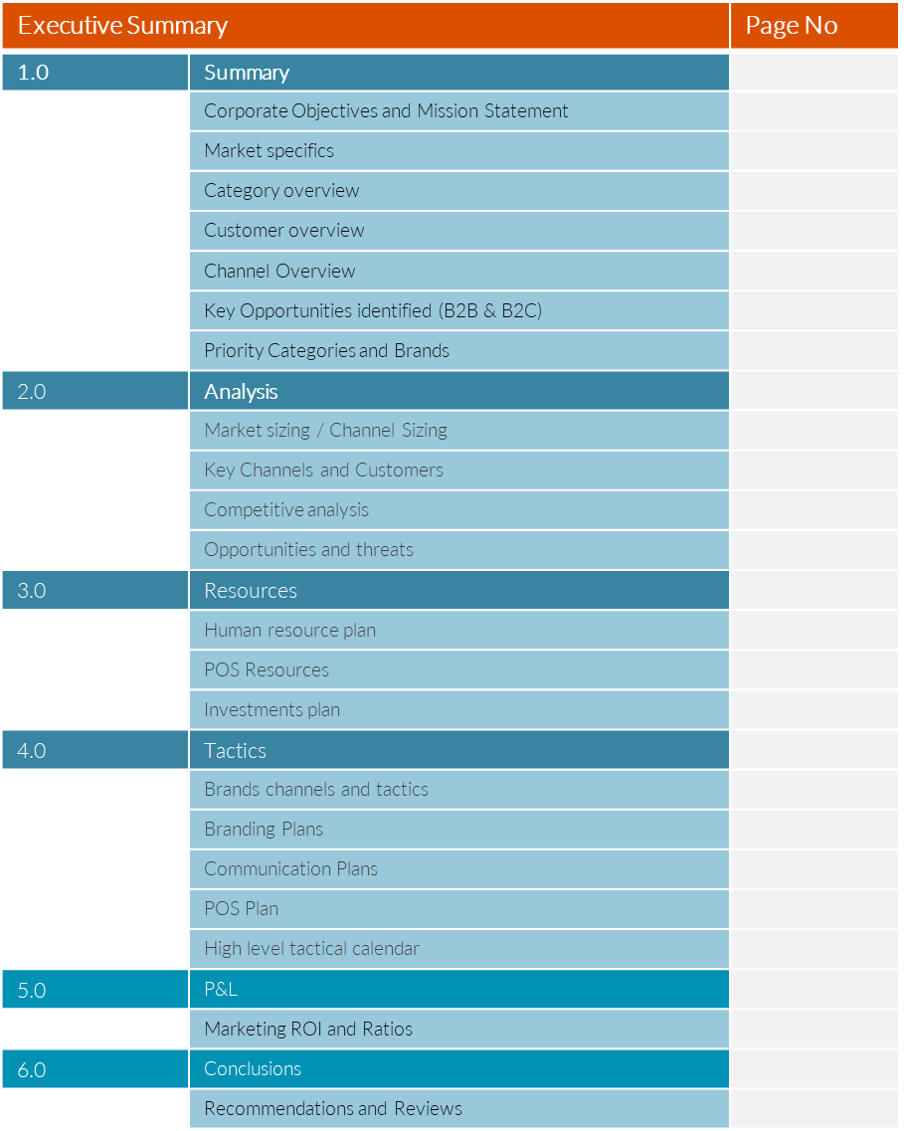
Tactics

Slide 37
Trade Marketing Plan.
Brands , Channels and Tactics

Slide 38


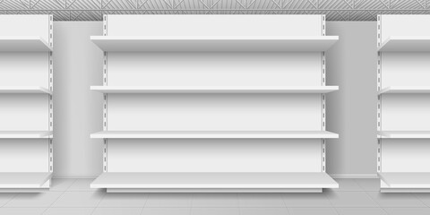
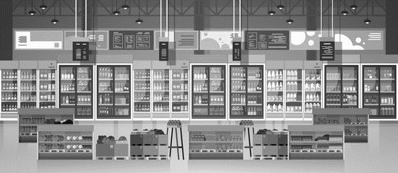
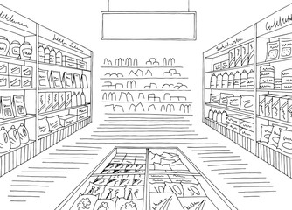
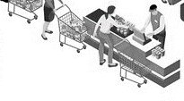
Trade Marketing Plan.
Branding Opportunities
Tide detergents
The Branding plan in trade marketing will cover the following areas
In Category at the store
In Communication at the store
In Displays
Anywhere where the consumer looks and touches outside the category
On pack for Promotions
Promotional Staff

Slide 39
Trade Marketing Plan.
Branding & Visibility Plan
Source : This file can be found on UpskilPRO.com reference file 8101

Slide 40
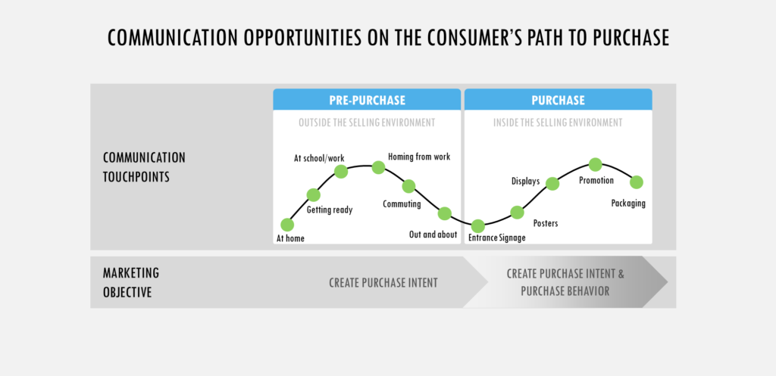
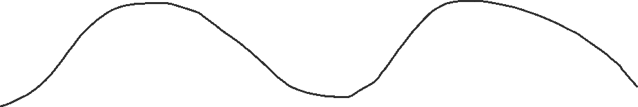
Trade Marketing Plan.
TM Communication Opportunities before a purchase
Before
Purchase
During
Purchase
Work
Displays
Communication Engagement
Promotions
School
Travel
Posters
Category
Home
Arrival
Check out
Signage
TM Objective
Purchase Engagement creation
Purchase Engagement creation & Altered behaviour

Slide 41
Trade Marketing Plan.
Planning Exercise – SWOT Execution
11001
A – Segment Description Keep this to a specific area of the organisation and high importance
B – Critical Success Factors ( CSF) Relate this to how your customers choose
C – Weighting weight each factor in importance totalling 100
D – Strength Weakness Analysis Impact |  |  |  | Impact
CSF | We | Comp A | Comp B | Comp C | Comp D
In this case how its about how your customers would rate you and the other competitors in each of the CSF’s , you will multiply the score by the weight.
Opportunities / Threats | Impact
A
B
C
D
Aim to crystalize on a few areas which will have effect on your business , please keep this strategic and top level.
Threats | Impact
Aim to crystalize on a few areas which will have effect on your business , please keep this strategic and top level.
Key unresolved issues | Impact
Aim to crystalize on a few areas which will have effect on your business , please keep this strategic and top level.

Slide 42
Financials
P&L

Slide 43
Trade Marketing Plan.
Financial Plan
Comments
Trade marketing is not a function judged by its finance delivery similar to sales , rather its contribution to sales can be evaluated , utilizing sources of sales contribution.
Primary driver function will always be sales and for specific accounts will be Key Account Management teams , both of which are sales functions .
In the financial table alongside we look at a P&L across a region and over 6 different channels , this is done for reasons of clarity and performance and also because this company can and has built a P&L which can be supported by data sources.
Typically the trade marketing function will work on how much volume can be sold with different types of engagement.
Eventually an account will be compromise of 2 sources of sales from a brand owner company
A Direct Sales
B Promoted product sales
C Totals of ( A + B )
The component of B will be a portion or fraction of A

Slide 44
Trade Marketing ROI

Slide 45
Created by
ex-Procter & Gamble, Rothmans, BAT, Gillette, Nokia,
Microsoft & 3M managers.
UpskilPRO tools are designed in easy-to-use solutions, all you need to do is download the tool and get to work immediately . All UpskilPRO material has taken 100’s of hours and many 1000’s of $ to build , all this expertise and content is brought to you for a fraction of the cost to help professionals enhance their capability.
core areas which are best suited to improve using our tools:
        Subject matter expertise
        Best practices
        Analytical output & charting
        Prioritization
        Process
        Training
Making life simpler for
Sales & Marketing professionals.
Tools in one place to get 10X productive now.

Slide 46
Trade Marketing Plans
Trade Marketing Plans
Sales & Marketing Fundamentals.
UpskilPRO e Institute for Sales & Marketing
Tools, Content & Templates
Hand built using experience & insight

