Slide 1

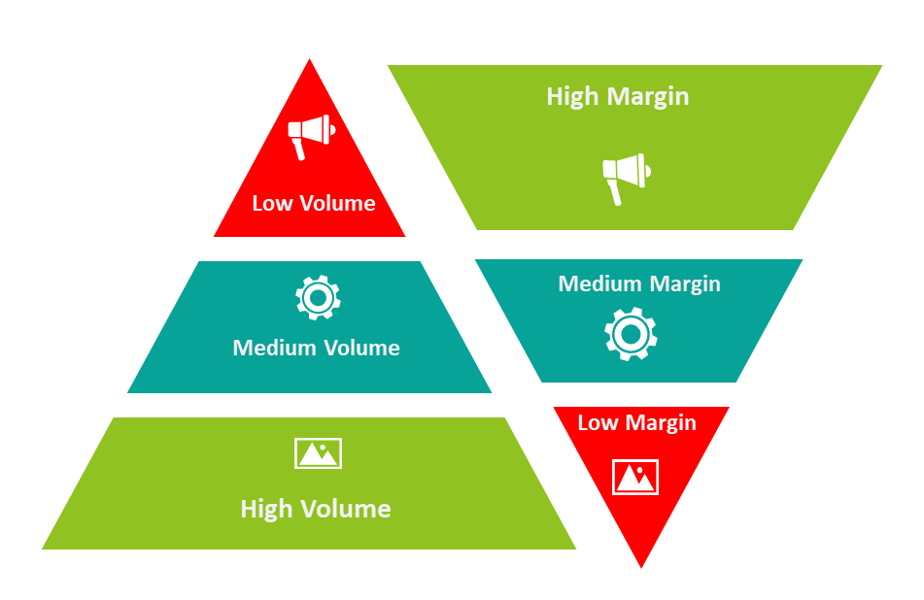



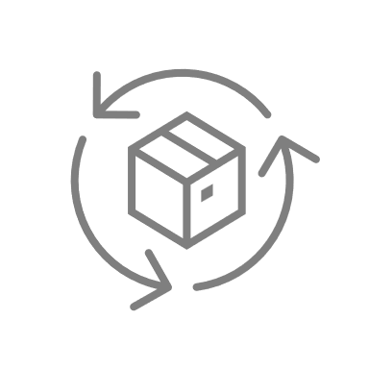
Channel Product Portfolios
Engage channels with portfolios that work through them to reach your target market
UpskilPRO e Institute for Sales & Marketing
Tools, Content & Templates
Hand built using experience & Insight

Slide 2
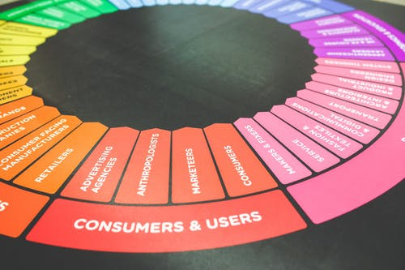

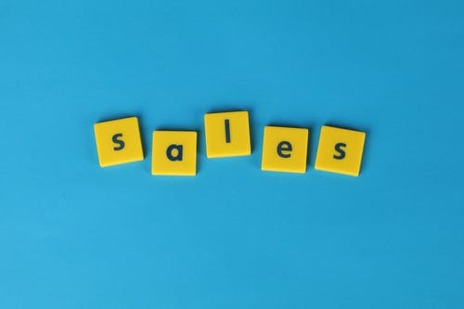

Created by
ex-Procter & Gamble, Rothmans, BAT, Gillette, Nokia,
Microsoft & 3M managers.
UpskilPRO tools are designed in easy-to-use solutions, all you need to do is download the tool and get to work immediately . All UpskilPRO material has taken 100’s of hours and many 1000’s of $ to build , all this expertise and content is brought to you for a fraction of the cost to help professionals enhance their capability.
core areas which are best suited to improve using our tools:
        Subject matter expertise
        Best practices
        Analytical output & charting
        Prioritization
        Process
        Training
Making life simpler for
Sales & Marketing professionals.
Tools in one place to get 10X productive now.

Slide 3


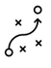

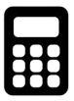
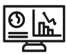
Job Descriptions
Develop roles clearly and completely across varying levels of experience
Agreements
Draft your business agreements across a variety of areas
Templates
Templates are designed based gather information in a structured manner
KPI’s
Performance indicator, a quantifiable measure of performance over time versus a specific objective.
Content Modules
Best practice material in power point for use as a knowledge base in business training , planning and execution .
Strategic tools
These tools are recognised the world over in business schools, consulting firms and companies who plan strategically.
Gain a competitive edge using the best tools and techniques to build a better you .
Analytical Tools
Interactive excel tools on specific business areas based on your data inputs delivered in a workbook model with instructions.
Scorecards
Designed as functional or subject indicators across a variety off situations to enable performance of situational evaluation versus aligned standards.
Calculators
calculate the right ratios for businesses looking for benchmarks in a variety of situations
Assessments
Assessments are designed around specific areas to conduct reviews and will center around a benchmark reviewing individuals or functions
Checklists
Designed around achieving milestones in a sequential manner.
Research
Research tools for sales and marketing engagement

Slide 4
2017
2018
100’s of tools grouped in 12 categories, 50 tool types and 12 business functions in 1 place.
get 10X productive now !
Categories
Functions
Analytical Tools
Types
Business Development
Agreements
Advertising
Customer Acquisition
Margins
Partner Search
Reports
Category Management
Assessments
Agreements
Customer Management
Market Analysis
Persona Development
Retail Measurement
Channel Management
Content Modules
Analytics
Distribution
Market Development
Planning
Reviews
Distribution
Checklists
Barriers
Distributor Management
Market Research
Positioning
Sales Management
Distributor Management
Calculators
Business Reviews
Forecasting
Market Segmentation
Pricing
Scorecards
General Management
Job Descriptions
Business Intelligence
GAP Analysis
Market Size
Prioritization
Segmentation
Key Account Management
KPI’s
Channels
Go To Market
Marketing
Product Development
Six Sigma
Marketing
Research
Communication
Job Descriptions
Marketing Comms
Product Life Cycle
Socio Economic Classification
Marketing Operations
Strategic Tools
Competitive Evaluation
Key Account Plans
Merchandising
Profit & Loss
Territory Design
Sales Management
Scorecards
Competitive Intelligence
Management Summary
New Market Entry
Promotions
Trade Marketing
Shopper Marketing
Templates
Trade Marketing

Slide 5
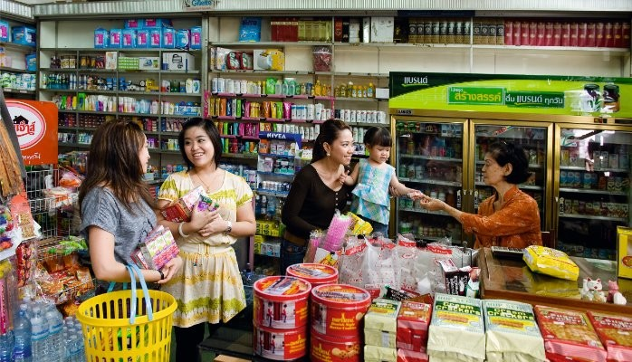
Channel Portfolios
Every channel has a unique set of customers and circumstances , engaged brands understand and design portfolios that work for channels and end-users.

Slide 6
Channel Portfolios

Slide 7
Channel Portfolios
Management Summary
Management Summary Channel portfolio management strategy , will be based on and the fight portfolio for the right channel and the channel portfolio fit will be strategic in nature as opposed to operational . Portfolio : Channel design will be based on customer insights.
Mission |  |  | Vision
Financials | Top line from X Mn $ to Y Mn $ in 3 years |  | Contribution gross margins increase from 46% to 48% |  | Contribution income to increase from 19% to 23%
Channel Data |  | LY Sales | TY Plan | TY Sales | TY vs Plan | LY vs Plan
 | Channel A
 | Channel B
 | Channel C
 | Channel D
Initiatives | Budgets |  | Technologies |  | Strategic Channel Programs
Teams | Lead team |  | New Hires |  | TY Initiatives

Slide 8





Channel Portfolio
Channel best practices design
Packaging Variations
Pricing
Customer service
Customize the packaging and variations to keep the product manageable at the channel end
.
Design a channel pricing strategy which is understood by all stakeholders to enable shopping without confusion
Ensure you have a customer service approach to enable a streamlined approach
.
Standardize
Backup channel
Standardize the features and benefits to fit the consumers time to shop and the amount of time spent in from of the product
.
Simplification
Every channel must have a back up channel to provide any support
.
Make sure that the entire process is simplified , with a contractual element and recorded
.

Slide 9
Channel Portfolio
Market Model.
SOHO
( Small office Home office)
Reseller Channel
Mini enterprise
< 10 Employees
< 2.0 Mn Euro
Small enterprise
accounts
Value Added reseller
Small enterprise
< 50 Employees
< 10.0 Mn Euro
Mid sized enterprise or accounts
Mid size neighborhood retailer format
Medium enterprise
< 250 Employees
< 50.0 Mn Euro
Large enterprise
accounts
Large retailer
Box format
Large enterprise
> 250 Employees
> 50.0 Mn Euro
Markets
Categories
Simple Categories
Mass Categories
Complex Categories
Products
Products
Comment
Industry classifications are generally nationally driven and each region and nation have classifications which are nationally driven
We use the european classification for reason of standardization ( european commission )
In a multi channel multi manufacturer environment it is expected that accounts will buy from channels which deliver them good to great service hence the various possibilities indicated above

Slide 10
Channel Portfolio
Channel setup guidelines (Example)
Channels
Geography
Customers
Classify channels
Segment geography clearly
Classify Customers in line with channel
Classify Customers to Channels
Align customers to regions and geography
Align customers to products
Set Channel guidelines
Align customers to Regions
Ensure multi geography customers are recorded
A
B
C
Set Customer discounts
Align financial codes to customers to allocate expenses credit and debit
Organize products into categories
Set Channel Discounts
Align products to channels
Budget codes for channels and customers
Set product discounts
Align Pricing strategy to channel
Record pricing strategy
Record expense codes
Discounts
Direct Expenses
Product

Slide 11
Channel Portfolio
Basic Channel Approach
Overall Category Sales Contribution
Your category sales contribution . Both are different , this requires category insight to find out if your brand is under contributing .
Basic go to market layout of channels
Push Campaigns
Sales
Contribution
Category
Contribution
Direct Sales
Channel partners
Customer
Brand Owner
or
Manufacturer
Customer
Value Added Resellers
Customer
Internet / reseller
Customer
Wholesalers / Stockists
Pull Campaigns
Demand creation campaigns using the marketing mix
Comment
Most generic descriptors have been used for channels
The model uses a flow from manufacturing to customer / end-user .
The emerging channel is the online reseller who is able to resell online to other e commerce resellers

Slide 12
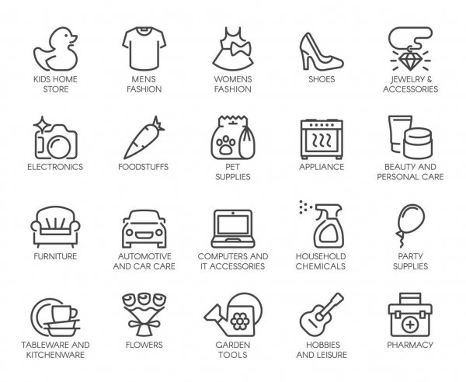

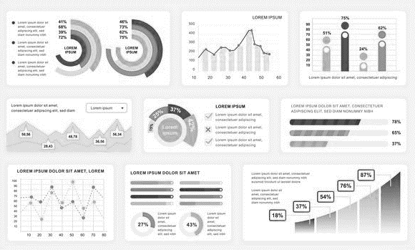
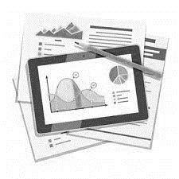
Channel Portfolio
Channels / Categories / Reports
Channels
Categories
Report Outputs
Grocery
Food
Category Sales
Convenience
Non-Food
Category Share
Compiler
Inputs
Pharmacy
Beauty Care
Market Share
Report
/ outputs
Duty Free
Beverages
Out of Stocks
Gas Stations
Snacks
Distribution
Comment
Above example has been simplified for the reason every country has differences and category reading is dependant on individual countries and brands
Above channels have been reduced for the example
Reporting capabilities are far more than shown above , and in many cases can be produced for clients per briefing
The flow chart is more applicable for the process .

Slide 13

Channel Portfolio
Aligning Product & Portfolio to Channels
200 ML
2.99$
2 X 200 ML
4.99$
200 ML
300 ML
1 X 300 ML
2.99$
Base Product
Promoted Product
100 ML free
200 ML Base Size
Base Product
Bundled Product
Promoted Product
Core product
Minor changes , product remains universal
Same bar code
List price is fixed
Regular price
Core of forecasting planning
Core product bundled into multiples
Same product
Bar code changes
List price may not change
Retail price usually is lower
This package is seasonal
This product is layered onto the regular product forecast
Core product is produced to signify value with package alterations
Single and multiple pack
Same but slightly different packaging
Bar code could change
List price may not change
Retail price usually is lower or higher depending on pack size and configuration
This package is strategically seasonal
This product is layered onto the regular product forecast

Slide 14
Channel Portfolio
Key elements in portfolio alignment to channels
 | Regular Product | Bundled Product | Promoted Product
Rationale | Regular products form the bulk of the brand development and launch process. | Bundled products are brought in by brand marketers usually to incentivize customers to buy , or switch from alternate brands . | Promoted products are usually a 2nd step when the brand is slightly mature or mature to drive volume mainly
Promotion design | Product design is defined around a standard size/s which will form the core of the business | This area is usually driven by adding a 2nd product and labelling it with a lower price of just offering a smaller pack free . | The promoted product can undergo many transformations , it can have price , extra volume or added incentives in purchase
Forecasting | Mainly forms the 80 to 90 % of the forecast | Balance of forecast | Balance of forecast
Price | A standard price is established for reference such as a list price or end user price | Here onwards the base price is used as a reference point to discount or offer extra value packs | Here onwards the base price is used as a reference point to discount or offer extra value packs
Category | Establish product and category presence | Remains anchored to category | Remains anchored to category
Sub Category | Branch into unmet needs which are core + fringe | Remains anchored to subcategory | Remains anchored to subcategory
Channel | Define Channel relevance based on where end user shops and channel intersect

Slide 15



Channel Portfolio
The Channel and end-user alignment
Channel Features
Shopping convenience
Ambience
Widely present
Fresh product
Specialists
Specific product range
Channel A
Channel B
Channel C
Channel D
Each Channel has its specifics , and the driving factors for each channel are different from the other competing channels.
End users can be of both B2B and B2C , what is important to understand is their requirements and how they prefer to be served
Customer & Channel alignment
Customer & Channel mis alignment
End user A
End User Features
Solution primarily
Brand
Fair price
Convenience
Availability
Warranties
Returns
Size
Packaging
End User B
End user C
End User D

Slide 16
Channel Portfolio

Slide 17
Channel Portfolio
Product Portfolio Management for Channels
Product Tier
Purpose
Volume
Value
Features
A
High Margin
High level of product differentiation , well positioned and drives a high satisfaction level coupled with brand awareness
Low volume – high margin
Typically, high end of product features
Volume share low – Value Share high
Gross Profitability highest in this tier
Low Volume
B
Moderate product differentiation , more driven by alignment with specific consumer needs and price points , usually acts as a net for A .
Medium Margin
Mid volume – High to mid margin
Typically, some features will be strategically lacking in product features
Volume share will play a supportive nature to value share
Gross Profitability moderate in this tier
Medium Volume
Low Margin
Higher volume – low margin
Basic product features
Gross Profitability highest in this tier .
This segment is more tactical in nature to outflank competition or simply because no alternatives have been planned
C
Low level of differentiation , these products are usually created to act as a flanker sometimes or net strategy to keep the consumer locked into the brand .
High Volume

Slide 18
Channel Portfolio
Brand Strategy
Product Tier
Purpose
Solution Segmentation
Features
A
High level of product differentiation , well positioned and drives a high satisfaction level coupled with brand awareness
Low volume – high margin
Typically, high end of product features
Volume share low – Value Share high
Gross Profitability highest in this tier
Premium
B
Mid volume – High to mid margin
Typically, some features will be strategically lacking in product features
Volume share will play a supportive nature to value share
Gross Profitability moderate in this tier
Moderate product differentiation , more driven by alignment with specific consumer needs and price points , usually acts as a net for A .
Value Added
C
Higher volume – low margin
Basic product features
Gross Profitability highest in this tier .
This segment is more tactical in nature to outflank competition or simply because no alternatives have been planned
Low level of differentiation , these products are usually created to act as a flanker sometimes or net strategy to keep the consumer locked into the brand .
Basic

Slide 19
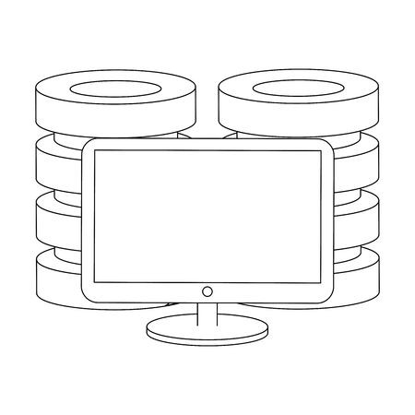



Channel Portfolio
Integration with Customer Management
Seamless integration across all touch points of the Customer facing function providing constant and timely interaction
Customers
Constant engagement with communication
The customer has a secure and private connection with the brand owner to manage his or her business.
Integrated web presence across the region and world with customer access and log in to drive up to date information , order management , outstanding account , points earned , notices to manage , documents to update and process view.
Fully integrated call centres providing up to the minute engagement and feedback with both customer and company
Field force automation now used across all functions as an integrator to drive one database and constant engagement with the customer.

Slide 20
Channel Portfolio
Channel Advantages
Channel Advantages
High
High engagement
Feedback intensive
Low cost per contact
Upselling possibilities high
Instant data capture.
Sales force
Channel Drivers
Value added
Partners
Distributors
Basis purpose of the sale channel is to connect customers , brand owners and end-users .
Different brands and solutions will drive different strategies to reach end user this results in what is called the Omni Channel experience
Every brand owner will evolve different channel strategies to resolve 4 main areas
Cost to serve
Preferred channel of end-users
Ability to manage and influence end users and customers
Business contribution
Retail
Value added sales
Direct sales channels
Tele
marketing
E
commerce
Indirect channels
Closer to end sale
Larger business scale
Higher relative cost per engagement
Faster decision making
Direct marketing channels
Channel disadvantages
low
low
Cost per transaction
High
Distribution Channels :
Each product and category interacts differently with channels based on A) Brand initiatives B) Strategy C) Priorities
The models above may all be used or only one , it is dependent on the strategy and the planning used to arrive at such a conclusion
Each channel has different cost layers to deliver service
In the example above the cost per transaction is largely modelled around the distance to end user , the 3 models reflect the distance and the cost .
Strategically the prioritization works around working with the larger and complex customer groups and moving the smaller and less profitable groups to inside sales or telemarketing
E commerce is a strategic decision mainly , as opposed to a cost based decision

Slide 21
Channel Portfolio
Basic Universe / Category – GTM Channels
B2C
B2B
Internet
Retail Channels are measured
  Biannually or annually
Clear segmentation of outlet types
No of outlets by Geography
Turnover
Category Sales
Distribution
Brand availability
Volume share
Value share
Electronic Data transfer
Most Channel types are measured
B2B products sold in a retail environment are mostly covered or measured
These categories are often found in the outlet under Home or Maintenance
Most B2B companies do not buy audit data for many reasons leading to the relevant category not being measured.
As the sales is often made to smaller or very large non-retail outlets sales are not necessarily captured
B2B products sold on the web , are recorded giving rich data availability .
Some of the categories sold on the web are smaller compared to Brick & Mortar channels.
Universe Availability
DATA
E commerce
Tele channels
Websites
E marketplace
Mail Catalogues
Retail stores
Online resellers
Data availability is robust
Electronic data availability
Costs are based on contract to supply
Data is fragmented
Mostly manual
Data availability
Universe / Category Data
Research Companies specializing in B2C
Research Companies specializing in B2B
Data aggregator companies or digital specialists

Slide 22








Channel Portfolio
Basic Category – GTM Channels
DIRECT SALES
INDIRECT SALES
DIRECT TO CUSTOMER
Lower cost to sales ratio
Wider portfolio management
Local engagement
Expanded geographical presence
Increased points of contact
Low sales cost
Wider reach
Efficient transactions
Wider portfolio management
Loyalty management
Reach & penetration
Sales – Medium to Complex
Key account control
Complex service requirement
Goals / Purpose
Roles / Functions
Distributors
Resellers
Value Added Resellers
Retail Stores
Agents
Brokers
Integrators
Aggregators
Service partners
E commerce
Tele channels
Websites
E marketplace
Mail Catalogues
Retail stores
Online resellers
Field Representatives
Category Managers
Account Managers
Account executives
Technical Representatives
Global Subject Matter Experts
EXAMPLES

Slide 23
Channel Portfolio
Market evaluation criteria.
Market evaluation criteria
We start with identifying drivers to weight the 9 important drivers indicating importance ( cost to serve to barriers )
We then weight the drivers to reflect the intensity and importance of the driver in the decision making process
Drivers are situational in both identification and importance
We recommend identifying the drivers closer to the decision making process end result and working back from there
Sources in this context are for data and intelligence sources gathering.
* This file is available on www.upskilpro.com in an editable version , use the reference number provided on the top right in red

Slide 24
Channel Portfolio
Market Verticals and Classifications.
Consumer Goods | Construction | Automotive Manufacturing | Telecommunication | Mass Transportation
Consumer Packaged Goods | Construction Equipment | EM Vehicle | Networking Equipment | Passenger Buses
Household products | Building Technologies & Automation | Light Vehicles | Network Services | Passenger Aircraft
Beauty & personal care | Power Tools | Medium and Heavy-duty | Network Infrastructure | Passenger Rail
Luxury products | Smart Building | Electric Vehicle Systems | Enterprise Network Systems | Passenger shipping
Consumer Electronics | Energy Management Systems | Off-highway Equipment | Broadband/VoIP | Trams
Life Style products | Green IT | Buses/ Trucks | Hosted Applications | Inland shipping
Sports Goods | Smart Energy | Material Handling Equipment | Voice/Data/Video | Metro ( intercity )
Verticals & Classifications
We recommend identifying the verticals for any business for intelligence tracking and monitoring reasons
The possibility of a business having more than one vertical in a business is possible
For identifying verticals a good start would be to start online with industry classification , or with consulting forms and or the market research service providers

Slide 25
Channels II
Segmenting Customers by Portfolio.
Turnover
Portfolio A
Portfolio B
Portfolio C
Portfolio D
Commodities
Tenders
Channel
Direct Sales
Business Partners / Distributor
Inside Sales
< - Low Sales revenue High – >
Direct Mail
Internet
Sales cycle
Multi Channel approach is based on efficiency drivers of A) Time ,B) Resources management
As the time taken for a call in Direct sales will be different for different channels and different classes of customers .
Efficiency comes from segmenting the customers into buckets based on criteria and then approaching them from a resource management perspective

Slide 26
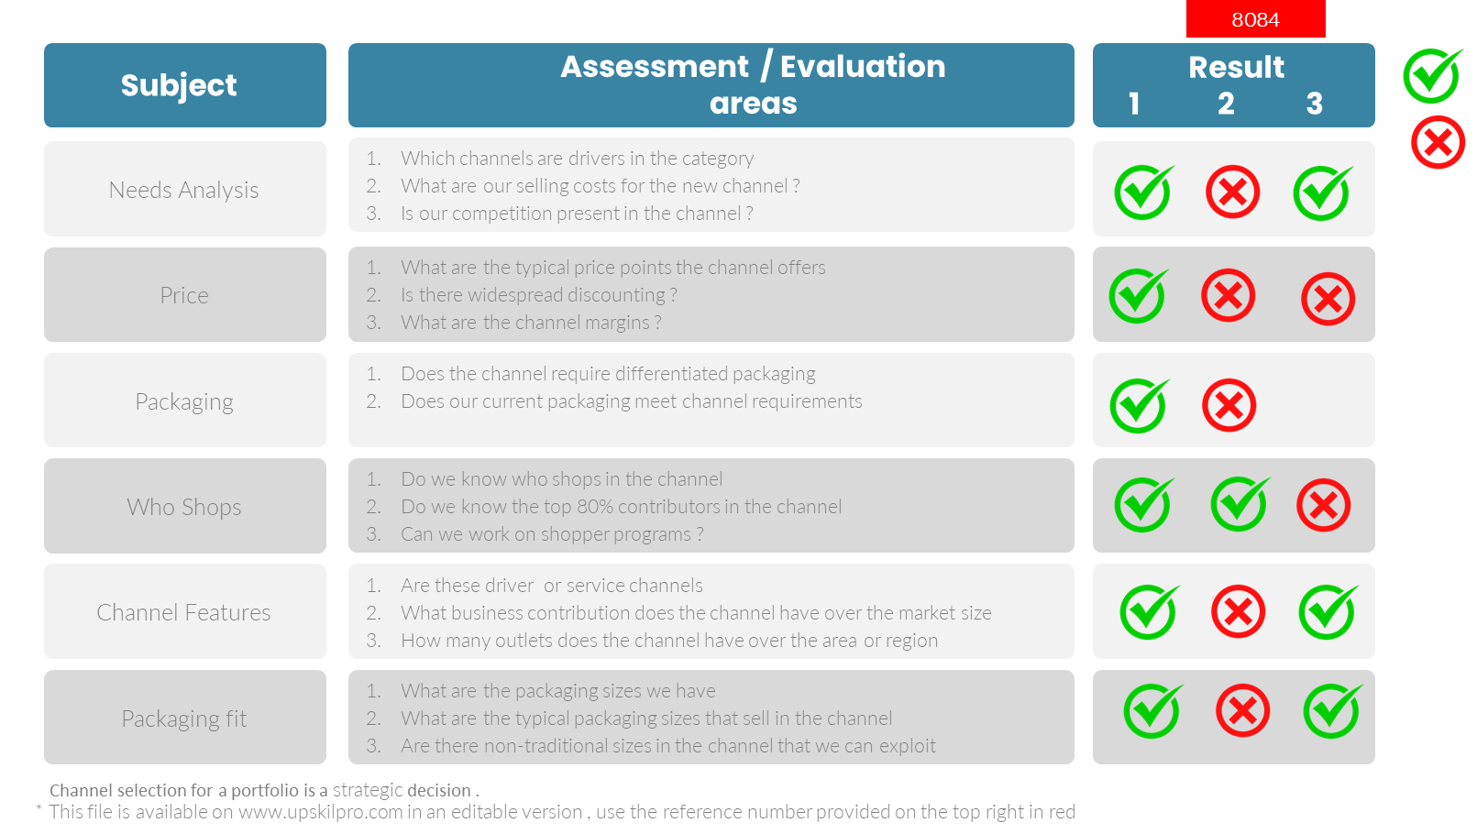
Channel Portfolio
Scorecard – Aligning channel and portfolio

Slide 27
Thank you !

Slide 28
Job Descriptions
Develop roles clearly and completely across varying levels of experience
Agreements
Draft your business agreements across a variety of areas
Templates
Templates are designed based gather information in a structured manner
KPI’s
Performance indicator, a quantifiable measure of performance over time versus a specific objective.
Content Modules
Best practice material in power point for use as a knowledge base in business training , planning and execution .
Strategic tools
These tools are recognised the world over in business schools, consulting firms and companies who plan strategically.
Gain a competitive edge using the best tools and techniques to build a better you .
Analytical Tools
Interactive excel tools on specific business areas based on your data inputs delivered in a workbook model with instructions.
Scorecards
Designed as functional or subject indicators across a variety off situations to enable performance of situational evaluation versus aligned standards.
Calculators
calculate the right ratios for businesses looking for benchmarks in a variety of situations
Assessments
Assessments are designed around specific areas to conduct reviews and will center around a benchmark reviewing individuals or functions
Checklists
Designed around achieving milestones in a sequential manner.
Research
Research tools for sales and marketing engagement

Slide 29
Channel Portfolios
Engage channels with portfolios that work through them to reach your target market
UpskilPRO e Institute for Sales & Marketing
Tools, Content & Templates
Hand built using experience & Insight

