Slide 1

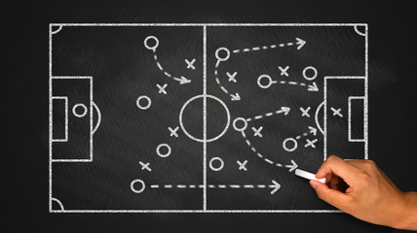
Trade Marketing.
Tactics
Sales & Marketing Fundamentals.
UpskilPRO e Institute for Sales & Marketing
Tools, Content & Templates
Hand built using experience & insight

Slide 2
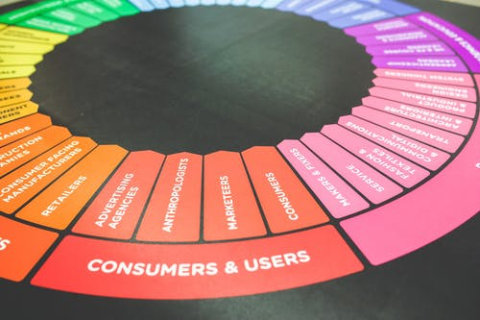



Created by
ex-Procter & Gamble, Rothmans, BAT, Gillette, Nokia,
Microsoft & 3M managers.
UpskilPRO tools are designed in easy-to-use solutions, all you need to do is download the tool and get to work immediately . All UpskilPRO material has taken 100’s of hours and many 1000’s of $ to build , all this expertise and content is brought to you for a fraction of the cost to help professionals enhance their capability.
core areas which are best suited to improve using our tools:
        Subject matter expertise
        Best practices
        Analytical output & charting
        Prioritization
        Process
        Training
Making life simpler for
Sales & Marketing professionals.
Sales & Marketing Fundamentals.
Tools in one place to get 10X productive now.

Slide 3


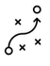

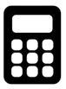

Job Descriptions
Develop roles clearly and completely across varying levels of experience
Agreements
Draft your business agreements across a variety of areas
Templates
Templates are designed based gather information in a structured manner
KPI’s
Performance indicator, a quantifiable measure of performance over time versus a specific objective.
Content Modules
Best practice material in power point for use as a knowledge base in business training , planning and execution .
Strategic tools
These tools are recognised the world over in business schools, consulting firms and companies who plan strategically.
Gain a competitive edge using the best tools and techniques to build a better you .
Analytical Tools
Interactive excel tools on specific business areas based on your data inputs delivered in a workbook model with instructions.
Scorecards
Designed as functional or subject indicators across a variety off situations to enable performance of situational evaluation versus aligned standards.
Calculators
calculate the right ratios for businesses looking for benchmarks in a variety of situations
Assessments
Assessments are designed around specific areas to conduct reviews and will center around a benchmark reviewing individuals or functions
Checklists
Designed around achieving milestones in a sequential manner.
Research
Research tools for sales and marketing engagement

Slide 4
2017
2018
100’s of tools grouped in 12 categories, 50 tool types and 12 business functions in 1 place.
get 10X productive now !
Categories
Functions
Analytical Tools
Types
Business Development
Agreements
Advertising
Customer Acquisition
Margins
Partner Search
Reports
Category Management
Assessments
Agreements
Customer Management
Market Analysis
Persona Development
Retail Measurement
Channel Management
Content Modules
Analytics
Distribution
Market Development
Planning
Reviews
Distribution
Checklists
Barriers
Distributor Management
Market Research
Positioning
Sales Management
Distributor Management
Calculators
Business Reviews
Forecasting
Market Segmentation
Pricing
Scorecards
General Management
Job Descriptions
Business Intelligence
GAP Analysis
Market Size
Prioritization
Segmentation
Key Account Management
KPI’s
Channels
Go To Market
Marketing
Product Development
Six Sigma
Marketing
Research
Communication
Job Descriptions
Marketing Comms
Product Life Cycle
Socio Economic Classification
Marketing Operations
Strategic Tools
Competitive Evaluation
Key Account Plans
Merchandising
Profit & Loss
Territory Design
Sales Management
Scorecards
Competitive Intelligence
Management Summary
New Market Entry
Promotions
Trade Marketing
Shopper Marketing
Templates
Trade Marketing

Slide 5



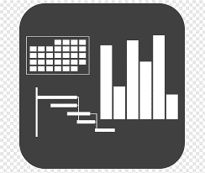




7 Benefits of using UpskilPRO :
Improve your knowledge
with professional Strategic Tools , Templates and planning documents for any business situation!
Use ready made tools
with filled in examples and ready to print & edit at your convenience . Just edit and fill-in the blanks !
Develop YOUR BUSINESS
Learn , & utilize the knowledge and processes and enhance your capabilities as the other companies have
We Created UpskilPRO for the
  Sales Professional
  Trade Marketer
  Marketing Executive
  Operations Manager
  VP/Director/Manager
100’s of tools , TEMPLATES & documents
CREATED BY
world class sales and marketing
business professionals.
All tools
are based on topics and subject based situations and are simple and easy to use .
SAVE THOUSANDS OF DOLLARS
The average company will save 1000’s of $ per employee in time & effort using our ready tools !
Top Quality Tools & Templates for developing both you and your business.
www.upskilpro.com

Slide 6


Trade Marketing
Examples of TM .
Brand marketing talks to people , Trade Marketing talks with them.
Category
POS
Retailer
Consumer
ROI
Promotions

Slide 7

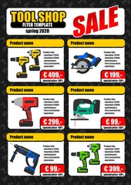

Every store will demand different tactics within the TM plan , the trade marketing challenge is to drive specific tactics that actively drive the brand engagement concentrating on key consumer benefits.

Slide 8
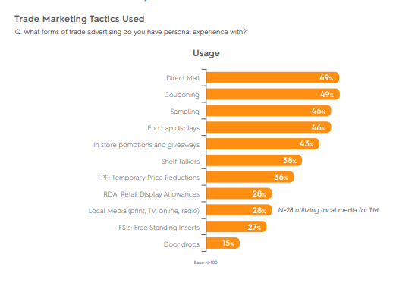
Importance of Trade marketing
Trade Marketing Tactics used
Key Findings
Trade marketing is in a period of significant flux with online sales causing a re-examination of both tactics and budgeting.
Marketers are frustrated by challenges like reaching younger consumers and trackability.
The growth of ecommerce is bringing these frustrations to a head as brands face the reality of the need to support their products and increase sales in the dimension of online shopping.
Print is the medium with the greatest perceived decline in effectiveness.
Paid search both on stand-alone ecommerce sites and retail sites is seen as one of the areas with the
greatest increase in effectiveness.
Marketers are approaching online in respect to trade with concerns unique to digital.
The majority noted that the issue of Top Rank Persistence (the phenomenon of a brand that achieves a high
Ranking in organic search remaining in that slot due to sales dominance) is the most significant
Concern about online, however this is closely followed by Amazon’s control of pricing.
Online ad fraud, while clearly a concern, does not weigh on marketers minds as heavily as issues like Amazon setting prices and the complexity of managing online ad campaigns.
The ability to address customers as one person, whether they are online or offline is the top priority among marketers.
The retail technologies of greatest interest include using voice activated assistants like Alexa , Google, and the devices that feature them.
Source : www.criteo.com

Slide 9

Importance
of
Trade marketing.
The importance of trade marketing is realized in context and application .
The sales function manages distribution channel and distributors , the marketing function manages the consumer directly using research and media reach leaving the engagement of the customer and the consumer at POS the key challenge.
POS emphasis of relies on 4 points
A Promotional activity at POS
B In store communication
C Brand visibility
D influencing the consumer at the POS.
Executing trade marketing at the point of sale gives manufacturers a sustainable competitive advantage and delivers marketing messaging and sales engagement smoothly .
Trade marketing is applicable both from a B2B & B2C perspective and executable across countries channels customers and consumers.
Consumer
Brand Owner
Trade Channel

Slide 10
Relativity of
Trade marketing
To understand trade marketing, it must be placed in context and application .
Sales as a function manages distribution channel and distributors whilst marketing handles the aspect of how to influence the consumer directly using research , product portfolio and media reach , this in turn leaves the aspect of how to identify communicate and manage the consumer at the point of sale .this responsibility is what we called trade marketing .
the emphasis of trade marketing relies on 4 areas
  A Promotional activity at the point-of-sale
  B In store communication
  C Brand and product visibility
  D Influencing the consumer at the point POS.
Executing trade marketing at the point of sale gives manufacturers a sustainable competitive advantage and helped deliver marketing messaging and sales engagement smoothly .
Trade marketing is not the exclusive domain of any channel but applicable both from a B2B & B2C irrespective of which the principles are wholly adoptable and executable across countries channels customers and consumers.
Brand
Marketing
Consumer
Brand Owner
Trade
Marketing
Trade Channel
Category
marketing
Shopper marketing

Slide 11
Who uses trade marketing
Manufacturers use trade marketing to reach various channels which are of key importance to them these manufacturers and implement various marketing strategies to communicate value to their consumers .
Emphasis | Company | Channel | Customer | Consumer
Promotion
Price
Communication
Visibility
Conversion

Slide 12
Executional tactic
1
Trade marketing is a valuable resource to fund to function effectively it requires a clear understanding of its target audience for to understand your target audience you need some basic Trade research and Consumer research. Both these forms of research and analysis are Usually the domain of marketing or brand marketing.
Consumer research will help you understand who your target market is , their consumer profile , market segmentation and social economic classification .
Trade research will help you understand where your target market purchases from competitive market shares , channel shares brand shares and the relative importance off the outlets you will be targeting to execute trade marketing
Once you have the above information it makes your task off customer identification and prioritisation easier to develop your trade marketing plan for execution.
Consumer
Brand Owner
Trade & Consumer Research
Know your consumer
Trade Channel
Know your customer

Slide 13
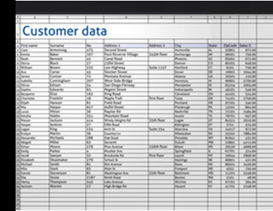
Executional tactic 2
Once you have the necessary research the next step visually is to develop a trade marketing plan for execution this plan will contain both as in as input factors your trade and consumer research in turn it will help you identify which of the outlets you are targeting will be relevant to execute your trade marketing efforts .
Each off your customers ( POS ) will have different profiles this is where once you apply the inputs of your consumer and trade research as an output you will be able to identify which are the key outlets in the universe that are important to your trade marketing efforts and prioritise them .
Customer account analytics

Slide 14
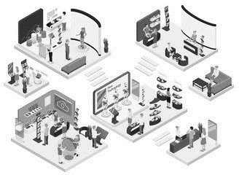
Executional tactic 3
Trade exhibitions and shows are an easy way to showcase your product and technology two potential customers as the common factor is the theme of the trade and customer visits to the trade exhibition .
choose the theme of the trade well after research once you have your presents in place develop and efficient and organised team with the necessary marketing collateral which we will use to engage communicate and possibly convert your consumers to your brand this great exhibitions are a great way to develop new partnerships for your brand and company
Trade shows

Slide 15
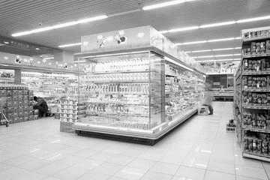
Executional tactic 4
Branding and communication are extremely important aspects these help you develop brand recall brand association across bought a bit B and a bit to see environment whilst why is marketing will develop ways to communicate to your target audience your branding and communication efforts at the venue will help razor venison recall there were driving an emotional engagement with your channel and trade partners thereby driving engagement .
Branding & Communication

Slide 16

Executional tactic 5
Generate brand awareness by driving engagement
online through newsletters banners , and teasers And digital communication through social media platforms all driving engagement back to your website as quite a bit of online research is conducted before any form or for decision that's taken
whilst offline engagement may be driven by door drops Flyers Coupons and information packages Direct to your target market in a specified zone which may be residential or business specific in order to be targeted
Below the line communication

Slide 17
Executional tactic 6
Create promotions are an excellent way to execute your messaging and your product directly at the point of sale , in order to be relevant trade promotions must address the right tonality, message , promotional offer in a highly visible manner at the point of sale. The key aspects have a great trade promotion are
  Visibility
  Quality
  Price
  Features
  Reason to buy
Promotions

Slide 18
Executional tactic 7
To balance the trade marketing strategy you will have to decide whether to market offline , online or both. An online presence will cover mix of e-mail social media ad and possibly even messengering there are various ways you can engage between landing pages, CRM, e-mail campaigns and even chat bots.
This raises your engagement possibility tremendously and brings in efficiencies and better targeting off your target market.
Communication

Slide 19
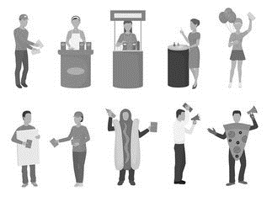
Executional tactic 8
Point off sale engagement.
one of the most effective ways to engage customers and consumers at the point of sale is to use promotional teams who can work to a specific script developed for engagement and communication whilst targeting engaging and managing the consumer engagement allowing them to upsell down sell or convert from competitive brands .
POS Engagement

Slide 20
Thank you !

Slide 21
Job Descriptions
Develop roles clearly and completely across varying levels of experience
Agreements
Draft your business agreements across a variety of areas
Templates
Templates are designed based gather information in a structured manner
KPI’s
Performance indicator, a quantifiable measure of performance over time versus a specific objective.
Content Modules
Best practice material in power point for use as a knowledge base in business training , planning and execution .
Strategic tools
These tools are recognised the world over in business schools, consulting firms and companies who plan strategically.
Gain a competitive edge using the best tools and techniques to build a better you .
Analytical Tools
Interactive excel tools on specific business areas based on your data inputs delivered in a workbook model with instructions.
Scorecards
Designed as functional or subject indicators across a variety off situations to enable performance of situational evaluation versus aligned standards.
Calculators
calculate the right ratios for businesses looking for benchmarks in a variety of situations
Assessments
Assessments are designed around specific areas to conduct reviews and will center around a benchmark reviewing individuals or functions
Checklists
Designed around achieving milestones in a sequential manner.
Research
Research tools for sales and marketing engagement

Slide 22
Trade Marketing.
Tactics
Sales & Marketing Fundamentals.
UpskilPRO e Institute for Sales & Marketing
Tools, Content & Templates
Hand built using experience & insight

