Slide 1
Understanding Distribution.
Understand the context of distribution when discussing and measuring it.
UpskilPRO e Institute for Sales & Marketing
Tools, Content & Templates
Hand built using experience & insight

Slide 2
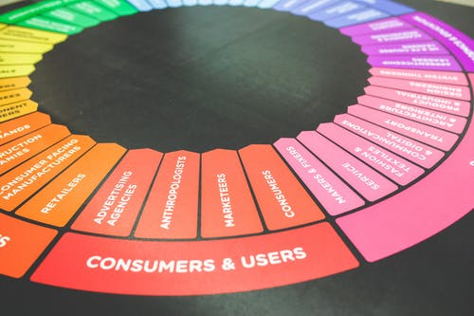
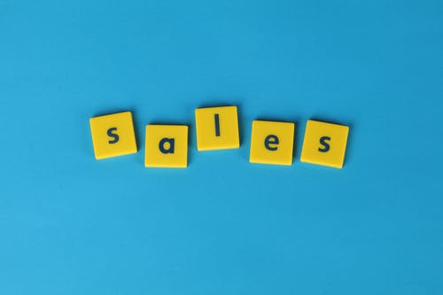
Created by
ex-Procter & Gamble, Rothmans, BAT, Gillette, Nokia,
Microsoft & 3M managers.
UpskilPRO tools are designed in easy-to-use solutions, all you need to do is download the tool and get to work immediately . All UpskilPRO material has taken 100’s of hours and many 1000’s of $ to build , all this expertise and content is brought to you for a fraction of the cost to help professionals enhance their capability.
core areas which are best suited to improve using our tools:
Subject matter expertise
Best practices
Analytical output & charting
Prioritization
Process
Training
Making life simpler for
Sales & Marketing professionals.
Tools in one place to get 10X productive now.

Slide 3
Job Descriptions
Develop roles clearly and completely across varying levels of experience
Agreements
Draft your business agreements across a variety of areas
Templates
Templates are designed based gather information in a structured manner
KPI’s
Performance indicator, a quantifiable measure of performance over time versus a specific objective.
Content Modules
Best practice material in power point for use as a knowledge base in business training , planning and execution .
Strategic tools
These tools are recognised the world over in business schools, consulting firms and companies who plan strategically.
Gain a competitive edge using the best tools and techniques to build a better you .
Analytical Tools
Interactive excel tools on specific business areas based on your data inputs delivered in a workbook model with instructions.
Scorecards
Designed as functional or subject indicators across a variety off situations to enable performance of situational evaluation versus aligned standards.
Calculators
calculate the right ratios for businesses looking for benchmarks in a variety of situations
Assessments
Assessments are designed around specific areas to conduct reviews and will center around a benchmark reviewing individuals or functions
Checklists
Designed around achieving milestones in a sequential manner.
Research
Research tools for sales and marketing engagement

Slide 4
2017
2018
100’s of tools grouped in 12 categories, 50 tool types and 12 business functions in 1 place.
get 10X productive now !
Categories
Functions
Analytical Tools
Types
Business Development
Agreements
Advertising
Customer Acquisition
Margins
Partner Search
Reports
Category Management
Assessments
Agreements
Customer Management
Market Analysis
Persona Development
Retail Measurement
Channel Management
Content Modules
Analytics
Distribution
Market Development
Planning
Reviews
Distribution
Checklists
Barriers
Distributor Management
Market Research
Positioning
Sales Management
Distributor Management
Calculators
Business Reviews
Forecasting
Market Segmentation
Pricing
Scorecards
General Management
Job Descriptions
Business Intelligence
GAP Analysis
Market Size
Prioritization
Segmentation
Key Account Management
KPI’s
Channels
Go To Market
Marketing
Product Development
Six Sigma
Marketing
Research
Communication
Job Descriptions
Marketing Comms
Product Life Cycle
Socio Economic Classification
Marketing Operations
Strategic Tools
Competitive Evaluation
Key Account Plans
Merchandising
Profit & Loss
Territory Design
Sales Management
Scorecards
Competitive Intelligence
Management Summary
New Market Entry
Promotions
Trade Marketing
Shopper Marketing
Templates
Trade Marketing

Slide 5
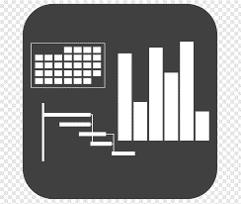
7 Benefits of using UpskilPRO :
Improve your knowledge
with professional Strategic Tools , Templates and planning documents for any business situation!
Use ready made tools
with filled in examples and ready to print & edit at your convenience . Just edit and fill-in the blanks !
Develop YOUR BUSINESS
Learn , & utilize the knowledge and processes and enhance your capabilities as the other companies have
We Created UpskilPRO for the
Sales Professional
Trade Marketer
Marketing Executive
Operations Manager
VP/Director/Manager
100’s of tools , TEMPLATES & documents
CREATED BY
world class sales and marketing
business professionals.
All tools
are based on topics and subject based situations and are simple and easy to use .
SAVE THOUSANDS OF DOLLARS
The average company will save 1000’s of $ per employee in time & effort using our ready tools !
Top Quality Tools & Templates for developing both you and your business.
www.upskilpro.com

Slide 6
Understanding Distribution
Absolute distribution
Numeric Distribution
Volume weighted Distribution
Numeric Distribution
Weighted Distribution
The easiest form of distribution measurement.
It measures the availably of the product in the number of points of sale used as a base
Every outlet contributes one POS no matter what the numbers of distribution or product value sold .
A slightly more intensive way of calculating distribution .
All commodity volume concentrates on the outlet's contribution of sale to the base and uses that as an indicator of category contribution of sales , leading to the presence of your product in relation to the category sales .
The higher the category sales contribution the higher your distribution of ACV
www.upskilpro.com
www.free-powerpoint-templates-design.com

Slide 7
Understanding Distribution
How do you evaluate distribution
Retailers
Technology
Retail Audit
Companies
Physical
verification
Retail audit companies extract sales data under license from the retailers they operate with and will be able to extrapolate this data and provide it as a service .
This data is pertinent only to channels and outlets which have a data share agreement.
When approached directly retailers and channel providers will give data sometimes for a fee or as a business gesture to build relationship .
The challenge is assimilating data when it is from many different sources and data types
Companies have developed technology using downloadable applications which are given to users who take photographs in the outlets and the data is automatically uploaded to the server .
While this is a solution it is not a strategic information gathering solution
A physical verification like canvassing is possible using human resources who measure distribution directly at source .
In this case it makes sense to verify distribution using a sample set of outlets if covering a large geographic expanse
www.upskilpro.com

Slide 8
Understanding Channels
Distribution Channels
Planning Templates
Brand Owner
Product / Service creation
Logistics Hub
Physical Distribution
Reseller
Channel /s
End-user
Manufacturer
Manufacturer
Manufacturer
Manufacturer
Distributor
Wholesaler
Agent -
Consumer Retailers
Online e reseller
E commerce
Specialist Shops
Company
DIY Stores
Gas Stations
Consumer
While selecting a distribution channel for foreign markets, the management of the exporting company should consider the following aspects:
(i) Who are the consumers? Which are the available retail outlets to reach them?
(ii) Which type of market coverage is required, keeping in view the product and consumer characteristics?
(iii) Are there any internal constraints for the exporter like finance which will influence the decision regarding choice of the distribution channel?
(iv) What are the expectations from the channel members? Are there some specific expectations?
(v) What is the required support system to satisfy the expectations of the channel members?
Duty Free
Converters
Value Added Reseller

Slide 9
Understanding Distribution
Types of Retailers
The objectives behind presence in large chains and convenience are different . The sales strategy will drive a mix between distribution and sales availability
Planning Templates
Large / Organized
Channel and Widespread
Bulk & resale
Online
Department stores
Convenience stores
Merchant Wholesalers
E commerce stores
Specialty stores
Gas station stores
Full-service wholesalers
Hyper markets
Limited-Service Wholesalers
Supermarkets
Brokers & Agents
Discount stores
Branches & Mini Wholesalers
Warehouse stores
Specialized Wholesalers
We have added Discount and Dollar stores anyway due to their large outlet footprint
Discount Stores
Dollar Stores
https://www.marketing91.com/6-types-wholesalers-wholesaler/
Drug Stores
Comment
These chains are usually nation wide
Buying operations are usually central and deliveries local
Unit cost efficiency is high
Comment
Convenience stores drive neighbourhood sales and sheer convenience
In number of stores they have a higher number of doors than chain stores
They remain to a degree privately and individually owned.
Comment
Wholesale remains the backbone of channels
They drive sales for brands which are not deliberately retail driven
Wholesale can drive product into retail
Unit cost differential is a key factor
Comment
Online stores continue to offer convenience to a great degree and price competitiveness
Their individual share of the overall market is in the region of 8 – 12% of category sales generally

Slide 10
Understanding Distribution
Universal Distribution View
Strategic Context
Executive Intent
Customer Marketing
Price Position
Intellectual property
Consumer Marketing
Value Creation
Primary Sale
Secondary Sale
Transportation
Sales
Volume
Units
Market Share in Volume
Online
Modern Trade
Distribution center
Convenience
Inland Transportation
Consumer Marketing
B2B
Manufacturer / Distributor
Consumer
Volume Weighted Distribution
Manufacturing
Numeric Distribution
Value
US $
Market Share in Value
Manufacturers
Add Value
Customer/ Trade Marketing
Duty Free
Wholesale

Slide 11
Understanding Distribution
Universal Distribution measured across 4 areas
Brand Environment
B2B – B2C
Numeric Distribution
Volume weighted Distribution
Retail Perspective
Numeric Distribution
Volume weighted Distribution
Brand
Retail Chain
Category
Retail Outlet
No 1
Subcategory
No 3
Category
SKU
Subcategory
Geography Perspective
Numeric Distribution
Volume weighted Distribution
Wholesale Perspective
Numeric Distribution
Volume weighted Distribution
Country
Wholesale
State
Cash & Carry
No 4
No 2
City
Specialist Wholesale
Town
Agents and Brokers
Village

Slide 12
Understanding Distribution
Distribution Broken-down .
Brand Environment
B2B – B2C
Explanation
Laundry Detergents
Category A
Category B
Brand
More than one brand may be part of a category and a brand may be present across many categories , there fore measuring brand availability across categories is a top line measure
Category
A grouping of products which have similar solutions for the end user , manufacturers and retailers group them into categories
Laundry Detergents
Subcategory
Many sub categories may comprise into one category, usually its left to companies and marketers who wish to segment the market and find unmet needs which result in sub categories being defined regularly.
High Suds
Low Suds
SKU
A Category may have many categories , which may have many competing brands within them, brand owners or manufacturers typically have brands across categories or one brand across many categories
Geography Perspective
Retail Perspective
Wholesale Perspective
Country
Retail Chain
Wholesale
State
Retail Outlet
Cash & Carry
City
Category
Specialist Wholesale
Town
Subcategory
Agents and Brokers
Village
Tools, Content & Templates
Hand built using experience & insight

Slide 13
Understanding Distribution
Distribution Broken-down .
Brand environment
B2B – B2C
Geography Perspective
Retail Perspective
Wholesale Perspective
Brand
Country
Retail Chain
Wholesale
Category
State
Retail Outlet
Cash & Carry
Subcategory
City
Category
Category
SKU
Town
Subcategory
Subcategory
Village
These are the 4 common layers of product and led distribution from a wholesale perspective .
You can be as innovative as you wish in driving distribution parameters
These are the 4 common layers of product and led distribution from a retail perspective .
You can be as innovative as you wish , in the above case we have used publicly available data to drive a distribution framework
These are the 5 common layers of product and geography led distribution.
You can be as innovative as you wish , in the above case we have used publicly available data to drive a distribution framework
These are the 5 common layers of product and geography led distribution.
You can be as innovative as you wish , in the above case we have used publicly available data to drive a distribution framework
Tools, Content & Templates
Hand built using experience & insight

Slide 14
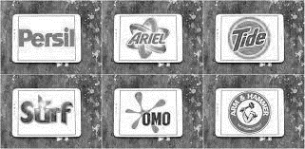
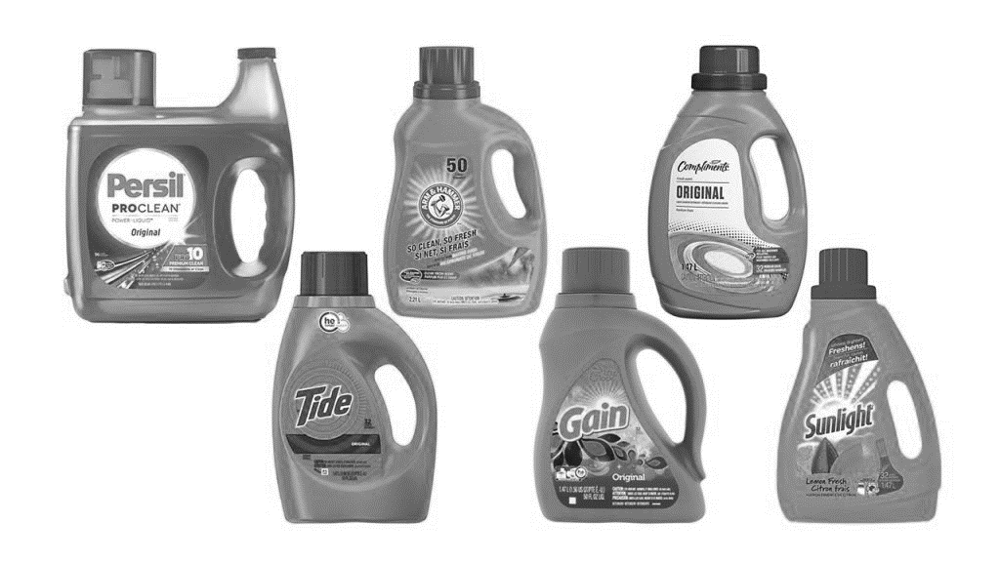
Understanding Distribution
Distribution Broken-down .
Brand Environment
B2B – B2C
Brand
Distribution measured at brand level only , this means availability of a product with specific brand.
Category
The presence of a category, which is at a high level , is this category available , what is the penetration of the category in X,Y Channel ?
Subcategory
The presence of a sub category, which is at a level below category , is this sub category available , what is the penetration of the category in X,Y Channel ?
SKU
The presence of a specific SKU , which is the lowest measure of distribution and the most challenging. which is at a level below category , is this sub category available , what is the penetration of the category in X,Y Channel ?
These are the 4 common layers of product and category led distribution
Tools, Content & Templates
Hand built using experience & insight

Slide 15
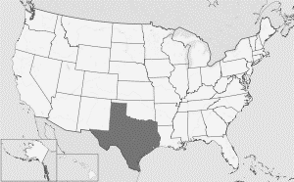
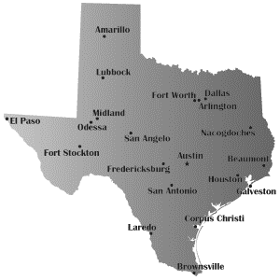
Understanding Distribution
Distribution Broken-down .
Geography Perspective
State of Texas
Incorporated Municipalities
Cities
Country
State
City
Town
Village
These are the 5 common layers of product and geography led distribution.
You can be as innovative as you wish , in the above case we have used publicly available data to drive a distribution framework
Tools, Content & Templates
Hand built using experience & insight

Slide 16
Thank you !

Slide 17
Job Descriptions
Develop roles clearly and completely across varying levels of experience
Agreements
Draft your business agreements across a variety of areas
Templates
Templates are designed based gather information in a structured manner
KPI’s
Performance indicator, a quantifiable measure of performance over time versus a specific objective.
Content Modules
Best practice material in power point for use as a knowledge base in business training , planning and execution .
Strategic tools
These tools are recognised the world over in business schools, consulting firms and companies who plan strategically.
Gain a competitive edge using the best tools and techniques to build a better you .
Analytical Tools
Interactive excel tools on specific business areas based on your data inputs delivered in a workbook model with instructions.
Scorecards
Designed as functional or subject indicators across a variety off situations to enable performance of situational evaluation versus aligned standards.
Calculators
calculate the right ratios for businesses looking for benchmarks in a variety of situations
Assessments
Assessments are designed around specific areas to conduct reviews and will center around a benchmark reviewing individuals or functions
Checklists
Designed around achieving milestones in a sequential manner.
Research
Research tools for sales and marketing engagement

Slide 18
Understanding Distribution.
Understand the context of distribution when discussing and measuring it.
UpskilPRO e Institute for Sales & Marketing
Tools, Content & Templates
Hand built using experience & insight

