Slide 1

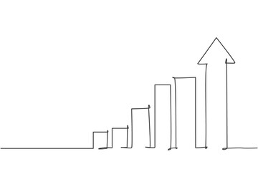
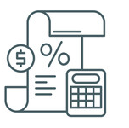
Channel Financials
Channel Financials
Evaluate the difference between Business financials and Channel financials.
UpskilPRO e Institute for Sales & Marketing
Tools, Content & Templates
Hand built using experience & Insight

Slide 2
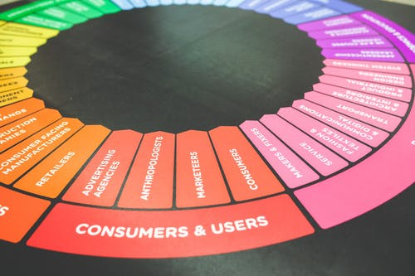

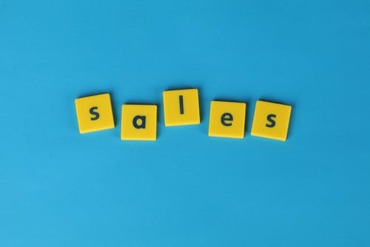

Created by
ex-Procter & Gamble, Rothmans, BAT, Gillette, Nokia,
Microsoft & 3M managers.
UpskilPRO tools are designed in easy-to-use solutions, all you need to do is download the tool and get to work immediately . All UpskilPRO material has taken 100’s of hours and many 1000’s of $ to build , all this expertise and content is brought to you for a fraction of the cost to help professionals enhance their capability.
core areas which are best suited to improve using our tools:
        Subject matter expertise
        Best practices
        Analytical output & charting
        Prioritization
        Process
        Training
Making life simpler for
Sales & Marketing professionals.
Tools in one place to get 10X productive now.

Slide 3


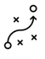

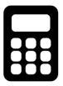
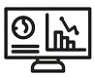
Job Descriptions
Develop roles clearly and completely across varying levels of experience
Agreements
Draft your business agreements across a variety of areas
Templates
Templates are designed based gather information in a structured manner
KPI’s
Performance indicator, a quantifiable measure of performance over time versus a specific objective.
Content Modules
Best practice material in power point for use as a knowledge base in business training , planning and execution .
Strategic tools
These tools are recognised the world over in business schools, consulting firms and companies who plan strategically.
Gain a competitive edge using the best tools and techniques to build a better you .
Analytical Tools
Interactive excel tools on specific business areas based on your data inputs delivered in a workbook model with instructions.
Scorecards
Designed as functional or subject indicators across a variety off situations to enable performance of situational evaluation versus aligned standards.
Calculators
calculate the right ratios for businesses looking for benchmarks in a variety of situations
Assessments
Assessments are designed around specific areas to conduct reviews and will center around a benchmark reviewing individuals or functions
Checklists
Designed around achieving milestones in a sequential manner.
Research
Research tools for sales and marketing engagement

Slide 4
2017
2018
100’s of tools grouped in 12 categories, 50 tool types and 12 business functions in 1 place.
get 10X productive now !
Categories
Functions
Analytical Tools
Types
Business Development
Agreements
Advertising
Customer Acquisition
Margins
Partner Search
Reports
Category Management
Assessments
Agreements
Customer Management
Market Analysis
Persona Development
Retail Measurement
Channel Management
Content Modules
Analytics
Distribution
Market Development
Planning
Reviews
Distribution
Checklists
Barriers
Distributor Management
Market Research
Positioning
Sales Management
Distributor Management
Calculators
Business Reviews
Forecasting
Market Segmentation
Pricing
Scorecards
General Management
Job Descriptions
Business Intelligence
GAP Analysis
Market Size
Prioritization
Segmentation
Key Account Management
KPI’s
Channels
Go To Market
Marketing
Product Development
Six Sigma
Marketing
Research
Communication
Job Descriptions
Marketing Comms
Product Life Cycle
Socio Economic Classification
Marketing Operations
Strategic Tools
Competitive Evaluation
Key Account Plans
Merchandising
Profit & Loss
Territory Design
Sales Management
Scorecards
Competitive Intelligence
Management Summary
New Market Entry
Promotions
Trade Marketing
Shopper Marketing
Templates
Trade Marketing

Slide 5
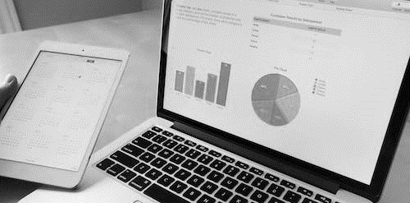
Channel Financials
Financial granularity , in multi channels , it becomes imperative to understand how each channel is performing and when the business size is right treat each channel as a separate business .

Slide 6
Channel Financials
Management Summary
Management Summary Channel management strategy and appropriate choice of channels based on data and customer throughput will be the 2 elements of our decision making capabilities in managing channels .
Mission |  |  | Vision
Financials | Top line from X Mn $ to Y Mn $ in 3 years |  | Contribution gross margins increase from 46% to 48% |  | Contribution income to increase from 19% to 23%
Channel Data |  | LY Sales | TY Plan | TY Sales | TY vs Plan | LY vs Plan
 | Channel A
 | Channel B
 | Channel C
 | Channel D
Initiatives | Budgets |  | Technologies |  | Strategic Channel Programs
Teams | Lead team |  | New Hires |  | TY Initiatives

Slide 7
Channel Financials
Topic - Channel setup guidelines (Example)
Channels
Geography
Customers
Classify channels
Segment geography clearly
Classify Customers in line with channel
Classify Customers to Channels
Align customers to regions and geography
Align customers to products
Set Channel guidelines
Align customers to Regions
Ensure multi geography customers are recorded
A
B
C
Set Customer discounts
Align financial codes to customers to allocate expenses credit and debit
Organize products into categories
Set Channel Discounts
Align products to channels
Budget codes for channels and customers
Set product discounts
Align Pricing strategy to channel
Record pricing strategy
Record expense codes
Discounts
Direct Expenses
Product

Slide 8
Channel Financials
Cost per transaction
Gross Margins
Sales – Cost of Sales
Gross Margin % ----------------------------- X 100
Sales
The higher the margin given to a channel distributor The lower is to margin retained by the brand owner
how does the margin to channels increases the cost of goods increases
the fundamental rule of any price reductions or expenses from the trade is that they will be added to the cost of goods thereby increasing the cost of goods .
generally brand owners look at competitive distribution margins and what in their opinion the P&L can sustain Before committing do a channel margin
in this module our interest is to examine the possibility of each channel having its own P&L nearby increasing accountability and financial responsibility by the business teams

Slide 9
Channel Financials
Cost per transaction
Contribution Margins
Sales – Cost of Sales – Variable Costs
Contribution Margin % = ----------------------------------------------- X 100
Sales
From an accounting perspective gross margins and contribution margins are used at different times
When using contribution margins distributors we should allocate costs to the specific product or customers this is where they use relevant variable costs to arrive at the actual margins in a perspective it cost to serve perspective
in this module our interest is to examine the possibility of each channel having its own P&L nearby increasing accountability and financial responsibility by the business teams

Slide 10
Channel Financials
Cost per transaction
Operating Margins
Sales – Cost of Sales – Overhead Costs
Operating Margin % = ----------------------------------------------- X 100
Sales

Slide 11
Channel Financials
Cost per transaction
Net Margins
Sales – Cost of Sales – Overhead Costs – Interest
Net Margin % = --------------------------------------------------------- X 100
Sales

Slide 12
Channel Financials
Cost Classification
Marketing-driven costs
Relationship management
Allowances
Programmes ( loyalty programmes)
Sales-driven costs
Discounts/rebates
Promotions
Sales person time required
Sales cycle times and conversion rates
Sales channel used
Transaction-driven costs
Order complexity
Size of order
Logistics-driven costs
Shop-to points
Returns
Inventory-driven costs
Inventory levels
Product mix required
Finance-driven costs
Credit limits
Credit period taken
Cost headers are usually standard in finance and therefore the same in most if not all companies , however what is not the same in most companies is the level of detail in assigning costs.
Right at the outset a company must decide what level of detail they wish to see in the business model , previously it might have been complex in a manual model , but with an ERP system it gives you great freedom but the work to assign costs to territories starts early in the organisational design business .
In the example below its possible the level of detail shown will help the organisation for many years in to the future , however the blue boxes are standardized , and the red boxes are rarely included in the P&L reporting , this allows companies to apply percentages and averages in the cost allocations which in turn does not drive visibility and manageability of true cost structures
Country
Business
Channel
Customer
State
Category
Sub-Category
Product

Slide 13
Channel Financials
Topic – Profitability by channel ( Plan )
Channel Profitability is viewed across 5 layers – A) Geography B) Regional C) Channel D) Product E) Customers
Customers
There may be 100’s of customers , in any ERP system it will automatically drill down , but the cost inputs are usually reserved for KAM customers all others are left as is
National
Channel
A Region is split into countries which is again split into states , and in some cases districts .
A channel is split across more than 1 geography .
Product
Regional
Product mix may differ across many channels and so the cost of doing business
The direct expenses involved in managing a channel will differ gain with some channels being more complex to manage versus others .
Contribution Income
SgNA
CoGS

Slide 14
Channel Financials
Cost per transaction
National
P&L
National P&L is used by all organisations as it reflects the financial performance at the national level
Regional P&L
Regional P&L is used mainly in larger countries whilst and the smaller ones it may be difficulty dividing the territory and designing P&L reporting which becomes highly complex in smaller countries
Channel P&L
In larger countries which have multi channel responsibility our recommendation is to view sales performance at the channel level to understand not only performance but planning and execution quit of financial perspective , this is not This is not done unless the ERP system has the functionality
Product P&L
Whilst the product panel is reflected in the national P&L it is not the same , within a flexible accounting or ERP system you can divide the various businesses into product P&L’s to drive business clarity And objectivity , this is specially useful when conducting data analytics and building business plans
Customer P&L
In large organisations specially where key account management is a function having a customer centric P&L allows the customer focussed organisation to focus not only on revenue but on income

Slide 15
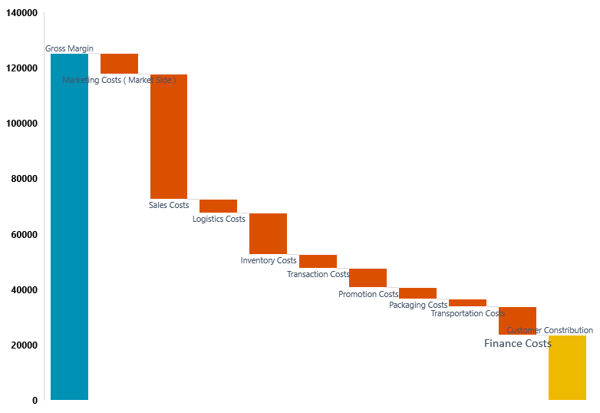
Channel Financials
Cost Classification
Cost to serve in a single or multi channel environment determines the actual efficiency of an individual channel or customer.
If the number of ship to points increase especially by customer or product then you have mounting costs .
Companies establish a raft of measures from
Minimum order quantity
Specific days for shipment
Collation of orders
And minimum order value
The primary goal to manage costs should be ensuring trackability , if the ERP system can track cost allocations by delivery , by product , by customer , by channel and by category and finally business , then it makes the choice much easier on how to manage costs .
In principle if the contribution margin , takes into account the cost structure , leaving the fixed costs , which need to be less than the contribution for the business to make a profit
Cost to Serve
www.upskilpro.com

Slide 16
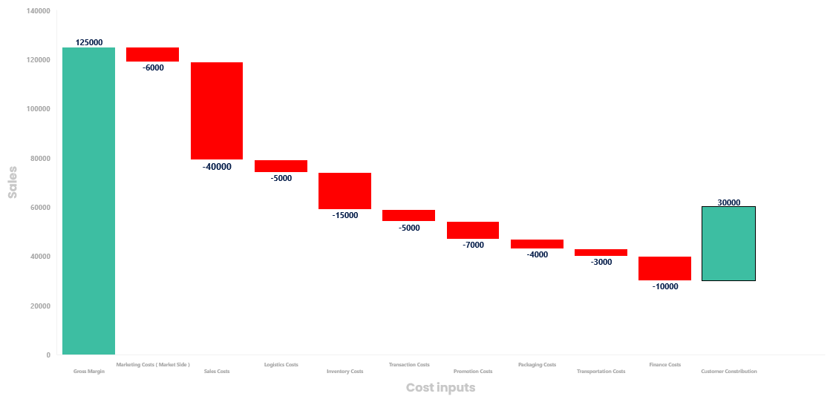
Channel Financials
Revenue Walk by Channel
Business Specifics | Inputs
Channel
Business
Region
Country
Channel Share %
Business Share %
Leader
Cost to Serve
www.upskilpro.com

Slide 17

Channel Financials
Financial Matrix Reporting
National P&L
In any business the sum of all parts interact with each other , likewise in the 5 view financials we show below its left to each individual business to prioritize the level of importance for each of the 5 financial views and more. There will always be a standard summary view while all other views will be left to the business manager’s discretion and level of data granularity desired.
Product P&L
Regional P&L
Channel P&L
Customer P&L

Slide 18
Channel Financials
Cost per transaction
Engagement Cost
High
100$- 125 $
Sales force
Value added
Partners
80$ - 100 $
Distributors
60$ - 80$
Retail
Value added sales
Direct sales channels
40$ – 60$
Inside SALES
E
commerce
Indirect channels
20$ - 40 $
Direct marketing channels
10$ - 20 $
low
low
Cost per transaction
High
Distribution Channels :
Each product and category interacts differently with channels based on A) Brand initiatives B) Strategy C) Priorities
The models above may all be used or only one , it is dependent on the strategy and the planning used to arrive at such a conclusion
Each channel has different cost layers to deliver service
In the example above the cost per transaction is largely modelled around the distance to end user , the 3 models reflect the distance and the cost .
Strategically the prioritization works around working with the larger and complex customer groups and moving the smaller and less profitable groups to inside sales or telemarketing
E commerce is a strategic decision mainly , as opposed to a cost based decision

Slide 19
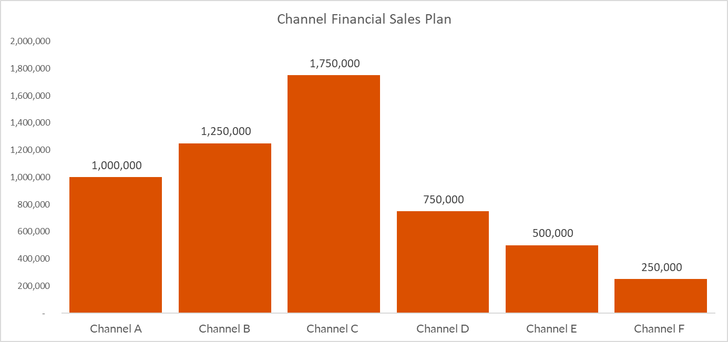
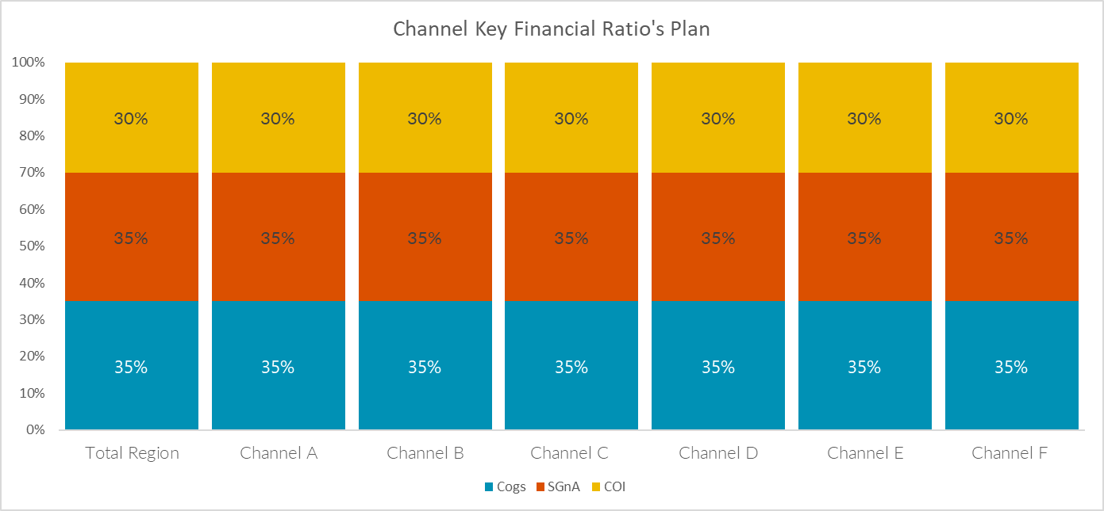
Channel Financials
Channel Profitability ( Plan )
* This file is available on www.upskilpro.com in an editable version , use the reference number provided on the top right in red

Slide 20
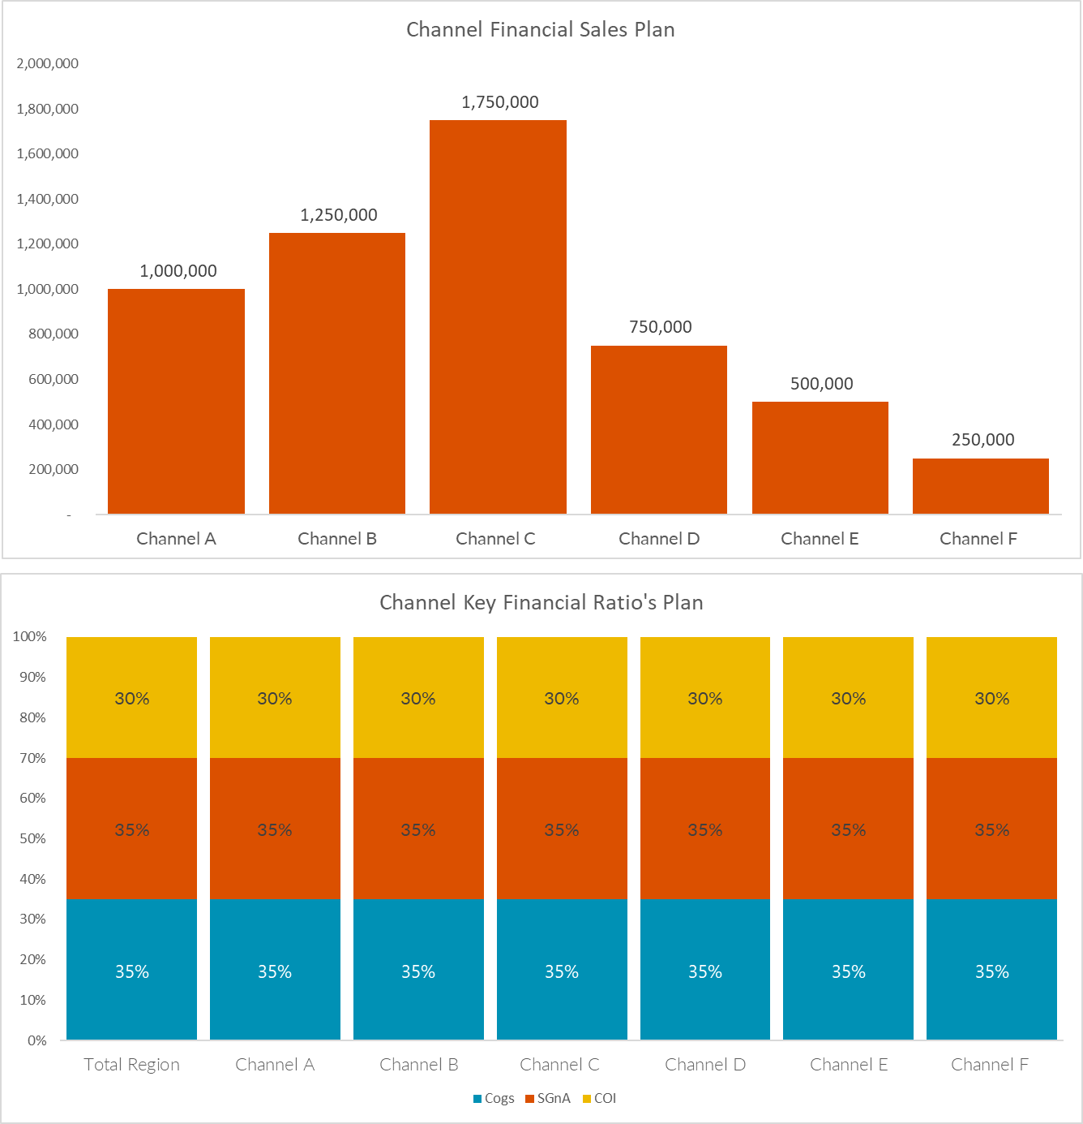
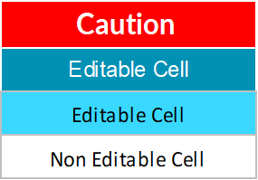
Channel Financials
Topic - Channel Profitability ( Plan )
Plan
All numbers are illustrative
we assumed cogs to be a standard 35% across channels
R&D ,sales costs, admin ,other costs are assumed to be standard for each channel .
You will see the operating profit is planned at 30 % by channel
This P&L is a plan and indicates the annual plan across all channels using a standard set of assumptions.
The second aspect is management needs to prioritise channel performance as a KPI and organisational driver , for this you will see the next slide where the actual are indicated
* This file is available on www.upskilpro.com in an editable version , use the reference number provided on the top right in red

Slide 21
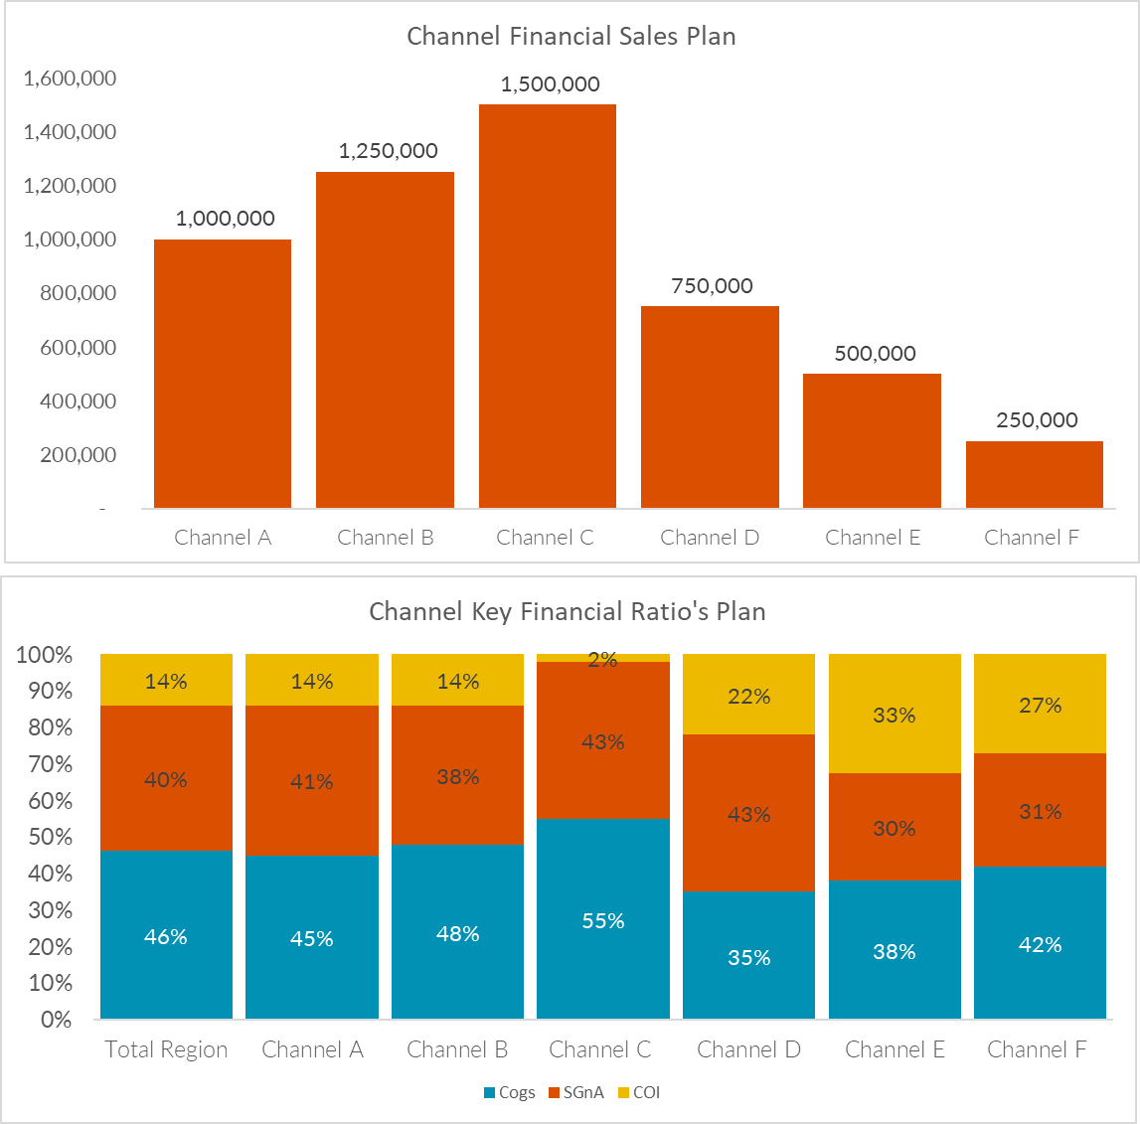
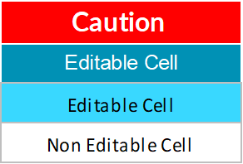
Channel Financials
Topic - Channel Profitability ( Actual )
Actual
All numbers are fictional
In this case Cogs has gone up to 46 % s
R&D ,sales costs, admin ,other costs are assumed to be different for each channel for a variety of reasons.
You will see the operating profit differs by channel
one of the difficulties of evaluating financial performance by channel boils down to how the financials are set up in the ERP system most modern ERP systems have channel functionality.
The second aspect is management need to prioritise channel performance as a KPI and organisational driver
* This file is available on www.upskilpro.com in an editable version , use the reference number provided on the top right in red

Slide 22
Channel Financials
Topic - Channel Profitability ( Performance )
In conclusion you will see our top line came in 6% below plan an hour Cox swelled from 35 to 46% and our operating profit dropped from 1.8 mn to 800,000 or 44% of the plan
This slide is how most companies look at sales performance at the top level.
if most companies were to look at sales performance by channel it would help understanding what the channel efficiencies are and the problems
Evaluating business performance at Country , Geography m Channel and product level will help organisations develop and understand their business better .
* This file is available on www.upskilpro.com in an editable version , use the reference number provided on the top right in red

Slide 23
Channel Financials
Topic - Channel Profitability ( Actual )
Sample table for illustration
Channel Profitability is viewed across 4 layers – A) Geography B) Channel C) Product D) Direct Expenses
Customers
Right channel , Right customer, Right database
Geography
Channel
A Region is split into geographies which consist of many channels
A channel is split across many geographies .
Product
Direct Expenses
Product mix may differ across many channels and so the cost of doing business
The direct expenses involved in managing a channel will differ gain with some channels being more complex to manage versus others .
Contribution Income
SgNA
CoGS

Slide 24
Channel Financials
Transaction Cost by Channel
Typically, a cost to serve approach will help define the right allocation of resources to the right channel.
Lower end of transaction cost .
Higher end of transaction cost .
The above approach is taken as an all-up cost to serve basis , which includes all costs incurred to be served to the customer
Elements of cost to serve are discussed in the next chart
01
02
03
04

Slide 25
Channel Financials
Module

Slide 26
Thank you !

Slide 27
Job Descriptions
Develop roles clearly and completely across varying levels of experience
Agreements
Draft your business agreements across a variety of areas
Templates
Templates are designed based gather information in a structured manner
KPI’s
Performance indicator, a quantifiable measure of performance over time versus a specific objective.
Content Modules
Best practice material in power point for use as a knowledge base in business training , planning and execution .
Strategic tools
These tools are recognised the world over in business schools, consulting firms and companies who plan strategically.
Gain a competitive edge using the best tools and techniques to build a better you .
Analytical Tools
Interactive excel tools on specific business areas based on your data inputs delivered in a workbook model with instructions.
Scorecards
Designed as functional or subject indicators across a variety off situations to enable performance of situational evaluation versus aligned standards.
Calculators
calculate the right ratios for businesses looking for benchmarks in a variety of situations
Assessments
Assessments are designed around specific areas to conduct reviews and will center around a benchmark reviewing individuals or functions
Checklists
Designed around achieving milestones in a sequential manner.
Research
Research tools for sales and marketing engagement

Slide 28
Channel Financials
Channel Financials
Evaluate the difference between Business financials and Channel financials.
UpskilPRO e Institute for Sales & Marketing
Tools, Content & Templates
Hand built using experience & Insight

