Slide 1

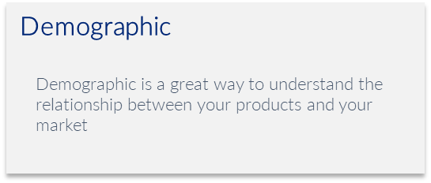
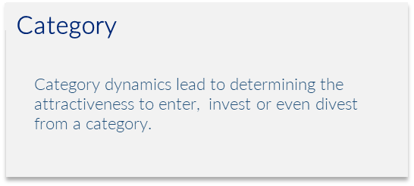

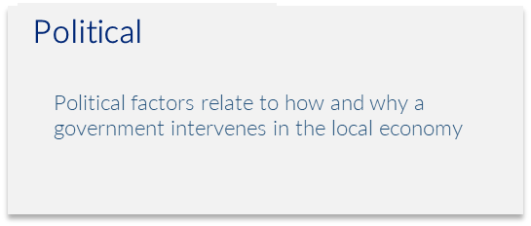
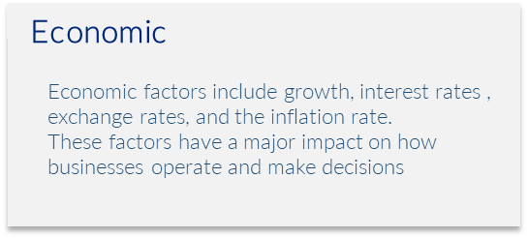
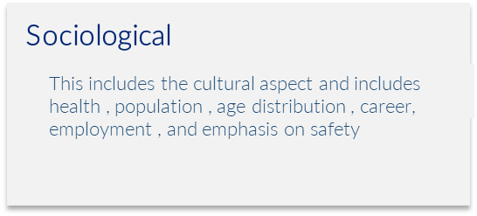
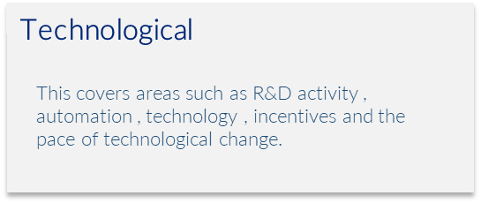
D
C
P
E
S
T
DCPEST
Category Analysis
Evaluate categories before engaging them.
UpskilPRO e Institute for Sales & Marketing
Tools, Content & Templates
Hand built using experience & Insight

Slide 2
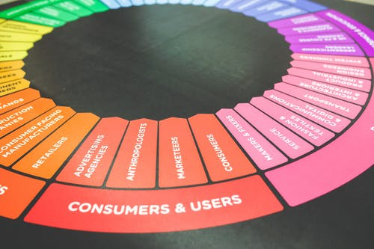



Created by
ex-Procter & Gamble, Rothmans, BAT, Gillette, Nokia,
Microsoft & 3M managers.
UpskilPRO tools are designed in easy-to-use solutions, all you need to do is download the tool and get to work immediately . All UpskilPRO material has taken 100’s of hours and many 1000’s of $ to build , all this expertise and content is brought to you for a fraction of the cost to help professionals enhance their capability.
core areas which are best suited to improve using our tools:
        Subject matter expertise
        Best practices
        Analytical output & charting
        Prioritization
        Process
Capability enhancement tools for
Consumer Marketing, Trade Marketing &
Sales excellence professionals.
Tools in one place to get 10X productive now.

Slide 3


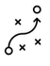

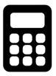
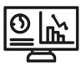
Job Descriptions
Develop roles clearly and completely across varying levels of experience
Agreements
Draft your business agreements across a variety of areas
Templates
Templates are designed based gather information in a structured manner
KPI’s
Performance indicator, a quantifiable measure of performance over time versus a specific objective.
Content Modules
Best practice material in power point for use as a knowledge base in business training , planning and execution .
Strategic tools
These tools are recognised the world over in business schools, consulting firms and companies who plan strategically.
Gain a competitive edge using the best tools and techniques to build a better you .
Analytical Tools
Interactive excel tools on specific business areas based on your data inputs delivered in a workbook model with instructions.
Scorecards
Designed as functional or subject indicators across a variety off situations to enable performance of situational evaluation versus aligned standards.
Calculators
calculate the right ratios for businesses looking for benchmarks in a variety of situations
Assessments
Assessments are designed around specific areas to conduct reviews and will center around a benchmark reviewing individuals or functions
Checklists
Designed around achieving milestones in a sequential manner.
Research
Research tools for sales and marketing engagement

Slide 4
2017
2018
100’s of tools grouped in 12 categories, 50 tool types and 12 business functions in 1 place.
get 10X productive now !
Categories
Functions
Analytical Tools
Types
Business Development
Agreements
Advertising
Customer Acquisition
Margins
Partner Search
Reports
Category Management
Assessments
Agreements
Customer Management
Market Analysis
Persona Development
Retail Measurement
Channel Management
Content Modules
Analytics
Distribution
Market Development
Planning
Reviews
Distribution
Checklists
Barriers
Distributor Management
Market Research
Positioning
Sales Management
Distributor Management
Calculators
Business Reviews
Forecasting
Market Segmentation
Pricing
Scorecards
General Management
Job Descriptions
Business Intelligence
GAP Analysis
Market Size
Prioritization
Segmentation
Key Account Management
KPI’s
Channels
Go To Market
Marketing
Product Development
Six Sigma
Marketing
Research
Communication
Job Descriptions
Marketing Comms
Product Life Cycle
Socio Economic Classification
Marketing Operations
Strategic Tools
Competitive Evaluation
Key Account Plans
Merchandising
Profit & Loss
Territory Design
Sales Management
Scorecards
Competitive Intelligence
Management Summary
New Market Entry
Promotions
Trade Marketing
Shopper Marketing
Templates
Trade Marketing

Slide 5
DCPEST Analysis
Evaluate categories before you engage them .

Slide 6
DEMOGRAPHIC

Slide 7
PEST Analysis
4 Key reasons to use one
DCPEST Analysis is useful for four main reasons:
It helps you understand the category attractiveness and challenges before you commit to engaging the category
It helps you to spot business or personal opportunities, and it gives you advanced warning of significant threats.
It reveals the direction of change within your business environment. This helps you shape what you're doing, so that you work with change, rather than against it.
It helps you avoid starting projects that are likely to fail, for reasons beyond your control.
It can help you break free of unconscious assumptions when you enter a new country, region, or market; because it helps you develop an objective view of this new environment.

Slide 8
DCPEST Analysis
Analysis summary
Demographic
Demographic is a great way to understand the relationship between your products and your market
Political
Political factors relate to how and why a government intervenes in the local economy
Category
Sociological
Category dynamics lead to determining the attractiveness to enter, invest or even divest from a category.
This includes the cultural aspect and includes health , population , age distribution , career, employment , and emphasis on safety
Economic
Economic factors include growth, interest rates , exchange rates, and the inflation rate.
These factors have a major impact on how businesses operate and make decisions
Technological
This covers areas such as R&D activity , automation , technology , incentives and the pace of technological change.

Slide 9

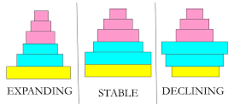

DCPEST Analysis
Demographic Analysis Components
Age: Age refers to the number of years an individual has lived. It is typically categorized into different age groups or cohorts, such as children, teenagers, young adults, middle-aged adults, and seniors. Age data is crucial for understanding generational differences and their impact on consumer behaviour and preferences.
Gender: Gender refers to the classification of individuals as male or female. Gender data helps in understanding gender-specific preferences, buying behaviours, and social dynamics. It is important to note that gender is not limited to binary categories, and some analyses may consider non-binary or other gender identities.
Income: Income represents the amount of money an individual or household earns within a specific timeframe. Income data helps identify purchasing power, socioeconomic status, and affordability of products or services. It is often categorized into income brackets or percentiles to analyze spending patterns across different income levels.
Education Level: Education level indicates the highest level of formal education completed by individuals. It ranges from no formal education to primary, secondary, tertiary (college or university), and advanced degrees. Education data provides insights into knowledge levels, professional qualifications, and potential interests or preferences.
Marital Status: Marital status refers to an individual's legal relationship status, such as married, single, divorced, widowed, or separated. Marital status data can influence purchasing decisions, household composition, and family dynamics.
Household Size: Household size represents the number of individuals residing in a household. It helps in understanding the composition of households, including the presence of children, multigenerational families, or single-person households. Household size data is useful for analysing consumption patterns, housing needs, and family-oriented marketing strategies.
Geographic Location: Geographic location refers to the physical location of individuals or households. It can be analysed at various levels, such as country, region, city, or neighbourhood. Geographic data helps in understanding regional or local variations in demographics, culture, preferences, and market dynamics.
Ethnicity/Race: Ethnicity or race refers to a person's cultural or racial background. It provides insights into cultural diversity, identity, and preferences. Ethnicity or race data helps businesses understand consumer behaviour within specific ethnic or racial groups and develop targeted marketing strategies.
Occupation: Occupation represents the type of work or profession in which individuals are engaged. Occupation data helps in understanding employment patterns, income levels, and potential interests or needs related to specific industries or job roles.
Language: Language represents the primary language(s) spoken or understood by individuals. Language data is important for creating effective communication strategies, particularly in multicultural or multilingual markets.

Slide 10

DCPEST Analysis
Factors to consider
Demographic/s
Product selection: Demographics can help retailers determine which products are most likely to appeal to different customer segments. Merchandising: Demographics can inform the layout and organization of products within a category.
Pricing: Demographics can also influence pricing strategies for different product categories or budget-conscious customers.
Marketing: Demographics can inform the messaging and advertising tactics used to promote different product categories.

Slide 11
DCPEST Analysis
Demographic Analysis Table
Comment :
This table represents a basic demographic summary table indicating a population representation.
A demographic analysis for any marketing engagement will cover the above in relation to the brand positioning , for example if you are planning a cereal powder for infants , it's wise to see if the demographic is represented along with the birth rate to plan category engagement. In the above case.
In the case of trade marketing, it’s a good idea to review the shopper profile in relation to the brand priorities as well , combining the average basket size to the day and customer.

Slide 12
CATEGORY

Slide 13
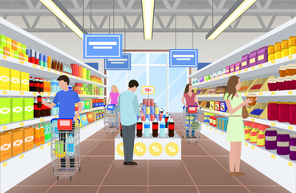
DCPEST Analysis
Factors to consider
Category
What is the size of the category in both value and volume
Who are the competitors
What are the market shares
What are the USP’s of the top competitors
Key attributes which contribute to the success of the key competitors
Is there data availability from research partners.
Here are some specific ways that demographics can inform category management:
Product selection: Demographics can help retailers determine which products are most likely to appeal to different customer segments. For example, if a store's customer base is predominantly young adults, it may be more profitable to stock trendy, affordable products rather than high-end luxury items.
Merchandising: Demographics can inform the layout and organization of products within a category. For instance, if a store's customer base includes many families with young children, it may make sense to place kid-friendly products at eye level and create a designated "family" section within the store.
Pricing: Demographics can also influence pricing strategies for different product categories. For example, if a store caters primarily to budget-conscious customers, it may need to offer lower prices and frequent discounts to remain competitive.
Marketing: Demographics can inform the messaging and advertising tactics used to promote different product categories. For example, if a store's customer base is largely made up of millennials, it may be more effective to use social media and influencer marketing to reach this audience rather than traditional print or TV ads.
Overall, demographics are an important tool for category management because they help retailers better understand and serve their customers. By tailoring their strategies to the unique needs and preferences of different customer segments, retailers can improve customer satisfaction, drive sales, and build brand loyalty.

Slide 14


DCPEST Analysis
Category Analysis Components
Here are 10 key steps in putting together a category analysis in general.
Define the Category: Clearly define the product or service category you want to analyze. For example, if you are analysing the smartphone market, specify the criteria and boundaries of the category.
Gather Data: Collect relevant data from various sources to gain a comprehensive understanding of the category. These sources may include market research reports, industry publications, competitor websites, customer surveys, social media platforms, and internal sales data.
Identify Market Trends: Analyze the current market trends within the category. Look for factors such as market size, growth rate, customer preferences, technological advancements, and regulatory changes. Identify any emerging trends or shifts in consumer behaviour that may impact the category.
Assess Competitors: Identify and analyze key competitors within the category. Evaluate their market share, product offerings, pricing strategies, distribution channels, promotional activities, and customer feedback. Identify their strengths, weaknesses, opportunities, and threats (SWOT analysis) to understand their competitive position.
Understand Consumer Behaviour: Study consumer behaviour within the category. Identify target customer segments, their demographics, psychographics, purchasing habits, and preferences. Determine the factors that influence their purchase decisions, such as price, quality, brand reputation, convenience, or product features.
Evaluate Marketing Channels: Assess the distribution channels and marketing strategies used within the category. Understand how products or services are typically marketed, distributed, and sold. Determine the effectiveness of different channels (e.g., online, retail, direct sales) and identify any untapped opportunities.
Analyze Pricing and Profitability: Examine pricing strategies within the category. Evaluate the pricing levels, discounts, promotions, and perceived value of products or services. Assess the profitability of the category by analysing the cost structure, profit margins, and potential pricing opportunities.
Identify Growth Opportunities: Based on the analysis, identify potential growth opportunities within the category. This could include targeting new customer segments, expanding into new geographic markets, introducing innovative products, or leveraging emerging trends.
Summarize and Present Findings: Compile the analysis findings into a comprehensive report or presentation. Highlight key insights, market trends, competitor analysis, consumer behaviour patterns, and growth opportunities. Use visual aids, graphs, and charts to enhance the clarity of the presentation.
Develop Actionable Recommendations: Based on the analysis, provide actionable recommendations for the business. Suggest strategies to capitalize on identified growth opportunities, address weaknesses, differentiate from competitors, and optimize marketing efforts within the category.
This or this ?

Slide 15
DCPEST Analysis
Category Analysis Components
Marketers' perspective
Products | Positioning Claims | Price
No of products in category Dominant brand and estimated share Typical sizes Typical segments Estimated shares of brands competing | Health Freshness Longevity | Price range Price Pyramid to brands Average price Average size per serve
Drivers | Packaging | Promotion
Volume driven Convenience Health Technology | Type of packaging Size of packaging Formats of available packaging | Types of promotions Typical promotion design Discounts Cross Category
This table represents a basic view of a marketer reviewing a category and the areas to review ( purely from a high level )
The marketer's perspective is from a long-term category development view , starting with is there a category and is there an “unmet need “.

Slide 16
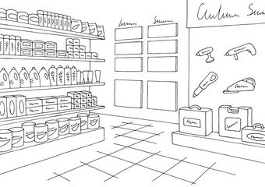
DCPEST Analysis
Category Analysis Components
Trade Marketers perspective
Products | Promotion | Price | Share
No of products in category Dominant brand and estimated share Typical sizes Typical segments Estimated shares of brands competing | Types of promotions Typical promotion design Discounts Cross Category | Price range Price Pyramid to brands Average price Average size per serve | Brand volume share Brand Value Share Shelf Share
Visibility | Category | Volume | Value
Location Share of shelf Cross category presence Communication material Category communication | Does the category exist Sub-Category if any | Shelf offtake in pieces or units | Shelf offtake in $
This table represents a basic view of a trade marketer reviewing a category and the areas to review ( purely from a high level )
The trade marketer's perspective develops from 1) the account , 2) the category and 3) the shopper engagement & experience at the category.

Slide 17
POLITICAL

Slide 18

DCPEST Analysis
Factors to consider
Political
When is the country's next local, state, or national election? How could this change government or regional policy?
Who are the most likely contenders for power? What are their views on business policy, and on other policies that affect your organization?
Depending on the country, how well developed are property rights and the rule of law, and how widespread are corruption and organized crime? How are these situations likely to change, and how is this likely to affect you?
Could any pending legislation or taxation changes affect your business, either positively or negatively?
How will business regulation, along with any planned changes to it, affect your business? And is there a trend towards regulation or deregulation?
How does government approach corporate policy, corporate social responsibility, environmental issues, and customer protection legislation? What impact does this have, and is it likely to change?
What is the likely timescale of proposed legislative changes?
Are there any other political factors that are likely to change?

Slide 19
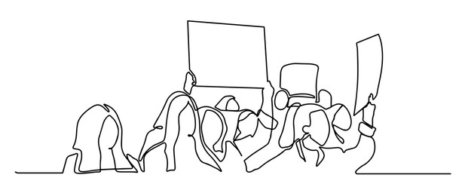
DCPEST Analysis
Political Analysis Components
Political Factors to Consider | Score
When is the country's next local, state, or national election? How could this change government or regional policy?
Who are the most likely contenders for power? What are their views on business policy, and on other policies that affect your organization?
Depending on the country, how well developed are property rights and the rule of law, and how widespread are corruption and organized crime? How are these situations likely to change, and how is this likely to affect you?
Could any pending legislation or taxation changes affect your business, either positively or negatively?
How will business regulation, along with any planned changes to it, affect your business? And is there a trend towards regulation or deregulation?
How does government approach corporate policy, corporate social responsibility, environmental issues, and customer protection legislation? What impact does this have, and is it likely to change?
What is the likely timescale of proposed legislative changes?
Are there any other political factors that are likely to change?
TOTALS
Scoring Guide
High | 9 | High risk
Medium | 3 | Moderate change
Low | 1 | Low change
NA | 0 | No change
This table represents a basic view of a DC PEST analysis for marketing in general to summarize the situation.
Please consider political factors from a direct influence perspective as far as possible , which will impact the category and brand , you may relate this to Tobacco , Alcohol , Electric Vehicles and Green House Gases for instance . Similarly reach out to analyse the factors to consider when doing your political analysis.

Slide 20
ECONOMIC

Slide 21

DCPEST Analysis
Factors to consider
Economic Factors to Consider
How stable is the current economy? Is it growing, stagnating, or declining?
Are key exchange rates stable, or do they tend to vary significantly?
Are customers' levels of disposable income rising or falling? How is this likely to change in the next few years?
What is the unemployment rate? Will it be easy to build a skilled workforce? Or will it be expensive to hire skilled labour?
Do consumers and businesses have easy access to credit? If not, how will this affect your organization?
How is globalization affecting the economic environment?
Are there any other economic factors that you should consider?

Slide 22
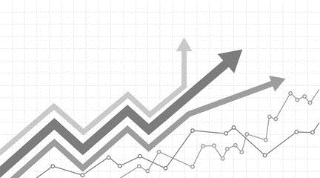
DCPEST Analysis
Economic Analysis Components
Economic Factors to Consider | Score
How stable is the current economy? Is it growing, stagnating, or declining?
Are key exchange rates stable, or do they tend to vary significantly?
Are customers' levels of disposable income rising or falling? How is this likely to change in the next few years?
What is the unemployment rate? Will it be easy to build a skilled workforce? Or will it be expensive to hire skilled labour?
Do consumers and businesses have easy access to credit? If not, how will this affect your organization?
How is globalization affecting the economic environment?
Are there any other economic factors that you should consider?
TOTALS
Scoring Guide
High | 9 | High risk
Medium | 3 | Moderate change
Low | 1 | Low change
NA | 0 | No change
This table represents a basic view of a DC PEST analysis for marketing in general to summarize the situation.
Please consider political factors from a direct influence perspective as far as possible , which will impact the category and brand , you may relate this to Tobacco , Alcohol , Electric Vehicles and Green House Gases for instance . Similarly reach out to analyse the factors to consider when doing your political analysis.

Slide 23
SOCIOLOGICAL

Slide 24

DCPEST Analysis
Factors to consider
Socio-Cultural Factors to Consider
What is the population's growth rate and age profile? How is this likely to change?
Are generational shifts in attitude likely to affect what you're doing?
What are your society's levels of health, education, and social mobility? How are these changing, and what impact does this have?
What employment patterns, job market trends, and attitudes toward work can you observe? Are these different for different age groups?
What social attitudes and social taboos could affect your business? Have there been recent socio-cultural changes that might affect this?
How do religious beliefs and lifestyle choices affect the population?
Are any other socio-cultural factors likely to drive change for your business?

Slide 25
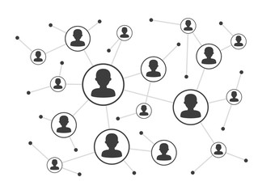
DCPEST Analysis
Sociological Analysis Components
Sociological Factors to Consider | Score
What is the population's growth rate and age profile? How is this likely to change?
Are generational shifts in attitude likely to affect what you're doing?
What are your society's levels of health, education, and social mobility? How are these changing, and what impact does this have?
What employment patterns, job market trends, and attitudes toward work can you observe? Are these different for different age groups?
What social attitudes and social taboos could affect your business? Have there been recent socio-cultural changes that might affect this?
How do religious beliefs and lifestyle choices affect the population?
Are any other socio-cultural factors likely to drive change for your business?
TOTALS
Scoring Guide
High | 9 | High risk
Medium | 3 | Moderate change
Low | 1 | Low change
NA | 0 | No change
This table represents a basic view of a DC PEST analysis for marketing in general to summarize the situation.
Please consider Socio cultural factors from a direct influence perspective as far as possible , which will impact the category and brand , you may relate this to ageing populations , immigration , education , age related laws , retirement , baby boom etc.
Similarly reach out external bodies to analyse the factors to consider when doing your sociological analysis.

Slide 26
TECHNOLOGICAL

Slide 27

DCPEST Analysis
Factors to consider
Technological Factors to Consider
Are there any new technologies that you could be using?
Are there any new technologies on the horizon that could radically affect your work or your industry?
Do any of your competitors have access to new technologies that could redefine their products?
In which areas do governments and educational institutions focus their research? Is there anything you can do to take advantage of this?
How have infrastructure changes affected work patterns (for example, levels of remote working)?
Are there existing technological hubs that you could work with or learn from?
Are there any other technological factors that you should consider?

Slide 28

DCPEST Analysis
Technological Analysis Components
Technological Factors to Consider | Score
Are there any new technologies that you could be using?
Are there any new technologies on the horizon that could radically affect your work or your industry?
Do any of your competitors have access to new technologies that could redefine their products?
In which areas do governments and educational institutions focus their research? Is there anything you can do to take advantage of this?
How have infrastructure changes affected work patterns (for example, levels of remote working)?
Are there existing technological hubs that you could work with or learn from?
Are there any other technological factors that you should consider?
TOTALS
Scoring Guide
High | 9 | High risk
Medium | 3 | Moderate change
Low | 1 | Low change
NA | 0 | No change
This table represents a basic view of a DC PEST analysis for marketing in general to summarize the situation.
Please consider Technological factors from a direct and indirect influence perspective as far as possible , which will impact the category and brand , you may relate this to new software , artificial intelligence , cost to use per unit , licensing ageing , the recent effects of covid and the learnings from them etc.

Slide 29
DCPEST Analysis
Analysis Tool
DCPEST analysis is a strategic business tool used by organizations to discover, evaluate, organize, and track macro-economic factors which can impact on their business now and in the future.
Insert your own criteria and drivers for building out a robust analysis
Demographic
Political
Technological
A
B
C
D
E
F
G
H
A
B
C
D
E
F
G
H
A
B
C
D
E
F
G
H
Category
Economic
Sociological
A
B
C
D
E
F
G
H
A
B
C
D
E
F
G
H
A
B
C
D
E
F
G
H

Slide 30
DC | PEST Analysis
Assess key factors before you commit your trade marketing / marketing resources.

Slide 31
Thank You

Slide 32
D
C
P
E
S
T
DCPEST
Category Analysis
Evaluate categories before engaging them.
UpskilPRO e Institute for Sales & Marketing
Tools, Content & Templates
Hand built using experience & Insight

