Slide 1

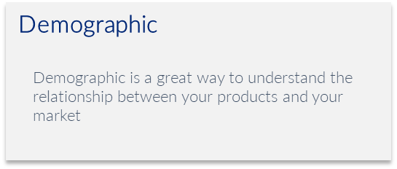
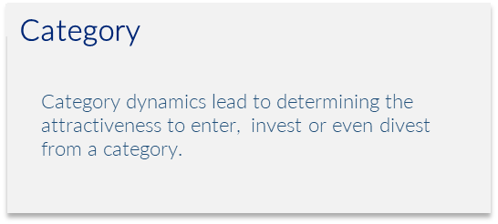

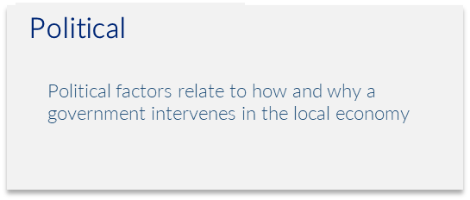
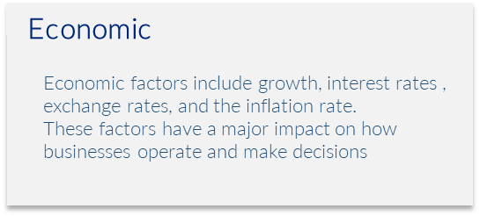
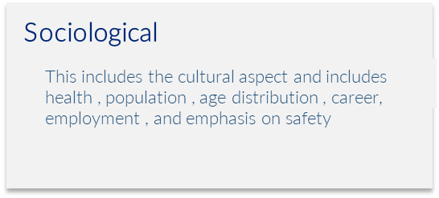
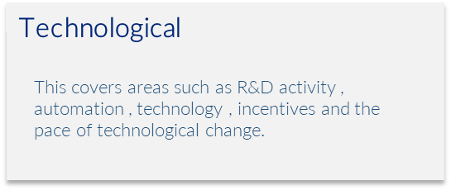
D
C
P
E
S
T
DCPEST
Category Analysis
Evaluate categories before engaging them.
UpskilPRO e Institute for Sales & Marketing
Tools, Content & Templates
Hand built using experience & Insight

Slide 2
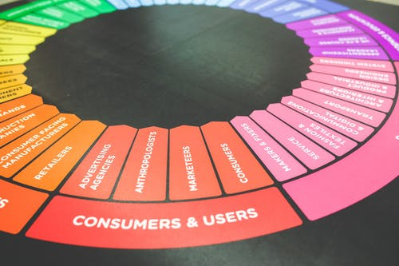



Created by
ex-Procter & Gamble, Rothmans, BAT, Gillette, Nokia,
Microsoft & 3M managers.
UpskilPRO tools are designed in easy-to-use solutions, all you need to do is download the tool and get to work immediately . All UpskilPRO material has taken 100’s of hours and many 1000’s of $ to build , all this expertise and content is brought to you for a fraction of the cost to help professionals enhance their capability.
core areas which are best suited to improve using our tools:
        Subject matter expertise
        Best practices
        Analytical output & charting
        Prioritization
        Process
Capability enhancement tools for
Consumer Marketing, Trade Marketing &
Sales excellence professionals.
Tools in one place to get 10X productive now.

Slide 3


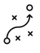

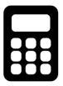
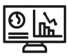
Job Descriptions
Develop roles clearly and completely across varying levels of experience
Agreements
Draft your business agreements across a variety of areas
Templates
Templates are designed based gather information in a structured manner
KPI’s
Performance indicator, a quantifiable measure of performance over time versus a specific objective.
Content Modules
Best practice material in power point for use as a knowledge base in business training , planning and execution .
Strategic tools
These tools are recognised the world over in business schools, consulting firms and companies who plan strategically.
Gain a competitive edge using the best tools and techniques to build a better you .
Analytical Tools
Interactive excel tools on specific business areas based on your data inputs delivered in a workbook model with instructions.
Scorecards
Designed as functional or subject indicators across a variety off situations to enable performance of situational evaluation versus aligned standards.
Calculators
calculate the right ratios for businesses looking for benchmarks in a variety of situations
Assessments
Assessments are designed around specific areas to conduct reviews and will center around a benchmark reviewing individuals or functions
Checklists
Designed around achieving milestones in a sequential manner.
Research
Research tools for sales and marketing engagement

Slide 4
2017
2018
100’s of tools grouped in 12 categories, 50 tool types and 12 business functions in 1 place.
get 10X productive now !
Categories
Functions
Analytical Tools
Types
Business Development
Agreements
Advertising
Customer Acquisition
Margins
Partner Search
Reports
Category Management
Assessments
Agreements
Customer Management
Market Analysis
Persona Development
Retail Measurement
Channel Management
Content Modules
Analytics
Distribution
Market Development
Planning
Reviews
Distribution
Checklists
Barriers
Distributor Management
Market Research
Positioning
Sales Management
Distributor Management
Calculators
Business Reviews
Forecasting
Market Segmentation
Pricing
Scorecards
General Management
Job Descriptions
Business Intelligence
GAP Analysis
Market Size
Prioritization
Segmentation
Key Account Management
KPI’s
Channels
Go To Market
Marketing
Product Development
Six Sigma
Marketing
Research
Communication
Job Descriptions
Marketing Comms
Product Life Cycle
Socio Economic Classification
Marketing Operations
Strategic Tools
Competitive Evaluation
Key Account Plans
Merchandising
Profit & Loss
Territory Design
Sales Management
Scorecards
Competitive Intelligence
Management Summary
New Market Entry
Promotions
Trade Marketing
Shopper Marketing
Templates
Trade Marketing

Slide 5
DCPEST Analysis
Evaluate categories before you engage them .

Slide 6
PEST Analysis
4 Key reasons to use one
DCPEST Analysis is useful for four main reasons:
It helps you understand the category attractiveness and challenges before you commit to engaging the category
It helps you to spot business or personal opportunities, and it gives you advanced warning of significant threats.
It reveals the direction of change within your business environment. This helps you shape what you're doing, so that you work with change, rather than against it.
It helps you avoid starting projects that are likely to fail, for reasons beyond your control.
It can help you break free of unconscious assumptions when you enter a new country, region, or market; because it helps you develop an objective view of this new environment.

Slide 7
DCPEST Analysis
Analysis summary
Demographic
Demographic is a great way to understand the relationship between your products and your market
Political
Political factors relate to how and why a government intervenes in the local economy
Category
Sociological
Category dynamics lead to determining the attractiveness to enter, invest or even divest from a category.
This includes the cultural aspect and includes health , population , age distribution , career, employment , and emphasis on safety
Economic
Economic factors include growth, interest rates , exchange rates, and the inflation rate.
These factors have a major impact on how businesses operate and make decisions
Technological
This covers areas such as R&D activity , automation , technology , incentives and the pace of technological change.

Slide 8

DCPEST Analysis
Factors to consider
Demographic/s
Product selection: Demographics can help retailers determine which products are most likely to appeal to different customer segments. Merchandising: Demographics can inform the layout and organization of products within a category.
Pricing: Demographics can also influence pricing strategies for different product categories or budget-conscious customers.
Marketing: Demographics can inform the messaging and advertising tactics used to promote different product categories.

Slide 9
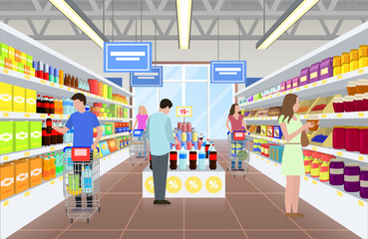
DCPEST Analysis
Factors to consider
Category
What is the size of the category in both value and volume
Who are the competitors
What are the market shares
What are the USP’s of the top competitors
Key attributes which contribute to the success of the key competitors
Is there data availability from research partners.
Here are some specific ways that demographics can inform category management:
Product selection: Demographics can help retailers determine which products are most likely to appeal to different customer segments. For example, if a store's customer base is predominantly young adults, it may be more profitable to stock trendy, affordable products rather than high-end luxury items.
Merchandising: Demographics can inform the layout and organization of products within a category. For instance, if a store's customer base includes many families with young children, it may make sense to place kid-friendly products at eye level and create a designated "family" section within the store.
Pricing: Demographics can also influence pricing strategies for different product categories. For example, if a store caters primarily to budget-conscious customers, it may need to offer lower prices and frequent discounts to remain competitive.
Marketing: Demographics can inform the messaging and advertising tactics used to promote different product categories. For example, if a store's customer base is largely made up of millennials, it may be more effective to use social media and influencer marketing to reach this audience rather than traditional print or TV ads.
Overall, demographics are an important tool for category management because they help retailers better understand and serve their customers. By tailoring their strategies to the unique needs and preferences of different customer segments, retailers can improve customer satisfaction, drive sales, and build brand loyalty.

Slide 10

DCPEST Analysis
Factors to consider
Political
When is the country's next local, state, or national election? How could this change government or regional policy?
Who are the most likely contenders for power? What are their views on business policy, and on other policies that affect your organization?
Depending on the country, how well developed are property rights and the rule of law, and how widespread are corruption and organized crime? How are these situations likely to change, and how is this likely to affect you?
Could any pending legislation or taxation changes affect your business, either positively or negatively?
How will business regulation, along with any planned changes to it, affect your business? And is there a trend towards regulation or deregulation?
How does government approach corporate policy, corporate social responsibility, environmental issues, and customer protection legislation? What impact does this have, and is it likely to change?
What is the likely timescale of proposed legislative changes?
Are there any other political factors that are likely to change?

Slide 11

DCPEST Analysis
Factors to consider
Economic Factors to Consider
How stable is the current economy? Is it growing, stagnating, or declining?
Are key exchange rates stable, or do they tend to vary significantly?
Are customers' levels of disposable income rising or falling? How is this likely to change in the next few years?
What is the unemployment rate? Will it be easy to build a skilled workforce? Or will it be expensive to hire skilled labour?
Do consumers and businesses have easy access to credit? If not, how will this affect your organization?
How is globalization affecting the economic environment?
Are there any other economic factors that you should consider?

Slide 12

DCPEST Analysis
Factors to consider
Technological Factors to Consider
Are there any new technologies that you could be using?
Are there any new technologies on the horizon that could radically affect your work or your industry?
Do any of your competitors have access to new technologies that could redefine their products?
In which areas do governments and educational institutions focus their research? Is there anything you can do to take advantage of this?
How have infrastructure changes affected work patterns (for example, levels of remote working)?
Are there existing technological hubs that you could work with or learn from?
Are there any other technological factors that you should consider?

Slide 13

DCPEST Analysis
Factors to consider
Socio-Cultural Factors to Consider
What is the population's growth rate and age profile? How is this likely to change?
Are generational shifts in attitude likely to affect what you're doing?
What are your society's levels of health, education, and social mobility? How are these changing, and what impact does this have?
What employment patterns, job market trends, and attitudes toward work can you observe? Are these different for different age groups?
What social attitudes and social taboos could affect your business? Have there been recent socio-cultural changes that might affect this?
How do religious beliefs and lifestyle choices affect the population?
Are any other socio-cultural factors likely to drive change for your business?

Slide 14
DCPEST Analysis
Analysis Tool
DCPEST analysis is a strategic business tool used by organizations to discover, evaluate, organize, and track macro-economic factors which can impact on their business now and in the future.
Insert your own criteria and drivers for building out a robust analysis
Demographic
Political
Technological
A
B
C
D
E
F
G
H
A
B
C
D
E
F
G
H
A
B
C
D
E
F
G
H
Category
Economic
Sociological
A
B
C
D
E
F
G
H
A
B
C
D
E
F
G
H
A
B
C
D
E
F
G
H

Slide 15
D
C
P
E
S
T
DCPEST
Category Analysis
Evaluate categories before engaging them.
UpskilPRO e Institute for Sales & Marketing
Tools, Content & Templates
Hand built using experience & Insight

