Slide 1
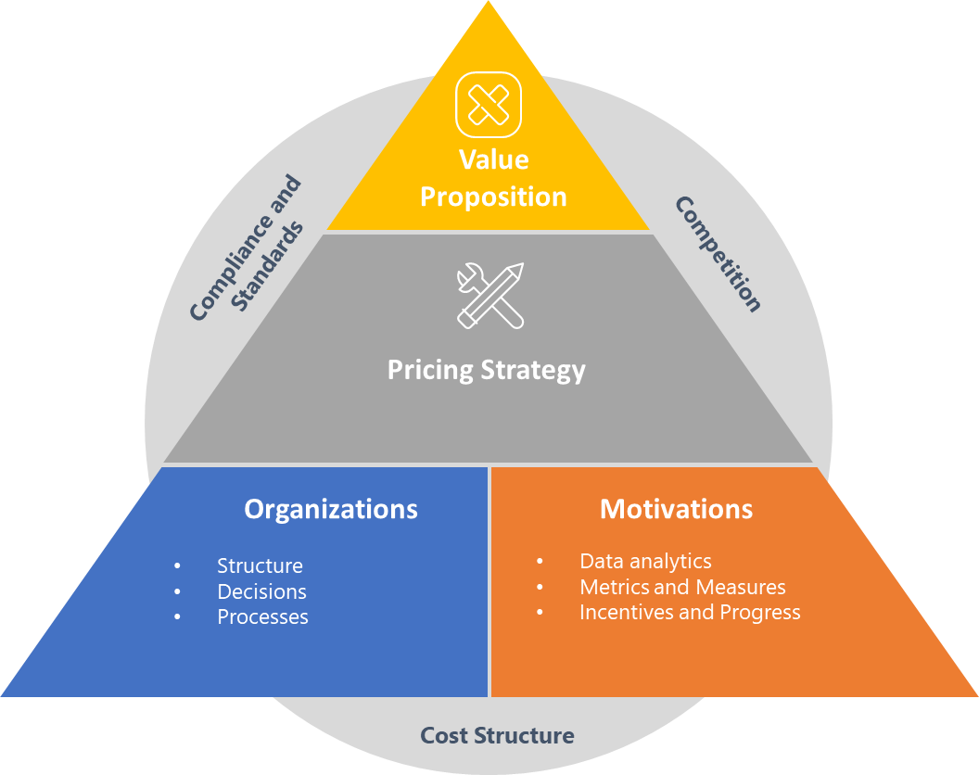
Scorecard-Channel Pricing Strategy.
Establish the synergy between channel and portfolio alignment .
UpskilPRO e Institute for Sales & Marketing
Tools, Content & Templates
Hand built using experience & insight

Slide 2
Pricing Strategy
Score Card
In progress / completed
Not yet completed
2003
Macro level features
State
Micro level features
State
List Price
Customer Segmentation
Identified Channel Discounts
Channel Segmentation
Identified Category Discounts
Customer Alignment to Discounts
Identified Tier Discounts
Customer Classification
Identified Payment on time Discounts
Pricing Policy
Identified Product Discounts
Pricing Currency
Identified Special Discounts
Pricing KPI’s
Identified Activity Discounts
Pricing Committee
Identified Objective Discounts
Price Communication
Sub Total
9/9
Sub Total
9/9
Total
18/18
www.upskilpro.com

