Slide 1

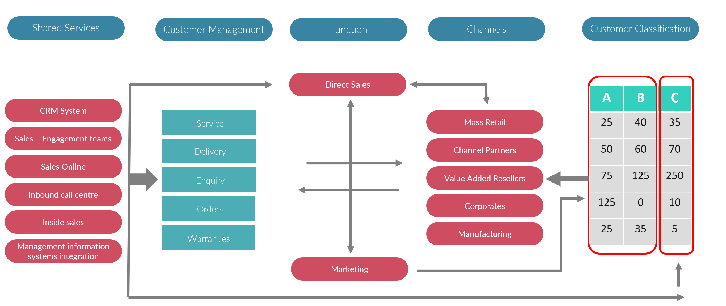
Channel Models
Different channel models and the importance of channels to the sales & marketing mix .
UpskilPRO e Institute for Sales & Marketing
Tools, Content & Templates
Hand built using experience & Insight

Slide 2
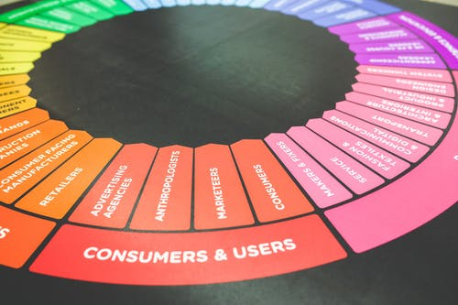

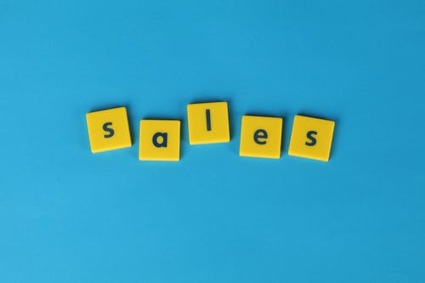

Created by
ex-Procter & Gamble, Rothmans, BAT, Gillette, Nokia,
Microsoft & 3M managers.
UpskilPRO tools are designed in easy-to-use solutions, all you need to do is download the tool and get to work immediately . All UpskilPRO material has taken 100’s of hours and many 1000’s of $ to build , all this expertise and content is brought to you for a fraction of the cost to help professionals enhance their capability.
core areas which are best suited to improve using our tools:
        Subject matter expertise
        Best practices
        Analytical output & charting
        Prioritization
        Process
        Training
Making life simpler for
Sales & Marketing professionals.
Tools in one place to get 10X productive now.

Slide 3


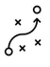

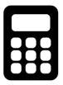
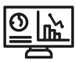
Job Descriptions
Develop roles clearly and completely across varying levels of experience
Agreements
Draft your business agreements across a variety of areas
Templates
Templates are designed based gather information in a structured manner
KPI’s
Performance indicator, a quantifiable measure of performance over time versus a specific objective.
Content Modules
Best practice material in power point for use as a knowledge base in business training , planning and execution .
Strategic tools
These tools are recognised the world over in business schools, consulting firms and companies who plan strategically.
Gain a competitive edge using the best tools and techniques to build a better you .
Analytical Tools
Interactive excel tools on specific business areas based on your data inputs delivered in a workbook model with instructions.
Scorecards
Designed as functional or subject indicators across a variety off situations to enable performance of situational evaluation versus aligned standards.
Calculators
calculate the right ratios for businesses looking for benchmarks in a variety of situations
Assessments
Assessments are designed around specific areas to conduct reviews and will center around a benchmark reviewing individuals or functions
Checklists
Designed around achieving milestones in a sequential manner.
Research
Research tools for sales and marketing engagement

Slide 4
2017
2018
100’s of tools grouped in 12 categories, 50 tool types and 12 business functions in 1 place.
get 10X productive now !
Categories
Functions
Analytical Tools
Types
Business Development
Agreements
Advertising
Customer Acquisition
Margins
Partner Search
Reports
Category Management
Assessments
Agreements
Customer Management
Market Analysis
Persona Development
Retail Measurement
Channel Management
Content Modules
Analytics
Distribution
Market Development
Planning
Reviews
Distribution
Checklists
Barriers
Distributor Management
Market Research
Positioning
Sales Management
Distributor Management
Calculators
Business Reviews
Forecasting
Market Segmentation
Pricing
Scorecards
General Management
Job Descriptions
Business Intelligence
GAP Analysis
Market Size
Prioritization
Segmentation
Key Account Management
KPI’s
Channels
Go To Market
Marketing
Product Development
Six Sigma
Marketing
Research
Communication
Job Descriptions
Marketing Comms
Product Life Cycle
Socio Economic Classification
Marketing Operations
Strategic Tools
Competitive Evaluation
Key Account Plans
Merchandising
Profit & Loss
Territory Design
Sales Management
Scorecards
Competitive Intelligence
Management Summary
New Market Entry
Promotions
Trade Marketing
Shopper Marketing
Templates
Trade Marketing

Slide 5



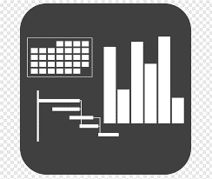




7 Benefits of using UpskilPRO :
Improve your knowledge
with professional Strategic Tools , Templates and planning documents for any business situation!
Use ready made tools
with filled in examples and ready to print & edit at your convenience . Just edit and fill-in the blanks !
Develop YOUR BUSINESS
Learn , & utilize the knowledge and processes and enhance your capabilities as the other companies have
We Created UpskilPRO for the
  Sales Professional
  Trade Marketer
  Marketing Executive
  Operations Manager
  VP/Director/Manager
100’s of tools , TEMPLATES & documents
CREATED BY
world class sales and marketing
business professionals.
All tools
are based on topics and subject based situations and are simple and easy to use .
SAVE THOUSANDS OF DOLLARS
The average company will save 1000’s of $ per employee in time & effort using our ready tools !
Top Quality Tools & Templates for developing both you and your business.
www.upskilpro.com

Slide 6
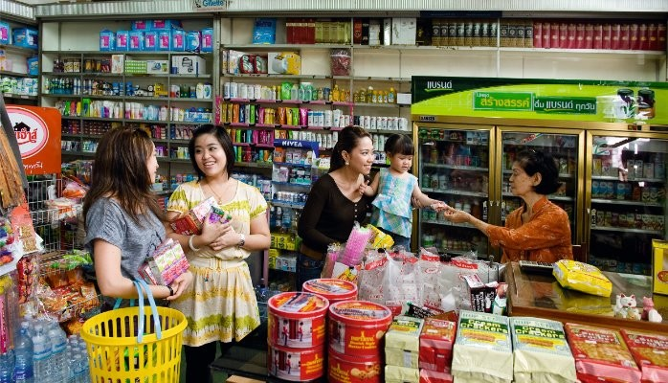
Brands that pay attention to the challenging and changing dynamics in traditional trade stand poised to drive not only visibility and share but enduring customer engagement.

Slide 7
Channel Models
Distribution channels are responsible to create a two-sided connection from the manufacturer to the customer.
Most organisations focus on one direction.

Slide 8
Channel Models

Slide 9
Channel Models
Management Summary
Management Summary Channel management strategy and appropriate choice of channels based on data and customer throughput will be the 2 elements of our decision making capabilities in managing channels .
Mission |  |  | Vision
Financials | Top line from X Mn $ to Y Mn $ in 3 years |  | Contribution gross margins increase from 46% to 48% |  | Contribution income to increase from 19% to 23%
Channel Data |  | LY Sales | TY Plan | TY Sales | TY vs Plan | LY vs Plan
 | Channel A
 | Channel B
 | Channel C
 | Channel D
Initiatives | Budgets |  | Technologies |  | Strategic Channel Programs
Teams | Lead team |  | New Hires |  | TY Initiatives

Slide 10
Channel Models
Types of Distribution Channels
Direct Distribution
Indirect Distribution
Manufacturer
Manufacturer
Agent -
Distributor
Export House
Buying organization
Wholesaler
Wholesaler
Retailers
Retailers
While selecting a distribution channel for foreign markets, the management of the exporting company should consider the following aspects:
(i) Who are the consumers? Which are the available retail outlets to reach them?
(ii) Which type of market coverage is required, keeping in view the product and consumer characteristics?
(iii) Are there any internal constraints for the exporter like finance which will influence the decision regarding choice of the distribution channel?
(iv) What are the expectations from the channel members? Are there some specific expectations?
(v) What is the required support system to satisfy the expectations of the channel members?

Slide 11
Channel Models
Topic - Channel setup guidelines (Example)
Channels
Geography
Customers
Classify channels
Segment geography clearly
Classify Customers in line with channel
Classify Customers to Channels
Align customers to regions and geography
Align customers to products
Set Channel guidelines
Align customers to Regions
Ensure multi geography customers are recorded
A
B
C
Set Customer discounts
Align financial codes to customers to allocate expenses credit and debit
Organize products into categories
Set Channel Discounts
Align products to channels
Budget codes for channels and customers
Set product discounts
Align Pricing strategy to channel
Record pricing strategy
Record expense codes
Discounts
Direct Expenses
Product

Slide 12
Channel Models
Market Coverage Model.
Shared Services
Customer Management
Function
Channels
Customer Classification
Direct Sales
A | B | C
25 | 40 | 35
50 | 60 | 70
75 | 125 | 250
125 | 0 | 10
25 | 35 | 5
CRM System
Service
Mass Retail
Sales – Engagement teams
Delivery
Channel Partners
Sales Online
Enquiry
Value Added Resellers
Inbound call centre
Orders
Corporates
Inside sales
Warranties
Manufacturing
Management information systems integration
Marketing
Market Coverage Model segmenting channels / Customers into 3 broad segments :
Segment A & B are composed of high value and strategic customers
Segment C is composed of customers who are small and order management and servicing are taking up too much time in direct servicing.
In the example above they have segmented the customers into 3 clear segments for ease of management
The shared service organisation while managing all 3 segments , in this case also directly manages the Segment C as it has implants of Inside Sales agents on board
Broad segmentation of customers has to build on business strategy and a clear customer evaluation of cost benefit analysis to allocate them .

Slide 13
Channel Models
Distribution Channels
Brand Owner
Product / Service creation
Logistics Hub
Physical Distribution
Reseller
Channel /s
End-user
Manufacturer
Manufacturer
Manufacturer
Manufacturer
Distributor
Wholesaler
Agent -
Consumer Retailers
Online e reseller
E commerce
Specialist Shops
Company
DIY Stores
Gas Stations
Consumer
While selecting a distribution channel for foreign markets, the management of the exporting company should consider the following aspects:
(i) Who are the consumers? Which are the available retail outlets to reach them?
(ii) Which type of market coverage is required, keeping in view the product and consumer characteristics?
(iii) Are there any internal constraints for the exporter like finance which will influence the decision regarding choice of the distribution channel?
(iv) What are the expectations from the channel members? Are there some specific expectations?
(v) What is the required support system to satisfy the expectations of the channel members?
Duty Free
Converters
Value Added Reseller

Slide 14
Channel Models
Market Model.
SOHO
( Small office Home office)
Reseller Channel
Mini enterprise
< 10 Employees
< 2.0 Mn Euro
Small enterprise
accounts
Value Added reseller
Small enterprise
< 50 Employees
< 10.0 Mn Euro
Mid sized enterprise or accounts
Mid size neighborhood retailer format
Medium enterprise
< 250 Employees
< 50.0 Mn Euro
Large enterprise
accounts
Large retailer
Box format
Large enterprise
> 250 Employees
> 50.0 Mn Euro
Markets
Categories
Simple Categories
Mass Categories
Complex Categories
Products
Products
Comment
Industry classifications are generally nationally driven and each region and nation have classifications which are nationally driven
We use the european classification for reason of standardization ( european commission )
In a multi channel multi manufacturer environment it is expected that accounts will buy from channels which deliver them good to great service hence the various possibilities indicated above

Slide 15
Channel Models
Basic Universe / Category – GTM Channels
B2C
B2B
Internet
Retail Channels are measured
  Biannually or annually
Clear segmentation of outlet types
No of outlets by Geography
Turnover
Category Sales
Distribution
Brand availability
Volume share
Value share
Electronic Data transfer
Most Channel types are measured
B2B products sold in a retail environment are mostly covered or measured
These categories are often found in the outlet under Home or Maintenance
Most B2B companies do not buy audit data for many reasons leading to the relevant category not being measured.
As the sales is often made to smaller or very large non-retail outlets sales are not necessarily captured
B2B products sold on the web , are recorded giving rich data availability .
Some of the categories sold on the web are smaller compared to Brick & Mortar channels.
Universe Availability
DATA
E commerce
Tele channels
Websites
E marketplace
Mail Catalogues
Retail stores
Online resellers
Data availability is robust
Electronic data availability
Costs are based on contract to supply
Data is fragmented
Mostly manual
Data availability
Universe / Category Data
Research Companies specializing in B2C
Research Companies specializing in B2B
Data aggregator companies or digital specialists

Slide 16
Channel Models
Basic Channel Approach
Overall Category Sales Contribution
Your category sales contribution . Both are different , this requires category insight to find out if your brand is under contributing .
Basic go to market layout of channels
Push Campaigns
Sales
Contribution
Category
Contribution
Direct Sales
Channel partners
Customer
Brand Owner
or
Manufacturer
Customer
Value Added Resellers
Customer
Internet / reseller
Customer
Wholesalers / Stockists
Pull Campaigns
Demand creation campaigns using the marketing mix
Comment
Most generic descriptors have been used for channels
The model uses a flow from manufacturing to customer / end-user .
The emerging channel is the online reseller who is able to resell online to other e commerce resellers

Slide 17

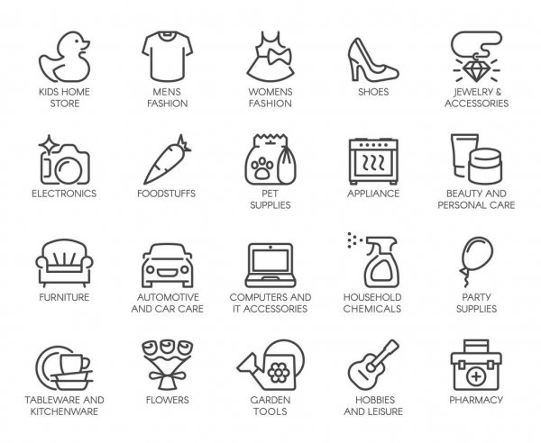
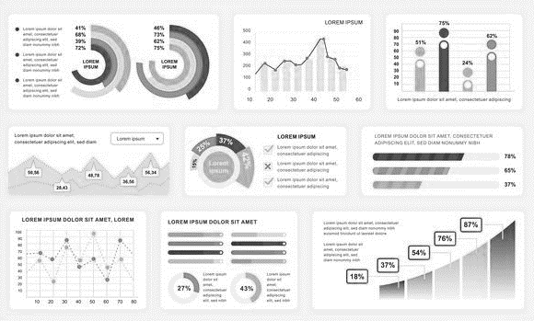
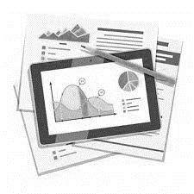
Channel Models
Channels / Categories / Reports
Channels
Categories
Report Outputs
Grocery
Food
Category Sales
Convenience
Non-Food
Category Share
Compiler
Inputs
Pharmacy
Beauty Care
Market Share
Report
/ outputs
Duty Free
Beverages
Out of Stocks
Gas Stations
Snacks
Distribution
Comment
Above example has been simplified for the reason every country has differences and category reading is dependant on individual countries and brands
Above channels have been reduced for the example
Reporting capabilities are far more than shown above , and in many cases can be produced for clients per briefing
The flow chart is more applicable for the process .

Slide 18
Channel Models
Market Coverage Model. ( Goals & Purpose )
DIRECT SALES
INDIRECT SALES
DIRECT TO CUSTOMER
Lower cost to sales ratio
Wider portfolio management
Local engagement
Expanded geographical presence
Increased points of contact
Low sales cost
Wider reach
Efficient transactions
Wider portfolio management
Loyalty management
Reach & penetration
Sales – Medium to Complex
Key account control
Complex service requirement
Goals / Purpose
Roles / Functions
Distributors
Resellers
Value Added Resellers
Retail Stores
Agents
Brokers
Integrators
Aggregators
Service partners
E commerce
Tele channels
Websites
E marketplace
Mail Catalogues
Retail stores
Online resellers
Field Representatives
Category Managers
Account Managers
Account executives
Technical Representatives
Global Subject Matter Experts

Slide 19
Channel Models
3 Categories of Go to Market Channels.
 | Direct Channels | Indirect Channels | Direct to consumers
Levers of distribution | Key account management | Market Expansion | Maximum reach in the value chain
 | Quality service | Geographic expansion | Penetration and reach efficient
 | Excellent business planning | Customer support | Quicker turn around time
 | Quick reaction | Broader solutions | Quality business planning
 | Quick decisions |  | Refill and repurchase efficient
Methods of executing strategy | Global Managers | Distributors | Marketing mix efficient
 | Filed Managers | Resellers | Internet
 | Marketing Managers | Mass Merchandisers | Social media
 | Corporate Managers | Integrators / Applicators | Retail
 | Technical Representatives | Representatives | Internet e busines models

Slide 20
Channel Models
Types of Distribution Channels
Types of Distribution Channels: B2C
Manufacturer
Manufacturer
Manufacturer
Manufacturer
Manufacturer
Manufacturer
Agent
Agent
Agent
-
-
-
Wholesaler
-
-
Wholesaler
-
-
Retailer
Retailer
-
Retailer
Retailer
-
Consumer
Consumer
Consumer
Consumer
Consumer
Consumer
Distribution Channels :
Each product and category interacts differently with channels based on A) Brand initiatives B) Strategy C) Priorities
The models above may all be used or only one , it is dependent on the strategy and the planning used to arrive at such a conclusion
Channel selection is largely influenced by 2 factors , A ) Most effective channel to reach target market B) Cost effective route C) Strategic utilization of said channel
In the example above the Consumer or the end user are the same
It is possible that there may be slight variations based on local market conditions to the example above

Slide 21
Channel Models
Types of Distribution Channels
Types of Distribution Channels: B2B
Manufacturer
Manufacturer
Manufacturer
Manufacturer
Manufacturer
Manufacturer
Agent
Agent
-
-
-
-
Wholesaler
-
Wholesaler
-
-
-
-
-
-
-
Retailer
-
Industrial Consumer
Industrial Consumer
Industrial Consumer
Industrial Consumer
Consumer
Consumer
Distribution Channels :
Each product and category interacts differently with channels based on A) Brand initiatives B) Strategy C) Priorities
The models above may all be used or only one , it is dependent on the strategy and the planning used to arrive at such a conclusion
Channel selection is largely influenced by 2 factors , A ) Most effective channel to reach target market B) Cost effective route C) Strategic utilization of said channel
In the example above the Consumer or the end user are the same
It is possible that there may be slight variations based on local market conditions to the example above

Slide 22








Channel Models
Basic Category – GTM Channels
DIRECT SALES
INDIRECT SALES
DIRECT TO CUSTOMER
Lower cost to sales ratio
Wider portfolio management
Local engagement
Expanded geographical presence
Increased points of contact
Low sales cost
Wider reach
Efficient transactions
Wider portfolio management
Loyalty management
Reach & penetration
Sales – Medium to Complex
Key account control
Complex service requirement
Goals / Purpose
Roles / Functions
Distributors
Resellers
Value Added Resellers
Retail Stores
Agents
Brokers
Integrators
Aggregators
Service partners
E commerce
Tele channels
Websites
E marketplace
Mail Catalogues
Retail stores
Online resellers
Field Representatives
Category Managers
Account Managers
Account executives
Technical Representatives
Global Subject Matter Experts
EXAMPLES

Slide 23
Channel Models
Channel Readiness Matrix

Slide 24
Channel Models
Market Verticals and Classifications.
Consumer Goods | Construction | Automotive Manufacturing | Telecommunication | Mass Transportation
Consumer Packaged Goods | Construction Equipment | EM Vehicle | Networking Equipment | Passenger Buses
Household products | Building Technologies & Automation | Light Vehicles | Network Services | Passenger Aircraft
Beauty & personal care | Power Tools | Medium and Heavy-duty | Network Infrastructure | Passenger Rail
Luxury products | Smart Building | Electric Vehicle Systems | Enterprise Network Systems | Passenger shipping
Consumer Electronics | Energy Management Systems | Off-highway Equipment | Broadband/VoIP | Trams
Life Style products | Green IT | Buses/ Trucks | Hosted Applications | Inland shipping
Sports Goods | Smart Energy | Material Handling Equipment | Voice/Data/Video | Metro ( intercity )
Verticals & Classifications
We recommend identifying the verticals for any business for intelligence tracking and monitoring reasons
The possibility of a business having more than one vertical in a business is possible
For identifying verticals a good start would be to start online with industry classification , or with consulting forms and or the market research service providers

Slide 25
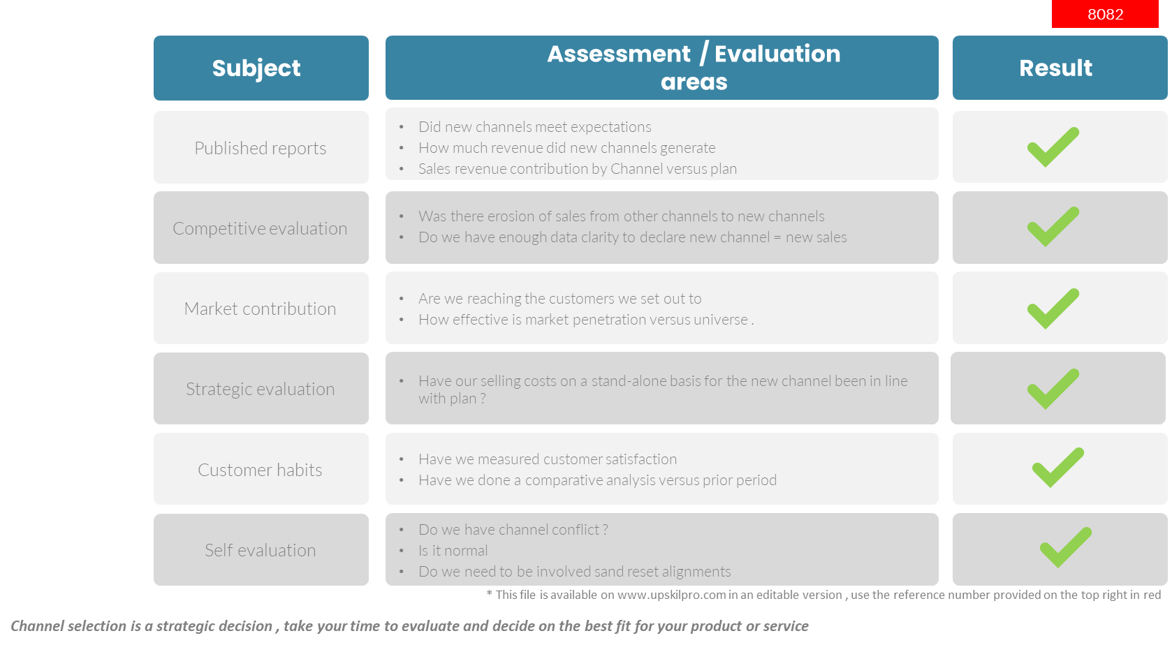
Channel Models
Scorecard - How to find the right channel

Slide 26
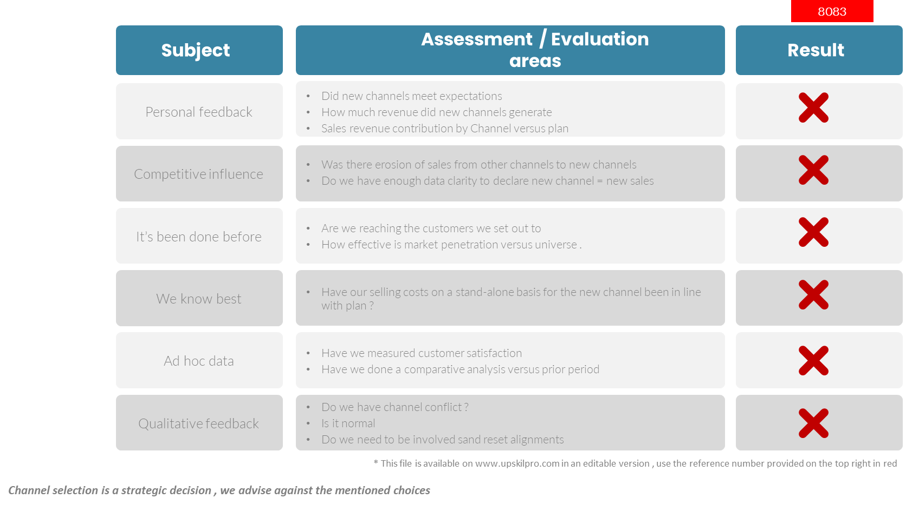
Channel Models
Scorecard - What to do and not to do !

Slide 27
Channel Models
Channel Coverage Flow
Brand Owner
Product / Service creation
Logistics Hub
Physical Distribution
Reseller
Channel /s
End-user
Manufacturer
Manufacturer
Manufacturer
Manufacturer
Distributor
Wholesaler
Company
Agent -
Consumer Retailers
Consumer
Online e reseller
Value Added Reseller
E commerce
Specialist Shops
DIY Stores
Gas Stations
While selecting a distribution channel for foreign markets, the management of the exporting company should consider the following aspects:
(i) Who are the consumers? Which are the available retail outlets to reach them?
(ii) Which type of market coverage is required, keeping in view the product and consumer characteristics?
(iii) Are there any internal constraints for the exporter like finance which will influence the decision regarding choice of the distribution channel?
(iv) What are the expectations from the channel members? Are there some specific expectations?
(v) What is the required support system to satisfy the expectations of the channel members?
Duty Free

Slide 28
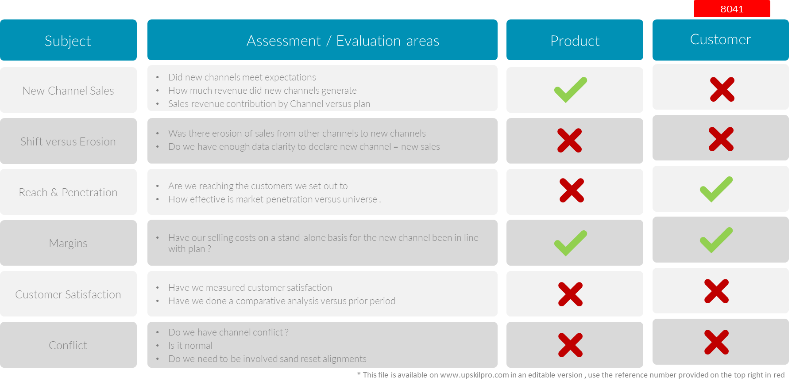
Channel Models
Scorecard - Channel Baseline Management Areas.

Slide 29
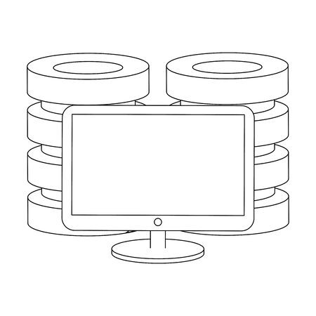
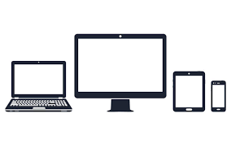


Channel Models
Integration with Customer Management
Seamless integration across all touch points of the Customer facing function providing constant and timely interaction
Customers
Constant engagement with communication
The customer has a secure and private connection with the brand owner to manage his or her business.
Integrated web presence across the region and world with customer access and log in to drive up to date information , order management , outstanding account , points earned , notices to manage , documents to update and process view.
Fully integrated call centres providing up to the minute engagement and feedback with both customer and company
Field force automation now used across all functions as an integrator to drive one database and constant engagement with the customer.

Slide 30
Channel Models
Cost per transaction
Engagement Cost
High
100$- 125 $
Sales force
Value added
Partners
80$ - 100 $
Distributors
60$ - 80$
Retail
Value added sales
Direct sales channels
40$ – 60$
Inside SALES
E
commerce
Indirect channels
20$ - 40 $
Direct marketing channels
10$ - 20 $
low
low
Cost per transaction
High
Distribution Channels :
Each product and category interacts differently with channels based on A) Brand initiatives B) Strategy C) Priorities
The models above may all be used or only one , it is dependent on the strategy and the planning used to arrive at such a conclusion
Each channel has different cost layers to deliver service
In the example above the cost per transaction is largely modelled around the distance to end user , the 3 models reflect the distance and the cost .
Strategically the prioritization works around working with the larger and complex customer groups and moving the smaller and less profitable groups to inside sales or telemarketing
E commerce is a strategic decision mainly , as opposed to a cost based decision

Slide 31
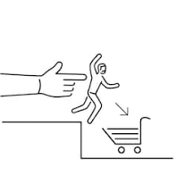

Channel Models
Push – Pull
Push
Pull
Trade show promotions to encourage retailer demand
Direct selling to customers in showrooms or face to face
Negotiation with retailers to stock your product
Efficient supply chain allowing retailers an efficient supply
Packaging design to encourage purchase
Point of sale displays
Advertising and mass media promotion
Word of mouth referrals
Customer relationship management
Sales promotions and discounts
Push
Strategies
Promotional Activities
Demand
Producer
Channels
End-user
Marketing communication
Pull
Strategies
Producer
Promotional Activities
Channels
Demand
End-user
Demand creation

Slide 32
#1
Channel Models
Channel Description Guidelines (Example)

Slide 33
Channel Models
Channel Description Guidelines (Example)
#2

Slide 34
Channel Models
Channel Description Guidelines (Example)
#3

Slide 35
Channel Models

Slide 36
Channel Models
Single Channel Model.
Lead to sales management in single channel environment
 | Lead Generation | Qualification | Proposals | Sales Closure | Fulfilment | Customer care
Direct sales
Business partners
Tele channels
Direct mail
Internet
Task
Channel
< - Low Sales revenue High – >
Sales cycle

Slide 37
Channel Models
Market Coverage Model.
Lead to sales management in single channel environment
 | Lead Generation | Qualification | Proposals | Sales Closure | Fulfilment | Customer care
Direct sales
Business partners
Tele channels
Direct mail
Internet
Channel
Task
< - Low Sales revenue High – >
Sales cycle
Multi Channel approach is based on efficiency drivers of A) Time ,B) Resources management
As the time taken for a call in Direct sales will be different for different channels and different classes of customers .
Efficiency comes from segmenting the customers into buckets based on criteria and then approaching them from a resource management perspective

Slide 38
Channel Models
Account Management with emphasis on efficiency & cost .
Ac Strategy
AC Classification
Grow
> 1,000,000 $
Manage
> 500,000 $
Maintain
> 50,000 $
Turnover
National
Accounts
Region A
Accounts
Region B
Accounts
Region C
Accounts
Region D
Accounts
Region E
Accounts
Channel
Direct Sales
Business Partners / Distributor
< - Low Sales revenue High – >
Inside Sales
Direct Mail
Internet
Multi Channel approach is based on efficiency drivers of A) Time ,B) Resources management
Classify accounts into buckets to manage and hand over ( Maintain )
Refocus the sales force on the green and yellow buckets
Transfer the red bucket to inside sales for management and growing across upsell and cross sell capabilities
Review and reclassify accounts every 6 months
Set clear criteria for bucketing customers so no overlap occurs

Slide 39
Channel Models
Market Coverage Model.
Customers / Markets
Channel
Coverage
Integration
Results
Markets
What specific benefits have been achieved by competition in their go to market model investments
Revenue
Market Share
Cash Improvement
Loyalty
Retention
How can we link achievement to investments for the above points
Markets & Geographic of competitive presence
Key Markets & Segments competitive forces are increasing in local investments and resources for market penetration
Where are the problems and obstacles in these markets
Sales channels being used by competitive forces
  Field Sales
  Business Partners
  Direct to Customer
Which Channels are getting increased investment
Which channels are seeing decreased investments
Competitor coverage of sales channels
Coverage Model of all types of channels
Sales strategy by account and channel classification
Areas of increase and decrease in channel coverage
Competitor coverage in Omni channel coverage
Channel Conflict management
Measurement and monitoring of channel performance and results
Financial results from any channel integration efforts
Customers
Run trade marketing exercise to evaluate universe of outlets .
This will five you the Geographic , Channel , Type of outlets by classification which will help drill down focus for execution planning.
Review test and execution results from using analytical tools and reports
Retail Audit reports
Retail census reports
Mystery shopper
Shopper feedback
Shop manager feedback
Online poll.
Segment outlets or most visited sites by demographic to plan better alignment with product portfolio
Plan portfolio and trade marketing activity with an omni channel approach to target consumers and portfolios accurately
Which Customer and Consumer segments are being targeted

Slide 40
Channel Models
Analysis & Planning Model .
Go to Market Analysis & Planning Model | Q1 |  |  | Q2 |  |  | Q3 |  |  | Q4
 | JAN | FEB | MAR | APR | MAY | JUN | JUL | AUG | SEP | OCT | NOV | DEC
Complete Market Identification and Initial country assumptions
Identify Market Size , Competition , and Business models
Country visit to validate findings
Prioritize portfolio, Pricing and Sourcing models
Identify and Close Sales Channel prioritization
Marketing & Research plan completion ( Rev 1 )
Partner meet and plan finalization
Sign off from Partners
Sales and Marketing review & finalization ( Rev 2 and Finalization )
Results, ( Status ) marked alongside in color codes
Indicator for completion
Analysis & Planning Model for Go to Market :
Market entry models can vary in terms of complexity and timeframes .
We have shown a 12 month model for clarity and the time planning involved behind steps running in parallel
In the steps above we have stayed with the most critical steps in place
Depending on the Industry , category, market, level of planning, no of layers , and the market attractiveness quotient plans may take more or less time.
Indicator for in progress
Indicator for either not completed or not started

Slide 41
Channel Models
Implementation Model.
Go to Market Execution & Review Model | Q1 |  |  | Q2 |  |  | Q3 |  |  | Q4
 | JAN | FEB | MAR | APR | MAY | JUN | JUL | AUG | SEP | OCT | NOV | DEC
Research & Marketing Plan Review
Test Market using Samples and outlets ( Optional )
Finalize Portfolio & Pricing
Finalize Sourcing and Packaging
Certify Product , Source , TM with local authorities ( new Market )
Train & Test teams to handle product range
Team Briefing and Launch / Execute Sales Plan to gain distribution
Day 30 Execute Marketing Plan ( Post distribution )
Reviews - Day 60 , Day 90 , Day 180 , Day 270 , & Day 360
Results, ( Status ) marked alongside in color codes
Indicator for completion
Execution & Review Model for Go to Market :
Time plans show are for visual purposes , Market entry models can vary in terms of complexity and timeframes .
We have shown a 12 month model for clarity and the time planning involved behind steps running in parallel in all totalling 24 Months
In the steps above we have stayed with the most critical steps in place.
Depending on the Industry , category, market, level of planning, no of layers , and the market attractiveness quotient plans may take more or less time.
Indicator for in progress
Indicator for either not completed or not started

Slide 42
Channel Models
Segmenting Customers by Portfolio.
Turnover
Portfolio A
Portfolio B
Portfolio C
Portfolio D
Commodities
Tenders
Channel
Direct Sales
Business Partners / Distributor
Inside Sales
< - Low Sales revenue High – >
Direct Mail
Internet
Sales cycle
Multi Channel approach is based on efficiency drivers of A) Time ,B) Resources management
As the time taken for a call in Direct sales will be different for different channels and different classes of customers .
Efficiency comes from segmenting the customers into buckets based on criteria and then approaching them from a resource management perspective

Slide 43
Channel Models
Segmenting Customers by Geography.
Turnover
National
Region A
Region B
Region C
Region D
Region E
Channel
Direct Sales
Business Partners / Distributor
Inside Sales
< - Low Sales revenue High – >
Direct Mail
Internet
Sales cycle
Multi Channel approach is based on efficiency drivers of A) Time ,B) Resources management
As the time taken for a call in Direct sales will be different for different channels and different classes of customers .
Efficiency comes from segmenting the customers into buckets based on criteria and then approaching them from a resource management perspective

Slide 44
Channel Models
Topic - Segmenting Customers by Turnover.
Turnover
10,000,000 $
5,000,000 $
3,000,000 $
1,000,000 $
500,000 $
250,000 $
Channel
Direct Sales
Business Partners /
Distributor
Inside Sales
< - Low Sales revenue High – >
Direct Mail
Internet
Sales cycle
Multi Channel approach is based on efficiency drivers of A) Time ,B) Resources management
As the time taken for a call in Direct sales will be different for different channels and different classes of customers .
Efficiency comes from segmenting the customers into buckets based on criteria and then approaching them from a resource management perspective

Slide 45
Channel Models
Segmenting Customers by Profitability.
Turnover
1,000,000 $
500,000 $
300,000 $
100,000 $
50,000 $
25,000 $
Channel
Direct Sales
Business Partners / Distributor
Inside Sales
< - Low Sales revenue High – >
Direct Mail
Internet
Sales cycle
Multi Channel approach is based on efficiency drivers of A) Time ,B) Resources management
As the time taken for a call in Direct sales will be different for different channels and different classes of customers .
Efficiency comes from segmenting the customers into buckets based on criteria and then approaching them from a resource management perspective

Slide 46
Thank you !

Slide 47
Job Descriptions
Develop roles clearly and completely across varying levels of experience
Agreements
Draft your business agreements across a variety of areas
Templates
Templates are designed based gather information in a structured manner
KPI’s
Performance indicator, a quantifiable measure of performance over time versus a specific objective.
Content Modules
Best practice material in power point for use as a knowledge base in business training , planning and execution .
Strategic tools
These tools are recognised the world over in business schools, consulting firms and companies who plan strategically.
Gain a competitive edge using the best tools and techniques to build a better you .
Analytical Tools
Interactive excel tools on specific business areas based on your data inputs delivered in a workbook model with instructions.
Scorecards
Designed as functional or subject indicators across a variety off situations to enable performance of situational evaluation versus aligned standards.
Calculators
calculate the right ratios for businesses looking for benchmarks in a variety of situations
Assessments
Assessments are designed around specific areas to conduct reviews and will center around a benchmark reviewing individuals or functions
Checklists
Designed around achieving milestones in a sequential manner.
Research
Research tools for sales and marketing engagement

Slide 48
Channel Models
Different channel models and the importance of channels to the sales & marketing mix .
UpskilPRO e Institute for Sales & Marketing
Tools, Content & Templates
Hand built using experience & Insight

