Slide 1


Trade Marketing.
Territory Design
Sales & Marketing Fundamentals.
UpskilPRO e Institute for Sales & Marketing
Tools, Content & Templates
Hand built using experience & insight

Slide 2
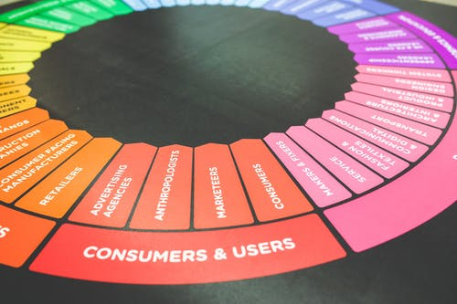



Created by
ex-Procter & Gamble, Rothmans, BAT, Gillette, Nokia,
Microsoft & 3M managers.
UpskilPRO tools are designed in easy-to-use solutions, all you need to do is download the tool and get to work immediately . All UpskilPRO material has taken 100’s of hours and many 1000’s of $ to build , all this expertise and content is brought to you for a fraction of the cost to help professionals enhance their capability.
core areas which are best suited to improve using our tools:
        Subject matter expertise
        Best practices
        Analytical output & charting
        Prioritization
        Process
        Training
Making life simpler for
Sales & Marketing professionals.
Sales & Marketing Fundamentals.
Tools in one place to get 10X productive now.

Slide 3


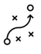

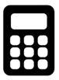

Job Descriptions
Develop roles clearly and completely across varying levels of experience
Agreements
Draft your business agreements across a variety of areas
Templates
Templates are designed based gather information in a structured manner
KPI’s
Performance indicator, a quantifiable measure of performance over time versus a specific objective.
Content Modules
Best practice material in power point for use as a knowledge base in business training , planning and execution .
Strategic tools
These tools are recognised the world over in business schools, consulting firms and companies who plan strategically.
Gain a competitive edge using the best tools and techniques to build a better you .
Analytical Tools
Interactive excel tools on specific business areas based on your data inputs delivered in a workbook model with instructions.
Scorecards
Designed as functional or subject indicators across a variety off situations to enable performance of situational evaluation versus aligned standards.
Calculators
calculate the right ratios for businesses looking for benchmarks in a variety of situations
Assessments
Assessments are designed around specific areas to conduct reviews and will center around a benchmark reviewing individuals or functions
Checklists
Designed around achieving milestones in a sequential manner.
Research
Research tools for sales and marketing engagement

Slide 4
2017
2018
100’s of tools grouped in 12 categories, 50 tool types and 12 business functions in 1 place.
get 10X productive now !
Categories
Functions
Analytical Tools
Types
Business Development
Agreements
Advertising
Customer Acquisition
Margins
Partner Search
Reports
Category Management
Assessments
Agreements
Customer Management
Market Analysis
Persona Development
Retail Measurement
Channel Management
Content Modules
Analytics
Distribution
Market Development
Planning
Reviews
Distribution
Checklists
Barriers
Distributor Management
Market Research
Positioning
Sales Management
Distributor Management
Calculators
Business Reviews
Forecasting
Market Segmentation
Pricing
Scorecards
General Management
Job Descriptions
Business Intelligence
GAP Analysis
Market Size
Prioritization
Segmentation
Key Account Management
KPI’s
Channels
Go To Market
Marketing
Product Development
Six Sigma
Marketing
Research
Communication
Job Descriptions
Marketing Comms
Product Life Cycle
Socio Economic Classification
Marketing Operations
Strategic Tools
Competitive Evaluation
Key Account Plans
Merchandising
Profit & Loss
Territory Design
Sales Management
Scorecards
Competitive Intelligence
Management Summary
New Market Entry
Promotions
Trade Marketing
Shopper Marketing
Templates
Trade Marketing

Slide 5



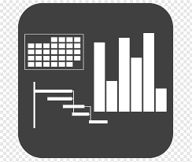




7 Benefits of using UpskilPRO :
Improve your knowledge
with professional Strategic Tools , Templates and planning documents for any business situation!
Use ready made tools
with filled in examples and ready to print & edit at your convenience . Just edit and fill-in the blanks !
Develop YOUR BUSINESS
Learn , & utilize the knowledge and processes and enhance your capabilities as the other companies have
We Created UpskilPRO for the
  Sales Professional
  Trade Marketer
  Marketing Executive
  Operations Manager
  VP/Director/Manager
100’s of tools , TEMPLATES & documents
CREATED BY
world class sales and marketing
business professionals.
All tools
are based on topics and subject based situations and are simple and easy to use .
SAVE THOUSANDS OF DOLLARS
The average company will save 1000’s of $ per employee in time & effort using our ready tools !
Top Quality Tools & Templates for developing both you and your business.
www.upskilpro.com

Slide 6
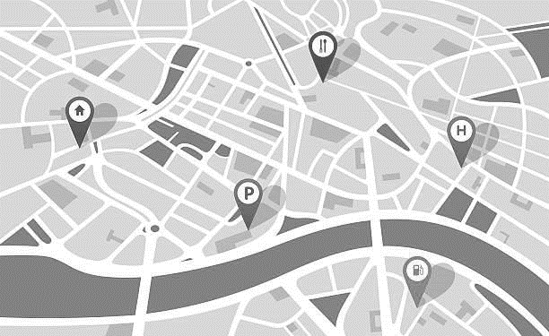
“Territory design is the art of knowing which customers are where and the science of knowing how to ensure sales force coverage is productively maximized ”

Slide 7


Trade Marketing
Examples of TM .
Brand marketing talks to people , Trade Marketing talks with them.
Category
POS
Retailer
Consumer
ROI
Promotions

Slide 8
Trade Marketing
Retail Census .
We cover territory design from the perspective of what factors need to be consider whilst putting together a territory and what elements make a difference and planning a territory interface to all its components within the organisation a territory cannot be hey silent component but rather needs to be interfaced with the corporation from finance legal supply chain and the various functions which will treat it as a customer
In this module we cover 2 parts
Outlet census
Territory design
Outlet census covers all refers to understanding how many off your target channel outlets exist in a nominated geography it doesn't matter which industry you belong to what matters is understanding how many of your customer types or doing business within a specific geography.

Slide 9
Retail Census

Slide 10




Trade Marketing
Retail Census .
There are two methods to conduct a census off the number of outlets which lie within them this would cover all types of outlets within the scope off a single industry .
the task of collecting documenting and clarifying all the necessary features off the outlet including their geographical location is called is census enumeration.
Retail index
Scan track

Slide 11



Trade Marketing
Retail Census .
Channels not covered
Channels covered
Wholesalers
Street vendors
Airports
Duty free
Movie theatres
Exports
Warehouse
Fitness centres
Internet cafes
Drug stores
Cash and carry
Restaurants
Coffee shops
Bakeries
Flea markets
Hypermarkets
Supermarkets
Convenience stores
Wine and liquor shops
Independent groceries
Chain groceries
The purpose of the above table is to illustrate what is covered in a retail census and who is covering it
While the above table is retail centric this is because brand owners in the consumer goods industry are able sign off a retail census with common objectives in mind
In the b2b environment it will need modification and alignment with brand owners to sign off on a census or for the research company to talk to multiple brand owners and put together a census .
the major point is it can be done for b2b, but a single brand owner might find costs prohibitive .
Nielsen refer to the census as RMS or retail measurement services
Source : Nielsen retail measurement services

Slide 12
Trade Marketing
Retail Census .
Market
Product
Fact
Period
Markets are a composition of geographies , channels and accounts of all sizes
Products are a composition of a total category , driven by manufacturer , brands , price segments and volume formats
Facts are a composition of the location of business, the retail price, product distribution availability , sales share and purchases by the consumer
Periods are a representation of months ( time frame ) which can be configured into days , weeks , months , and quarters running along a same period previous year basis
Source : Nielsen retail measurement services

Slide 13





Trade Marketing
Retail Census What & How .
The real question is which industries have a census and how do I get a census data set for my industry .
the most popular industries which have a census for the outlets contained in their specific country geographies are mostly what in the CPG and allied industries , And this is possible mainly for outlet types which are serviced by CPG companies for the rest of the outlets which are not mainstream or serviced by CPG it's a discussion to be had quit a research organisation the type of AC Nielsen who specialise in this day to pick up as a service .
let's take an example if you wish to know how many automobile garages there are in Poland then the first call would be 2 the top ranked research agencies to ask them if they cover or if they have data for garages in Poland chances are the answer will be “no”.
then the next stage is to ask if we can commission it the cost might be prohibitive if it is a single customer and more long lasting if multiple customers were to Commission the research as costs will be lower and more data points will be accumulated .
  Option would be too look at the relevant ministry in your city such as economic department which may have compiled this data in a more basic form which may merely give you the number of outlets by city or town and nothing more.
  Option two might be to use the Yellow Pages and compile the data
  Option three might be to use online desk research capabilities and compile the data
  The three options above are purely data capture exercises what they won't do is give you the level of information exchange which the CPG companies get out of utilising Nielsen reports and data

Slide 14
Territory Design

Slide 15
Trade Marketing
Basic rules for efficient territory coverage and management.
Efficient territory coverage
Location mapping is important for efficient time management .
Account classification is key for managing time on site .
Locations
Account Classification
Objectives
Driving & Admin time
Objectives management are important to ensure productivity on calls.
Driving and admin time management ensure calls are well managed and documented .

Slide 16
Trade Marketing
Territory Design Best Practices
Build
Build
Alignment
Build territories from the ground up aligning all characteristics and processes visible .
Align customers to territories and then to regions , this will keep the territory alignment to geograpies clear.
Balance
Alignment
Balance
Best Practices
Census
Balance territories in clear segments of channel and accounts indicating varying scales of resources needed .
Develop and publish the census of accounts to align and allow for further development using both internal and external sources and data
Quota
Census
Quota
Bill to Ship to
Quotas represent opportunity , base these on sound data and calculation to drive the economic value of a region , this will go a long way in aligning territories to teams .
Bill to
Ship to
Ensure all accounts have a bill to and ship to as the management of some accounts may be different from the physical location .

Slide 17
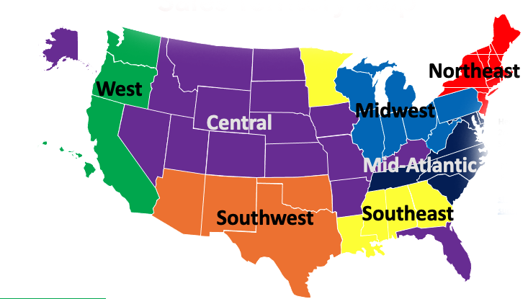
Trade Marketing
What is a territory ? .
In the sales context a territory is a designated area allocated and assigned to a named territory , it may be a cluster of accounts of similar types , or dissimilar types but its common features are that it is primarily a geographical expanse , which uses a common demarcation which is either natural or man mage such as roads or rivers as an example.
The sales territory design is often different for each company but drives on common features such as , Accounts , Account types , Channels , and account classification all within demarcated geographies.

Slide 18
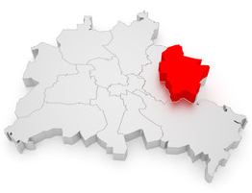
Trade Marketing
Territory Features .
Territory design is both an art and a science , the best way to design a territory is to look ahead at the strategic plan and work backward to the type of territory design which matches it.
Territory 1
Account
Business
Listing
Account Type
Zip Code
Division
Category
Classification
Street
Sales Organization
Subcategory
Channel
Municipality
Product
Credit Rating
City
State
A sales territory can be as complex or simple as you desire.
Most territories evolve from analogue to a digital form which makes mapping and management much simpler , the key for territory design is to ensure the mapping tool used is interfaced with the financial system of the company to ensure data pick up and analysis
Country

Slide 19




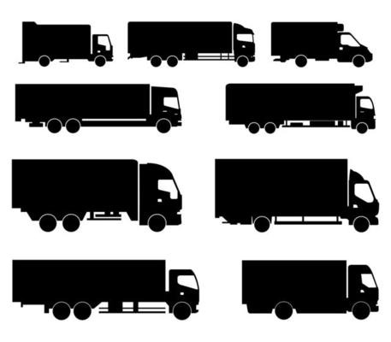
Trade Marketing
Supply Chain .
Territory design implications
Territory design implications
RETAILER
Manufacturing
Inland Transportation
Distributor Or Wholesaler
Transportation
Retail
Customer
Sell in
Sell Through
( Sell to larger or smaller retailers serviced by brand owner )
POS - Sell out
( Point of sale )
End consumer
( Consumer the product)
There are two different types of data capture 1 is the product sale at to retail end where in the final sale is concluded to the consumer 2 the actual documentation or sensors of the type of retail or wholesale outlet in the census in numeration tallying up from neighbourhood to city to state and finally country
This will give us the number of outlets by type for the for the assigned region
This data is usually collected based on an omnibus approach buy the bigger brand owners
This approach may not be only related to retail but can be designed and approached for any industry but the costs and timing may vary.
Data capture ( Product/Outlet/ Geography ) by research companies like Nielsen

Slide 20
Trade Marketing
Efficient Coverage .
Make Territory Coverage Efficient
Business/Account locations
Geography and driving time
AWARENESS
DESIRE
KNOWLEDGE
ABILITY
REINFORCEMENT
Balance territories on metrics similar to the ones used to pay sales commissions
Build territories from the ground up for greater clarity and alignment
Build territories around logical geographies & customers, not sales reps.
Base quotas on opportunity , market size and actual sales from each territory
Involve field managers in the territory alignment process.

Slide 21
Trade Marketing
Call Planning steps .
1
2
3
4
5
6
Frequency
Classification
Objectives
Functions
Efficiency
Scheduling
Calls usually based on customer types fall into Weekly , Fortnightly and monthly
All customers are classified , this way you can do a journey plan based on Classification or geography first
Set objectives for every call , between tactical ,operational and strategic
Engage with support functions to ensure all customer needs have ben met prior to the call.
Plan the journey in a logical one directional manner to be efficient with time and resources
Use calendars to plan your call schedules and additionally let your customers know you will be there at a specific time and day
Call Report Input
Review Call Objectives
Source : Nielsen retail measurement services

Slide 22
Trade Marketing
Travel Time.
Efficient sales call planning will take into account the following elements
Effort = frequency x (duration + travel)
Within a segment, accounts with high travel time
Usually have a lower ROI
Must deliver more sales per call vs. average account
Might be less attractive than lower potential accounts
Might be better covered by inside sales
Sales effort is more than the number of calls
Call
01
Call
02
Call
03
Call
04
Source : Nielsen retail measurement services

Slide 23


Trade Marketing
The case for Inside sales .
Value Added
Accounts
Broad Based Accounts
Fulfilment accounts
High
Inside Sales
The concept of inside sales has been around for a while , companies are reorganising their customer management around direct and indirect calls , to ensure the customer is well managed and taken care off.
The advantage of having inside sales manage customers is it gives them flexibility and time to review what business needs are in the convenience of their own office , the below situations are and indication of the flexibility
Transfers of -Direct customers to Inside sale
Transfers of - Inside sales to direct management
Decisions to transfer are usually based on pre built parameters
Attractiveness
Low
Call
01
Call
02
Call
03
Call
04
Low
Effort
High

Slide 24



Trade Marketing
The case for Inside sales .
Value Added
Accounts
Broad Based Accounts
Fulfilment accounts
Inside Sales background
Inside sales teams are based in the same central office or remote stations and have the same call hours as regular teams its an efficient way to get customer management and service delivered for the low revenue or transient customers you wish to give great service to .
Communication is telephone and digital .
REVENUES
Case for Inside Sales
Features
Teams are sales trained
Product trained
Have databases of all customers
Contact customers directly
Upsell customers
Incentive based performance
Transfer accounts which are
low revenue
Distant geographically
Small portfolios
Cost of call exceeds revenues
Transfer can be temporary
Account can revert to direct coverage
Qualify accounts for Inside sales transfer
Treatment of account remains the same as regular customers
Direct coverage
Inside Sales
ACCOUNTS
Call
01
Call
02
Call
03
Call
04

Slide 25
4 ways to build the sales team staffing plan

Slide 26
Trade Marketing
The Economic method # 1.
The economic method.
From a new economic viewpoint it is viable to hire A sales person as long as marginal revenues generated by that sales person exceed marginal costs this means as long as the sales person makes a positive financial contribution then an additional person can be hired if we use that line of thinking which is best as an economic theory then we can look at the four possibilities below
When MR > MC We can hire additional sales people
When MR = MC This means that the ideal number of salespeople are those that currently exist
When MC > MR additional salespeople cannot be hired
MR = Marginal revenue
MC = Marginal cost
From the example you can see that 37 salespeople at a maximum can be hired before your revenue meets marginal cost.
While this can be understood as a hiring guidance a general rule of thumb , additional sales people may be hard as long as they can positively bring in revenue while this calculation is also a simplistic method it gives you a bit of reasoning using the economic method .
1 Where the Salesforce is directly recruited by the company and maintained on it's payroll in this case the number 37 is possible as long as it is carefully reviewed
2 if one were to pay only Commission on sales in other words a contract Salesforce then as long as the economic commissions paid are lower then the difference between Mr and MC then the company can go on hiring people .
In example 2 it's important to note the turnover and motivation of a contract Salesforce will be far lower then one hired directly on the payroll for the company
Source : Nielsen retail measurement services

Slide 27
Trade Marketing
The breakdown method #2.
The break down method
Sales force size = Forecasted Sales ( $ or units ) / Average sales ( $ or units ) per person
If a company in the chemical industry forecasts a market potential or opportunity of 250 Mn $ , where the average sales person sells 20 Mn $ annually then the simple calculation for a sales force would be as follows
  Sales Size 250 MN $
  Average Sales Person sells 20 Mn $
  This will require 12.5 Sales people
Sales force size = Forecasted Sales ( 240,000 units ) / Average sales ( 10,000 units ) per person
  If a company in the chemical industry forecasts a market potential or opportunity of 240,000 units , where the average sales person sells 10 thousand units annually then the simple calculation for a sales force would be as follows
  Sales Size 240,000 Units
  Average Sales Person sells 10,000 Units
  This will require 24 Sales people
This example Is one of the simplest ways to calculate what the size off the sale forces is required.
However this is a very simple matter of calculation as only two metrics are used in the computation of which one of the forecast and the other is an average no other considerations have been given which makes this a back of the envelope calculation however in a sense of quick calculation this can give an indication off a general idea
Source : Nielsen retail measurement services

Slide 28
Trade Marketing
The sales coverage method #3.
The sales coverage method
Sales coverage method takes into account the territory and the number of accounts within the territory
for this method you require
The territory
The number of accounts within the territory and their classification
The expected coverage by week and month
The expected time spent by account type
If you utilise the four inputs as mentioned above you will require a calculation table as shown on right this table will allow you to estimate a variety of inputs to arrive at an output of how many salesman are required utilising the four variables shown above.

Slide 29
Trade Marketing
The P&L method #4.
The sales coverage method
Sales coverage method takes into account the territory and the number of accounts within the territory
for this method you require
The territory
The number of accounts within the territory and their classification
The expected coverage by week and month
The expected time spent by account type
If you utilise the four inputs as mentioned above you will require a calculation table as shown on right this table will allow you to estimate a variety of inputs to arrive at an output of how many salesman are required utilising the four variables shown above.

Slide 30
Trade Marketing
Ethical issues in territory design.
MILESTONE
1
2
3
4
5
Territory design
Service Levels
Switching
Partner Relations
Pay for performance
How are sales territories designed is it a process seniority order war are they designed fairly ?
How are service levels designed is it based on classification order size lower discounts or profitability ?
Do we switch from agents to salespeople what will the responsibilities be and the financial aspects
Many relationships do not have clear contracts is there any coercion or is there a questionable clause in the contract ?
Pay for performance must comply what legal requirements and must be the same for local or international hires .
START

Slide 31
Trade Marketing
Call Planning .
1
Assign accounts
There are two ways to approach call planning
Use zones or calendars , the choice is left to the organisation and the level of sophistication
Steps to call planning
Assign your accounts to days and weeks
Aim to meet a call frequency requirement
Cluster daily and weekly calls by geography to ensure the planning is Immaculate
Schedule calls in preassigned intervals to ensure missed calls can be made at a suitable time
Ensure all calls have a clear contact for communication and alignment based on responsibility
Develop account objectives in a short medium- and long-term format to align them to calls
Ensure account data is available updated in an updated form prior to the call ( basically a CRM based system )
Ensure finance ,logistics and legal update the territory owner on a regular basis
2
Assign call frequency
3
Cluster calls
Schedule calls
4
5
Develop
account objectives
Account data
6
7
Functional alignment
Source : Nielsen retail measurement services

Slide 32
Trade Marketing
Aligning development plans to regions and territories .
Territories
Account 1 | Account 2 | Account 3 | Account 4
Strategic objectives | Strategic objectives | Strategic objectives | Strategic objectives
Annual objectives | Annual objectives | Annual objectives | Annual objectives
Monthly and call objectives | Monthly and call objectives | Monthly and call objectives | Monthly and call objectives
Region
www.upskilpro.com

Slide 33
Trade Marketing
Work : Opportunities : Account balance.
Size
New vs Old
Portfolio
Focus
A
Size – Large accounts versus small accounts
in each territory you will have large and small accounts these will need to be classified and designed and important level for management
B
New versus existing accounts
the journey with the customer is completely different in existing and new accounts more effort is required on getting a new account on board
75%
80%
C
Portfolio focus
This refers to product listing each account will have a different prioritisation of portfolios this needs to be constantly reviewed
40%
20%
D
Strategic versus operational accounts
Every account will get tagged with is strategic or operational focus to be classified strategic only a few accounts will make the cut ,for operational accounts you will need to classify them into A,B,C or something similar for management.
www.upskilpro.com

Slide 34
Trade Marketing
Work : Opportunities : Account balance.
Territory
balance
Work
Accounts
Equal Opportunities
Drive accounts to territory alignment
Classify all accounts in 3 layers for simplicity
Ensure the day has maximized calls and administration time
Ensure calls and accounts have objectives for development
Goals vs objectives
Balance territories fairly
Drive achievements versus goals and objectives
Institute on the job training in calls
Give sales managers and reps equal development opportunities
Drive productive account coverage objectives
Calls
On the Job Training
Classification
Development opportunities
Objectives
Visible objectives
Classification
Alignment
Data
Accounts
Account classification is key for territory and sales rep development
Align accounts and coverage time to balance productivity and objectives
Ensure all accounts have data points which can be utilized for fair results measurement
www.upskilpro.com

Slide 35
Thank you !

Slide 36
Job Descriptions
Develop roles clearly and completely across varying levels of experience
Agreements
Draft your business agreements across a variety of areas
Templates
Templates are designed based gather information in a structured manner
KPI’s
Performance indicator, a quantifiable measure of performance over time versus a specific objective.
Content Modules
Best practice material in power point for use as a knowledge base in business training , planning and execution .
Strategic tools
These tools are recognised the world over in business schools, consulting firms and companies who plan strategically.
Gain a competitive edge using the best tools and techniques to build a better you .
Analytical Tools
Interactive excel tools on specific business areas based on your data inputs delivered in a workbook model with instructions.
Scorecards
Designed as functional or subject indicators across a variety off situations to enable performance of situational evaluation versus aligned standards.
Calculators
calculate the right ratios for businesses looking for benchmarks in a variety of situations
Assessments
Assessments are designed around specific areas to conduct reviews and will center around a benchmark reviewing individuals or functions
Checklists
Designed around achieving milestones in a sequential manner.
Research
Research tools for sales and marketing engagement

Slide 37
Trade Marketing.
Territory Design
Sales & Marketing Fundamentals.
UpskilPRO e Institute for Sales & Marketing
Tools, Content & Templates
Hand built using experience & insight

