Slide 1



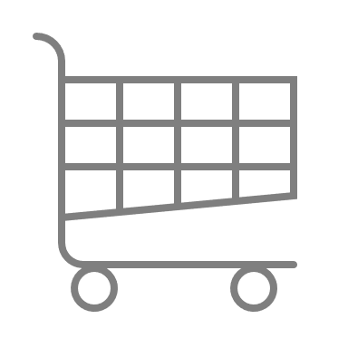



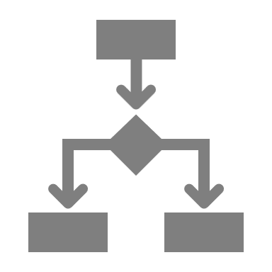
Channels of distribution
Channels of distribution
Evaluate and use different channels to reach your target market .
UpskilPRO e Institute for Sales & Marketing
Tools, Content & Templates
Hand built using experience & Insight

Slide 2
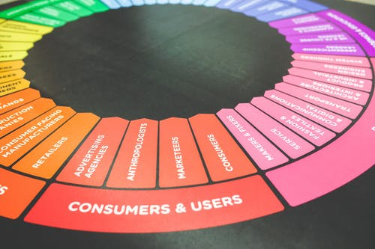

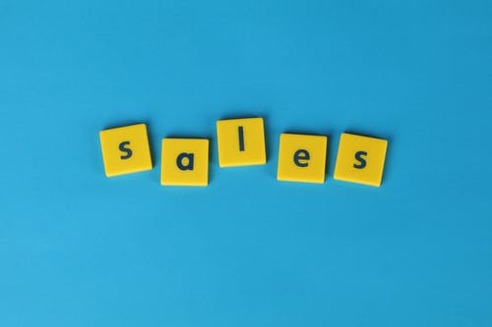

Created by
ex-Procter & Gamble, Rothmans, BAT, Gillette, Nokia,
Microsoft & 3M managers.
UpskilPRO tools are designed in easy-to-use solutions, all you need to do is download the tool and get to work immediately . All UpskilPRO material has taken 100’s of hours and many 1000’s of $ to build , all this expertise and content is brought to you for a fraction of the cost to help professionals enhance their capability.
core areas which are best suited to improve using our tools:
        Subject matter expertise
        Best practices
        Analytical output & charting
        Prioritization
        Process
        Training
Making life simpler for
Sales & Marketing professionals.
Tools in one place to get 10X productive now.

Slide 3


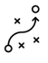

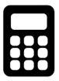
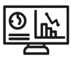
Job Descriptions
Develop roles clearly and completely across varying levels of experience
Agreements
Draft your business agreements across a variety of areas
Templates
Templates are designed based gather information in a structured manner
KPI’s
Performance indicator, a quantifiable measure of performance over time versus a specific objective.
Content Modules
Best practice material in power point for use as a knowledge base in business training , planning and execution .
Strategic tools
These tools are recognised the world over in business schools, consulting firms and companies who plan strategically.
Gain a competitive edge using the best tools and techniques to build a better you .
Analytical Tools
Interactive excel tools on specific business areas based on your data inputs delivered in a workbook model with instructions.
Scorecards
Designed as functional or subject indicators across a variety off situations to enable performance of situational evaluation versus aligned standards.
Calculators
calculate the right ratios for businesses looking for benchmarks in a variety of situations
Assessments
Assessments are designed around specific areas to conduct reviews and will center around a benchmark reviewing individuals or functions
Checklists
Designed around achieving milestones in a sequential manner.
Research
Research tools for sales and marketing engagement

Slide 4
2017
2018
100’s of tools grouped in 12 categories, 50 tool types and 12 business functions in 1 place.
get 10X productive now !
Categories
Functions
Analytical Tools
Types
Business Development
Agreements
Advertising
Customer Acquisition
Margins
Partner Search
Reports
Category Management
Assessments
Agreements
Customer Management
Market Analysis
Persona Development
Retail Measurement
Channel Management
Content Modules
Analytics
Distribution
Market Development
Planning
Reviews
Distribution
Checklists
Barriers
Distributor Management
Market Research
Positioning
Sales Management
Distributor Management
Calculators
Business Reviews
Forecasting
Market Segmentation
Pricing
Scorecards
General Management
Job Descriptions
Business Intelligence
GAP Analysis
Market Size
Prioritization
Segmentation
Key Account Management
KPI’s
Channels
Go To Market
Marketing
Product Development
Six Sigma
Marketing
Research
Communication
Job Descriptions
Marketing Comms
Product Life Cycle
Socio Economic Classification
Marketing Operations
Strategic Tools
Competitive Evaluation
Key Account Plans
Merchandising
Profit & Loss
Territory Design
Sales Management
Scorecards
Competitive Intelligence
Management Summary
New Market Entry
Promotions
Trade Marketing
Shopper Marketing
Templates
Trade Marketing

Slide 5

Distribution channels are responsible to create a two-sided connection from the manufacturer to the customer.
We usually focus on one direction.

Slide 6
Channels of distribution
“ A product with better distribution will Always win over a superior product with poor distribution or customer access that's reality”.

Slide 7
Channels of distribution

Slide 8
Channels of distribution
Management Summary
Management Summary Channel management strategy and appropriate choice of channels based on data and customer throughput will be the 2 elements of our decision making capabilities in managing channels .
Mission |  |  | Vision
Financials | Top line from X Mn $ to Y Mn $ in 3 years |  | Contribution gross margins increase from 46% to 48% |  | Contribution income to increase from 19% to 23%
Channel Data |  | LY Sales | TY Plan | TY Sales | TY vs Plan | LY vs Plan
 | Channel A
 | Channel B
 | Channel C
 | Channel D
Initiatives | Budgets |  | Technologies |  | Strategic Channel Programs
Teams | Lead team |  | New Hires |  | TY Initiatives

Slide 9
Channels of distribution
Market Coverage Model process.
Develop Product
&
Channel matrix
PRODUCTS AND SERVICES
For many small business owners, maintaining positive cash flow and a stable balance sheet can be an ongoing battle that consumes.
Develop Channel Universe
Develop Market / Channel Coverage Model .
Set up test market for coverage model
Develop
Channel qualification matrix

Slide 10
Channels of distribution
Market Coverage Model. ( Goals & Purpose )
DIRECT SALES
INDIRECT SALES
DIRECT TO CUSTOMER
Lower cost to sales ratio
Wider portfolio management
Local engagement
Expanded geographical presence
Increased points of contact
Low sales cost
Wider reach
Efficient transactions
Wider portfolio management
Loyalty management
Reach & penetration
Sales – Medium to Complex
Key account control
Complex service requirement
Goals / Purpose
Roles / Functions
Distributors
Resellers
Value Added Resellers
Retail Stores
Agents
Brokers
Integrators
Aggregators
Service partners
E commerce
Tele channels
Websites
E marketplace
Mail Catalogues
Retail stores
Online resellers
Field Representatives
Category Managers
Account Managers
Account executives
Technical Representatives
Global Subject Matter Experts

Slide 11
Channels of distribution
Types of Distribution Channels
Direct Distribution
Indirect Distribution
Manufacturer
Manufacturer
Agent -
Distributor
Export House
Buying organization
Wholesaler
Wholesaler
Retailers
Retailers
While selecting a distribution channel for foreign markets, the management of the exporting company should consider the following aspects:
(i) Who are the consumers? Which are the available retail outlets to reach them?
(ii) Which type of market coverage is required, keeping in view the product and consumer characteristics?
(iii) Are there any internal constraints for the exporter like finance which will influence the decision regarding choice of the distribution channel?
(iv) What are the expectations from the channel members? Are there some specific expectations?
(v) What is the required support system to satisfy the expectations of the channel members?

Slide 12
Channels of distribution
Types of Distribution Channels
Direct Distribution
Indirect Distribution
Manufacturer
Manufacturer
Agent -
Export House
Distributor
Wholesaler
Wholesaler
Retailers
Retailers
While selecting a distribution channel for foreign markets, the management of the exporting company should consider the following aspects:
(i) Who are the consumers? Which are the available retail outlets to reach them?
(ii) Which type of market coverage is required, keeping in view the product and consumer characteristics?
(iii) Are there any internal constraints for the exporter like finance which will influence the decision regarding choice of the distribution channel?
(iv) What are the expectations from the channel members? Are there some specific expectations?
(v) What is the required support system to satisfy the expectations of the channel members?

Slide 13
Channels of distribution
Channel setup guidelines (Example)
Channels
Geography
Customers
Classify channels
Segment geography clearly
Classify Customers in line with channel
Classify Customers to Channels
Align customers to regions and geography
Align customers to products
Set Channel guidelines
Align customers to Regions
Ensure multi geography customers are recorded
A
B
C
Set Customer discounts
Align financial codes to customers to allocate expenses credit and debit
Organize products into categories
Set Channel Discounts
Align products to channels
Budget codes for channels and customers
Set product discounts
Align Pricing strategy to channel
Record pricing strategy
Record expense codes
Discounts
Direct Expenses
Product

Slide 14
Channels of Distribution
Channel Advantages
Channel Advantages
High
High engagement
Feedback intensive
Low cost per contact
Upselling possibilities high
Instant data capture.
Sales force
Channel Drivers
Value added
Partners
Distributors
Basis purpose of the sale channel is to connect customers , brand owners and end-users .
Different brands and solutions will drive different strategies to reach end user this results in what is called the Omni Channel experience
Every brand owner will evolve different channel strategies to resolve 4 main areas
Cost to serve
Preferred channel of end-users
Ability to manage and influence end users and customers
Business contribution
Retail
Value added sales
Direct sales channels
Tele
marketing
E
commerce
Indirect channels
Closer to end sale
Larger business scale
Higher relative cost per engagement
Faster decision making
Direct marketing channels
Channel disadvantages
low
low
Cost per transaction
High
Distribution Channels :
Each product and category interacts differently with channels based on A) Brand initiatives B) Strategy C) Priorities
The models above may all be used or only one , it is dependent on the strategy and the planning used to arrive at such a conclusion
Each channel has different cost layers to deliver service
In the example above the cost per transaction is largely modelled around the distance to end user , the 3 models reflect the distance and the cost .
Strategically the prioritization works around working with the larger and complex customer groups and moving the smaller and less profitable groups to inside sales or telemarketing
E commerce is a strategic decision mainly , as opposed to a cost based decision

Slide 15
Channels of distribution
Market Coverage Model.
Shared Services
Customer Management
Function
Channels
Customer Classification
Direct Sales
A | B | C
25 | 40 | 35
50 | 60 | 70
75 | 125 | 250
125 | 0 | 10
25 | 35 | 5
275 | 260 | 370
CRM System
Service
Mass Retail
Sales – Engagement teams
Delivery
Channel Partners
Sales Online
Enquiry
Value Added Resellers
Inbound call centre
Orders
Corporates
Management information systems integration
Manufacturing
Inside sales
Warranties
Marketing
Market Coverage Model segmenting channels / Customers into 3 broad customer classification segments :
Segment A & B are composed of high value and strategic customers
Segment C is composed of customers who are small and order management and servicing are taking up too much time in direct servicing.
In the example above they have segmented the customers into 3 clear segments for ease of management
The shared service organisation while managing all 3 segments , in this case also directly manages the Segment C as it has implants of Inside Sales agents on board
Broad segmentation of customers has to build on business strategy and a clear customer evaluation of cost benefit analysis to allocate them .

Slide 16
Channels of distribution
Basic Channel Approach
Overall Category Sales Contribution
Your category sales contribution . Both are different , this requires category insight to find out if your brand is under contributing .
Basic go to market layout of channels
Push Campaigns
Sales
Contribution
Category
Contribution
Direct Sales
Channel partners
Customer
Brand Owner
or
Manufacturer
Customer
Value Added Resellers
Customer
Internet / reseller
Customer
Wholesalers / Stockists
Pull Campaigns
Demand creation campaigns using the marketing mix
Comment
Most generic descriptors have been used for channels
The model uses a flow from manufacturing to customer / end-user .
The emerging channel is the online reseller who is able to resell online to other e commerce resellers

Slide 17








Channels of distribution
GTM Channels
DIRECT SALES
INDIRECT SALES
DIRECT TO CUSTOMER
Lower cost to sales ratio
Wider portfolio management
Local engagement
Expanded geographical presence
Increased points of contact
Low sales cost
Wider reach
Efficient transactions
Wider portfolio management
Loyalty management
Reach & penetration
Sales – Medium to Complex
Key account control
Complex service requirement
Goals / Purpose
Roles / Functions
Distributors
Resellers
Value Added Resellers
Retail Stores
Agents
Brokers
Integrators
Aggregators
Service partners
Field Representatives
Category Managers
Account Managers
Account executives
Technical Representatives
Global Subject Matter Experts
E commerce
Tele channels
Websites
E marketplace
Mail Catalogues
Retail stores
Online resellers
EXAMPLES

Slide 18
Channels of distribution
Types of consumption across Channels
Efficiency or Inefficiency ?
Channels
Consumption
Direct sales
Customer
Key Takeaway .
As you build out your channel model using our channel selection advanced tool you will be forced to evaluate selection of channels and rate them in importance .
Once you have done the rating you will need to clarify if all the areas under consumption belong to 1 channel or are designed for maximum strategic effect .
Setting a channel priority on how to reach identified end customer will avoid many overlap issues later including grey markets
Same customer many channels , creates a inefficiency of channel resources and in companies where different business go to the channel , its probable that the channel management matrix needs to be relooked
Business Partners
Manufacturer
Customer
Tele channels
Customer
Internet
Customer
Miscellaneous
Brand owner
Push activities
Pull Activities

Slide 19
Channels of distribution
Types of Distribution Channels
Types of Distribution Channels: B2C
Manufacturer
Manufacturer
Manufacturer
Manufacturer
Manufacturer
Manufacturer
Agent
Agent
Agent
-
-
-
Wholesaler
-
-
Wholesaler
-
-
Retailer
Retailer
-
Retailer
Retailer
-
Consumer
Consumer
Consumer
Consumer
Consumer
Consumer
Distribution Channels :
Each product and category interacts differently with channels based on A) Brand initiatives B) Strategy C) Priorities
The models above may all be used or only one , it is dependent on the strategy and the planning used to arrive at such a conclusion
Channel selection is largely influenced by 2 factors , A ) Most effective channel to reach target market B) Cost effective route C) Strategic utilization of said channel
In the example above the Consumer or the end user are the same
It is possible that there may be slight variations based on local market conditions to the example above

Slide 20
Channels of distribution
Types of Distribution Channels
Types of Distribution Channels: B2B
Manufacturer
Manufacturer
Manufacturer
Manufacturer
Manufacturer
Manufacturer
Agent
Agent
-
-
-
-
Wholesaler
-
Wholesaler
-
-
-
-
-
-
-
Retailer
-
Industrial Consumer
Industrial Consumer
Industrial Consumer
Industrial Consumer
Consumer
Consumer
Distribution Channels :
Each product and category interacts differently with channels based on A) Brand initiatives B) Strategy C) Priorities
The models above may all be used or only one , it is dependent on the strategy and the planning used to arrive at such a conclusion
Channel selection is largely influenced by 2 factors , A ) Most effective channel to reach target market B) Cost effective route C) Strategic utilization of said channel
In the example above the Consumer or the end user are the same
It is possible that there may be slight variations based on local market conditions to the example above

Slide 21
Channels of distribution
Distribution Channels
Brand Owner
Product / Service creation
Logistics Hub
Physical Distribution
Reseller
Channel /s
End-user
Manufacturer
Manufacturer
Manufacturer
Manufacturer
Distributor
Wholesaler
Agent -
Consumer Retailers
Online e reseller
E commerce
Specialist Shops
Company
DIY Stores
Gas Stations
Consumer
While selecting a distribution channel for foreign markets, the management of the exporting company should consider the following aspects:
(i) Who are the consumers? Which are the available retail outlets to reach them?
(ii) Which type of market coverage is required, keeping in view the product and consumer characteristics?
(iii) Are there any internal constraints for the exporter like finance which will influence the decision regarding choice of the distribution channel?
(iv) What are the expectations from the channel members? Are there some specific expectations?
(v) What is the required support system to satisfy the expectations of the channel members?
Duty Free
Converters
Value Added Reseller

Slide 22
Channel Classifications

Slide 23
Channels of distribution
3 Categories of “Go to Market” Channels.
 | Direct Channels | Indirect Channels | Direct to consumers
Levers of distribution | Key account management | Market Expansion | Maximum reach in the value chain
 | Quality service | Geographic expansion | Penetration and reach efficient
 | Excellent business planning | Customer support | Quicker turn around time
 | Quick reaction | Broader solutions | Quality business planning
 | Quick decisions |  | Refill and repurchase efficient
Methods of executing strategy | Global Managers | Distributors | Marketing mix efficient
 | Field Managers | Resellers | Internet
 | Marketing Managers | Mass Merchandisers | Social media
 | Corporate Managers | Integrators / Applicators | Retail
 | Technical Representatives | Representatives | Internet e busines models

Slide 24
Channels of distribution
Market Verticals and Classifications.
Consumer Goods | Construction | Automotive Manufacturing | Telecommunication | Mass Transportation
Consumer Packaged Goods | Construction Equipment | EM Vehicle | Networking Equipment | Passenger Buses
Household products | Building Technologies & Automation | Light Vehicles | Network Services | Passenger Aircraft
Beauty & personal care | Power Tools | Medium and Heavy-duty | Network Infrastructure | Passenger Rail
Luxury products | Smart Building | Electric Vehicle Systems | Enterprise Network Systems | Passenger shipping
Consumer Electronics | Energy Management Systems | Off-highway Equipment | Broadband/VoIP | Trams
Life Style products | Green IT | Buses/ Trucks | Hosted Applications | Inland shipping
Sports Goods | Smart Energy | Material Handling Equipment | Voice/Data/Video | Metro ( intercity )
Verticals & Classifications
We recommend identifying the verticals for any business for intelligence tracking and monitoring reasons
The possibility of a business having more than one vertical in a business is possible
For identifying verticals a good start would be to start online with industry classification , or with consulting forms and or the market research service providers

Slide 25
Channels of distribution
Basic Universe / Category – GTM Channels
B2C
B2B
Internet
Retail Channels are measured
  Biannually or annually
Clear segmentation of outlet types
No of outlets by Geography
Turnover
Category Sales
Distribution
Brand availability
Volume share
Value share
Electronic Data transfer
Most Channel types are measured
B2B products sold in a retail environment are mostly covered or measured
These categories are often found in the outlet under Home or Maintenance
Most B2B companies do not buy audit data for many reasons leading to the relevant category not being measured.
As the sales is often made to smaller or very large non-retail outlets sales are not necessarily captured
B2B products sold on the web , are recorded giving rich data availability .
Some of the categories sold on the web are smaller compared to Brick & Mortar channels.
Universe Availability
DATA
E commerce
Tele channels
Websites
E marketplace
Mail Catalogues
Retail stores
Online resellers
Data availability is robust
Electronic data availability
Costs are based on contract to supply
Data is fragmented
Mostly manual
Data availability
Universe / Category Data
Research Companies specializing in B2C
Research Companies specializing in B2B
Data aggregator companies or digital specialists

Slide 26
Channels of distribution
Channel Coverage Flow
Brand Owner
Product / Service creation
Logistics Hub
Physical Distribution
Reseller
Channel /s
End-user
Manufacturer
Manufacturer
Manufacturer
Manufacturer
Distributor
Wholesaler
Company
Agent
Consumer Retailers
Consumer
Online e reseller
Value Added Reseller
E commerce
Specialist Shops
DIY Stores
Gas Stations
While selecting a distribution channel for foreign markets, the management of the company should consider the following aspects:
(i) Who are the consumers? Which are the available retail outlets to reach them?
(ii) Which type of market coverage is required, keeping in view the product and consumer characteristics?
(iii) Are there any internal constraints for the exporter like finance which will influence the decision regarding choice of the distribution channel?
(iv) What are the expectations from the channel members? Are there some specific expectations?
(v) What is the required support system to satisfy the expectations of the channel members?
Duty Free

Slide 27
Channel Scorecards

Slide 28
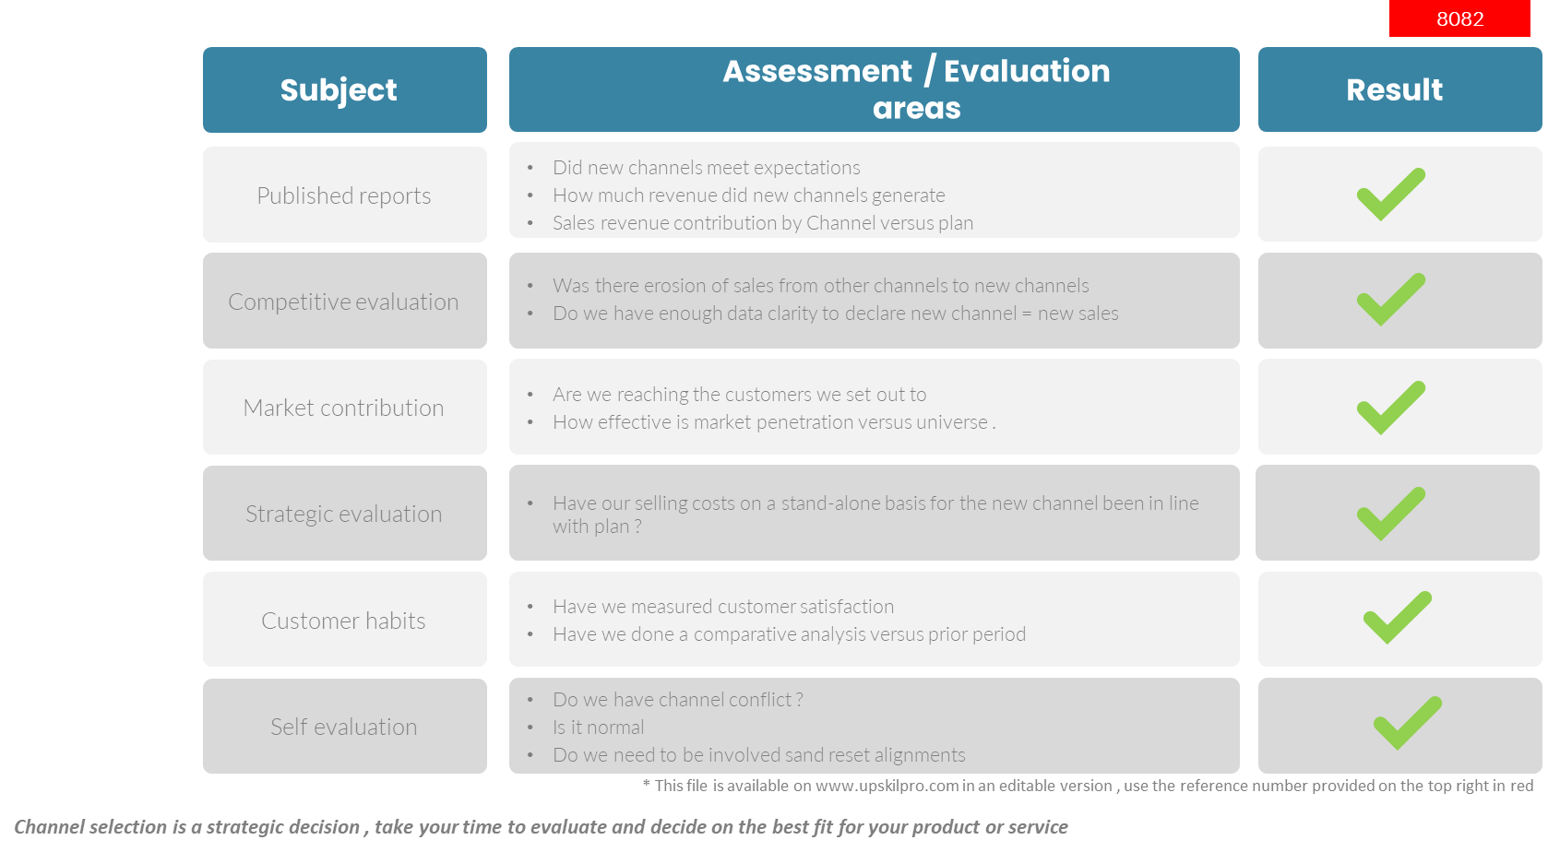
Channels of Distribution
Scorecard - How to find the right channel

Slide 29
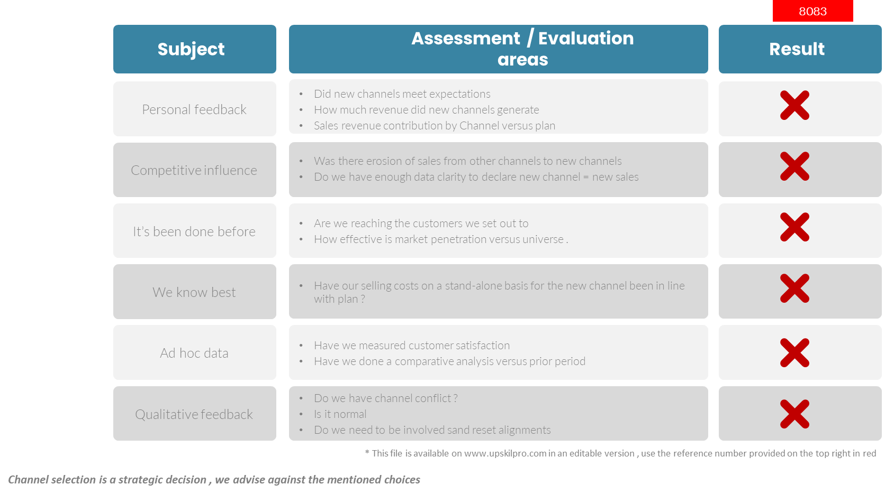
Channels of distribution
Scorecard - What to do and not to do !

Slide 30
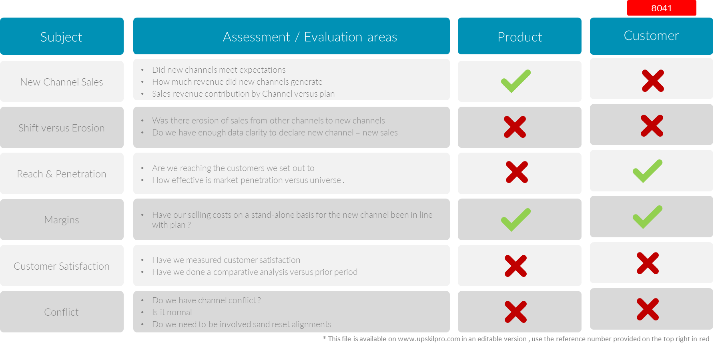
Channels of distribution
Scorecard - Channel Baseline Management Areas.

Slide 31
Channel Promotions

Slide 32
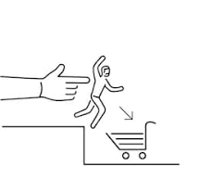

Channels of Distribution
Push – Pull
Push
Pull
Trade show promotions to encourage retailer demand
Direct selling to customers in showrooms or face to face
Negotiation with retailers to stock your product
Efficient supply chain allowing retailers an efficient supply
Packaging design to encourage purchase
Point of sale displays
Advertising and mass media promotion
Word of mouth referrals
Customer relationship management
Sales promotions and discounts
Push
Strategies
Promotional Activities
Demand
Producer
Channels
End-user
Marketing communication
Pull
Strategies
Producer
Promotional Activities
Channels
Demand
End-user
Demand creation

Slide 33
Channels of distribution
Market evaluation criteria.
Market evaluation criteria
We start with identifying drivers to weight the 9 important drivers indicating importance ( cost to serve to barriers )
We then weight the drivers to reflect the intensity and importance of the driver in the decision making process
Drivers are situational in both identification and importance
We recommend identifying the drivers closer to the decision making process end result and working back from there
Sources in this context are for data and intelligence sources gathering.
* This file is available on www.upskilpro.com in an editable version , use the reference number provided on the top right in red

Slide 34
Channels of distribution
Channel Readiness Matrix

Slide 35

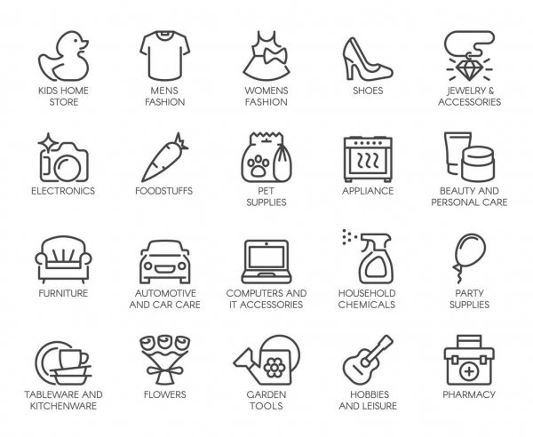
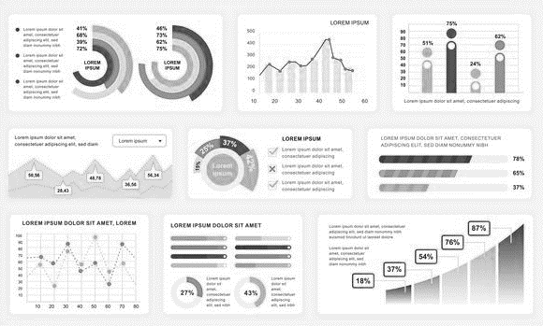
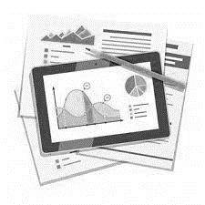
Channels of distribution
Channels / Categories / Reports
Channels
Categories
Report Outputs
Grocery
Food
Category Sales
Convenience
Non-Food
Category Share
Compiler
Inputs
Pharmacy
Beauty Care
Market Share
Report
/ outputs
Duty Free
Beverages
Out of Stocks
Gas Stations
Snacks
Distribution
Comment
Above example has been simplified for the reason every country has differences and category reading is dependant on individual countries and brands
While the data may be available for download from a retailer , the customer has to decide which data is relevant and the account has to decide on access protocol to that specific data
Reports are dependant on which channel , Which category and finally what type of report design.
Above channels have been reduced for the example
Reporting capabilities are far more than shown above , and in many cases can be produced for clients per briefing
The flow chart is more applicable for the process .

Slide 36





Channels of distribution
Channel best practices design
Packaging Variations
Pricing
Customer service
Customize the packaging and variations to keep the product manageable at the channel end
.
Design a channel pricing strategy which is understood by all stakeholders to enable shopping without confusion
Ensure you have a customer service approach to enable a streamlined approach
.
Standardize
Backup channel
Standardize the features and benefits to fit the consumers time to shop and the amount of time spent in from of the product
.
Simplification
Every channel must have a back up channel to provide any support
.
Make sure that the entire process is simplified , with a contractual element and recorded
.

Slide 37
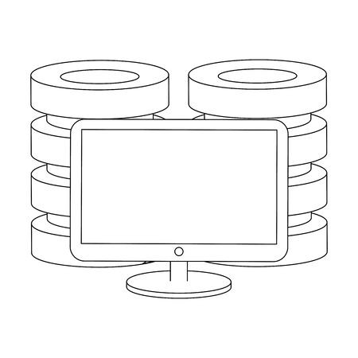
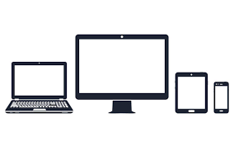


Channels of distribution
Integration with Customer Management
Seamless integration across all touch points of the Customer facing function providing constant and timely interaction
Customers
Constant engagement with communication
The customer has a secure and private connection with the brand owner to manage his or her business.
Integrated web presence across the region and world with customer access and log in to drive up to date information , order management , outstanding account , points earned , notices to manage , documents to update and process view.
Fully integrated call centres providing up to the minute engagement and feedback with both customer and company
Field force automation now used across all functions as an integrator to drive one database and constant engagement with the customer.

Slide 38
Channels of distribution
Market Coverage Model.
Shared Services
Customer Management
Function
Channels
Customer Classification
Direct Sales
A | B | C
25 | 40 | 35
50 | 60 | 70
75 | 125 | 250
125 | 0 | 10
25 | 35 | 5
CRM System
Service
Mass Retail
Sales – Engagement teams
Delivery
Channel Partners
Sales Online
Enquiry
Value Added Resellers
Inbound call centre
Orders
Corporates
Inside sales
Warranties
Manufacturing
Management information systems integration
Marketing
Market Coverage Model segmenting channels / Customers into 3 broad segments :
Segment A & B are composed of high value and strategic customers
Segment C is composed of customers who are small and order management and servicing are taking up too much time in direct servicing.
In the example above they have segmented the customers into 3 clear segments for ease of management
The shared service organisation while managing all 3 segments , in this case also directly manages the Segment C as it has implants of Inside Sales agents on board
Broad segmentation of customers has to build on business strategy and a clear customer evaluation of cost benefit analysis to allocate them .

Slide 39
Channel Reporting

Slide 40
Channels of distribution
Channel reporting

Slide 41
Managing Channels

Slide 42
Channels of distribution
Internal Stakeholder Alignment .
Customers / Markets
What Markets are our products available in today , both Geographically & vertically
Which products and solution do we serve to these markets
What re the new markets and segments we are targeting ?
What are the current markets we are planning to exit ?
Do we have all the information on all the current and new markets and segments ?
Markets
Solutions
Markets
Segments
Products
What is our strategy for winning in Customers and Accounts
What do we know about why our customers want to do business with us
How does our competition do business by channel
Do we have any feedback from customers on the boxes alongside
Customers
Accounts
Customers
Channels
Competition
What channels do we know off and which ones do we use to serve customers with which product portfolios
How do we measure effectiveness of our Coverage and Channel strategy ?
Let's develop a SWOT analysis of our approach
What are our Channel building initiatives , both singular and Omni channel initiatives
Do we have a channel prioritization list
Have we done a channel needs and customer satisfaction matrix analysis
Customers
Channels
Channels
Strategy
Products
What is our portfolio design strategy
Can we develop a pyramid of offerings and classify them from excellent to poor ?
Which offering is not selling well ?
Any new changes in the plan ?
What is the consumer and customer feedback on our portfolio offering s ?
Product
Products
Customer
Markets
Strategy
Channels
Do we have a differentiated messaging for our Customers and Consumers ?
What is our prioritized media strategy based on segmentation
Is our media targeting working
Do we need any message refining to reach our customers and consumers
Communication
Pricing
Products

Slide 43
Channels Scorecard

Slide 44
Channels of distribution
New Channel Evaluation - 3 Months.
2001
Subject
Assessment / Evaluation areas
Result
New Channel Sales
Did new channels meet expectations
How much revenue did new channels generate
Sales revenue contribution by Channel versus plan
Shift versus Erosion
Was there erosion of sales from other channels to new channels
Do we have enough data clarity to declare new channel = new sales
Reach & Penetration
Are we reaching the customers we set out to
How effective is market penetration versus universe .
Margins
Have our selling costs on a stand-alone basis for the new channel been in line with plan ?
Customer Satisfaction
Have we measured customer satisfaction
Have we done a comparative analysis versus prior period
Conflict
Do we have channel conflict ?
Is it normal
Do we need to be involved sand reset alignments

Slide 45
Thank you !

Slide 46
Job Descriptions
Develop roles clearly and completely across varying levels of experience
Agreements
Draft your business agreements across a variety of areas
Templates
Templates are designed based gather information in a structured manner
KPI’s
Performance indicator, a quantifiable measure of performance over time versus a specific objective.
Content Modules
Best practice material in power point for use as a knowledge base in business training , planning and execution .
Strategic tools
These tools are recognised the world over in business schools, consulting firms and companies who plan strategically.
Gain a competitive edge using the best tools and techniques to build a better you .
Analytical Tools
Interactive excel tools on specific business areas based on your data inputs delivered in a workbook model with instructions.
Scorecards
Designed as functional or subject indicators across a variety off situations to enable performance of situational evaluation versus aligned standards.
Calculators
calculate the right ratios for businesses looking for benchmarks in a variety of situations
Assessments
Assessments are designed around specific areas to conduct reviews and will center around a benchmark reviewing individuals or functions
Checklists
Designed around achieving milestones in a sequential manner.
Research
Research tools for sales and marketing engagement

Slide 47
Channels of distribution
Channels of distribution
Evaluate and use different channels to reach your target market .
UpskilPRO e Institute for Sales & Marketing
Tools, Content & Templates
Hand built using experience & Insight

