Slide 1

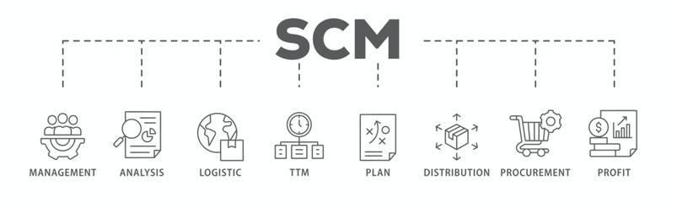
Trade Marketing Plans
Trade Marketing Plans
Sales & Marketing Fundamentals.
UpskilPRO e Institute for Sales & Marketing
Tools, Content & Templates
Hand built using experience & insight

Slide 2
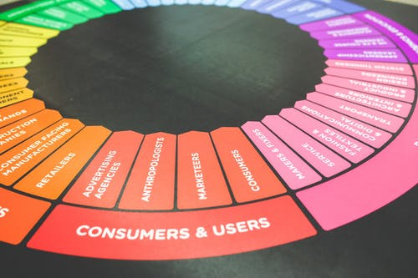

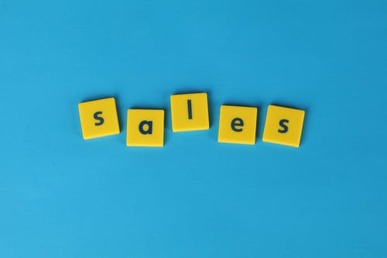

Created by
ex-Procter & Gamble, Rothmans, BAT, Gillette, Nokia,
Microsoft & 3M managers.
UpskilPRO tools are designed in easy-to-use solutions, all you need to do is download the tool and get to work immediately . All UpskilPRO material has taken 100’s of hours and many 1000’s of $ to build , all this expertise and content is brought to you for a fraction of the cost to help professionals enhance their capability.
core areas which are best suited to improve using our tools:
        Subject matter expertise
        Best practices
        Analytical output & charting
        Prioritization
        Process
        Training
Making life simpler for
Sales & Marketing professionals.
Tools in one place to get 10X productive now.

Slide 3


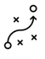



Job Descriptions
Develop roles clearly and completely across varying levels of experience
Agreements
Draft your business agreements across a variety of areas
Templates
Templates are designed based gather information in a structured manner
KPI’s
Performance indicator, a quantifiable measure of performance over time versus a specific objective.
Content Modules
Best practice material in power point for use as a knowledge base in business training , planning and execution .
Strategic tools
These tools are recognised the world over in business schools, consulting firms and companies who plan strategically.
Gain a competitive edge using the best tools and techniques to build a better you .
Analytical Tools
Interactive excel tools on specific business areas based on your data inputs delivered in a workbook model with instructions.
Scorecards
Designed as functional or subject indicators across a variety off situations to enable performance of situational evaluation versus aligned standards.
Calculators
calculate the right ratios for businesses looking for benchmarks in a variety of situations
Assessments
Assessments are designed around specific areas to conduct reviews and will center around a benchmark reviewing individuals or functions
Checklists
Designed around achieving milestones in a sequential manner.
Research
Research tools for sales and marketing engagement

Slide 4
2017
2018
100’s of tools grouped in 12 categories, 50 tool types and 12 business functions in 1 place.
get 10X productive now !
Categories
Functions
Analytical Tools
Types
Business Development
Agreements
Advertising
Customer Acquisition
Margins
Partner Search
Reports
Category Management
Assessments
Agreements
Customer Management
Market Analysis
Persona Development
Retail Measurement
Channel Management
Content Modules
Analytics
Distribution
Market Development
Planning
Reviews
Distribution
Checklists
Barriers
Distributor Management
Market Research
Positioning
Sales Management
Distributor Management
Calculators
Business Reviews
Forecasting
Market Segmentation
Pricing
Scorecards
General Management
Job Descriptions
Business Intelligence
GAP Analysis
Market Size
Prioritization
Segmentation
Key Account Management
KPI’s
Channels
Go To Market
Marketing
Product Development
Six Sigma
Marketing
Research
Communication
Job Descriptions
Marketing Comms
Product Life Cycle
Socio Economic Classification
Marketing Operations
Strategic Tools
Competitive Evaluation
Key Account Plans
Merchandising
Profit & Loss
Territory Design
Sales Management
Scorecards
Competitive Intelligence
Management Summary
New Market Entry
Promotions
Trade Marketing
Shopper Marketing
Templates
Trade Marketing

Slide 5








7 Benefits of using UpskilPRO :
Improve your knowledge
with professional Strategic Tools , Templates and planning documents for any business situation!
Use ready made tools
with filled in examples and ready to print & edit at your convenience . Just edit and fill-in the blanks !
Develop YOUR BUSINESS
Learn , & utilize the knowledge and processes and enhance your capabilities as the other companies have
We Created UpskilPRO for the
  Sales Professional
  Trade Marketer
  Marketing Executive
  Operations Manager
  VP/Director/Manager
100’s of tools , TEMPLATES & documents
CREATED BY
world class sales and marketing
business professionals.
All tools
are based on topics and subject based situations and are simple and easy to use .
SAVE THOUSANDS OF DOLLARS
The average company will save 1000’s of $ per employee in time & effort using our ready tools !
Top Quality Tools & Templates for developing both you and your business.
www.upskilpro.com

Slide 6
Trade Marketing Plans.
Directional Summary
Trade Marketing Plans set the tone for ensuring that the marketing objectives are translated into engaging the customer at the category or in specific events , this is the part where the actual engagement between company , customer , brand and category takes place.

Slide 7
Summary |  | Page No
1.0 | Summary
 | Corporate Objectives and Mission Statement
 | Market specifics
 | Category overview
 | Customer overview
 | Channel Overview
 | Key Opportunities identified (B2B & B2C)
 | Priority Categories and Brands
2.0 | Analysis
 | Market sizing / Channel Sizing
 | Key Channels and Customers
 | Competitive analysis
 | Opportunities and threats
3.0 | Resources
 | Human resource plan
 | POS Resources
 | Investments plan
4.0 | Tactics
 | Brands channels and tactics
 | Branding Plans
 | Communication Plans
 | POS Plan
 | High level tactical calendar
5.0 | P&L
 | P&L
 | Marketing ROI and Ratios
6.0 | Conclusions
 | Recommendations and Reviews
Trade Marketing Plan.

Slide 8
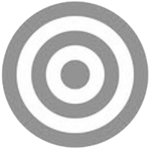
Trade Marketing Planning Process.
Corporate Objectives
Corporate objectives usually contain at least the following elements:
Such a corporate plan, containing projected profit and loss accounts and balance sheets, being the result of the process described above, is more likely to provide long-term stability for a company than plans based on a more intuitive process containing forecasts , technologies , trends etc
Summary
The desired level of profitability
Business boundaries
  What kind of products will be sold to what kinds of markets
  (marketing)
  What kinds of facilities will be developed (operations, R&D,
  information systems, distribution, etc.)
  The size and character of the labour force (personnel)
  Funding (finance)
Other corporate objectives, such as social responsibility, corporate image, stock market image, employer image, etc.
Trade Marketing
Focus on Markets / Customers &
Products
Corporate
OBJECTIVES
Business
Focus resources which must be applied on your markets
Corporate
This covers business plans based specifically on each business vertical

Slide 9
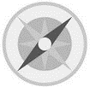
Trade Marketing Plans.
Mission Statements
Mission Statement
A Trade marketing plan should begin with a mission or purpose statement.
This is perhaps the most difficult aspect of trade marketing planning for managers to master, because it is largely philosophical and qualitative in nature. Many organizations find their different departments, and sometimes even different groups in the same department, pulling in different directions, often with poor results, simply because the organization hasn’t defined the boundaries of the business and the way it wishes to do business.
The following should appear in a mission or purpose statement, which
should normally run to no more than one page:
Role or contribution
Profit (specify), or
Service, or
Opportunity seeker
Business definition – define the business, preferably in terms of the benefits
you provide or the needs you satisfy, rather than in terms of what you
make.
Distinctive competences – these are the essential skills/capabilities resources that underpin whatever success has been achieved to date.
Competence can consist of one particular item or the possession of a number
of skills compared with competitors. If, however, you could equally
well put a competitor’s name to these distinctive competences, then they
are not distinctive competences.
Indications for the future
What the firm will do
What the firm might do
What the firm will never do
Mission
STATEMENT
1

Slide 10
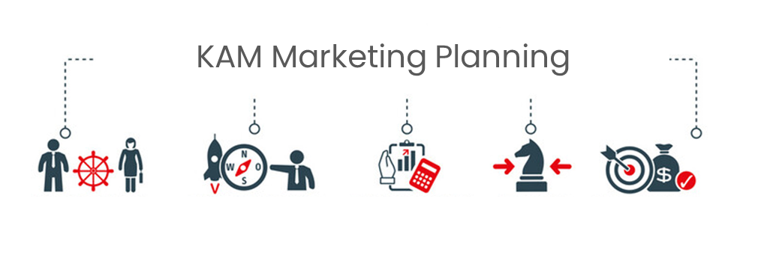
Trade Marketing Planning Process.
Marketing Objectives
An objective is what you want to achieve.
A strategy is how you plan to achieve your objectives ,
Tactics are a series of steps engaged in to deliver the strategy
Trade Marketing Plans
There can be objectives and strategies for varying levels in trade marketing.
Overall Trade marketing objectives are brand driven and resultant in shelf offtake and market share gains in general versus identified competition, its important this aligns with the business and corporate direction.
Tactically for example, there can be branding objectives , category presence, POS, Display , Consumer engagement, displays, consumer contacts, volume offtake, market share improvement etc , all of which are framed differently and come one level below in the tactical engagement part, and strategies and pricing objectives and strategies.
However, the important point to remember about trade marketing objectives is that they are about products and markets. Common sense will confirm that it is only by selling something to someone that the company’s financial goals can be achieved, and that advertising, pricing, service levels, are the means (or tactics) by which we might succeed in doing this.
Objectives should be capable of measurement, Directional terms such as “maximize”, “minimize”, “penetrate”, “increase”, etc. are only acceptable if quantitative measurement can be attached to them. Measurement should be in terms of some, or all, of the following: sales volume, sales value, market share, profit, and percentage penetration of outlets (e.g. to have 25% of all retail outlets stocking our product by year 2).
The elements of Trade Marketing are reflected in the below matrix requiring a prioritized manner of application
Markets | Account | Category
Portfolio | Budgets | Customers
Tactics | Timeframe | Organisation

Slide 11
Summary |  | Page No
1.0 | Summary
 | Corporate Objectives and Mission Statement
 | Market specifics
 | Category overview
 | Customer overview
 | Channel Overview
 | Key Opportunities identified (B2B & B2C)
 | Priority Categories and Brands
2.0 | Analysis
 | Market sizing / Channel Sizing
 | Key Channels and Customers
 | Competitive analysis
 | Opportunities and threats
3.0 | Resources
 | Human resource plan
 | POS Resources
 | Investments plan
4.0 | Tactics
 | Brands channels and tactics
 | Branding Plans
 | Communication Plans
 | POS Plan
 | High level tactical calendar
5.0 | P&L
 | P&L
 | Marketing ROI and Ratios
6.0 | Conclusions
 | Recommendations and Reviews
Trade Marketing Summary

Slide 12
Trade Marketing Plan.
Trade Marketing Objectives
Business | XX | Market | AA
Brand | YY | Area | ZZ
Objective | To Increase the brand market share of brand XX from 3.2 % to 5 % in Walmart , Mississauga , by conducting a consumer promotion of Buy 2 Get 1 free in the 300ML size along with POS placements and in store promotion during the period of Jan 1 to Jan 30, 20XX
Objective | 3.2 % | 5% | Gain of 1.8%
Review Date 15 Feb | Name
Initiator 1
Reviewer 2
Reviewer 3
Objectives should be
Specific
Measurable
Actionable
Relevant
Timebound

Slide 13
Trade Marketing Plan.
Market Specifics
Overview | Data | Commentary | Basic Analysis
Business
Brand | Market Size | Competitive analysis | Strengths
Category | Market value | Brand reviews | Weaknesses
Account / Customers | Brand Shares Volume | Channel reviews | Opportunities
Competing brands | Brand Shares in $ |  | Threats
The above pertains to useful information on one sheet as the idea of trade marketing is to review one category and brand at a time , including conflicting brands and categories into one analysis will not serve any clear purpose.

Slide 14
Trade Marketing Plan.
Category Overview
Business |  | Country – Canada | City - Vancouver
 |  | Account – Farm Fresh | Category – Batteries
Overview | Alkaline | Lithium Iron | Total
Category size
Competing Brands
Category segmentation
Dominant Channels
Support channels
Category size in units
Category size in $
Brand shares in $
Brand shares in %
Comment
Retail audit companies and some other research companies generally provide the above data on request which is based on retail POS data.

Slide 15
Trade Marketing Plan.
Customer Overview
Business | Country | State | City
Customer | Pentagon Enterprises LLC , Vancouver
Category | Batteries and Chargers
Brand | Cider Batteries
 | Previous year | Last Year | This Year
Category size | 459 mn $ | 512 mn $ | 569Mn$
Customer Size / Turnover | 35.00 Mn $ | 36.9mn$ | 39.1 Mn $ ( Est )
Competing Brands | None | Competing brand XX
Dominant Channels | Garages & Dealerships
Support channels | DIY
Category size in units | 75,000 | 82500 | 90150 Est
Category size in $ | 459 mn $ | 512 mn $ | 529Mn$
Brand shares in $ | 7.6% | 7.20 % | 7.39%
Brand shares in %
The data above is mainly pertinent to Trade marketing requirements as a basic format , this is not to be mistaken as a key account template or set of information for the purposes of the exercise .

Slide 16
Trade Marketing Plan.
Channel Overview
Business | XX | Market | AA
Category | Batteries and Chargers
Category size | 459 mn $ | 512 mn $ | 529Mn$
Competing Brands | Previous year | Last Year | This Year
Brand A | 17.2% | 17.4% | 18.9%
Brand B | 9.5% | 10.5% | 12%
Brand C | 24% | 18% | 16%
Channel segmentation
Garages | 38% | 40% | 41%
DIY | 25% | 24% | 23%
Auto Dealerships | 22% | 19% | 17%
Electric Shops | 15% | 17% | 19%
Brand shares in %
Brand A | 23% | 25% | 27%
Brand B | 19% | 20% | 18%
Brand C | 16% | 17% | 17%
The data above is mainly pertinent to Trade marketing requirements as a basic

Slide 17
Trade Marketing Plan.
Key Opportunities identified
Business | Brand | Channel | Category | Customer
Brand Share
Distribution Gaps
Pricing
Volume
Store Branding
Category Branding
POS Placement
Check out placement
Shelf Share
Category relaying
Branding
Communication engagement
Consumer Promotions
Trade Promotions
Sampling
Direct Mail
Guiding comments :
Opportunities can be identified from any of the 4 vertical columns , the idea is to widen the possible areas for later selection
Add comments here that will provide a high-level support to your key opportunities not otherwise covered in the data above for high level engagement

Slide 18
Trade Marketing Plan.
Priority Categories & Brands
Priorities | Priority Level | Comments
Brand
Brand A | Drive Brand
Brand B | Support Brand
Brand C | Maintain Brand
Brand D | Maintain Brand
Segment
Segment A | Expand Segment
Segment B | Consolidate Segment
Segment C | Maintain Segment
Segment D | Maintain Segment
Categories
Category A | Focus Category
Category B | Focus Category
Category C | Support Category
Category D | Maintain |category
Guiding comments : Add comments here that will provide a high-level support to your key opportunities , break them down to guide stakeholder engagement.

Slide 19
Summary |  | Page No
1.0 | Summary
 | Corporate Objectives and Mission Statement
 | Market specifics
 | Category overview
 | Customer overview
 | Channel Overview
 | Key Opportunities identified (B2B & B2C)
 | Priority Categories and Brands
2.0 | Analysis
 | Market sizing / Channel Sizing
 | Key Channels and Customers
 | Competitive analysis
 | Opportunities and threats
3.0 | Resources
 | Human resource plan
 | POS Resources
 | Investments plan
4.0 | Tactics
 | Brands channels and tactics
 | Branding Plans
 | Communication Plans
 | POS Plan
 | High level tactical calendar
5.0 | P&L
 | P&L
 | Marketing ROI and Ratios
6.0 | Conclusions
 | Recommendations and Reviews
Trade Marketing Analysis

Slide 20
Trade Marketing Plan.
Market & Channel Sizing
Market | Category | Subcategory | Last Year
Business Comments | Cover high level indicator comments to align your audience here at a category level | Cover high level indicator comments to align your audience here at a subcategory level | Cover any comments relevant to the last year performance for your audience here
 | Previous year | Last Year | This Year
Category size | 459 mn $ | 512 mn $ | 569Mn$
Customer Size / Turnover | 35.00 Mn $ | 36.9mn$ | 39.1 Mn $ ( Est )
Competing Brands | None | Competing brand XX
Dominant Channels | Garages & Dealerships
Support channels | DIY
Category size in units | 75,000 | 82500 | 90150 Est
Category size in $ | 459 mn $ | 512 mn $ | 529Mn$
Brand shares in $ | 7.6% | 7.20 % | 7.39%
Brand shares in %
Guiding comments : Add comments here that will provide a high-level support to your key opportunities , break them down to guide stakeholder engagement.

Slide 21
Trade Marketing Plan.
Key Channels
Driver & Support Channels | Prioritization | Market Contribution $ | Market Contribution % | Business Contribution $ | Business Contribution % | Strategies
Channel A | Drive Channel |  |  |  |  | All Category dominance , complete branding and annual TM plan tie up for all major categories
Channel B | Drive Channel |  |  |  |  | All Category dominance , complete branding and annual TM plan tie up for all major categories
Channel C | Support Channel |  |  |  |  | Specific Category dominance , situational branding engagement and thematic TM plan tie up for all agreed categories only
Channel D | Support Channel |  |  |  |  | Specific Category dominance , situational branding engagement and thematic TM plan tie up for all agreed categories only
Channel E | Maintain Channel |  |  |  |  | Assign category engagement based on opportunistic engagement specific to channel dynamics and agreements
Channel F | Maintain Channel |  |  |  |  | Assign category engagement based on opportunistic engagement specific to channel dynamics and agreements
Channel G | Maintain Channel |  |  |  |  | Assign category engagement based on opportunistic engagement specific to channel dynamics and agreements
Totals |  | US $ | 100% | US$ | 100%
 | Drive | Support | Maintain
Business Reviews
Spend on promotions | 7% | 4% | 3%
Spend on POS | 3%
Brand Priorities | Designated brands only |  | Historical
Promotion Types
Account Specific
Channel Specific | A&B | C&D | E/F/G
Guiding comments : It's important to nominate channel importance to the particular brand and category to manage its level of engagement , your level of resource management will differ for each of the prioritization levels
Add comments here that will provide a high-level support to your key opportunities , break them down to guide stakeholder engagement.

Slide 22
Trade Marketing Plan.
Key Customers
Channels | REVENUE Contribution $ | REVENUE Contribution $ | REVENUE Contribution $ | REVENUE Contribution % | REVENUE Contribution % | REVENUE Contribution % | TM Prioritization | Strategies
Customer A |  |  |  |  |  |  | Engage & Drive
Customer B |  |  |  |  |  |  | Engage & Drive
Customer C |  |  |  |  |  |  | Engage & Maintain
Customer D |  |  |  |  |  |  | Engage & Maintain
Customer E |  |  |  |  |  |  | Monitor & Manage
Customer F |  |  |  |  |  |  | Monitor & Manage
Customer G |  |  |  |  |  |  | Monitor & Manage
Customer H |  |  |  |  |  |  | Monitor & Manage
Customer I |  |  |  |  |  |  | Monitor & Manage
Customer J |  |  |  |  |  |  | Monitor & Manage
Rest |  |  |  |  |  |  | Sales Engagement
Totals | US $ | 100% | US$ |  |  | 100%

Slide 23
Trade Marketing Plan.
Competitive Analysis
Competitive Analysis To establish the competitive landscape and competitive forces arrayed in a way it can be understood logically and strategically.
Public Domain | Step 1 Company description Demographics , Size and Locations | Step 2 Summary of key management Identify the management structure and their strengths , this will be an indicator of past successes and possible future alignments | Step 3 Financials Publicly available financials preferably trended over a period
Evaluation | Step 5 Product / Services Rank the key attributes and rank them for objectivity | Step 5 Strategy ( Sales & Marketing ) brand positioning consistently along identified drivers | Step 6 Positioning analysis Stress of key areas of differentiation where you measure or state the uniqueness exists
Estimation | Step 7 Threats Look at threats both as short terms and long term , establish threats across a variety of drivers/attributes | Step 8 Opportunities The opportunities exist externally and internally, the external ones represent direct revenue the internal ones reflection.
Guiding comments : Add comments here that will provide a high-level support to your key opportunities , break them down to guide stakeholder engagement.

Slide 24
Trade Marketing Plan Competitive evaluation framework
Competitive strength
Competitive weakness
-
-
-
Portfolio Coverage
* This file is available on www.upskilpro.com in an editable version , use the reference number provided on the top right

Slide 25
Trade Marketing Plan.
SWOT – Review of O&T
11001
A – Segment Description Keep this to a specific area of the organisation and high importance
B – Critical Success Factors ( CSF) Relate this to how your customers choose
C – Weighting weight each factor in importance totalling 100
D – Strength Weakness Analysis Impact |  |  |  | Impact
CSF | We | Comp A | Comp B | Comp C | Comp D
In this case how it's about how your customers would rate you and the other competitors in each of the CSF’s , you will multiply the score by the weight.
Opportunities | Impact
A
B
C
D
Aim to crystalize on a few areas which will have effect on your business , please keep this strategic and top level.
Threats | Impact
A
B
C
D
Aim to crystalize on a few areas which will have effect on your business , please keep this strategic and top level.
Key unresolved issues | Impact
A
B
C
D
Aim to crystalize on a few areas which will have effect on your business , please keep this strategic and top level.

Slide 26
Summary |  | Page No
1.0 | Summary
 | Corporate Objectives and Mission Statement
 | Market specifics
 | Category overview
 | Customer overview
 | Channel Overview
 | Key Opportunities identified (B2B & B2C)
 | Priority Categories and Brands
2.0 | Analysis
 | Market sizing / Channel Sizing
 | Key Channels and Customers
 | Competitive analysis
 | Opportunities and threats
3.0 | Resources
 | Human resource plan
 | POS Resources
 | Investments plan
4.0 | Tactics
 | Brands channels and tactics
 | Branding Plans
 | Communication Plans
 | POS Plan
 | High level tactical calendar
5.0 | P&L
 | P&L
 | Marketing ROI and Ratios
6.0 | Conclusions
 | Recommendations and Reviews
Trade Marketing Resources

Slide 27
Trade Marketing Plan.
Human Resource Plan

Slide 28
Trade Marketing Plan.
Human Resource Plan

Slide 29
Trade Marketing Plan.
Planning Exercise – SWOT Execution

Slide 30
Trade Marketing Plan.
Investments Plan

Slide 31
Summary |  | Page No
1.0 | Summary
 | Corporate Objectives and Mission Statement
 | Market specifics
 | Category overview
 | Customer overview
 | Channel Overview
 | Key Opportunities identified (B2B & B2C)
 | Priority Categories and Brands
2.0 | Analysis
 | Market sizing / Channel Sizing
 | Key Channels and Customers
 | Competitive analysis
 | Opportunities and threats
3.0 | Resources
 | Human resource plan
 | POS Resources
 | Investments plan
4.0 | Tactics
 | Brands channels and tactics
 | Branding Plans
 | Communication Plans
 | POS Plan
 | High level tactical calendar
5.0 | P&L
 | P&L
 | Marketing ROI and Ratios
6.0 | Conclusions
 | Recommendations and Reviews
Trade Marketing Tactics

Slide 32
Trade Marketing Plan.
Brands , Channels and Tactics

Slide 33
Trade Marketing Plan.
Planning Exercise – SWOT Execution

Slide 34

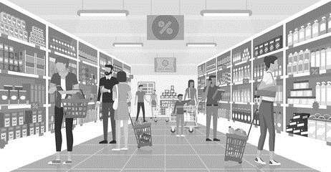
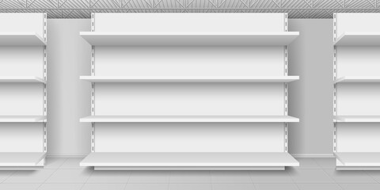
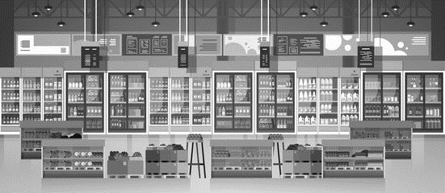
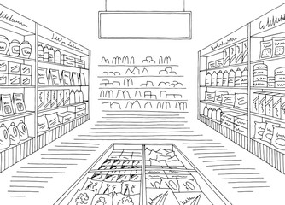
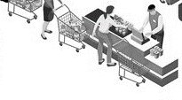
Trade Marketing Plan.
Branding Plan
Tide detergents
The Branding plan in trade marketing will cover the following areas
In Category at the store
In Communication at the store
In Displays
Anywhere where the consumer looks and touches outside the category
On pack for Promotions
Promotional Staff

Slide 35
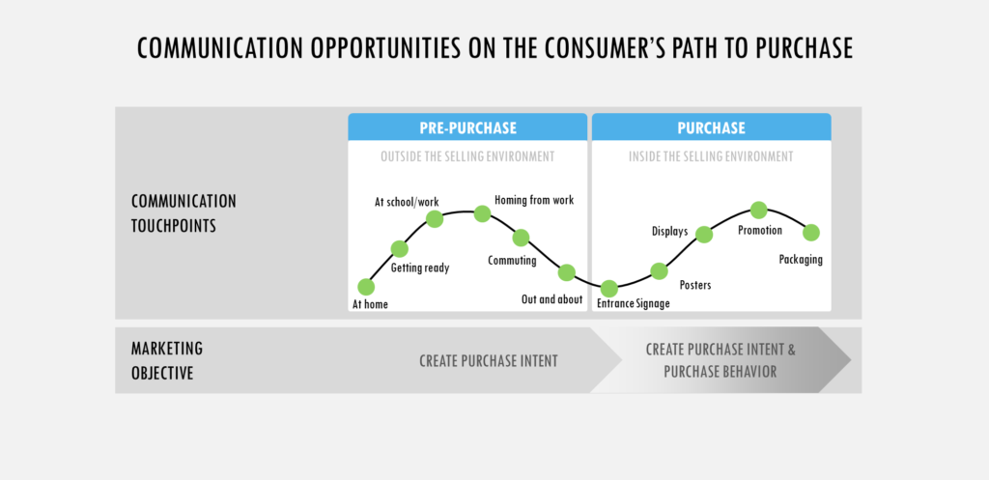
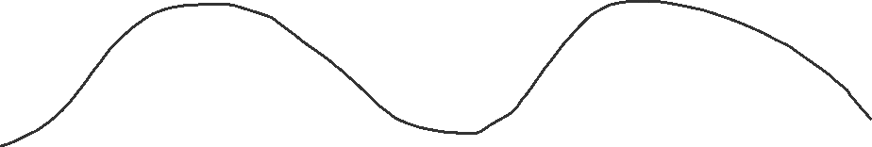
Trade Marketing Plan.
TM Communication Plans
Before
Purchase
During
Purchase
Work
Displays
Communication Engagement
Promotions
School
Travel
Posters
Category
Home
Arrival
Check out
Signage
TM Objective
Purchase Engagement creation
Purchase Engagement creation & Altered behaviour

Slide 36
Trade Marketing Plan.
Communication Plans
Brand | Account | Message | Staff Training | Objective
In-Store Experience
Consider how you're in-store environment communicates your brand message.
Implement visual merchandising strategies that align with your brand and product positioning.
Train staff to effectively communicate the brand message and assist customers.
Communication Objectives:
Clearly state the communication objectives, such as increasing brand awareness, driving sales, or promoting a new product line.
Set measurable goals to evaluate the success of your communication efforts.

Slide 37
Trade Marketing Plan.
POS Plan
Brand | Type | Units | Unit Costs | Volume | Total cost | Channel | Comments
Green | Merchandising
Blue | Training
Red | Shelf Talkers
Red | Header Boards
Red | Displays
Red | Uniforms
Understand Your Goals:
Know Your Target Audience:
Consistent Branding:
Eye-Catching Design:
Clarity of Message:
Placement and Visibility:
Promotional Offers and Incentives:
Interactive Elements:
Product Information
Seasonal Relevance:
Durability and Quality:
Compliance and Regulations:
Test and Measure:
Flexibility and Adaptability:
Collaboration with Retailers:
Sustainability:
Training for Staff:
This is a 17-point checklist for those embarking on developing a POS plan as studies will show more than 60 % of POS material tends to be outdated , wasted , and not used

Slide 38
Trade Marketing Plan.
High Level Tactical Plan
High level plans establish concepts and alignment
Low level plan establish detailed planning and execution
Brand | Channel | Account
High level plan
Brand
Channel
Budgets
Promotions
Resources
Time Frames
Low level plan
Accounts
Geographies
Promotion design
Quantity
Training
Time Frames
Placement
Agreements
Calendars
High Level tactical plans for alignment
Keep brand strategy in mind and align your tactical planning and execution
Your lower-level tactical plans will differ from account to channel and geography at times
Ensure your tactical plans are set up with clear SMART objectives
A list of accounts and plans will be necessary as they will constitute all your resource allocation mainly
There must be some room for tactical plans on an ad hoc basis in case of sudden situations
Trade marketing tactical plans are account and channel focussed and will cover agreed accounts

Slide 39
Summary |  | Page No
1.0 | Summary
 | Corporate Objectives and Mission Statement
 | Market specifics
 | Category overview
 | Customer overview
 | Channel Overview
 | Key Opportunities identified (B2B & B2C)
 | Priority Categories and Brands
2.0 | Analysis
 | Market sizing / Channel Sizing
 | Key Channels and Customers
 | Competitive analysis
 | Opportunities and threats
3.0 | Resources
 | Human resource plan
 | POS Resources
 | Investments plan
4.0 | Tactics
 | Brands channels and tactics
 | Branding Plans
 | Communication Plans
 | POS Plan
 | High level tactical calendar
5.0 | P&L
 | P&L
 | Marketing ROI and Ratios
6.0 | Conclusions
 | Recommendations and Reviews
Trade Marketing
Financials

Slide 40
Trade Marketing Plan.
Financials
 | View A | View B
Revenue ( Estimated ) 1.0
Cost breakdown ( 2.0 )
Code A
Code B
Code C
Code D
Code E
Code F
Code G
Code H
Code I
Code J
Sub Totals of 2.0
Guiding Comment | Estimate the revenue from sale of related products and services and deduct the related costs. | The actual costs involved become your cost driven activities and are aligned to the master P&L of the Sales division or business
Financials
In most companies the P&L remains the point of reference for all discussions and engagement as the data contained is free from any form of manual inputs
In the case of trade marketing the financial is usually cost centre driven as the top line is aligned to sales and covers all products and all businesses along with all customers and channels.
View B is the way most companies will align TM as the audit centric way is to treat TM as a cost centre
View A could be interpreted as an internal exercise purely to review performance and other criteria the business may want to evaluate.

Slide 41
Trade Marketing ROI

Slide 42
The 6 Steps to setting up KPI’s
Senior Management
Measures to drive
performance
Get the leadership committed to driving the KPI and Balanced scorecard organization wide.
Leading & Selling
Develop a reporting format , refine KPI’s constantly and use checklists and exhibits to get the process moving
Lead & Sell by emotional drivers of your audience , this is the most critical factor.
Upskill inhouse resources
Select an inhouse person to run the KPI program , with inhouse expertise teams will fall into place
Measures that work
Organizational
Critical Success Factors
Find measures that create the appropriate behavioral response
CSF is mostly issues operationalized and the origin of all performance measures .
www.upskilpro.com

Slide 43
Trade Marketing
Marketing Metrics : Key performance Indicators
Gross Profit
Working
Explanation
Gross profit is the simplest profitability metric because it defines profit as all income that remains after accounting for the cost of goods sold (COGS). COGS includes only those expenses directly associated with the production or manufacture of items for sale, including raw materials and the wages for labour required to make or assemble goods..
Selling Price
-
Cost price
Margins %
=
x
100
Selling Price
www.upskilpro.com

Slide 44
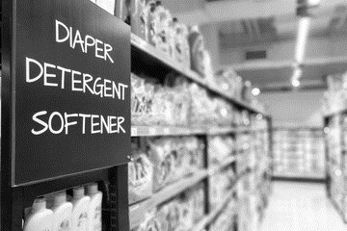
Trade Marketing
Marketing Metrics : Key performance Indicators
Shelf Share
Working
Explanation
Shelf share is seen as a basic metric converted into a percentage of the linear meter that your brand occupies versus the shelf length in meters.
Your brand in linear meters
Shelf Share %
=
x
100
Total shelf space in linear meters
Total category space Is the sum of all brands in the in a specific category translated into metres .
always clarify the brands you include in a particular category to avoid deletion or duplication
www.upskilpro.com

Slide 45
Trade Marketing
Marketing Metrics : Key performance Indicators
Category Share
Working
Explanation
Category share is seen as a basic metric converted into a percentage of the linear meters that your brand occupies versus the total metres of the category .
Your brand in linear meters
Shelf Share %
=
x
100
Total category space in linear meters
Total category space Is the sum of all brands in the in a specific category translated into metres .
always clarify the brands you include in a particular category to avoid deletion or duplication
www.upskilpro.com

Slide 46
Trade Marketing
Marketing Metrics : Key performance Indicators
Category Value Share
Working
Explanation
Category value share
Establish the sum of all products in a specific category multiplied by their volume and the net price ( US $ or other currency ) in a given time period.
Establish the above by brand , this gives you individual brand share
Divide the brand share by the total category sales , this will give you individual brand value share
Total brand sale in $
Category Value Share $
=
x
100
Total category sale in $
Marketers use two forms of category share depending on the discussion and the analysis
value share establishes the share of sales in absolute terms versus total category size and sales this allows marketers to view 1 aspect
volume share establishes the share of sales irrelevant of the package size this when viewed as a category does not reflect the right picture for it to be accurate you will need to view it in a similar sized sub category
Therefore it's important to use both metrics carefully
www.upskilpro.com

Slide 47
Trade Marketing
Marketing Metrics : Key performance Indicators
Category Volume Share
Working
Explanation
Category volume share
Establish the sum of all products in a specific category multiplied by their volume in a given time period.
Establish the above by brand , this gives you individual brand share
Divide the brand share by the total category sales in volume this will give you individual brand value share
Total brand sale in volume
Category Volume Share $
=
x
100
Total category sale in volume
Marketers use two forms of category share depending on the discussion and the analysis
Value share establishes the share of sales in absolute terms versus total category size and $ sales this allows marketers to view 1 aspect
Volume share establishes the share of sales irrelevant of the package size this when viewed as a category does not reflect the right picture for it to be accurate you will need to view it in a similar sized sub category
Therefore it's important to use both metrics carefully
www.upskilpro.com

Slide 48
Trade Marketing
Marketing Metrics : Key performance Indicators
Markup
Working
Explanation
Markup refers to the difference between the selling price of a good or service and its cost. It is expressed as a percentage above the cost. In other words, it is the premium over the total cost of the good or service that provides the seller with a profit.
Selling Price
-
Cost price
Markup %
=
x
100
Cost Price
www.upskilpro.com

Slide 49
Trade Marketing
Marketing Metrics : Key performance Indicators
Margins
Working
Explanation
Margin refers to the difference between the selling price of a good or service and its cost. It is expressed as a percentage above the Sales price. In other words, it is the premium over the total cost of the good or service that provides the seller with a profit.
Selling Price
-
Cost price
Margin %
=
x
100
Selling Price
3
www.upskilpro.com

Slide 50
Trade Marketing
Marketing Metrics : Key performance Indicators
Break even volume
Working
Explanation
The break-even level represents the sales amount—in either unit or revenue terms that is required to cover total costs (both fixed and variable). Profit at break-even is zero. Break-even is only possible if a firm’s prices are higher than its variable costs per unit. If so, then each unit of product sold will generate some “contribution” toward covering fixed costs. The difference between price per unit and variable cost per unit is defined as Contribution per Unit.
Fixed Costs $
Breakeven Volume %
=
Contribution per unit $
3
www.upskilpro.com

Slide 51
Trade Marketing
Marketing Metrics : Key performance Indicators
Break even revenue $
Working
Explanation
Break-even revenue is the amount of money the business generates from the sale of the break-even quantity. Therefore, the calculation of annual break-even units and revenue is used to determine the volumes of production and sales that must be realized to achieve the profit targets for the year.
Break even revenue $
=
Breakeven volume ( units )
X
price per unit
Or
Fixed costs $
Break even revenue $
=
Contribution margin %
3
www.upskilpro.com

Slide 52
Trade Marketing
Marketing Metrics : Key performance Indicators
Numeric Distribution
Working
Explanation
Numeric distribution is the number of outlets in which a product or reference is available. This indicator is generally compared with the total number of points of sale in the universe studied to calculate the percentage of distribution.
Number of outlets carrying brand
Numeric Distribution %
=
Total number of outlets
3
Numeric Distribution % =
www.upskilpro.com

Slide 53
Trade Marketing
Marketing Metrics : Key performance Indicators
ACV
All Commodity Distribution
Working
Explanation
ACV Distribution has a benefit over numeric distribution , which is it provides a great view and measure of customer traffic as it measures the store category sales not just the individual brand
Total sales of outlets carrying brand
ACV Distribution %
=
Total sales of all outlets
3
Numeric Distribution % =
www.upskilpro.com

Slide 54
Trade Marketing
Marketing Metrics : Key performance Indicators
PCV
Product Category volume distribution
Working
Explanation
ACV Distribution has a benefit over numeric distribution , which is it provides a great view and measure of customer traffic as it measures the store category sales not just the individual brand
Total Category sales of outlets carrying brand
PCV Distribution %
=
Total category sales of all outlets
3
Numeric Distribution % =
www.upskilpro.com

Slide 55
Trade Marketing
Marketing Metrics : Key performance Indicators
Out of stocks %
Working
Explanation
Out of stocks measures the effect of listed but unavailable product . This effectively translates into lost sales for the number of days the products is not available , rendering the loss of distribution , but also threatening the life of the product in that store by customers switching to other brands , which effectively translates into a lifetime loss of a customer .
OOS = Out of stock
Outlets where brand is listed but unavailable
OOS %
=
Total outlets where brand is listed
3
Numeric Distribution % =
www.upskilpro.com

Slide 56
Trade Marketing
Marketing Metrics : Key performance Indicators
Direct Product Profitability
Working
Explanation
DPP represents a products direct gross margin less its direct product costs .
Typically one would use a ABC system to generate direct costs for individual SKU’s , due to the complexity of the cost calculation it is not widely used .
DPP in $
=
Adjusted Gross margin
=
Direct product costs
3
DPP in $ =
Adjusted Gross margin – Direct product costs
Numeric Distribution % =
www.upskilpro.com

Slide 57
Trade Marketing
Marketing Metrics : Key performance Indicators
Total Sales
Working
Explanation
Once you establish baseline sales , you will be able to evaluate incremental sales coming from marketing activities.
Baseline sales helps isolate sales from the influences of Seasonality and competitive promotions
DPP in $
=
Baseline sales
+
Incremental sales from marketing
3
DPP in $ =
Adjusted Gross margin – Direct product costs
Numeric Distribution % =
www.upskilpro.com

Slide 58
Trade Marketing
Marketing Metrics : Key performance Indicators
Incremental sales from marketing
Working
Explanation
Once you establish baseline sales , you will be able to evaluate incremental sales coming from marketing activities.
Baseline sales helps isolate sales from the influences of Seasonality and competitive promotions
=
Incremental sales from advertising
+
Incremental sales form trade promotion
+
incremental sale from trade promotion
+
Any other incremental sales
3
DPP in $ =
Numeric Distribution % =
www.upskilpro.com

Slide 59
Trade Marketing
Marketing Metrics : Key performance Indicators
Mark Up
illustration
Mark up refers to the value that a player adds to the cost price of a product. The value added is called the mark-up. The mark-up added to the cost price usually equals retail price
Selling Price
-
Cost Price
Mark Up %
=
x
100
Cost Price
Revenue per unit
-
COgS per unit
Mark Up %
=
x
100
COgS per unit
www.upskilpro.com

Slide 60
Trade Marketing
Marketing Metrics : Key performance Indicators
Variable Costs
Working
Green marketing is a practice whereby companies seek to go above and beyond.
Variable Cost
=
Unit Volume (N)
X
Variable cost per unit ($)
www.upskilpro.com

Slide 61
Trade Marketing
Marketing Metrics : Key performance Indicators
Marketing Costs
Working
Marketing As a Percentage of Sales:
The level of marketing spending as a fraction of sales. This figure provides an indication of how heavily a company is marketing.
The appropriate level for this figure varies among products, strategies, and markets.
Marketing Spending $
Marketing as a % of Sales
=
Total Revenue in $
www.upskilpro.com

Slide 62
Trade Marketing
Marketing Metrics : Key performance Indicators
Contribution Gross Margin
Working
Contribution gross margin is know as the margin after deducting the cost of goods from nett sales revenue .
Mostly referred to as CGM this formula is not to be confused with contribution margin , which is very different .
Net Sales
-
Cost of Goods
Contribution Gross Margin %
=
Net Sales
www.upskilpro.com

Slide 63
Trade Marketing
Marketing Metrics : Key performance Indicators
Cannibalization Rate %
Working
Cannibalization rates represent an important factor in the assessment of new product strategies.
Fair share draw constitutes an assumption or expectation that a new product will capture sales (in unit or dollar terms) from existing products in proportion to the market shares of those existing products.
Sales lost from existing products in $
Cannibalization Rate %
=
Sales of new products in $
www.upskilpro.com

Slide 64
Trade Marketing
Marketing Metrics : Key performance Indicators
Test Drive
Working
The test-drive is the essential metric at the evaluative stage of the purchasing cycle.
You will need to design a evaluation design to offer the test drive and record it carefully .
So for every 1000 who were offered a test drive or coupon how many actually redeemed it or test drive based on your offer ?
This approach evaluates effectiveness of marketing campaigns and is a leading indicator of future sales.
Test Drive
=
Customer pretest of a product or service prior to purchase
www.upskilpro.com

Slide 65
Trade Marketing
Marketing Metrics : Key performance Indicators
Profit
Working
Example
The profit metric needs to be treated carefully as on initial view it could mislead.
Revenues by themself serve little purpose as it is only an indicator an a definitive metric.
Progress is judged by profitability not revenue, more commonly referred to as the bottom line or PBT.
You can have a High revenue top line but the resulting load of expenses can literally erode the bottom line denying increments, rewards and incentives to the employees.
A more balanced way is to look at both revenue line and income and derive the right balance which brings home the income and keeps the shareholders engaged.
Profit
=
Revenue – Cost
www.upskilpro.com

Slide 66
Trade Marketing
Marketing Metrics : Key performance Indicators
Price Premium
Working
Explanation
Price premium is the percentage in excess of the bench mark price established for a similar class of product .
Its basically a relative price . 4 Normally used benchmarks are
Price of a specified competitor product
Average price paid
Average price displayed
Average price charged
( Brand A price – Benchmark price )
Price Premium %
=
( Benchmark price )
Price Premium % =
www.upskilpro.com

Slide 67
Trade Marketing
Marketing Metrics : Key performance Indicators
Customer Lifetime Value
Working
Customer lifetime value is the dollar value of a customer relationship based on the present value of the projected future cash flows from the customer relationship.
When margins and retention rates are constant, the following formula can be used to calculate the lifetime value of a customer relationship
Retention rate %
Margin $
X
1+ Discount rate % - Retention Rate
The 3 parameters of CLV
Constant margin after deducting variable costs
Constant retention probability per period
Discount rate
Customer lifetime value (CLV) is an important concept in that it encourages firms to shift their focus from quarterly profits to the long-term health of their customer relationships.
Customer lifetime value is an important number because it represents an upper limit on spending to acquire new customers.
Margin $ X
www.upskilpro.com

Slide 68
Trade Marketing
Marketing Metrics : Key performance Indicators
Incremental sales from marketing
Working
Explanation
Once you establish baseline sales , you will be able to evaluate incremental sales coming from marketing activities.
Baseline sales helps isolate sales from the influences of Seasonality and competitive promotions
= Incremental sales from advertising
+ incremental sale from trade promotion
+ Any other incremental sales
Incremental sales from marketing
=
www.upskilpro.com

Slide 69
Trade Marketing
Marketing Metrics : Key performance Indicators
Marketing ROI
Working
Explanation
Deciding what to spend on. MROI is most often calculated at the program or campaign level so that marketers know which efforts have a higher return and therefore warrant further investment. It also informs future spending levels, allocation of the budget across programs and media, and which messages a marketer chooses.
Comparing marketing efficiency with competitors. Track competitors’ MROI to gauge how your company is performing against others in the industry. While MROI is not usually public information, marketing leaders can use published financial statement data to estimate MROI for a competitor.
Holding themselves accountable. The MROI calculation also prompts individual marketers to think about and justify every dollar before they spend it.
Incremental financial value gained as a result of marketing investment cost ($)
-
Cost of the marketing investment
Marketing ROI
=
Cost of the marketing investment
www.upskilpro.com

Slide 70
Trade Marketing
Marketing Metrics : Key performance Indicators
Customer Satisfaction
Working
Customer satisfaction is derived from answering a question posed to a respondent .
Q – How satisfied are you with XYZ ?
Q – Would you recommend us to your friends or colleagues ?
Q – How much do you plan to spend on XYZ brand in the next 3 months ?
The above needs a support program to be effective and gain interest such as rewards / Loyalty or recognition program.
Customer Satisfaction
=
Would you recommend this product or service to a friend or colleague
www.upskilpro.com

Slide 71
Trade Marketing
Marketing Metrics : Key performance Indicators
Churn rate
Working
This is based on your product sales cycle replenishment , of your customers buy every year and you have 100 customers at the beginning of the year and close the year with 80 , then your CR is 20%
However
If your product sales cycle replenishment is every 3 years ( like an lease car ) then you calculate in cycles of 3 , so if you start with 500 customers in a given year and 3 years later 90 of the original 500 have left then your churn rate is 6% per year as its 18% over 3 years divided by the number of years = 3 , delivering 6% per year . Then your CR is 6%
You may change the CR in line with your product sale replenishment cycle , for example it may be 30 days , 60 days , 90 or 180 days , you so you apply the calculation accordingly.
Churn rate
=
% of existing customers who stop purchasing products and services ( measure in a year )
www.upskilpro.com

Slide 72
Trade Marketing
Marketing Metrics : Key performance Indicators
Redemption rate
Working
Example
We sent out 1000 brochures offering 10$ off on a purchase of a Hand drill , the cost of the material despatched was 4$ X 1000 = 4,000 $.
100 customers responded and bought a hand drill which was 10% of the mailing list , since the cost of the mailing was 4,000$ and the 10$ on offer made now to 100 customers cost 10$ X 100 = 1,000$ the total cost was 5,000$.
Any profitability below 50$ per customer indicates a loss making proposition
The above is also known as the “ take rate “
Redemption rate
=
The number or % of customers accepting a marketing offer
No of accepted offers
Redemption rate
=
No of contracts
=
Cost is 5,000
Customer acquisition cost
100 customers
Customer acquisition cost
=
50 $ per customer
www.upskilpro.com

Slide 73
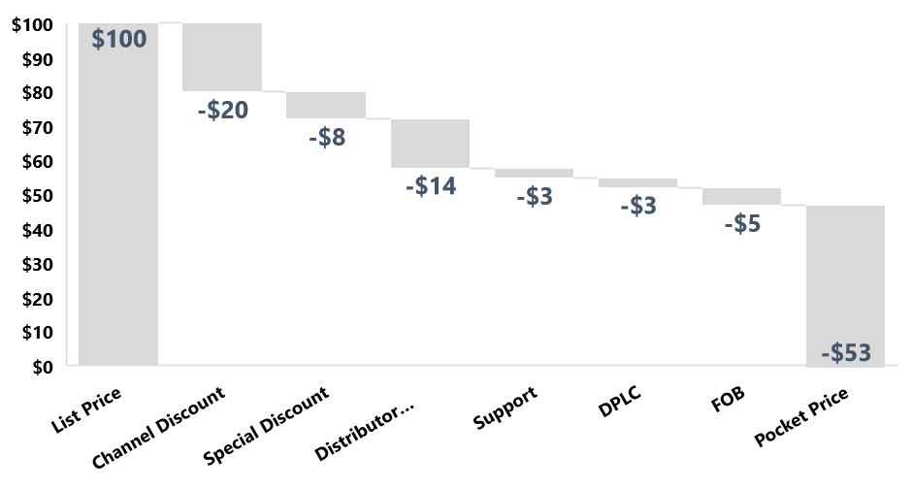
Trade Marketing
Marketing Metrics : Key performance Indicators
Pocket Price
Working
Explanation
The price paid for a product by customers after all discounts has been built in is called pocket price
Net Price per unit
Pocket price
=
List price per unit
Price Premium % =
www.upskilpro.com

Slide 74
Summary |  | Page No
1.0 | Summary
 | Corporate Objectives and Mission Statement
 | Market specifics
 | Category overview
 | Customer overview
 | Channel Overview
 | Key Opportunities identified (B2B & B2C)
 | Priority Categories and Brands
2.0 | Analysis
 | Market sizing / Channel Sizing
 | Key Channels and Customers
 | Competitive analysis
 | Opportunities and threats
3.0 | Resources
 | Human resource plan
 | POS Resources
 | Investments plan
4.0 | Tactics
 | Brands channels and tactics
 | Branding Plans
 | Communication Plans
 | POS Plan
 | High level tactical calendar
5.0 | P&L
 | P&L
 | Marketing ROI and Ratios
6.0 | Conclusions
 | Recommendations and Reviews
Trade Marketing
Trade Marketing
Recommendations
www.upskilpro.com

Slide 75




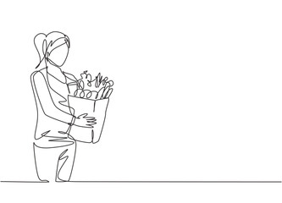
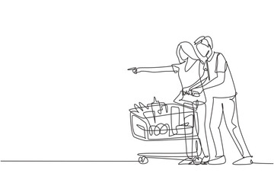
Trade Marketing
15 Recommendations
Remember, brand marketing talks to the customer , and trade marketing talks with the customer
Trade marketing is both an art and a science , choose the right individuals , base it on sound principles and clear objectives.
Build multiple relationships across functions , accounts and suppliers.
Use analytics to build your engagement and plans as the focus engagement becomes clearer
Build on external vendor relationships to deliver superior TM products for your business
No two accounts are the same , their needs are always different , spend time understanding them.
Alignment is key , align the TM function to clear objectives driven by identified businesses with clearly positioned requirements.
Sales & Trade Marketing are clearly different functions , do not mix them but align them instead.
The Skill set for both functions are clearly different , therefore the planning and execution must be based on clear fundamentals and insights.
Sales is a driver function ; your organisation must develop a view as to what the role of TM as a function is.
The Sales cycle may turn around relatively fast whereas the TM planning and execution cycle is based on many areas of engagement , clear planning and execution cycles will go a long way to building confidence and competence
The mindset and the level of engagement of both sales and TM will differ, rightly so, and that is what will keep the differentiation also.
Analysis , Planning and execution are 3 important areas of TM , these are the engagement standards you will want to ensure are constant.
Account relationships are key , encourage your sales and TM teams to engage frequently both in the field and in the customers presence to listen in and understand customers and categories more.
TM engagement with Brand Marketing is crucial , this is the point where the overall brand strategy is conveyed and executed in smaller forms across a larger area of customer and consumer engagement.
www.upskilpro.com

Slide 76
Thank you

Slide 77
Created by
ex-Procter & Gamble, Rothmans, BAT, Gillette, Nokia,
Microsoft & 3M managers.
UpskilPRO tools are designed in easy-to-use solutions, all you need to do is download the tool and get to work immediately . All UpskilPRO material has taken 100’s of hours and many 1000’s of $ to build , all this expertise and content is brought to you for a fraction of the cost to help professionals enhance their capability.
core areas which are best suited to improve using our tools:
        Subject matter expertise
        Best practices
        Analytical output & charting
        Prioritization
        Process
        Training
Making life simpler for
Sales & Marketing professionals.
Tools in one place to get 10X productive now.

Slide 78
Trade Marketing Plans
Trade Marketing Plans
Sales & Marketing Fundamentals.
UpskilPRO e Institute for Sales & Marketing
Tools, Content & Templates
Hand built using experience & insight

