Slide 1
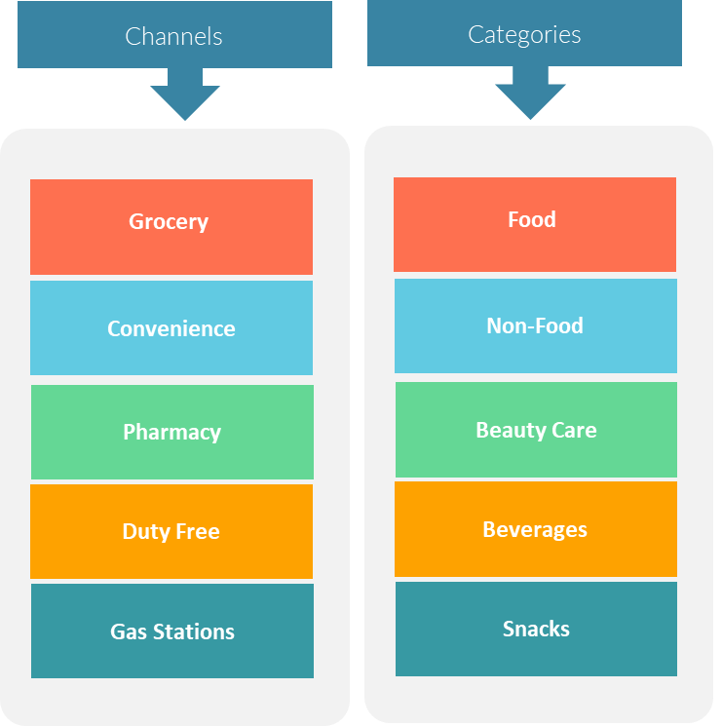
Scorecard-
Aligning Channel & Portfolio
Establish the synergy between channel and portfolio alignment .
UpskilPRO e Institute for Sales & Marketing
Tools, Content & Templates
Hand built using experience & insight

Slide 2
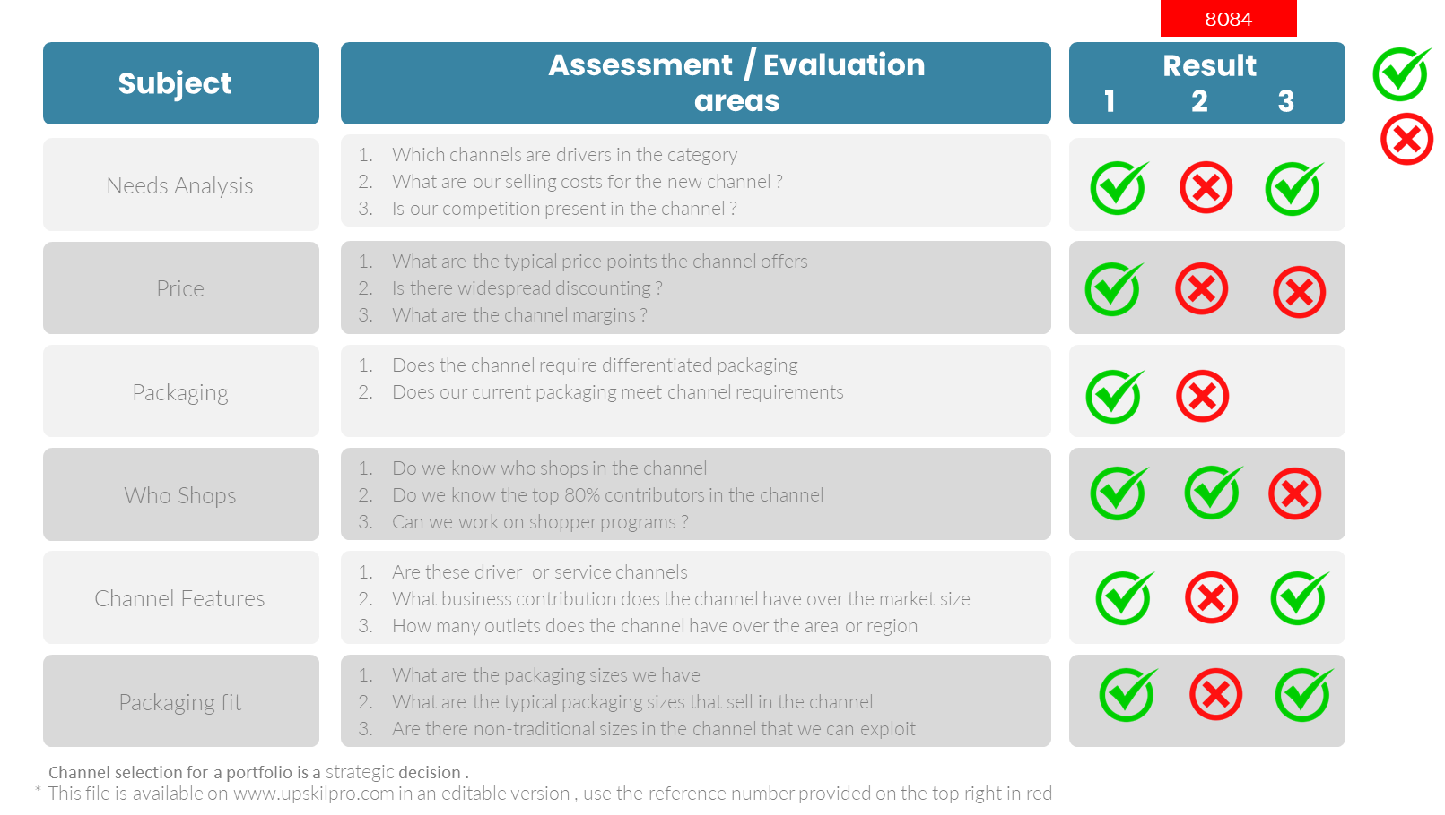
Channel Portfolio
Scorecard – Aligning channel and portfolio
2002.8084

