Slide 1
Marketing Control Mechanism
Align core techniques to monitor and engage with your marketing growth plans
UpskilPRO e Institute for Sales & Marketing
Tools, Content & Templates
Hand built using experience & insight

Slide 2
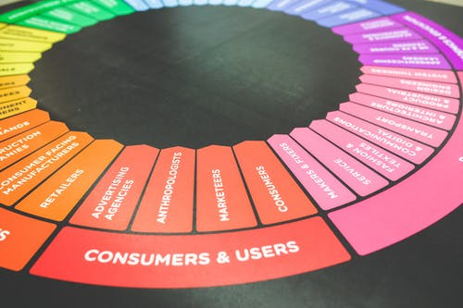
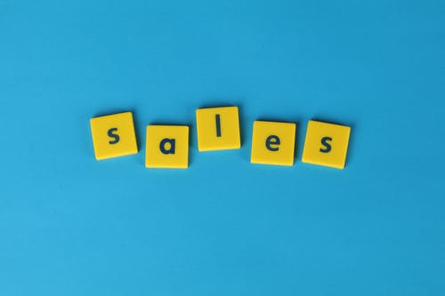
Created by
ex-Procter & Gamble, Rothmans, BAT, Gillette, Nokia,
Microsoft & 3M managers.
UpskilPRO tools are designed in easy-to-use solutions, all you need to do is download the tool and get to work immediately . All UpskilPRO material has taken 100’s of hours and many 1000’s of $ to build , all this expertise and content is brought to you for a fraction of the cost to help professionals enhance their capability.
core areas which are best suited to improve using our tools:
Subject matter expertise
Best practices
Analytical output & charting
Prioritization
Process
Making life simpler for
Sales & Marketing professionals.
Tools in one place to get 10X productive now.

Slide 3
Job Descriptions
Develop roles clearly and completely across varying levels of experience
Agreements
Draft your business agreements across a variety of areas
Templates
Templates are designed based gather information in a structured manner
KPI’s
Performance indicator, a quantifiable measure of performance over time versus a specific objective.
Content Modules
Best practice material in power point for use as a knowledge base in business training , planning and execution .
Strategic tools
These tools are recognised the world over in business schools, consulting firms and companies who plan strategically.
Gain a competitive edge using the best tools and techniques to build a better you .
Analytical Tools
Interactive excel tools on specific business areas based on your data inputs delivered in a workbook model with instructions.
Scorecards
Designed as functional or subject indicators across a variety off situations to enable performance of situational evaluation versus aligned standards.
Calculators
calculate the right ratios for businesses looking for benchmarks in a variety of situations
Assessments
Assessments are designed around specific areas to conduct reviews and will center around a benchmark reviewing individuals or functions
Checklists
Designed around achieving milestones in a sequential manner.
Research
Research tools for sales and marketing engagement

Slide 4
2017
2018
100’s of tools grouped in 12 categories, 50 tool types and 12 business functions in 1 place.
get 10X productive now !
Categories
Functions
Analytical Tools
Types
Business Development
Agreements
Advertising
Customer Acquisition
Margins
Partner Search
Reports
Category Management
Assessments
Agreements
Customer Management
Market Analysis
Persona Development
Retail Measurement
Channel Management
Content Modules
Analytics
Distribution
Market Development
Planning
Reviews
Distribution
Checklists
Barriers
Distributor Management
Market Research
Positioning
Sales Management
Distributor Management
Calculators
Business Reviews
Forecasting
Market Segmentation
Pricing
Scorecards
General Management
Job Descriptions
Business Intelligence
GAP Analysis
Market Size
Prioritization
Segmentation
Key Account Management
KPI’s
Channels
Go To Market
Marketing
Product Development
Six Sigma
Marketing
Research
Communication
Job Descriptions
Marketing Comms
Product Life Cycle
Socio Economic Classification
Marketing Operations
Strategic Tools
Competitive Evaluation
Key Account Plans
Merchandising
Profit & Loss
Territory Design
Sales Management
Scorecards
Competitive Intelligence
Management Summary
New Market Entry
Promotions
Trade Marketing
Shopper Marketing
Templates
Trade Marketing

Slide 5
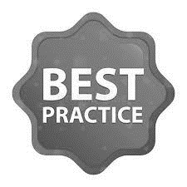
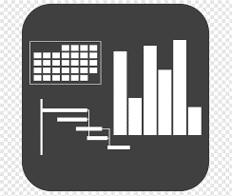
7 Benefits of using UpskilPRO :
Improve your knowledge
with professional Strategic Tools , Templates and planning documents for any business situation!
Use ready made tools
with filled in examples and ready to print & edit at your convenience . Just edit and fill-in the blanks !
Develop YOUR BUSINESS
Learn , & utilize the knowledge and processes and enhance your capabilities as the other companies have
We Created UpskilPRO for the
Sales Professional
Trade Marketer
Marketing Executive
Operations Manager
VP/Director/Manager
100’s of tools , TEMPLATES & documents
CREATED BY
world class sales and marketing
business professionals.
All tools
are based on topics and subject based situations and are simple and easy to use .
SAVE THOUSANDS OF DOLLARS
The average company will save 1000’s of $ per employee in time & effort using our ready tools !
Top Quality Tools & Templates for developing both you and your business.
www.upskilpro.com

Slide 6
Marketing Control Mechanism
Overview
Marketing control mechanisms are tools or techniques that help organizations measure and evaluate the effectiveness of their marketing activities and adjust as needed to ensure that they are meeting their marketing objectives. Some common marketing control mechanisms include:
Sales Analysis: Examining sales data to determine which products are selling well and which are not and making changes to marketing strategies accordingly.
Market Share Analysis: Calculating the organization's market share in the industry or market and comparing it to competitors to determine whether marketing efforts are effective.
Marketing ROI: Evaluating the return on investment for marketing activities by comparing the cost of marketing campaigns to the revenue generated by those campaigns.
Customer Feedback: Gathering feedback from customers through surveys, reviews, or social media to identify areas for improvement and adjust marketing strategies accordingly.
Marketing Budget Monitoring: Tracking marketing expenditures to ensure that they are within budget and that resources are being allocated effectively.
www.upskilpro.com

Slide 7
Marketing Control Mechanism
Overview
Purpose
Approach
The purpose off marketing control mechanisms is to offer objective control. And guidance towards the objective
The sole reason marketing controls exist Is simply to remind their audience of the objectives planned earlier and the necessary steps to be taken to achieve them.
The approach to using the Marketing control mechanism is to insert the controls once the plan is in place or even during the plan development , thereby the objective and the control are truly synchronized and the measures in the control mechanism are objective measurements , which can be traced back to a data source of objectivity like an agency , a computer or a regularly published report
www.upskilpro.com

Slide 8
Marketing Control Mechanism
Purpose & Approach
Type of control | Prime responsibility | Purpose | Approach
Annual control plan | Top Management Middle Management | Review planned results | Sales analysis Market share analysis Sales to expense ratios Financial analysis Market bases score card analysis
Profitability control | Marketing controller | Audit income loss and profitability | Profitability design by Product Territory Customer Segment Channel Order size
Efficiency control | Line and staff management Marketing controller | Evaluate and align spending control versus efficiency and impact | Efficiency pf Sales force Advertising Sales promotion Trade marketing Distribution
Strategic control | Top management Marketing auditor | Evaluate resource application versus best listed opportunities in Markets , products and channels | Marketing effectiveness rating Marketing audit Marketing excellence review Company ethical and social responsibility review
www.upskilpro.com

Slide 9
Marketing Control Mechanism
Align core techniques to monitor and engage with your marketing growth plans
UpskilPRO e Institute for Sales & Marketing
Tools, Content & Templates
Hand built using experience & insight

