Slide 1
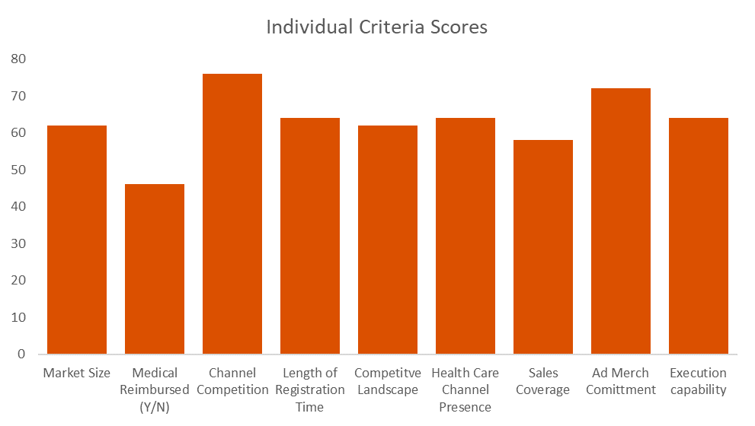
Prioritization Matrix Tool
Prioritize resources and plans based on quantitative inputs
UpskilPRO e Institute for Sales & Marketing
Tools, Content & Templates
Hand built using experience & Insight

