Slide 1

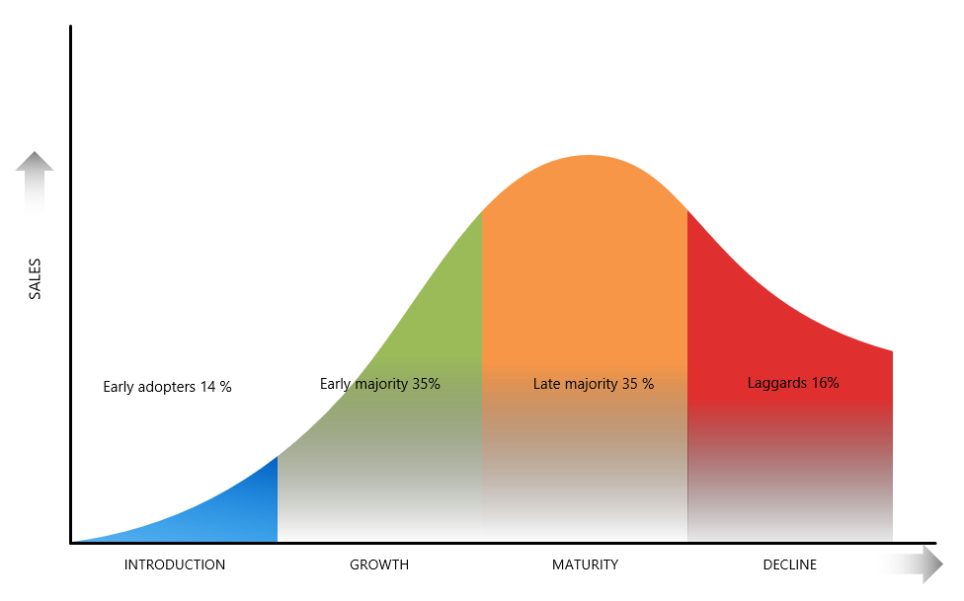
Product Life Cycle
We examine the PLC from various alternatives giving you the opportunity to understand some of the background and impacting factors that influence the PLC in business applications
UpskilPRO e Institute for Sales & Marketing
Tools, Content & Templates
Hand built using experience & Insight

Slide 2
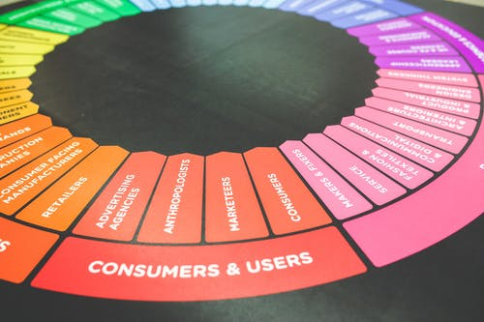

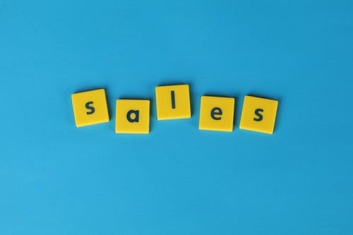
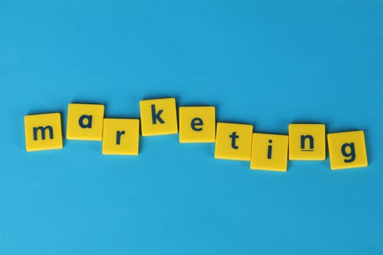
Created by
ex-Procter & Gamble, Rothmans, BAT, Gillette, Nokia,
Microsoft & 3M managers.
UpskilPRO tools are designed in easy-to-use solutions, all you need to do is download the tool and get to work immediately . All UpskilPRO material has taken 100’s of hours and many 1000’s of $ to build , all this expertise and content is brought to you for a fraction of the cost to help professionals enhance their capability.
core areas which are best suited to improve using our tools:
        Subject matter expertise
        Best practices
        Analytical output & charting
        Prioritization
        Process
Making life simpler for
Sales & Marketing professionals.
Tools in one place to get 10X productive now.

Slide 3


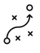

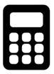
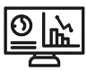
Job Descriptions
Develop roles clearly and completely across varying levels of experience
Agreements
Draft your business agreements across a variety of areas
Templates
Templates are designed based gather information in a structured manner
KPI’s
Performance indicator, a quantifiable measure of performance over time versus a specific objective.
Content Modules
Best practice material in power point for use as a knowledge base in business training , planning and execution .
Strategic tools
These tools are recognised the world over in business schools, consulting firms and companies who plan strategically.
Gain a competitive edge using the best tools and techniques to build a better you .
Analytical Tools
Interactive excel tools on specific business areas based on your data inputs delivered in a workbook model with instructions.
Scorecards
Designed as functional or subject indicators across a variety off situations to enable performance of situational evaluation versus aligned standards.
Calculators
calculate the right ratios for businesses looking for benchmarks in a variety of situations
Assessments
Assessments are designed around specific areas to conduct reviews and will center around a benchmark reviewing individuals or functions
Checklists
Designed around achieving milestones in a sequential manner.
Research
Research tools for sales and marketing engagement

Slide 4
2017
2018
100’s of tools grouped in 12 categories, 50 tool types and 12 business functions in 1 place.
get 10X productive now !
Categories
Functions
Analytical Tools
Types
Business Development
Agreements
Advertising
Customer Acquisition
Margins
Partner Search
Reports
Category Management
Assessments
Agreements
Customer Management
Market Analysis
Persona Development
Retail Measurement
Channel Management
Content Modules
Analytics
Distribution
Market Development
Planning
Reviews
Distribution
Checklists
Barriers
Distributor Management
Market Research
Positioning
Sales Management
Distributor Management
Calculators
Business Reviews
Forecasting
Market Segmentation
Pricing
Scorecards
General Management
Job Descriptions
Business Intelligence
GAP Analysis
Market Size
Prioritization
Segmentation
Key Account Management
KPI’s
Channels
Go To Market
Marketing
Product Development
Six Sigma
Marketing
Research
Communication
Job Descriptions
Marketing Comms
Product Life Cycle
Socio Economic Classification
Marketing Operations
Strategic Tools
Competitive Evaluation
Key Account Plans
Merchandising
Profit & Loss
Territory Design
Sales Management
Scorecards
Competitive Intelligence
Management Summary
New Market Entry
Promotions
Trade Marketing
Shopper Marketing
Templates
Trade Marketing

Slide 5



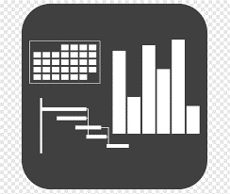




7 Benefits of using UpskilPRO :
Improve your knowledge
with professional Strategic Tools , Templates and planning documents for any business situation!
Use ready made tools
with filled in examples and ready to print & edit at your convenience . Just edit and fill-in the blanks !
Develop YOUR BUSINESS
Learn , & utilize the knowledge and processes and enhance your capabilities as the other companies have
We Created UpskilPRO for the
  Sales Professional
  Trade Marketer
  Marketing Executive
  Operations Manager
  VP/Director/Manager
100’s of tools , TEMPLATES & documents
CREATED BY
world class sales and marketing
business professionals.
All tools
are based on topics and subject based situations and are simple and easy to use .
SAVE THOUSANDS OF DOLLARS
The average company will save 1000’s of $ per employee in time & effort using our ready tools !
Top Quality Tools & Templates for developing both you and your business.
www.upskilpro.com

Slide 6
Product Life Cycle.
Watch the product life cycle, but more importantly watch the market life cycle.
Philip Kotler.

Slide 7
Product Life Cycle
Solutions for business productivity challenges.
New uses of a product can also revitalize an old brand
As the industry approaches maturity, the industry life cycle curve becomes noticeably flatter
When sales reach maturity.
A prime example is Arm & Hammer baking soda. In 1969, sales were dropping due to the introduction of packaged foods with baking soda as an added ingredient and an overall decline in home baking. New uses for the product as a deodorizer for refrigerators and later as a laundry additive, toothpaste additive, and carpet freshener extended the life cycle of the baking soda industry. Promoting new uses for old brands can increase sales by increasing usage frequency. In some cases, this strategy is cheaper than trying to convert new users in a mature market.
Some experts have labelled an additional stage, called expansion, between growth and maturity. While sales are expanding and earnings are growing from these "cash cow" products, the rate has slowed from the growth stage. In fact, the rate of sales expansion is typically equal to the growth rate of the economy.
Some competition from late entrants will be apparent, and these new entrants will try to steal market share from existing products. Thus, the marketing effort must remain strong and must stress the unique features of the product or the firm to continue to differentiate a firm's offerings from industry competitors.
An example is feminine hygiene products. Sales in the United States have reached maturity due to a number of external reasons, like the stable to declining population growth rate and the aging of the baby boomers, who may no longer be consumers for these products. But when makers of these products concentrated on foreign markets, sales grew and the maturity of the product was prolonged. Often so-called "dog" products can find new life in other parts of the world. However, once world saturation is reached, the eventual maturity and decline of the industry or product line will result.

Slide 8
Product Life Cycle
Legitimate criticism
The product life cycle has attracted some legitimate criticism:
The duration of the stages varies widely from industry to industry,
It is often not clear what stage of the life cycle an industry is in.
This problem diminishes the usefulness of the concept as a planning tool.
Industry growth does not always go through the S-shaped pattern at all. Sometimes industries skip maturity, passing straight from growth to decline.
Sometimes industry growth revitalizes after a period of decline, as has occurred in the motorcycle and bicycle industries and recently in the radio broadcasting industry. Some industries seem to skip the slow take-off of the introductory phase altogether.
The PLC is a fact of sales and marketing , and all products go through the life cycle , some shorter and some longer , the key determinants of the length of the cycle depend on many factors in the external environment . Within the market factors such as Industry , technology , market cycles , business cycles and the customers and consumers facing a huge selection of choices forces choices of one brand over the other in a rapidly changing technologically supported world. Understanding your product sales cycle versus the time span from launch helps understand the stage of the PLC currently at.
In summary the PLC is real , it really depends on your data analysis , research findings and sales data ( external & Internal ) along with a financial view to decipher which way the category and your brand is heading , not sure , then we suggest reaching out to a brand and a business you are familiar with and looking deeply into its performance

Slide 9
Product Life Cycle
The 4 Stages
* This file is available on www.upskilpro.com in an editable version , use the reference number provided on the top right in red

Slide 10
Product Life Cycle
The 4 Stages
What Is a Product Life Cycle?
The term product life cycle refers to the length of time a product is introduced to consumers into the market until it's removed from the shelves.
The 4 Stages of the PLC
introduction,
growth,
maturity, and
decline.
This concept is when it is appropriate to increase advertising, reduce prices, expand to new markets, or redesign packaging. The process of strategizing ways to continuously support and maintain a product is called PLC Management.
PRODUCT
EXTENSION
SALES
Early adopters 14 %
Early majority 35%
Late majority 35 %
Laggards 16%
INTRODUCTION
GROWTH
MATURITY
DECLINE
TIME

Slide 11
Product Life Cycle
The 4 Stages
PLC Key steps
PRODUCT LIFE CYCLE
Use standardized principles of accounting to estimate revenue and profits .i.e. GAAP principles
Use a comparison of both Volume and Value
Select the portfolio
Apply the 4 classifications to the portfolio
Simulate data to align with the 4 stages
Align with actions & recommendations for each relative stage
Representative in this sample simulation of Sales revenues , you may decide to follow the Generally accepted principle of Gross sales or Net Sales .
What's key is to assign all product portfolios into the 4 PLC quadrants before undertaking the charting exercise
01
02
Profitability is generally referred to as net Profitability or Contribution income .

Slide 12

Product Life Cycle
The Product Development Stage.
Introduction
Growth
Maturity
Decline
Sales
Review
Idea Phase
Launch
Forecasting
Idea Screening
Test Marketing
Communication
Financial Analysis
Product Mock-up
Concept Development
Product Development Organisation
Time
Product Development
Market Development

Slide 13
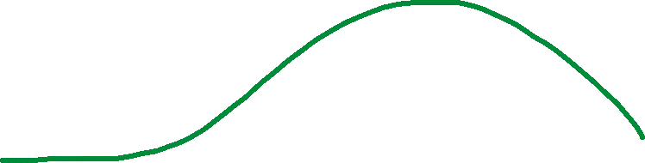

Product Life Cycle
The 4 Stages
The Introduction stage immediately post manufacturing approvals is the state where all the work of the preceding period come to bear on the
Forecasting
Communication
Launch
Reviews
Pricing stabilizes , profitability improves , and the business had turned a corner with good market share, revenues , and income
Sales
Profits
Product Development
Introduction
Growth
Maturity
Decline
The product development stage takes up a major part of the resources
Material
Manpower
Time
Manufacturing alignment
Sales
Profits
Investments
Losses
Once the phase has emerged into the growth phase its now a multitude of factors , from distribution , advertising , channel management and competitive influences that will help drive the sales higher and improve profitability also in turn
When recognized that the decline phase has set in , the possibilities are many , from repositioning the brand , finding new markets , or adapting to new uses to extend the product life .

Slide 14
Pricing Environment
Product Life Cycle Influences in pricing
Depending on the industry and the product life cycle stage most of the price management settles into a tactical set of engagements while holding price.
The pricing adjustments tactically come into engagement and help align the marketing mix with improved productivity
Very industry has different life cycles, at this stage the emphasis lies additionally on the marketing mix to drive pricing strategy alignment with tactical leverage.
Pricing & margins are under pressure mostly at launch phase, a strategy alignment along with the operating plan will prepare a sound base.
The Maturity phase is when companies start preparing on 2 strategies , revalidate pricing and review tactical adjustments.
Its important to know when the decline phase starts as it requires intensive management of existing stock and management of stakeholders to ensure the exit strategy is seamless with a back up plan in place .
PRODUCT
EXTENSION
SALES
The growth phase presents sales velocity , with emphasis on getting the marketing mix elements right .
Companies usually continue to drive a premium pricing strategy
New Product introductions bring something new to the consumer , if it addresses an existing or perceived gap , a skim price model is applicable for the early part of the PLC . This largely depends on the industry
Pricing Model
Sales velocity increases and so do market complexities on pricing & PLC management
INTRODUCTION
GROWTH
MATURITY
DECLINE

Slide 15
Product Life Cycle
Product Life Cycle Influences in pricing
Stage # 5
Growing maturity
When life cycles were longer, firms could enter a market, fail, redevelop products, then renter with a reasonable chance of success. Today, re-entry windows are closing.
ii. Shortening product life cycles reduce the time — in early growth — to earn highest unit profit margins.
iii. Good strategic thinking early in the life cycle is more important than ever.
iv. Faster cycles require proactive management of strategy over the life cycle; evolutionary approaches may be too slow.
Stage # 6
Maturity
Stage # 7
Maturity – Concentrated
Stage # 8
Maturity – Fragmented
Stage # 4
Late Growth
Stage # 9
Decline
PRODUCT
EXTENSION
Stage # 2
Early growth leaders
Stage # 3
Early growth followers
.
Stage # 1
Pioneers
SALES
INTRODUCTION
EARLY
GROWTH
LATE
GROWTH
MATURITY
DECLINE
TIME

Slide 16
Pricing Environment
Product Life Cycle Influences in pricing
Stage # 5
Growing maturity
The Maturity phase is when companies start preparing on 2 strategies , revalidate portfolio , , pricing and review tactical adjustments
Stage # 6
Maturity
Late growth stage is when the product or service portfolio is gaining traction and sales are on an upswing with sales in some cases outstripping forecast
Stage # 7
Maturity – Concentrated
Early growth phase happens when the channels , partners and products are operating in a trial phase with followers delivering trust and buying product with initial emphasis on the marketing mix delivery
Stage # 8
Maturity – Fragmented
Stage # 4
Late Growth
Stage # 9
Decline
Its important to know when the decline phase starts as it requires intensive management of existing stock and management of stakeholders to ensure the exit strategy is seamless with a back up plan in place .
PRODUCT
EXTENSION
Stage # 2
Early growth leaders
Stage # 3
Early growth followers
No Man’s land , some enterprising consumers have looked up the product and decided to take a risk and buy the product even though the rest of the market is still way behind , these consumers are usually well informed and tech savvy consumers in today's environment
.
Stage # 1
Pioneers
SALES
INTRODUCTION
EARLY
GROWTH
LATE
GROWTH
MATURITY
DECLINE
TIME

Slide 17
Product Life Cycle
Topic – 5x4 Behavior
PRODUCT
EXTENSION
SALES
INTRODUCTION
GROWTH
MATURITY
DECLINE

Slide 18
Product Life Cycle
Relationship – PLC & Product Portfolio
High
Market share
Low
Star
Problem Child
Growth Stage
High
Introduction
Maturity Stage
Growth rate
Cash Cow
Dog
Decline Stage
Low

Slide 19
Product Life Cycle
Product life cycle matrix
1. Problem Child
Products which demand high investment for little short-term returns in revenue
Initially funded by income from Cash Cows
Either become the next generation of Stars (eventually Cash Cows), or are abandoned
2. Star
Best Profit and Potential.
May require investment to become established as market
leaders
New variants with high value-added features to increase
market share
4. Dog
Obsolete products that don’t warrant any further investment or development
Market share has eroded by competition, new developments, or customer needs
At the final stage of the Product Lifecycle
3. Cash Cow
Established products which produce cash with minimal investment in time and/or money
Cosmetic changes are used to maintain market share against competitors
Goal is to extend period of cash generation for as long as possible
High
Market Growth
Low
Market Share
Low
High

Slide 20
Product Life Cycle
Product / Market expansion matrix
Existing Products
New Products
Market Penetration
Reduce price to attract new customers
Improve promotion and/or distribution
Acquire competitor to gain market share
Product Development
Investment in research & development
Acquire competitor to merge products
Launch new products and services
Existing Markets
Market Development
Strategic partnerships for channel sales
Expand into new market segment
Expand into new customer segment
Diversification
Related: synergies with existing products
Unrelated: no synergies exist
Highest risk strategy
New Markets

Slide 21
Product Life Cycle
Sales & Marketing Characteristics
* This file is available on www.upskilpro.com in an editable version , use the reference number provided on the top right in red

Slide 22
Product Life Cycle
Marketing Implications on the PLC.
* This file is available on www.upskilpro.com in an editable version , use the reference number provided on the top right in red

Slide 23
Product Life Cycle
Objectives & Strategies – PLC.
* This file is available on www.upskilpro.com in an editable version , use the reference number provided on the top right in red

Slide 24
Product Life Cycle
Competitive Advantage Sources
* This file is available on www.upskilpro.com in an editable version , use the reference number provided on the top right in red

Slide 25


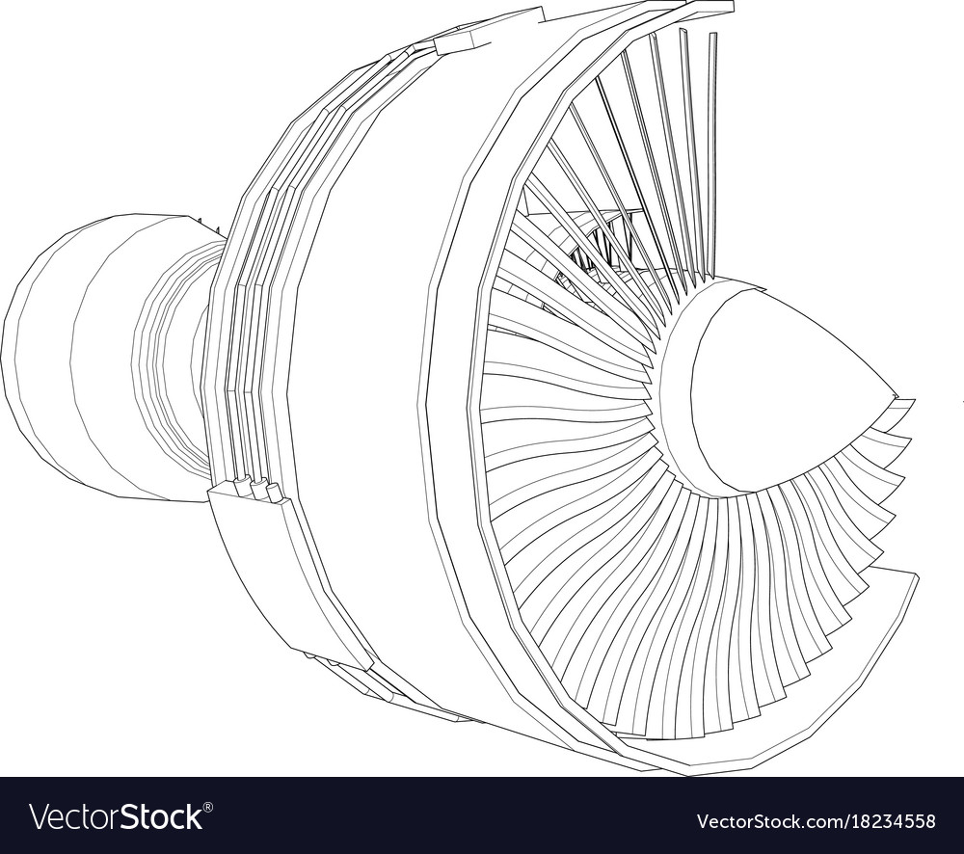

Product Life Cycle
Planning for Possibilities
Scenario 1- Introduction Stage – Pioneers:
Most products do not generate profits in introduc­tion.
Pioneering firms typically incur significant R&D, market-launch expenses; they must also invest in plant, equipment, systems/processes, before launch.
Marketing expenses are high; revenues may not cover operating costs, much less fixed costs.
Pioneer
Existing & Thriving
Funding
Early stage launch
Low Margin
Margins from strong SBU support new launches and struggling ventures
Angel Investors & Venture Capitalists lend credence and credit
Scenario # 1
Cash Flow Negative(-)
Margin
Cash Flow Positive (+)

Slide 26
Product Life Cycle
Barriers to entry
Government-Imposed
Product-Specific
Firm-Driven
Barriers:
Scenario # 1
Patents are the most common government-imposed barrier.
Patents provide owners with legal monopo­lies for several years.
Firms can petition the courts to enforce these patent monopolies via patent infringe­ment lawsuits
New Licences difficult for new entrants
Access to capital
Access to raw materials
Product innovation reduces barriers
Low-Cost Barriers via Penetration Pricing
First-Mover Advantage

Slide 27
Product Life Cycle
Leaders & Followers
Early growth leaders
Early growth followers
Continue to Be Leader — Maintain Position
Continue to Be Leader – Enhance Position:
Seek market leadership
Copy the leader
Copy & Overtake
Scenario # 2 & # 3
Continue to Be Leader – Conclusion
Settle for 2nd place
Retreat to a Market Segment
Exit the Market
Focus on a market segment
Exit the Market
FINANCIAL PLANNING

Slide 28
Product Life Cycle
Late Growth
Key areas to focus on to grow
the firm receives minimal value from early market leader- ship/followership.
The customer benefits/values that drove purchases in introduction/early growth are still important, but they may not enter customer choice decisions :
Qualify Value versus Benefits
Scenario # 4
Late Growth
Market Segmentation to focus on key
prioritized segment
Narrow market segments , offer higher margins and excellent defender capabilities
FINANCIAL PLANNING

Slide 29
Product Life Cycle
Leaders & Followers
I Behavioural Barriers:
This requires significant change by customers. Techies were early users of PCs — difficult-to-use operating systems — CP/M, MS-DOS. The mass market developed when Apple/ others offered easy-to-use systems
II Economic Barriers:
These are often linked to technology. Example- When Roundup herbicide lost patent pro­tection in the Philippines, Monsanto cut prices to compete with cheaper generics. Monsanto discov­ered it had vastly underestimated price elasticity; sales grew dramatically as many farmers could now afford Roundup
I
Maturity
Scenario # 5
II
III Government-Imposed Barriers:
This inhibit competition/ innovation. When governments remove regulations, competitors often enter, growth explodes.
III
IV Technological Barriers:
These may be circumvented by innovation.
Generally, if any of these barriers are in place, the market is not really mature; the key strategic objec­tive should be growth. The most serious barrier may be lack of creativity. Creatively generating/analysing opportunities and approaching seemingly mature markets can spur growth in several ways
IV
V
V Improve the Product/Service:
Firms should expect sales to slow if products/services do not satisfy customer needs
adding services may be an attractive option.
Improve Physical Distribution
Reposition the Brand:
Enter New Markets:

Slide 30
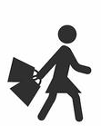


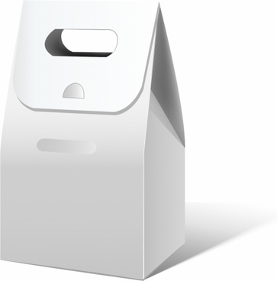
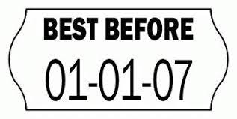
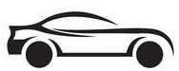
Product Life Cycle
Increase product use
Ease of use
Increase
consumption
Improve
packaging
Scenario # 5
New uses
New Segments
Model Change
Product expiry
Constant changes to the model or version result in uptake .
However this can only be successful when you have the market share and the volume to drive financial control .
Product expiry is a great way to limit consumption of the product before a certain date and encourage replenishment .
Best before is the terminology used in case using expiry dates is not warranted by law.
Companies usually broaden the target segment to include new users into the fray .
New Segments
New uses
New Applications
Packaging plays a big part in product consumption , most manufacturers also include usage instructions to drive consumption .
Improved packaging is one compelling reason consumers buy a product.
Consumption increase .
There are a few ways to increase consumption
Package size
Instruction
Sensory load
Advertising
Sampling
Promotions
Trade in
Coupons
Referrals
Exchange.
Ease of use
If consumers find a product effective to use and easier to use chances are they will not only buy the product but recommend it also
Contact lenses
Vacuum cleaner bags
Batteries

Slide 31
Product Life Cycle
Concentrated Market leaders ( Phase 6 )
Maintain Leadership
Harvest
Pressures:
i. Few opportunities.
ii. Internally focused funding criteria.
iii. Political power champions.
The trick is finding the right investment level to sustain profits in the medium/long run.
Causes of Underinvestment:
i. Fear of cannibalization.
ii. Inertia.
iii. Limited view of competition.
The firm is market leader, but a harvest strategy may be more important than maintaining sales/market share.
Scenario # 6
Reasons:
i. Change in corporate strategy.
ii. Desire to avoid specific competitors.
iii. Government regulations impose restrictions.
iv. Investment requirements become too high.
v. New technology makes firm products obsolete.
Once the firm decides to harvest, the critical question- Fast or slow?
For slow harvesting, the firm should focus on three issues:
i. Cut costs — simplifying product line, reduce support.
ii. Minimize further investment.
iii. Raise prices.

Slide 32
Product Life Cycle
Maturity
Holding market share roughly constant over the long run can be viable. The firm requires a profitable position/strengths in one or more segments.
Find a buyer for which the product is a good fit; the firm secures cash quickly.
Options for segmentation typically appear in early growth, then become numerous in late growth/maturity. Creative segmen­tation is the dominant option for countering market- leader advantages. Another segment option- Offering only essential benefits/values — getting back to basics
Market Segmentation
Continue Moving
Exit
Creative Segmentation
Maintain position
Divest
Scenario # 7
Regrouping
Rationalize position
Liquidate
Offensive
A follower acquires several unprofitable/marginally profitable low-market-share products, then executes a roll-up into a single offer. By rationalizing oper­ations, distribution, marketing, the follower may become a strong competitor.
If the leader has been lazy, under- invested, set prices too high, served customers poorly, then direct attack may be the follower s best option. Good market insight helps identify leader weak spots; the follower can invest to exploit them.
If profits are marginal/negative, rationalizing operations may be the way to go. The firm should examine all aspects of operations, distri­bution, sales with a fine-tooth comb, then make tough cost-cutting decisions.
If no buyers appear, close down, sell assets
FINANCIAL PLANNING

Slide 33
Product Life Cycle
Fragmented markets
Key areas to focus on to grow
Fragmented markets have many players, but no firm is dominant.
leader/follower distinctions have little relevance. An important objective is increasing market share.
Acquisition:
Acquisition is similar to grouping — can be very successful when geography drives fragmentation.
Scenario # 8
Fragmented markets
Standardization, Branding:
Many players typically offer a wide range of products/ services. Standardization is a way to reduce varia­tion/improve consistency across suppliers; branding assures customers that each provider supplies the same value. Franchising a brand is a related option.
FINANCIAL PLANNING

Slide 34
Product Life Cycle
Decline
Recognition is usually preceded by clear signs such as competition activities , slowing sales , eroding market share and the market feedback .
This situation is usually faced by companies who have rapidly been overtaken by technology or circumstances beyond their conscious control or lastly inattentiveness to marketing fundamentals
Decline stage
Market engagement
Business strengths
Holding market share roughly constant over the long run can be viable. The firm requires a profitable position/strengths in one or more segments.
Rapid decline
Commodity based market
No price insensitive segments
Recognize decline
Market aggressively
Scenario # 9
Competitor characteristics
Switching
Negotiating
Review production capacity
Holding market share roughly constant over the long run can be viable. The firm requires a profitable position/strengths in one or more segments.
Usually signs of decline are supported by competitive activity and hard negotiation in market
Low switching costs
Bankruptcy laws
Review capacity utilization for competition
Product is part of a vertically integrated system
Govt subsidy for some forms to remain
Leverage brand with adjacent extensions

Slide 35
Product Life Cycle
Mapping the portfolio

Slide 36
Product Life Cycle
The 4 Stages ( Simulated Calculator )
* This file is available on www.upskilpro.com in an editable version , use the reference number provided on the top right in red

Slide 37
Product Life Cycle

Slide 38
Thank you !

Slide 39
Job Descriptions
Develop roles clearly and completely across varying levels of experience
Agreements
Draft your business agreements across a variety of areas
Templates
Templates are designed based gather information in a structured manner
KPI’s
Performance indicator, a quantifiable measure of performance over time versus a specific objective.
Content Modules
Best practice material in power point for use as a knowledge base in business training , planning and execution .
Strategic tools
These tools are recognised the world over in business schools, consulting firms and companies who plan strategically.
Gain a competitive edge using the best tools and techniques to build a better you .
Analytical Tools
Interactive excel tools on specific business areas based on your data inputs delivered in a workbook model with instructions.
Scorecards
Designed as functional or subject indicators across a variety off situations to enable performance of situational evaluation versus aligned standards.
Calculators
calculate the right ratios for businesses looking for benchmarks in a variety of situations
Assessments
Assessments are designed around specific areas to conduct reviews and will center around a benchmark reviewing individuals or functions
Checklists
Designed around achieving milestones in a sequential manner.
Research
Research tools for sales and marketing engagement

Slide 40
Product Life Cycle
We examine the PLC from various alternatives giving you the opportunity to understand some of the background and impacting factors that influence the PLC in business applications
UpskilPRO e Institute for Sales & Marketing
Tools, Content & Templates
Hand built using experience & Insight

