Slide 1
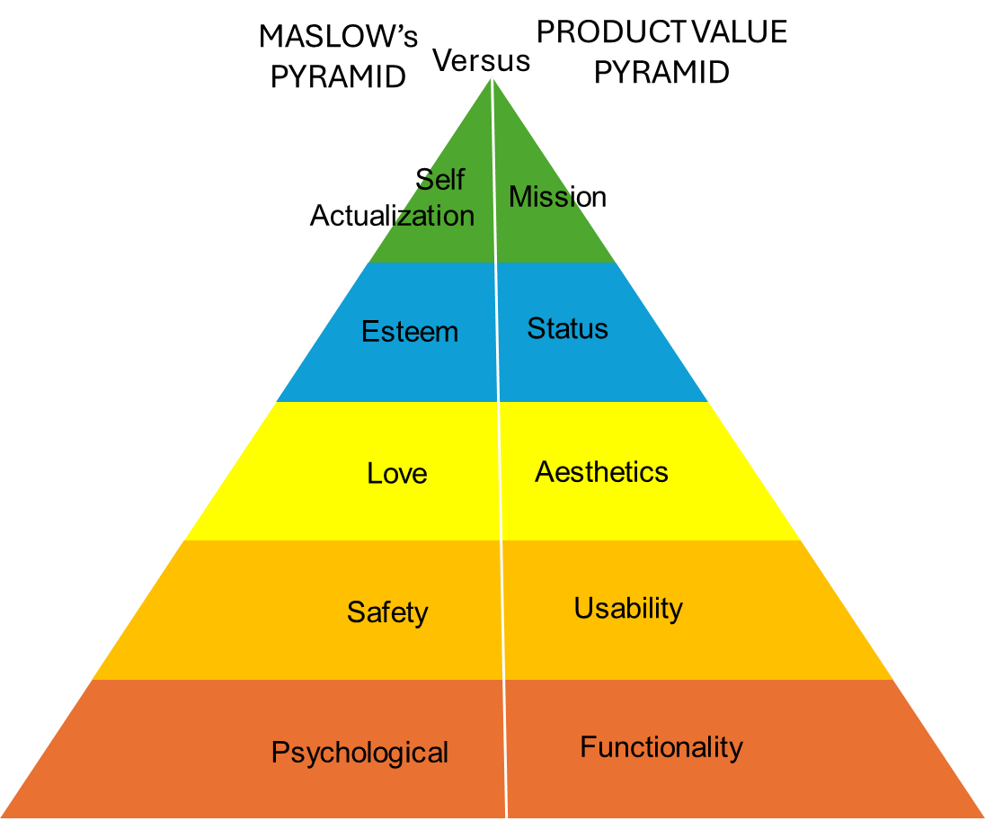
Comphrensive Sales Training .
Identifying Customer Needs
Handling objections is both an art and a science.
Techniques for identifying needs.
Module 5
UpskilPRO e Institute for Sales & Marketing
Tools, Content & Templates
Hand built using experience & insight

Slide 2
Job Descriptions
Develop roles clearly and completely across varying levels of experience
Agreements
Draft your business agreements across a variety of areas
Templates
Templates are designed based gather information in a structured manner
KPI’s
Performance indicator, a quantifiable measure of performance over time versus a specific objective.
Content Modules
Best practice material in power point for use as a knowledge base in business training , planning and execution .
Strategic tools
These tools are recognised the world over in business schools, consulting firms and companies who plan strategically.
Gain a competitive edge using the best tools and techniques to build a better you .
Analytical Tools
Interactive excel tools on specific business areas based on your data inputs delivered in a workbook model with instructions.
Scorecards
Designed as functional or subject indicators across a variety off situations to enable performance of situational evaluation versus aligned standards.
Calculators
calculate the right ratios for businesses looking for benchmarks in a variety of situations
Assessments
Assessments are designed around specific areas to conduct reviews and will center around a benchmark reviewing individuals or functions
Checklists
Designed around achieving milestones in a sequential manner.
Research
Research tools for sales and marketing engagement

Slide 3
Identifying Customer Needs
Module 5
Techniques for understanding needs
www.upskilpro.com

Slide 4
Module 5 - Summary .
Identifying customer needs is a crucial aspect of the sales and marketing process. It requires a deep understanding of customer behaviour, preferences, and pain points.
Two fundamental techniques for identifying these needs are asking open-ended questions and active listening.

Slide 5
Module 5 - Identifying Customer needs.
Learning Objective: Understanding and Identifying customer needs is a crucial aspect of the sales and marketing process, in this module you will be able to understand the bigger process.
Understanding Customer Needs
Techniques for Identifying Needs
Analysing Customer Feedback
Aligning Solutions to Customer
Monitoring and Adapting to Changing Needs
Identifying Customer Needs
Articulating Customer Needs
Benefits of Needs-Based Selling
Impact on Customer Satisfaction and Loyalty
Asking open-ended questions
Active listening
Integration of techniques
Needs assessment tools.
Using feedback to understand needs.
Implementing changes based on feedback.
Customizing products and services
Presenting tailored solutions
Staying updated on industry trends
Continually assessing and adapting to customer needs
www.upskilpro.com

Slide 6
Asking open ended questions
www.upskilpro.com

Slide 7
Module 5 - techniques for identifying needs.
Asking open ended questions.
Open-Ended Question Formula
Creating effective open-ended questions involves a few key components to ensure that they prompt detailed, thoughtful responses. Here's a formula to guide you in crafting open-ended questions:
Formula: "How/What/Why + Context + Desired Insight“
How/What/Why: Start the question with "How," "What," or "Why" to encourage expansive answers.
Context: Provide context or a specific scenario related to the question.
Desired Insight: Specify the type of information or insight you are seeking.
www.upskilpro.com

Slide 8
Module 5 - techniques for identifying needs.
Asking open ended questions.
Market Research:
"Why do you prefer our product over competitors, and what specific benefits stand out to you?"
How/What/Why: Why
Context: Preference for our product over competitors
Desired Insight: Specific benefits that stand out
Employee Engagement:
"How has the recent training program influenced your approach to your work?"
How/What/Why: How
Context: Recent training program
Desired Insight: Influence on approach to work
Customer Satisfaction:
"What challenges have you faced with our service, and how can we improve to better meet your needs?"
How/What/Why: What
Context: Challenges faced with our service
Desired Insight: How to improve to meet needs better
Customer Feedback:
"What do you think about our new product features, and how do they impact your daily tasks?"
How/What/Why: What
Context: Our new product features
Desired Insight: Impact on daily tasks
www.upskilpro.com

Slide 9
Module 5 - techniques for identifying needs.
Asking open ended questions.
Designing Open-Ended Questions
Crafting Thoughtful Questions: Develop questions that encourage detailed responses, such as "Can you describe the challenges you face with your current solution?" or "What improvements would make our product more useful to you?"
Avoiding Leading Questions: Ensure questions are neutral and do not lead the customer towards a particular answer.
Following Up on Responses
Probing for More Information: Ask follow-up questions to dig deeper into the customer's initial responses. For example, "Can you tell me more about why that particular feature is important to you?"
Clarifying Ambiguities: If the customer's response is unclear, ask for clarification to ensure you fully understand their needs.
Implementing the Questions
Creating a Comfortable Environment: Build rapport with the customer to make them feel comfortable sharing their thoughts.
Using a Conversational Approach: Integrate open-ended questions naturally into the conversation rather than making it feel like an interrogation.
Preparing for the Interaction
Understanding the Customer Background: Research the customer's industry, company, and role to tailor questions that are relevant and insightful.
Setting Objectives: Clearly define what you aim to achieve from the interaction, such as understanding specific pain points or uncovering unmet needs.
www.upskilpro.com

Slide 10
Active listening

Slide 11
Module 5 - Identifying Customer Needs.
Active Listening.
: Reflecting and Paraphrasing
Restating the Customer’s Words: Repeat back what the customer has said in your own words to show you understand. For instance, "So what I'm hearing is that the current system is too slow, and this affects your productivity, right?"
Summarizing Key Points: Periodically summarize the key points of what the customer has shared to ensure mutual understanding.
Asking Clarifying Questions
Seeking Further Explanation: Ask questions that help clarify any vague or ambiguous statements. For example, "When you say the system is 'too slow,' can you describe what specific tasks are affected?"
Exploring Emotions and Motivations: Inquire about the emotional impact and underlying motivations behind the customer’s statements. For example, "How does this issue impact your day-to-day operations and your team's morale?"
Preparing to Listen
Minimizing Distractions: Ensure you are in an environment where you can focus entirely on the customer, free from interruptions.
Setting an Intentional Mindset: Approach the conversation with the intent to understand, not just to respond.
Demonstrating Active Listening
Maintaining Eye Contact: Show that you are engaged by maintaining appropriate eye contact.
Using Affirmative Nods and Gestures: Nod and use other body language cues to indicate that you are listening and understanding.
www.upskilpro.com
www.upskilpro.com

Slide 12
Integration of techniques

Slide 13
Module 5 - Identifying Customer Needs.
Integration of techniques.
Analyzing and Acting on Information
Identifying Patterns and Themes: Review the collected information to identify common themes and patterns in customer needs.
Developing Actionable Insights: Translate the identified needs into actionable insights that can inform product development, marketing strategies, and sales approaches.
Combining Open-Ended Questions and Active Listening
Sequential Use in Conversations: Use open-ended questions to initiate discussions and follow up with active listening techniques to fully understand the responses.
Creating a Dialogue Loop: Foster a continuous loop of asking, listening, reflecting, and probing to dig deeper into the customer's needs.
Documenting Insights
Recording Conversations: With the customer's permission, record conversations to ensure no details are missed.
Taking Detailed Notes: Write down key insights, including specific phrases and expressions used by the customer, which can be valuable for later analysis.
www.upskilpro.com

Slide 14
Needs assessment tools

Slide 15
Module 5 - Identifying Customer Needs.
Needs assessment tools.
Tools for understanding feedback and customer needs include:
Surveys and Questionnaires: Google Forms, SurveyMonkey, Type form.
Customer Feedback Platforms: Medallia, Qualtrics, Zendesk.
Social Media Monitoring: Hootsuite, Sprout Social, Brand watch.
Analytics Tools: Google Analytics, Mix panel, Hotjar.
Customer Relationship Management (CRM): Salesforce, HubSpot, Zoho CRM.
Voice of Customer (VoC) Programs: Clarabridge, In Moment.
Net Promoter Score (NPS) Tools: Delighted, Promoter.io.
Sentiment Analysis: Monkey Learn, Lexalytics, Aylien.

Slide 16
Module 5 - Identifying Customer Needs.
Needs assessment tools.
1
2
3
4
Surveys and Questionnaires:
Google Forms, SurveyMonkey, and Type form allow you to create and distribute surveys to collect customer feedback.
Customer Feedback Platforms:
Medallia, Qualtrics, and Zendesk gather and analyze customer feedback to improve satisfaction and experiences.
Social Media Monitoring:
Hootsuite, Sprout Social, and Brand watch track and analyze customer mentions and sentiments on social media platforms.
Analytics Tools:
Google Analytics, Mix panel, and Hotjar provide insights into customer behavior and interactions on your website.
5
6
7
8
Customer Relationship Management (CRM):
Salesforce, HubSpot, and Zoho CRM manage customer data and interactions to enhance relationships and retention..
Voice of Customer (VoC) Programs:
Clarabridge and In Moment collect and analyze customer feedback from multiple channels to understand their needs and preferences.
Net Promoter Score (NPS) Tools:
Delighted and Promoter.io measure customer loyalty and satisfaction through NPS surveys.
Sentiment Analysis:
Monkey Learn, Lexalytics, and Aylien analyze text data to determine customer sentiments and emotions.

Slide 17
Module 5 - Identifying Customer Needs.
Needs assessment tools.
Last but not the least…..
9
Human ear
Using the human ear and brain is an effective form of understanding customer feedback because it allows for nuanced interpretation and empathy that automated systems may miss..
10
10
The brain
Ultimately, the human ear and brain integrate cognitive and emotional intelligence, leading to richer insights and more effective solutions.
The eye
Using the human eye in understanding customer feedback allows for observation of non-verbal cues such as body language and facial expressions, which convey emotions and attitudes.
Moreover, humans can adapt their responses in real-time, ask follow-up questions for clarification, and provide immediate support and resolution.

Slide 18
Conclusion

Slide 19
Module 5 - Identifying Customer Needs.
Conclusion.
Conclusion
Effectively identifying customer needs requires a combination of asking open-ended questions and active listening. These techniques, when used together, enable sales and marketing professionals to gain a deeper understanding of their customers. By preparing thoroughly, crafting thoughtful questions, and actively listening, professionals can uncover valuable insights that drive customer satisfaction and loyalty.
Documenting and analysing these insights further ensures that the identified needs are effectively addressed, leading to better customer relationships and business success.

Slide 20
Comphrensive Sales Training .
Identifying Customer Needs
Handling objections is both an art and a science.
Techniques for identifying needs.
Module 5
UpskilPRO e Institute for Sales & Marketing
Tools, Content & Templates
Hand built using experience & insight

