Slide 1

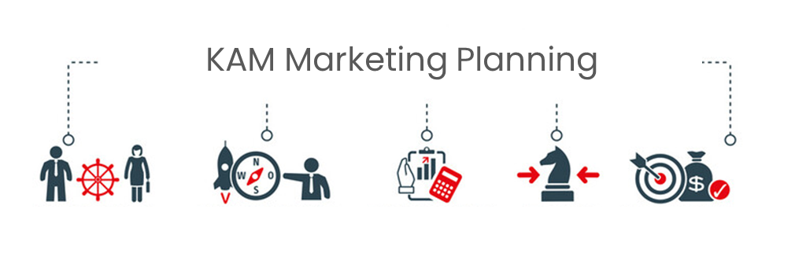
Key Account Management.
Module 8 – Marketing Planning for
Key Account Engagement .
Sales & Marketing Fundamentals.
UpskilPRO e Institute for Sales & Marketing
Tools, Content & Templates
Hand built using experience & insight

Slide 2
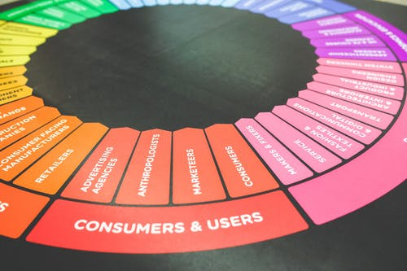



Created by
ex-Procter & Gamble, Rothmans, BAT, Gillette, Nokia,
Microsoft & 3M managers.
UpskilPRO tools are designed in easy-to-use solutions, all you need to do is download the tool and get to work immediately . All UpskilPRO material has taken 100’s of hours and many 1000’s of $ to build , all this expertise and content is brought to you for a fraction of the cost to help professionals enhance their capability.
core areas which are best suited to improve using our tools:
        Subject matter expertise
        Best practices
        Analytical output & charting
        Prioritization
        Process
        Training
Making life simpler for
Sales & Marketing professionals.
Tools in one place to get 10X productive now.

Slide 3


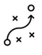

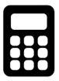
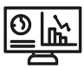
Job Descriptions
Develop roles clearly and completely across varying levels of experience
Agreements
Draft your business agreements across a variety of areas
Templates
Templates are designed based gather information in a structured manner
KPI’s
Performance indicator, a quantifiable measure of performance over time versus a specific objective.
Content Modules
Best practice material in power point for use as a knowledge base in business training , planning and execution .
Strategic tools
These tools are recognised the world over in business schools, consulting firms and companies who plan strategically.
Gain a competitive edge using the best tools and techniques to build a better you .
Analytical Tools
Interactive excel tools on specific business areas based on your data inputs delivered in a workbook model with instructions.
Scorecards
Designed as functional or subject indicators across a variety off situations to enable performance of situational evaluation versus aligned standards.
Calculators
calculate the right ratios for businesses looking for benchmarks in a variety of situations
Assessments
Assessments are designed around specific areas to conduct reviews and will center around a benchmark reviewing individuals or functions
Checklists
Designed around achieving milestones in a sequential manner.
Research
Research tools for sales and marketing engagement

Slide 4
2017
2018
100’s of tools grouped in 12 categories, 50 tool types and 12 business functions in 1 place.
get 10X productive now !
Categories
Functions
Analytical Tools
Types
Business Development
Agreements
Advertising
Customer Acquisition
Margins
Partner Search
Reports
Category Management
Assessments
Agreements
Customer Management
Market Analysis
Persona Development
Retail Measurement
Channel Management
Content Modules
Analytics
Distribution
Market Development
Planning
Reviews
Distribution
Checklists
Barriers
Distributor Management
Market Research
Positioning
Sales Management
Distributor Management
Calculators
Business Reviews
Forecasting
Market Segmentation
Pricing
Scorecards
General Management
Job Descriptions
Business Intelligence
GAP Analysis
Market Size
Prioritization
Segmentation
Key Account Management
KPI’s
Channels
Go To Market
Marketing
Product Development
Six Sigma
Marketing
Research
Communication
Job Descriptions
Marketing Comms
Product Life Cycle
Socio Economic Classification
Marketing Operations
Strategic Tools
Competitive Evaluation
Key Account Plans
Merchandising
Profit & Loss
Territory Design
Sales Management
Scorecards
Competitive Intelligence
Management Summary
New Market Entry
Promotions
Trade Marketing
Shopper Marketing
Templates
Trade Marketing

Slide 5



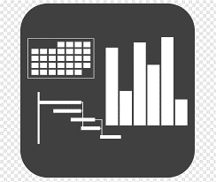




7 Benefits of using UpskilPRO :
Improve your knowledge
with professional Strategic Tools , Templates and planning documents for any business situation!
Use ready made tools
with filled in examples and ready to print & edit at your convenience . Just edit and fill-in the blanks !
Develop YOUR BUSINESS
Learn , & utilize the knowledge and processes and enhance your capabilities as the other companies have
We Created UpskilPRO for the
  Sales Professional
  Trade Marketer
  Marketing Executive
  Operations Manager
  VP/Director/Manager
100’s of tools , TEMPLATES & documents
CREATED BY
world class sales and marketing
business professionals.
All tools
are based on topics and subject based situations and are simple and easy to use .
SAVE THOUSANDS OF DOLLARS
The average company will save 1000’s of $ per employee in time & effort using our ready tools !
Top Quality Tools & Templates for developing both you and your business.
www.upskilpro.com

Slide 6
Account Management & Marketing Planning
Directional Summary
Marketing Planning sets the tone for ensuring that the marketing toolkit is centred around driving the business objectives, within this environment we will build on concepts of marketing planning built around a core of key account planning and developing the strategic plan for a key account key account plan and centre the topic around strategic planning for key accounts.

Slide 7
Account Management & Marketing Planning.
Strategic Planning Process in 10 Steps
Mission
Phase A
Corporate Objectives
Goal Setting
Marketing Audit
Phase B
SWOT Analysis
The Strategic Plan
Mission Statement
Financial Statement
Market Overview
SWOT Analysis
Assumptions
Marketing Objectives & Strategies
3 Year Forecast and Budgets
Assumptions
Review
Marketing Objectives & Strategies
Phase C
Forecasted results
Alternate plans
Strategy Formulation
Budget
Phase D
Execution Program
Resource Allocation & Evaluation

Slide 8


Account Management & Marketing Planning.
Strategic Planning : Segment treatment importance
Corporate Strategic Plan
Sales & Marketing Plan – Key Accounts
Corporate Strategic Plan
Business Segment Plan
Business Segment Plan
Business Segment Plan
Sales & Distribution Plan
Account Plan
Account Plan
Account Plan
Account Plan
Account Plan
Account Plan
Marketing Plan
Channel 1
Channel 2
Channel 3
Key Accounts are one part of the business segmentation , as such while your treatment for key accounts may be more strategic followed by annual tactical or operational plans other accounts or channels may well have different objectives , strategies and tactics , in most businesses it depends on
Which Channel
Which Product Portfolio
What Competitive influences
Where Distribution
When and if there is seasonality in the business
Geographies
Geographies
Geographies
Geographies
Geographies
Geographies
Accounts
Accounts
Accounts
Accounts
Accounts
Accounts

Slide 9
Account Management & Marketing Planning.
Tactical Vs Strategic Planning
4 Quadrant Directional matrix for developing Key accounts
Tactical PLAN
Board
Senior Management
Middle Management
Operations Management
Strategic
Poor investments
Will yield negligible results
Good to excellent allocation of results will yield excellent results
Tactical
High
Grade
Tactics
Poor investments
Will not yield any results
Investments and resources will just about return a low index
Strategic PLAN
Board
Senior Management
Middle Management
Operations Management
Low
Quality
Strategic
Tactical
Low Quality
Strategy
High Grade

Slide 10
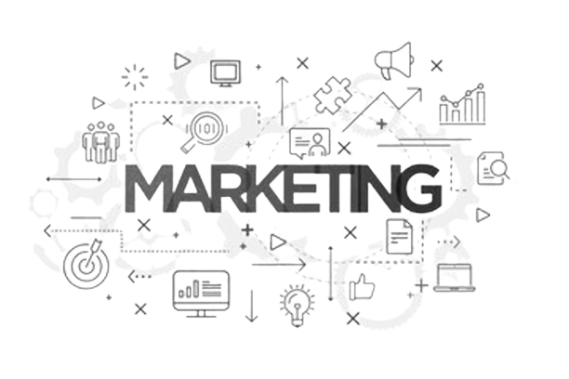
Account Management & Marketing Planning.
Strategic Planning Detail
Strategic Marketing Plan
Purpose Statement
Financial Summary
Market Overview
  Market Detail
  How the market functions
Key Segments
SWOT on Priority Segments
  Valuation of each segment
  Value creation to compel customer purchase
Summary of SWOT by portfolio segment
  Relate Segment Strength
  Financial Analysis for 3 to 5 years
Assumptions
Marketing Objectives and Delivery including Strategy
Develop in line with Portfolio Strategy
Budgets
  Time Span of 3 Years or 5 as to the length of your strategic Plan
In developing the strategic marketing plan for key accounts it will depend on the level of marketing savviness in the organisation .
for example the difference between the tactical plan and the strategic plan will need to be explained as both cover completely different timeframes and completely different sets of activities.
The strategic and tactical plan to be built will need engagement with the sales community the overall marketing community and the brand marketing organisation.
The overall tactical and strategic plan will be focused on the state of Key accounts , Brand priorities and the state of the economy .
Additionally the overall categories within the environment which will need direct marketing engagement to drive brand shares and consumer satisfaction.
PLANNING

Slide 11

Account Management & Marketing Planning.
Planning
Tactical Marketing Planning
Strategic Marketing Planning
A tactical marketing plan essentially is part of the strategic marketing plan broken down into smaller segments , how ever it may differ slightly in the fact that it may also cover objectives not entirely central to the strategic
A Strategic marketing plan can usually go from 3 to 5 years , depending on the type of industry and the company culture and investments
Tactical Objectives
Tactical Objectives
Tactical Objectives
Tactical Objectives
Tactical Objectives
Objectives
Objectives
Strategic Plan
Year 1
Year 2
Year 3
Year 4
Year 5
Year 1
Year 2
Year 3
Year 4
Year 5
Years Typically
Years Typically

Slide 12
Account Management & Marketing Planning.
Planning Process ( Strategic & Operations )
Consolidation of Plans
Operational Planning
Reviews & Updates
Audits
Strategic Planning Updates
Implementation
Jan
Feb
Mar
Apr
May
Jun
Jul
Aug
Sep
Oct
Nov
Dec

Slide 13
Account Management & Marketing Planning.
Strategic Planning : Customer Role Importance
Pointers
Developing a role versus delivery importance map is always a recommendation to ensure both sides are engaged and no role is neglected inadvertently.
This map will ensure communication is productive and aligned with expectations on the customer side also.
The scoring used is a Six Sigma methodology to ensure we have relevant scores and choices are well thought out before assigning a score.
The above tool is available for download from www.upskilpro.com , please use the reference # in the red box at top right.

Slide 14
Account Management & Marketing Planning.
Strategic Planning : Cost allocation
High fixed Cost allocation
To a very great degree how you view profitability in the interim periods of a time span depend on your company’s alignment to accounting principles or adherence to accounting standards .
While the overall accounting standard of a company is aligned to GAAP financial standards in the US , it also depends on how your organisation treats the cost allocations in this context of allocating all costs up front or scheduling the costs in line with a pre agreed business and financial plan submitted.
Profitability in any financial standard will be the outcome after all revenues out strip costs allocated and booked for a given period .
Sales revenue +ve $
Contribution margin
Rolled up cost
Fixed cost allocation
% or $
Revenue ( -ve)
Variable cost
Low fixed cost allocation
Volume ( Cases / Units )
Sales revenue ( +ve)
Volume
(Negative)
Volume
mid point / or Break even
Volume
(Positive)
Contribution margin
Revenue ( -ve)
Rolled up cost
Time periods
Variable cost Increases
Low-cost allocation
% or $
Volume
mid point / or Break even
Volume
(Positive)
Time periods

Slide 15
Key Account Management
Marketing Planning Components

Slide 16
Executive Summary |  | Page No
1.0 | Summary
 | Key Ac Team
 | Customer contact and vertical / horizontal relationships
 | Summary and detailed customer history
 | Current issues
2.0 | Customer Business Summary
 | Market Position
 | Market Business environment
 | External issue and internal issues for customer
 | Competitive position matrix
 | Customer objectives
 | Customer strategies
3.0 | Objectives and Strategies
 | Customer critical success factor criteria
 | External issues for customer
 | Competitive position
 | ExCo objectives
 | ExCo business strategies
 | Ex Co Relationship strategies
 | Risks and Dependencies ( External & Internal)
4.0 | Action , Review and Updates
 | Action Plan
 | Review
Account Management & Marketing Planning.
Strategic Plan Outline.

Slide 17
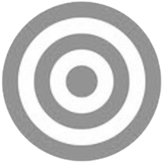
Account Management & Marketing Planning.
Corporate objectives
2
Summary
The desired level of profitability
Business boundaries
  What kind of products will be sold to what kinds of markets
  (marketing)
  What kinds of facilities will be developed (operations, R&D,
  information systems, distribution, etc.)
  The size and character of the labour force (personnel)
  Funding (finance)
Other corporate objectives, such as social responsibility, corporate image, stock market image, employer image, etc.
Marketing
Focus on Markets / Customers &
Products
Corporate
OBJECTIVES
Business
Focus on resources which must be applied on your markets
Corporate
This covers business plans based specifically on each business vertical
Corporate objectives usually contain at least the following elements:
Such a corporate plan, containing projected profit and loss accounts and balance sheets, being the result of the process described above, is more likely to provide long-term stability for a company than plans based on a more intuitive process and containing forecasts which tend to be little more than extrapolations of previous trends..

Slide 18
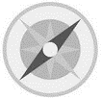
Account Management & Marketing Planning.
Mission Statements
Mission Statement
A strategic marketing plan should begin with a mission or purpose statement.
This is perhaps the most difficult aspect of marketing planning for managers to master, because it is largely philosophical and qualitative in nature. Many organizations find their different departments, and sometimes even different groups in the same department,
pulling in different directions, often with disastrous results, simply because the organization hasn’t defined the boundaries of the business and the way it wishes to do business.
The following should appear in a mission or purpose statement, which
should normally run to no more than one page:
Role or contribution
Profit (specify), or
Service, or
Opportunity seeker
Business definition – define the business, preferably in terms of the benefits
you provide or the needs you satisfy, rather than in terms of what you
make.
Distinctive competences – these are the essential skills/capabilities resources that underpin whatever success has been achieved to date.
Competence can consist of one particular item or the possession of a number
of skills compared with competitors. If, however, you could equally
well put a competitor’s name to these distinctive competences, then they
are not distinctive competences.
Indications for the future
What the firm will do
What the firm might do
What the firm will never do
Mission
STATEMENT
1

Slide 19
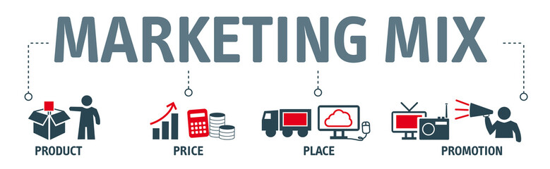
Account Management & Marketing Planning.
Marketing Objectives & Strategies
An objective is what you want to achieve. A strategy is how you plan to achieve your objectives , tactics are a series of steps engaged in to deliver the strategy
There can be objectives and strategies for varying levels in marketing. For example, there can be advertising objectives and strategies and pricing objectives and strategies.
However, the important point to remember about marketing objectives is that they are about products and markets only. Common sense will confirm that it is only by selling something to someone that the company’s financial goals can be achieved, and that advertising, pricing, service levels, and so on are the means (or strategies) by which we might succeed in doing this.
Thus, pricing objectives, sales promotion objectives, advertising objectives, and the like should not be confused with marketing objectives.
They should be capable of measurement, otherwise they are not objectives. Directional terms such as “maximize”, “minimize”, “penetrate”, “increase”, etc. are only acceptable if quantitative measurement can be attached to them. Measurement should be in terms of some, or all, of the following: sales volume, sales value, market share, profit, and percentage penetration of outlets (e.g. to have 25% of all retail outlets stocking our product by year 2).
Marketing objectives are simply about one, or more, as shown below:
  Existing products for existing markets
  New products for existing markets
  Existing products for new markets
  New products for new markets

Slide 20
Account Management & Marketing Planning.
Conducting a marketing audit
The External Element | The Internal Element
Business and economic environment Economic political, fiscal, legal, Social , Cultural Technological Intra-company The market Total market, size, Market shares Growth, and trends (value volume) Market Characteristics, developments, trends, Products , Prices , Physical distribution , Channels , customers , consumers , Communication and industry practices Competition Major competitors Key strengths and weaknesses Size Market share coverage Market standing and reputation Production capabilities Distribution policies Marketing methods Extent of diversification Personnel issues International links Profitability | Own company Sales (total, by geographical social, cultural, technological location, by industrial type, by customer, by product) Market Shares Profit margins and costs Marketing Information and research Marketing mix Product Management Price Distribution Promotion Operation readiness Resource and engagement Key Strengths and Weaknesses Opportunities and Strengths
Two kinds of variables
Any company carrying out an audit will be faced with two kinds of variables.
There is the kind over which the company has no direct control, for
example economic and market factors. Second, there are those over which
the company has complete control, the operational variables, which are
usually the firm’s internal resources. This division suggests that the best
way to structure an audit is in two parts, external and internal. The Table al left shows areas which should be investigated under both headings. Each
should be examined with a view to building up an information base relevant to the company’s performance.

Slide 21










Account Management & Marketing Planning.
Conducting a marketing audit
Market overview
This step which appears prominently in the actual strategic marketing
plan should spell out clearly:
  What the market is;
  How it works;
  What the key decision-making points are;
  What the segments are.
Market definition is key to success and must be defined relative to need sets rather than in product/service terms.
Product
Needs
Market

Slide 22
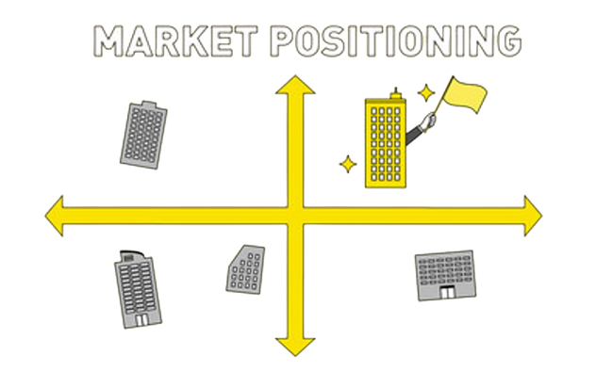
Account Management & Marketing Planning.
Market Overview
Defining your market
Define what your market is
Define how your market works
Explain what the key decision points are
What are your market segments
So how do we define our markets ?
First we don’t define a market by its product application , as this is not only misleading but it reduces the opportunity and the possibilities .
So what we do is to address the opportunity at a broader level so as to include all the possible smaller and bigger opportunities that the umbrella description covers , this way when you address your target market you are able to clarify both their need and your solution
Broader market | Need definition
Asset Purchase | We refer to the liquid funds needed to fund the purchase of an automobile , dwelling , or the bridging loan to construct a house
Wealth management | Growth and management of liquid assets with stipulated and published risk levels
Financial personal protection | The business of providing insurance coverage for a variety of stipulated reasons

Slide 23
Account Management & Marketing Planning.
Market Segmentation process
Who buys
Recording information about the decision
makers in terms of who they are – Customer
Profiling. Demographics, geographics etc.
Testing a current segmentation hypothesis
to see if it stacks up – Preliminary Segments
Who buys what
Building a customer model of the market – based on either the different combinations of KDFs customers are
known to put together, or derived from the random sample in a research project. Can be constructed by
Preliminary Segment. Each customer in the model (sample) is called a Microsegment. Each micro-segment is profiled using information from the data listed in
‘Who buys’. Each micro-segment is sized to reflect
the value or volume they represent in the market
Market mapping
Market definition – ‘A customer need that can be satisfied by the products or services seen as alternatives’. It is based around what the customers perceive as distinct activities or
needs they have which different customers could be satisfying by using alternative products or services.
The distribution and value added chain that exists for the defined market. The decision makers in that market and the amount of product or service they are responsible for in their decision making.
What is bought
Listing the features customers look for in
their purchase – what, where, when
and how.
Focusing in onto those features
customers use to select between the
alternative offers available – Key
Discriminating Features KDFs.
Why
1. As customers only seek out features regarded as key because of the benefit(s) these features are seen to offer them, the benefits delivered by each KDF should be listed. For some customers it is only by combining certain KDFs that they attain the benefit(s) they
seek-benefits should also be looked at from this perspective.
These benefits are Critical Purchase Influences CPIs.
2. For thoroughness, benefits can be looked at from the perspective of each Preliminary Segment.
3. Once the CPIs for the market have been developed their relative importance to each micro-segment is addressed (by distributing 100 points between the CPIs)
Market mapping
Market definition – ‘A customer need that can be satisfied by the products or services seen as alternatives’. It is based around what the customers perceive as distinct activities or
needs they have which different customers could be satisfying by using alternative products or services.
The distribution and value added chain that exists for the
Forming segments
1. By attributing a ‘score’ to all the CPIs for each micro-segment, the similarity between micro-segments
can be determined.
2. Micro-segments with similar requirements are brought together to form clusters.
3. Clusters are sized by adding the volumes or values represented by each micro-segment

Slide 24
Account Management & Marketing Planning.
Market Segmentation process – Summary
Why market segmentation is vital in key account planning
In a competitive world, few companies can afford to compete only on price as that weakens the position right asway and is not a long term strategy. Conversely very few companies can afford to be “all things to all people”. The main aim of market segmentation as part of the marketing
planning process is to enable a business concern to target its effort at the most promising opportunities. However, what is an opportunity for firm
A is not necessarily an opportunity for firm B.
So a firm needs to develop a typology of the customer or segment it prefers, for this can be an instrument of great productivity.
The whole point of market segmentation is that a firm must either:
  Define its markets broadly enough to ensure that its costs for key activities are competitive or
  Define its markets in such a way that it can develop specialized skills in serving them to overcome a relative cost disadvantage.
  Both strategies have to be related to a firm’s distinctive competence and to that of its competitors.
Correct market definition is crucial for the following:
  Share measurement
  Growth measurement
  The specification of target customers
  The recognition of relevant competitors
  The formulation of marketing objectives and strategies
  To summarize, the objectives of market segmentation are as follows:
  To help determine marketing direction through the analysis and
  understanding of trends and buyer behaviour.
  To help determine realistic and obtainable marketing and sales objectives.
  To help improve decision making by forcing managers to consider the
A clear and comprehensive understanding of their market, how it works, how it breaks down into natural segments, and the specific nature of the
unique value sought by each of these segments will obviously give key account managers a significant advantage in building long-term relationships
with their customers

Slide 25
Account Management & Marketing Planning.
SWOT Analysis
The marketing audit is a method of determining what the company’s marketing objectives and strategies should be based on the evaluation of all the elements .
One key strategic tool employed is the SWOT analysis .
A SWOT analysis is an audit into 4 key strategic areas in reference to your business.
A SWOT is a summary of the audit under the headings, internal strengths, and weaknesses as they relate to external opportunities and
threats.
The SWOT should be conducted for each segment that is considered to be important in the company’s future. Each entry or SWOT These SWOT analyses should, if possible,
contain just a few lines of observations focusing on key factors only. They should highlight internal differential strengths and weaknesses versus competitors and key external opportunities and threats.
A summary of reasons for good or bad performance should be included. They
should be evaluative and concise statements, add relevant and important data, and interpret using relative scores or evaluative engagement.
Helpful
Harmful
Internal
Strengths
Weakness
External
Opportunities
Threats

Slide 26
Strategic Analysis Tool
SWOT Analysis
6012
Strength
Weakness
What advantages do our organization represent
Key Features
Technologies and Resources
USP
Market share
Profitability
Patents
Pipeline
High A&M Ratio
Competitive advantages
Brand share
Corporate brand awareness
Company staff , How ready are they for the market in terms of training and qualification
Troubling internal trends
Under investments
Operational pain points
Issues in functions
Marketing or sales strategy gaps
Customer feedback
Category trends
Highest scores
Prevention of growth and improvement
Internal FACTORS
Opportunities
Threats
Trends
Opportunities without solutions
Government
Lifestyle
Population
Health
Our performance in relation to economic boom - bust cycles
Legislation
Regulations
Organizational culture
Product or service compatibility with market expectations
Opportunities = Creative solutions
Potential and real threats
External FACTORS
The full tool is downloadable from www.upskilpro.com , please use the number in the red box for reference
www.upskilpro.com

Slide 27

Account Management & Marketing Planning.
SWOT Analysis
What happens to the results of the audit?
An audit should be conducted with a means to evaluate and protect Strength & Weaknesses and protect and manage the Opportunities and threats coming from external sources
One key suggestion to organisations is to conduct the audit with a view to actioning the audit , most companies use the audit as a back up for decisions already made , or to strengthen their marketing plans visual impact. While at the audit stage
Key issues at the audit stage is Rather insufficient attention on analysis and specifically focusing on which trends and vertical developments will affect the organisation and company accordingly it's important to develop a complete checklist which suits your business and prioritise them into most to least important that way you stay focused on the important ones.
Another aspect is over reliance on information that is not central do your marketing and companies situation by this beautiful do and under an unnecessary clutter of reports , detailed yet unnecessary history my product all of which maybe summarised into a line or two or better still not included in the initial analysis as they are not central .
Developing a checklist which is completely relevant do your business is one way of staying on focus to ensuring your resources are completely aligned to your evaluation

Slide 28

Account Management & Marketing Planning.
Assumptions
Every marketing plan with reference to the external environment will have a set of key assumptions this is simply to let the audience and the team know what their external intelligence sources or letting them know of the developing competition which they should plan in for their engagement .
What is the marketing planning process and the audit in particular and the SWOT analysis assumptions will I have been engaged and these assumptions have to be made before the planning process can proceed in a simpler way this is part of standardising the planning environment do keep in mind assumptions or a statement off market development based on marketing intelligence gathered from the external environment accordingly assumptions are few but critical and central to the planning process good examples off assumptions are in the box on right.
Key assumption examples use mainly as reference
Manufacturing plant capacity will increase from 103% to 120% as part of new plans coming into operation
Price engagement will force net prize levels down by 12% across all product categories
Expected new product introduction buy competitor why will be introduced by Q2

Slide 29
Account Management & Marketing Planning.
SWOT Analysis
The full tool is downloadable from www.upskilpro.com , please use the number in the red box for reference
www.upskilpro.com

Slide 30
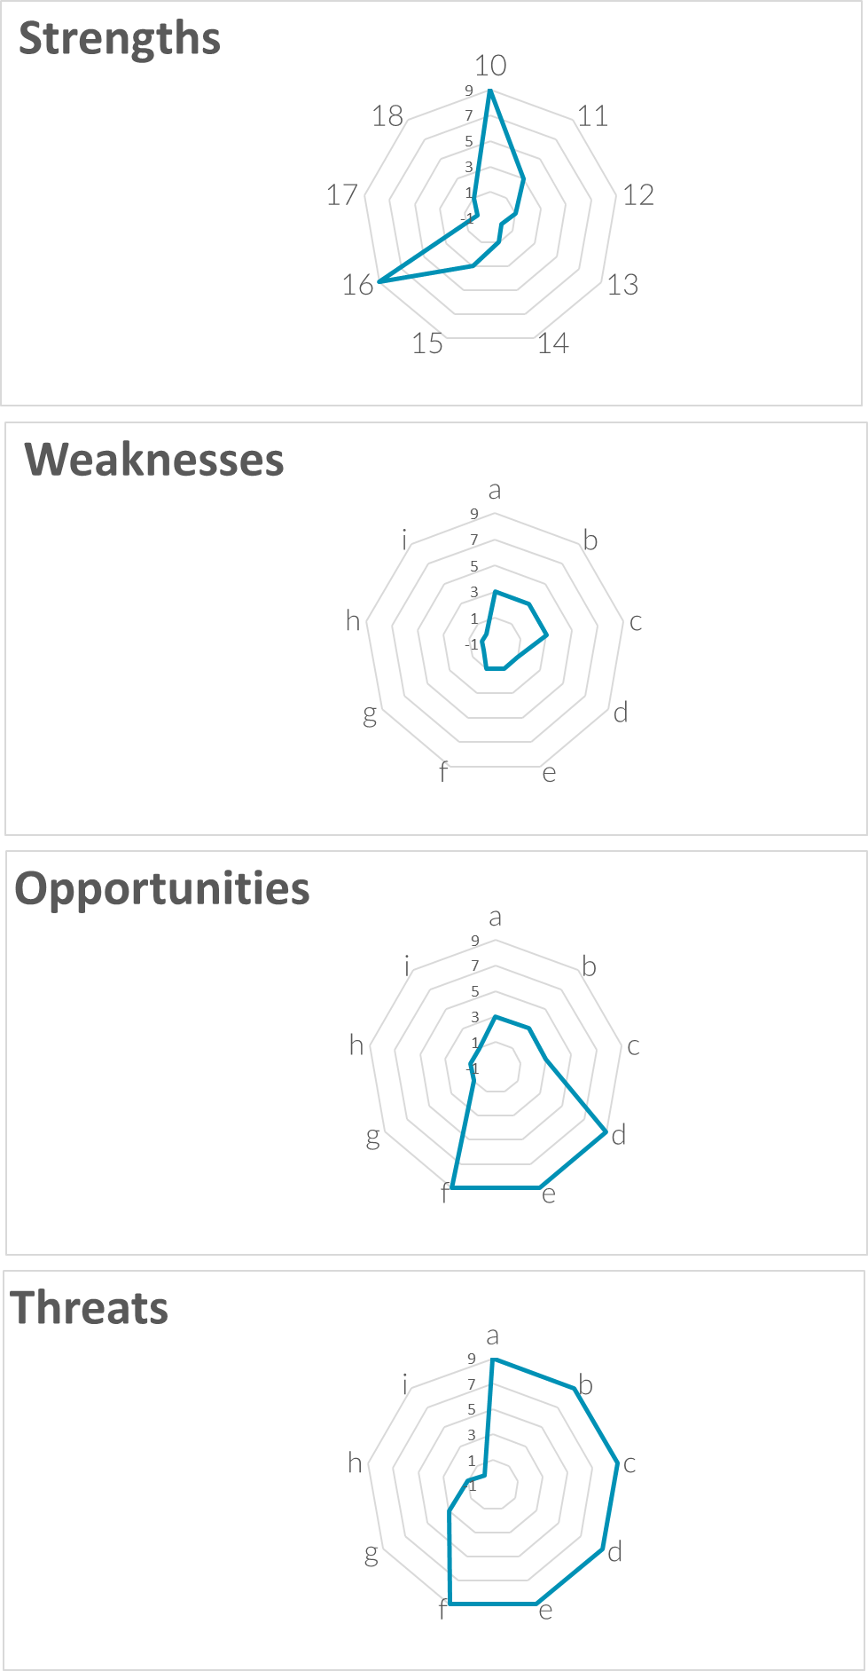
Account Management & Marketing Planning.
SWOT Analysis
6013
The full tool is downloadable from www.upskilpro.com , please use the number in the red box for reference
www.upskilpro.com

Slide 31
Account Management & Marketing Planning.
Budgets
So the common questions asked by businesses
Should packaging should be a marketing or a production expense ? It just depends on how you define cost of goods
Another example his insistence on high service levels which result in inventory carrying costs this depends on how you do your analysis and where you focus your resources this falls under business common sense
Within the price environment discounting reduces your gross income accordingly promotional discounts quantity discounts royalties sales Commission all should be given careful attention as many of them end up being legacy costs and have never been challenged .
In the above examples it's easier to say why zero based object zero based budget may well be better then the then working off the previous years budget
In every marketing plan you will have P and L which is central to letting your audience know the growth trajectory of the business within the P and L you will have a budget you to develop a detailed plan for the first year and the forecast for the next two years this allows you to generate A3 to five year plan with all the necessary assumptions and facts reflected within the plan
There are two ways to deliver a budget either it is based on the previous year or it is based on a zero budget platform .developing a budget from the previous year at times masks sudden inefficiencies which are not seen by the team and the audience and act as a pillow for inefficiency Simply put but just developed on the previous year are opaque and do not justify critical evaluation .
However, within a “0” based budget department heads will have to redo a marketing plan from scratch where in every activity starts from zero and this costed out plan will give managers the chance to re-evaluate and question their own plans since all the data is now being rebuilt.
one of the other aspects of zero-based plan is that it allows the business to develop specific plans for specific objectives which are independent of each other in another way each specific purpose planned can be related to a major objective

Slide 32
Account Management & Marketing Planning.
Implementation & Action Plan
Tactical Plan
Objectives
In a 1-year tactical plan, the general marketing strategies would be developed into specific sub-objectives, each supported by more detailed strategy and action statements.
A company organized according to functions might have an advertising plan, a sales promotion plan, a pricing plan, and so on.
A product-based company might have a product plan, with objectives, strategies, and tactics for price, place, and promotion as necessary. A market or geographically based company might have a market plan, with objectives, strategies, and tactics for the 4Ps as necessary
Volume Plan
Customer Plan
Pricing Plan
Product Plan
Channel Plan
Promotion Plan
Distribution Plan
New Product Plan
Costing Plan
Sourcing Plan
Hiring Plan
Communication Plan
Trade Marketing Plan
Shopper Plan
Loyalty Plan
Media Plan

Slide 33
Thank you !

Slide 34
Job Descriptions
Develop roles clearly and completely across varying levels of experience
Agreements
Draft your business agreements across a variety of areas
Templates
Templates are designed based gather information in a structured manner
KPI’s
Performance indicator, a quantifiable measure of performance over time versus a specific objective.
Content Modules
Best practice material in power point for use as a knowledge base in business training , planning and execution .
Strategic tools
These tools are recognised the world over in business schools, consulting firms and companies who plan strategically.
Gain a competitive edge using the best tools and techniques to build a better you .
Analytical Tools
Interactive excel tools on specific business areas based on your data inputs delivered in a workbook model with instructions.
Scorecards
Designed as functional or subject indicators across a variety off situations to enable performance of situational evaluation versus aligned standards.
Calculators
calculate the right ratios for businesses looking for benchmarks in a variety of situations
Assessments
Assessments are designed around specific areas to conduct reviews and will center around a benchmark reviewing individuals or functions
Checklists
Designed around achieving milestones in a sequential manner.
Research
Research tools for sales and marketing engagement

Slide 35
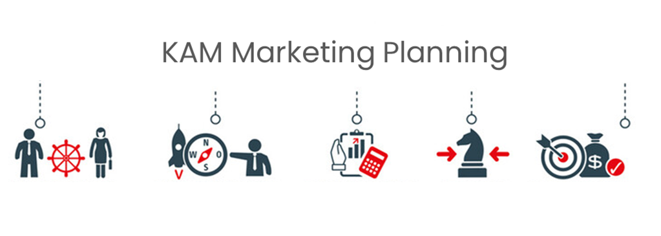
Key Account Management.
Module 8 – Marketing Planning for
Key Account Engagement .
Sales & Marketing Fundamentals.
UpskilPRO e Institute for Sales & Marketing
Tools, Content & Templates
Hand built using experience & insight

