Slide 1
Key Account Management.
Module 4 – Relationship Development .
Sales & Marketing Fundamentals.
UpskilPRO e Institute for Sales & Marketing
Tools, Content & Templates
Hand built using experience & insight

Slide 2
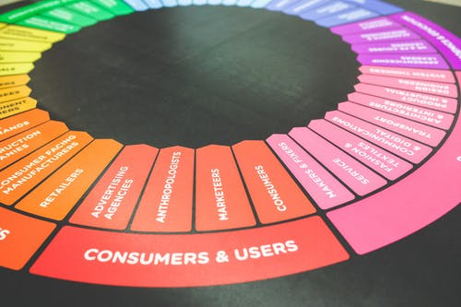
Created by
ex-Procter & Gamble, Rothmans, BAT, Gillette, Nokia,
Microsoft & 3M managers.
UpskilPRO tools are designed in easy-to-use solutions, all you need to do is download the tool and get to work immediately . All UpskilPRO material has taken 100’s of hours and many 1000’s of $ to build , all this expertise and content is brought to you for a fraction of the cost to help professionals enhance their capability.
core areas which are best suited to improve using our tools:
Subject matter expertise
Best practices
Analytical output & charting
Prioritization
Process
Training
Making life simpler for
Sales & Marketing professionals.
Tools in one place to get 10X productive now.

Slide 3
Job Descriptions
Develop roles clearly and completely across varying levels of experience
Agreements
Draft your business agreements across a variety of areas
Templates
Templates are designed based gather information in a structured manner
KPI’s
Performance indicator, a quantifiable measure of performance over time versus a specific objective.
Content Modules
Best practice material in power point for use as a knowledge base in business training , planning and execution .
Strategic tools
These tools are recognised the world over in business schools, consulting firms and companies who plan strategically.
Gain a competitive edge using the best tools and techniques to build a better you .
Analytical Tools
Interactive excel tools on specific business areas based on your data inputs delivered in a workbook model with instructions.
Scorecards
Designed as functional or subject indicators across a variety off situations to enable performance of situational evaluation versus aligned standards.
Calculators
calculate the right ratios for businesses looking for benchmarks in a variety of situations
Assessments
Assessments are designed around specific areas to conduct reviews and will center around a benchmark reviewing individuals or functions
Checklists
Designed around achieving milestones in a sequential manner.
Research
Research tools for sales and marketing engagement

Slide 4
2017
2018
100’s of tools grouped in 12 categories, 50 tool types and 12 business functions in 1 place.
get 10X productive now !
Categories
Functions
Analytical Tools
Types
Business Development
Agreements
Advertising
Customer Acquisition
Margins
Partner Search
Reports
Category Management
Assessments
Agreements
Customer Management
Market Analysis
Persona Development
Retail Measurement
Channel Management
Content Modules
Analytics
Distribution
Market Development
Planning
Reviews
Distribution
Checklists
Barriers
Distributor Management
Market Research
Positioning
Sales Management
Distributor Management
Calculators
Business Reviews
Forecasting
Market Segmentation
Pricing
Scorecards
General Management
Job Descriptions
Business Intelligence
GAP Analysis
Market Size
Prioritization
Segmentation
Key Account Management
KPI’s
Channels
Go To Market
Marketing
Product Development
Six Sigma
Marketing
Research
Communication
Job Descriptions
Marketing Comms
Product Life Cycle
Socio Economic Classification
Marketing Operations
Strategic Tools
Competitive Evaluation
Key Account Plans
Merchandising
Profit & Loss
Territory Design
Sales Management
Scorecards
Competitive Intelligence
Management Summary
New Market Entry
Promotions
Trade Marketing
Shopper Marketing
Templates
Trade Marketing

Slide 5
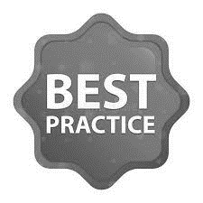
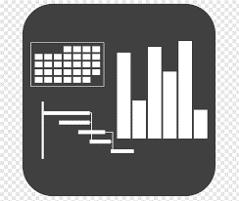
7 Benefits of using UpskilPRO :
Improve your knowledge
with professional Strategic Tools , Templates and planning documents for any business situation!
Use ready made tools
with filled in examples and ready to print & edit at your convenience . Just edit and fill-in the blanks !
Develop YOUR BUSINESS
Learn , & utilize the knowledge and processes and enhance your capabilities as the other companies have
We Created UpskilPRO for the
Sales Professional
Trade Marketer
Marketing Executive
Operations Manager
VP/Director/Manager
100’s of tools , TEMPLATES & documents
CREATED BY
world class sales and marketing
business professionals.
All tools
are based on topics and subject based situations and are simple and easy to use .
SAVE THOUSANDS OF DOLLARS
The average company will save 1000’s of $ per employee in time & effort using our ready tools !
Top Quality Tools & Templates for developing both you and your business.
www.upskilpro.com

Slide 6
Key Account Management
Developing relationships

Slide 7
Developing Relationships
Directional Summary
Key Account Management
Developing relationships
To do business, organisations must highlight a few aspects primarily, such as technology, product, price, systems, capability, and most important to develop on the attributes individuals who can develop and nurture relationships to further business goals. Quite often many companies will evaluate the relationship factor from a good too bad perspective and decide on next steps.
In order to be recognised as a good business partner too many companies think developing relationships alone will make a difference to the business. In fact, a good relationship is seen as critical part of the full set of wheels of doing business from the image shown to your right, to develop long term business relationships, the effect of a sound relationship which is balanced and built on knowledge, trust and solid business ethics will go a long way.

Slide 8
Developing Relationships
Customer Development Stages / Segments
Customers citing some key factors is building relationships
Key factors cited are across industries and reflect common pain points of customers in the majority of problems encountered
Trust – always behaving appropriately
Leverage – something unique, and not always price
Unique competitive advantage/customization – or else why bother?
Cost reduction – without sacrificing value targets
Simplicity – reducing their complexity
Continuity – being around in the future as well as the present
Supply chain integration – smoother, cheaper
Global consistency – the same offer, anywhere
Consultancy – calling on the supplier’s expertise
Strategic concentration of resources and investment – where worthwhile.

Slide 9
Developing Relationships
Customer Development Stages / Segments
Essential | Stage | Expectation
All relationships | Contractual | Maintains agreed promises
 |  | Rules and Business practice
Above basis relationships | Competence | Functional Competence
 |  | Professional Standards
 | Trust / Goodwill | Constant commitment Align with partner requests and engagement Performance engagement Avoid short term thinking Technology development Inventory reduction
Interdependent and Integrates engagement relationships
Source :7024 Account Management - Relationship development @ www.upskilPRO.com

Slide 10
Developing Relationships
Understanding Customers
Customer – Concerns and Issues environment
Customer – Active Market environment
The relationship has been segmented into 4 distinct parts for better understanding
To gain a deep understanding of the customer’s business:
When suppliers understand more about a customer's business , they make better decisions which benefit both businesses .
Successful companies whether in the B2B space or B2C have made time to understand their customers better .
The 4 stages indicated at left are part of understanding how to view customers and their factors both affecting them and influencing them from external market factors.
Customer Intimacy and engagement
Customer – Power environment
Customer – Business environment

Slide 11
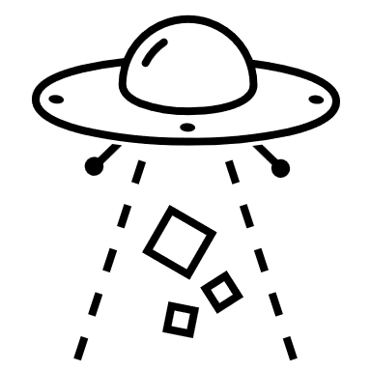
Developing Relationships
Segmenting Customers by Stages
To gain a deep understanding of the customer’s business:
Collect and analyze all the information you have and all the information you can get about the customer and its marketplace, this is the due diligence part
Analyze what the information means in terms of issues and strategies,
Once you have the material ready , meet with the customer and agree on what is factually correct, and possibly what needs to be amended.
Clarify customer expectation both towards your role and towards your company.

Slide 12
Developing Relationships
Understanding the Customer management strategy
Customer Development Stages
Understanding the Customer management strategy.
Customers will have a developed strategy to manage brand owners ( Suppliers )
Sometimes you may find both customer and brand owner strategy run parallel
Brand owners are not obligated for many reasons to divulge to business or accounts what generally as a management strategy has been deployed for the business.
In the case of Businesses ( KA ) buyers or buying partners generally based on wide experience usually work out the strategy themselves do not explicitly tell suppliers which generic supplier management strategy has been selected for them .
Brand owners apply different strategies to different products, and they may apply different strategies to the same products at different times, this is part of their product marketing and sales plans.

Slide 13
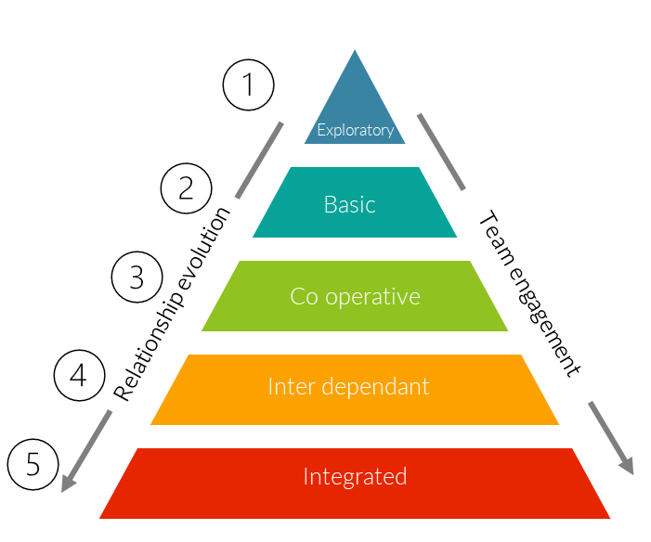
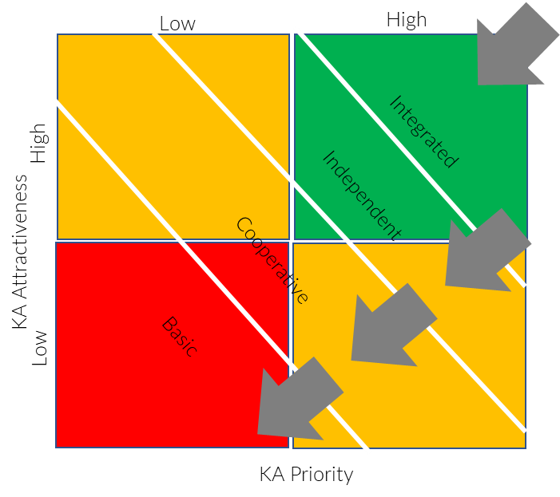
Developing Relationships
Relationship – Versus Strategy
Basic
Co operative
Inter Dependent
Integrated
Transactional efficiency
Price sensitive
Multiple suppliers
No contracts or clauses
Low or no information exchange
Purely profit motivation
Engagement driven selling company
Newly listed supplier
Exit clauses are open
Contacts are multi layered
Organisation is fairly flat
Information exchange nil
Forecasting engagement
Low trust
Mutual importance
Exit clauses appear
Multi function contacts
Above average understanding of customer
Information exchange at mid point
Joint activity planning
Investment in relationship
Process management
Trust engagement
Mutual respect and recognition
Real partnership
Sole supplier
Exit barriers
Open costing visibility
Mutual trust
Long term planning
Engaged information share
Sustainable profitability.
For simplicity we have removed the “exploratory” relationship which comes before the “basic “ relationship
Source :7024 Account Management - Relationship development @ www.upskilPRO.com

Slide 14
Developing Relationships
Customer desired features from suppliers.
A Quick evaluation of the five stages in key Account Management
Use this chart as a summary for orientation, rebuild the explanations making it close to your region and country model and use this chart for all engagement internally for business development and planning
Featured | Exploratory | Basic | Cooperative | Inter Dependent | Integrated
Emphasis | Reputation | Transactions Price | Transactional but engaging | Mutual | Open / Strategically driven
Supplier Status | Several suppliers | From 1 to many | Preferred | Leading or sole supplier | Leading or primary
Ease of passage | Easy | Easy | Difficulty level slight | Difficult | Exit barriers and contracts
Information exchange | Engaging but careful | Transaction based | Limited | Volume driven Sensitive sharing | Open and engaging on all areas
Contact | Proprietor | Buyer | KAM Buyer Logistics Order processing | Engaging within all functions | Engaging and intimate access organisations
Access to account | On request | Basic | Delivers above basic | Intermittent | Engaged and scheduled
Organization & Process | Basic | Basic with few more features | Standard | Adaptation and streamlining | Joint business processes designed
Cost | Basic and ad hoc investments | Basic to limited | Increasing costs with overall plans | Major investments with fully developed plans | Larger investments with strategic intent and visible results
Trust | Exploratory | Neutral | Basic and increasing relationship | Barriers to relationship lowered | Best in class based on engaging trust
Planning | Introduction and sketchy | Basic and core to outline planning | More futuristic | Joint planning engagement | Planning is strategic offset with tactics
Potential | Qualification process | Basic | Development and engaging | Basic criteria for success now aligned | Revenue and growth delivery
Source :7024 Account Management - Relationship development @ www.upskilPRO.com

Slide 15
Developing Relationships
Customer Development Stages / Segments
Low
High
Low
High
Star
( Growth )
Strategic
( Invest )
High
High
Integrated
Independent
KA Attractiveness
KA Attractiveness
Prune or Filter
( Cash )
Status
( Maintain)
Cooperative
Low
Basic
Low
KA Priority
KA Priority
Color codes _ Green for attractive , Yellow for Maintain , & Red for unattractive or divest .
The 4 Boxes are modelled after the BCG Matrix for evaluating on a 2-scale diagram the status to build out a strategy.
The best way to build out the diagram ( BCG Matrix ) is to use the excel tool provided on our website , using the scoring mechanism to arrive at which account falls into which of the 4 boxes .
KA Refers to Key account.

Slide 16
Developing Relationships.
Key Stakeholder Mapping
Mapping explanation
CFO
In the stakeholder mapping process its important to evaluate relationships which are based on 2 parameters
Identified relationship
Status of relationship
CEO
P Assistant
Identified Relationship
Status of Relationship
Key Driver
High
CFO
Business Mgr.
Influencer
Moderate
Support
Low
Analytics
Internal Audit
Operations
Test Mgr.
Category Mgr.
Logistics Mgr.
Category A
Category B
Category C
Category D
Purchasing
Quality
Site
Project
Batch Control

Slide 17
Developing Relationships
Mapping Customer Functions by Importance & Relationship
CEO
CFO
Purchasing
Quality
Site
Project
Batch Control
Business Mgr
Test MGr
Analytics
Personal Assistant
Category Mgr
Internal Audit
Operations
Logistics
Category A
Category B
Category C
Category D
Function
Assigned 2 States
Scoring / Coding
Important
Moderately Important
Relatively Low
CEO
Importance
Relationship

Slide 18
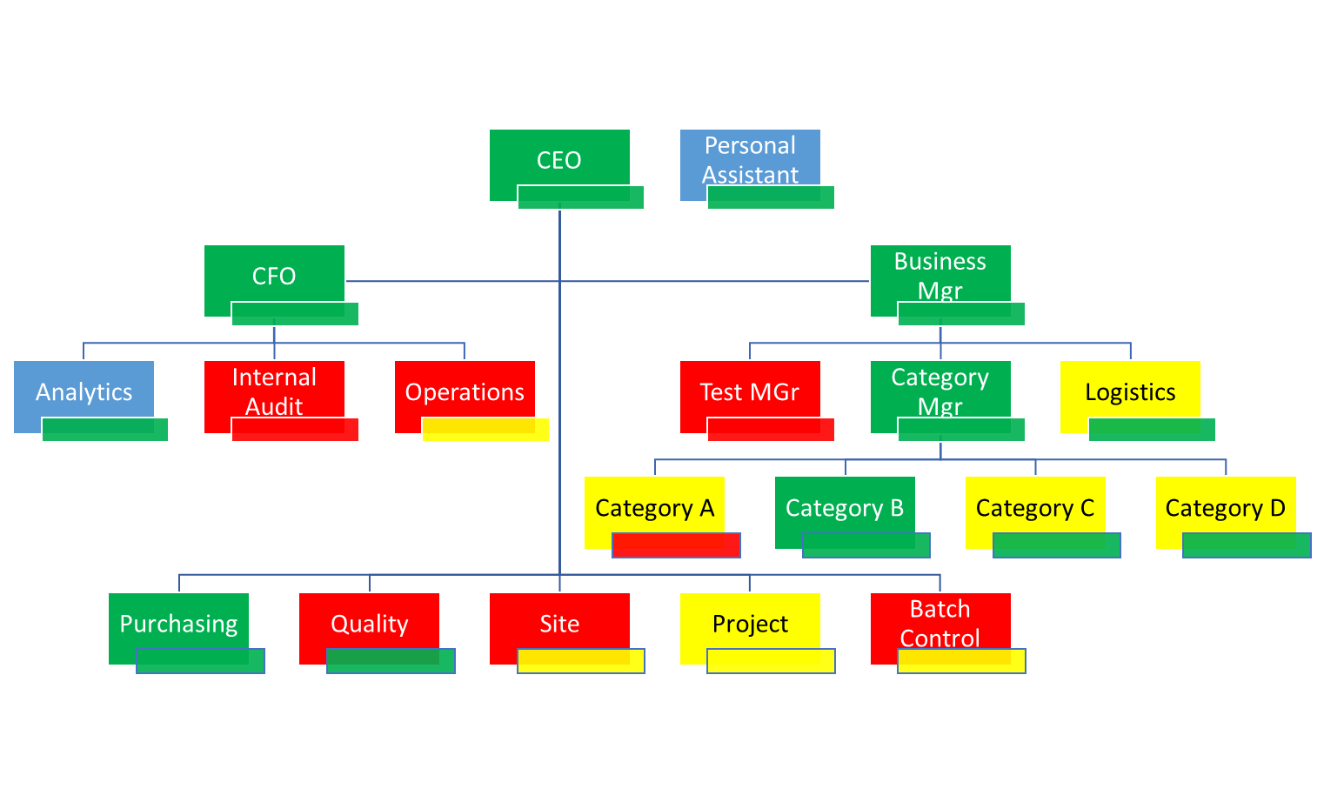
Developing Relationships
Mapping Customer Functions by Importance & Relationship
Mapping a customer organisation
The first step would be to get an organisation chart or layout of the organisation , functions and the individuals associated to each function.
Step 1 Layout the organisation functions
Step 2 Insert names into each box
Step 3 Colour code each function ( Importance ) box with one of the recommended colours indicated below for importance to your organisation.
Step 4 Super impose a 2nd box ( relationship ) below each box for simplicity , colour code this box with the relationship level you currently have.
Comment
Each function box will now have 2 colours for simplicity , one for importance and the 2nd for relationship
Update this chart every quarter ideally for the organisation tactical plan.
All personnel changes must be reflected to keep this chart UpToDate.
Do you have an up-to-date copy of your customer’s organization
chart?
● Do you understand the relevance and importance of each person/position
to your business?
● Do you know how each feels about your company?
● Have you looked at the overall picture and identified relationship gaps
that need to be addressed?
Function
Assigned 2 States
Importance Scoring
Relationship Scoring
CEO
Importance
Important
Excellent relationship
Moderately Important
Relationship in development
Relationship
Low to none relationship
Relatively Low

Slide 19
Developing Relationships
Relationship Building.
Activity :
Activities are joint and emanate from the strategic plan for identification on gaps and solutions analysis to close the gap. These areas are based around activities that the brand owner and the business owner execute together such as sales and marketing campaigns , trade marketing etc the level of coordination is high here.
Resource
In some industries these may be referred to as a joint venture of sorts in the milder form or even a full scale joint venture , examples are investments , R&D , engagement projects, a logistics facilities or technology platform that used by both parties and require a commitment between the two parties.
People bonds:
Only through interacting with people do any of the above get agreed and implemented, so people are the facilitators of all these other links.
Activities
Resources
People

Slide 20
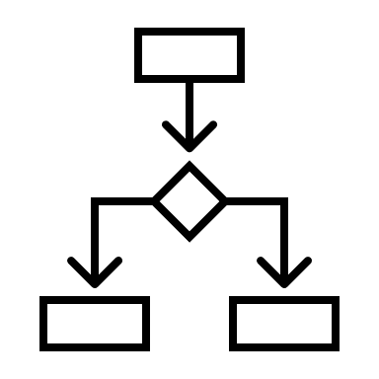
Developing Relationships
Building – Engaging - Relationships.
Quick Check in !
Do you add value to your customer?
Which of the following or similar initiatives have you put into practice for your key customer in the last year?
Help with solving glitches in their processes?
Saving cost for their department?
Providing useful information from your organization that is not readily available to the, similar to Market research data , category data , trends etc ?
Extending expert functions to advise on something which is new to them? , similar to Six Sigma , Marketing analytics , or specific software for example.
Supporting training for their staff to develop their skills (not training on your products)? This will be skill upgrades or process upgrades in general which lead to efficiency improvement and in some cases is measurable
Research
Data
Cost
Expertise
Organization
Functions
Training

Slide 21
Developing Relationships
6 Features of Interdependent Relationships
Interdependent Relationships – A Key KAM Feature
Engaging Intercompany relationships
Information Exchange Engagement
Contact Engagement and Relevance
Interdependent Relationships
Joint activity planning and execution
Mutual importance and recognition
Strategic Plans and Engagement

Slide 22
Developing Relationships
Menu of Identified areas for relationship development .
Feature | Objective | Possibilities
Strategic Planning | Evaluate market/ Consumer habits Formulate a partner plan Develop annual plans with tactical elements | Set investment calendar Calendar and Process schedule Highlight competitive advantages and developments
Information | Identify information and reports required on both sides Identify quality , quantity , frequency and type of reports | Identify and perform gap analysis Develop menu and inventory of reports and manage internal access and requests
Joint activities | Develop joint activities across functions Highlight driver functions of IT , Marketing , Lab , Projects , Training etc | Develop in partnership a joint plan to develop core functions in specific areas. Highlight quick wins and delayed wins
Relationships | Peer relations development Code and grade relationships | Peer partnership programs Engage in development strategies for skills and engagement
Contacts | Identify all function based contacts Map all contacts to 2 levels , Importance and relationship | Increase functional engagement Spread access for contacts to desired level
Peer roles & Importance | Both sides acknowledge importance of peer functions both vertical and horizontal | Develop and engage along with trust. Arrive at decisions on how to leverage the roles for dual benefits

Slide 23
Developing Relationships
Multi level engagement .
Senior Management
These roles are the decision makers who will ensure your initiatives get the necessary support and resources – key elements are Strategy , Meetings , engagement and course correction.
CFO
CEO
CMO
Middle Level Management
These roles are the drivers of the project and planning ensuring that the success is tantamount for recognition – Key elements are planning , development , and change management
KAM
KAM
BDM
R&D
Product M
Analyst &
Scientific Affairs
Operations & Tactics
Analyst
A
These roles are the backbone of the project ensuring that everything keeps moving to specification and alignment. Key elements are project delivery in alignment with schedule
Category Sup
B
Channel Mgr.
C
Brand / TM owner
Business / Channel

Slide 24
Developing Relationships
Multi level engagement relationships .
The black arrows indicate the relationship trajectory whether upward cyclones downwards
Senior Management
Middle Management
Operations /
Tactics
Brand
/ TM owner
Business
/ Channel
Brand
/ TM owner
Business
/ Channel
Brand
/ TM owner
Business
/ Channel
Brand
/ TM owner
Business
/ Channel
Balanced
Limited
Transactional
Weighted
Relationships

Slide 25
Developing Relationships
Customer Development Stages / Segments
Balanced contact profile:
Indicates an interdependent relationship, if the key account manager is managing, briefing and coordinating the internal relationships as well. If not, it could indicate a cooperative relationship with insufficient coordination and control. There could be many more contacts than shown, but this kind of number is probably the least necessary for an interdependent relationship. Good coordination and management required.
Limited contact:
Indicates a basic relationship, possibly a new one. To develop the relationship, appropriate contacts need to be identified on both sides and at all levels. People need to understand how the key account manager will run the relationship, what it is trying to achieve,
what is their role in it, and what others will be doing as well.
Transaction-weighted contact profile
This also indicates a basic relationship, albeit an older one, in which more links have been established. However, links are all focused on people concerned with the short term and transactions. To develop this relationship, efforts need
to be made to form links higher up the organization.
High contact ratio
The ratio of customer staff involved in the relationship to supplier staff involved is a good diagnostic measure. Here the key account manager is holding on to almost all the links, although there is a substantial number of them. Nevertheless, relationship and
business development will be hampered in this situation, and the key account manager needs to delegate and encourage others to act as principal contact in some of

Slide 26
Thank you !

Slide 27
Job Descriptions
Develop roles clearly and completely across varying levels of experience
Agreements
Draft your business agreements across a variety of areas
Templates
Templates are designed based gather information in a structured manner
KPI’s
Performance indicator, a quantifiable measure of performance over time versus a specific objective.
Content Modules
Best practice material in power point for use as a knowledge base in business training , planning and execution .
Strategic tools
These tools are recognised the world over in business schools, consulting firms and companies who plan strategically.
Gain a competitive edge using the best tools and techniques to build a better you .
Analytical Tools
Interactive excel tools on specific business areas based on your data inputs delivered in a workbook model with instructions.
Scorecards
Designed as functional or subject indicators across a variety off situations to enable performance of situational evaluation versus aligned standards.
Calculators
calculate the right ratios for businesses looking for benchmarks in a variety of situations
Assessments
Assessments are designed around specific areas to conduct reviews and will center around a benchmark reviewing individuals or functions
Checklists
Designed around achieving milestones in a sequential manner.
Research
Research tools for sales and marketing engagement

Slide 28
Key Account Management.
Module 4 – Relationship Development .
Sales & Marketing Fundamentals.
UpskilPRO e Institute for Sales & Marketing
Tools, Content & Templates
Hand built using experience & insight

