Slide 1
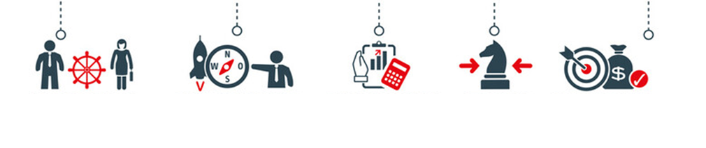
Trade Marketing
Key Performance Indicators
Sales & Marketing Fundamentals.
UpskilPRO e Institute for Sales & Marketing
Tools, Content & Templates
Hand built using experience & insight

Slide 2
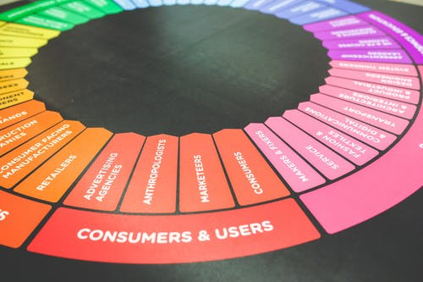
Created by
ex-Procter & Gamble, Rothmans, BAT, Gillette, Nokia,
Microsoft & 3M managers.
UpskilPRO tools are designed in easy-to-use solutions, all you need to do is download the tool and get to work immediately . All UpskilPRO material has taken 100’s of hours and many 1000’s of $ to build , all this expertise and content is brought to you for a fraction of the cost to help professionals enhance their capability.
core areas which are best suited to improve using our tools:
Subject matter expertise
Best practices
Analytical output & charting
Prioritization
Process
Training
Making life simpler for
Sales & Marketing professionals.
Tools in one place to get 10X productive now.

Slide 3
Job Descriptions
Develop roles clearly and completely across varying levels of experience
Agreements
Draft your business agreements across a variety of areas
Templates
Templates are designed based gather information in a structured manner
KPI’s
Performance indicator, a quantifiable measure of performance over time versus a specific objective.
Content Modules
Best practice material in power point for use as a knowledge base in business training , planning and execution .
Strategic tools
These tools are recognised the world over in business schools, consulting firms and companies who plan strategically.
Gain a competitive edge using the best tools and techniques to build a better you .
Analytical Tools
Interactive excel tools on specific business areas based on your data inputs delivered in a workbook model with instructions.
Scorecards
Designed as functional or subject indicators across a variety off situations to enable performance of situational evaluation versus aligned standards.
Calculators
calculate the right ratios for businesses looking for benchmarks in a variety of situations
Assessments
Assessments are designed around specific areas to conduct reviews and will center around a benchmark reviewing individuals or functions
Checklists
Designed around achieving milestones in a sequential manner.
Research
Research tools for sales and marketing engagement

Slide 4
2017
2018
100’s of tools grouped in 12 categories, 50 tool types and 12 business functions in 1 place.
get 10X productive now !
Categories
Functions
Analytical Tools
Types
Business Development
Agreements
Advertising
Customer Acquisition
Margins
Partner Search
Reports
Category Management
Assessments
Agreements
Customer Management
Market Analysis
Persona Development
Retail Measurement
Channel Management
Content Modules
Analytics
Distribution
Market Development
Planning
Reviews
Distribution
Checklists
Barriers
Distributor Management
Market Research
Positioning
Sales Management
Distributor Management
Calculators
Business Reviews
Forecasting
Market Segmentation
Pricing
Scorecards
General Management
Job Descriptions
Business Intelligence
GAP Analysis
Market Size
Prioritization
Segmentation
Key Account Management
KPI’s
Channels
Go To Market
Marketing
Product Development
Six Sigma
Marketing
Research
Communication
Job Descriptions
Marketing Comms
Product Life Cycle
Socio Economic Classification
Marketing Operations
Strategic Tools
Competitive Evaluation
Key Account Plans
Merchandising
Profit & Loss
Territory Design
Sales Management
Scorecards
Competitive Intelligence
Management Summary
New Market Entry
Promotions
Trade Marketing
Shopper Marketing
Templates
Trade Marketing

Slide 5
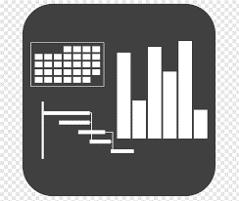
7 Benefits of using UpskilPRO :
Improve your knowledge
with professional Strategic Tools , Templates and planning documents for any business situation!
Use ready made tools
with filled in examples and ready to print & edit at your convenience . Just edit and fill-in the blanks !
Develop YOUR BUSINESS
Learn , & utilize the knowledge and processes and enhance your capabilities as the other companies have
We Created UpskilPRO for the
Sales Professional
Trade Marketer
Marketing Executive
Operations Manager
VP/Director/Manager
100’s of tools , TEMPLATES & documents
CREATED BY
world class sales and marketing
business professionals.
All tools
are based on topics and subject based situations and are simple and easy to use .
SAVE THOUSANDS OF DOLLARS
The average company will save 1000’s of $ per employee in time & effort using our ready tools !
Top Quality Tools & Templates for developing both you and your business.
www.upskilpro.com

Slide 6
Trade Marketing Plans.
Directional Summary
Trade Marketing Plans set the tone for ensuring that the marketing objectives are translated into engaging the customer at the category or in specific events , this is the part where the actual engagement between company , customer , brand and category takes place.

Slide 7
Trade Marketing ROI

Slide 8
The 6 Steps to setting up KPI’s
Senior Management
Measures to drive
performance
Get the leadership committed to driving the KPI and Balanced scorecard organization wide.
Leading & Selling
Develop a reporting format , refine KPI’s constantly and use checklists and exhibits to get the process moving
Lead & Sell by emotional drivers of your audience , this is the most critical factor.
Upskill inhouse resources
Select an inhouse person to run the KPI program , with inhouse expertise teams will fall into place
Measures that work
Organizational
Critical Success Factors
Find measures that create the appropriate behavioral response
CSF is mostly issues operationalized and the origin of all performance measures .
www.upskilpro.com

Slide 9
The 6 Steps to setting up KPI’s
Senior Management
Measures to drive
performance
Get the leadership committed to driving the KPI and Balanced scorecard organization wide.
Leading & Selling
Develop a reporting format , refine KPI’s constantly and use checklists and exhibits to get the process moving
Lead & Sell by emotional drivers of your audience , this is the most critical factor.
Upskill inhouse resources
Select an inhouse person to run the KPI program , with inhouse expertise teams will fall into place
Measures that work
Organizational
Critical Success Factors
Find measures that create the appropriate behavioral response
CSF is mostly issues operationalized and the origin of all performance measures .
www.upskilpro.com

Slide 10
Trade Marketing
Marketing Metrics : Key performance Indicators
Direct Trade Marketing KPI
Indirect Trade Marketing KPI
Gross Profit
Working
Explanation
Gross profit is the simplest profitability metric because it defines profit as all income that remains after accounting for the cost of goods sold (COGS). COGS includes only those expenses directly associated with the production or manufacture of items for sale, including raw materials and the wages for labour required to make or assemble goods..
Selling Price
-
Cost price
Margins %
=
x
100
Selling Price
www.upskilpro.com

Slide 11
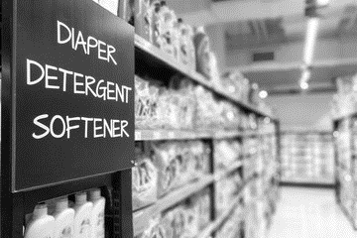
Trade Marketing
Marketing Metrics : Key performance Indicators
Direct Trade Marketing KPI
Indirect Trade Marketing KPI
Shelf Share
Working
Explanation
Shelf share is seen as a basic metric converted into a percentage of the linear meter that your brand occupies versus the shelf length in meters.
Your brand in linear meters
Shelf Share %
=
x
100
Total shelf space in linear meters
Total category space Is the sum of all brands in the in a specific category translated into metres .
always clarify the brands you include in a particular category to avoid deletion or duplication
www.upskilpro.com

Slide 12
Trade Marketing
Marketing Metrics : Key performance Indicators
Direct Trade Marketing KPI
Indirect Trade Marketing KPI
Category Share
Working
Explanation
Category share is seen as a basic metric converted into a percentage of the linear meters that your brand occupies versus the total metres of the category .
Your brand in linear meters
Shelf Share %
=
x
100
Total category space in linear meters
Total category space Is the sum of all brands in the in a specific category translated into metres .
always clarify the brands you include in a particular category to avoid deletion or duplication
www.upskilpro.com

Slide 13
Trade Marketing
Marketing Metrics : Key performance Indicators
Direct Trade Marketing KPI
Indirect Trade Marketing KPI
Category Value Share
Working
Explanation
Category value share
Establish the sum of all products in a specific category multiplied by their volume and the net price ( US $ or other currency ) in a given time period.
Establish the above by brand , this gives you individual brand share
Divide the brand share by the total category sales , this will give you individual brand value share
Total brand sale in $
Category Value Share $
=
x
100
Total category sale in $
Marketers use two forms of category share depending on the discussion and the analysis
value share establishes the share of sales in absolute terms versus total category size and sales this allows marketers to view 1 aspect
volume share establishes the share of sales irrelevant of the package size this when viewed as a category does not reflect the right picture for it to be accurate you will need to view it in a similar sized sub category
Therefore it's important to use both metrics carefully
www.upskilpro.com

Slide 14
Trade Marketing
Marketing Metrics : Key performance Indicators
Direct Trade Marketing KPI
Indirect Trade Marketing KPI
Category Volume Share
Working
Explanation
Category volume share
Establish the sum of all products in a specific category multiplied by their volume in a given time period.
Establish the above by brand , this gives you individual brand share
Divide the brand share by the total category sales in volume this will give you individual brand value share
Total brand sale in volume
Category Volume Share $
=
x
100
Total category sale in volume
Marketers use two forms of category share depending on the discussion and the analysis
Value share establishes the share of sales in absolute terms versus total category size and $ sales this allows marketers to view 1 aspect
Volume share establishes the share of sales irrelevant of the package size this when viewed as a category does not reflect the right picture for it to be accurate you will need to view it in a similar sized sub category
Therefore it's important to use both metrics carefully
www.upskilpro.com

Slide 15
Trade Marketing
Marketing Metrics : Key performance Indicators
Direct Trade Marketing KPI
Indirect Trade Marketing KPI
Markup
Working
Explanation
Markup refers to the difference between the selling price of a good or service and its cost. It is expressed as a percentage above the cost. In other words, it is the premium over the total cost of the good or service that provides the seller with a profit.
Selling Price
-
Cost price
Markup %
=
x
100
Cost Price
www.upskilpro.com

Slide 16
Trade Marketing
Marketing Metrics : Key performance Indicators
Direct Trade Marketing KPI
Indirect Trade Marketing KPI
Margins
Working
Explanation
Margin refers to the difference between the selling price of a good or service and its cost. It is expressed as a percentage above the Sales price. In other words, it is the premium over the total cost of the good or service that provides the seller with a profit.
Selling Price
-
Cost price
Margin %
=
x
100
Selling Price
3
www.upskilpro.com

Slide 17
Trade Marketing
Marketing Metrics : Key performance Indicators
Direct Trade Marketing KPI
Indirect Trade Marketing KPI
Break even volume
Working
Explanation
The break-even level represents the sales amount—in either unit or revenue terms that is required to cover total costs (both fixed and variable). Profit at break-even is zero. Break-even is only possible if a firm’s prices are higher than its variable costs per unit. If so, then each unit of product sold will generate some “contribution” toward covering fixed costs. The difference between price per unit and variable cost per unit is defined as Contribution per Unit.
Fixed Costs $
Breakeven Volume %
=
Contribution per unit $
3
www.upskilpro.com

Slide 18
Trade Marketing
Marketing Metrics : Key performance Indicators
Direct Trade Marketing KPI
Indirect Trade Marketing KPI
Break even revenue $
Working
Explanation
Break-even revenue is the amount of money the business generates from the sale of the break-even quantity. Therefore, the calculation of annual break-even units and revenue is used to determine the volumes of production and sales that must be realized to achieve the profit targets for the year.
Break even revenue $
=
Breakeven volume ( units )
X
price per unit
Or
Fixed costs $
Break even revenue $
=
Contribution margin %
3
www.upskilpro.com

Slide 19
Trade Marketing
Marketing Metrics : Key performance Indicators
Direct Trade Marketing KPI
Indirect Trade Marketing KPI
Numeric Distribution
Working
Explanation
Numeric distribution is the number of outlets in which a product or reference is available. This indicator is generally compared with the total number of points of sale in the universe studied to calculate the percentage of distribution.
Number of outlets carrying brand
Numeric Distribution %
=
Total number of outlets
3
Numeric Distribution % =
www.upskilpro.com

Slide 20
Trade Marketing
Marketing Metrics : Key performance Indicators
Direct Trade Marketing KPI
Indirect Trade Marketing KPI
ACV
All Commodity Distribution
Working
Explanation
ACV Distribution has a benefit over numeric distribution , which is it provides a great view and measure of customer traffic as it measures the store category sales not just the individual brand
Total sales of outlets carrying brand
ACV Distribution %
=
Total sales of all outlets
3
Numeric Distribution % =
www.upskilpro.com

Slide 21
Trade Marketing
Marketing Metrics : Key performance Indicators
Direct Trade Marketing KPI
Indirect Trade Marketing KPI
PCV
Product Category volume distribution
Working
Explanation
ACV Distribution has a benefit over numeric distribution , which is it provides a great view and measure of customer traffic as it measures the store category sales not just the individual brand
Total Category sales of outlets carrying brand
PCV Distribution %
=
Total category sales of all outlets
3
Numeric Distribution % =
www.upskilpro.com

Slide 22
Trade Marketing
Marketing Metrics : Key performance Indicators
Direct Trade Marketing KPI
Indirect Trade Marketing KPI
Out of stocks %
Working
Explanation
Out of stocks measures the effect of listed but unavailable product . This effectively translates into lost sales for the number of days the products is not available , rendering the loss of distribution , but also threatening the life of the product in that store by customers switching to other brands , which effectively translates into a lifetime loss of a customer .
OOS = Out of stock
Outlets where brand is listed but unavailable
OOS %
=
Total outlets where brand is listed
3
Numeric Distribution % =
www.upskilpro.com

Slide 23
Trade Marketing
Marketing Metrics : Key performance Indicators
Direct Trade Marketing KPI
Indirect Trade Marketing KPI
Direct Product Profitability
Working
Explanation
DPP represents a products direct gross margin less its direct product costs .
Typically one would use a ABC system to generate direct costs for individual SKU’s , due to the complexity of the cost calculation it is not widely used .
DPP in $
=
Adjusted Gross margin
=
Direct product costs
3
DPP in $ =
Adjusted Gross margin – Direct product costs
Numeric Distribution % =
www.upskilpro.com

Slide 24
Trade Marketing
Marketing Metrics : Key performance Indicators
Direct Trade Marketing KPI
Indirect Trade Marketing KPI
Total Sales
Working
Explanation
Once you establish baseline sales , you will be able to evaluate incremental sales coming from marketing activities.
Baseline sales helps isolate sales from the influences of Seasonality and competitive promotions
DPP in $
=
Baseline sales
+
Incremental sales from marketing
3
DPP in $ =
Adjusted Gross margin – Direct product costs
Numeric Distribution % =
www.upskilpro.com

Slide 25
Trade Marketing
Marketing Metrics : Key performance Indicators
Direct Trade Marketing KPI
Indirect Trade Marketing KPI
Incremental sales from marketing
Working
Explanation
Once you establish baseline sales , you will be able to evaluate incremental sales coming from marketing activities.
Baseline sales helps isolate sales from the influences of Seasonality and competitive promotions
=
Incremental sales from advertising
+
Incremental sales form trade promotion
+
incremental sale from trade promotion
+
Any other incremental sales
3
DPP in $ =
Numeric Distribution % =
www.upskilpro.com

Slide 26
Trade Marketing
Marketing Metrics : Key performance Indicators
Direct Trade Marketing KPI
Indirect Trade Marketing KPI
Mark Up
illustration
Mark up refers to the value that a player adds to the cost price of a product. The value added is called the mark-up. The mark-up added to the cost price usually equals retail price
Selling Price
-
Cost Price
Mark Up %
=
x
100
Cost Price
Revenue per unit
-
COgS per unit
Mark Up %
=
x
100
COgS per unit
www.upskilpro.com

Slide 27
Trade Marketing
Marketing Metrics : Key performance Indicators
Direct Trade Marketing KPI
Indirect Trade Marketing KPI
Marketing Costs
Working
Marketing As a Percentage of Sales:
The level of marketing spending as a fraction of sales. This figure provides an indication of how heavily a company is marketing.
The appropriate level for this figure varies among products, strategies, and markets.
Marketing Spending $
Marketing as a % of Sales
=
Total Revenue in $
www.upskilpro.com

Slide 28
Trade Marketing
Marketing Metrics : Key performance Indicators
Direct Trade Marketing KPI
Indirect Trade Marketing KPI
Contribution Gross Margin
Working
Contribution gross margin is know as the margin after deducting the cost of goods from nett sales revenue .
Mostly referred to as CGM this formula is not to be confused with contribution margin , which is very different .
Net Sales
-
Cost of Goods
Contribution Gross Margin %
=
Net Sales
www.upskilpro.com

Slide 29
Trade Marketing
Marketing Metrics : Key performance Indicators
Direct Trade Marketing KPI
Indirect Trade Marketing KPI
Cannibalization Rate %
Working
Cannibalization rates represent an important factor in the assessment of new product strategies.
Fair share draw constitutes an assumption or expectation that a new product will capture sales (in unit or dollar terms) from existing products in proportion to the market shares of those existing products.
Sales lost from existing products in $
Cannibalization Rate %
=
Sales of new products in $
www.upskilpro.com

Slide 30
Trade Marketing
Marketing Metrics : Key performance Indicators
Direct Trade Marketing KPI
Indirect Trade Marketing KPI
Test Drive
Working
The test-drive is the essential metric at the evaluative stage of the purchasing cycle.
You will need to design a evaluation design to offer the test drive and record it carefully .
So for every 1000 who were offered a test drive or coupon how many actually redeemed it or test drive based on your offer ?
This approach evaluates effectiveness of marketing campaigns and is a leading indicator of future sales.
Test Drive
=
Customer pretest of a product or service prior to purchase
www.upskilpro.com

Slide 31
Trade Marketing
Marketing Metrics : Key performance Indicators
Direct Trade Marketing KPI
Indirect Trade Marketing KPI
Profit
Working
Example
The profit metric needs to be treated carefully as on initial view it could mislead.
Revenues by themself serve little purpose as it is only an indicator an a definitive metric.
Progress is judged by profitability not revenue, more commonly referred to as the bottom line or PBT.
You can have a High revenue top line but the resulting load of expenses can literally erode the bottom line denying increments, rewards and incentives to the employees.
A more balanced way is to look at both revenue line and income and derive the right balance which brings home the income and keeps the shareholders engaged.
Profit
=
Revenue – Cost
www.upskilpro.com

Slide 32
Trade Marketing
Marketing Metrics : Key performance Indicators
Direct Trade Marketing KPI
Indirect Trade Marketing KPI
Price Premium
Working
Explanation
Price premium is the percentage in excess of the bench mark price established for a similar class of product .
Its basically a relative price . 4 Normally used benchmarks are
Price of a specified competitor product
Average price paid
Average price displayed
Average price charged
( Brand A price – Benchmark price )
Price Premium %
=
( Benchmark price )
Price Premium % =
www.upskilpro.com

Slide 33
Trade Marketing
Marketing Metrics : Key performance Indicators
Direct Trade Marketing KPI
Indirect Trade Marketing KPI
Customer Lifetime Value
Working
Customer lifetime value is the dollar value of a customer relationship based on the present value of the projected future cash flows from the customer relationship.
When margins and retention rates are constant, the following formula can be used to calculate the lifetime value of a customer relationship
Retention rate %
Margin $
X
1+ Discount rate % - Retention Rate
The 3 parameters of CLV
Constant margin after deducting variable costs
Constant retention probability per period
Discount rate
Customer lifetime value (CLV) is an important concept in that it encourages firms to shift their focus from quarterly profits to the long-term health of their customer relationships.
Customer lifetime value is an important number because it represents an upper limit on spending to acquire new customers.
Margin $ X
www.upskilpro.com

Slide 34
Trade Marketing
Marketing Metrics : Key performance Indicators
Direct Trade Marketing KPI
Indirect Trade Marketing KPI
Incremental sales from marketing
Working
Explanation
Once you establish baseline sales , you will be able to evaluate incremental sales coming from marketing activities.
Baseline sales helps isolate sales from the influences of Seasonality and competitive promotions
= Incremental sales from advertising
+ incremental sale from trade promotion
+ Any other incremental sales
Incremental sales from marketing
=
www.upskilpro.com

Slide 35
Trade Marketing
Marketing Metrics : Key performance Indicators
Direct Trade Marketing KPI
Indirect Trade Marketing KPI
Marketing ROI
Working
Explanation
Deciding what to spend on. MROI is most often calculated at the program or campaign level so that marketers know which efforts have a higher return and therefore warrant further investment. It also informs future spending levels, allocation of the budget across programs and media, and which messages a marketer chooses.
Comparing marketing efficiency with competitors. Track competitors’ MROI to gauge how your company is performing against others in the industry. While MROI is not usually public information, marketing leaders can use published financial statement data to estimate MROI for a competitor.
Holding themselves accountable. The MROI calculation also prompts individual marketers to think about and justify every dollar before they spend it.
Incremental financial value gained as a result of marketing investment cost ($)
-
Cost of the marketing investment
Marketing ROI
=
Cost of the marketing investment
www.upskilpro.com

Slide 36
Trade Marketing
Marketing Metrics : Key performance Indicators
Direct Trade Marketing KPI
Indirect Trade Marketing KPI
Customer Satisfaction
Working
Customer satisfaction is derived from answering a question posed to a respondent .
Q – How satisfied are you with XYZ ?
Q – Would you recommend us to your friends or colleagues ?
Q – How much do you plan to spend on XYZ brand in the next 3 months ?
The above needs a support program to be effective and gain interest such as rewards / Loyalty or recognition program.
Customer Satisfaction
=
Would you recommend this product or service to a friend or colleague
www.upskilpro.com

Slide 37
Trade Marketing
Marketing Metrics : Key performance Indicators
Direct Trade Marketing KPI
Indirect Trade Marketing KPI
Churn rate
Working
This is based on your product sales cycle replenishment , of your customers buy every year and you have 100 customers at the beginning of the year and close the year with 80 , then your CR is 20%
However
If your product sales cycle replenishment is every 3 years ( like an lease car ) then you calculate in cycles of 3 , so if you start with 500 customers in a given year and 3 years later 90 of the original 500 have left then your churn rate is 6% per year as its 18% over 3 years divided by the number of years = 3 , delivering 6% per year . Then your CR is 6%
You may change the CR in line with your product sale replenishment cycle , for example it may be 30 days , 60 days , 90 or 180 days , you so you apply the calculation accordingly.
Churn rate
=
% of existing customers who stop purchasing products and services ( measure in a year )
www.upskilpro.com

Slide 38
Trade Marketing
Marketing Metrics : Key performance Indicators
Direct Trade Marketing KPI
Indirect Trade Marketing KPI
Redemption rate
Working
Example
We sent out 1000 brochures offering 10$ off on a purchase of a Hand drill , the cost of the material despatched was 4$ X 1000 = 4,000 $.
100 customers responded and bought a hand drill which was 10% of the mailing list , since the cost of the mailing was 4,000$ and the 10$ on offer made now to 100 customers cost 10$ X 100 = 1,000$ the total cost was 5,000$.
Any profitability below 50$ per customer indicates a loss making proposition
The above is also known as the “ take rate “
Redemption rate
=
The number or % of customers accepting a marketing offer
No of accepted offers
Redemption rate
=
No of contracts
=
Cost is 5,000
Customer acquisition cost
100 customers
Customer acquisition cost
=
50 $ per customer
www.upskilpro.com

Slide 39
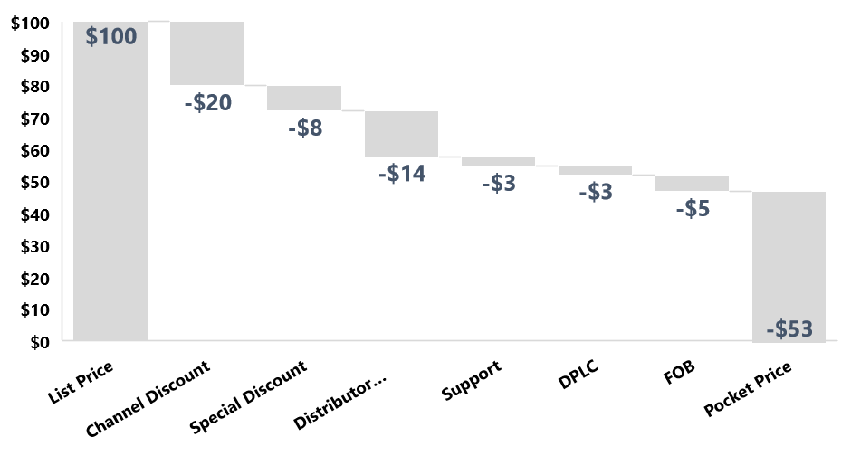
Trade Marketing
Marketing Metrics : Key performance Indicators
Direct Trade Marketing KPI
Indirect Trade Marketing KPI
Pocket Price
Working
Explanation
The price paid for a product by customers after all discounts has been built in is called pocket price
Net Price per unit
Pocket price
=
List price per unit
Price Premium % =
www.upskilpro.com

Slide 40
Created by
ex-Procter & Gamble, Rothmans, BAT, Gillette, Nokia,
Microsoft & 3M managers.
UpskilPRO tools are designed in easy-to-use solutions, all you need to do is download the tool and get to work immediately . All UpskilPRO material has taken 100’s of hours and many 1000’s of $ to build , all this expertise and content is brought to you for a fraction of the cost to help professionals enhance their capability.
core areas which are best suited to improve using our tools:
Subject matter expertise
Best practices
Analytical output & charting
Prioritization
Process
Training
Making life simpler for
Sales & Marketing professionals.
Tools in one place to get 10X productive now.

Slide 41
Trade Marketing
Key Performance Indicators
Sales & Marketing Fundamentals.
UpskilPRO e Institute for Sales & Marketing
Tools, Content & Templates
Hand built using experience & insight

