Slide 1
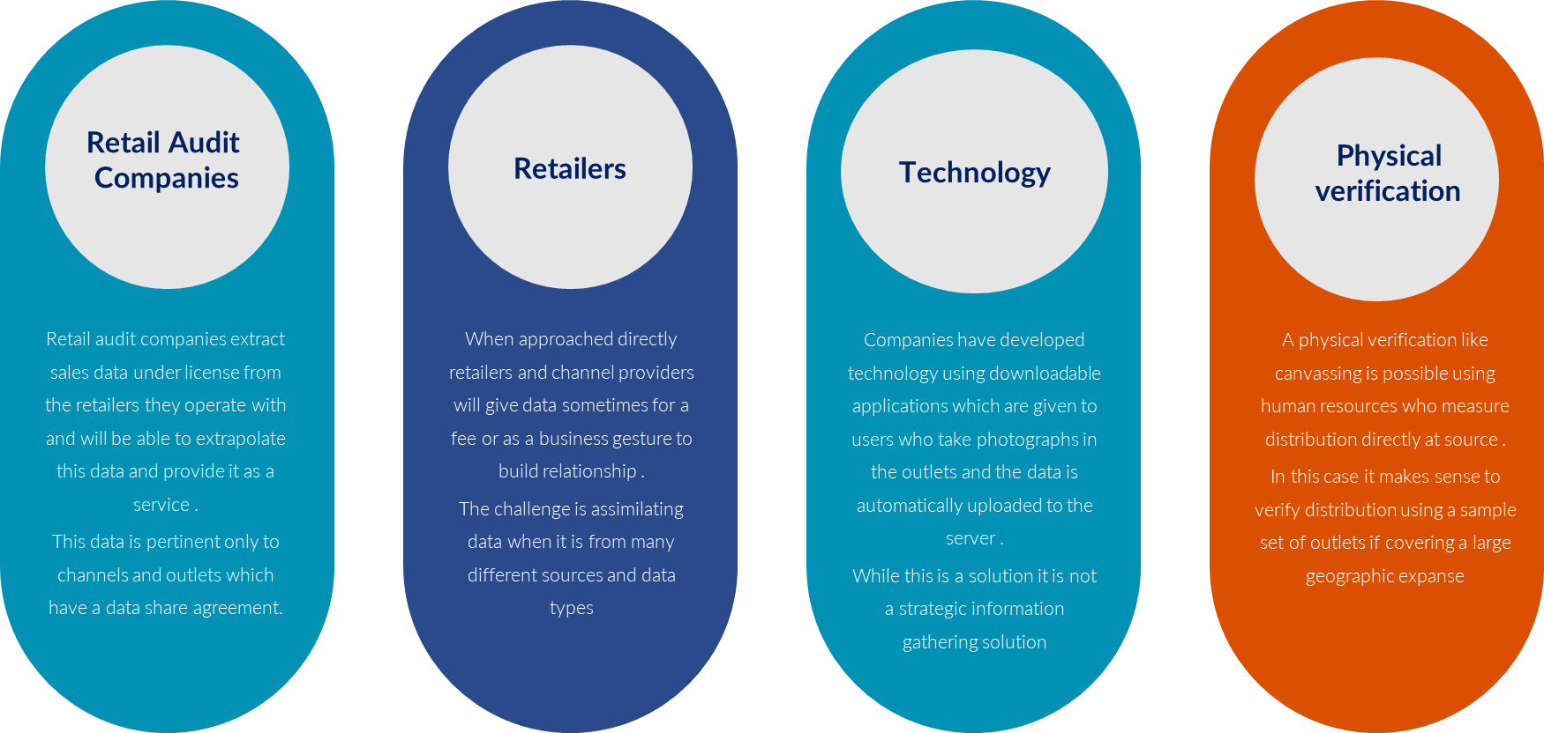
Scorecard – Channel Distribution
Channel Post Launch Evaluation
UpskilPRO e Institute for Sales & Marketing
Tools, Content & Templates
Hand built using experience & insight

Slide 2
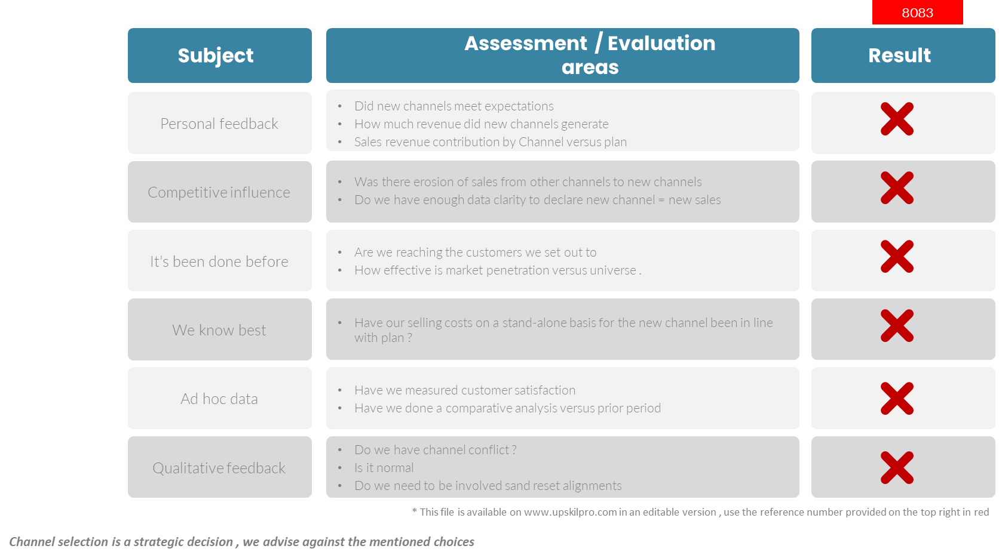
Channels of distribution
Scorecard – Channel Post Launch Evaluation!
3005

Slide 3
Scorecard – Channel Distribution
Channel Post Launch Evaluation
UpskilPRO e Institute for Sales & Marketing
Tools, Content & Templates
Hand built using experience & insight

