Slide 1

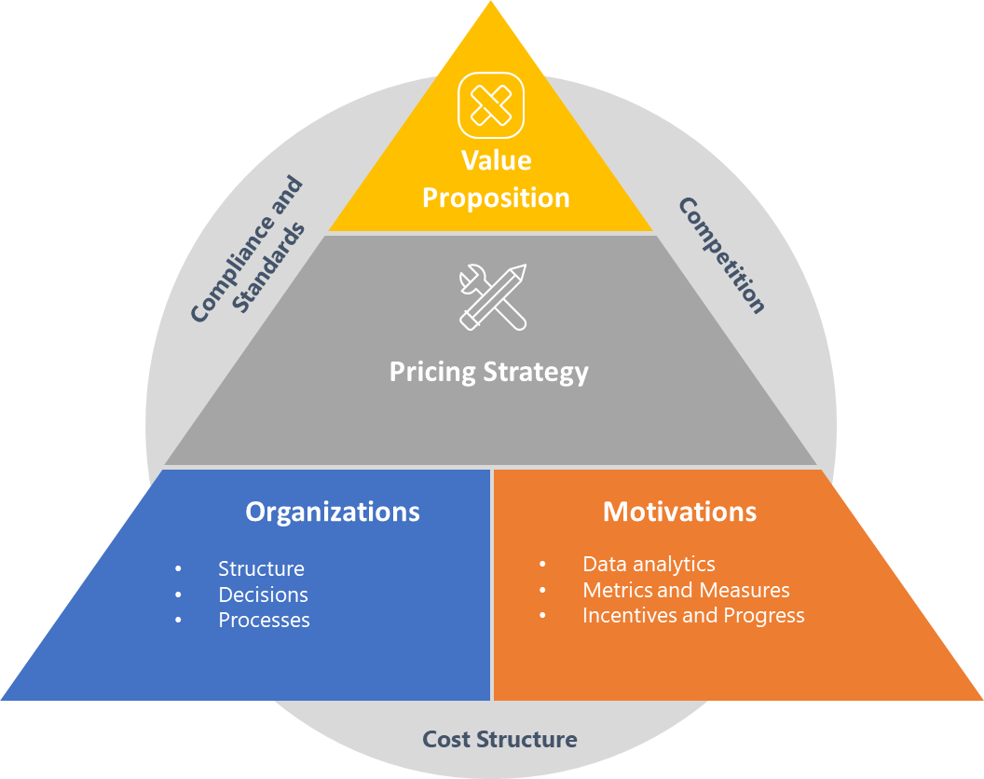
Pricing Strategies
Engage with time tested price strategies , used and deployed for leading brands at different stages and review what's useful for your organisation and brand
UpskilPRO e Institute for Sales & Marketing
Tools, Content & Templates
Hand built using experience & insight

Slide 2
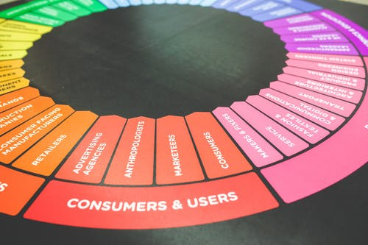

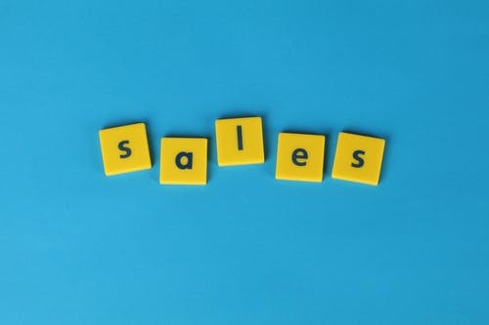

Created by
ex-Procter & Gamble, Rothmans, BAT, Gillette, Nokia,
Microsoft & 3M managers.
UpskilPRO tools are designed in easy-to-use solutions, all you need to do is download the tool and get to work immediately . All UpskilPRO material has taken 100’s of hours and many 1000’s of $ to build , all this expertise and content is brought to you for a fraction of the cost to help professionals enhance their capability.
core areas which are best suited to improve using our tools:
        Subject matter expertise
        Best practices
        Analytical output & charting
        Prioritization
        Process
Making life simpler for
Sales & Marketing professionals.
Tools in one place to get 10X productive now.

Slide 3


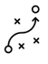

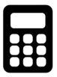
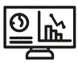
Job Descriptions
Develop roles clearly and completely across varying levels of experience
Agreements
Draft your business agreements across a variety of areas
Templates
Templates are designed based gather information in a structured manner
KPI’s
Performance indicator, a quantifiable measure of performance over time versus a specific objective.
Content Modules
Best practice material in power point for use as a knowledge base in business training , planning and execution .
Strategic tools
These tools are recognised the world over in business schools, consulting firms and companies who plan strategically.
Gain a competitive edge using the best tools and techniques to build a better you .
Analytical Tools
Interactive excel tools on specific business areas based on your data inputs delivered in a workbook model with instructions.
Scorecards
Designed as functional or subject indicators across a variety off situations to enable performance of situational evaluation versus aligned standards.
Calculators
calculate the right ratios for businesses looking for benchmarks in a variety of situations
Assessments
Assessments are designed around specific areas to conduct reviews and will center around a benchmark reviewing individuals or functions
Checklists
Designed around achieving milestones in a sequential manner.
Research
Research tools for sales and marketing engagement

Slide 4
2017
2018
100’s of tools grouped in 12 categories, 50 tool types and 12 business functions in 1 place.
get 10X productive now !
Categories
Functions
Analytical Tools
Types
Business Development
Agreements
Advertising
Customer Acquisition
Margins
Partner Search
Reports
Category Management
Assessments
Agreements
Customer Management
Market Analysis
Persona Development
Retail Measurement
Channel Management
Content Modules
Analytics
Distribution
Market Development
Planning
Reviews
Distribution
Checklists
Barriers
Distributor Management
Market Research
Positioning
Sales Management
Distributor Management
Calculators
Business Reviews
Forecasting
Market Segmentation
Pricing
Scorecards
General Management
Job Descriptions
Business Intelligence
GAP Analysis
Market Size
Prioritization
Segmentation
Key Account Management
KPI’s
Channels
Go To Market
Marketing
Product Development
Six Sigma
Marketing
Research
Communication
Job Descriptions
Marketing Comms
Product Life Cycle
Socio Economic Classification
Marketing Operations
Strategic Tools
Competitive Evaluation
Key Account Plans
Merchandising
Profit & Loss
Territory Design
Sales Management
Scorecards
Competitive Intelligence
Management Summary
New Market Entry
Promotions
Trade Marketing
Shopper Marketing
Templates
Trade Marketing

Slide 5



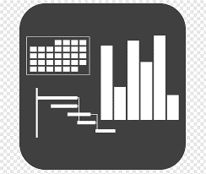




7 Benefits of using UpskilPRO :
Improve your knowledge
with professional Strategic Tools , Templates and planning documents for any business situation!
Use readymade tools
with filled in examples and ready to print & edit at your convenience . Just edit and fill-in the blanks !
Develop YOUR BUSINESS
Learn , & utilize the knowledge and processes and enhance your capabilities as the other companies have
We Created UpskilPRO for the
  Sales Professional
  Trade Marketer
  Marketing Executive
  Operations Manager
  VP/Director/Manager
100’s of tools , TEMPLATES & documents
CREATED BY
world class sales and marketing
business professionals.
All tools
are based on topics and subject based situations and are simple and easy to use .
SAVE THOUSANDS OF DOLLARS
The average company will save 1000’s of $ per employee in time & effort using our ready tools !
Top Quality Tools & Templates for developing both you and your business.
www.upskilpro.com

Slide 6

Pricing strategy is awareness,
awareness is control
&
control is profitability.

Slide 7
Pricing Environment
The Pricing Management Summary
Enter your company vision here
8092
Pricing Management Summary Our go to market model is designed with 3 key criteria to drive market share and profitability . A) Analytics & Intelligence B) Market specific product fit C) Full process ownership
Mission |  |  |  | Vision
Financials ( Clarify 1 or 3 years ) | Top line from X Mn $ to Y Mn $ in 3 years |  |  | Contribution gross margins increase from 46% to 48% |  | Contribution income to increase from 19% to 23%
Growth contribution |  |  | Last Year Sales | This year Plan | This Year Sales | This Year vs Plan | Last Year vs Plan
 | Nett Sales
 | % Volume
 | % Price increase
 | % Translation
 | % Sales Growth
Price Index | Price Index versus competition |  |  | Price index versus last year |  | Price index versus previous year
Teams | Pricing Audit process Schedule | H1 | H1 | Pricing Process and Policy Manager Responsible |  | Pricing Management Committee members
 | Dates | Auditor 1 Auditor 2 | H2 | Dates | Policy Manager | Dates | Member 1 Member 2 Member 3
Your accounting standard is best . Net sales is used in line with International Accounting Standards
Enter your company mission here
www.upskilpro.com

Slide 8
Pricing Strategies
Pricing Ownership
Pricing background
All Prices have an anchor
All Prices are measurable
All Prices must have an owner
1
2
3
Understand consumption
Understand competition
Understand USP
Understand layers of pricing
Understand your market
Understand final consumption
Develop your price versus features
Understand the market you compete in
Understand how you will measure price
Align pricing to financials
Align pricing to specific activity
Develop KPI’s
Develop Pricing team responsibility
Automate pricing
Develop customer segmentation
Develop Channel Segmentation
Develop clear pricing Structure
Develop internal competencies
Develop internal stakeholders
Align Strategic Plan engagement
Sync with Operating plan
Enabler for growth
www.upskilpro.com

Slide 9
Pricing Strategies
Strategic Pricing Values
Value
Proposition
Legal , ethical and compliance standards ensure engagement and context to the organization for profitable results
Compliance and Standards
Competition
Strategic Pricing values
Understand value to Selling value
Operational efficiency to service organisation
From features to structures
Key to embed the pricing strategy within the organization with communication and training
Pricing Strategy
Organizations
Motivations
Setting measures and using data analytics aligned with the organization builds trust and ownership in functions
The biggest impact on pricing decisions comes form the organization , forming pricing organizations and committees delivers better strategy and alignment to the overall plan.
Structure
Decisions
Processes
Data analytics
Metrics and Measures
Incentives and Progress
Pricing ownership aligned with metrics and visibility of data is key to engaging internal audiences
Cost Structure
Opportunities , constraints embedded in the companies cost structure
www.upskilpro.com

Slide 10
Pricing Environment
Pricing Gears
3
SPECIAL DISCOUNTS & TERMS
4
PROFITABILITY
7
UNIT COST
2
TRADE TERMS
1
LIST OR PUBLIC
PRICE REVIEW
5
TAXES / CLEARANCE
6
DUTIES
www.upskilpro.com

Slide 11
Pricing Strategies
The Strategic Pricing Pyramid
Price Setting
Understanding the mix between , cost , price positioning , CoGS , and competition is crucial to establish the price strategy relevant to the business .
Price
Policy
Clearly structured policies enable a company to achieve its planned ( immediate ) objectives without causing customers, to adapt their behaviour in ways that undermine the volume or profitability of future sales. Additionally it establishes the current terms playbook on how to deal with customers , products and geographies in price terms.
Price
communication
Design communication across the value chain delivering different stage messages to consumers so as to arrive at price in a meaningful manner .
Design and develop price structures that align prices with differences in value and cost across segments for different customer choices .
Price Structure
Value is created from understanding customers and their needs and planning accordingly , create value cost effectively , and convince customers to pay for that value precisely
Value Creation
www.upskilpro.com

Slide 12
Pricing Environment
Price Design
Market Pricing
Price Policy
Price Execution
Pricing Profitability
Pricing Analytics
www.upskilpro.com

Slide 13
Pricing Strategies
Ownership
Consumption
Strategies
Industry
Channels
Companies
Analytics
Operating Plans
Strategic Plans
Distribution
Policies
Unit Economics
Financial Plans & Standards
Research
Pricing Profitability
To deliver effective pricing strategy , it is essential to organize around 4 fundamental areas
Industry
Financial discipline
Pricing Custodianship
Effective consumer understanding
Stakeholders
www.upskilpro.com

Slide 14
Pricing Environment
Product Life Cycle Influences in pricing
Depending on the industry and the product life cycle stage most of the price management settles into a tactical set of engagements while holding price.
The pricing adjustments tactically come into engagement and help align the marketing mix with improved productivity
Very industry has different life cycles, at this stage the emphasis lies additionally on the marketing mix to drive pricing strategy alignment with tactical leverage.
Pricing & margins are under pressure mostly at launch phase, a strategy alignment along with the operating plan will prepare a sound base.
The Maturity phase is when companies start preparing on 2 strategies , revalidate pricing and review tactical adjustments.
Its important to know when the decline phase starts as it requires intensive management of existing stock and management of stakeholders to ensure the exit strategy is seamless with a back up plan in place .
PRODUCT
EXTENSION
SALES
The growth phase presents sales velocity , with emphasis on getting the marketing mix elements right .
Companies usually continue to drive a premium pricing strategy
New Product introductions bring something new to the consumer , if it addresses an existing or perceived gap , a skim price model is applicable for the early part of the PLC . This largely depends on the industry
Pricing Model
Sales velocity increases and so do market complexities on pricing & PLC management
INTRODUCTION
GROWTH
MATURITY
DECLINE
www.upskilpro.com

Slide 15
Pricing Strategies
#2 Competitive Price Segmentation
Price Structure
Tactical Price Variations
#2
Unit pricing
Tiered pricing, bundled pricing, subscription
Pricing for revenue (yield).
Customer Segmentation
Channel Segmentation
Target Market
Socio economic classification
Deregulation
Price discounts, rebates, coupons,
Temporary sales, and other forms of promotional or tactical discounts.
market and required organizational capabilities. While individual
price variances would be tactical decisions, the choice to allow them
Consistently high prices
Everyday Low prices
Price variance to drive market share and / or profits.
Customer mix management
See example ( next page ) of a Price structure embedded with tactical price variations serving , product categories , Customers , Channels and Price determinant features.
www.upskilpro.com

Slide 16
Pricing Strategies
#3 Competitive Price Reaction
Competitive Advantage
( With Pricing power )
Competitive Advantage
( Without Pricing power )
#3
Unit pricing
Tiered pricing, bundled pricing, subscription
Pricing for revenue (yield).
Customer Segmentation
Channel Segmentation
Target Market
Socio economic classification
Deregulation
Price discounts, rebates, coupons,
Temporary sales, and other forms of promotional or tactical discounts.
market and required organizational capabilities. While individual
price variances would be tactical decisions, the choice to allow them
Consistently high prices
Everyday Low prices
Price variance to drive market share and / or profits.
Customer mix management
See example ( next page ) of a Price structure embedded with tactical price variations serving , product categories , Customers , Channels and Price determinant features.
www.upskilpro.com

Slide 17
Pricing Environment
Common pricing strategies
Setting a high price initially because of a market of product advantage while recognizing that the advantage is not sustainable. As competitors respond and supply of competing alternatives increases, prices must come down to remain competitive. Skimming is appropriate for pulling profits from market segments that are not sensitive to price.
Setting prices high because of significant product differentiation or brand perception. Premium pricing is appropriate when substantial and sustainable competitive advantages exist.
Skimming
Premium
Volume
High
Low
Premium
Skimming
High
Price
Economy
Penetration
Low
Penetration
Initially setting prices artificially low to gain market share, then increasing price once share targets are achieved. Penetration pricing is appropriate when the threat of competition is imminent and the opportunity to lower production costs comes as a result of volume sales. This strategy’s appeal increases as the market potential grows
Low frills pricing enabled by keeping marketing and production costs to a bare minimum. Economy pricing is appropriate when a product is a “Cash Cow” and marketing for the product category done by competitors provides adequate awareness.
Economy
www.upskilpro.com

Slide 18
Pricing Strategies
Pricing Strategies
Value
Premium
Cost plus
Penetration
Psychology
Competition
Skimming
Economy
Promotional
Strategic Intent
Tactical Intent
www.upskilpro.com

Slide 19
Pricing Strategies
Positioning
Price skimming may be considered to high a price to pay for by certain consumers
High reliance on differentiation and features to establish a unique position.
Value reigns supreme
Short terms strategy
High profits in the short term
Skim
Price could be higher or lower than the competitive price point
Competition
More Benefits
Neutral
Price
Value
Less Benefits
Price neutral is low on price war probability
High on peer feature comparison for entrenched competitors
Stresses more on the marketing mix to deliver price neutral as a strategy
Price neutral can be the starting point for establishing a price strategy
Perceived as low benefit to low price
Price is established as lower relative to competition.
Lower profitability
Relatively higher volumes
Difficult to defend
Penetrate
Benefits
www.upskilpro.com

Slide 20
Pricing Strategies
#2 Tactics for Segment pricing.
Strategic and operational discounts applied at various levels for management
Analytical Tools
Basic Price List Structure
Segments / Channels
Tiers – Customers are divided into tiers to manage them better – This gives customers price and service advantages in relation to contribution
Product – This is clear product descriptions which are the same across all company systems and specially customer invoice
Category – This is a tactical discount in relation to category importance and priorities , it may be withdrawn at any stage as it is time bound and separate to normal discounts
List Price – This is the most important position in the price list as it defines the starting point of customer value and of the price discount strategy
Channel Discount – This may be a normal discount applied in line with industry standards
Special Discount _ this is a normal exigency discount field used in special strategic circumstances
Tiers Discount – This is applied on a mix of customer importance and category importance , on the basis of customer achieving strategic objectives and maintaining this discount over a period.
Activity Discount – This is a tactical discount used on a tactical basis on a limited basis for execution based initiatives
Prompt Payment – This field is driven by operational excellence objectives in this case for securing outstanding payment on time .
Final price – may be taken as nett price after all discounts .
* This file is available on www.upskilpro.com in an editable version , use the reference number provided on the top right

Slide 21
Pricing Strategies
Value Based Pricing Strategy
Differentiation and leverage of features and benefits
Complexities and granularity of detail
Value based Pricing ( Strategy ).
Value based pricing or value added pricing , is the capability to set a price by which the brand owner differentiates his brand offering versus a competitor for a particular customer segment
Generally used as an umbrella or positioning to convey the value of a product in the eyes of a consumer
Good marketers execute a value-based pricing approach using points 1 & 2 and build a framework that leverages their brand, product features, audience demographics, and market position.
Disadvantages of value-based pricing
Complex: A value-based pricing can be difficult to implement because it is a complex process that involves lots of research and analysis.
Time consuming: Because there is considerable research and analysis involved, creating a value-based pricing strategy takes time to set up.
Communication Campaign
Marketing Campaign
Target Audience
Comparative exchange Value
Competitive Landscape
Price Position
Advantages of value-based pricing
Considers internal and external variables, it is more strategic than cost-based pricing as it works on differentiation versus competition.
Value-based pricing requires a lot of research which gives you a better understanding of your audience, competitors, and market.
More insights: executed research and work on audience can spark ideas for product development.
Higher profits: In a value-based pricing method, you “maximize” your price by asking the highest possible price you can based on perceived value.
Self Fulfilment
Benefit P3
Markets
Channels
Distribution
Portfolio
Pricing
Features
Benefit P2
Missing benefit N1
Psychological needs
  Segmentation
  Targeting
  Positioning
Benefit P1
High end of market
Alternate comparable
Product
Appropriate customer value to be exchanged
Own Brand Price Position
Competitive Price Position
Basic needs
Each benefit placed above a core product gives the consumer additional motivation to buy
www.upskilpro.com

Slide 22
Pricing Strategies
Premium Pricing
Price premium bandwidth defined ; a premium price can be as high as your defined strategy dictates.
The defined price at which the product will be eventually positioned
Premium Pricing ( Strategy).
A premium pricing strategy deploys a higher price as a psychological attribute , relating to USP , Intellectual Property , Patents , quality , additional features , service .
It is a strategy which reflects both a competitive landscape evaluation and a gap in the current market offering
Price positioning Territory
The complete set of defined values the product offers a potential customer
A premium pricing strategy deploys a higher price as a psychological attribute , relating to quality , and features , service . It is a strategy which reflects both a competitive landscape evaluation and a gap in the current market offering.
Skimming / Premium
Own brand
Competitor A
Competitor B
Product
Cost
Value
Price Position
Positive Margins
Convey & Communicate
Inline / Parity
A representation of the product representing its features and in finished form
Baseline for nearest defined competitor
Penetration
A representation of the product cost including fixed and variable / CoGs
Negative Margins
The baseline may be identified as a branded competitor or global competitor with the right blend of attributes before the premium position is put into place.
References
The nearest identified competitor is identified as a baseline and the premium position is identified versus the baseline .
A reference point of a competitive landscape evaluation pointing to the relevant market leader helps decide the reference point of establishing the competitive positioning . It is not entirely or wholly necessary in some cases , but helps always to navigate a strategy .
www.upskilpro.com

Slide 23
Pricing Strategies
Penetration Strategy
Penetration Pricing ( Strategy ).
Price positioning Territory
Usually this is an early entry strategy , or late life maturity method to drive sales , the key factor is with low margins the volume may well be higher than the value of sales , the advantage is high volume sales could be a market share retention strategy , or defensive strategy to keep the competition on a defence and make it expensive for them to enter the market or stay long penetration strategy involves setting a price so low that the new product sells briskly.
Skimming / Premium
Own brand
Competitor B
Competitor A
Factors Supporting Penetration
A key factor supporting the use of a penetration strategy is the ability of a price that is low with respect to the product’s VTC to serve as an incentive for the customer to buy. A penetration strategy depends on a large market response to a low price. One way such a large market response might occur is if the low price leads customers to find new uses for the product
Factors not supporting Penetration
If the price determinant is so small it may not be noticed by customers
Positive Margins
Inline / Parity
Product
Cost
Value
Price Position
Penetration
Negative Margins
Convey & Communicate
www.upskilpro.com

Slide 24
Pricing Strategies
Economy Pricing Strategy
Economy Pricing ( Strategy ).
An economy pricing strategy is usually deployed by organizations who have low production costs , in some cases little or no marketing capability and assets deployment , so executing a low-price strategy to drive volume works well for them , in many ways its like a cost-plus strategy .
At its core, an economy pricing strategy is like a cost-plus strategy , which has low production costs and set a price for it that provides you with a gross profit.
Product Solutions
Price positioning Territory
Skimming / Premium
Premium
Own brand
Competitor A
Factors Supporting Economy Pricing
If you have a differentiated product tier strategy , which addresses the customer needs at a multi level basis , it is possible that for each need or level you may have a differentiated product addressing needs .
Everyday low pricing in key retailers, while this serves as a crowd puller it may have a category profit margin decrease , however in the larger business it will have a positive upside
It’s easy to implement, keeps costs low, and makes your product or service appealing to buyer persona’s interested in a value deal or promotion , it drives lower customer acquisition costs relative to other strategies
Quicker market entry
Most commonly related to a customer acquisition strategy as opposed to a pricing strategy.
Competitor B
Positive Margins
Value Added
Basic
Inline / Parity
Product
Cost
Value
Price Position
Penetration
Negative Margins
Factors against Economy pricing
Economy pricing works in specific market conditions, organisations which have low or no brand awareness are more in the commodity product category , while those in the aware and branded category can deploy this strategy and also as quickly start to exit from it
Companies that have no market share or brand awareness won’t be able to keep their operational costs low enough to make this pricing model work. And if you’re just starting out, economy pricing can negatively impact the customers’ perception of value for your brand.
The model relies on thin profit margins to keep prices low and requires a consistent volume of new customers to maintain revenue.
Pricing your product or service so low makes it hard for potential customers to connect the value of the product with its price and makes it difficult to raise prices.
www.upskilpro.com

Slide 25
Pricing Strategies
Skimming Strategy
Skimming Pricing ( Strategy ).
Price positioning Territory
A skimming pricing strategy will involve or deploy a price which is highest in the market appealing to some but not all customers , while volume may initially be low , the average value of the customer may be the highest in a comparable environment .
The skimming strategy involves setting a price so high that it appeals to aspirational customers mostly , while the profitability may be high it may not be a viable long term strategy.
Skimming / Premium
Own brand
Competitor A
Competitor B
Product
Cost
Value
Price Position
Positive Margins
Convey & Communicate
Factors Supporting Skimming
A key factor underling a skimming strategy in setting an initial price wherein the customers associate risk , in this case the technology industry is one example in relation to products that are new to the market commonly referred to as innovative and new. Most commonly consumers have understood the cycle associated with skimming and technology and the bulk wait on the side-lines for the prices to drop and the first bugs to have been fixed before committing
Economic risk, a possibility that a consumer product involving a large expenditure may not perform as Expected
Physical risk, such the chance that a new recreational product could lead to accidents or that a new medical procedure could have serious unforeseen side effects
Inline / Parity
Penetration
Negative Margins
www.upskilpro.com

Slide 26
Pricing Strategies
Cost Plus or Mark up Pricing.
Cost Plus Pricing ( Strategy ).
Cost plus pricing is a very simple cost-based pricing strategy for setting the prices of goods and services. With cost-plus pricing you first add the direct material cost, the direct labor cost and overheads to determine what it costs the company to offer the product or service.
A markup percentage is added to the total cost to position selling price . This markup percentage is profit. Thus, you need to start out with a solid and accurate understanding of all the business' costs and where those costs are coming from.
Price positioning Territory
Product
Value
Generate Margin
Profit
Cost
Cost
Factors Supporting Cost Plus.
Factors against Cost Plus.
Simple consistent method for allocating overhead costs each accounting period going forward to maintain integrity with the cost build-up.
Locking revenues in with a contract: Any supplier would like to have a contract with cost-plus pricing because it essentially guarantees sales with a certain profit percentage and coverage of all production costs with no risk of having a loss.
A way for suppliers to justify and explain a price increase: With cost-plus pricing, price increases are easier to roll out because companies can simply inform clients that the costs to produce the product have risen.
Pricing doesn't consider the competition: The product could be priced too high, which would cost the company in terms of lost sales and market share. The pricing could also be lower than the competition's, causing the company to lose potential profits because of not charging the market rate for its goods.
Suppliers have little incentive to control or reduce costs: When they've entered into a cost-plus pricing arrangement, companies end up producing what they want, regardless of what it costs to produce or how it sells in the market.
Runaway costs from suppliers hired on a cost-plus basis: Suppliers have the incentive to include every possible cost in a cost-plus contract, rather than looking for ways to cut costs and streamline.
Doesn't consider most recent replacement costs. The cost-plus method is based on historical costs and doesn't factor in any recent changes in the amount of costs incurred.
Selling Price
Material Cost
Labour Cost
Overheads
Mark up
www.upskilpro.com

Slide 27
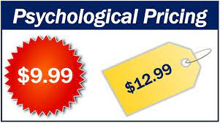
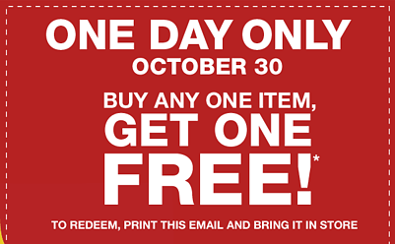
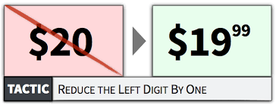
Pricing Strategies
Psychology Pricing Strategy
Psychology Pricing ( Strategy ).
Psychological pricing is the business practices of setting prices lower than a whole number. The idea behind psychological pricing is that customers will read the slightly lowered price and treat it lower than the price is. An example of psychological pricing is an item that is priced $3.99 but conveyed by the consumer as 3 dollars and not 4 dollars, treating $3.99 as a lower price than $4.00.
Product
Cost
Convey & Communicate
Price Position
Value
Factors Supporting Psychology Pricing
One day sales only
Lower the threshold , 1.99$ makes it more appealing to a consumer than 2.05 $
Prices ending in a 9 have a higher or increased demand from consumers
Value price ( 99$ ) or prestige price ( 100 $ ).
“Buy 1 Get 1 Free” is better than “50% off”
19 is better than 19.00$ as the lack of the decimal points and the Currency indicator make it easy for consumers to part with their money.
Factors against Economy pricing
Psychology pricing works in specific conditions , not al conditions, however some industries are more suited than others , industries like Retail , Online e commerce portals, and car rental agencies for example use this approach more because consumers are either looking for a deal or can be swayed by a deal.
Pricing in isolation seldom works , it works well with brand awareness , communication and comparisons.
www.upskilpro.com

Slide 28
Pricing Strategies
Promotional Pricing Strategy
Promotional Pricing (Tactic).
Promotional pricing primarily acts as a sales multiple factor , its typical characteristic is a % amount reduction for a time period or a free product or service attached to make it attractive , this in turn artificially increases a product's value for a sales boost by creating a time line and limited product scenario , it works well if the promotion is time bound and temporary .
It looses all relevance if it is available all through they the year.
The act of offering a lower price temporarily is to enhance the effectiveness of sales efforts to cost sensitive users.
Promotional pricing can also act as a sales initiative amid launching products or services.
Business Segment
Price positioning Territory
Tactics
Everyday base Price Business
Regular
Non promoted
Business
Base business
Loyal customers
Actual market share
Normal Margins
Planned Margins
70%
Product
Cost
Value
Price Position
50%
Psychological Price Business
Promoted Business
Sale conversion
Loyalty base
Market Share driver
Low Margins
30%
Factors Supporting Economy Pricing
Increase sale conversion and customer base
Works very well to increase sales and loyalty if used very carefully
Usually its best budgeted for in the annual plan to keep profitability aligned
Margins after Promotion
Margins before Promotion
Factors against Economy pricing
Used as a tactical tool constantly it looses relevance
Used constantly it can result in loyal customers switching to brands
Promotions sometimes convey varying messages , from desperateness , quality issues and lack of customer loyalty base.
Margins averaged
www.upskilpro.com

Slide 29
Pricing Strategies
Topic – Cost versus Value Based Pricing
Impulse and Trust
Cost Based Price
Product
Cost
Price
Customer Price
Buyer’s perception
Value Based Price
Customer Price
Value
Price
Product
Cost Based Price
Value Based Price
In a cost based pricing scenario , usually a decided margin is placed which decides the final price to the customer , this is often done when a basic approach is used to execute a pricing strategy.
In a value based pricing scenario , usually the final price is decided based on marketing inputs from a consumer perspective of , Affordability , Perceived Value and Value proposition which decides the final price to the customer , this is often done when the price is determined from a top down approach using marketing influences.
www.upskilpro.com

Slide 30
Pricing Strategy
Score Card
In progress / completed
Not yet completed
2003
Macro level features
State
Micro level features
State
List Price
Customer Segmentation
Identified Channel Discounts
Channel Segmentation
Identified Category Discounts
Customer Alignment to Discounts
Identified Tier Discounts
Customer Classification
Identified Channel Discounts
Pricing Policy
Identified Product Discounts
Pricing Currency
Identified Special Discounts
Pricing KPI’s
Identified Activity Discounts
Pricing Committee
Identified Objective Discounts
Price Communication
Sub Total
9/9
Sub Total
9/9
Total
18/18
www.upskilpro.com

Slide 31
Thank you !

Slide 32
Job Descriptions
Develop roles clearly and completely across varying levels of experience
Agreements
Draft your business agreements across a variety of areas
Templates
Templates are designed based gather information in a structured manner
KPI’s
Performance indicator, a quantifiable measure of performance over time versus a specific objective.
Content Modules
Best practice material in power point for use as a knowledge base in business training , planning and execution .
Strategic tools
These tools are recognised the world over in business schools, consulting firms and companies who plan strategically.
Gain a competitive edge using the best tools and techniques to build a better you .
Analytical Tools
Interactive excel tools on specific business areas based on your data inputs delivered in a workbook model with instructions.
Scorecards
Designed as functional or subject indicators across a variety off situations to enable performance of situational evaluation versus aligned standards.
Calculators
calculate the right ratios for businesses looking for benchmarks in a variety of situations
Assessments
Assessments are designed around specific areas to conduct reviews and will center around a benchmark reviewing individuals or functions
Checklists
Designed around achieving milestones in a sequential manner.
Research
Research tools for sales and marketing engagement

Slide 33
Created by
ex-Procter & Gamble, Rothmans, BAT, Gillette, Nokia,
Microsoft & 3M managers.
UpskilPRO tools are designed in easy-to-use solutions, all you need to do is download the tool and get to work immediately . All UpskilPRO material has taken 100’s of hours and many 1000’s of $ to build , all this expertise and content is brought to you for a fraction of the cost to help professionals enhance their capability.
core areas which are best suited to improve using our tools:
        Subject matter expertise
        Best practices
        Analytical output & charting
        Prioritization
        Process
Making life simpler for
Sales & Marketing professionals.
Tools in one place to get 10X productive now.

Slide 34
Pricing Strategies
Engage with time tested price strategies , used and deployed for leading brands at different stages and review what's useful for your organisation and brand
UpskilPRO e Institute for Sales & Marketing
Tools, Content & Templates
Hand built using experience & insight

