Slide 1
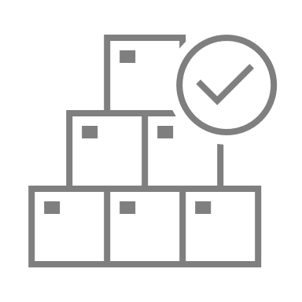
readiness
Pricing Construction
Score card
Price
Quickly evaluate your pricing readiness in 10 steps.
Planning Templates
assessment
UpskilPRO e Institute for Sales & Marketing
Tools, Content & Templates
Hand built using experience & Insight

Slide 2
Pricing Construction
Price list features readiness assessment scorecard
These are basic components of a price construction in a distribution led business leading to a value pricing model.
old no
8081
FEATURES
Tick for Readiness
new no
2010
List Price
Customer Sales Price
Channel Discounts
Features In Place
10
Distributor Discounts
Features not in Place
0
Gross Margin
Landed Cost
Readiness Level
10
Duties
Transportation
Net Factory Cost
A readiness level of 10 indicates you can manage prices effectively and translate into Financials with measurability
Product Stock No and ID

Slide 3
readiness
Pricing Construction
Score card
Price
Quickly evaluate your pricing readiness in 10 steps.
Planning Templates
assessment
UpskilPRO e Institute for Sales & Marketing
Tools, Content & Templates
Hand built using experience & Insight

