Slide 1
Key Account Management.
Module 10 – The KAM Role .
Sales & Marketing Fundamentals.
UpskilPRO e Institute for Sales & Marketing
Tools, Content & Templates
Hand built using experience & insight

Slide 2
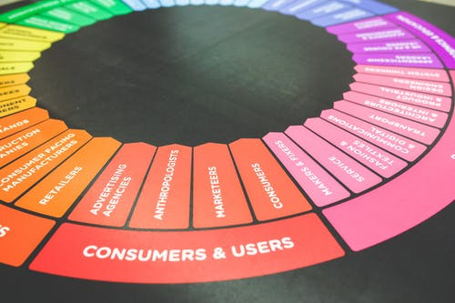
Created by
ex-Procter & Gamble, Rothmans, BAT, Gillette, Nokia,
Microsoft & 3M managers.
UpskilPRO tools are designed in easy-to-use solutions, all you need to do is download the tool and get to work immediately . All UpskilPRO material has taken 100’s of hours and many 1000’s of $ to build , all this expertise and content is brought to you for a fraction of the cost to help professionals enhance their capability.
core areas which are best suited to improve using our tools:
Subject matter expertise
Best practices
Analytical output & charting
Prioritization
Process
Training
Making life simpler for
Sales & Marketing professionals.
Tools in one place to get 10X productive now.

Slide 3
Job Descriptions
Develop roles clearly and completely across varying levels of experience
Agreements
Draft your business agreements across a variety of areas
Templates
Templates are designed based gather information in a structured manner
KPI’s
Performance indicator, a quantifiable measure of performance over time versus a specific objective.
Content Modules
Best practice material in power point for use as a knowledge base in business training , planning and execution .
Strategic tools
These tools are recognised the world over in business schools, consulting firms and companies who plan strategically.
Gain a competitive edge using the best tools and techniques to build a better you .
Analytical Tools
Interactive excel tools on specific business areas based on your data inputs delivered in a workbook model with instructions.
Scorecards
Designed as functional or subject indicators across a variety off situations to enable performance of situational evaluation versus aligned standards.
Calculators
calculate the right ratios for businesses looking for benchmarks in a variety of situations
Assessments
Assessments are designed around specific areas to conduct reviews and will center around a benchmark reviewing individuals or functions
Checklists
Designed around achieving milestones in a sequential manner.
Research
Research tools for sales and marketing engagement

Slide 4
2017
2018
100’s of tools grouped in 12 categories, 50 tool types and 12 business functions in 1 place.
get 10X productive now !
Categories
Functions
Analytical Tools
Types
Business Development
Agreements
Advertising
Customer Acquisition
Margins
Partner Search
Reports
Category Management
Assessments
Agreements
Customer Management
Market Analysis
Persona Development
Retail Measurement
Channel Management
Content Modules
Analytics
Distribution
Market Development
Planning
Reviews
Distribution
Checklists
Barriers
Distributor Management
Market Research
Positioning
Sales Management
Distributor Management
Calculators
Business Reviews
Forecasting
Market Segmentation
Pricing
Scorecards
General Management
Job Descriptions
Business Intelligence
GAP Analysis
Market Size
Prioritization
Segmentation
Key Account Management
KPI’s
Channels
Go To Market
Marketing
Product Development
Six Sigma
Marketing
Research
Communication
Job Descriptions
Marketing Comms
Product Life Cycle
Socio Economic Classification
Marketing Operations
Strategic Tools
Competitive Evaluation
Key Account Plans
Merchandising
Profit & Loss
Territory Design
Sales Management
Scorecards
Competitive Intelligence
Management Summary
New Market Entry
Promotions
Trade Marketing
Shopper Marketing
Templates
Trade Marketing

Slide 5
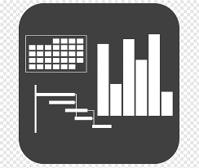
7 Benefits of using UpskilPRO :
Improve your knowledge
with professional Strategic Tools , Templates and planning documents for any business situation!
Use ready made tools
with filled in examples and ready to print & edit at your convenience . Just edit and fill-in the blanks !
Develop YOUR BUSINESS
Learn , & utilize the knowledge and processes and enhance your capabilities as the other companies have
We Created UpskilPRO for the
Sales Professional
Trade Marketer
Marketing Executive
Operations Manager
VP/Director/Manager
100’s of tools , TEMPLATES & documents
CREATED BY
world class sales and marketing
business professionals.
All tools
are based on topics and subject based situations and are simple and easy to use .
SAVE THOUSANDS OF DOLLARS
The average company will save 1000’s of $ per employee in time & effort using our ready tools !
Top Quality Tools & Templates for developing both you and your business.
www.upskilpro.com

Slide 6
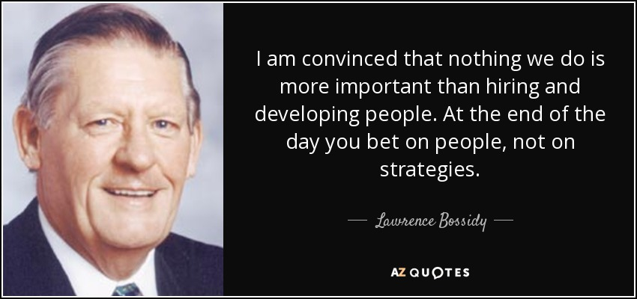
The Key Account Role
Role

Slide 7
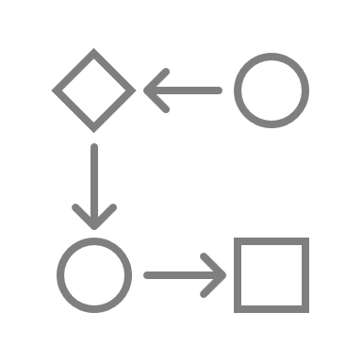
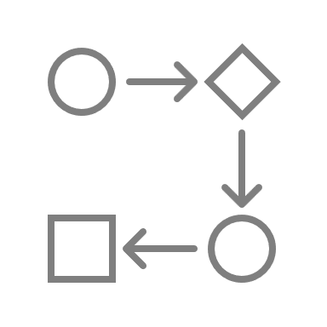
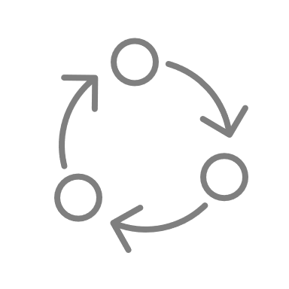
The Key Account Role
Directional Summary
The role of KA manager or the role of KA Management ?
Exactly how the role of key account management depends on what is your expectation of Key account management for instance is it a tactical role or a strategic role are you looking at incremental sales or market share will you be able to support different strategies for key accounts versus one size fits all.
Companies which make a success auto key account management focus on growing the account focusing on the customer and the consumer developing strategies to grow market share and deliver satisfied customers.
Unlike other roles KAM roles are focused on multiple directions aimed at different functions thereby they require a certain amount of skill sets which rise above the usual single functional requirement that most other roles have.

Slide 8
The Key Account Role
Iceberg View
Job Specification covered
33%
Most companies will cover the Job description from a high level and keep the drivers low in the KAM role leaving most of the emerging tasks to be discovered by the incoming candidate in our estimation about 1/3 off the job specification will be visible to the candidate
Job Specification not covered
66%
About 2/3rd of the job description delivery which is not covered comes with experience, time, and effort from the KAM manager this leads to constant evaluation of the job and the tasks at hand. In our experience the job specification will vary from country ,category ,company expectations ,seniority ,financials and the product life cycle accordingly we recommend breaking up key account roles into three or four levels of seniority to give teams time to develop .

Slide 9
The Key Account Role
Iceberg View
Opportunity
Key customers should be treated differently because of the size and the nature of the business and should be presented in tactical & strategic plans as a separate business opportunity and development
Customer risk can be monitored both internally and externally and evaluated as a possibility whilst forecasting revenue and profitability streams along with, if necessary, any legal implications .
Strategy and key account management measurements
Account management is a long-term strategy and they are also heavily dependent upon city councils' management and investor expectations ask the involved strategic investments ahead of time accordingly the key account management function needs to identify and report measures of a financial nature on a regular basis pertaining to shareholder value .
Risk
Customer asset value
customer lifetime value is the net present value of customers measure the order lifetime off their relationship with you usually fix the relationship. Between three and five years to assess 1) asset value and 2) cost of acquisition
Return on Investment
(RoI)
This measurement is expected from the operational level and strategic plans as this ranges from one year to five years it will include the costs and the deliverables for the management to evaluate and act upon

Slide 10
The Key Account Role
Role
Organization
Strategy
Functional
Key account managers
Present one face to the customer and deliver a centralized product to satisfy the customer and ensure we have created sustainable competitive advantages
Planning
Move the engagement from tactical low-level engagement to deliver strategy as a key element of planning and execution delivering trust & focus.
Personal
Proficiency
Internal
External
Key Customers
Manage customers , relationships , strategic relationships , sustainability , repeat business and long-term dependability and revenue
Engagement & processes
Deliver one face to the customer coupling best practices in managing the customer , category and deliverable revenue stream
Markets
Extensional
Operations

Slide 11
The Key Account Role
Role
Account focus and needs
Shared customers
We have outlined 8 different areas off needs that the role will address once these are by no means to be concluded they are clearly derived from what most key accounts will align with saying these are our strategies so the role of the key account will be to deliver.
What the customer and the supplier agree are the most important and these eight more or less aligned with what key accounts usually say other most important areas
Engaging strategies
Engage & prioritization of resources
Margin management
Coordination , regionally and globally
Profitability
Growth

Slide 12
The Key Account Role
Strategy realization and key account management measurements
Customer attractiveness needs to be monitored to ensure that the company’s strategy is aligned , the important point being that the customer is also on a growth trajectory.
Customer attractiveness
Customer profitability is important as it keeps the customers interest and investments in the business , to do so measurement both as a supplier and the customer internally should be able to monitor overall financial profitability .
Customer profitability
Calculating risk is important and also difficult , tracing risk starts externally via sources of risk to each customer , will allows us to evaluate exposure and impacts to the supplier business , this exercise is best done with all key customers.
Risk measurement
Customer Satisfaction
Customer satisfaction is best conducted by a 3rd party using a varied set of parameters and techniques on a set of subject matter parameters using depth and breadth with an agreed frequency standard.
Relationship
Measuring relationship is a very sensitive area , as there are many contact points , and the fact that relationship is a lead indicator ( ahead of the curve ) its best that experienced external research companies conduct this sensitive reading and that the supplier name is represented amongst a range of names as a bench mark indicator
Business extension
Business growth can be calculated at 2 levels 1) customer level 2) supplier level as both are different measurements ,it's always best to define your measurement areas and include them as organic and new business at customer and supplier level
Customer retention
Customer retention in your key account list should be based I'm not just share of business or spend but parameters which are more strategic in context and display long term thinking

Slide 13
The Key Account Role
Role of KAM
Engagement
Execution
Vision
 | Customer & Markets | Implementing KAM | Strategy & Organisation
Strategy | Mutually engaged customers | Single point of contact | Strategy & Vision
Insights & Analytics | Developing functional and relation driven business engagement | Utilising analytics and insights to deliver category and business growth | Engaging market insight and effecting market changes in direction
New Business | Joing planning and execution | Delivering capacity utilisation new market‘s and categories aligned with plans | Identify new markets
Planning | Engaging the category and capabilities of the customer and our products | Evaluation and planning systematically to deliver plants | Planning value addition for customer and supplier execution plans
NPD | Forecasting and evaluation | delivering category excitement | Innovation
Product development | Product feature delivery and excitement of customers | Aligning product categories to customers categories | Route to market strategy hinging on product and marketing engagement
Risk | Managing assets and resources | third party reporting | Risk management

Slide 14
The Key Account Role
Role of broader organisation in KAM
“Values to excel at”
Activity | Accountability
Strategy | Constant commitment and engagement from senior management delivering talk down engagement
Barriers | Develop’ s internal culture fosters collaboration and alignment and works towards breaking down barriers.
Resources | Harnesses organisation resources behind KAM aimed at delivering a superior product
Support | Engage engages cross functional rolls and promotes KAM function both internally and externally
Decisions | Delivers quick decisions based on commitments plans and reviews
Brand | Executes marketing excellence behind the brand
Monitoring | identify key measurement indices and makes the case for business evaluation and comparisons
In the above table we refer to 7 key characteristics that fall into the general best practices to help any function thrive in an organisation , specially one that is customer facing in a sales and marketing environment .
The key values from 1 to 7 embody an organisation which wants to be excellent in delivering a superior product and service to a customer , apply this to the key account function to gauge the current instance and where you would like them to be , apply this set of 7 values under your “values to excel at” communication in the organisation .

Slide 15
The Key Account Role
TRIFECTA ( 3 elements )
 | Customer | Mutuality | Supplier
Implementation | Customer intimacy | Mutuality through expertise | Customer engagement
 | Understand customer needs | Value development | Strategy & tactic development
 | Delivery on time | Accountability | Coordination
Facilitation | Relationship leverage specifically in suppliers | Central point of engagement | Relationship development
 | Managers customer and supplier | Expertise | Brand building
 | Single point of contact | Prime contact | Point of first contact
Facilitation
By trifecta we mean the three elements ,
Customer
Supplier
Mutuality
we break this down into two areas of implementation and facilitation implementation takes care of all the proactive measures to deliver value to the organisation and facilitation takes care of the execution of all the effort taken to bring the key account management role to its execution
Execution

Slide 16
The Key Account Role
TRIFECTA
Develops so supplier strategy for the customer
Aligns corporate strategy with customer strategy
We evaluate key account management from stage 1 to stage 4 , as we focus on each stage the seniority of the contacts and the decision-making levels move up significantly in both an escalating and transition impact.
Peer contacts at senior levels
peer contacts with escalating authority levels
Stage 4
Manages contentious issues
Access to senior management
Works out solutions with access to senior management
Stage 3
Responsibility acceptance
Handles customer issues
All issues stop here
Escalating Impact
Stage 2
Stage 1
Single point of contact
Escalation point of contact
Peer level of contact
Strategic contact
Key Transitions

Slide 17
The Key Account Role
Cross functional team
Functional alignment teams
Key Account Manager
Product / Manager
Customer engagement
Supply Chain
Marketing
As KAM accounts need to be managed across functional teams, we illustrate with a diagram on right indicating that the Salesforce inside sales and customer management are engaged from a geographical point to each of the functions in the customer engagement process such as purchasing supply chain and the buyers notwithstanding R&D engagement.
we recommend building up the contact list on two levels
Importance
Current level of engagement
Geography 1
Sales Force
R&D
Purchasing
Supply Chain
Marketing
Inside sales
Customer engagement
Buyers
Geography 2
Sales Force
Regional sales team
Inside Sales
Geography
1
Customer engagement
Buyers
Primary
Customer Engagement
( Role )
Geography 3
Sales force
Geography
2
Inside sales
Buyers
Customer engagement
Geography
3

Slide 18
The Key Account Role
Time & Task allocation ( breakdown)
11003
 | Customer | Time allocation
Market Focussed | Developing relationships | 20%
Market Focussed | Deal management | 5%
Market Focussed | Strategy & planning | 15%
Market Focussed | Direct selling | 10%
Market Focussed | Brand promotions and engagement | 15%
Internally Focussed | Internal engagement & alignment | 5%
Internally Focussed | Problem solving | 5%
Internally Focussed | Reporting | 10
Internally Focussed | Training and development | 15%
 | Totals | 100 %
This table may be used as an example , as there are many things that are not measured resulting in an overload on the KAM role
The point is may be taken as averages from the market as they represent an average bye activity
We are focused the points around 2 main groups market focused and internally focused in this case
The market focused activities contribute 60 plus percent of the total time spent
Training and development may be taken as both supplier training and customer training

Slide 19
Thank you !

Slide 20
Job Descriptions
Develop roles clearly and completely across varying levels of experience
Agreements
Draft your business agreements across a variety of areas
Templates
Templates are designed based gather information in a structured manner
KPI’s
Performance indicator, a quantifiable measure of performance over time versus a specific objective.
Content Modules
Best practice material in power point for use as a knowledge base in business training , planning and execution .
Strategic tools
These tools are recognised the world over in business schools, consulting firms and companies who plan strategically.
Gain a competitive edge using the best tools and techniques to build a better you .
Analytical Tools
Interactive excel tools on specific business areas based on your data inputs delivered in a workbook model with instructions.
Scorecards
Designed as functional or subject indicators across a variety off situations to enable performance of situational evaluation versus aligned standards.
Calculators
calculate the right ratios for businesses looking for benchmarks in a variety of situations
Assessments
Assessments are designed around specific areas to conduct reviews and will center around a benchmark reviewing individuals or functions
Checklists
Designed around achieving milestones in a sequential manner.
Research
Research tools for sales and marketing engagement

Slide 21
Key Account Management.
Module 10 – The KAM Role .
Sales & Marketing Fundamentals.
UpskilPRO e Institute for Sales & Marketing
Tools, Content & Templates
Hand built using experience & insight

