Slide 1
Trade Marketing.
Digital engagement
Sales & Marketing Fundamentals.
UpskilPRO e Institute for Sales & Marketing
Tools, Content & Templates
Hand built using experience & insight

Slide 2
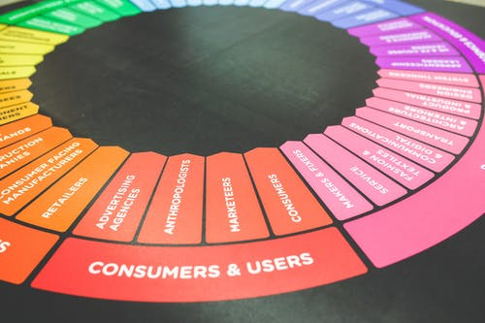
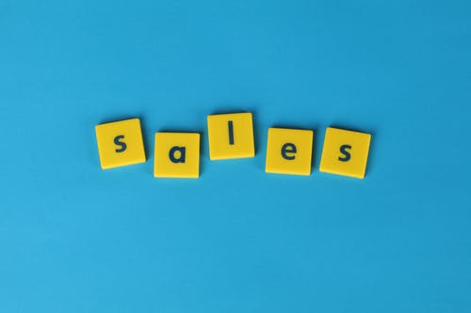
Created by
ex-Procter & Gamble, Rothmans, BAT, Gillette, Nokia,
Microsoft & 3M managers.
UpskilPRO tools are designed in easy-to-use solutions, all you need to do is download the tool and get to work immediately . All UpskilPRO material has taken 100’s of hours and many 1000’s of $ to build , all this expertise and content is brought to you for a fraction of the cost to help professionals enhance their capability.
core areas which are best suited to improve using our tools:
Subject matter expertise
Best practices
Analytical output & charting
Prioritization
Process
Training
Making life simpler for
Sales & Marketing professionals.
Sales & Marketing Fundamentals.
Tools in one place to get 10X productive now.

Slide 3
Job Descriptions
Develop roles clearly and completely across varying levels of experience
Agreements
Draft your business agreements across a variety of areas
Templates
Templates are designed based gather information in a structured manner
KPI’s
Performance indicator, a quantifiable measure of performance over time versus a specific objective.
Content Modules
Best practice material in power point for use as a knowledge base in business training , planning and execution .
Strategic tools
These tools are recognised the world over in business schools, consulting firms and companies who plan strategically.
Gain a competitive edge using the best tools and techniques to build a better you .
Analytical Tools
Interactive excel tools on specific business areas based on your data inputs delivered in a workbook model with instructions.
Scorecards
Designed as functional or subject indicators across a variety off situations to enable performance of situational evaluation versus aligned standards.
Calculators
calculate the right ratios for businesses looking for benchmarks in a variety of situations
Assessments
Assessments are designed around specific areas to conduct reviews and will center around a benchmark reviewing individuals or functions
Checklists
Designed around achieving milestones in a sequential manner.
Research
Research tools for sales and marketing engagement

Slide 4
2017
2018
100’s of tools grouped in 12 categories, 50 tool types and 12 business functions in 1 place.
get 10X productive now !
Categories
Functions
Analytical Tools
Types
Business Development
Agreements
Advertising
Customer Acquisition
Margins
Partner Search
Reports
Category Management
Assessments
Agreements
Customer Management
Market Analysis
Persona Development
Retail Measurement
Channel Management
Content Modules
Analytics
Distribution
Market Development
Planning
Reviews
Distribution
Checklists
Barriers
Distributor Management
Market Research
Positioning
Sales Management
Distributor Management
Calculators
Business Reviews
Forecasting
Market Segmentation
Pricing
Scorecards
General Management
Job Descriptions
Business Intelligence
GAP Analysis
Market Size
Prioritization
Segmentation
Key Account Management
KPI’s
Channels
Go To Market
Marketing
Product Development
Six Sigma
Marketing
Research
Communication
Job Descriptions
Marketing Comms
Product Life Cycle
Socio Economic Classification
Marketing Operations
Strategic Tools
Competitive Evaluation
Key Account Plans
Merchandising
Profit & Loss
Territory Design
Sales Management
Scorecards
Competitive Intelligence
Management Summary
New Market Entry
Promotions
Trade Marketing
Shopper Marketing
Templates
Trade Marketing

Slide 5
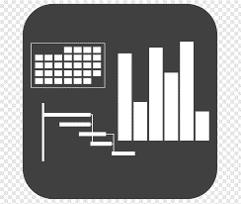
7 Benefits of using UpskilPRO :
Improve your knowledge
with professional Strategic Tools , Templates and planning documents for any business situation!
Use ready made tools
with filled in examples and ready to print & edit at your convenience . Just edit and fill-in the blanks !
Develop YOUR BUSINESS
Learn , & utilize the knowledge and processes and enhance your capabilities as the other companies have
We Created UpskilPRO for the
Sales Professional
Trade Marketer
Marketing Executive
Operations Manager
VP/Director/Manager
100’s of tools , TEMPLATES & documents
CREATED BY
world class sales and marketing
business professionals.
All tools
are based on topics and subject based situations and are simple and easy to use .
SAVE THOUSANDS OF DOLLARS
The average company will save 1000’s of $ per employee in time & effort using our ready tools !
Top Quality Tools & Templates for developing both you and your business.
www.upskilpro.com

Slide 6
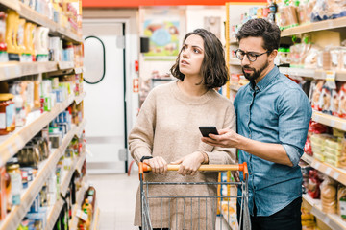
One of the highest penetration electronic devices in our lives is the mobile phone.
The sheer capacity of mobile apps is overwhelming in addition to this technology office geofencing and targeted offers this in turn offers retailers real time connection to consumers.

Slide 7
Trade Marketing
Examples of TM .
Brand marketing talks to people , Trade Marketing talks with them.
Category
POS
Retailer
Consumer
ROI
Promotions

Slide 8
Trade Marketing.
Engagement
A key aspect of the digital revolution coupled with consumption is the retailers ability to provide information and even engage in conversations with customers which in turn drives up the engagement perspective between retailer and consumer
One of the key challenges is for the design of offers and the display of merchandise in relation to the channel format this may be both offline and online the key challenge for marketers and retailers is to make assortment sizes or packet savers simpler delivering quality information and accurate descriptions.
An overlooked area is the merchandise presentation in the category many a time the store merchandising guidelines take over which results sometimes in a confusing set-of merchandising identity on shelf not related to what the manufacturers brand guidelines for merchandising are .
A key element is product packaging as it raises or lowers expectations in relation to product content some examples of this are perfume‘s creams Which can be quite confusing as an example of perfumes it is estimated that about 20% of the packaging contains perfume what’s left is the balance of 80% of the packaging ( air or space ) is clever utilization of packaging design.
www.upskilpro.com

Slide 9
Trade Marketing.
Visual display
One of the key challenges is for design of offers display merchandise in relation to the channel format this may be both off and online the key challenge for marketers and retailers is to make assortment sizes or packet savers simpler delivering quality information and ensuring that each item is specific to its description .
Another overlooked area is the merchandise presentation in the category which falls into three areas vertical horizontal mainly and diagonal sometimes , the criticality here is if the brand is powerful and the brand owner invests then the possibility of the brand owner getting his design is highly probable weather body colour horizontal in the event it’s a inactive brand then the store merchandising guidelines take over which results sometimes in a confusing set-of merchandising identity on shelf .
Another key element is product packaging as it raises or lowers expectations in relation to product content some examples of this are perfume‘s creams Which can be quite confusing as an example of perfumes it is estimated that about 20% of the packaging contains perfume what is the balance 80% is the clever design of packaging to deliver increased benefits and value to the consumer
another aspect appears Just a relation of sale prize what is the location of the product and displace is estimated with the sale prize may be more effective when placed to the right offer advertised reference price as opposed to the left.
www.upskilpro.com

Slide 10
Trade Marketing.
Technology & Tools
Retail continues to benefit from technological change in turn technology is a game changer for consumers enabling them to make better quality decisions and receive targeted communication with expedited service.
The cost to reach consumers is getting lower the gamechanger here once again as technology the landscape is full of mobile apps scan technologies self-checkouts smart pay et cetera
Retailers now offer manned and unmanned checkouts the difference being unmanned checkouts use self-checkout technology allowing shoppers to themselves scan the product and bag the product being with their cards this lowers costs .
Digital messaging at the category using the header boards , shelf talkers , audio systems , and the checkout are all areas to align technology with the shopper for subtle messaging
Another advantage of technology is using data analytics gathered from cash registers , store entry , footfall & epos data hand along with store cameras that gives them real time quality data feed hello and in turn allowing them to reduce wait times estimated from 5 minutes to about 45 seconds per consumer
The most important aspect of this technology revolution is for the supermarket staff they have to concentrate on specific areas thereby reducing their physical output increasing their happiness quotient and reducing stress.
One of the highest penetration electronic devices in our lives is the mobile phone. The sheer capacity of mobile apps is overwhelming in addition to this technology, office geofencing and targeted offer retailers real time connection to consumers.
Mobile apps and promotions can take advantage of positioning information offering location relevant promotions This capability allows retailers and Brands to adapt promotions.

Slide 11
Trade Marketing.
Big Data
The retail industry is driven by consumers product‘s categories and the data they contain.
The amount of data generated from a single individual can be traced to his receipt at the checkout and his personalised information stored by the supermarket if he is a member of their club which in a period of time will generate almost for her preferences in terms of products sizes branch categories and quantities coupled together with seasonality location and shopping bag size this makes for a sizable amount of data when you consider The average shopper spends under 60 hours a year in the supermarket And on average 34 million shoppers every single day of the week
Broad segments of the big data are customer and household information general or loyalty sales website social data product location time and channel .
www.upskilpro.com

Slide 12
Trade Marketing.
Analytics
Data is considered the most valuable resource next to oil and gold , data gives any industry that capability to develop strategies which in turn drive profitability.
Strategies are driven by market ,manufacturer, store and consumer
Strategy the store level is driven by marketing mix location and the environment, at the store level executional actions include specific pricing first followed dynamic pricing mobile targeting and technology to improve consumer experiences
www.upskilpro.com

Slide 13
Trade Marketing.
Analytics
Grocery Shopping Facts & Numbers
1. The US grocery market size is $758.5 billion.
What is even more impressive is the size of the global grocery market — over $12 trillion!
2. The mass-market players accounted for 48.1% of sales in 2020.
The top 10 American supermarket companies in terms of sales are:
Walmart (Walmart and Sam’s Club)
Kroger (Kroger, Harris Teeter and Smith’s)
Costco
Albertsons (Safeway, Albertsons, and Vons)
Ahold Delhaize (Food Lion, Stop & Shop and Hannaford)
Publiz Super Markets
H.E. Butt Grocery
Meijer
Wakefern Food (ShopRite, Price Rite, The Fresh Grocer, Dearborn Market and Gourmet Garage)
Aldi and Whole Foods
3. Walmart dominates the sector with a 16.3% market share in 2020.
4. Grocery store food prices rose 3.5% in 2020.
5. The average time spent grocery shopping is 41 minutes.
(6. Saturday is the most popular day for grocery shopping.
7. Grocery stores in the US are busiest Monday through Thursday.
8. 64% of US consumers have shopped for groceries online.
9. US online grocery sales totalled $95.8 billion in 2020.
10. Online grocery sales in the US are estimated to reach $187.7 billion by 2024.
11. People tend to spend nearly $40 more when doing grocery shopping online.
12. More than 60% of offline grocery shoppers consider buying new brands.
13. Grocery shopping accounts for 39% of voice-based orders.
14. 45% of Millennials do their grocery shopping online.
Supermarket Statistics
15. Women are more likely to do most of the grocery shopping.
16. On average, grocery shoppers in the US are 44 years old.
17. Women take longer to get their shopping done.
(18. Almost 25% of grocery shopping money gets spent on processed foods and sweets.
19. 83% of shoppers prefer going to traditional supermarkets to drugstores, supercentres, gourmet grocers, or warehouse clubs.
20. 69% of women make a grocery shopping list beforehand, compared to 52% of men.
21. On average, multi-person households spend $121.50 for groceries every week.
22. Professional personal grocery shoppers earn on average about $27 per hour.
23. There are more than 42,505 supermarkets in the US.
24. The average grocery store size in 2020 was 38,000 square feet.
The average grocery store size is currently 38,000 square feet, with small formats ranging in size between 12,000 square feet and 25,000 square feet, and even smaller in urban markets.
Commonly forgotten grocery items are toilet paper, paper towels, laundry detergent, razors, Kleenex, dish soap, shampoo, trash bags, coffee, milk, batteries, and toothpaste.
www.upskilpro.com

Slide 14
Trade Marketing
Digital engagement
Trade marketing facilitates the exchange of value between manufacturers and retailers resulting in consumers getting great choices and value for their budgets in the form of displays , deals , promotions and coupons at the point of sale
Technology has always been a game changer and disruptor , within the retail industry its gaining pace in adoption , digital presents a superb way to increase consumer and customer engagement
Every new technology introduced has helped bring consumers and product closer starting with newspapers radio television Web 2.0 and the advent of increased social media platforms the possibilities off interacting and engaging consumers and customers has grown manifold this is overcome space limitations of physical stores generating limitless variety in consumer choices and more specifically convenience
Source : www.criteo.com

Slide 15
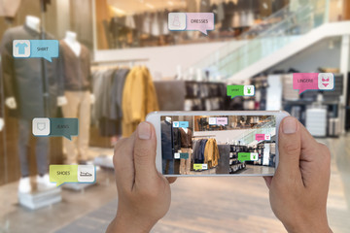
Trade Marketing
Digital engagement
While the concept of retailing has changed enormously in the last 50 years trade marketing however has not changed very much and its concepts as it lays great emphasis on the engagement on the shop floor between the consumer the brand and the retailer .
Trade marketing growing popularity with CPG manufacturers is used it as a way to drive sales and market share in the retail environments globally it now represents between half a trillion to a trillion at the sub industry within retail but it hasn't kept pace with changes in consumer behaviour .
Trade marketing essentially will aim at getting consumer attention at the POS however they lag behind following consumers with their shift to online purchase.
Currently about 15% of manufacturers have brick & mortar + e commerce budgets whilst 25% have no e-commerce budget currently but there being multiple digital touchpoints in both research and purchase indicators suggest the lag in trade marketing .
When employed as a marketing channel digital remains relatively underutilised, most retailers use static messaging for consumers whilst digital media is capable of far more from precise audience targeting and robust campaign measurement .
Not utilising the strengths of digital is a missed opportunity to create online experiences for users and improved market share for manufacturers
Does online come up in your trade marketing negotiations ?
Retailer : okay , we’ll take 12,500 Cases @ 105 $ per case
Manufacturer : lets make that 15,000 Cases
Retailer : Just reviewed , we can go with14,000 cases @ 100$ along with a merchandising contribution of 125,000$
Manufacturer , seems possible , but what will I get for my 125,000 $ ?
Retailer : the usual , central shelf location , magazine inserts , and inclusion in our leaflet campaigns
Manufacturer : what about getting us online , 45% of our sales is online
Retailer : we shall revert to you soon.
Source : Josh Leibowitz, How Did We Get Here? A Short History Of Retail, LinkedIn, 7 June 2013

Slide 16
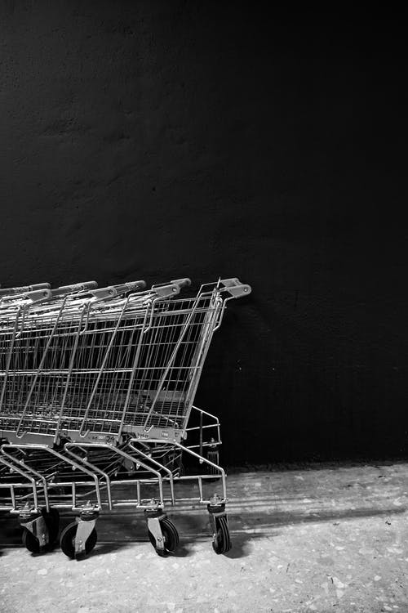
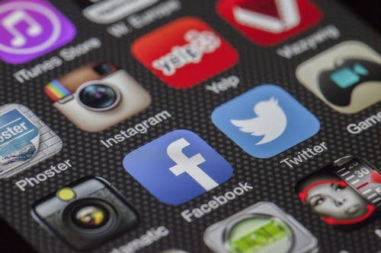
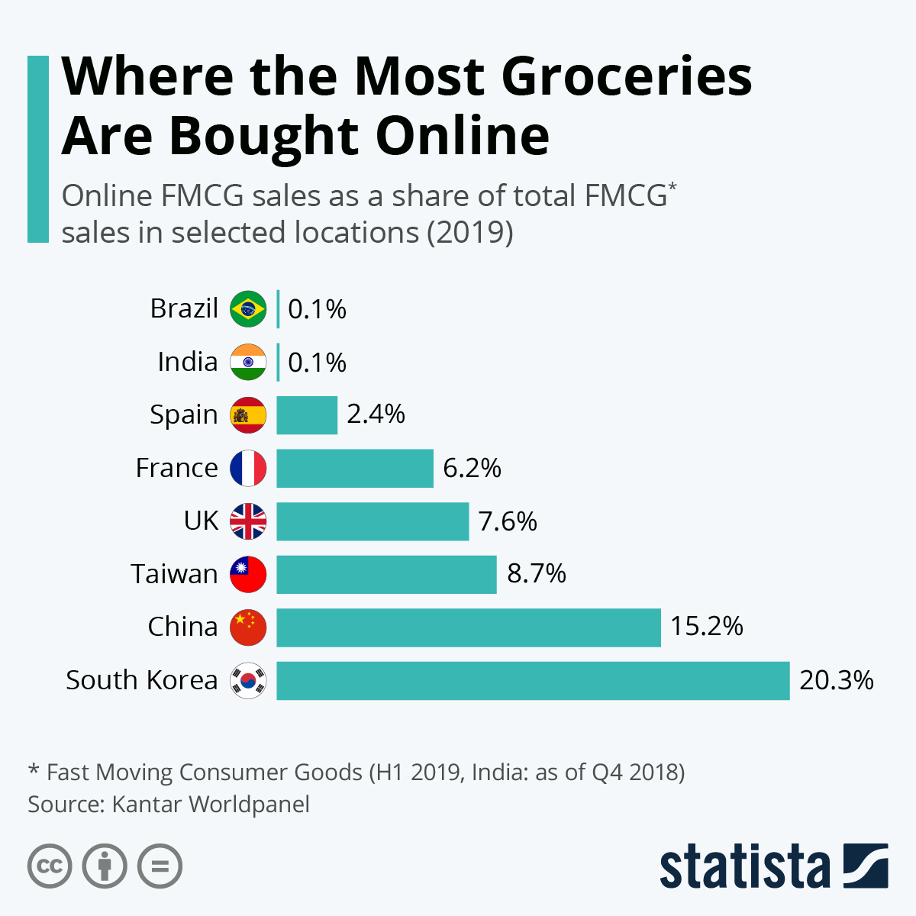
Trade Marketing
Digital engagement
Mobile shopping
With trade marketing resources and budgets focus on influencing the consumer within the retail store and additionally traditional media strategies the consumer of today does his research online and purchasing offline which basically means he or she educates themselves in advance on the category and the product‘s before making the purchase decision
Research indicators
75% customers discover products online
26% just cover products in store
39% of customers research online before purchase
Brand awareness brand perceptions and purchase decisions are shaped in advance much before the moment of purchase .
In this environment it makes perfectly good sense for brands and retailers to invest in digital trade marketing as well as consumer research .
As consumers purchases online applying digital targeting to trade campaigns and leveraging power off planned purchases will deliver positive step change for retailers and manufacturers
Source : Navigating the new digital by Deloitte

Slide 17
Trade Marketing
Digital engagement
Tooling up ?
Many tools which can be used in the trade marketing environment relevance is what is most important whilst using these tools relevance between what type of communication and to whom you want to send it broadly there are two target markets the first target market is your retailer and his environment your second target market is your consumer and his environment .
Examples of tools would be ad servers to manage messaging traffic and deliver transparent campaigns which is quickly becoming it must CR M tools will help you engage your channel partners and retailers really well and your messaging and communication
the web offers an amazing amount of tools in a very structural advantages manner over a current analogue environment delivering enormous advantages
The engagement between retailers and manufacturers needs to work towards digital customer journeys optimization and personalization whilst this is true towards the top end of the trade it does not hold so for the lower end of the trade.

Slide 18
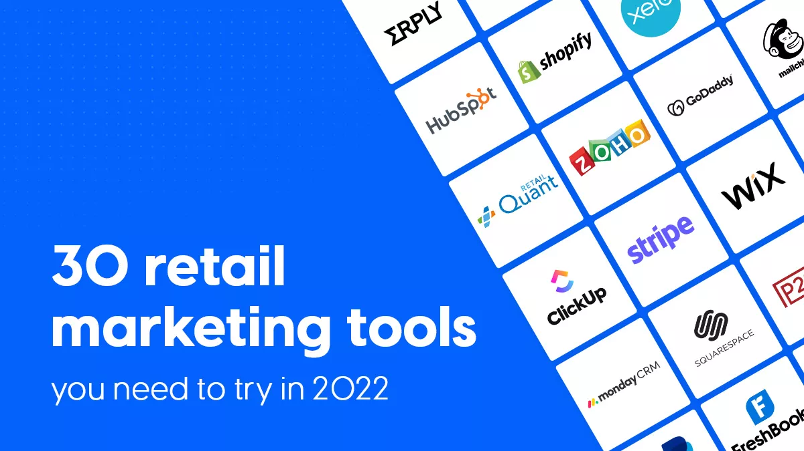
Retail marketing tools
Accounting software tools
CRM software tools
Ecommerce software tools
Retail management software tools
Retail POS software tools
Facebook
Instagram
LinkedIn
Twitter
Flip snack

Slide 19
Thank you !

Slide 20
Job Descriptions
Develop roles clearly and completely across varying levels of experience
Agreements
Draft your business agreements across a variety of areas
Templates
Templates are designed based gather information in a structured manner
KPI’s
Performance indicator, a quantifiable measure of performance over time versus a specific objective.
Content Modules
Best practice material in power point for use as a knowledge base in business training , planning and execution .
Strategic tools
These tools are recognised the world over in business schools, consulting firms and companies who plan strategically.
Gain a competitive edge using the best tools and techniques to build a better you .
Analytical Tools
Interactive excel tools on specific business areas based on your data inputs delivered in a workbook model with instructions.
Scorecards
Designed as functional or subject indicators across a variety off situations to enable performance of situational evaluation versus aligned standards.
Calculators
calculate the right ratios for businesses looking for benchmarks in a variety of situations
Assessments
Assessments are designed around specific areas to conduct reviews and will center around a benchmark reviewing individuals or functions
Checklists
Designed around achieving milestones in a sequential manner.
Research
Research tools for sales and marketing engagement

Slide 21
Trade Marketing.
Digital engagement
Sales & Marketing Fundamentals.
UpskilPRO e Institute for Sales & Marketing
Tools, Content & Templates
Hand built using experience & insight

