Slide 1

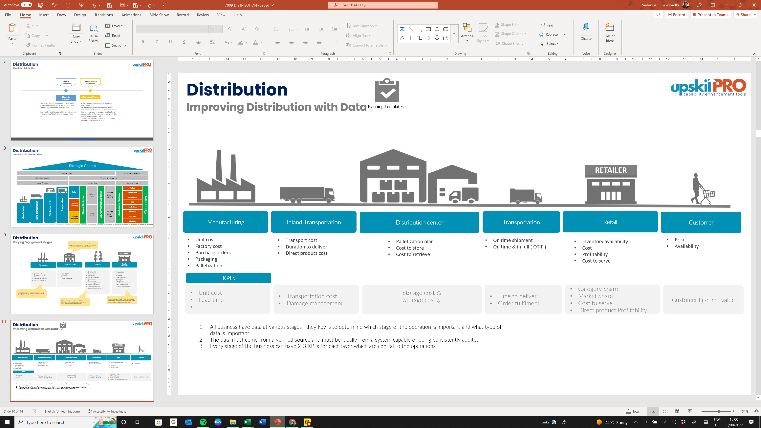
Distribution
Engage & assess the difference in distribution engagement and view different perspectives of applying distribution into practice
UpskilPRO e Institute for Sales & Marketing
Tools, Content & Templates
Hand built using experience & insight

Slide 2
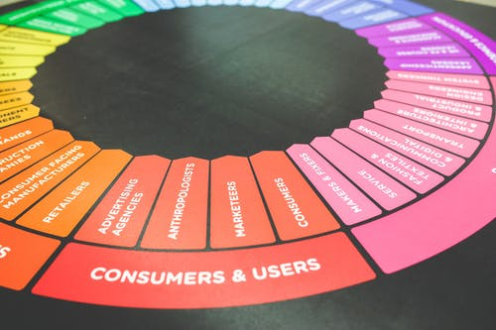

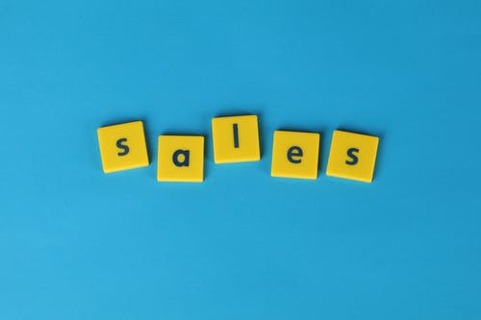
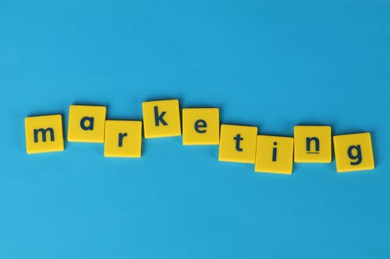
Created by
ex-Procter & Gamble, Rothmans, BAT, Gillette, Nokia,
Microsoft & 3M managers.
UpskilPRO tools are designed in easy-to-use solutions, all you need to do is download the tool and get to work immediately . All UpskilPRO material has taken 100’s of hours and many 1000’s of $ to build , all this expertise and content is brought to you for a fraction of the cost to help professionals enhance their capability.
core areas which are best suited to improve using our tools:
        Subject matter expertise
        Best practices
        Analytical output & charting
        Prioritization
        Process
Making life simpler for
Sales & Marketing professionals.
Tools in one place to get 10X productive now.

Slide 3


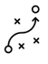

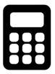
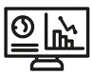
Job Descriptions
Develop roles clearly and completely across varying levels of experience
Agreements
Draft your business agreements across a variety of areas
Templates
Templates are designed based gather information in a structured manner
KPI’s
Performance indicator, a quantifiable measure of performance over time versus a specific objective.
Content Modules
Best practice material in power point for use as a knowledge base in business training , planning and execution .
Strategic tools
These tools are recognised the world over in business schools, consulting firms and companies who plan strategically.
Gain a competitive edge using the best tools and techniques to build a better you .
Analytical Tools
Interactive excel tools on specific business areas based on your data inputs delivered in a workbook model with instructions.
Scorecards
Designed as functional or subject indicators across a variety off situations to enable performance of situational evaluation versus aligned standards.
Calculators
calculate the right ratios for businesses looking for benchmarks in a variety of situations
Assessments
Assessments are designed around specific areas to conduct reviews and will center around a benchmark reviewing individuals or functions
Checklists
Designed around achieving milestones in a sequential manner.
Research
Research tools for sales and marketing engagement

Slide 4
2017
2018
100’s of tools grouped in 12 categories, 50 tool types and 12 business functions in 1 place.
get 10X productive now !
Categories
Functions
Analytical Tools
Types
Business Development
Agreements
Advertising
Customer Acquisition
Margins
Partner Search
Reports
Category Management
Assessments
Agreements
Customer Management
Market Analysis
Persona Development
Retail Measurement
Channel Management
Content Modules
Analytics
Distribution
Market Development
Planning
Reviews
Distribution
Checklists
Barriers
Distributor Management
Market Research
Positioning
Sales Management
Distributor Management
Calculators
Business Reviews
Forecasting
Market Segmentation
Pricing
Scorecards
General Management
Job Descriptions
Business Intelligence
GAP Analysis
Market Size
Prioritization
Segmentation
Key Account Management
KPI’s
Channels
Go To Market
Marketing
Product Development
Six Sigma
Marketing
Research
Communication
Job Descriptions
Marketing Comms
Product Life Cycle
Socio Economic Classification
Marketing Operations
Strategic Tools
Competitive Evaluation
Key Account Plans
Merchandising
Profit & Loss
Territory Design
Sales Management
Scorecards
Competitive Intelligence
Management Summary
New Market Entry
Promotions
Trade Marketing
Shopper Marketing
Templates
Trade Marketing

Slide 5



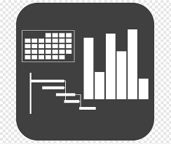




7 Benefits of using UpskilPRO :
Improve your knowledge
with professional Strategic Tools , Templates and planning documents for any business situation!
Use ready made tools
with filled in examples and ready to print & edit at your convenience . Just edit and fill-in the blanks !
Develop YOUR BUSINESS
Learn , & utilize the knowledge and processes and enhance your capabilities as the other companies have
We Created UpskilPRO for the
  Sales Professional
  Trade Marketer
  Marketing Executive
  Operations Manager
  VP/Director/Manager
100’s of tools , TEMPLATES & documents
CREATED BY
world class sales and marketing
business professionals.
All tools
are based on topics and subject based situations and are simple and easy to use .
SAVE THOUSANDS OF DOLLARS
The average company will save 1000’s of $ per employee in time & effort using our ready tools !
Top Quality Tools & Templates for developing both you and your business.
www.upskilpro.com

Slide 6
Distribution.
Distribution , Is about getting the relevant product and mix to the right customer. Don’t confuse distribution with Sales , Trade Marketing or Consumer marketing.

Slide 7
Distribution
Business Summary Plan
Distribution – Business Summary Plan We shall use a well designed distribution model utilizing local efficiencies in every market as the first stage we do business focussing on volume weightage , followed by numeric distribution, supported by data for decision making.
Internal | Step 1 Enter 3 assigned and identified markets of XX , YY & ZZ | Step 2 Contribution gross margins to be managed within from 52% to 54% | Step 3 Channel Margins 20% Distributor Margins 20 %
External | Step 5 Pre designed consumer price to drive financial model . On 100 we expect NFC to be 15 , Channel and Distributor margins to be 45 and CGM to be 50 | Step 5 Local Staff will be appointed to manage the organisation and drive training and corporate alignment of the brand . Headcount of 7 is approved | Step 6 Drop shipment from factory direct to distributor cleared and forwarded – costing to be set at DPLC
Process & Organisation | Step 7 Market management committee in place from key functions | Step 8 RACI Matrix deployed for accountability | Step 9 Operational plan 2 Years Strategic plan +3 Years Total 5 Year Plan development

Slide 8

Distribution
Management Summary
Core Initiatives
BASELINE
GOALS
Key Metrics
2020
2021
2022
INITIATIVE
DESCRIPTION
Rev. / Location
Company Locations
Headcount
Productivity
Inventory Turns
Nett Sales Margin
Trade Marketing %
$18m
5
15
$1.2m
4.2
44.5%
6.5%
$19.1m
6
17
$1.12m
4.0
46.3%
6.75%
$20.4m
7
16
$1.25m
4.6
47.1%
7.2%
Initiative 1 | Increase product availability from 235 locations to 321 locations with average sale > $63K/outlet
Initiative 2 | Drive productivity improvement from 1.12 to 1.25
Initiative 3 | Distribution teams to focus on volume weighted distribution from 78% to 85%
Initiative 4 | Assist TM teams in securing 125 display locations
Initiative 5 | Increase SKU distribution from 6.6 to 8.0 in average store
www.upskilpro.com

Slide 9
Distribution
Absolute distribution
Numeric Distribution
Volume weighted Distribution
Numeric Distribution
All Category Volume
The easiest form of distribution measurement.
It measures the availably of the product in the number of points of sale used as a base
Every outlet contributes one POS no matter what the numbers of distribution or product value sold .
A slightly more intensive way of calculating distribution .
All commodity volume concentrates on the outlet's contribution of sale to the base and uses that as an indicator of category contribution of sales , leading to the presence of your product in relation to the category sales .
The higher the category sales contribution the higher your distribution of ACV
www.upskilpro.com
www.free-powerpoint-templates-design.com

Slide 10




Distribution
Universal Distribution View
Strategic Context
Executive Intent
Intellectual property
Legal
Finance
Logistics
Labs
Sales
KAM
Shopper Marketing
Trade Marketing
Brand Marketing
Value Creation
Primary Sale
Secondary Sale
Sales
Volume
Units
Market Share in Volume
Online
Modern Trade
Transportation
Distribution center
Convenience
Inland Transportation
Consumer Marketing
B2B
Manufacturer / Distributor
Consumer
Volume Weighted Distribution
Manufacturing
Numeric Distribution
Value
US $
Market Share in Value
Manufacturers
Add Value
Customer Marketing
Duty Free
Wholesale
www.upskilpro.com

Slide 11


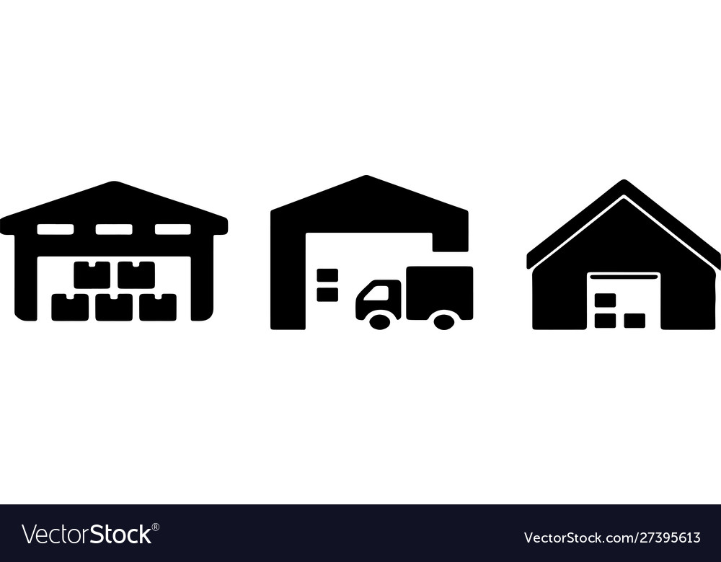
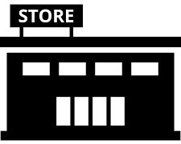
Distribution
Varying Engagement stages
The distribution center is a key point of product assembly or staging before it reaches the distributor. It may or may not be in the same country.
RETAILER
Manufacturer
Distribution Centre
Distributor
Retailer
Wholesaler
Physical title
Product ownership
Manufacturing process
Intellectual property
Industry standards
Physical title
Information
Payments
Order Processing
Physical title
Information
Payments
Order placement
Negotiation
Promotions
Trade engagement
Order Processing
Sales engagement
Account management
Physical title
Information
Payments
Order placement
Negotiation
Promotions
Inventory management
Trade engagement
Category management
The manufacturer may be sub contracted or it may be a manufacturer run operation like ( Nestle , P&G , Ford , Nokia, Samsung etc. ) .
In the example above we have placed a range of responsibilities on the retail end for describing the engagement . There may be more depending on the country, relationship and the engagement
We have described a single layer of distribution or distributor , in some cases there may be multiple layers across channels and geographies.
www.upskilpro.com

Slide 12

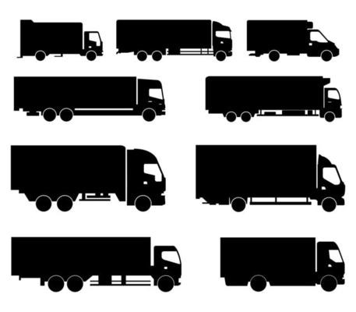
Distribution
Improving Distribution with Data
Planning Templates
RETAILER
Manufacturing
Inland Transportation
Distribution center
Transportation
Retail
Customer
Unit cost
Factory cost
Purchase orders
Packaging
Palletization
Transport cost
Duration to deliver
Direct product cost
Palletization plan
Cost to store
Cost to retrieve
On time shipment
On time & in full ( OTIF )
Inventory availability
Cost
Profitability
Cost to serve
Price
Availability
KPI’s
Unit cost
Lead time
Transportation cost
Damage management
Storage cost %
Storage cost $
Time to deliver
Order fulfilment
Category Share
Market Share
Cost to serve
Direct product Profitability
Customer Lifetime value
All business have data at various stages , they key is to determine which stage of the operation is important and what type of data is important
The data must come from a verified source and must be ideally from a system capable of being consistently audited
Every stage of the business can have 2-3 KPI’s for each layer which are central to the operations
www.upskilpro.com

Slide 13
Evaluating Distribution
www.upskilpro.com

Slide 14
Distribution
How do you evaluate distribution
Retailers
Technology
Retail Audit
Companies
Physical
verification
Retail audit companies extract sales data under license from the retailers they operate with and will be able to extrapolate this data and provide it as a service .
This data is pertinent only to channels and outlets which have a data share agreement.
When approached directly retailers and channel providers will give data sometimes for a fee or as a business gesture to build relationship .
The challenge is assimilating data when it is from many different sources and data types
Companies have developed technology using downloadable applications which are given to users who take photographs in the outlets and the data is automatically uploaded to the server .
While this is a solution it is not a strategic information gathering solution
A physical verification like canvassing is possible using human resources who measure distribution directly at source .
In this case it makes sense to verify distribution using a sample set of outlets if covering a large geographic expanse
www.upskilpro.com

Slide 15
Distribution
Numeric Distribution Tracker
Analytical Tools
* This file is available on www.upskilpro.com in an editable version , use the reference number provided on the top right

Slide 16
Distribution
Volume weighted tracker
Analytical Tools
* This file is available on www.upskilpro.com in an editable version , use the reference number provided on the top right

Slide 17
Distribution
Vertical & Horizontal View
Analytical Tools
* This file is available on www.upskilpro.com in an editable version , use the reference number provided on the top right

Slide 18
Distribution
Annual Financial Forecast – Distributor or Manufacturer
Analytical Tools
www.upskilpro.com
* This file is available on www.upskilpro.com in an editable version , use the reference number provided on the top right

Slide 19
Distribution
Improving Distribution with Data
Analytical Tools
This tool is available for download from www.upskilpro.com for download , please use the no in the top right red box.
www.upskilpro.com

Slide 20
Distribution
Service Provider Margins by role
Planning Templates
ACTION
Roles / Phases
ROLES
Manufacturer
Finished goods
Service Provider
Solution Integrator
Advocacy
Value added service
Product resale
Proximity to product
Proximity to customer
Low value
Augmented product
Gross Margin
( Lowest )
Low % margins
Mid % margins
Higher % Margins
Gross Margin
( Higher )
www.upskilpro.com

Slide 21
Distribution
Distribution costs based on service compatibility
Distribution service costs offering based on 3 Distribution services provided
Full-service distributors offer all aspects from full business management to inventory and delivery management acting as an extended arm of your brand , a full value service may entail higher operating costs
Full Value service
FS
Margin %
Wide service distributors serve many brand owners and drive their business model on a range of populist measures , their product offering though broader may not be specialist
WS
Wider service
Narrow service offering
Narrow service distributors are more focused on a couple of distribution elements and may not be the right fit for everyone .
NS
Revenue $
www.upskilpro.com

Slide 22
Distribution
Distributors by Distribution Model
Value Added
Distributors
Broad Based Distributors
Fulfilment or Last mile distributors
High
Margin
Low
Low
Revenue
High
Distribution Channels :
Each product and category interacts differently with channels based on A) Brand initiatives B) Strategy C) Priorities
The models above may all be used or only one , it is dependent on the strategy and the planning used to arrive at such a conclusion
Each channel has different cost layers to deliver service
In the example above the cost per transaction is largely modelled around the distance to end user , the 3 models reflect the distance and the cost .
Strategically the prioritization works around working with the larger and complex customer groups and moving the smaller and less profitable groups to inside sales or telemarketing
E commerce is a strategic decision mainly , as opposed to a cost based decision
www.upskilpro.com

Slide 23
Assessing Distribution

Slide 24
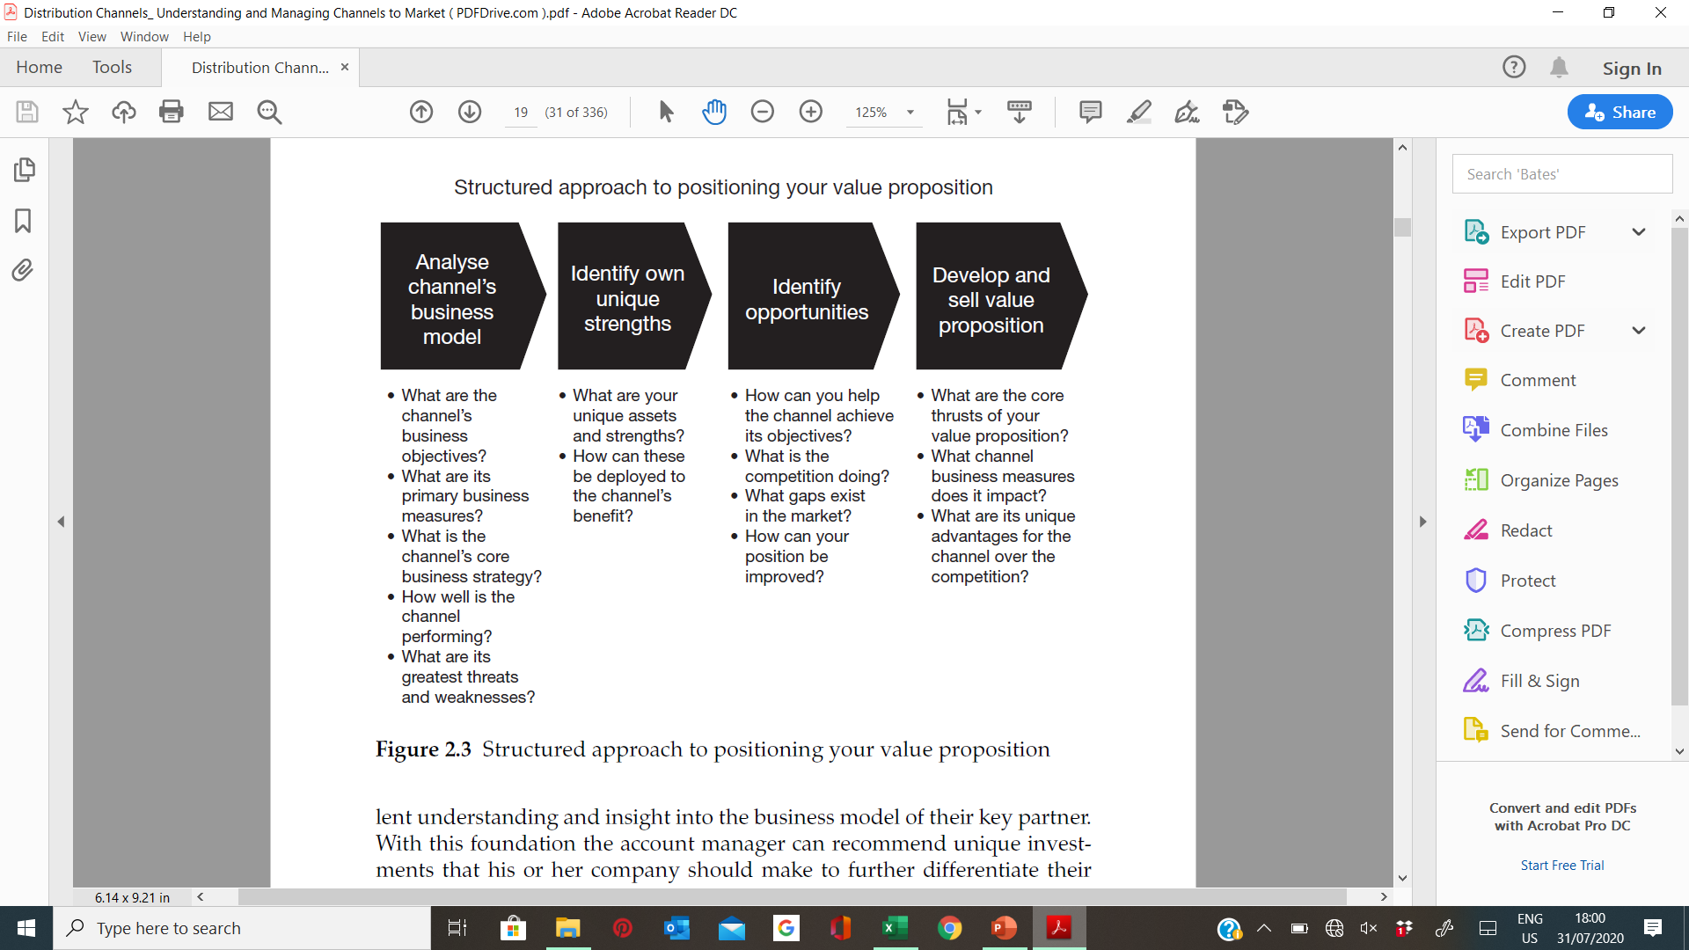
Distribution
Channel Access evaluation
Distribution modelling
Opportunity Identification
Value proposition development
Channel Partner
Evaluation
Evaluate all relevant channels
Channel features identification
Contribution in Sales $
Channel Size in $
Channel Characteristics
Competitive landscape
Prioritization Matrix development
Distribution Landscape evaluation
Competitive alignments matrix
Distribution overage
Universe landscape
VW heavy chains and outlets
Gap analysis
Competitive landscape
Improvement analysis
Value proposition development
Communication of VP
PEST Analysis
GAP Analysis
Channel partner landscape
Channel management matrix
Measurement matrix for evaluation
Interviews
Field evaluation
Service levels evaluation
www.upskilpro.com

Slide 25
Distribution
Distributor Assessment
Analytical Tools
www.upskilpro.com
* This file is available on www.upskilpro.com in an editable version , use the reference number provided on the top right

Slide 26
Distribution
Key Financial Distribution KPI’s
Analytical Tools
* This file is available on www.upskilpro.com in an editable version , use the reference number provided on the top right

Slide 27
Distribution
driven by shopping habits

Slide 28
Distribution
What is a Go to Market Channel
Channels
Consumption
Direct sales
Key Takeaway .
As you build out your channel model using our channel selection advanced tool you will be forced to evaluate selection of channels and rate them in importance .
Once you have done the rating you will need to clarify if all the areas under consumption belong to 1 channel or are designed for maximum strategic effect .
Setting a channel priority on how to reach identified end customer will avoid many overlap issues later including grey markets
Customer
Business Partners
Customer
Manufacturer
Tele channels
Customer
Internet
Customer
Miscellaneous
Brand owner
Push activities
Pull Activities
www.upskilpro.com

Slide 29
Distribution
Distribution targeted by shopping habits
Planning Templates
End users
Homemakers
Consumer Bachelors
Millennials Gen X , Baby Boomers
Passengers
Distribution Level 2
Modern Trade
Traditional Trade
Forecourts
Duty Free
Distribution ( Bulk )
Wholesaler
Distribution Level
Channel Team
Modern Trade
Channel Team
Traditional Trade
Channel team
Forecourts
Channel team
Duty Free
Brand Owner / Manufacturer
Manufacturer
www.upskilpro.com

Slide 30
Distribution
Distribution targeted by shopping habits
Planning Templates
End users
Homemakers
Consumer Bachelors
Millennials Gen X , Baby Boomers
Passengers
Distribution Level 2
Modern Trade
Traditional Trade
Forecourts
Duty Free
Wholesaler
Distribution Level 1
Channel Team
Modern Trade
Channel Team
Traditional Trade
Channel team
Forecourts
Channel team
Duty Free
Intermediate Processing
Wholesaler
Brand Owner / Manufacturer
Manufacturer
www.upskilpro.com

Slide 31
Distribution
Distribution targeted by shopping habits
Planning Templates
End-users
Construction
Oil & Gas
Manufacturing
Joinery
Specialist Wholesaler
Distribution Level 1
Distributor
Distributor
Distributor
Intermediate Processing
Converter
Brand Owner / Manufacturer
Manufacturer
www.upskilpro.com

Slide 32
Distribution
Types of consumption across Channels
Efficiency or Inefficiency ?
Channels
Consumption
Direct sales
Customer
Key Takeaway .
As you build out your channel model using our channel selection advanced tool you will be forced to evaluate selection of channels and rate them in importance .
Once you have done the rating you will need to clarify if all the areas under consumption belong to 1 channel or are designed for maximum strategic effect .
Setting a channel priority on how to reach identified end customer will avoid many overlap issues later including grey markets
Same customer many channels , creates a inefficiency of channel resources and in companies where different business go to the channel , its probable that the channel management matrix needs to be relooked
Business Partners
Manufacturer
Customer
Tele channels
Customer
Internet
Customer
Miscellaneous
Brand owner
Push activities
Pull Activities
www.upskilpro.com

Slide 33
Distribution
Marketing Mix facilitated distribution
Planning Templates
 | Brand Marketing | Shopper Marketing | Trade Marketing | Key Account Management | Sales & Distribution | Logistics | Brand
Manufacturer |  |  |  |  |  |  | TM Brands Categories Business verticals
Distribution Centre |  |  |  |  | Forecast alignment | On time deliveries
Distributors |  |  |  |  | Sales delivery
Channels |  |  |  | Select Specific KAM Accounts | All channel responsibility
Retailers |  |  | Relationship Executes Plans | KAM Relationship KAM Plan | Works alongside KAM team
Consumers | Advertising PR Research | Shopper segmentation communication | Engages consumers Promotes product
PUSH
PULL
www.upskilpro.com

Slide 34
Distribution Channels

Slide 35
Distribution
Channel Coverage
Planning Templates
Brand Owner
Product / Service creation
Logistics Hub
Physical Distribution
Reseller
Channel /s
End-user
Manufacturer
Manufacturer
Manufacturer
Manufacturer
Distributor
Wholesaler
Company
Agent -
Consumer Retailers
Consumer
Online e reseller
Value Added Reseller
E commerce
Specialist Shops
DIY Stores
Gas Stations
While selecting a distribution channel for foreign markets, the management of the exporting company should consider the following aspects:
(i) Who are the consumers? Which are the available retail outlets to reach them?
(ii) Which type of market coverage is required, keeping in view the product and consumer characteristics?
(iii) Are there any internal constraints for the exporter like finance which will influence the decision regarding choice of the distribution channel?
(iv) What are the expectations from the channel members? Are there some specific expectations?
(v) What is the required support system to satisfy the expectations of the channel members?
Duty Free
www.upskilpro.com

Slide 36
Distribution
Basic Channel Approach
Overall Category Sales Contribution
Planning Templates
Your category sales contribution . Both are different , this requires category insight to find out if your brand is under contributing .
Basic go to market layout of channels
Push Campaigns
Sales
Contribution
Category
Contribution
Customer
Direct Sales
Channel partners
Customer
Brand Owner
or
Manufacturer
Customer
Value Added Resellers
Customer
Internet / reseller
Customer
Wholesalers / Stockists
Pull Campaigns
Demand creation campaigns using the marketing mix
Comment
Most generic descriptors have been used for channels
The model uses a flow from manufacturing to customer / end-user .
The emerging channel is the online reseller who is able to resell online to other e commerce resellers
www.upskilpro.com

Slide 37
Distribution
Channel Coverage
Planning Templates
Brand Owner
Product / Service creation
Logistics Hub
Physical Distribution
Reseller
Channel /s
End-user
Manufacturer
Manufacturer
Manufacturer
Manufacturer
Distributor
Wholesaler
Company
Agent -
Consumer Retailers
Consumer
Online e reseller
Value Added Reseller
E commerce
Specialist Shops
DIY Stores
Gas Stations
While selecting a distribution channel for foreign markets, the management of the exporting company should consider the following aspects:
(i) Who are the consumers? Which are the available retail outlets to reach them?
(ii) Which type of market coverage is required, keeping in view the product and consumer characteristics?
(iii) Are there any internal constraints for the exporter like finance which will influence the decision regarding choice of the distribution channel?
(iv) What are the expectations from the channel members? Are there some specific expectations?
(v) What is the required support system to satisfy the expectations of the channel members?
Duty Free
www.upskilpro.com

Slide 38
Distribution
Channel Advantages
Channel Advantages
High
High engagement
Feedback intensive
Low cost per contact
Upselling possibilities high
Instant data capture.
Sales force
Channel Drivers
Value added
Partners
Distributors
Basis purpose of the sale channel is to connect customers , brand owners and end-users .
Different brands and solutions will drive different strategies to reach end user this results in what is called the Omni Channel experience
Every brand owner will evolve different channel strategies to resolve 4 main areas
Cost to serve
Preferred channel of end-users
Ability to manage and influence end users and customers
Business contribution
Retail
Value added sales
Direct sales channels
Tele
marketing
E
commerce
Indirect channels
Closer to end sale
Larger business scale
Higher relative cost per engagement
Faster decision making
Direct marketing channels
Channel disadvantages
low
low
Cost per transaction
High
Distribution Channels :
Each product and category interacts differently with channels based on A) Brand initiatives B) Strategy C) Priorities
The models above may all be used or only one , it is dependent on the strategy and the planning used to arrive at such a conclusion
Each channel has different cost layers to deliver service
In the example above the cost per transaction is largely modelled around the distance to end user , the 3 models reflect the distance and the cost .
Strategically the prioritization works around working with the larger and complex customer groups and moving the smaller and less profitable groups to inside sales or telemarketing
E commerce is a strategic decision mainly , as opposed to a cost based decision
www.upskilpro.com

Slide 39
Understanding Channels
Distribution Channels
Planning Templates
Brand Owner
Product / Service creation
Logistics Hub
Physical Distribution
Reseller
Channel /s
End-user
Manufacturer
Manufacturer
Manufacturer
Manufacturer
Distributor
Wholesaler
Agent -
Consumer Retailers
Online e reseller
E commerce
Specialist Shops
Company
DIY Stores
Gas Stations
Consumer
While selecting a distribution channel for foreign markets, the management of the exporting company should consider the following aspects:
(i) Who are the consumers? Which are the available retail outlets to reach them?
(ii) Which type of market coverage is required, keeping in view the product and consumer characteristics?
(iii) Are there any internal constraints for the exporter like finance which will influence the decision regarding choice of the distribution channel?
(iv) What are the expectations from the channel members? Are there some specific expectations?
(v) What is the required support system to satisfy the expectations of the channel members?
Duty Free
Converters
Value Added Reseller
www.upskilpro.com

Slide 40
Understanding Channels
Distribution Channels
Planning Templates
Brand Owner
Product / Service creation
Logistics Hub
Physical Distribution
Reseller
Channel /s
End-user
Manufacturer
Manufacturer
Manufacturer
Manufacturer
Distributor
Wholesaler
Agent -
Consumer Retailers
Online e reseller
E commerce
Specialist Shops
Company
DIY Stores
Gas Stations
Consumer
While selecting a distribution channel for foreign markets, the management of the exporting company should consider the following aspects:
(i) Who are the consumers? Which are the available retail outlets to reach them?
(ii) Which type of market coverage is required, keeping in view the product and consumer characteristics?
(iii) Are there any internal constraints for the exporter like finance which will influence the decision regarding choice of the distribution channel?
(iv) What are the expectations from the channel members? Are there some specific expectations?
(v) What is the required support system to satisfy the expectations of the channel members?
Duty Free
Converters
Value Added Reseller
www.upskilpro.com

Slide 41
Distribution
Types of Retailers
The objectives behind presence in large chains and convenience are different . The sales strategy will drive a mix between distribution and sales availability
Planning Templates
Large / Organized
Channel and Widespread
Bulk & resale
Online
Department stores
Convenience stores
Merchant Wholesalers
E commerce stores
Specialty stores
Gas station stores
Full-service wholesalers
Hyper markets
Limited-Service Wholesalers
Supermarkets
Brokers & Agents
Discount stores
Branches & Mini Wholesalers
Warehouse stores
Specialized Wholesalers
We have added Discount and Dollar stores anyway due to their large outlet footprint
DIY Stores
Dollar Stores
Drug Stores
Comment
These chains are usually nation wide
Buying operations are usually central and deliveries local
Unit cost efficiency is high
Comment
Convenience stores drive neighbourhood sales and sheer convenience
In number of stores they have a higher number of doors than chain stores
They remain to a degree privately and individually owned.
Comment
Wholesale remains the backbone of channels
They drive sales for brands which are not deliberately retail driven
Wholesale can drive product into retail
Unit cost differential is a key factor
Comment
Online stores continue to offer convenience to a great degree and price competitiveness
Their individual share of the overall market is in the region of 8 – 12% of category sales generally
www.upskilpro.com

Slide 42
Distribution
Types of Retailers
The objectives behind presence in large chains and convenience are different . The sales strategy will drive a mix between distribution and sales availability
Planning Templates
Large / Organized
Channel and Widespread
Bulk & resale
Online
Department stores
Convenience stores
Merchant Wholesalers
E commerce stores
Specialty stores
Gas station stores
Full-service wholesalers
Hyper markets
Limited-Service Wholesalers
Supermarkets
Brokers & Agents
Discount stores
Branches & Mini Wholesalers
Warehouse stores
Specialized Wholesalers
We have added Discount and Dollar stores anyway due to their large outlet footprint
DIY Stores
Dollar Stores
Drug Stores
Comment
These chains are usually nation wide
Buying operations are usually central and deliveries local
Unit cost efficiency is high
Comment
Convenience stores drive neighbourhood sales and sheer convenience
In number of stores they have a higher number of doors than chain stores
They remain to a degree privately and individually owned.
Comment
Wholesale remains the backbone of channels
They drive sales for brands which are not deliberately retail driven
Wholesale can drive product into retail
Unit cost differential is a key factor
Comment
Online stores continue to offer convenience to a great degree and price competitiveness
Their individual share of the overall market is in the region of 8 – 12% of category sales generally
www.upskilpro.com

Slide 43
Distribution
Types of consumption across Channels
Efficiency or Inefficiency ?
Channels
Consumption
Direct sales
Customer
Key Takeaway .
As you build out your channel model using our channel selection advanced tool you will be forced to evaluate selection of channels and rate them in importance .
Once you have done the rating you will need to clarify if all the areas under consumption belong to 1 channel or are designed for maximum strategic effect .
Setting a channel priority on how to reach identified end customer will avoid many overlap issues later including grey markets
Same customer many channels , creates a inefficiency of channel resources and in companies where different business go to the channel , its probable that the channel management matrix needs to be relooked
Business Partners
Manufacturer
Customer
Tele channels
Customer
Internet
Customer
Miscellaneous
Brand owner
Push activities
Pull Activities
www.upskilpro.com

Slide 44
Distribution
Self evaluation questions !
How do my sales perform where I have distribution versus sales of my competitors ?
What are the trends in those same areas
Choice of stores are relevant to % of distribution
Deciding what distribution is relevant to a business is a time consuming exercise as it takes a good reporting structure to finally arrive at the clarity needed to make a strategic decision .
Usually targeting the top accounts in any industry will give a high weighted distribution
Understanding
Numeric distribution is % of outlets selling a particular identified product
Do my products have a fair share of distribution
Do I know my numeric distribution and volume weighted distribution
How do I build out a better volume weighted strategy for execution
Do I suffer from out of stocks both at my level and that of the trade
Volume weighted distribution is % of outlets whose share of relevant $ sales is higher than their numeric distribution selling a particular identified product
Evaluating
Executing
It’s a matter of asking .
There are companies available both online and offline that provide industry specific data , and will tailor reports for a fee to suit your brief .
The data depth and breadth depends on your brief , budget and availability of the category in question , as not all categories are read in all countries .
Where do I get the data
How reliable will the data be
Who supplies the data
What does the data cover
www.upskilpro.com

Slide 45
Thank you

Slide 46
Job Descriptions
Develop roles clearly and completely across varying levels of experience
Agreements
Draft your business agreements across a variety of areas
Templates
Templates are designed based gather information in a structured manner
KPI’s
Performance indicator, a quantifiable measure of performance over time versus a specific objective.
Content Modules
Best practice material in power point for use as a knowledge base in business training , planning and execution .
Strategic tools
These tools are recognised the world over in business schools, consulting firms and companies who plan strategically.
Gain a competitive edge using the best tools and techniques to build a better you .
Analytical Tools
Interactive excel tools on specific business areas based on your data inputs delivered in a workbook model with instructions.
Scorecards
Designed as functional or subject indicators across a variety off situations to enable performance of situational evaluation versus aligned standards.
Calculators
calculate the right ratios for businesses looking for benchmarks in a variety of situations
Assessments
Assessments are designed around specific areas to conduct reviews and will center around a benchmark reviewing individuals or functions
Checklists
Designed around achieving milestones in a sequential manner.
Research
Research tools for sales and marketing engagement

Slide 47
Distribution
Engage & assess the difference in distribution engagement and view different perspectives of applying distribution into practice
UpskilPRO e Institute for Sales & Marketing
Tools, Content & Templates
Hand built using experience & insight

