Slide 1


Key Account Management.
Module 7 – Analysing Key Accounts.
Sales & Marketing Fundamentals.
UpskilPRO e Institute for Sales & Marketing
Tools, Content & Templates
Hand built using experience & insight

Slide 2
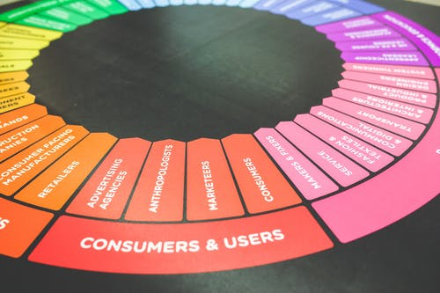



Created by
ex-Procter & Gamble, Rothmans, BAT, Gillette, Nokia,
Microsoft & 3M managers.
UpskilPRO tools are designed in easy-to-use solutions, all you need to do is download the tool and get to work immediately . All UpskilPRO material has taken 100’s of hours and many 1000’s of $ to build , all this expertise and content is brought to you for a fraction of the cost to help professionals enhance their capability.
core areas which are best suited to improve using our tools:
        Subject matter expertise
        Best practices
        Analytical output & charting
        Prioritization
        Process
        Training
Making life simpler for
Sales & Marketing professionals.
Tools in one place to get 10X productive now.

Slide 3


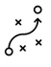

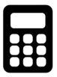

Job Descriptions
Develop roles clearly and completely across varying levels of experience
Agreements
Draft your business agreements across a variety of areas
Templates
Templates are designed based gather information in a structured manner
KPI’s
Performance indicator, a quantifiable measure of performance over time versus a specific objective.
Content Modules
Best practice material in power point for use as a knowledge base in business training , planning and execution .
Strategic tools
These tools are recognised the world over in business schools, consulting firms and companies who plan strategically.
Gain a competitive edge using the best tools and techniques to build a better you .
Analytical Tools
Interactive excel tools on specific business areas based on your data inputs delivered in a workbook model with instructions.
Scorecards
Designed as functional or subject indicators across a variety off situations to enable performance of situational evaluation versus aligned standards.
Calculators
calculate the right ratios for businesses looking for benchmarks in a variety of situations
Assessments
Assessments are designed around specific areas to conduct reviews and will center around a benchmark reviewing individuals or functions
Checklists
Designed around achieving milestones in a sequential manner.
Research
Research tools for sales and marketing engagement

Slide 4
2017
2018
100’s of tools grouped in 12 categories, 50 tool types and 12 business functions in 1 place.
get 10X productive now !
Categories
Functions
Analytical Tools
Types
Business Development
Agreements
Advertising
Customer Acquisition
Margins
Partner Search
Reports
Category Management
Assessments
Agreements
Customer Management
Market Analysis
Persona Development
Retail Measurement
Channel Management
Content Modules
Analytics
Distribution
Market Development
Planning
Reviews
Distribution
Checklists
Barriers
Distributor Management
Market Research
Positioning
Sales Management
Distributor Management
Calculators
Business Reviews
Forecasting
Market Segmentation
Pricing
Scorecards
General Management
Job Descriptions
Business Intelligence
GAP Analysis
Market Size
Prioritization
Segmentation
Key Account Management
KPI’s
Channels
Go To Market
Marketing
Product Development
Six Sigma
Marketing
Research
Communication
Job Descriptions
Marketing Comms
Product Life Cycle
Socio Economic Classification
Marketing Operations
Strategic Tools
Competitive Evaluation
Key Account Plans
Merchandising
Profit & Loss
Territory Design
Sales Management
Scorecards
Competitive Intelligence
Management Summary
New Market Entry
Promotions
Trade Marketing
Shopper Marketing
Templates
Trade Marketing

Slide 5



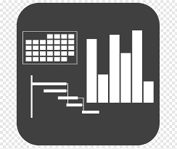




7 Benefits of using UpskilPRO :
Improve your knowledge
with professional Strategic Tools , Templates and planning documents for any business situation!
Use ready made tools
with filled in examples and ready to print & edit at your convenience . Just edit and fill-in the blanks !
Develop YOUR BUSINESS
Learn , & utilize the knowledge and processes and enhance your capabilities as the other companies have
We Created UpskilPRO for the
  Sales Professional
  Trade Marketer
  Marketing Executive
  Operations Manager
  VP/Director/Manager
100’s of tools , TEMPLATES & documents
CREATED BY
world class sales and marketing
business professionals.
All tools
are based on topics and subject based situations and are simple and easy to use .
SAVE THOUSANDS OF DOLLARS
The average company will save 1000’s of $ per employee in time & effort using our ready tools !
Top Quality Tools & Templates for developing both you and your business.
www.upskilpro.com

Slide 6
Analysing Key Accounts.
Directional Summary
Analysing Key accounts is a constant business and requires a mix of Good Planning, Customer Intimacy, Customer engagement and data to analyse account performance and within it the segments of your business.

Slide 7
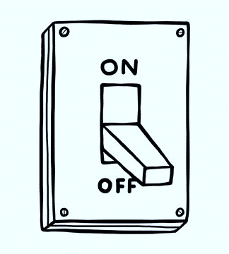
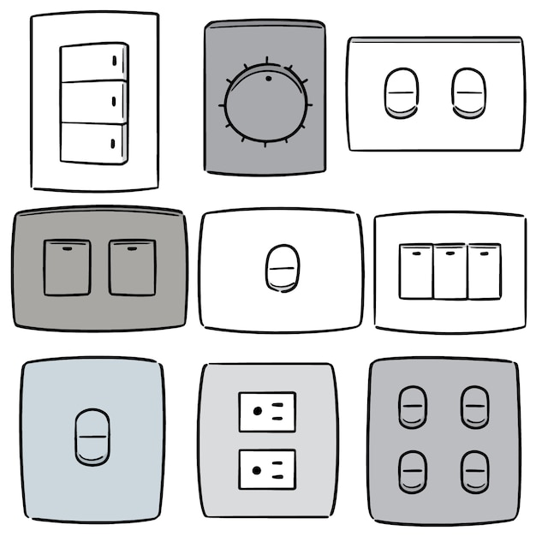
Analysing Key Accounts.
Business Segmentation Layout for 1 Business ( High level )
Revenue Recording
Distribution Shipments
Retail Distribution
Value Added Services
End Users
Sales Visibility
Reselling & Consumption
Local Distributors
Electrical
Wholesale & Retailers
Share 20%
Builders
Share 15%
Share 10%
DIY Retailers
Value Added Specialists
Electrical Companies
National Level Sales
State Distributors
Share 15%
Share 20%
Converters
Government Bodies
Share 30%
C Store Retailers
Share 5%
Consumers
National Distributor
Share 15%
Share 50%
Service Companies
Share 70%
Grocery Retailers
Share 50%
Distribution Share 100%
Channel Share 100%
Business Share 15%
End user Share 100%
Calculate sales based on level of shipment to arrive at data which is not double counted
We have used Electrical switches as an example
Every business is different we have given a general view for the exercise.

Slide 8











Analysing Key Accounts.
Directional Summary
Revenue Recording
Distribution Shipments
Retail Distribution
Value Added Services
End Users
Revenue recording covers the revenues sourced from the business based on product sales with the market discounts ( top line ) reflected.
This is a direct shipment from the brand owner to the customer (distributors ) or KA’s
Each account will have a “bill to and ship to” address thereby enabling consistent accuracy on sales and shipments.
In our example we show all 3 levels of sales broken into
National, state and local distributors
This could be a reflection of different products and different strategies
This segment refers to the retail segment which consists of many channels and types of retailers and wholesalers , this part in this example is serviced by any one or all of the distributors.
As you will notice they serve direct consumers who shop on their premises.
Value added services are typical to some products which are sold , in may well be finished or unfinished products , in our example we serve the value added products through the Electrical channel who serve both retailers and wholesalers.
As you will notice we have chosen only one value added specialist.
End users are typically those who open the package or consumer the product , they may be described both as independent consumer or business consumer or business entity .

Slide 9
Analysing Key Accounts.
Analysing your market
Supplier Pyramid
Supplier Features
Area | Contribution | Criteria
Strategic Suppliers | Primary Mover Channels drivers to market Value / revenue generation | Strategy driven Dual engagement on buyer and seller sides
Preferred Suppliers | All points solution Technology advantages Operational excellence | Relationship development Strategy for category management Service level scorecard
Commodity Suppliers | Cost improvement Service levels Transaction ease | Managed locally Performance driven Cost benefit
Strategic
Preferred
Commodity

Slide 10
Analysing Key Accounts.
Market Mapping
Who buys
Illustrate the decision maker by addressing who they are , their customer profiles , and the demographics and the geography relevant.
Its always a good idea to perform a current segmentation process so follow the flow.
Mapping the market
Who buys what
Define your market – you will define 2 areas , the way to market and the method you will employ to reach your market
The value chain that exists in your market including the distribution chain
The decision makers in the market and their responsibility
Build a customer model of the market based on any research that you may have or can ascertain from , define each cluster of customers as a segment.
Each segment has data related to who buys.
Each segment is representative of a value and volume in size to represent the market
What is bought
List the features customers look for in their purchase , relate these to what , when , where , and how.
Elaborate on to these features between what is available and what is expected , ascertain the gap
Segment checklist
Justify cluster size to warrant marketing efforts
Are the clusters different
Are the customers identified for each cluster
Will this effort drive a segment focus ?
Why
List key factors which customers look for , identify them with the benefits customers seek
Look at benefits from each segment for clarity
Once you have the benefits for each segment , attach a relative weight of importance to a scale of 100.
Forming segments
Develop a score for all segments
All segments which are similar are brought together to form a bigger segment or cluster

Slide 11
Analysing Key Accounts.
Critical Area – Marketing Segmentation
Market Segmentation must deliver one or more of the following
Market Segmentation Must
Objectives of Market Segmentation
Define its markets broadly enough to ensure that its costs for related activities
are competitive
To help determine marketing direction through the analysis and understanding
of trends and buyer behaviour.
To help improve decision making by forcing managers to consider the
available options in depth.
Or
Or
Define its markets in such a way that it can develop specialized skills in serving them to overcome a relative cost disadvantage
To help determine realistic and obtainable marketing and sales
objectives

Slide 12
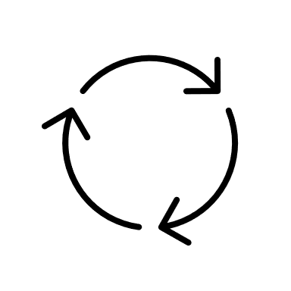
Analysing Key Accounts.
Analysis of Key Accounts – Policy Quadrant
4 Quadrant Directional matrix for developing Key accounts
Engage in Joint Business Planning Systems and Focus on processes
KAM Investments
Tailor portfolio
Basic KAM Investments
High
Cooperative KAM investments in Processes
Customer Attractiveness
Keep reviewing
BASIC Invest in developed relationships
Low
Cooperative
Maintain and Consistency
Low
High
KAM Stage
www.upskilpro.com

Slide 13
Analysing Key Accounts.
Business Partnership Process ( Impacting forces )
Market Selection
Criteria Selection
Summary
Define KA
Select KA
Portfolio Analysis
Impacting 5 Forces
Strategic
High Potential
KA Objectives Analysis
Gain Advantages
Objectives
Strategies
Plans
Financial Analysis
KA Analysis and Processes study
Support
Operational
KA Value chain analysis
Avoid
Disadvantages
By each key account
KA Buying and Information Needs
Sales History Exchange
Competitive Analysis

Slide 14
Analysing Key Accounts.
Porters 5 Forces ( Impacting forces )
Porter’s Five Forces. The framework is used to assess the attractiveness and profit potential of an industry or firm by analysing the 5 key forces active upon it.
Threat of new entrants
Rivalry among existing competitors
No of competitors
Diversity of competitors
Concentration of rivals / industry
Industry growth
Quality differences
Brand loyalty
Barriers to exit
Switching costs
Threat of new entrants
Barriers to entry
Economies of scale
Brand loyalty
Capital requirements
Cumulative experience
Government policies
Access to distribution channels
Switching costs
Rivalry – Industry growth, fixed costs/value added, product differences, brand identity, switching costs, diversity of competitors, exit barriers •
New entrants – Economics of scale, proprietary product differences, brand identity, switching costs, capital requirements, access to distribution, absolute cost advantages, learning curve, access to necessary inputs, government policy, expected retaliation •
Buyers – Bargaining leverage, buyer purchase volume, buyer switching costs, buyer information, substitute products, price sensitivity, product differences, brand identity, impact on quality/performance, decision makers’ incentives •
Suppliers – Differentiation of inputs, switching costs of suppliers and firms in the industry, presence of substitute inputs, supplier concentration, importance of volume supplier, cost relative to total purchases in the industry, impact of inputs on costs or differentiation •
Substitutes – Relative price performance of substitutes, switching costs, buyer propensity to substitute
Rivalry
Threats
Rivalry
among
existing competitors
Bargaining power of suppliers
Bargaining power of buyers
Buyers
Suppliers
Bargaining power of suppliers
No & size od suppliers
Uniqueness of suppliers product
Focal companies ability to substitute
Bargaining power of buyers
No of customers
Size of each customer order
Differences between competitors
Price sensitivity
Buyers ability to differentiate
Buyers information availability
Switching costs
Substitutes
Threat of substitute products
No of substitute products available
Buyers propensity to substitute
Relative price performance of substitute
Perceived level of product differentiation
Switching costs
Threat of substitute products

Slide 15
Analysing Key Accounts.
Resources & operations
Control System
Planning System
Marketing Objectives
Marketing Strategy
Information System
Structure
Marketing objectives:
Are the marketing objectives clearly stated and
consistent with marketing and corporate objectives?
Marketing strategy:
What is the strategy for achieving the stated
objectives? Have resources been allocated have the resources been allocated across the marketing mix
elements of the marketing mix?
Structure:
Are the marketing responsibilities and authorities clearly
structured along functional, product, end-user and territorial lines?
Information system: Is the marketing intelligence system producing accurate, sufficient and timely information about developments in the marketplace?
Is information gathered being used effectively in making marketing decisions?
Planning system:
Is the marketing planning system well conceived and effective?
Control system: Do control mechanisms and procedures exist within
the group to ensure planned objectives are achieved (e.g. meeting overall
objectives etc.)?

Slide 16

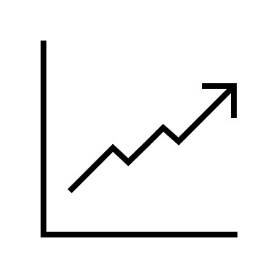


Analysing Key Accounts.
The External Audit
Business and economic environment
Economic Competition
Political/fiscal/legal
Social/cultural
Technological
Intracompany
The market
Total market, size, growth and trends (value/volume)
Market characteristics, development and trends
Products
Prices
Physical distribution
Channels
Customer/consumers
Communication
Industry practices
Competition
Major competitors
Size
Market shares/coverage
Market standing/reputation
Production capabilities
Distribution policies
Marketing methods
Extent of diversification
Personnel issues
International links
Profitability
Key strengths and weaknesses

Slide 17



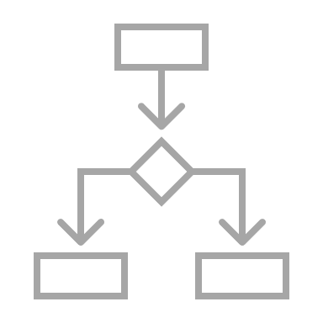


Analysing Key Accounts.
The Internal Audit
Marketing Operational Variables
Organisation / Company
Sales by Segmentation
Market Shares ( Value / Volume )
P&L / Margins / Costs
Marketing Processes to planning and execution
Marketing Organisation
Marketing Information and Research
Marketing Mix Variable
Product
Price
Distribution
Promotion
Process

Slide 18
Analysing Key Accounts.
PEST Analysis – The Market ( opportunities & threats)
Business& Environment | Factors | Critical Factors | Impact
Political |  | Legislation, Taxation, Regulatory, unions, pricing , labelling , advertising etc. | Direct impact on business
Economic |  | Inflation , Unemployment, raw material , Price.
Sociological |  | Education , Environment, Population , Age, unemployment,, consumer lifestyle
Technological |  | Disruption of business , 4G/5G,digitalization , equipment , substitutes etc
Inter Company |  | Capital Investment , consolidation , strikes etc
Complete Market
Market Characteristics | Dimensions | Size , Growth , Trends | Direct impact on business
 | Customers and Consumers | Demographics, Psychographics & Purchasing behaviour
Market Characteristics | Products & Characteristics | Weights, measures,sizes,packaging,related accessories or extensions. Prices, Distribution,Channels,Purchasing ability Geographic,Location,Stocks,Turnover,Profits,Needs,tastes,Attitudes,Decision makers, Purchasing decision process
Competition | Prices | Price levels , Price stickiness , Price inflation
 | Physical Distribution | Methods of distribution
 | Channels | Distribution channels , purchasing patterns , geographical locations, turnover etc ,
 | Communication | Internet , Sales force , Advertising , PR etc
 | Industry Practices | Profitability , Reputation , Capability , Diversification , Profitability, Investments , Acquisitions , etc.

Slide 19



Analysing Key Accounts.
Importance of market segmentation
Market Segmentation is required to adopt a focussed approach to our target markets .
By segmenting we are able to split ( segment ) our wide market into workable focussed groups of individuals who buy and consume products in a similar fashion
The Key of Segmentation is
The whole point of market segmentation is that a firm must either:
Define markets broadly
Segmentation in Key markets are done to ensure costs for specific activities are competitive
Define your markets in a manner in which you can develop and assign special skills to remain cost competitive
  The 2 points above have to be related to a companies competence and in line with its competition
To summarize,
Determine marketing direction through the analysis and understanding of trends and buyer behaviour.
Determine realistic and obtainable marketing and sales objectives.
Improve decision making by forcing managers to consider the available options in depth.

Slide 20
Analysing Key Accounts.
Sources of Sales in Segmentation
Sales Roll up
Customer Type
Geography Type
Portfolio Type
Channel Type
Market Shares / Profit Margins / Process
Market Research
Product Development
Product portfolio development
Stock level
Distribution
Pricing
Packaging
Discounts
Marketing Organisation
Training
POS
Advertising
Point of sale
Sales promotion
After Sales service
KA Analysis and Processes study
Customer Type
Ensure that all your customers are segmented into types based on a set of common criteria that is applicable base don size , value , market share , buying habits , strategic positioning , and commonality to your portfolio and its objectives
Geography Type
Most customer types will be found in more than 1 geography , once you have segmented you customer type it logical that you follow this process into each geography which will equate finally to a city, state and finally national roll up.
Portfolio Type ( Products )
All portfolios will not go into all customer types , you will need to ensure a proper fit analysis is done to ensure that the portfolios to the customer types are designed.
Channel Type
Every market will have multiple channel types functioning in it , its more than probable in most cases that your key accounts will belong to 1 specific channel or at times 2 or 3 based on strategic objectives , and design , so your portfolio strategy will have to accommodate the customer strategy.

Slide 21

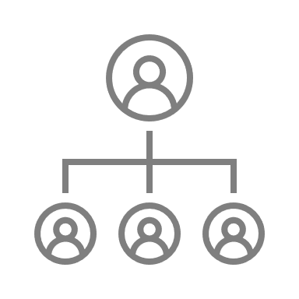












Analysing Key Accounts.
Components of a Key Account Plan.
Components
Buyer Side | Seller Side
Account Details | Your organisation structure for the key account
Business Categorization | Your leadership structure for peer to peer meetings
Product Group Categorization | Your planned product portfolio for fitting into the account
Financial Analysis by door compromising the entire business | Your sales and marketing collateral for the account
Account Sales by product and Category for current year and SPLY. ( same period last 2 years ) | Financial plan with all areas to ensure you calculate “Direct Product Profitability”
Buyer organisation design and Multi level touch points | Strategic account development plan
Category design for Key account where your products will fit in | Account marketing plan
Buyer objectives and metrics for the business | Account Sales Plan
Cost of doing business , this is key to cost your business P & L , Bonuses , Target achievement , Margins , Merchandising costs , etc | Business review components and calendar

Slide 22
Analysing Key Accounts.
Developing objectives based on Analysis
Customer
Industry Driving Forces
Define the Key Success Factors between Success & Failure
Situation Analysis
Strengths / Weaknesses | Opportunities & Threats
In relation to the Key Success factors where is my customer relatively
Current Advantage / Disadvantage | Possible Advantage / Disadvantage
Do my competitors have any unique advantage
Exploit Advantage Minimize Disadvantage | Develop Future Advantage Counter Disadvantages
How do you recommend your customer deploy his advantages to counter his competitors

Slide 23
Analysing Key Accounts.
Key Ratios / Financial Analysis
Key Ratios | This Year | Last Year | Formula | Source |  |  |  | Industry Ranking | Company Comments | Improvement Measures | Comments
Key Ratios | This Year | Last Year | Formula | System Reports | Financial Reports | External Reports | Research | Industry Ranking | Company Comments | Improvement Measures | Comments
Gross Profit Margin
Nett Profit margin
Stock Turnover
Marketing Costs
Collection Period
Operating Plan ( Revenue)
Actuals ( Revenue )
Indicator Descriptions | Gross Profit Sales before any discounts or offers |  | Nett Profit Sales after discounting all external discounts and offers |  | Stock Turnover Evaluates how soon funds flow through cost of goods sold to produce profit |  | Marketing Costs The actual costs of marketing your products in the specific KA. |  | Collection Period / Due Days Measures funds in market from date of invoice or no of days it takes to collect from due date
 | Operating Plan ( F ) The initial forecasted plan set both in volume and value |  | Operating Plan ( Act ) The review of the forecasted plan with actuals data done every quarter versus initial plan

Slide 24

Analysing Key Accounts.
Buying Process & Hierarchy
Cost
The Management Pyramid , The higher the cost, the higher up in the organization the purchasing decision be made as the level of expenditure figures increase so does the seniority in the hierarchy.
Freshness
The relative novelty or newness of the product will pose an element of commercial risk for an organization. A new and untried proposition will require support at a senior management level, whereas a routine, non-risky service can be handled at a lower
Complexity
The more complex the product offered, The more technical the implications which have to be understood within The client company. It is possible more specialist managers might be required to give their approval before the transaction can be completed.
Budget | Category head | Division Head | Business Head
>50,000$
<50,000
<30,000$
<20,000$
<10,000$
Comment
Selling to an organization can be a complex process because it is possible for a number of different people to become involved at the customer end. Although theoretically only one of these is the buyer, in practice he or she might not be allowed to make a decision to purchase until others with specific knowledge expertise or hierarchical responsibility have given their approval.

Slide 25





Analysing Key Accounts.
Problem Identification and Resolution in Buyers
 | Phase or Stage | Problem or Step Specification
 | Problem identification | A problem is identified or anticipated and a general solution worked out. For example, the marketing department finds that it has inadequate information about sales records and costs. It needs better information made available on the computer.
 | Problem Definition | The problem is examined in more detail in order to grasp the dimensions and, hence, the nature of the ultimate choice of solution. Taking our earlier example of the international chemical company further, investigation shows that the supplier’s original software system was not devised with the customer’s current marketing planning requirements in mind. A new system is required which can also provide the option for the inclusion of other new data.
 | Problem Specification | The various technical requirements are listed and a sum of money is allocated to cover the cost of investing in new software.
 | Search | A search is made for potential suppliers, in this case those with the capability of devising a ‘tailor-made’ system to meet the above requirements
 | Assessment | Proposals from interested suppliers are assessed and evaluated.
 | Selection | A supplier is selected and final details are probably negotiated prior to the next step
 | Agreement | A contract/agreement is signed.
 | Monitoring | The service is monitored in terms of meeting installation deadlines and performance claims

Slide 26
Analysing Key Accounts.
Decision Making Unit – Buying
Identification
Definition
Solution
Specification
Search
Assessment
Selection
Agreement
Monitoring
KA Analysis and Processes study
Formalize with agreement
Problem definition , use dimensional thinking , metrics , time , output , capabilities etc
Evaluate assessments and shortlist
Problem identification and high level solution
List requirements
Evaluate and monitor with deadlines and performance criteria
Select supplier based on criteria and clear final details
Search for suppliers who can tailor make or supply off shelf

Slide 27
Analysing Key Accounts.
History & Analysis

Slide 28
Analysing Key Accounts.
Comparing Key Accounts on Criteria

Slide 29
Analysing Key Accounts.
Strategic Planning Exercise – SWOT Execution
11001
A – Segment Description Keep this to a specific area of the organisation and high importance
B – Critical Success Factors ( CSF) Relate this to how your customers choose
C – Weighting weight each factor in importance totalling 100
D – Strength Weakness Analysis Impact |  |  |  | Impact
CSF | We | Comp A | Comp B | Comp C | Comp D
In this case how its about how your customers would rate you and the other competitors in each of the CSF’s , you will multiply the score by the weight.
Opportunities / Threats | Impact
A
B
C
D
Aim to crystalize on a few areas which will have effect on your business , please keep this strategic and top level.
Threats | Impact
Aim to crystalize on a few areas which will have effect on your business , please keep this strategic and top level.
Key unresolved issues | Impact
Aim to crystalize on a few areas which will have effect on your business , please keep this strategic and top level.

Slide 30
Analysing Key Accounts.
Profitability Awareness of Key Accounts
How well do you know the real profitability of your top 10 accounts, having taken into direct account costs ?

Slide 31
Thank you !

Slide 32
Job Descriptions
Develop roles clearly and completely across varying levels of experience
Agreements
Draft your business agreements across a variety of areas
Templates
Templates are designed based gather information in a structured manner
KPI’s
Performance indicator, a quantifiable measure of performance over time versus a specific objective.
Content Modules
Best practice material in power point for use as a knowledge base in business training , planning and execution .
Strategic tools
These tools are recognised the world over in business schools, consulting firms and companies who plan strategically.
Gain a competitive edge using the best tools and techniques to build a better you .
Analytical Tools
Interactive excel tools on specific business areas based on your data inputs delivered in a workbook model with instructions.
Scorecards
Designed as functional or subject indicators across a variety off situations to enable performance of situational evaluation versus aligned standards.
Calculators
calculate the right ratios for businesses looking for benchmarks in a variety of situations
Assessments
Assessments are designed around specific areas to conduct reviews and will center around a benchmark reviewing individuals or functions
Checklists
Designed around achieving milestones in a sequential manner.
Research
Research tools for sales and marketing engagement

Slide 33

Key Account Management.
Module 7 – Analysing Key Accounts.
Sales & Marketing Fundamentals.
UpskilPRO e Institute for Sales & Marketing
Tools, Content & Templates
Hand built using experience & insight

