Slide 1
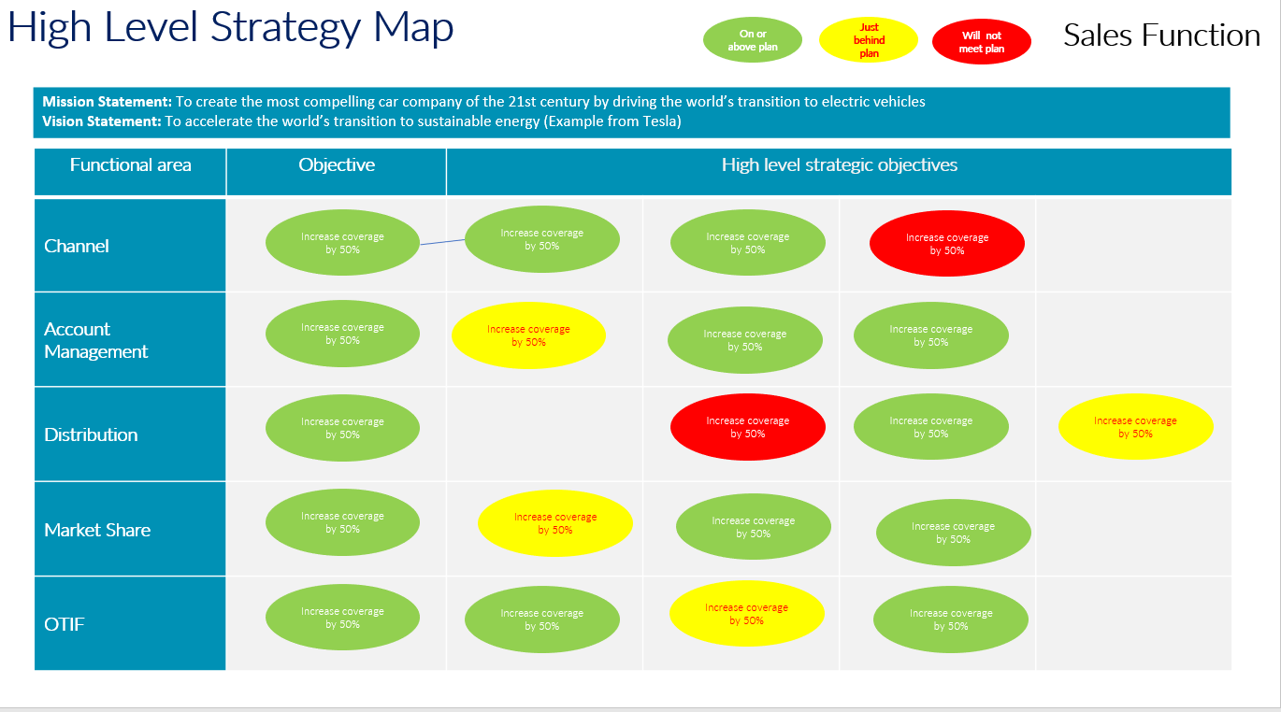
Strategy Map
High Level
Strategic decision-making involves thinking about the long-term course one will take through a broad competitive landscape.
UpskilPRO e Institute for Sales & Marketing
Tools, Content & Templates
Hand built using experience & Insight

Slide 2
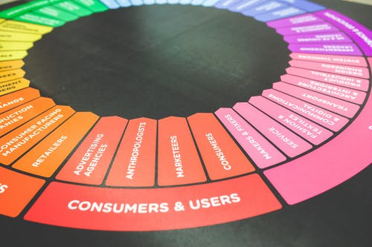
Created by
ex-Procter & Gamble, Rothmans, BAT, Gillette, Nokia,
Microsoft & 3M managers.
UpskilPRO tools are designed in easy-to-use solutions, all you need to do is download the tool and get to work immediately . All UpskilPRO material has taken 100’s of hours and many 1000’s of $ to build , all this expertise and content is brought to you for a fraction of the cost to help professionals enhance their capability.
core areas which are best suited to improve using our tools:
Subject matter expertise
Best practices
Analytical output & charting
Prioritization
Process
Capability enhancement tools for
Consumer Marketing, Trade Marketing &
Sales excellence professionals.
Tools in one place to get 10X productive now.

Slide 3
Job Descriptions
Develop roles clearly and completely across varying levels of experience
Agreements
Draft your business agreements across a variety of areas
Templates
Templates are designed based gather information in a structured manner
KPI’s
Performance indicator, a quantifiable measure of performance over time versus a specific objective.
Content Modules
Best practice material in power point for use as a knowledge base in business training , planning and execution .
Strategic tools
These tools are recognised the world over in business schools, consulting firms and companies who plan strategically.
Gain a competitive edge using the best tools and techniques to build a better you .
Analytical Tools
Interactive excel tools on specific business areas based on your data inputs delivered in a workbook model with instructions.
Scorecards
Designed as functional or subject indicators across a variety off situations to enable performance of situational evaluation versus aligned standards.
Calculators
calculate the right ratios for businesses looking for benchmarks in a variety of situations
Assessments
Assessments are designed around specific areas to conduct reviews and will center around a benchmark reviewing individuals or functions
Checklists
Designed around achieving milestones in a sequential manner.
Research
Research tools for sales and marketing engagement

Slide 4
2017
2018
100’s of tools grouped in 12 categories, 50 tool types and 12 business functions in 1 place.
get 10X productive now !
Categories
Functions
Analytical Tools
Types
Business Development
Agreements
Advertising
Customer Acquisition
Margins
Partner Search
Reports
Category Management
Assessments
Agreements
Customer Management
Market Analysis
Persona Development
Retail Measurement
Channel Management
Content Modules
Analytics
Distribution
Market Development
Planning
Reviews
Distribution
Checklists
Barriers
Distributor Management
Market Research
Positioning
Sales Management
Distributor Management
Calculators
Business Reviews
Forecasting
Market Segmentation
Pricing
Scorecards
General Management
Job Descriptions
Business Intelligence
GAP Analysis
Market Size
Prioritization
Segmentation
Key Account Management
KPI’s
Channels
Go To Market
Marketing
Product Development
Six Sigma
Marketing
Research
Communication
Job Descriptions
Marketing Comms
Product Life Cycle
Socio Economic Classification
Marketing Operations
Strategic Tools
Competitive Evaluation
Key Account Plans
Merchandising
Profit & Loss
Territory Design
Sales Management
Scorecards
Competitive Intelligence
Management Summary
New Market Entry
Promotions
Trade Marketing
Shopper Marketing
Templates
Trade Marketing

Slide 5
High Level Strategy Map
Strategy is, simply, the art and science of options. It is a matter of understanding current options, creating new options, and choosing among them.
Strategic decision-making involves thinking about the long-term course one will take through a broad competitive landscape.
Strategy provides the direction for operations.
Sun Tzu

Slide 6
High Level Strategy Map
On or above plan
Just behind plan
Will not meet plan
Sales Function
Mission Statement: To create the most compelling car company of the 21st century by driving the world’s transition to electric vehicles Vision Statement: To accelerate the world’s transition to sustainable energy (Example from Tesla)
Functional area | Objective | High level strategic objectives
Channel
Account Management
Distribution
Market Share
OTIF
Increase coverage by 50%
Increase coverage by 50%
Increase coverage by 50%
Increase coverage by 50%
Increase coverage by 50%
Increase coverage by 50%
Increase coverage by 50%
Increase coverage by 50%
Increase coverage by 50%
Increase coverage by 50%
Increase coverage by 50%
Increase coverage by 50%
Increase coverage by 50%
Increase coverage by 50%
Increase coverage by 50%
Increase coverage by 50%
Increase coverage by 50%
Increase coverage by 50%
Increase coverage by 50%
Increase coverage by 50%

Slide 7
High Level Strategy Map
On or above plan
Just behind plan
Will not meet plan
Marketing Function
Mission Statement: To create the most compelling car company of the 21st century by driving the world’s transition to electric vehicles Vision Statement: To accelerate the world’s transition to sustainable energy (Example from Tesla)
Functional area | Objective | High level strategic objectives
Product
Price
Distribution
Promotion
Communication
Broaden product portfolio into adjancies
Increase coverage by 50%
Increase coverage by 50%
Increase coverage by 50%
Drive value pricing by 7% overall increase
Increase coverage by 50%
Increase coverage by 50%
Increase coverage by 50%
Increase coverage by 4% points nationally.
Increase coverage by 50%
Increase coverage by 50%
Increase coverage by 50%
Share of promotions to increase to 24% maximum
Increase coverage by 50%
Increase coverage by 50%
Increase coverage by 50%
Drive communication using social media channels primarily
Increase coverage by 50%
Increase coverage by 50%
Increase coverage by 50%

Slide 8
High Level Strategy Map
On or above plan
Just behind plan
Will not meet plan
Sales Function
Mission Statement: To create the most compelling car company of the 21st century by driving the world’s transition to electric vehicles Vision Statement: To accelerate the world’s transition to sustainable energy (Example from Tesla)
 | Functional area | Objective | High level strategic objectives
What we are getting | Financial Perspective
 | Customer Perspective
What we're doing | Product Service Or Process
 | Learning and Growth

Slide 9
Strategy Map
High Level
Strategic decision-making involves thinking about the long-term course one will take through a broad competitive landscape.
UpskilPRO e Institute for Sales & Marketing
Tools, Content & Templates
Hand built using experience & Insight

