Slide 1
Y
Scorecard –
New Channel Baseline Management Areas
channel baseline areas
Establish new channel baseline areas to ascertain alignment with objectives
X
O
UpskilPRO e Institute for Sales & Marketing
Tools, Content & Templates
Hand built using experience & insight

Slide 2
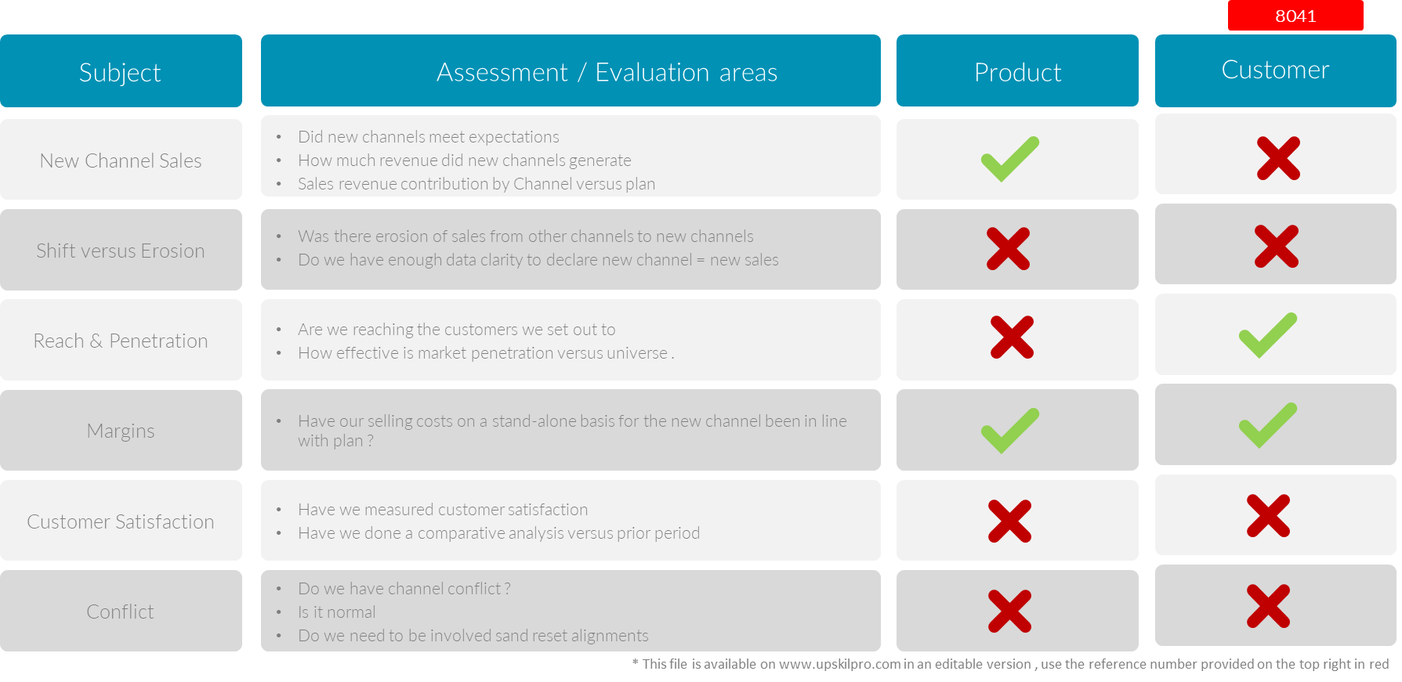
Channels of distribution
Scorecard – New Channel Baseline Management Areas.
2008
3006

Slide 3
Y
Scorecard –
New Channel Baseline Management Areas
channel baseline areas
Establish new channel baseline areas to ascertain alignment with objectives
X
O
UpskilPRO e Institute for Sales & Marketing
Tools, Content & Templates
Hand built using experience & insight

